Slide 1
Chapter 13: Industry Analysis
Analysis of Investments &
Management of Portfolios
10TH EDITION
Reilly & Brown

Slide 2
Why Do Industry Analysis?
The Purpose:
  Help find profitable investment opportunities
  Part of the three-step, top-down plan for valuing individual companies and selecting stocks for a portfolio
What Do We Learn From Industry Analysis?
  Is there a difference between the returns for alternative industries during specific time periods?
  Do firms within an industry show consistent performance over time?

Slide 3
Why Do Industry Analysis?
  Will an industry that performs well in one period continue to perform well in the future? That is, can we use past relationships between the market and an individual industry to predict future trends for the industry?
  Is there a difference in the risk for alternative industries?
  Does the risk for individual industries vary or does it remain relatively constant over time?

Slide 4
Why Do Industry Analysis?
Cross-Sectional Industry Performance
  Wide dispersion in rates of return in different industries
  Performance varies from year to year
  These results imply that industry analysis is important and necessary to uncover these substantial performance differences—that is, it helps identify both unprofitable and profitable opportunities
  See Exhibits 13.1 and 13.2

Slide 5
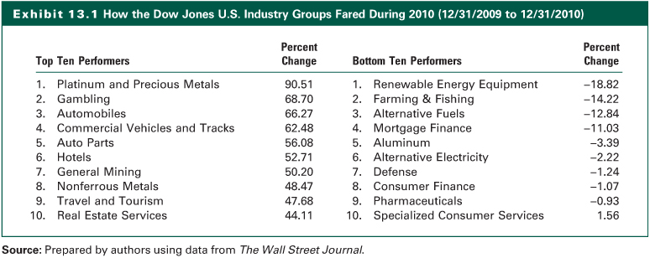
Exhibit 13.1

Slide 6
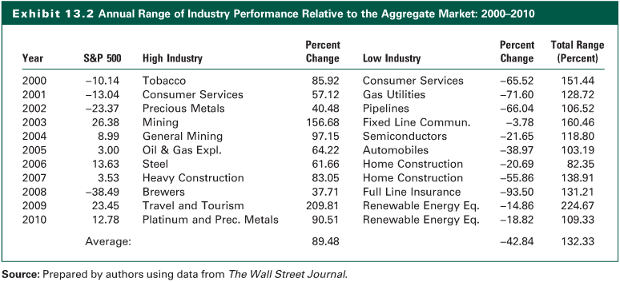
Exhibit 13.2

Slide 7
Why Do Industry Analysis?
Industry Performance over Time
  Research shows that there is almost no association in individual industry performance year to year or over sequential rising or falling markets
  Variables that affect industry performance change over time
Performance of Companies within an Industry
  There is wide dispersion in the performance of companies within an industry
  This reinforces the need for company analysis in addition to industry analysis

Slide 8
Why Do Industry Analysis?
Differences in Industry Risk
  Empirical studies have found a wide range of risk among different industries at a point in time, and that differences in industry risk typically widened during rising and falling markets
  Although risk measures for different industries have shown substantial dispersion during a period of time, individual industries’ risk measures are stable over time

Slide 9
Why Do Industry Analysis?
Industry Analysis Process
  The industry analysis process is similar to the analysis of the economy and the aggregate equity market
  The Macroanalysis of the Industry
    The business cycle and industry sectors
    Structural economic changes & alternative industries
    Evaluating an industry’s life cycle
    Analysis of the competitive environment in an industry
  The Microvaluation of the Industry
    Various valuation techniques

Slide 10
Business Cycle and Industry Sectors
Economic trends can and do affect industry performance
By identifying and monitoring key assumptions and variables, we can monitor the economy and gauge the implications of new information on our economic outlook and industry analysis

Slide 11
Business Cycle and Industry Sectors
Cyclical or Structural Changes
  Cyclical changes in the economy arise from the ups and downs of the business cycle
  Structure changes occur when the economy undergoes a major change in organization or how it functions
Rotation strategy is when one switches from one industry group to another over the course of a business cycle
See Exhibit 13.3

Slide 12
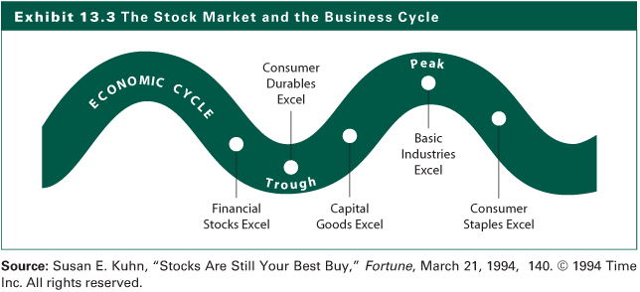
Exhibit 13.3

Slide 13
Business Cycle and Industry Sectors
Economic Variables and Different Industries
  Inflation
    Higher inflation is generally negative for stocks
  Interest Rates
    For example, financial and housing industries will be adversely affected by high interest rates
  International Economics
    Economic growth in world regions or specific countries benefits industries with a large presence in the areas
  Consumer Sentiment
    The performance of consumer cyclical industries will be affected by changes in consumer sentiment

Slide 14
Structural Economic Changes and Alternative Industries
Social Influences
  Demographics
  Lifestyles
Technology
Politics and Regulations
  Economic reasoning
  Fairness
  Regulatory changes affect numerous industries
  Regulations affect international commerce

Slide 15
Evaluating the Industry Life Cycle
When predicting the industry sales and trends in profitability, an insightful analysis is to view the industry over time in different stages
The Five-Stage Model
  Pioneering development
  Rapidly accelerating industry growth
  Mature industry growth
  Stabilization and market maturity
  Deceleration of growth and decline
See Exhibit 13.4

Slide 16
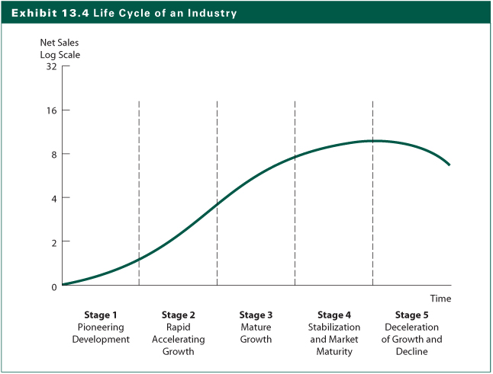
Exhibit 13.4

Slide 17
Analysis of Industry Competition
Competition and Expected Industry Returns
  Porter’s concept of competitive strategy is described as the search by a firm for a favorable competitive position in an industry
  To create a profitable competitive strategy, a firm must first examine the basic competitive structure of its industry
  The potential profitability of a firm is heavily influenced by the profitability of its industry

Slide 18
Analysis of Industry Competition
Porter’s Competitive Forces (Exhibit 13.5)
  Rivalry among existing competitors
    More rivalry means intense competition
  Threat of new entrants
    Are there barriers to entry?
  Threat of substitute products
    Substitute products limit the profit potential of an industry
  Bargaining power of buyers
    Volume discounts, quality demands
  Bargaining power of suppliers
    Can suppliers increase prices or reduce quality?

Slide 19
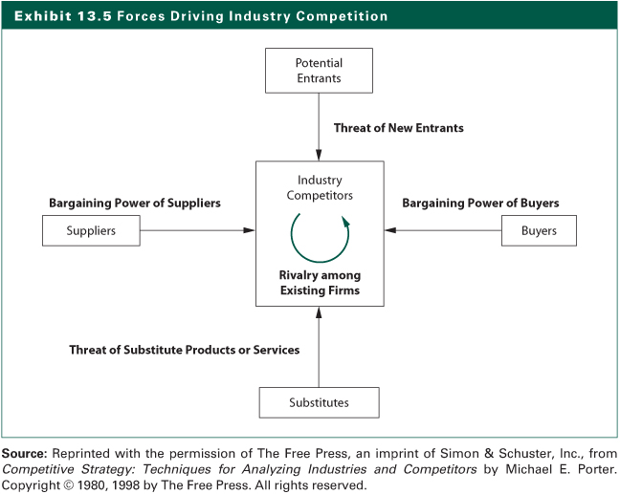
Exhibit 13.5

Slide 20
Estimating Industry Rates of Return
Do we go about valuing an industry?
Present value using required rate of return for the equity in the industry
Two-step P/E ratio approach uses expected value at the end of investment horizon and compute the expected dividend return during the period
Estimating required rate of return and growth rates are the key

Slide 21
Estimating Industry Rates of Return
Valuation using the reduced form DDM
D
P
=
1
i
k
−
g
where:
P_{i} = the price of industry i at time t
D₁ = the expected dividend for industry i in period 1 equal to D₀(1+g)
k = the required rate of return on the equity for industry i
g = the expected long-run growth rate of earnings and dividend for industry i

Slide 22
Estimating Industry Rates of Return
Estimating the Required Rate of Return (k)
  Influenced by the risk-free rate
  Expected inflation rate
  Risk premium for the industry versus the market
    business risk (BR)
    financial risk (FR)
    liquidity risk (LR)
    exchange rate risk (ERR)
    country political risk (CR)
  Or compare systematic risk (beta) for the industry to the market beta of 1.0

Slide 23
Estimating Industry Rates of Return
Estimating the Expected Growth Rate (g)
  Earnings and dividend growth are determined by the retention rate and the return on equity
  Earnings retention rate of industry compared to the overall market
  Return on equity is a function of
    the net profit margin
    total asset turnover
    a measure of financial leverage

Slide 24
Industry Valuation Using the Free Cash Flow to Equity (FCFE) Model
FCFE is defined as follows:
  FCFE=
  Net income
  + Depreciation
  - Capital expenditures
  - Δ in working capital
  - Principal debt repayments
  + New debt issues

Slide 25
Industry Valuation Using the Free Cash Flow to Equity (FCFE) Model
The Constant Growth FCFE Model
The Two-Stage Growth FCFE Model
  The two-stage model is similar to the two-stage DDM model
  IN the second stage, FCFE is assumed to grow at a constant rate, normally lower than that in the first stage period
FCFE
V
=
1
k
−
g

Slide 26
The Earnings Multiple Technique
Estimating Earnings per Share
  Start with forecasting sales per share
    Time series analysis
    Input-output analysis
    Industry-economy relationship
  Earnings forecasting and analysis of industry competition
    Competitive strategy
    Competitive environment
    Industry operating profit margin
    Industry earnings estimate
    Industry earnings multiplier

Slide 27
Industry Profit Margin Forecast
The Components of Net Profit Margin
  Industry’s operating profit margin (EBITDA / Sales)
    Regression analysis
    Time series analysis
    Long-term consideration including competitive structure
  Depreciation expense
    Generally increasing time series
    Specific estimate technique using the depreciation expense/PPE ratio
    Subtract depreciation from operating profit margin to determine industry’s net before interest and taxes

Slide 28
Industry Profit Margin Forecast
  Interest expense
    Calculate the annual total asset turnover (TATO)
    Use your current sales estimate and an estimate of TATO to estimate total assets next year
    Calculate the annual long-term (interest bearing) debt as a percent of total assets
    Estimate long-term debt for the next year
    Calculate the annual interest cost as a percent of long-term debt and analyze the trend
    Estimate next year’s interest cost of debt for this industry based upon your prior estimate of market yields
    Estimate interest expense based on the following estimates: (Interest Cost of Debt) (Outstanding Long-Term Debt)

Slide 29
Industry Profit Margin Forecast
Tax rate
  Regression analysis
  Time series plot
  After estimating the tax rate, multiply the EBT per share value by (1 - tax rate) to estimate earnings per share
  Derive an estimate of industry’s net profit margin as a check on your EPS estimate

Slide 30
Estimating an Industry Earnings Multiplier
Macroanalysis
  relationship between multiplier for the industry and the market
  variables that influence the multiplier:
    required rate of return (k): function of the nominal risk-free rate plus a risk premium
    expected growth rate of earnings and dividend
    dividend payout ratio

Slide 31
Estimating an Industry Earnings Multiplier
Microanalysis
  Estimate the variables that influence the industry earnings multiplier and compare them to the comparable values for the market P/E
  Industry multiplier versus the market multiplier
  Comparing dividend-payout ratios
  Estimating the required rate of return (k)
  Estimating the expected growth rate (g)
    g = Retention Rate (b) X Return on Equity (ROE)
    = (b) X (ROE)

Slide 32
Other Relative Valuation Ratios
Price-to-book value ratios (P/BV)
  See Exhibit 13.24
Price-to-cash flow ratios (P/CF)
  See Exhibit 13.25
Price-to-sales ratios (P/S)
  See Exhibit 13.26

Slide 33
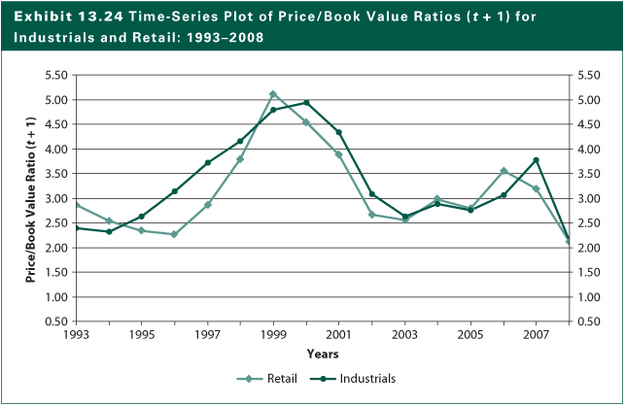
Exhibit 13.24

Slide 34
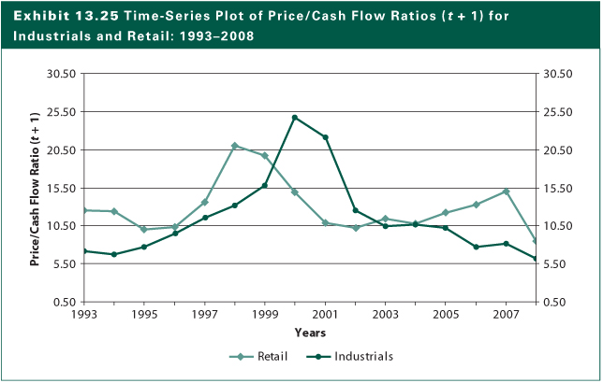
Exhibit 13.25

Slide 35
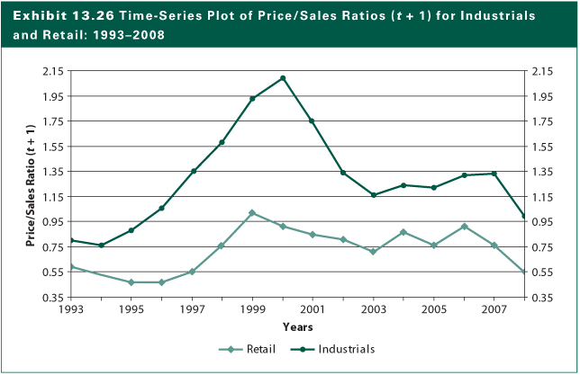
Exhibit 13.26

Slide 36
Global Industry Analysis
The macroeconomic environment in the major producing and consuming countries for this industry
An overall analysis of the significant companies in the industry and the products they produce
What are the accounting differences by country and how do these differences impact the relative valuation ratios?
What is the effect of currency exchange rate trends for the major countries?

Slide 37
The Internet Investments Online
http://www.lf.com
http://healthcaredistribution.org
http://retailindustry.about.com
http://valuationrespurces.com
http://www.nacds.org

