Slide 1
Economic Development: Overview
Lecture 1
EE461 – 2/2018
Chayanee Chawanote

Slide 2
What’s development?
Economic development entails far-reaching changes in the structure of economies, technologies, societies, and political systems.
Development economics is the study of economies that do not fit many of the basic assumptions underpinning economic analysis in high-income countries
  These basic assumptions are well-functioning markets, perfect information, and low transaction costs.
When these assumptions break down, so do the most basic welfare and policy conclusions of economics
  Hence, we need new tools.
  Ref: J. Edward Taylor
Notes:
J. Edward Taylor

Slide 3
Measurement of economic development
How do we evaluate the degree of “development”?
- levels and rates of growth of per capital income?
- distribution of income?
- Non-monetary aspects, i.e. human development?
Country | Per capita income (1993 PPP) | Income share of poorest 40% | Income share of richest 20%
Sri Lanka | 2,990 | 22 | 39
Guatemala | 3,350 | 8 | 63
Country | Life expectancy (years) | Infant mortality rate (per 1000) | Access to safe water (% of pop.) | Adult literacy rate (%)
Sri Lanka | 72 | 18 | 60 | 89
Guatemala | 65 | 48 | 62 | 54
Notes:
the poorest 40% of the population earn 8% of overall income while the richest 20% earn more than half of total income.

Slide 4
Measurement of economic development
Per capita gross national product = per-head value of final goods and services produced by the people of a country
https://blogs.worldbank.org/opendata/new-country-classifications-income-level-2017-2018
Middle-income countries have significantly higher inequality. Using GNP per capita as an overall development indicator might be dangerous.
Human Development Index (HDI)
  Long and healthy life: Life expectancy at birth (reflecting infant and child mortality)
  Knowledge: a weighted average of adult literacy (2/3) and enrollment rates in primary, secondary and tertiary education (1/3)
  A decent standard of living: Adjusted per capita income (less weight is given to higher incomes after $5000 PPP)
Notes:
less weight to higher incomes: diminishing marginal utility to higher incomes
problem with HDI**

Slide 5
Is the HDI Enough to Measure a Country’s Level of Development?
According to the UNDP, the answer is:
“Not at all.”
“The concept of human development is much broader than what can be captured in the HDI, or any other composite indices…”
“The HDI and the other composite indices can only offer a broad proxy on some of the key the issues of human development…”
“A fuller picture of a country's level of human development requires analysis of other human development indicators and information.”
Notes:
Is the HDI enough to measure a country’s level of development?
According to the UNDP website, the answer is no, but: http://hdr.undp.org/en/statistics/faq/question,70,en.html
But HDI is definitely better than GDP.
http://hdr.undp.org/en/statistics/faq/question,71,en.html
Ultimately, the concept of human development is much broader than what can be captured in the HDI, or any other composite index. The HDI, for example, does not reflect political participation or gender inequalities. The HDI and the other composite indices can only offer a broad proxy on some of the key issues of human development. A fuller picture of a country's level of human development requires analysis of other human development indicators and information.
It is worth asking students what indicators they would include if they were to create their own human development index (Note: this is one of the exercises that comes at the end of this presentation).

Slide 6
Measurement of economic development
How much ‘explanatory power’ per capita income has over development indicators?
  life expectancy at birth
  infant mortality rate
  adult literacy rate
Note: correlation between the two variables only says about the direction of relationship not the direction of causation !
The relationship between per capita income and the other indicators is strong, but far from perfect as we see no smooth curves b/w variables. Why?
  the distribution of per capita income
  social and cultural attitudes, government policy
  the operation of various markets and institutions
Notes:
- From the scatter plots, as we move into the range of countries with very high per capita income, these indicators are at high levels as well (lower for infant mortality rate).
- The idea of the scatter plot is to check the correlation between the two variables concerned
2nd point: That’s why besides economic growth, we need to also study income distribution and the operation of various markets and institutions
*Note this is cross-sectional data! the issues with data: panel vs. cross-sectional data vs. time series

Slide 7
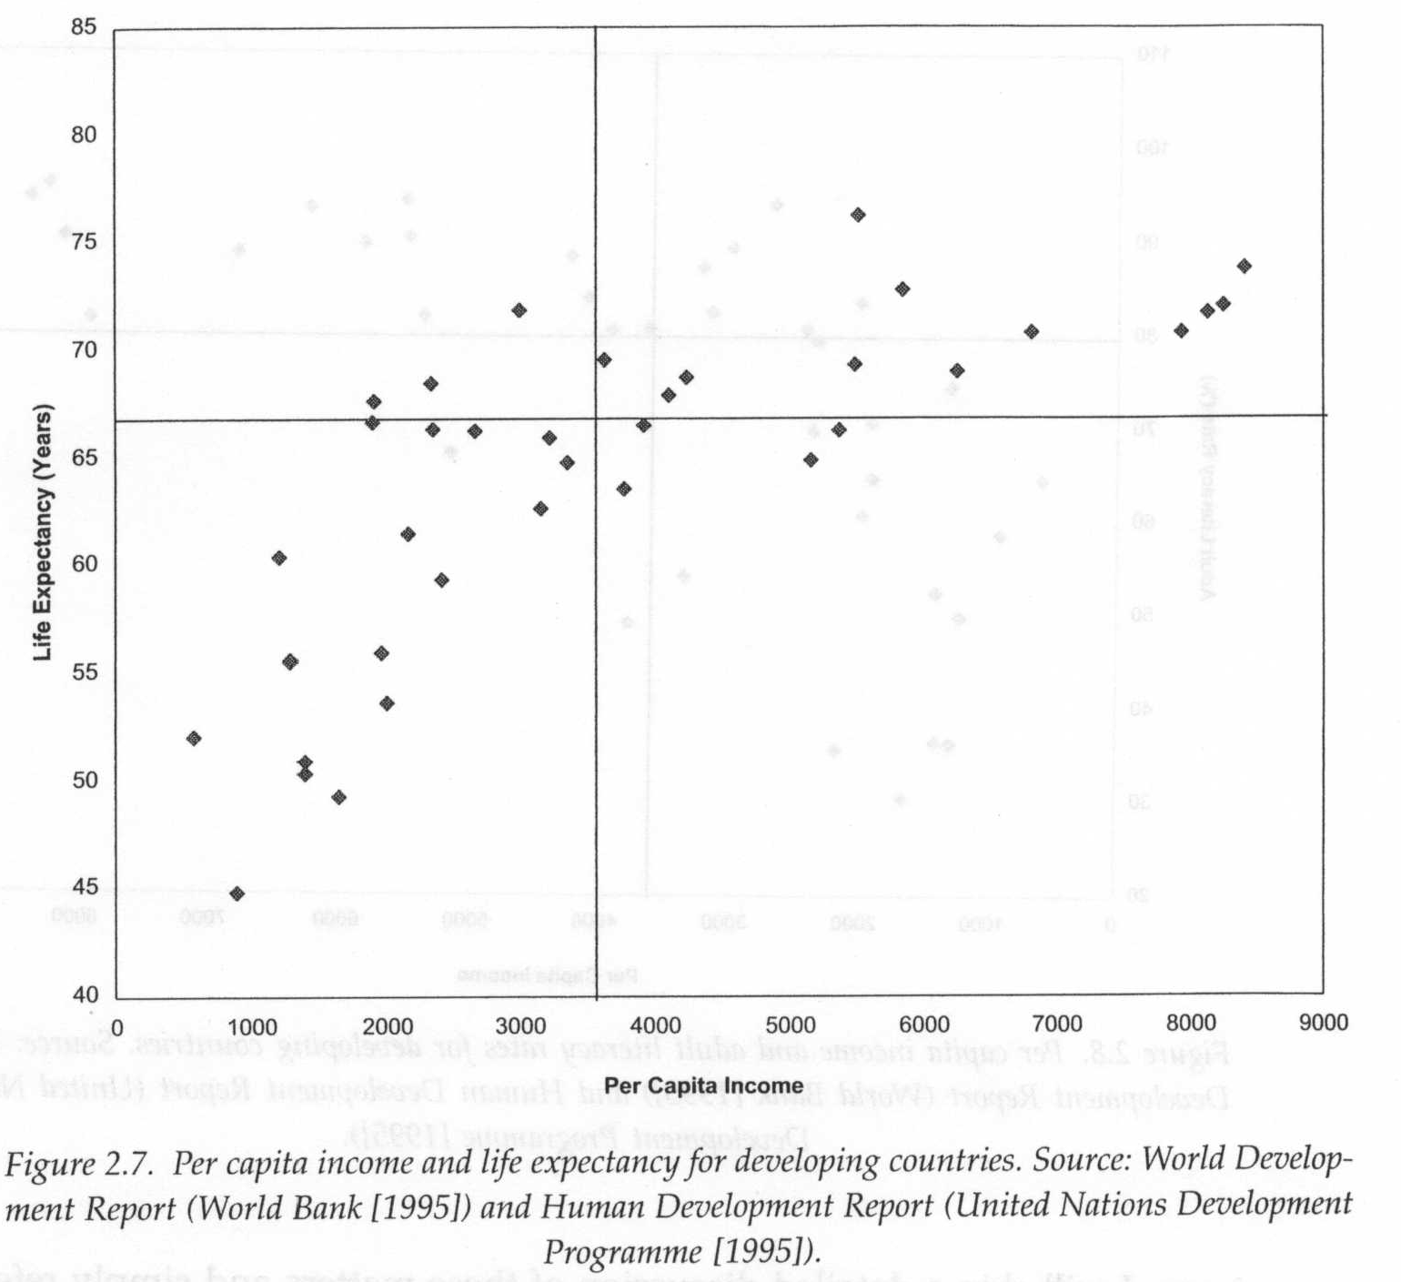
Life expectancy and per capita income

Slide 8
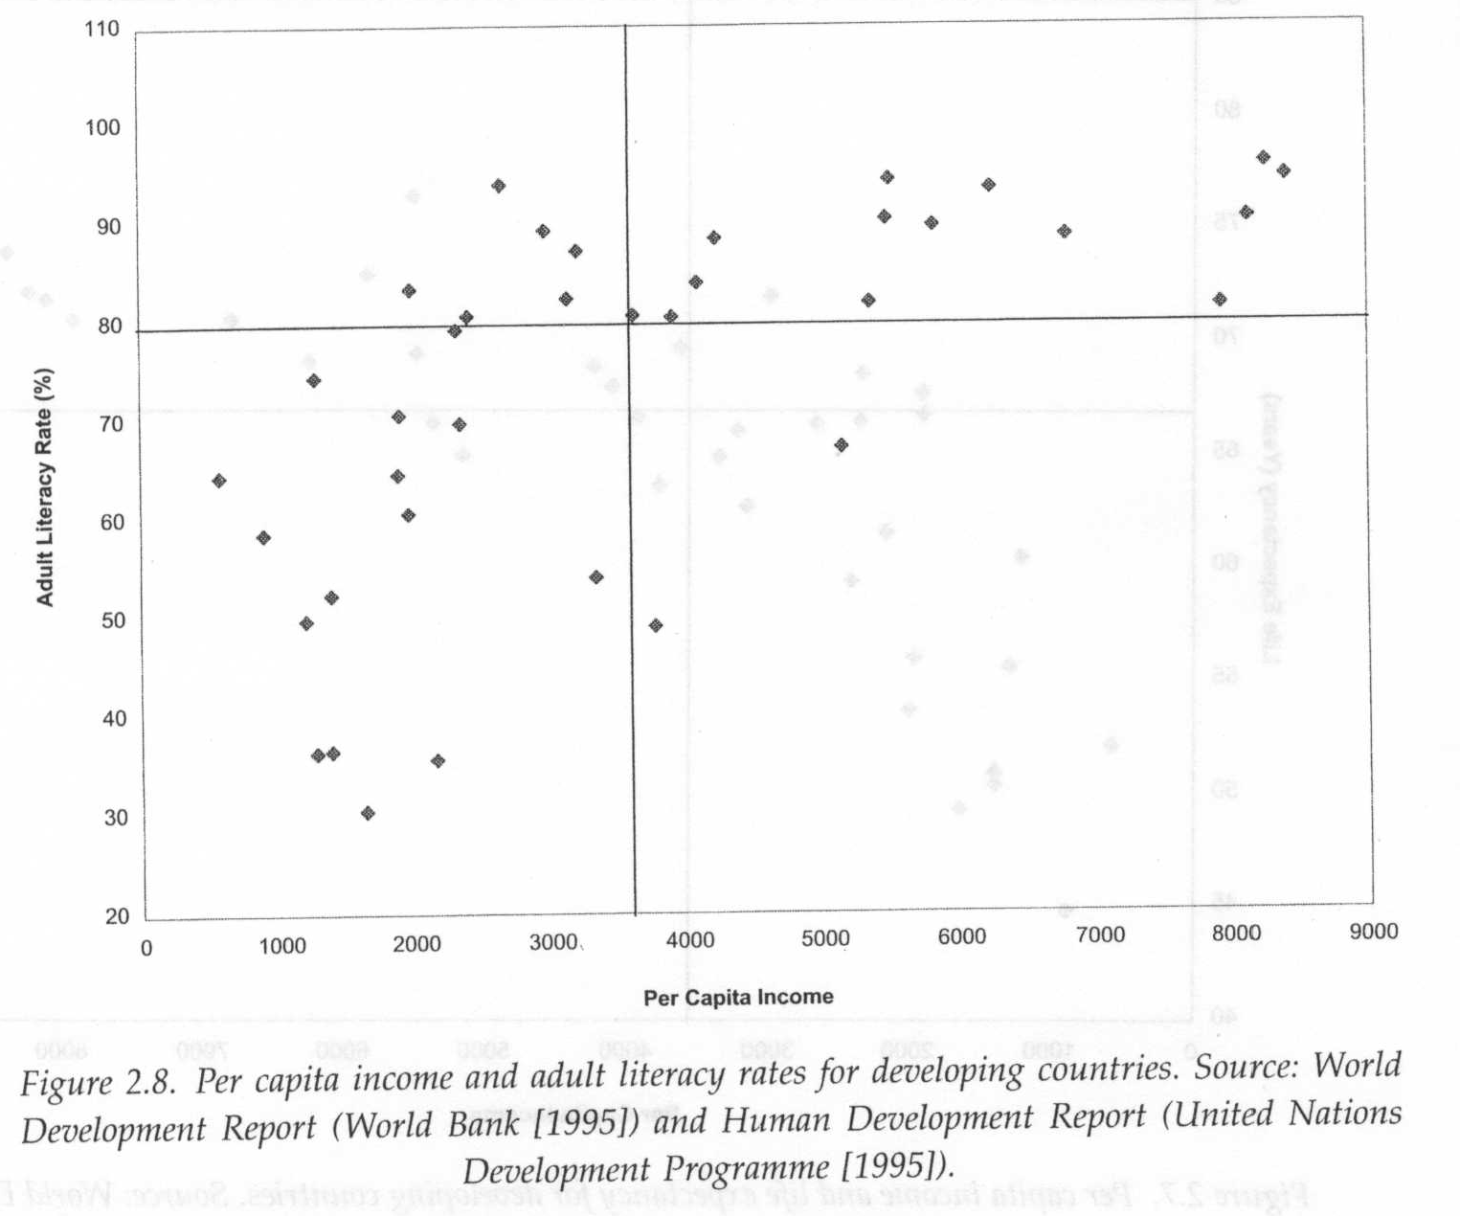
Adult literacy rates and per capita income

Slide 9
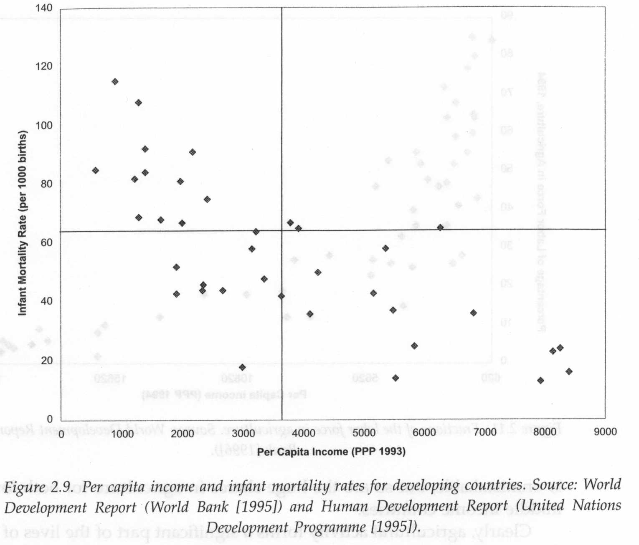
Infant mortality rates and per capita income

Slide 10
Structural characteristics of developing countries
Demographic characteristics
  As development proceeds, death rates plummet downward. Birth rates often remain high before go downward. At the beginning of development process, this leads to high population growth
  Why not good for high population growth (high birth rates)?
    help income to grow? what if we don’t have enough endowment?
    population is heavily weighted with children >> consequences?
  Population growth rates tend to decline with increased per capita income
Notes:
more economic dependence >> poverty, child labor, and low education.

Slide 11
Structural characteristics of developing countries
Occupational and production structure
  Agricultural activity is still the main fraction (more people in agricultural sector)
  Low productivity, low value fraction in GDP
Rapid rural-urban migration
  Rates of rural-urban migration are very high
  ‘Push’ from agriculture vs. ‘pull’ of urban sector
  Large fraction of nonrural labor force is engaged in a nebulous activity called ‘services’
    These services activities are informal, waiting positions or fall back options for laborers lacking an industrial job.

Slide 12
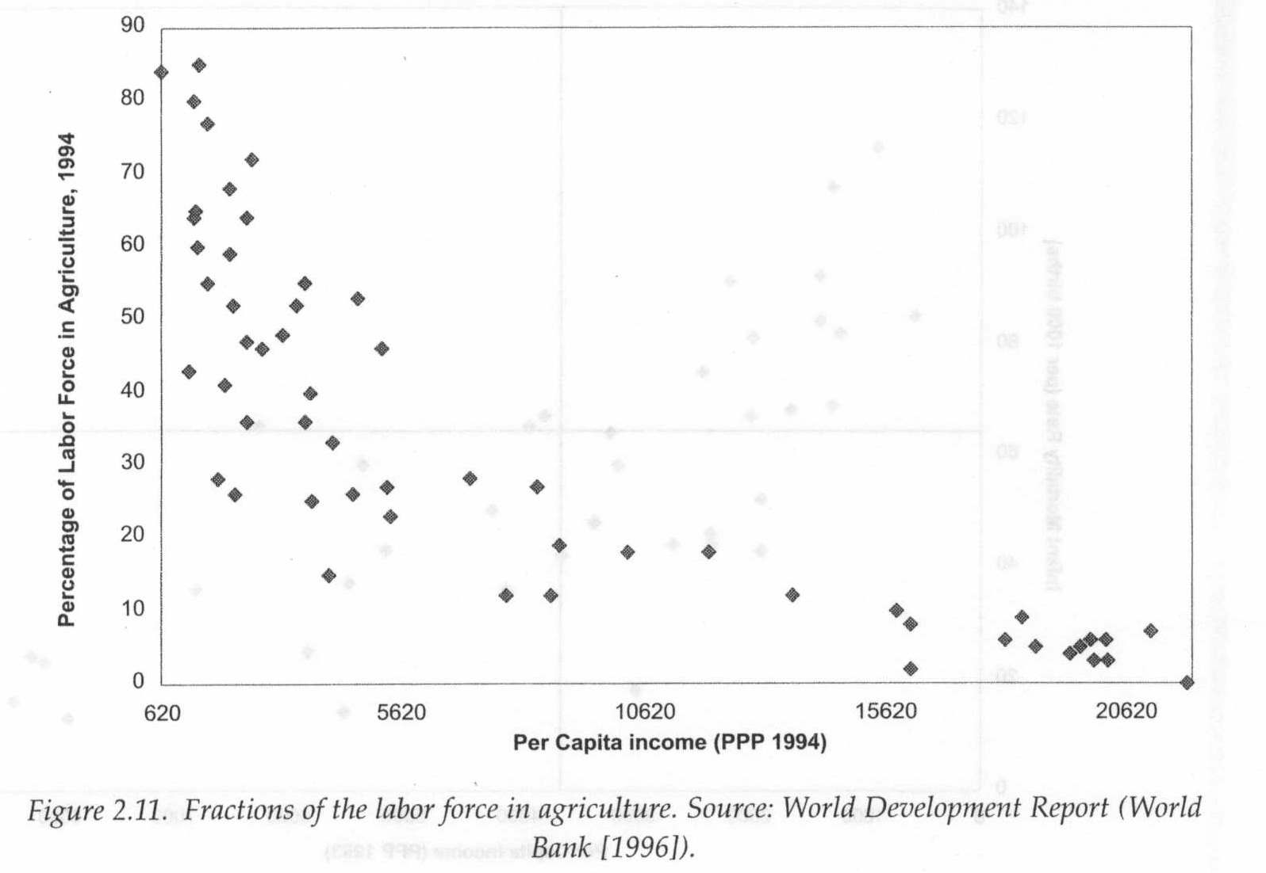
Fractions of the labor force in agriculture and per capita income

Slide 13
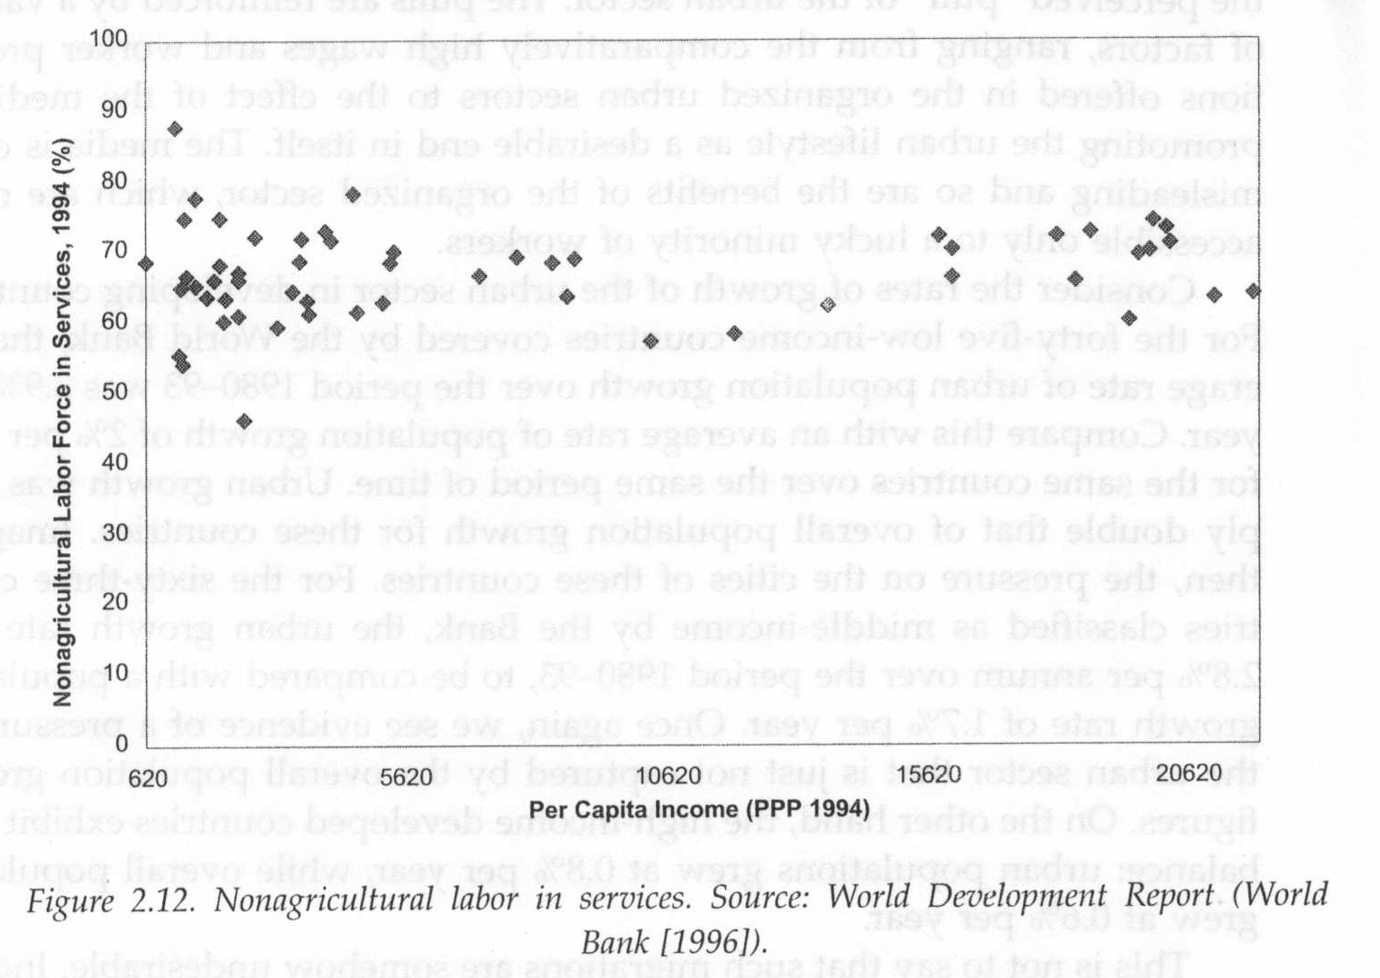
Nonagricultural labor in services and per capita income

Slide 14
http://data.worldbank.org/
http://databank.worldbank.org/data/reports.aspx?source=world-development-indicators
http://data.uis.unesco.org/Index.aspx
http://datatopics.worldbank.org/gender/home
http://blogs.worldbank.org/opendata/should-we-continue-use-term-developing-world

