Slide 1
Thailand’s Processed Food Industry
Mr. Bhanupong
Lecture 15

Slide 2
Course Syllabus lecture 15
The rise and fall of Thailand’s export-oriented industries
We explore processed food.
While facing non-tariff barriers imposed by developed countries, the industry is still leading exporters of Thailand.
Does the success of these industries bode well for the resilience and dynamism of the Thai manufacturing sector?

Slide 3
Outline
Exports Performance
Export competitiveness
Processed chicken
Frozen shrimp
SPS measures and impacts
Responses to NTBs

Slide 4
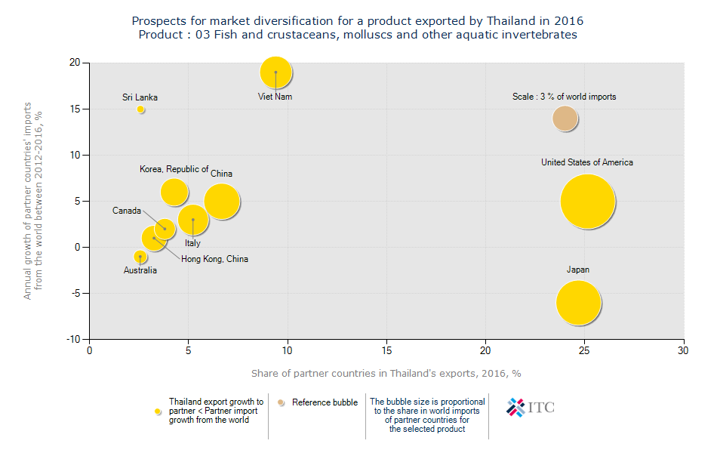
Product 03: Fish, Crustaceans, mollusks

Slide 5
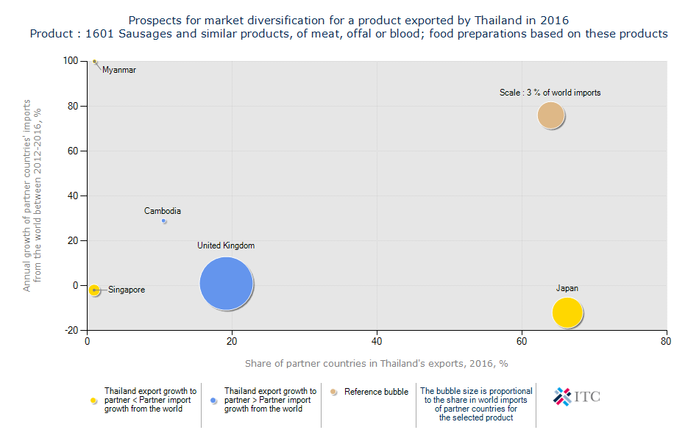
Sausages: product 1601

Slide 6
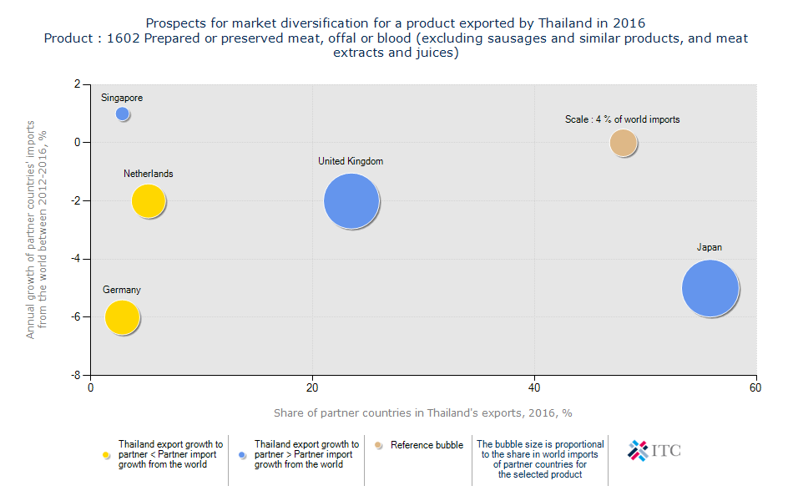
Prepared or preserved meat (Chicken) Product 1602

Slide 7
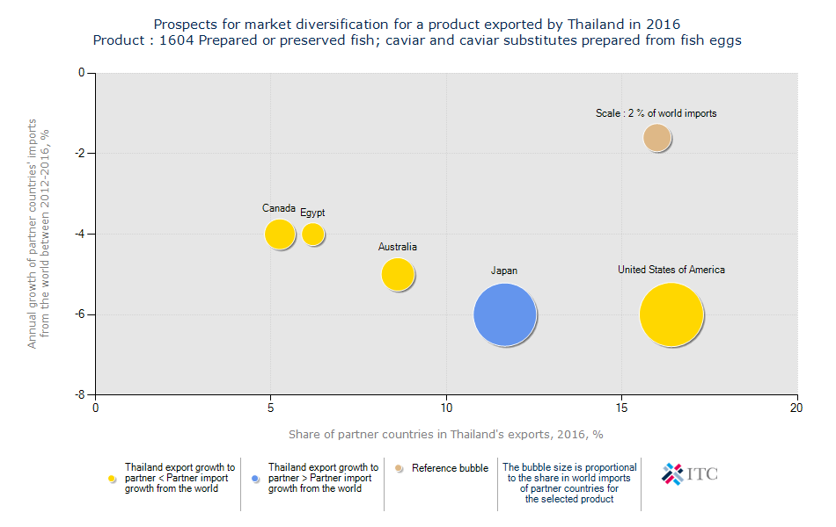
Prepared or preserved fish: Product 1604

Slide 8
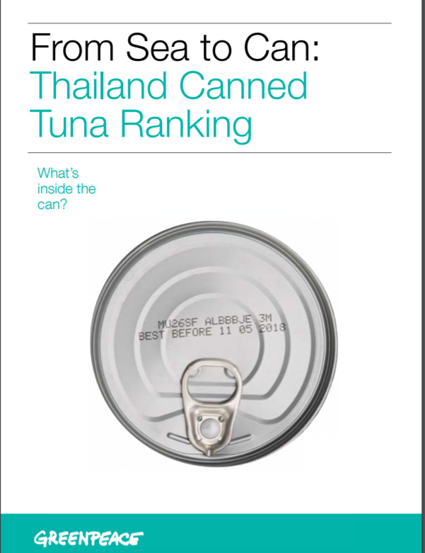

Slide 9
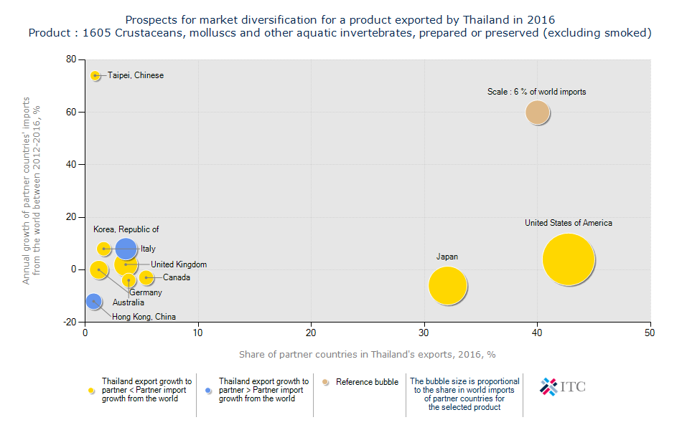
Crustaceans: product 1605

Slide 11
Early Mortality Syndrome (EMS)
In shrimp in SEA since 2012

Slide 12
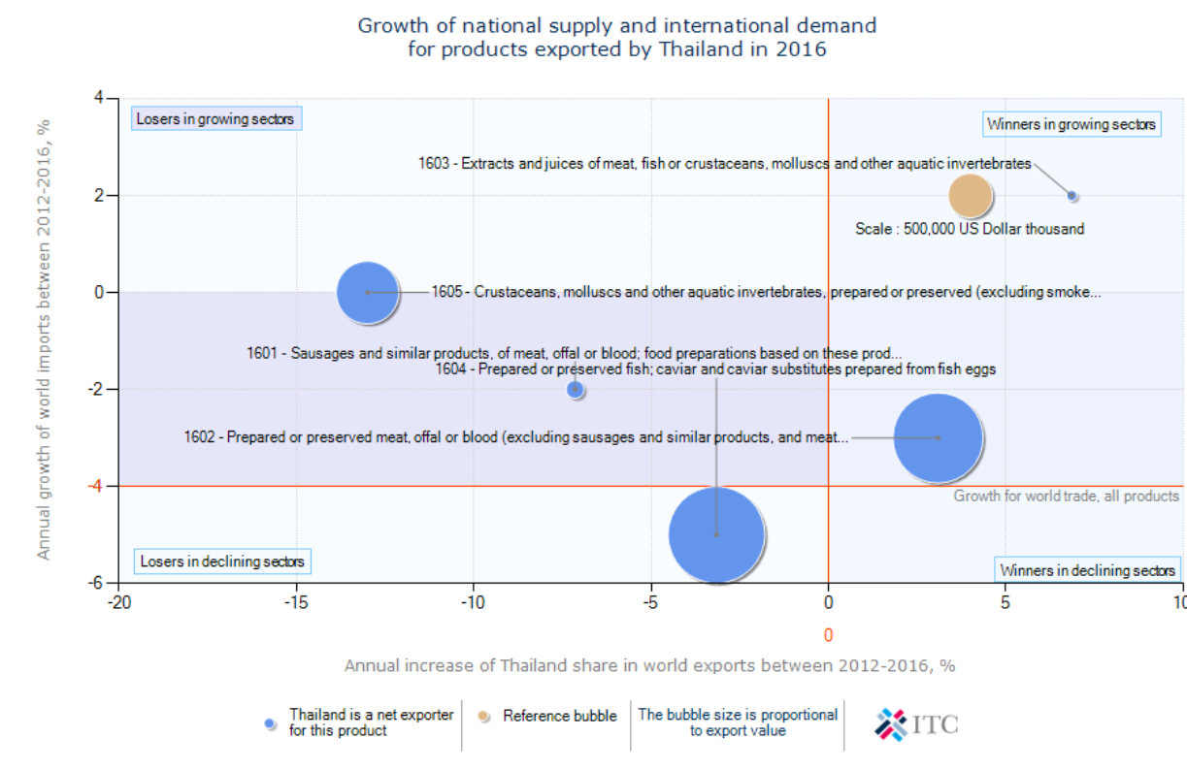
BCG Framework: Product 16xx

Slide 13
Trade Performance Index
Processed food exports (2016)
 | Value | Rank
Number of exporting countries | 169
Value of exports (in thousand US$) | 19,753,610
Export growth in value, p.a. (%) | -2% | 111
Share in national exports (%) | 9%
Share in national imports (%) | 3%
Relative trade balance (%) | 47%
Relative unit value (world average = 1) | 1

Slide 14
Trade Performance Index
Processed food exports (2016)
 | Value | Rank
169 countries
Net exports (in thousand US$) | 12,809,011 | 5
Per capita exports US$/inhabitant) | 286.9 | 45
Share in world market (%) | 2.67% | 14
Product diversification (N° of equivalent products) | 23 | 30
Market diversification (N° of equivalent markets) | 15 | 21

Slide 16
Benefits from processed food industry
Less reliance on imported raw materials: high value added.
Low capital intensity: creating more jobs
Close links with the agricultural sector
Output and exports reflect changing comparative advantage.
Wider scope for product differentiation than traditional agricultural commodities.

Slide 17
Major processed food exports
Processed seafood: canned tuna, fresh and frozen shrimp
Processed meat: chicken, pork
Processed vegetable and fruit: canned pineapple

Slide 18
An early warning indicator
The year 2001 witnessed the gain in Thailand’s market share of chicken exports to the EU, reaching above 35 percent in the total imports in the EU, at the expense of the US.
The rising market share is an early warning that the chicken industry will be subject to new barriers.
Nitrofuran detection was responsible for the decline of the Thai market share in 2002.
The Avian Influenza that triggered the ban on Thai chicken further depressed the share of Thai chicken in 2004.

Slide 19
GSP withdrawal: 1999
Nitrofuran: 2002

Slide 20
Further processed chicken
There was a sharp fall in exports of chilled and frozen chicken because of the ban on Thai chicken after the outbreak of Avian Influenza in 2004
Since it is safe to consume cooked chicken, Thai exporters began exporting boiled chicken and further processed chicken meat to compensate the fall in exports of frozen chicken.
In 2004, Thailand exported heat-treated chicken worth 20 billion baht, half of which went to Japan, followed by the EU.

Slide 22
Responses to non-tariff barriers
Thai food processing firms have to adjust in the new technical trade barriers:
Move from chilled and frozen to cooked chicken and further chicken exports.
Adopt a closed farming system (as opposed to free-range farming)
Invest directly in importing countries (CP Chilled chicken plants in UK)
Canned tuna green curry
Tuna spread
Kaew Kung ( frozen shrimp soup), 59 baht per cup, are produced in a billion-baht factory close to shrimp farms near Trad province.

Slide 23
Sanitary and Phytosanitary Standard (SPS)
SPS can be used as powerful tools to impede international trade and protect domestic producers through unjustified different requirements in different markets, unnecessary costly or time consuming tests, or duplicative conformity assessment procedures.

Slide 24
The case of the EU
The European Commission has set clear guidelines for producers and exporters to improve the healthiness of food for EU consumers.
Labeling requirements: nutritious values
Among the measures is voluntary "traffic labeling", which deems products either green, yellow or red, depending on the risk of causing obesity.
What causes obesity? Does it run in the family?

Slide 25
Pathogenic substance
The EU also has strengthened its food-safety measures dealing with pathogenic micro-organisms that could harm consumers.
The list of chemical residues from pesticides would be revised with tougher inspections to head off diseases.
Stringent checks on imported meat, fruit and vegetables are carried as a part of risk assessment procedure.
Is it safe to eat horse (dog) meat?
Red-meat stimulus substance was found in Nakorn Prathom pig farms.

Slide 26
Traceability (From Farms to Forks)
Most Thai exporters had co-operated well with previous EU requirements, including a 2005 traceability system for feed and food.
“The EU have found the Thai record was not too bad but not perfect,“
Based on 2006 statistics, there were 86 cases of Thai food imports with problems including nitrofurans in freshwater shrimp and pesticides in fresh vegetables.

Slide 27
On pesticides
The sharp increase in pesticide use by Thai farmers has alarmed international markets.
Department of Agriculture: We needed to impose a complete ban on four hazardous chemicals still used in Thailand but not in any developed country.
The country's record of pesticide use was worrying.

Slide 28
Thais love chemicals
Food and Agriculture Organization figures for 2007 show Thailand had 27,126 agricultural chemical brands registered for use - more than China (20,000), Vietnam (1,743), Indonesia (1,158), Malaysia (917), Burma (818) and Laos (100) combined.
Thailand is consuming a massive amount of chemicals,
Thai farmers still use agricultural chemicals that have been banned in many countries: carbofuran, dicrotophos, methyl and EPN.

Slide 29
Beware of Salmonella
People infected with salmonella and campylobacter may suffer from abdominal pain and diarrhea.
Salmonella is found in both chicken meat and eggs while campylobacter is found in chickens.

Slide 30
Quality improvement
Major causes of Thailand’s exports detention by USFDA are related to quality and safety of the products: unsafe coloring, filthy, salmonella.
Some are not difficult to deal with: nutrition labeling, specification of production process, listing of ingredients, factory certificates.

Slide 31
USFDA Detention of Thai food products in 2004
That was a decade ago. Has the pattern of detention changed since then?

Slide 33
A wake-up call: Rising Awareness of Food Safety Standards
2002: Declining exports of chicken
and shrimp to the EU
2004: (1) Outbreak of Avian Influenza
(2) Massive culling of chickens
(3) Reduction in domestic consumption
of chicken

Slide 34
Impact of the import bans

Slide 35
Thailand’s responses to shocks
National Bureau of Agricultural Commodity and Food Standards (ACFS) was established in 2002 to supervise and control food chain from farms to consumers.
ACFS established national standards for swine, poultry and daily farms.

Slide 36
ACFS: Thailand’s food inspector
ACFS inspection activity is conducted from hatchery to final markets at home and aboard.
Good agricultural Practice (GAP) involves the upstream activities at hatchery and farm levels.
The Good Manufacturing Practice (GMP) and HACCP (Hazard Analysis at Critical Control Points) are issued to qualified firms at the harvesting and processing plants.

Slide 37
Technical trade barriers from the down under
The Australian food safety regulations exemplify in trade-impeding effects of technical barriers.
Chicken meat imported into Australia must be heated at 70 Celsius for 143 minutes to assure disease-free meat.
Neither Thailand nor any other country has ever penetrated the Australian chicken market.

Slide 38
Technical trade barriers
Food safety standard became a thorny issue during the negotiation of free trade agreement between Thailand and Australia.
The Thai firms argued that they had a lot to lose because the aberration of food safety standards was still maintained after the removal of tariff barriers.

Slide 39
To retaliate the Aussie
Some Thai companies jokingly suggested the Thai government retaliate by requiring the same kind of heat treatment (70 Celsius) on imported wine and chocolates from Australia.
The basic argument is that food products that are subjected to heat treatment would change their nature and appearance after meeting the most stringent food safety regulations.
Thus unnecessarily high food safety standards can lead to zero volume of exports.

Slide 40
Nitrofuran and Thailand’s Exports of shrimp in 2002
Nitrofuran is a veterinary drug used in food-producing industries, but it is banned in many countries because of a link to cancer in humans.
The EU first employed costly new laboratory equipment--LCMS/MS--in March 2002.
The machine found nitrofuran residues in both Brazilian and Thai chickens and black tigers shrimps

Slide 41
Thai shrimp exporters and expensive instrument for detecting drug residues
The new LCSMS/MS instrument is so accurate that it can detect drug residues at parts per trillion.
While Brazilian exports were subject to only random check, Thai products were subject to a 100 percent testing.
The cost of the new testing equipment is 15 million baht ($350,000).
Small firms would not be able to afford this costly imported equipment.

Slide 42
Firms comply with Food Safety Standards imposed by importing countries, because they want to...
To satisfy customers’ requirements
To maintain market access
To access new markets
To increase operation efficiency

Slide 43
The way to respond to stringent food safety standards: Friendly shrimp farming
Switched from black tigers to white shrimp
Employed pro-biotic farming to create friendly environment for shrimp
Applied no anti-biotic to improve shrimps’ digestion system,
Reduced stress and increased virus resistance of baby shrimps (less crowded ponds)

Slide 44
Dynamic responses
But these measures also incur higher cost to producers
Must do proactive investment, anticipating more stringent food safety standards.
Upgrading laboratory standards
It boils down to whether MC exceeds MB.
The long-run benefit can be seen from rising market shares

Slide 45
Market penetration of Thai shrimp exports:
A rebound after upgrading food safety standards

Slide 48
Anti-Dumping Duty (ADD) and Non-Tariff Barriers (NTB)
Rising market shares can be thought of as an early warning indicator of incoming trade barriers, either in the form of ADD (USA) or NTB (EU).
There were other countries that are subjected to these anti-dumping duties: Vietnam, India, Indonesia, and China

Slide 49
Size matters
Large firms take advantage over smaller firms in the ability to comply with international food safety standards, because of lower average compliance cost.
Large firms have their own brands, which they must protect their reputation.
Large firms are more likely to form strategic partners.
More chances to be a member of exporters’ associations

Slide 50
Size matters in SPS compliance:
Average cost declines as production increases
AC
A
B
AC
Qa
Qb
Q

Slide 51
Disadvantages of small firms
Incur higher unit cost of upgrading safety standards
Require government assistance in providing information of food safety standards
Need subsidies on laboratories
Difficult to establish strategic partners.
A joint venture with importers is crucial if exporting firms want to gain access to developed countries, whose governments require plant inspection as a necessary condition for market access.

Slide 52
Don’t delay improvement in quality and safety standard
The sooner firms achieve stringent food safety standards, the greater their ability to compete in the world market.
Export market shares depend partly on firms’ accumulated investment to comply with food safety standard norms.
Abuses of SPS standards are more frequent in those markets where there are substantial domestic subsidies.

Slide 53
Product differentiation through raising food safety standards
SPS standards imposed by importing countries may increase domestic price level of the affected products, as there are lower level of imports.
Stringent SPS measures can be used to protect domestic industry by fending off the supply of imported product—at the cost of higher prices for domestic consumers

Slide 54
SPS compliance cost is in fact investment expenditure
Firm’s initial investment to comply with SPS measures would pay off in the long run.
Investment in upgrading food safety standard is related to export performance of the firms, specific industry, and the country that is aware of food safety standards.
Indirect subsidies through public spending on raising food safety concerns by government can reduce short-term adjustment costs.

Slide 55
Examples of industry responses to SPS measures
Substitution of soybean (GMO) by sunflower oil in canned tuna production
Established strategic partnerships in importing countries (CP and Queensland in fruit exports, Betrago and Sumitomo in exports of pork to Japan).
Integrated vertically (pig meat industry) and SPF (Specific Pathogen-Free) pork.

Slide 57
Functions of Exporters Associations
To prevent negative externality, export firms must be a member of an exporter association.
The associate provides vital information to government and exporter members, reducing information cost.
Screening and monitoring activity prevents moral hazard among members to maintain the sector’s reputation of high product quality and food safety.
Resource pooling and cost sharing in dealing with food safety standard issues can reduce compliance cost to SPS standards.

Slide 58
The way forward
The processed food industry is subject to a constant shock syndrome.
Tariff and non-tariff barriers can be substituted in importing countries.
When tariff barriers fall (due to FTAs) NTB rises (substitution of trade barriers).
Structural change: more concentration of the food industry, because size matters for international market access and competitiveness.

Slide 59
Impact of long-term investment in upgrading food safety standard
P
D2
S2
D1
C
B
S1
A
Q1
Q0
Q2
Q
Product differentiation through high SPS standard reduces the price elasticity and
Increases the demand for the product in the long run.

Slide 60
Conclusion
The concern for food safety increases with rising per capita income.
The higher the level of market penetration in importing countries, the higher the technical barriers.

Slide 61
Challenges in 2017
Falling prices may squeeze the profitability and cash flows of export companies in 2017.
Meanwhile, the shrimp industry is now facing investigation by the European Union for illegal, unregulated fishing, higher tariffs for exports to the EU, and low prices resulting from higher supply from many exporting countries.
USA measures in 2014: To comprehensively combat illegal, unreported, and unregulated (IUU) fishing and seafood fraud from entering the U.S. market place.

Slide 62
Challenges to Thailand’s seafood Industry
2012 | EMS (Emergency Mortality Syndrome)
2014 | Tier 3 Watch List on Human Trafficking (lowest) | GSP withdrawal by the EU on processed shrimp
2015 June 2016 | Yellow card by the EU for illegal fishing Upgraded to Tier 2 | GSP withdrawal on frozen and chilled shrimp

Slide 63
Thailand's multibillion-dollar seafood industry plagued by pirates and slaves on high seas
Overfishing and the use of illegal and undocumented trawlers has ravaged Thailand's marine ecosystems and even encouraged the use of slave labor from neighboring countries.
Thai fishing boats are now catching about 85 percent less than what they brought in 50 years ago, making it one of the most overfished regions on the planet.

Slide 64
Migrant workers: Slave workers?
Depleted fisheries in the Gulf of Thailand and Andaman Sea have, in turn, pushed Thai fishing boats farther and farther from home (Indonesia).
Fewer Thais are willing to take on the dangerous, low-level work, so fishing operations use brokers and agents to enlist migrant workers from impoverished neighboring countries such as Myanmar and Cambodia, often through trickery and kidnapping.

Slide 65
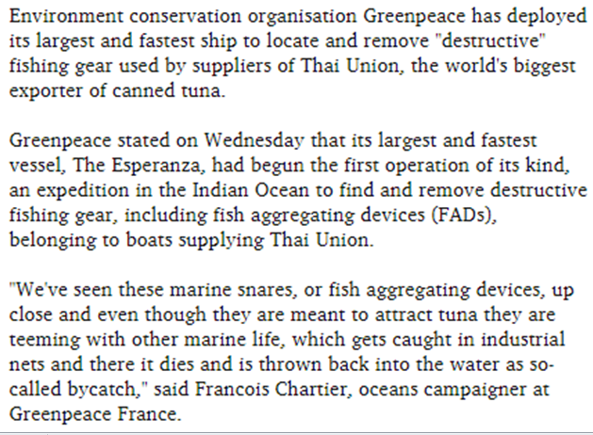
Greenpeace targets Thai Union suppliers' fishing gear 20 Apr 2016
FAD
TED= Turtle Excluding Device

Slide 66
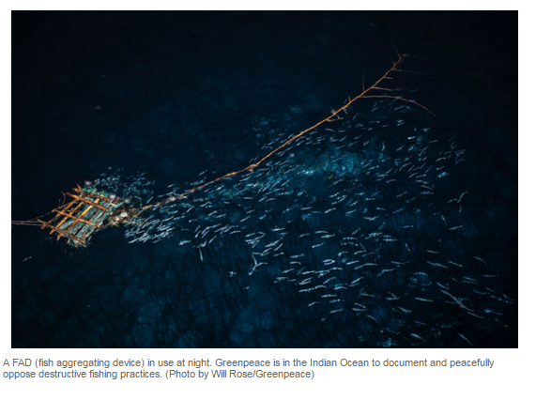
Fish Aggregating Devices (FADs)

Slide 67
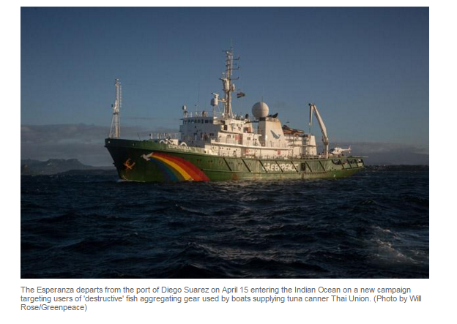
Thai Union vs. Greenpeace

Slide 68
Conclusion
Dynamism of the processed food industry is required to maintain the market share.
The sector must continuously invest in upgrading both safety and quality standards.
There will always be new challenges for processed food industries, which are constantly faced by new barriers.

