Slide 1
CASH MANAGEMENT SERVICES
FN323 Presentation

Slide 2
Why Cash Management?
To maximize profitability and liquidity
  To make sure the institutions do not run excessive risks
  To take advantages of discounts, business opportunities
  To arrange financing to obtain the most favorable terms
  To allow better planning
  To keep idle funds fully made use of

Slide 3
CASH MANAGEMENT SERVICES
Cash PAYMENT
Cash COLLECTION
LIQUIDITY Management

Slide 4
CASH PAYMENT

Slide 5
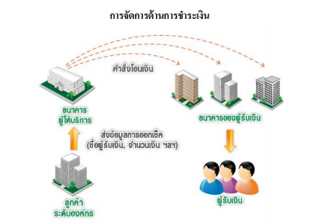
Cash Payment
EFT (Electronic Fund Transfer)
Direct Credit
Book transfer or Inter account transfer
Cashier Cheque
Payroll

Slide 6
CASH COLLECTION

Slide 7
Cash Collection
To collect cash payments more quickly and effectively.
EXAMPLES
Bill Payment
Cheque Collection (CQ)

Slide 8
Cash Collection
Bill Payment
Service provided to accept bill payments from customers conveniently via numerous channels, accompanied by information on the remitter of the funds.
Cheque Collection (CQ)
Service provided to manage your cheque collections efficiently, conveniently and quickly; you can credit cheques across clearing districts of all banks to your account easily.

Slide 9
LIQUIDITY MANAGEMENT

Slide 10
Liquidity Management
reduce interest expenses
increases income via higher interest
EXAMPLES
Liquidity Management Services
Automatic Funds Transfer

Slide 11
Liquidity Management Services
EXAMPLES
Fill Deficits
Sweep
Sweepback / Repositioning

Slide 12
Automatic Funds Transfer
Transfers from a current account to a savings account
Transfers from a current account to another current account
Transfers from a savings account to a savings account
automatically at the end of the day according to the terms and conditions that you set with the Bank
reduces mistakes or failures in fund transfers
higher interest (savings account)

Slide 13
QUESTIONS
AND
ANSWERS

Slide 14
THANK YOU
FOR YOUR ATTENTION
5604640564 Kwanrawee Yongthonsakul
5604640937 Pachara Sangkarat
5604641075 Peerada Kusalangkulwat
5604641141 Phat Aphiwatanakoon
5604641562 Sitthiwet Niyombundit

