Slide 1
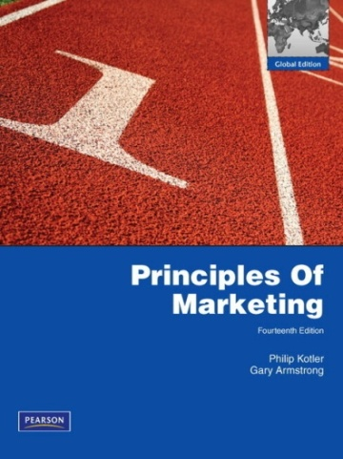
Integrated Marketing
Communications
MK 202 Fundamentals of Marketing
By
Aj. Suwalya Khemvaraporn
Date: October 25 ,2012

Slide 2
Communicating Customer Value
Integrated Marketing Communications Strategy

Slide 3
Contact
suwalya@yahoo.com
Mobile: 081-842-2043

Slide 4
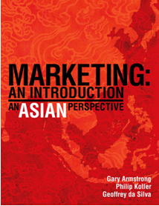
Texts

Slide 5
OBJECTIVE OUTLINE:
Objective 1: Define the five promotional mix tools for communicating customer value
PROMOTIONAL MIX
Objective 2: Discuss the changing communications landscape and the need for integrated marketing communications.
INTEGRATED MARKETING COMMUNICATIONS
Objective 3: Outline the communications process and the steps in developing effective marketing communications.
A VIEW OF THE COMMUNICATIONS PROCESS
STEPS IN DEVELOPING EFFECTIVE MARKETING COMMUNICATION
Objective 4: Explain the methods for setting the promotion budget and factors that effect the design of the promotion mix.
SETTING THE TOTAL PROMOTION BUDGET AND MIX
SOCIALLY RESPONSIBLE MARKETING COMMUNICATION

Slide 6
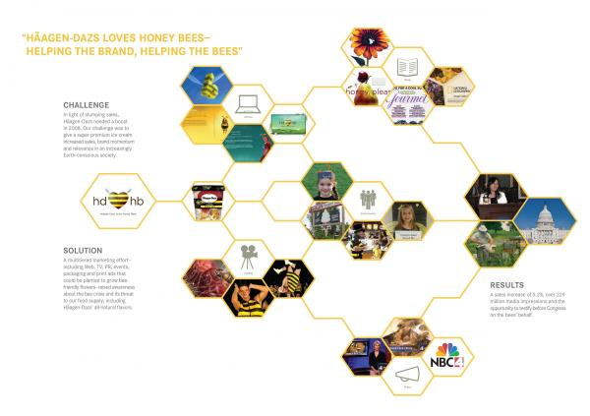


Opening Case Study- Haagen-Dazs: A Beautifully Integrated Marketing Communications Campaign
“Haagen-Dazs loves honey bees” integrated marketing campaign uses rich, well-coordinated blend of communications elements to successfully deliver Haagen –Dazs’ unique message and positioning.
“It’s the brand with heart and soul”, “We’re not only raising brand awareness, but making a difference in the world.”

Slide 7

Objective 1: Promotion Mix

Slide 8
The Promotion Mix or
Marketing Communications Mix
The promotion mix is the marketer’s bag of tools for communicating with customers and other
stakeholders. To deliver a clear and compelling
message, each tool must be carefully coordinated under the concept of integrated marketing communications

Slide 9
Definition: The Promotion Mix or
Marketing Communications Mix
The specific blend of promotional tools that the company uses to persuasively communicate customer value and build customer relationships.

Slide 10
Marketing Communications Mix
Advertising
  Any paid form of non personal presentation and promotion of ideas, goods, or services by an identified sponsor.
Sales Promotion
  Short-term incentives to encourage the purchase or sale of a product or service.
Public Relations (PR)
  Building good relations with the company’s various publics by obtaining favorable publicity, building up a good corporate image, and handling or heading off unfavorable rumors, stories, and events.

Slide 11
Marketing Communications Mix
Personal Selling
  Personal presentation by the firm’s sales force for the purpose of making sales and building customer relationships.
Direct Marketing
  Direct connections with carefully targeted individual consumers to both obtain an immediate response and cultivate lasting customer relationships—the use of telephone, mail, fax, e-mail, the Internet, and other tools to communicate directly with specific consumers.

Slide 12
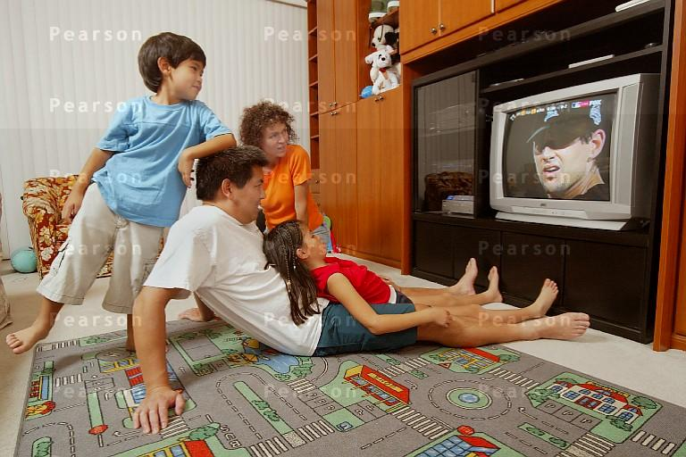
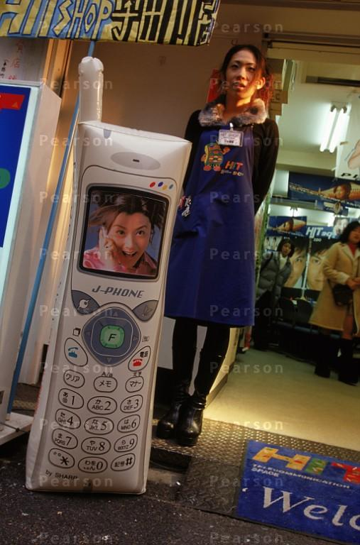
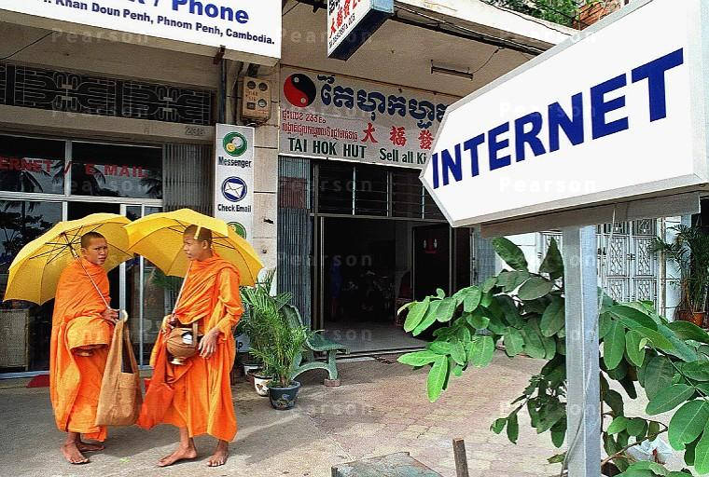
In order to communicate with customers in Asia, many different methods are used including media advertising, personal selling and even the Internet

Slide 13
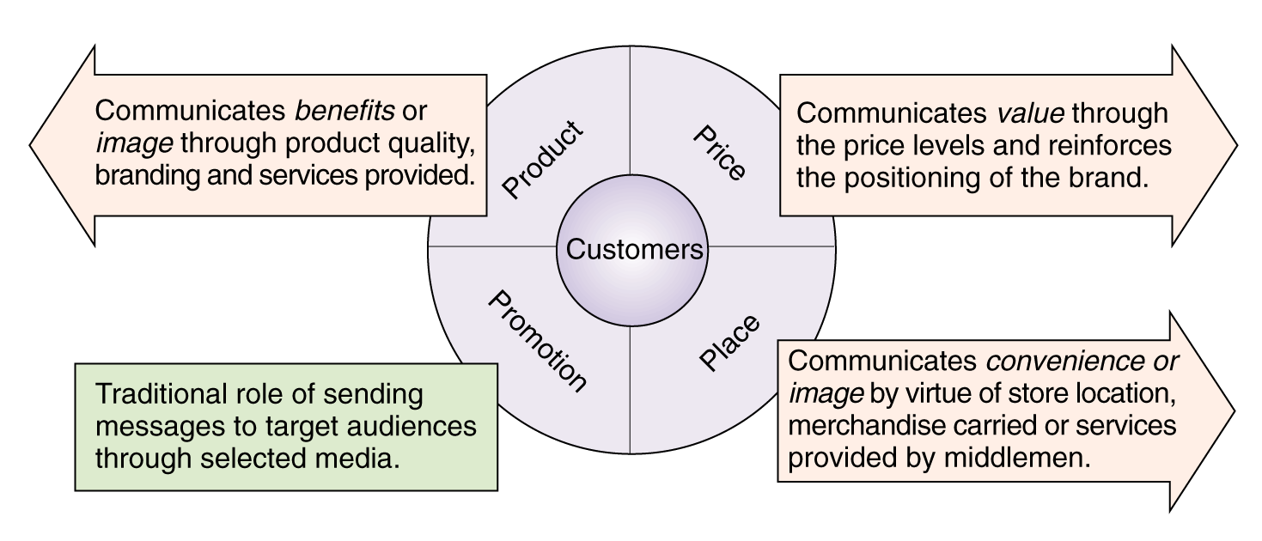
The “Communications Potential” of the Marketing Mix
Figure 12.1 (a)

Slide 14
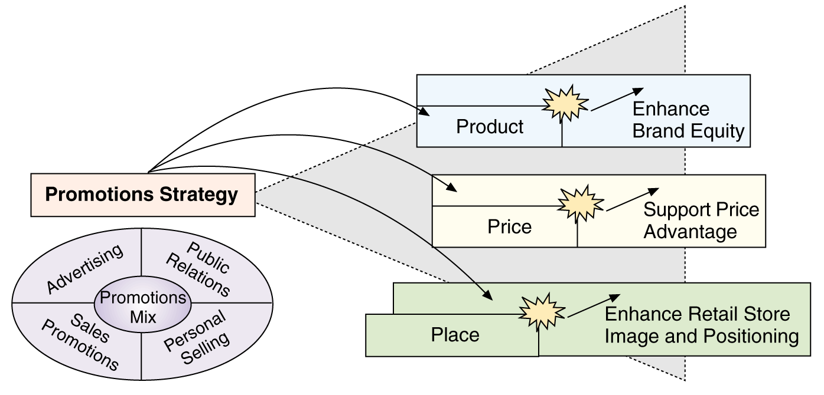
How Promotions Leverages Other Marketing Mix Variables
Figure 12.1 (b)

Slide 15
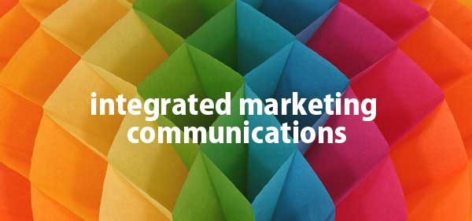
Objective 2: Integrated Markeing Communications
IMC

Slide 16
The Changing Communications Environment
Two factors are changing the face of today’s marketing communications:
As mass markets have fragmented, marketers
are shifting away from mass marketing
Vast improvements in information technology
are speeding the movement toward segmented
marketing

Slide 17
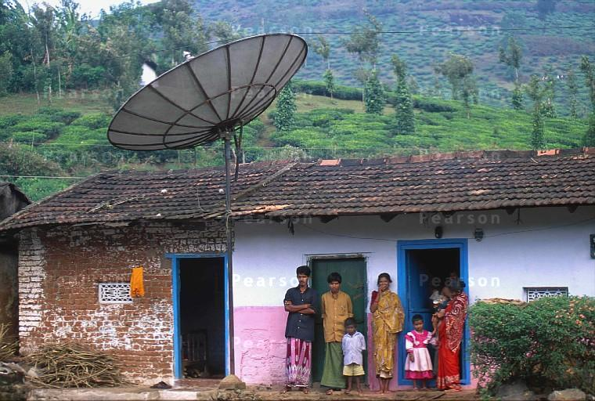
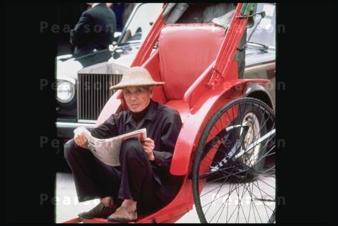
The challenge of communicating to vast rural and less affluent audiences in Asia is to know what types of media best suit those markets. Lack of affluence does not necessarily mean customers are not exposed to media and advertising

Slide 18


Kimberly-Clark – new IMC approaches
Targets new and expectant mothers through mommy blogs, Web sites,
print and online ads, e-mail, in-store promotions and in-hospital TV programming.

Slide 19
The need for IMC
Conflicting messages from different sources or promotional approaches can confuse company or brand images
The problem is particularly prevalent when functional specialists handle individual forms of marketing communications independently

Slide 20
The need for IMC
Using IMC, the company carefully
integrates and coordinates its many
communication channels to deliver
a clear, consistent, and compelling
message about the organization
and its products

Slide 21
The need for IMC
  The Internet must be integrated into the broader IMC mix
  Best bet is to wed traditional branding efforts with the interactivity and service capabilities of online communications
  GRADUAL BLENDING: of new and traditional media
  NEW MARKETING MODEL: will consist of a shifting mix of both traditional mass media and a wide array of exciting, new, more-targeted, and more personalized media.
  THE CHALLENGE: is to bridge the “media divide” that too often separates traditional media approaches from interactive and digital ones.

Slide 22
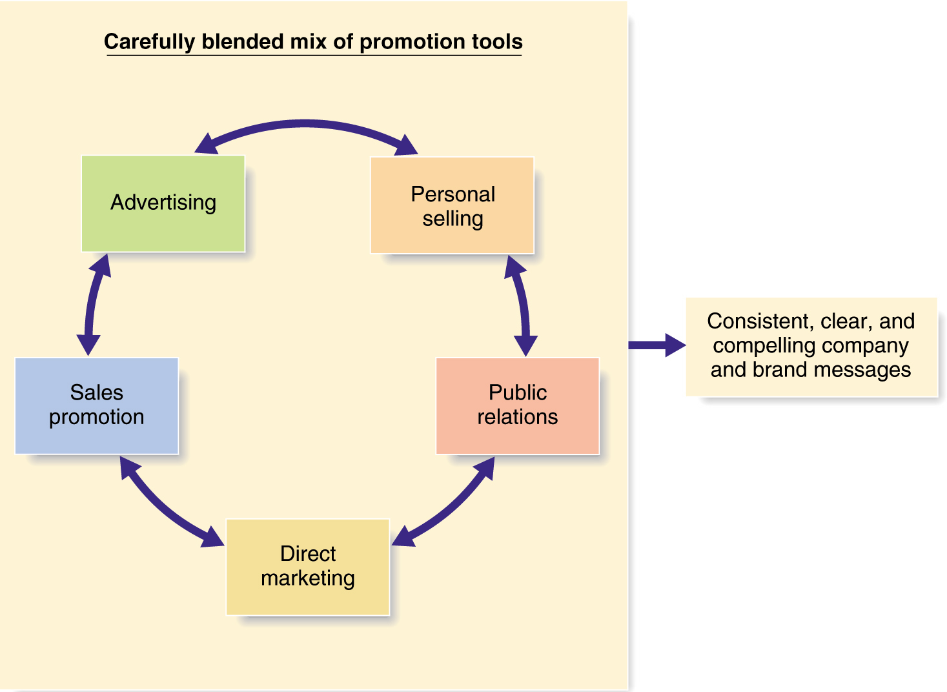
Integrated Marketing Communications
Figure 12.2

Slide 23
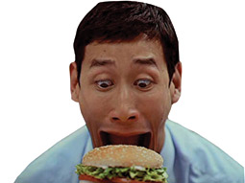
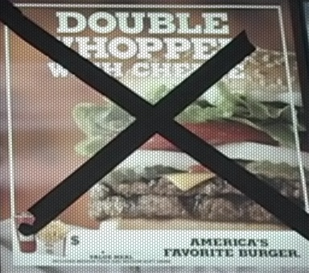

IMC: Burger King’s Whopper Freakout Campaign
Burger King’s richly integrated prolonged
Whopper Freakout campaign, which employed
A carefully coordinated mix of everything from
TV and radio ads to rich media ad banners
And a Freakout Web site, boosted store traffic
And Whopper sales by 20 percent.

Slide 24

Objective 3: A View of the Communications Process
Steps in Developing Effective Marketing Communication

Slide 25
The Communication Process
Communications efforts should be viewed from the perspective of managing customer relationships over time.
The communication process begins with an audit of all potential contacts a customer might have with the brand.
Effective communication requires knowledge of how communication works.

Slide 26
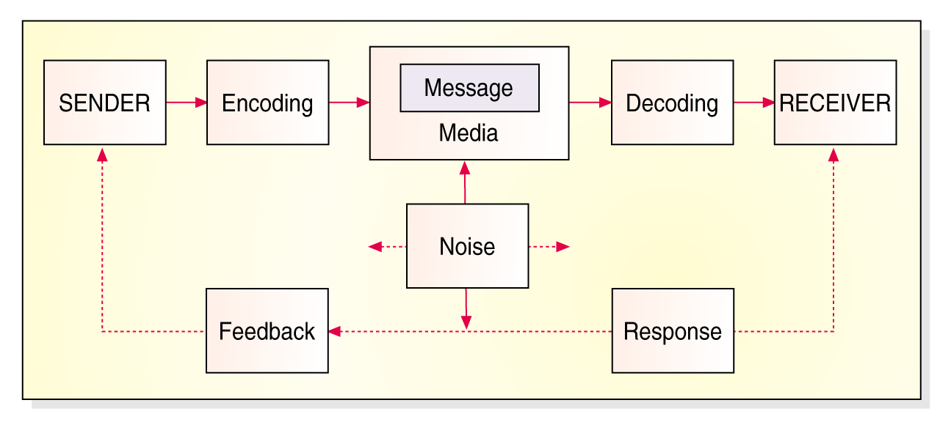
Elements in the Communications Process
Figure 12.4
Sender’s field of
experience
Receiver’s field of
experience

Slide 27
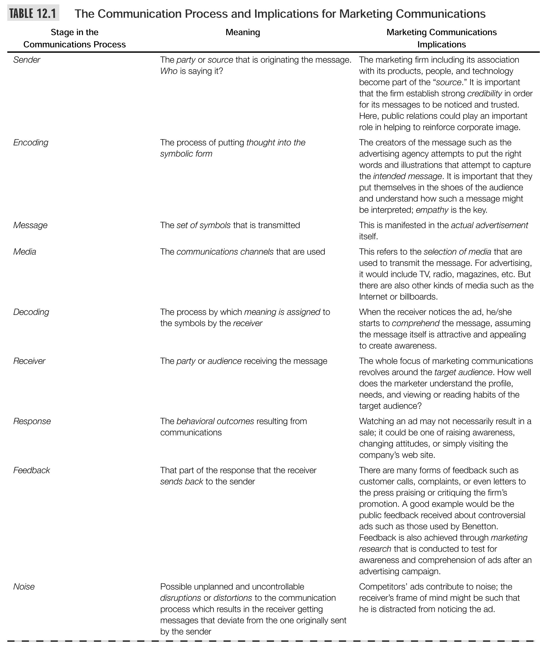

Slide 28
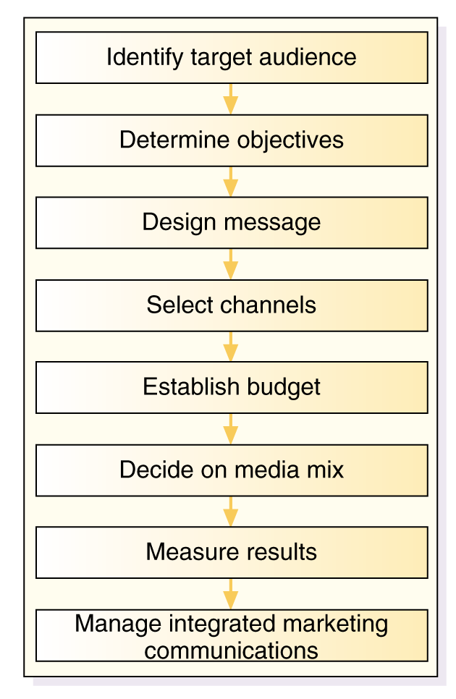
Figure 12.5
The Promotions Planning Process

Slide 29
Developing Effective Communication
Step 1: Identifying the Target Audience
  Affects decisions related to what, how, when, and where message will be said, as well as who will say it
Step 2: Determining Communication
Objectives
  Six buyer readiness stages
Awareness
Knowledge
Liking
Preference
Conviction
Purchase

Slide 30
Developing Effective Communication
  Six buyer readiness stages
A goal of marketing in general and of marketing
Communications in particular is to move target consumers
Through the buying process. Once again, it starts with understanding customer needs and wants
Believing this is the best
feeling
Awareness
Knowledge
Liking
Preference
Conviction
Purchase
Prefer over others

Slide 31

Developing Effective Communication
Step 3: Designing a Message
  AIDA framework guides message design
  Message content contains appeals or themes designed to produce desired results
    Rational appeals – Ex.Sunlight liquid Dishwash?
    Emotional appeals – Ex. Jubilee Diamonds?
      Love, pride, joy, humor, fear, guilt, shame
      or Moral appeal

Slide 32
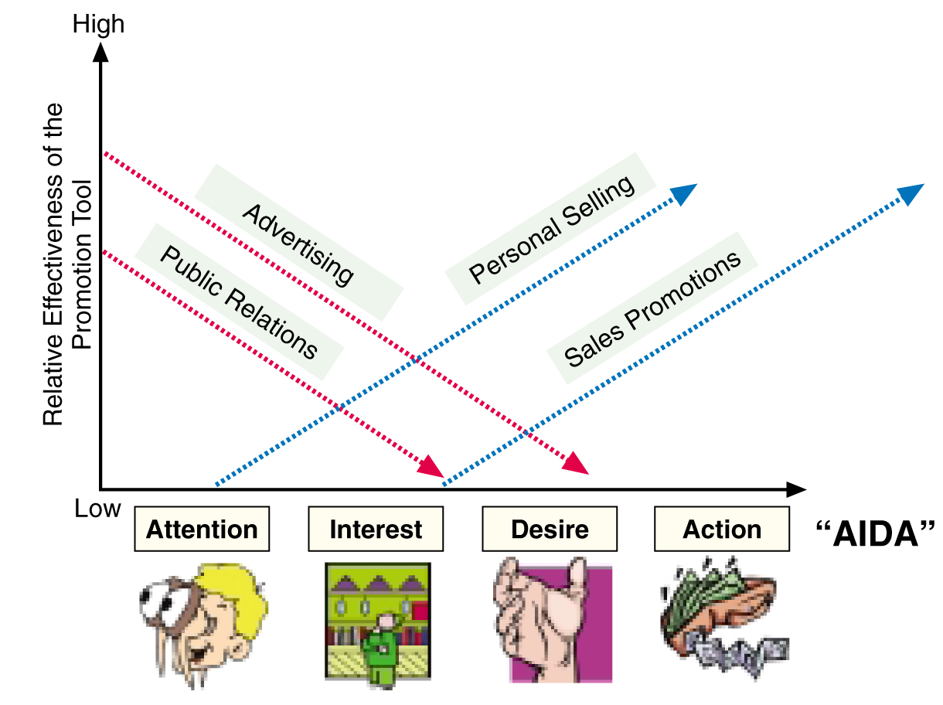
Deploying the Different Tools of Promotions to Coincide with Consumer Behavior (AIDA)
Figure 12.3 (C)

Slide 33
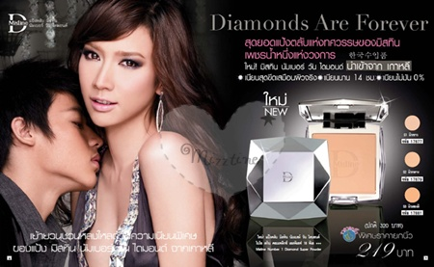
Developing Effective Communication
Step 3: Designing a Message
  Message Structure: Key decisions are required with respect to three message structure issues:
    Whether or not to draw a conclusion
    One-sided vs. two-sided argument
    Order of argument presentation
  Message Format: Design, layout, copy, color, shape, movement, words, sounds, voice, body language, dress, etc.

Slide 34
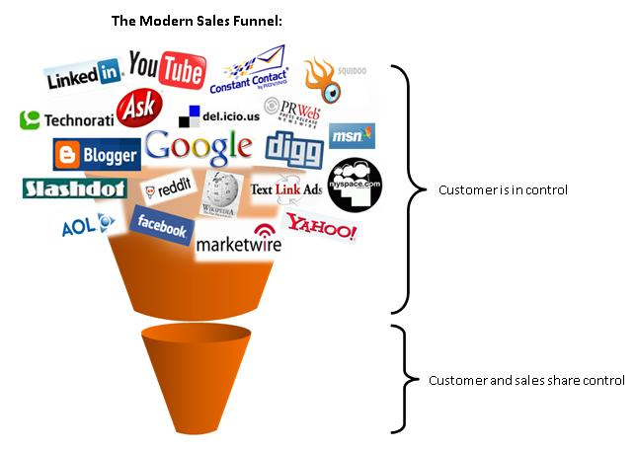

Developing Effective Communication
Step 4: Choosing Media
(and Media Mix)
  Personal communication channels
    Includes face-to-face, phone, mail, and Internet chat communications
    Word-of-mouth influence is often critical
    Buzz marketing cultivates opinion leaders
  Nonpersonal communication channels
    Includes media, atmosphere, and events

Slide 35
Figure 12.5
The Promotions Planning Process

Slide 36
Objective 4: Setting the Total Promotion Budget and Mix
Socially Responsible Marketing

Slide 37
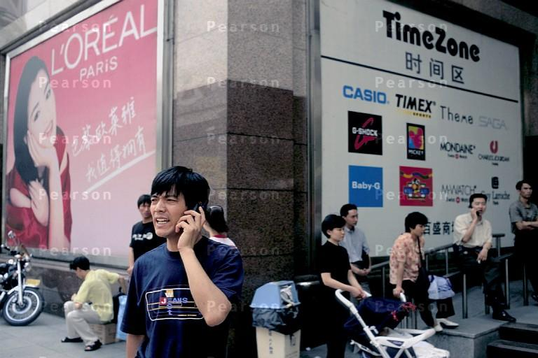
Most observers see China as registering the most dramatic increases in advertising expenditures as both global and local brands rush to capture the media landscape in major Chinese cities

Slide 38

Setting the Promotion Budget
Affordable
Based on What the Company Thinks it Can Afford
Percentage-of-Sales
Based on a Percentage of Current or Forecasted Sales
Competitive-Parity
Set Budget to Match Competitors
Objective-and-Task
Set Objectives, Determine Tasks to Achieve Objectives,
Sum of Task Costs Equals Budget

Slide 39
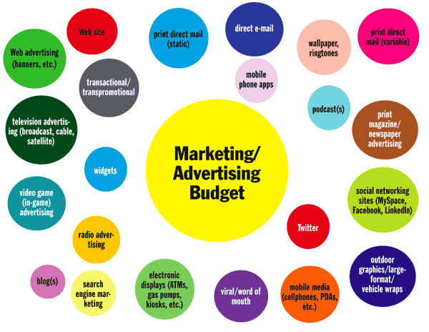
Media Mix

Slide 40
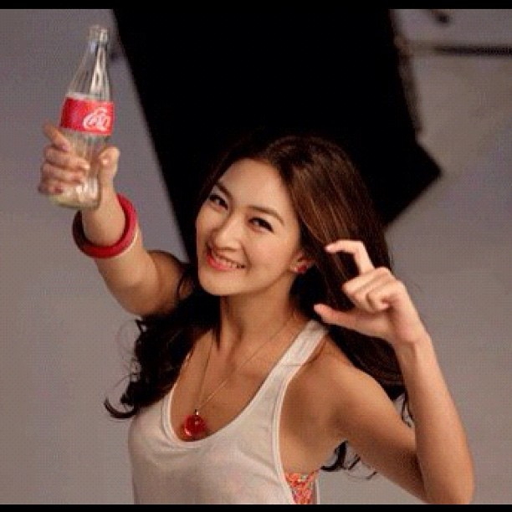
Advertising
Can reach masses of geographically dispersed buyers.
Can repeat a message many times.
Is impersonal, one-way communication.
Can be very costly for some media types.
Low cost per exposure, though overall costs are high
Consumers perceive advertised goods as more legitimate
Dramatizes company/brand
Builds brand image; may stimulate short-term sales

Slide 41

Personal Selling
Personal interaction allows for feedback and adjustments
Allows relationship building.
Most effective tool for building buyers’ preferences, convictions, and actions
Buyers are more attentive
Sales force represents a long-term commitment
Most expensive of the promotional tools

Slide 42
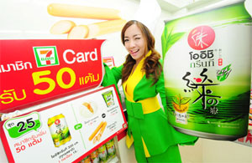
Sales Promotion
Makes use of a variety of formats: premiums, coupons, contests, etc.
Attracts attention, offers strong purchase incentives, dramatizes offers, boosts sagging sales
Offers strong incentives to buy.
Invites and rewards quick consumer response.
Stimulates quick response
Effects are short lived
Not effective at building long-term brand preferences

Slide 43
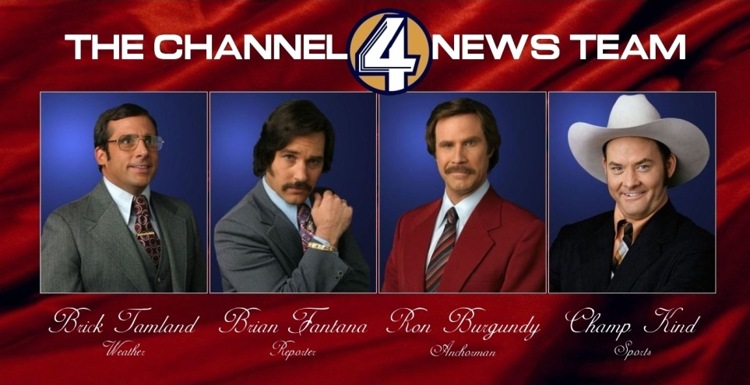
Public Relations
Very believable and credible
Reaches people who avoid salespeople and ads.
Can dramatize a company or product.
Tends to be used as an afterthought.
Planned use can be effective and economical.
Many forms: news stories, news features, events and sponsorships, etc

Slide 44

Direct Marketing
Many forms that share four characteristics:
  Nonpublic
  Immediate
  Customized
  Interactive
Well suited to highly targeted marketing.

Slide 45
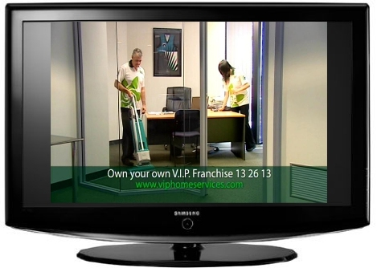

Promotion Mix Strategies
Push strategy: trade promotions and personal selling efforts push the product through the distribution channels.
Pull strategy: producers use advertising and consumer sales promotions to generate strong consumer demand for products.
vs

Slide 46
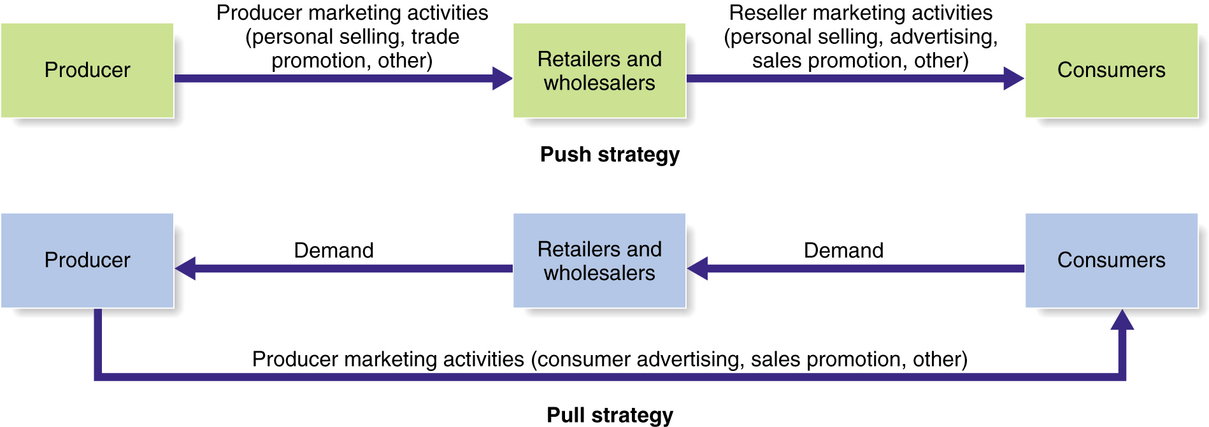
Push vs. Pull Promotion Strategy
Figure 12.6

Slide 47

Major Decisions in Advertising

Slide 48
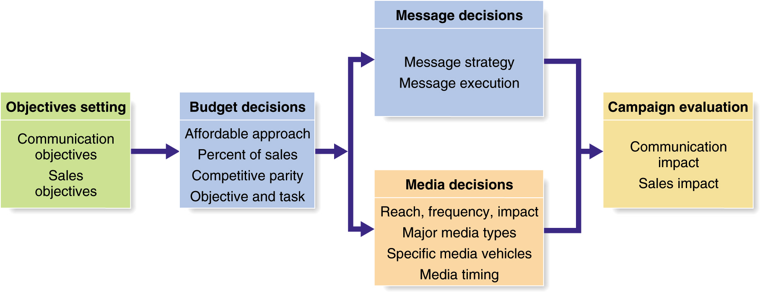
Major Decisions in Advertising
Figure 12.7

Slide 49
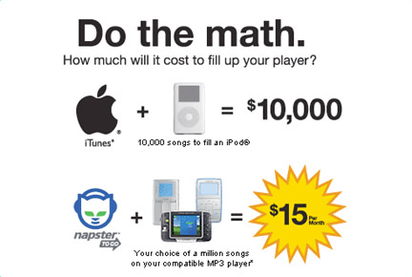
Setting Advertising Objectives
An advertising objective is a specific communication task to be accomplished with a specific target audience during a specific period of time.
Classified by purpose: Inform, Persuade, Compare, Remind

Slide 50
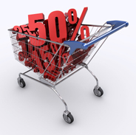
Purposes of Advertising
  Inform
    Introducing new products
  Persuade
    Becomes more important as competition increases
    Comparative advertising
  Remind
    Most important for mature products

Slide 51
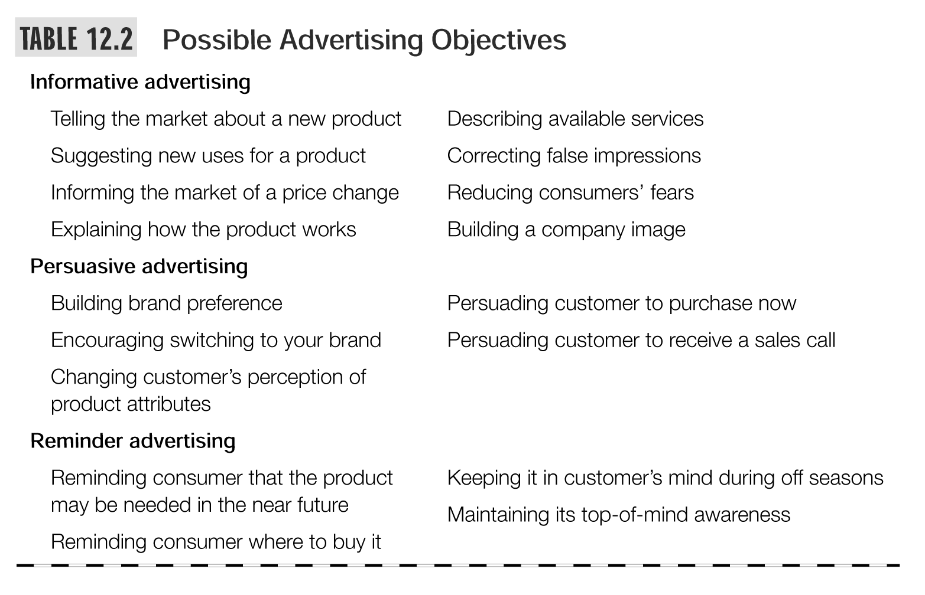

Slide 52
Developing Advertising Strategy
Consists of two major elements:
  Creating advertising messages
  Selecting advertising media

Slide 53
The Message Strategy
Identify Customer Benefits
Develop Compelling Creative Concept
The “Big Idea”
Advertising Appeals Should Be
Meaningful, Believable, & Distinctive

Slide 54
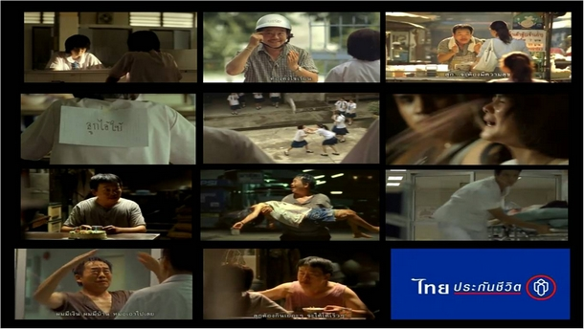


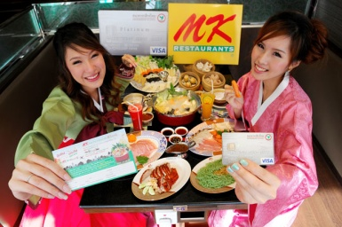
Message Execution
Slice of Life
Testimonial Evidence
or Endorsement
Lifestyle
Scientific Evidence
Typical
Approaches
Fantasy
Technical Expertise
Mood or Image
Personality Symbol
Musical

Slide 55


Message Execution
Choose a tone
Use memorable, attention-getting words
Choose correct format elements
  Illustration
  Headline
  Copy

Slide 56
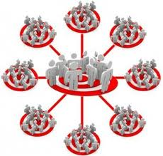
Selecting Advertising Media
Reach
  Percentage of people exposed to ad
Frequency
  Number of times a person is exposed to ad
Media Impact
  The qualitative value of a message exposure through a given medium

Slide 57
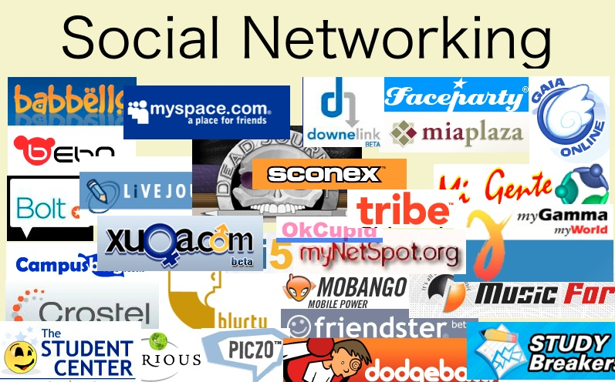
Choosing Media Type
Factors to consider:
  Media habits of target consumers
  Nature of the product
  Type of message
  Cost
  Media vehicles
    Specific media within each general media type

Slide 58
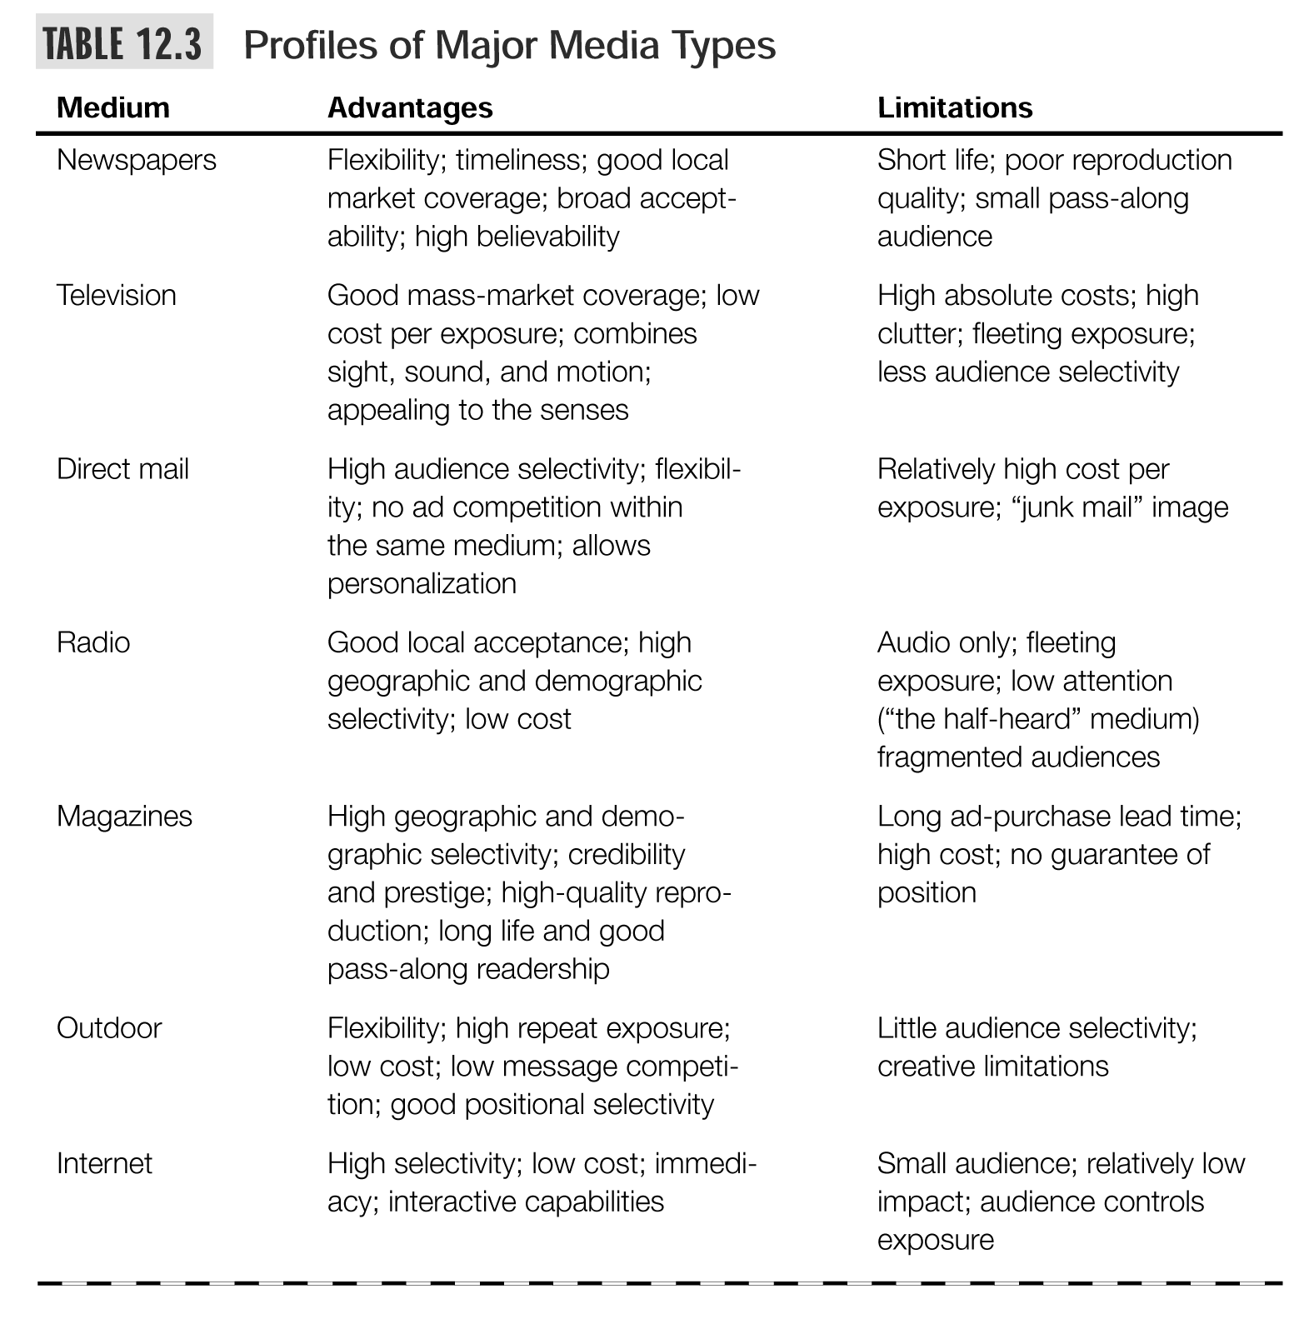

Slide 59
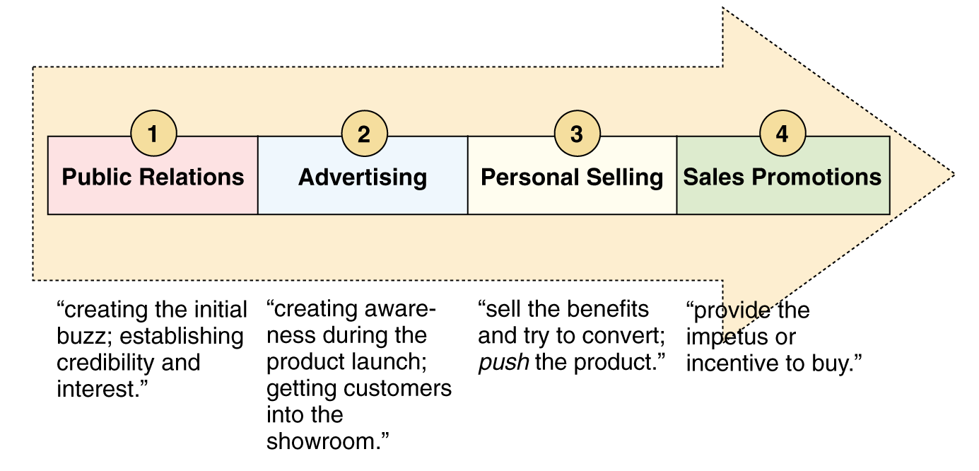
Creating Linkages Through an Effective Sequencing of Promotions Methods
Figure 12.3 (a)

Slide 60
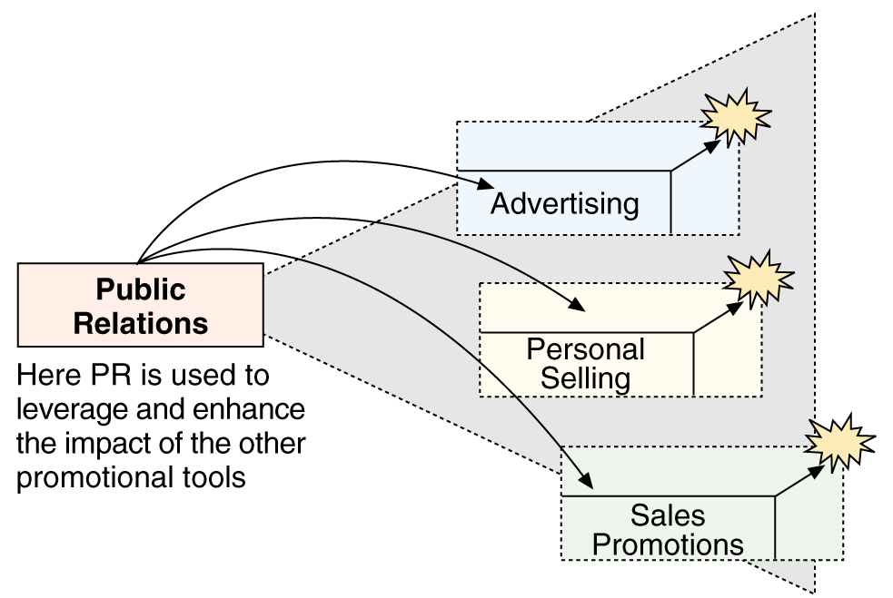
Creating Synergies Between the Different Tools of Promotions
Figure 12.3 (b)

Slide 61


Deciding on Media Timing
Must decide how to schedule the advertising over the course of a year
  Follow seasonal pattern
  Oppose seasonal pattern
  Same coverage all year
Choose the pattern of the ads
  Continuity
  Pulsing

Slide 62

Evaluating Communications Mix
Measure the communication effects of an ad.
“Copy Testing”
Measure the sales effects of an ad.
Is the ad increasing sales?

Slide 63
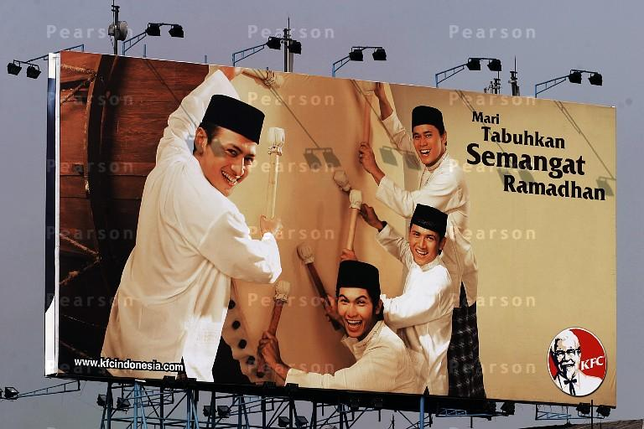
Creating ads for Asian markets must take cognizance of special cultural nuances in order to convey the right messages to target audiences

Slide 64
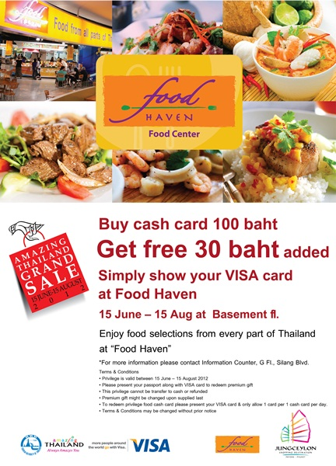
Sales Promotion
Sales promotion consists of short-term incentives to encourage the purchase or sales of a product or service.
The idea behind sales promotion is to generate immediate sales.

Slide 65
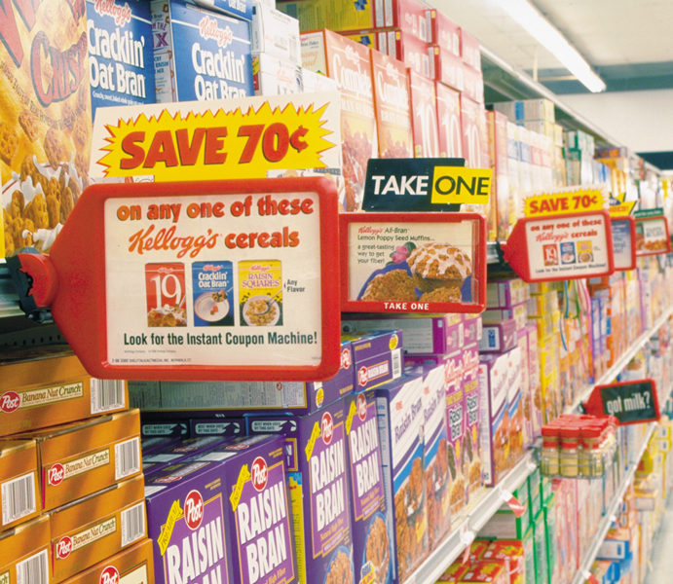
Sales Promotion
Today’s food marketers are using more and more push promotions, including consumer price promotions.

Slide 66
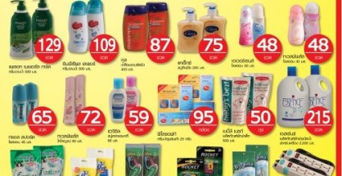
Rapid Growth of Sales Promotion
Sales promotion can take the form of consumer, business, trade, or sales force promotions.
Rapid growth in the industry has been achieved because:
  Product managers are facing more pressure to increase their current sales
  Companies face more competition
  Advertising efficiency has declined
  Consumers have become more deal oriented

Slide 67
Sales Promotion Objectives
Consumer Promotions: increase short-term sales or help build long-term market share.
Trade Promotions: get retailers to:
  carry new items and more inventory
  advertise products
  give products more shelf space
  buy ahead
Sales Force: getting more sales support.
In general, sales promotion should build long-term customer relationships.

Slide 68
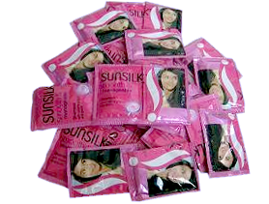
Consumer Sales Promotion Tools
Sample
Offers a trial amount of a product
Coupons
Savings when purchasing specified products
Cash Refunds
“Rebates”
Refund of part of the purchase price by mail
Price Packs
“Cents-Off Deals”
Reduced prices marked on the label or package by producer
Premiums
Goods offered free or low cost as an incentive to buy a product
Advertising
Specialties
Articles imprinted with an advertiser’s name given as gifts

Slide 69
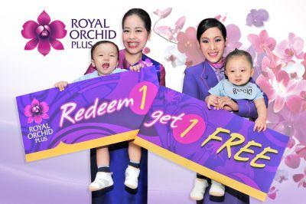
Consumer Sales Promotion Tools
Patronage Rewards
Cash or other award offered for regular use of a product or service
Point-of-Purchase
Promotions
Displays or demonstrations at the point of purchase or sale
Contest
Consumers submit an entry to be judged by a panel
Sweepstakes
Consumers submit their names for a drawing
Games
Consumers receive something each time they buy which may help them win a prize

Slide 70
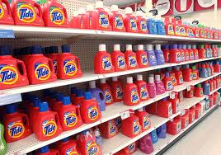
Trade Promotion
Objectives
Tools
Persuade resellers to carry a brand
Give a brand shelf space
Promote brand in advertising
Push brand to customers
Discounts
Allowances
Free Goods
Push Money
Specialty Advertising Items

Slide 71
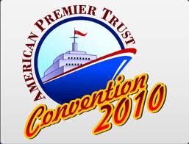
Business Promotion
Objectives
Tools
Generate business leads
Stimulate purchases
Reward customers
Motivate salespeople
Conventions
Trade shows
Sales contests

Slide 72
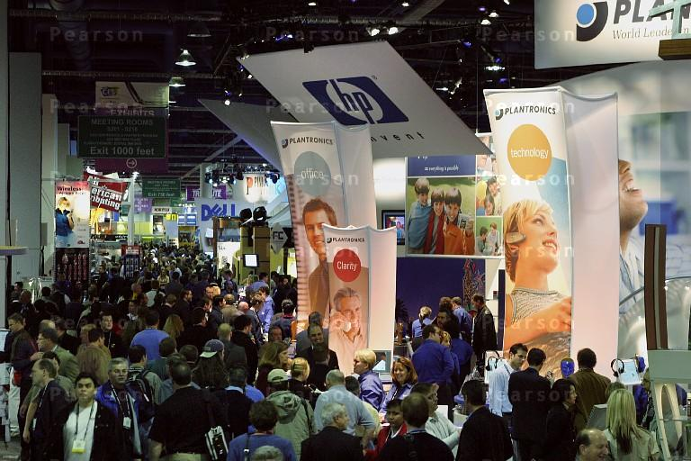
Trade shows are a popular means of promotions in business marketing

Slide 73

Public Relations(PR)
Public relations involves building good relations with the company’s various publics by obtaining favorable publicity, building up a good corporate image, and handling or heading off unfavorable rumors, stories, and events.

Slide 74

Public Relations (PR)
Role and Impact of Public Relations
  Strong impact on public awareness at lower cost than advertising
  Greater credibility than advertising
  Publicity is often underused
  Good public relations can be a powerful brand-building tool

Slide 75
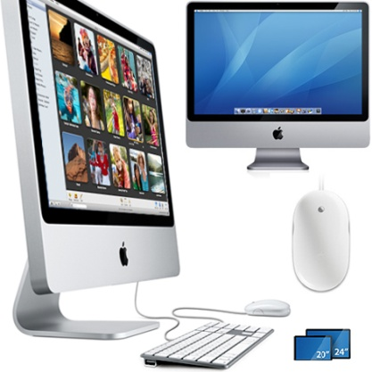
Public Relations Functions
Press relations or press agency
Product publicity
Public affairs
Lobbying
Investor relations
Development

Slide 76
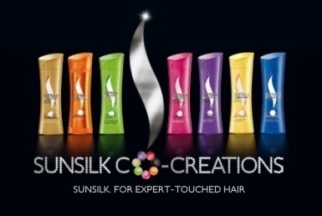
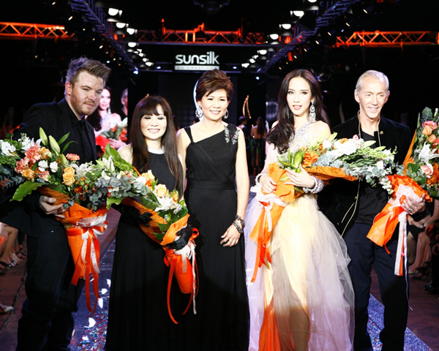
Public Relations Tools
Audiovisual materials
Corporate identity materials
Public service activities
Company Web site
News
Speeches
Special events
Buzz marketing
Mobile marketing
Written materials

Slide 77

Socially Responsible Marketing
Marketers should go beyond what is “legal” and communicate openly and responsibly with customers. Good customer relationships are built on honesty and trust.

Slide 78


Socially Responsible Marketing
Promoting socially responsible actions:
Frito-Lay ran ads promoting the compostable
Packaging for its SunChips brand. It also promoted a program challenging consumers to create their own videos encouraging positive change in the world which it ran on national TV.

Slide 79


