Slide 1
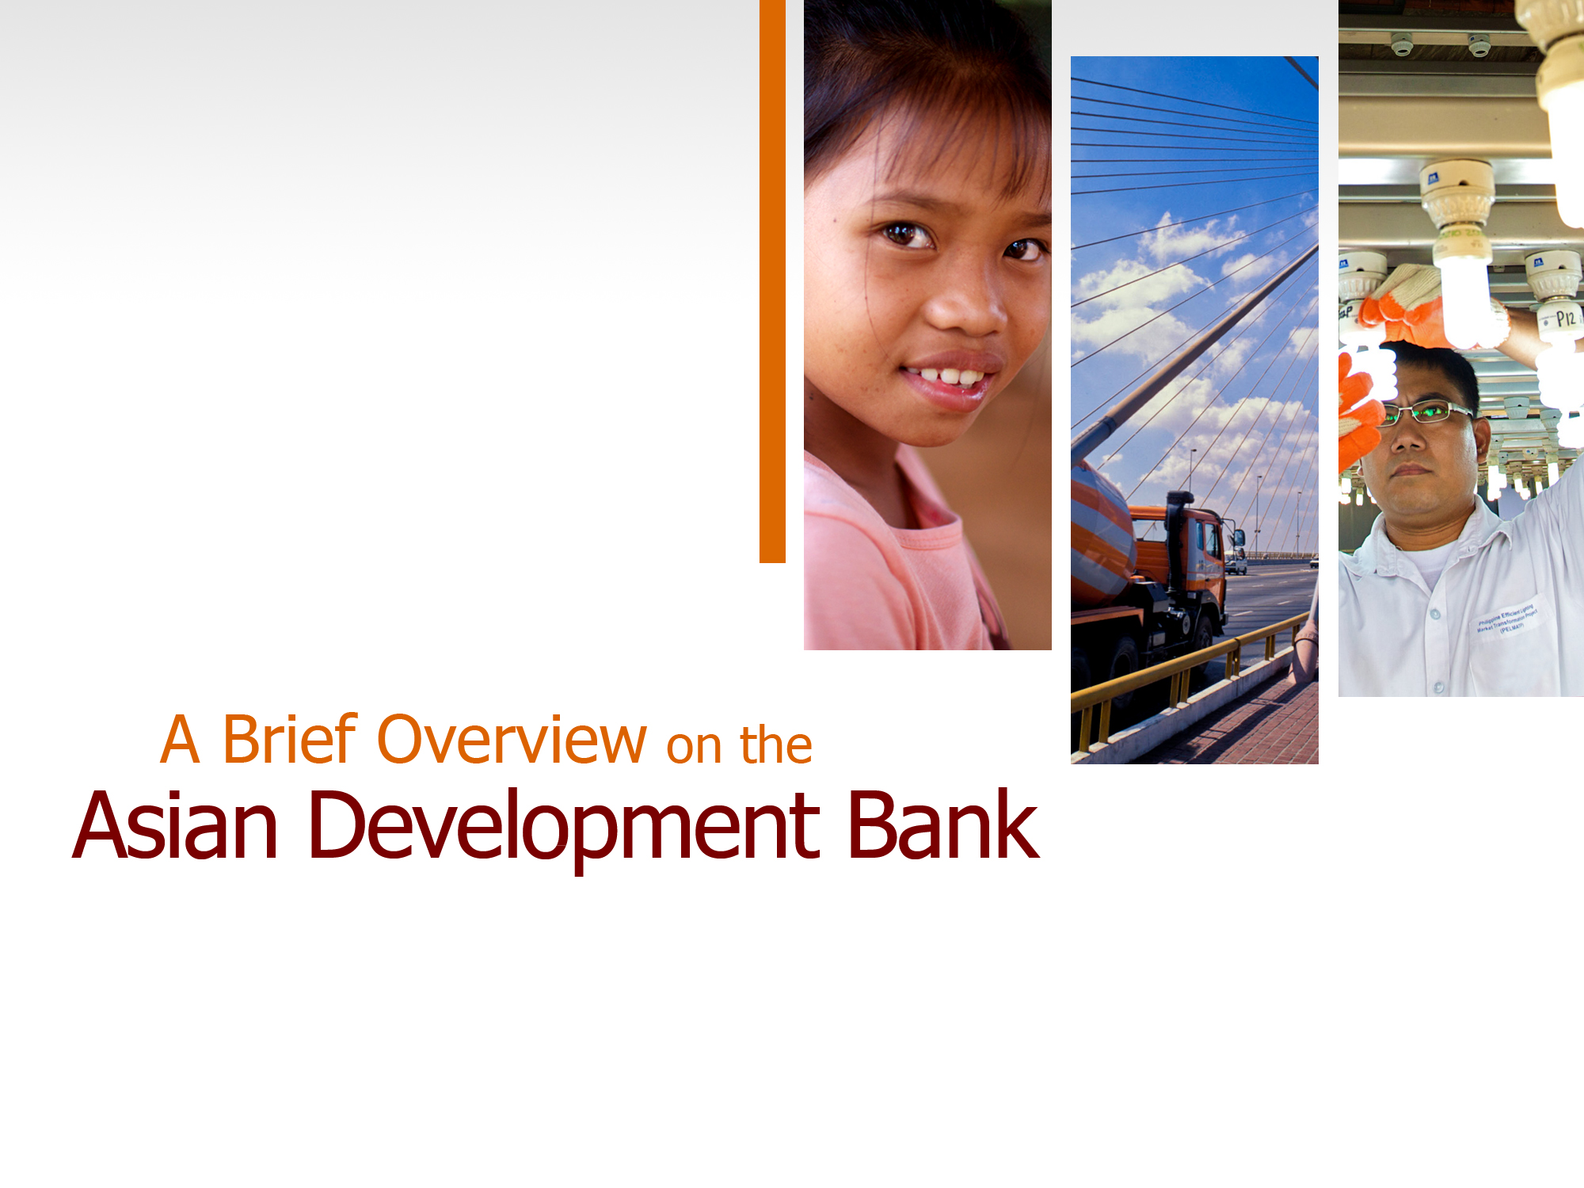


Slide 2
The Region’s
Poverty Challenge
Two-thirds of the world’s poor live in the region
828 million people live on less than $1.25 a day
1.7 billion live on less than $2 a day

Slide 3

ADB’s Vision
An Asia and Pacific region
free of poverty
ADB’s Mission
To help our developing member countries reduce poverty, and improve quality of life
Notes:
3
Poverty is the region’s greatest development challenge and ADB’s highest strategic priority. Our vision is clear and far-reaching: an Asia and Pacific region free of poverty.

Slide 4

Founded in 1966
67 members
48 in the region
41 borrowing members
Japan and the United States are the 2 largest members
Notes:
4
ADB is a multilateral public, non-profit institution, founded in 1966. Of our 67 member shareholders, 48 are from Asia and the Pacific, and 41 are borrowing members. Japan and the United States are ADB’s two largest shareholders.

Slide 5
ADB’s
Core Business
  Finance and Advice for Development Solutions
  Loans
  Technical Assistance
  Grants
  Guarantees
  Equity Investments
  Policy Dialogue
  Knowledge and Partnerships

Slide 6
Our Achievement ...
During 2006-2012, ADB, through the Asian Development Fund has:
built or upgraded over 135,000 classrooms;
trained over 660,000 teachers;
built or upgraded over 44,300 kilometers (km) of roads;
installed or rehabilitated over 17,800 km of water supply pipes;
upgraded sanitation in over 269,000 households;
improved over 1.8 million hectares of land as a result of irrigation, drainage, and flood management initiatives;
installed 300 megawatts of new generating capacity, and built or upgraded more than 34,127 kilometers of transmission and distribution lines; and
enabled new microfinance accounts and end borrowers to grow to over 2.7 million.
Note: as of 2012

Slide 7

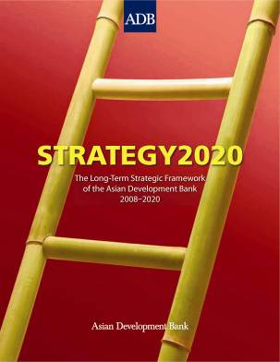
Strategy 2020
ADB’s Long-Term
Strategic Framework 2008–2020
Three Strategic Agendas
  Inclusive Growth
  Environmentally Sustainable Growth
  Regional Integration and Cooperation
Notes:
7
ADB’s overarching strategic document – Strategy 2020 – was adopted in 2008. It defines how we can help shape the region’s future, reduce poverty, and improve the quality of life and the living conditions for people in the Asia Pacific region.
At the heart of Strategy 2020 are 3 strategic agendas:
1. Inclusive growth focuses on increasing the poor’s access to markets and basic productive assets, and investing in high and sustainable economic progress so that all members of a society can participate in and benefit from growth.
2. Environmentally sustainable growth supports the use of environmentally friendly technologies, the adoption of environmental safeguards and the establishment of institutional capacities to strengthen their enforcement.
3. Regional integration supports accelerated growth, higher productivity and employment. It reduces economic disparities, and allows for closer policy coordination and collaboration on regional and global public goods, such as combating climate change and HIV/AIDS.

Slide 8
Key Challenge 1: Poverty
Majority of the world’s poor in the region…
Europe; 2.8M; 0.2%
Rest of the World; 23M; 2%
Latin America; 45M; 3%
54%
below $2/day
Sub-Saharan Africa; 388M; 28%
27%
below $1.25/day
Middle East and North Africa; 11.0 M; 0.8%
Poverty in the World
Poverty in Asia

Slide 9
Inequalities are rising in the region…

Slide 10
Significant increase in Asia’s contribution to greenhouse gases…
Key Challenge 2: Climate Change
Rest of the World
69%
Developing Asia
Rest of the World
55%
31%
45%
2007 (Actual)
2030 (Projections)

Slide 11
Key Challenge 2: Climate Change in Asia and Pacific — Projected Impacts
2050, 50% Viet Nam’s rice fields disappear
2050, 25% of Jakarta submerged
2060, 20 million Bangladeshis displaced by 1 meter sea rise

Slide 12
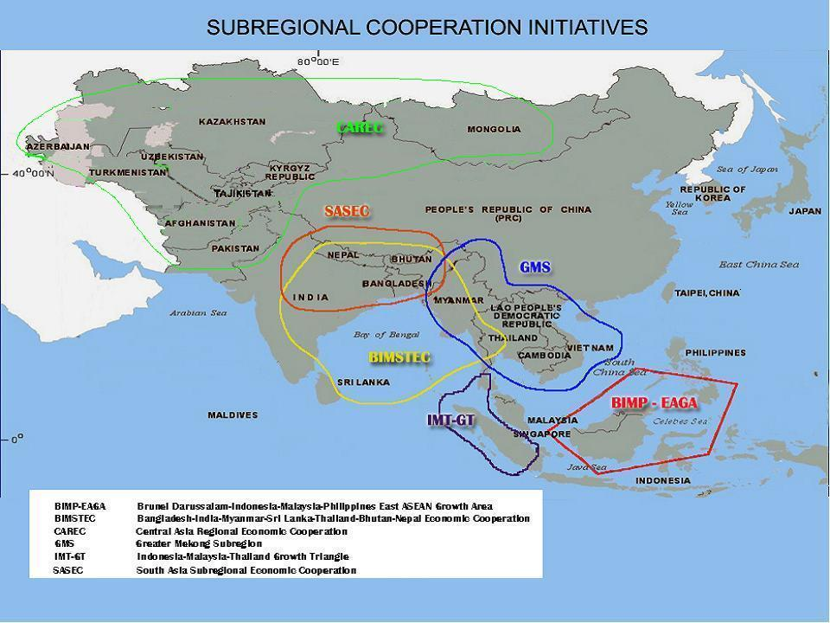
Key Challenge 3: Regional Cooperation
and Integration – Potential not fully realized…
Notes:
12

Slide 13
Strategy 2020
Drivers of Change
Private Sector Development
Good Governance and Capacity Development
Gender Equity
Knowledge Solutions
Partnerships

Slide 14
Strategy 2020
Core Operational Areas
Infrastructure
Environment
  Climate change
  Livable cities
  Complementary actions
Regional Cooperation and Integration
Finance Sector Development
Education
Notes:
To achieve our three agendas, Strategy 2020 focuses ADB’s operations in 5 core areas:
We are a major infrastructure lender, not only in building physical assets but also in improving the delivery of infrastructure services, which will create an enabling environment for the private sector.
Our assistance for environmentally sustainable development focuses on helping our developing member countries move to low-carbon growth paths and adapt to anticipated impacts of climate change. We also help countries address environmental problems resulting from rapid urbanization and mainstream environmental considerations into their policies and investment programs.
Regional cooperation and integration, finance sector development, and targeted support for education and skills training help ensure a balanced, relevant and inclusive approach to the region’s overall development.
Our operations in these five core operational areas comprised approximately 96 % of our overall operations in 2011.

Slide 15
Strategy 2020
Other Areas of Operations
Health
Agriculture
Disaster and Emergency Assistance
Notes:
ADB also continues to operate, on a limited scale, in other areas where its presence is needed. Our support for water and sanitation projects, public expenditure management, and mitigation of communicable diseases such as HIV/AIDS contribute to the overall health of the region’s population.
We support agriculture and rural development through infrastructure for rural transport, irrigation and water systems, and microfinance.
And we have a long history of responding quickly to emergency needs for rehabilitation and reconstruction. In fact, ADB is the first multilateral development bank to have a dedicated disaster policy.

Slide 16
Country Partnership Strategy (CPS)
Defines ADB’s strategy and program over a 5-year period at country level
Developed in partnership with a country and its long-term development objectives
Includes a pipeline of lending and non-lending assistance
Updated annually in the Country Operations Business Plan (COBP)

Slide 17
ADB- Thailand Country Partnership Strategy
(2013-2016)

Slide 18
Country Context - 1
Development Achievements:
  Impressive economic growth and poverty reduction
  Upper middle income country status reached in 2011
  Strategic location, economic size, regional economic hub, regional integration (ASEAN/AEC 2015)
Development Challenges:
  Since late 1990s, global economic shocks, natural disasters and socio-political tensions have resulted in fluctuating growth
  Risk of “getting stuck” in the middle income country trap
  Persisting economic inequality, aging population, and environmental degradation
Notes:
Thailand is one of developing Asia’s great success stories. It reached upper-middle income country status in 2011 after several decades of rapid economic growth and impressive achievements in poverty reduction and rising living standards. Poverty is down from 36% in 1988 to about 8% today—on the back of sustained economic growth and investments in rural infrastructure, together with targeted income generation programs.
With its strategic location and economic size, Thailand has become an important regional economic hub. Regional integration, driven by the creation of the ASEAN economic community (AEC) in 2015, is creating enormous opportunities for Thailand. At the same time, Thailand’s socio-economic success has important spill over benefits for its neighboring countries.
However, global economic shocks, natural disasters and socio-political tensions have contributed to slower and more variable economic growth in the past decade or so. Persisting economic inequality, an aging population, and environmental degradation pose important challenges.
Rising labor costs and uneven development patterns in the context of regional integration require a reorientation of development strategies toward pursuing inclusive growth, fostering innovation, improving productivity, and enhancing environmental sustainability—to avoid the middle income trap and achieve national development aspirations.

Slide 19
Key Development Issues -1
Inequality
Competitiveness / middle income trap
  Transition from low-cost/low-skill to knowledge based economy focused on value creation
  Infrastructure/logistics (low investment rate, access to services and markets, logistics costs, climate change, urbanization, regionalization, etc.)
  Low Technological sophistication and capacity for innovation
  Education quality and skills mismatch
  Access to finance
  Preparedness for external shocks

Slide 20
Key Development Issues -2
Regionalization
  ASEAN/AEC, GMS, IMT-GT, BIMSTEC
Environment
  Environmental consideration in econ development planning and enforcement of ENV safeguards and quality standards
  Improve resource use efficiency and reduce GHG emissions
  integrated sustainable urban development
  strengthening climate resilience and disaster preparedness
Governance
  corruption
  rule of law

Slide 21
Program Overview -1
Infrastructure
  Transport planning: multi-modal, inter-city and sub-regional linkages; energy efficiency; climate change
  Reform of State Railway of Thailand
  PPP assessment for priority projects
  Research and development infrastructure
  ADB’s private sector operations: opportunities in transport, clean energy, water and sanitation, and waste management
Finance
  Inclusive Finance: access to finance and financial literacy
  Pension reform
  Mortgage insurance
  Regulatory reform (SFIs and non-bank)

Slide 22
Program Overview –2
Environment
  Private sector – clean energy investment opportunities
  Mainstreaming ENV/CC in transport planning (incl. low carbon)
  Green cities (pilot)
  Water resources and flood risk management
Regional Cooperation and Integration
  Bilateral cooperation with Thai government (NEDA, TICA, line ministries) on neighboring countries
  Subregional economic cooperation programs – ASEAN/AEC, GMS, IMT-GT, BIMSTEC

Slide 23

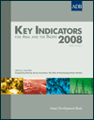

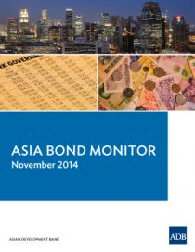
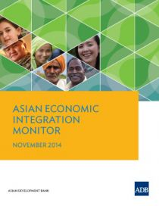
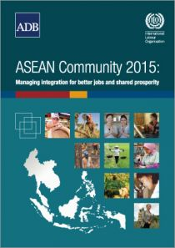
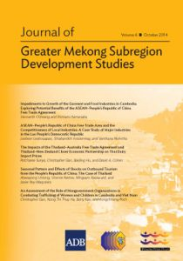
Knowledge Products
Asian Development Outlook
Key Indicators
Asian Economic Integration Monitor
Sustainability Report
ADB Working Paper Series
Asia Bond Monitor
Asian Bonds Online (website)

Slide 24
Thank you

