Slide 1

Tulip Mania
Kristen Eummelen

Slide 2
17th century, 1634-1637
Bubble
Prices reached really high levels
Collapsed

Slide 3
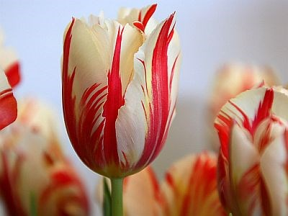
Admired because of novelty and could withstand the climate
Virus
Status symbol
High prices

Slide 4
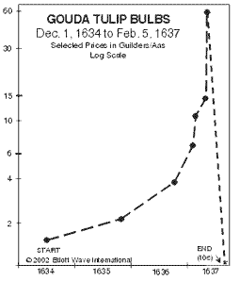
First financial bubble
Formal future market with tulip contracts for future bulb purchases
Bulb buyers started with inventories
Gave up belonings
Twenty-fold increase in one month
10 times a craftsman’s annual income

Slide 5
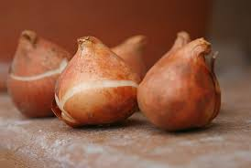
Mistake of sailor

Slide 6
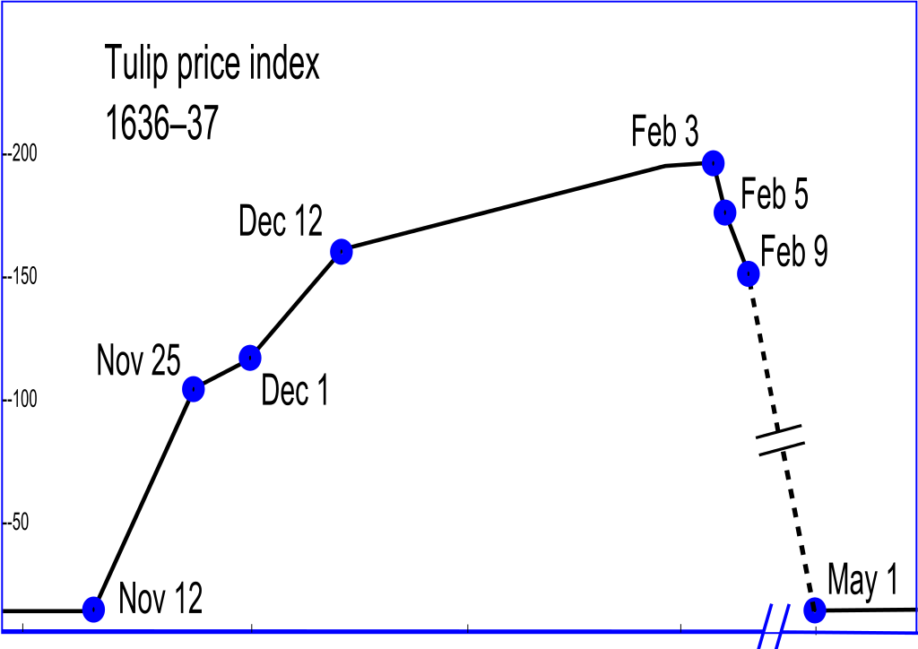
Like all bubbles, it collapsed
Domino effect
Panic in the land
Dealers refuse to honor contracts
Lead to an economic crisis

Slide 7
Other bubbles followed
South sea bubble
Real estate craze in Florida

Slide 8

Thank you for your attention

