Slide 1
Topic 3 Part 4
The Theory of Demand
(Chapter 5)

Slide 2
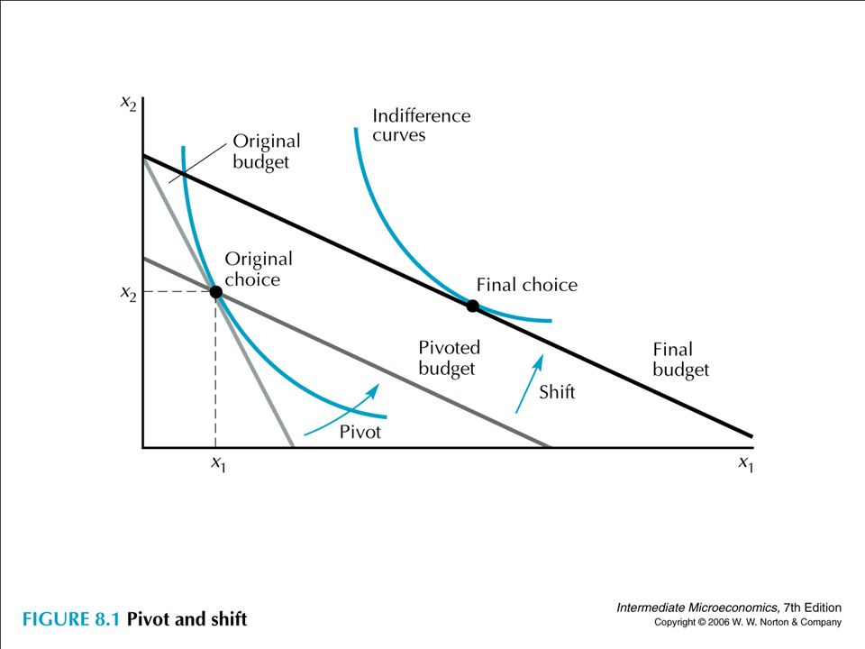
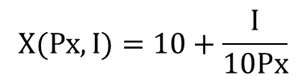
SE = 15.3 – 14 = 1.3
IE = 16 – 15.3 = 0.7
TE = SE + IE = 1.3 + 0.7 = 2
or TE = – 14 + 16 = 2
Y
$$X(Px,I)=10+\frac{I}{10Px}$$
X_{A}(3, 120)
X_{C}(2, 120)
X_{B}(2, 106)
14 15.3 16
X
SE IE

Slide 3
Income Compensation in Slutskian Method
In the diagram before, Bundle B is on the BL with a lower income of $106 although the consumer has the income of $120. WHY?
As previously mentioned in Topic 3 Part 2 Page 23, Slutskian and Hicksian Methods “compensate” income of the consumer when identifying the substitution effect.

Slide 4
Income Compensation in Slutskian Method
“Compensate” refers to the approach that
  Slutskian Method gives the consumer just enough money to get back to his original bundle A, so that his purchasing power is constant.
  Hicksian Method gives the consumer just enough money to get back to his original utility, so that his utility is constant.

Slide 5
Income Compensation in Slutskian Method
However, when Px falls, it is obvious that the consumer can still get back to his original Bundle A, and he should have excess money to buy something else. Thus, his purchasing power is greater after Px falls.
Since Slutskian Method holds the purchasing power constant, money has to be taken from the consumer to reduce his purchasing power.
This is why at Pivoted BL, Income falls to $106.

Slide 6
Income Compensation in Slutskian Method
Thus, according to Hicks and Slutsky,
to “compensate” the consumer,
  the income at the Pivoted BL will be reduced when Px falls.
  the income at the Pivoted BL will be raised when Px rises.

Slide 7
Ans(c): SE = 21, IE = 0

Slide 8
Consumer Surplus
The individual’s demand curve can be seen as the individual’s willingness to pay curve.
On the other hand, the individual actually pay the market price for (all) the units consumed.
Consumer Surplus is the difference between what the consumer is willing to pay and what the consumer actually pays.

Slide 9
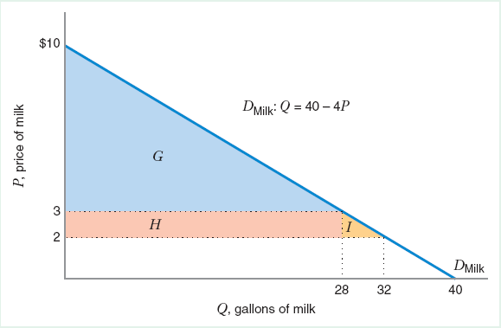
Consumer Surplus
The area under an ordinary demand curve and above the market price provides a measure of consumer surplus.

Slide 10
Consumer Welfare (Hicksian Approach)
Economists often measures the impact of price changes on a consumer’s well-being in monetary terms.
This is why we learn about consumer surplus.
Other measures include
  Compensating Variation (CV)
  Equivalent Variation (EV)

Slide 11
Compensating Variation (CV) is calculated by K – L.
The amount of additional money a consumer would need to reach his initial utility after a change in prices.
CV: Difference b/w the income required to buy A at initial price and the income required to buy B (SE bundle) at final price.
Y is a composite good with Py = 1.
CV

Slide 12
Equivalent Variation (EV) is calculated by J – K.
The change in income, at current prices, that would have the same effect on consumer welfare as would the change in prices, at current income.
EV: Difference b/w the income required to buy A at initial price and the income required to buy E at initial price.
Note: E gives the same utility as C does.
EV
Y is a composite good with Py = 1.

Slide 13
Applications of the Theory of Demand
Market Demand and Network Externalities
Demand for Leisure and Supply for Labor
Consumer Price Index

Slide 14
Market Demand
The market demand function is the horizontal sum of the individual demands.
In other words, market demand is obtained by adding the quantities demanded by the individuals (or segments) at each price and plotting this total quantity for all possible prices.

Slide 15
Market Demand
P
P
P
10
Q = 10 - P
Q = 20 – 5P
4
Q
Q
Q
Segment 1
Segment 2
Market Demand
Q₁ = 10 – P, for P < 10
Q₁ = 0, for P ≥ 10
Q₂ = 20 – 5P, for P < 4
Q₂ = 0, for P ≥ 4
Q_{M} = 30 – 6P, for P < 4
Q_{M} = 10 – P, for 4 ≤ P < 10
Q_{M} = 0, for P ≥ 10
Exercise
Suppose there are 10 identical consumers whose individual inverse demand is given by P = 20 – 2Q.
Derive the market demand function.

Slide 16
Network Externalities
If one consumer's demand for a good changes with the number of other consumers who buy the good, there are network externalities.
For example, think about a food review on YouTube. Your demand for the food may increase when there are many people buying the same food.

Slide 17
Network Externalities
Bandwagon effect: A positive network externality that refers to the increase in each consumer’s demand for a good as more consumers buy the good.
For example, Facebook likely confers positive network externalities since it is more useful to a user if more people are using it as well.

Slide 18
Network Externalities
P
D₂ (mkt demand when people believes that many people are buying)
D₁
Bandwagon Effect:
(increased quantity demanded when more consumers purchase)
A
•
P₁
B
C
•
•
P₂
Market Demand
w/ Positive Net. Ext.
Pure
Price
Effect
Bandwagon Effect
Q
Q₁
Q₂
Q₃ (Q₂ + Bandwagon Effect)

Slide 19
Network Externalities
Snob effect: A negative network externality that refers to the decrease in each consumer’s demand as more consumers buy the good.
For example, a road can confer negative network externalities since a driver on the road creates traffic for other drivers.

Slide 20
Network Externalities
P
Market Demand
w/ Negative Net. Ext.
Snob Effect:
(decreased quantity demanded when more consumers purchase)
A
•
P₁
C
B
•
•
P₂
D₁
D₂ (mkt demand when people believes that many people are buying)
Snob Effect
Pure Price Effect
Q
Q₁
Q₃
Q₂

Slide 21
Labor-Leisure Trade-off
All workers face labor-leisure trade-off.
They have 24 hours a day, which are allocated between working and resting.
Workers value both income from working and their leisure time.
MU for both are positive but diminishing.

Slide 22
Key Ideas
One can think of “wage” as “price of leisure” since when we rest, we forego wage income.
Leisure is a normal good: as income rise, people want to consume more leisure.

Slide 23
Key Ideas
Now, if wage rises, leisure becomes more expensive.
SE implies that workers will work more.
IE implies that, with more money from higher wage, workers can work less and rest more.
Two effects work in the opposite directions.

Slide 24
Labor Supply Curve
The labor supply curve slopes upward over the region where the SE associated with the wage increase outweighs the IE.
Because leisure is more expensive, workers substitute away from leisure and work more.

Slide 25
Labor Supply Curve
The labor supply curve bends backward over the region where the IE outweighs the SE.
Given a higher wage, workers now become richer. Since leisure is a normal good, more leisure is consumed, and workers work less.

Slide 26
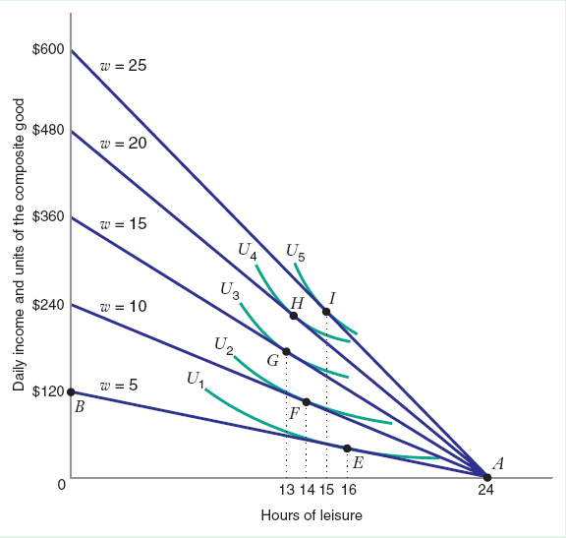
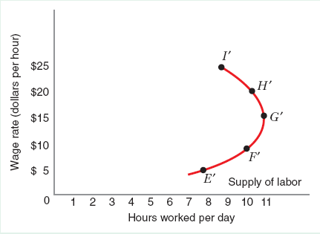
Labor Supply Curve
Backward-Bending Labor Supply
Hrs of Leisure
Hrs of Work

Slide 27
Consumer Price Index (CPI)
CPI is an index (a number) that tells us about the cost of living of typical consumers.
It measures changes in the price level and can be used to calculate the inflation rate.
CPI is a fixed-weight index, calculated from a fixed basket of goods.

Slide 28
Consumer Price Index (CPI)
Since CPI is calculated from a fixed basket of goods, it ignores the fact that people would “substitute” expensive goods with cheaper goods.
This is called the “substitution bias” and causes CPI to overestimate the cost of living when the price level rises.

Slide 29
Consumer Price Index (CPI)
Example
Assume a consumer buys two goods:
food with P_{F,1} = $3 and clothing with P_{C,1} = $8.
At these prices, the consumer buy 80 units of food and 30 units of clothing, (F, C) = (80, 30).
Thus, the cost of living before the price change is $480.

Slide 30
Consumer Price Index (CPI)
Example (cont)
Suppose the prices of food and clothing rises; the new prices are P_{F,2} = $6 and P_{C,2} = $9.
CPI assumes that the consumer would still buy the original bundle, (F, C) = (80, 30). With this approach, the cost of living after the price change would be $750.
CPI = 750/480 = 1.56. Inflation = 56%.

Slide 31
Consumer Price Index (CPI)
Example (cont)
In reality, there exists a bundle that could give the consumer the same happiness as (F, C) = (80, 30).
From the diagram, such bundle is (40, 60) and costs $720 after the price change.
If CPI were to account for the substitution, CPI would be 720/480 = 1.5. Inflation = 50%.

