Slide 1

Leadership in Marketing
MK 341: Special Topics in Marketing 1
Marketing Leadership Development and Cross-cultural Management
By Ajarn Suwalya K.

Slide 2
What we plan to achieve
Inspirational Leaders Individual Sharing
Activity
Reasons why Leadership is Important for Marketing
Success stories of Market Leaders
Breakdown of six leadership qualities
Individual Work Deadlines

Slide 3

Reflection Session
Inspirational Leader
Each student to share ideal leader and reasons
Everyone to listen and acknowledge

Slide 4
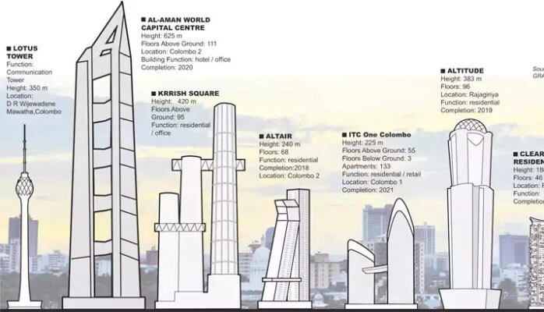
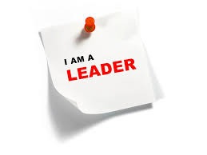
Exercise 1: Leader Activity

Slide 5
What is Market Leadership?

Slide 6
Market Leader
Definition: A market leader could be a product, brand, company, organisation, group name which has the highest percentage of total sales revenue of a particular market. ... Description: Market leader can be attributed to a firm which has the largest market share in a given industry.

Slide 7
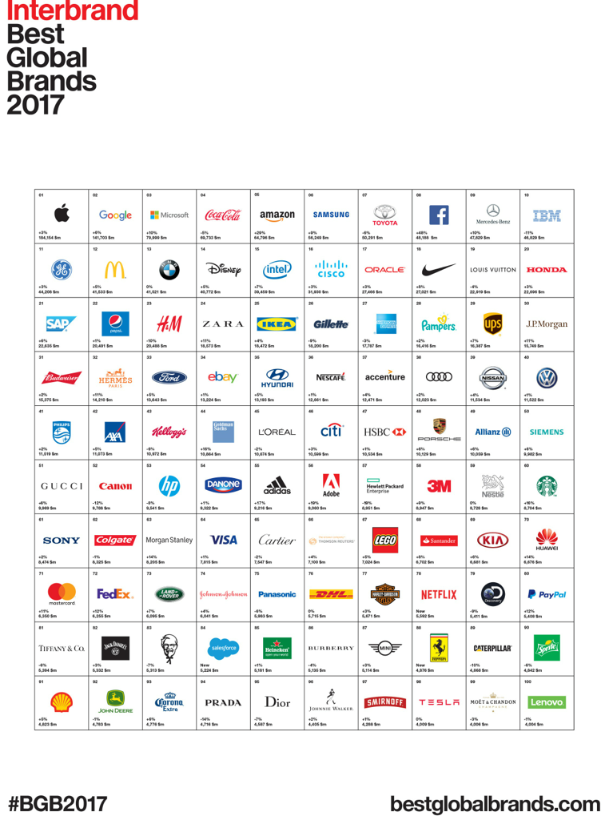

Slide 8
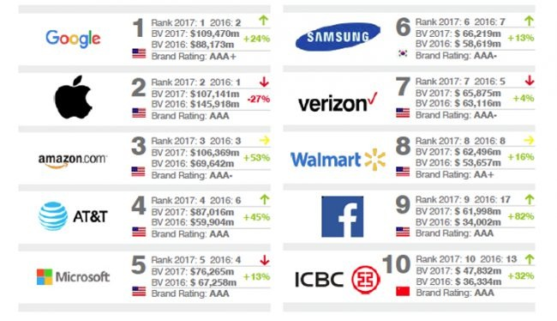
What are the strongest brands?

Slide 9
Who drives the success of the business?

Slide 10

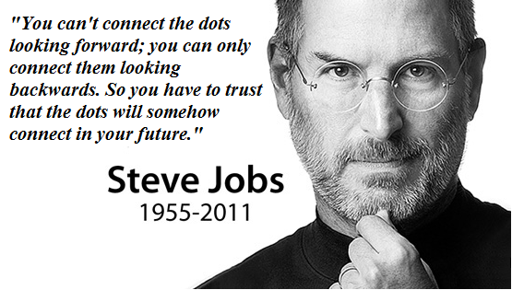

Business Leaders
YouTube: I Got Fired from Apple and it Changed my Life/ Steve Jobs by Goalcast

Slide 11
Business Leaders
Steve Jobs 7 Rules of Success
1. Work with Passion
2. Believe in Teamwork
3. Don't Wish Keep Moving
4. Don't Live a Limited Life
5.Everything Happens for the Good
6.Make a Quality Product and Service
7.Appreciate your Competitor Work and Learn

Slide 12

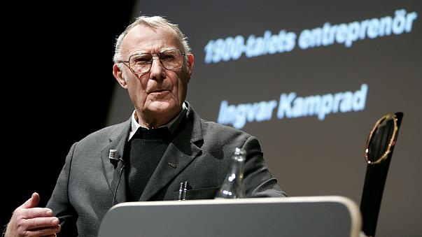
Business Leaders
YouTube: Ingvar Kamprad Success Story by Evan Carmichael

Slide 13
Business Leaders
Ingvar Kamprad Success Story
1. Build your Customers
2. Lead by Example
3. Never Waste your Time

Slide 14

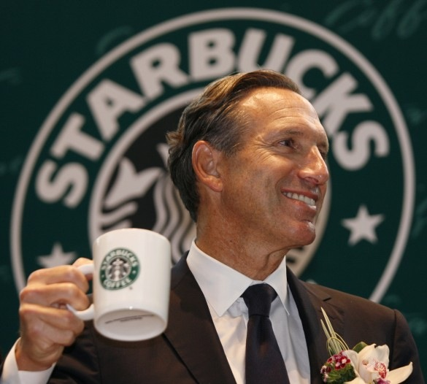
Business Leaders
YouTube: Starbucks One Word Success Story #LOVE by Evan Carmichael

Slide 15
Business Leaders
Howard Schultz's 10 Rules for Success
1. Dream Big Dreams
2.Change your Mindset
3.Have a Heart
4. Celebrate Mistakes
5. Don't advertise
6. Care for your People
7. Have Strong Values
8. Do what you Love
9. Exceed Expectation
10. Stand for Something Important

Slide 16

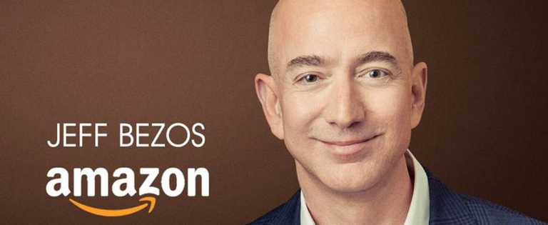
Business Leaders
YouTube: World's Richest Person Jeff Bezos Amazon CEO Motivational Speech by Motivational Videos For Students

Slide 17
Business Leaders
Jeff Bezos the Richest Person in the World
" Regret Minamalization Framework"
…Project Yourself to Age 80

Slide 18

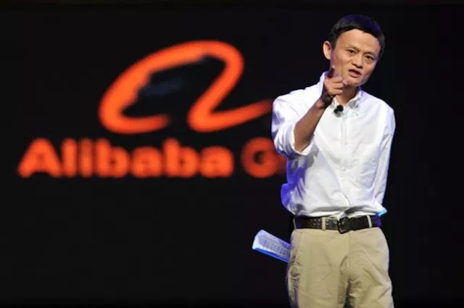
Business Leaders
YouTube: GREATEST SUCCESS STORY( Featuring Jack Ma) Motivational Video by Eternal Explorer- Motivation

Slide 19
Business Leaders
Jack Ma Greatest Success Story
1.Persistence
2.Optimistic
3.Opportunities lies in Complaints
4.Make things Different, Start Doing
5.Use Instinct…Needs of Customer
6.Make the Move
7.You Believe it, team a believe it
8.Work Day and Night
9.Make mistakes, When you Fall , Stand-up
10.Work for myself and think about others

Slide 20
Exercise 2:
What similarities and differences ?
Briefing
Each Group share with class

Slide 21
Leadership Influences on Corporate Culture

Slide 22
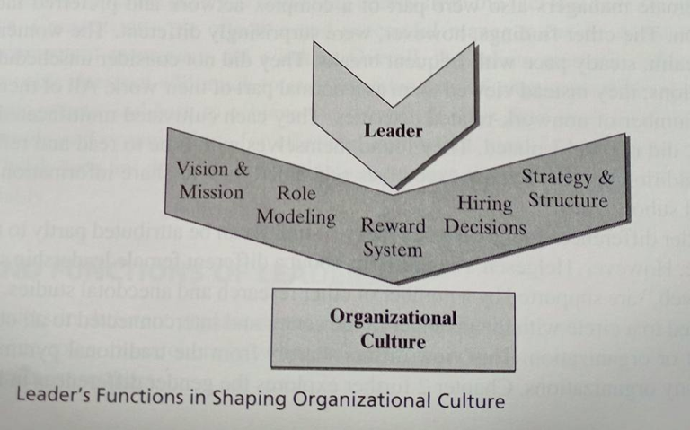
Functions of Leaders
1d

Slide 23

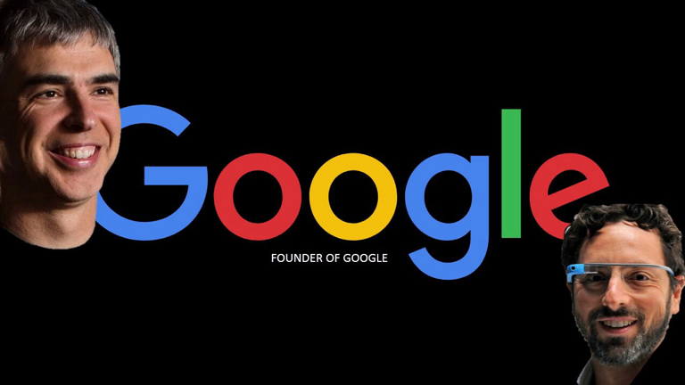
Founders of Google:Larry Page and Sergey Brin
Toutube:
1.Google Interns' first week by Google
2. Coolest Office a Ever?( Google Office Tour) Hype Hunt: EP 18 by Clicknetwork

Slide 24
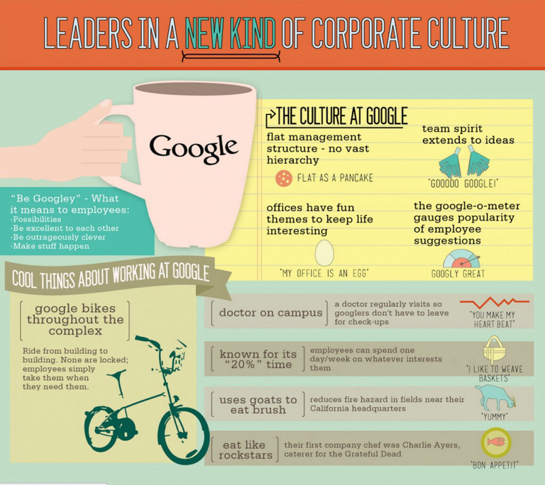

Slide 25
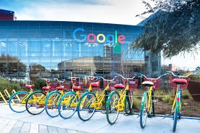

Slide 26


Slide 27
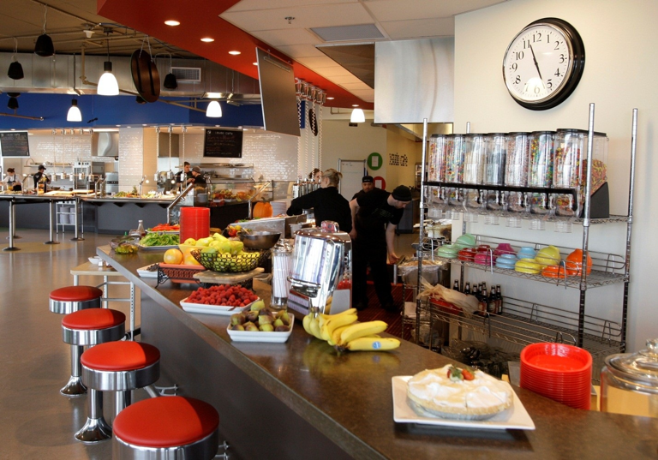

Slide 28
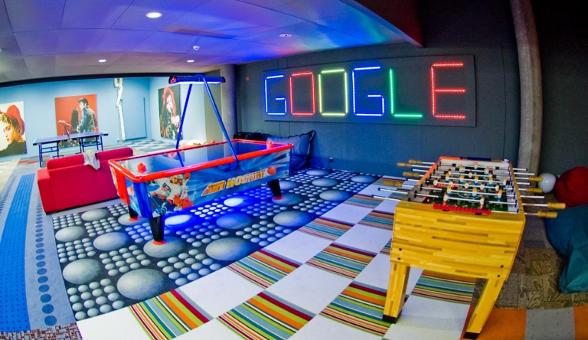

Slide 29
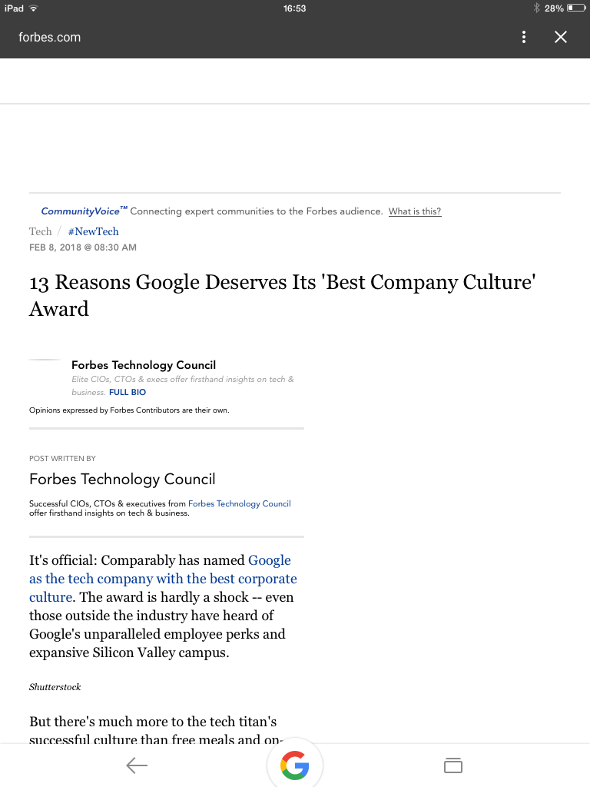

The Best Company Culture Award
Moodle Upload

Slide 30
13-reasons-google-deserves-its-best-company-culture-award
https://www.forbes.com/sites/forbestechcouncil/2018/02/08/13-reasons-google-deserves-its-best-company-culture-award/
1. True Flexibility
2. The Freedom To Be Creative
3. A Fun Environment
4. The People And Their Expertise
5. Dog-Friendly Workplace
6. Shared Values Across The Organization
7. Constant Innovation

Slide 31
13-reasons-google-deserves-its-best-company-culture-award
https://www.forbes.com/sites/forbestechcouncil/2018/02/08/13-reasons-google-deserves-its-best-company-culture-award/
8. Trust
9. Alignment With Employees' Wants And Needs
10. A Growth And Improvement Mindset
11. A Dedicated Focus On Employee Happiness
12.'Radical Candor'
13. A Clear Purpose

Slide 32
Six Leadership Qualities

Slide 33
Individual Assignment
Please bring photos of your…
1. Highlights in childhood and teenager
2. Family and Friends
3.Achievements
4.Your life’s best moments
We will share this in next class.

Slide 34
Six Leadership Qualities
Vision
Confidence
Communications
Team-building
Innovation- creativity
Change

Slide 35
What we accomplished
Inspirational Leaders Individual Sharing
Activity
Reasons why Leadership is Important for Marketing
Success stories of Market Leaders
Breakdown of six leadership qualities
Individual Work Deadlines

Slide 36


