Slide 1
TA session#2
FN 201 section 2

Slide 2
Example 5-5
You have $42,180.53 in a brokerage account, and you plan to deposit an additional $5,000 at the end of every future year until your account totals $250,000. You expect to earn 12% annually in the account. How many years will it take to reach your goal?

Slide 3
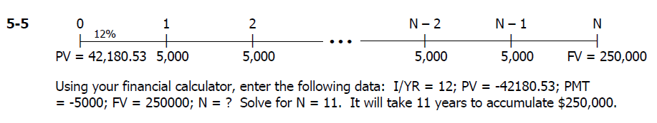
Notes:
PV and PMT should have the same sign

Slide 4
Example 5-7
An investment will pay $100 at the end of each of the next 3 years, $200 at the end of Year 4, $300 at the end of Year 5, and $500 at the end of Year 6. If other investments of equal risk earn 8% annually, what is its present value? Its future value?

Slide 5
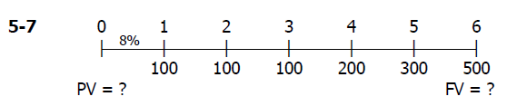
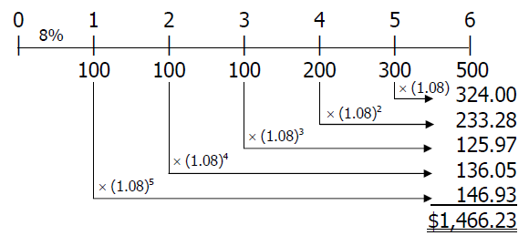
Using a financial calculator, enter the following: CF0 = 0; CF1 = 100; Nj = 3; CF4 = 200 (Note calculator will show CF2 on screen.); CF5 = 300 (Note calculator will show CF3 on screen.); CF6 = 500 (Note calculator will show CF4 on screen.); and I/YR = 8. Solve for NPV = $923.98.
To solve for the FV of the cash flow stream with a calculator that doesn’t have the NFV key, do the following: Enter N = 6, I/YR = 8, PV = -923.98, and PMT = 0. Solve for FV = $1,466.24. You can check this as follows:

Slide 6
Example 5-9
If you deposit $100 today in an account that pays 5% interest annually, how long will it take to triple your money?

Slide 7
5-9 Using the financial calculator, we find the number of years for the deposit to triple as follows:
Number of years (N) =22.5: Input I/YR = 5%, PV = –100, PMT = 0, FV = 300.

Slide 8
Example 5-20
Your client is 40 years old; and she wants to begin saving for retirement, with the first payment to come one year from now. She can save $5,000 per year; and you advise her to invest it in the stock market, which you expect to provide an average return of 9% in the future.
a. If she follows your advice, how much money will she have at 65?
b. How much will she have at 70?
c. She expects to live for 20 years if she retires at 65 and for 15 years if she retires at 70. If her investments continue to earn the same rate, how much will she be able to withdraw at the end of each year after retirement at each retirement age?

Slide 9
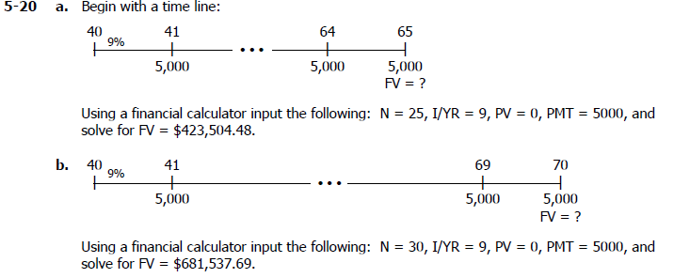

Slide 10
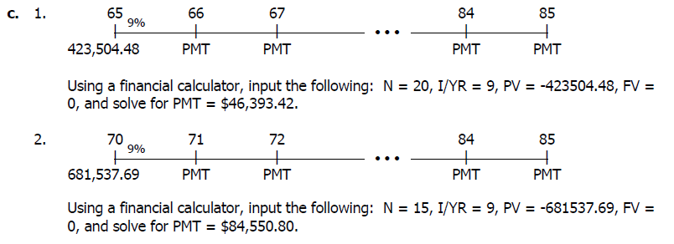

Slide 11
Example 5-21
A rookie midfielder is negotiating his first Japan Soccer Premier League contract. His opportunity cost is 10%. He has been offered these possible 4-year contracts. Payments are guaranteed, and they would be made at the end of each year. Terms of each contract are as follows
1
2
3
4
Contract 1 $3,000,000 $3,000,000 $3,000,000 $3,000,000
Contract 2 $2,000,000 $3,000,000 $4,000,000 $5,000,000
Contract 3 $7,000,000 $1,000,000 $1,000,000 $1,000,000
As his advisor, which contract would you recommend that he accept?

Slide 12
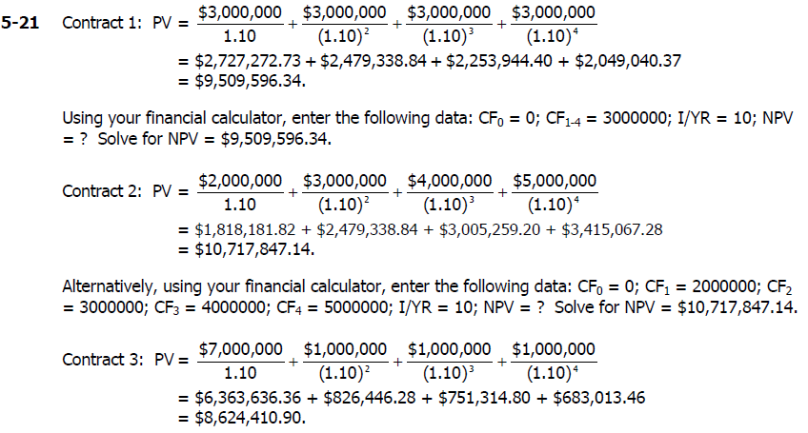
Alternatively, using your financial calculator, enter the following data: CF0 = 0; CF1 = 7000000; CF2= 1000000; CF3 = 1000000; CF4 = 1000000; I/YR = 10; NPV = ? Solve for NPV = $8,624,410.90.
Contract 2 gives the quarterback the highest present value; therefore, he should accept Contract 2.

Slide 13
Example 5-22
Wang Yun just won the lottery, and she must choose among three award options. She can elect to receive a lump sum today of $ 61 million, to receive 10 end-of-year payments of $9.5 million, or to receive 30 end-of-year payments of $5.5 million
a. If she thinks she can earn 7% annually, which should she choose?
b. If she expects to earn 8% annually, which is the best choice?
c. If she expects to earn 9% annually, which option would you recommend
d. Explain how interest rates influence the optimal choice

Slide 14
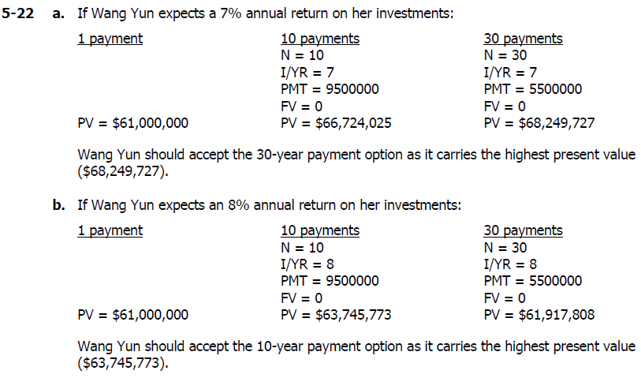

Slide 15
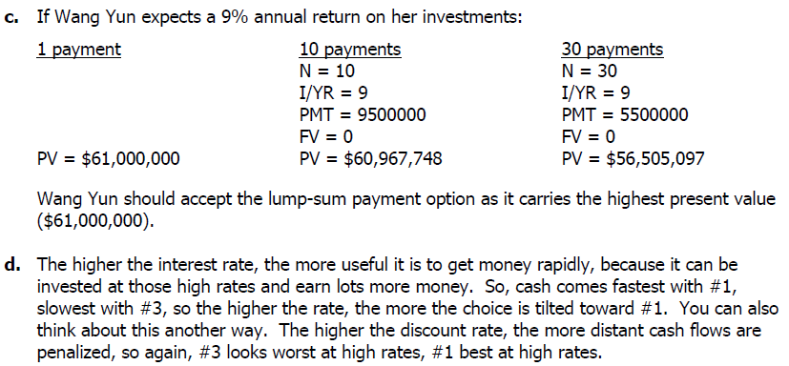

Slide 16
Example 5-24
Find the amount to which $500 will grow under each of these conditions
a. 12% compounded annually for 5 years
b. 12% compounded semiannually for 5 years
c. 12% compounded quarterly for 5 years
d. 12% compounded monthly for 5 years
f. Why does the observed pattern of FVs occur?

Slide 17
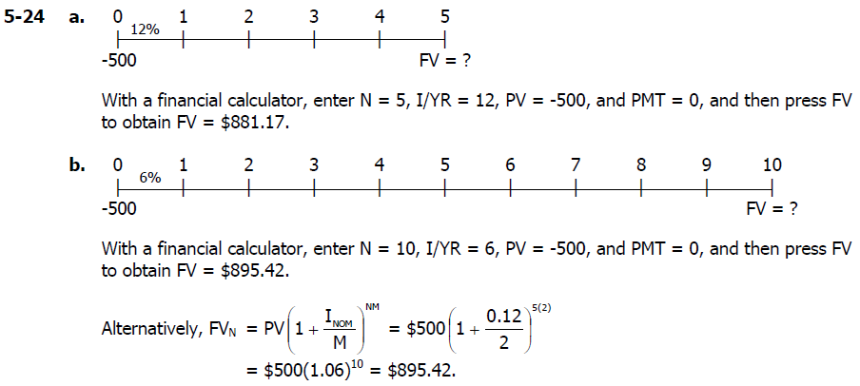

Slide 18
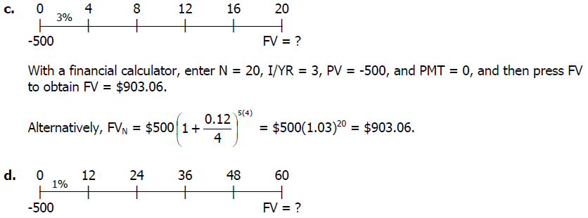
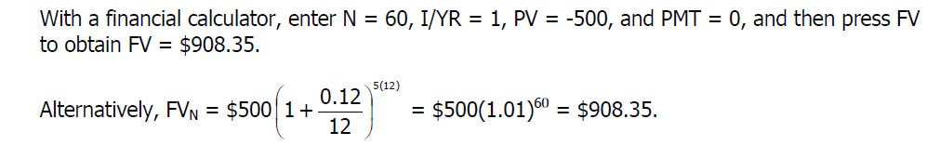

Slide 19
Example 5-32
Shan Chen and Shan Xia, who are twins, just received $30,000 each for their 25th birthday. They both have aspirations to become millionaires. Each plans to make a $5,000 annual contribution to her “early retirement fund” on her birthday, beginning a year from today. Shan Chen opened an account with the Asiana Regional Bond Fund, a mutual fund that invests in high-quality bonds whose investors have earned 6% per year in the past. Shan Xia invested in the First Renewable Tech Fund, which invests in small, newly issued bio-tech stocks and whose investors have earned an average of 20% per year in the fund’s relatively short history.
a. If the two women’s funds earn the same returns in the future as in the past, how old will each be when she becomes a millionaire?
b. How large would Shan Chen’s annual contributions have to be for her to become a millionaire at the same age as Shan Xia, assuming their expected returns are realized?
c. Is it rational or irrational for Shan Chen to invest in the bond fund rather than in stocks?
Notes:
Don’t forget that signs of PMT and PV should go tgt.

Slide 20
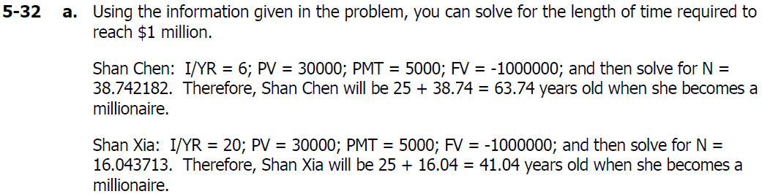
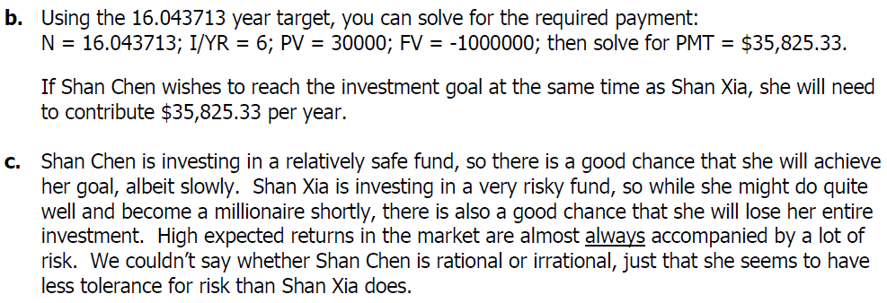

Slide 21
Example 5-35
You want to buy a house within 3 years, and you are currently saving for the down payment. You plan to save $5,000 at the end of the first year, and you anticipated that your annual savings will increase by 10% annually thereafter. Your expected annual return is 7%. How much will you have for a down payment at the end of Year 3?

Slide 22


