Slide 1
Optimization without Constraints: One Independent Variable I
Pawin Siriprapanukul
CW Ch.9

Slide 2
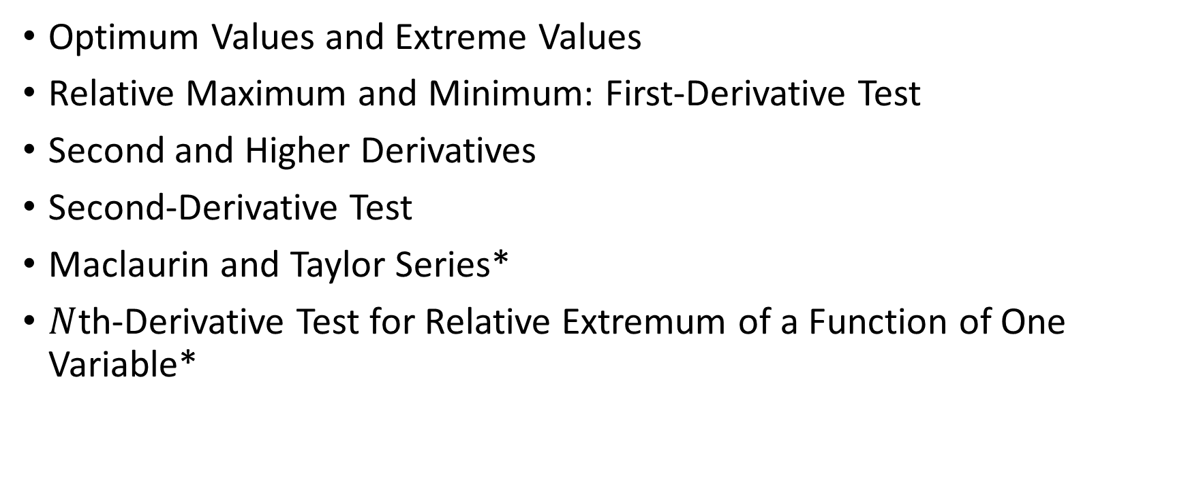
Outline
Optimum Values and Extreme Values
Relative Maximum and Minimum: First-Derivative Test
Second and Higher Derivatives
Second-Derivative Test
Maclaurin and Taylor Series*
$N$th-Derivative Test for Relative Extremum of a Function of One Variable*

Slide 3
Optimum Values and Extreme Values
The most common criterion of choice among alternatives in economics is the goal of maximizing something (such as maximizing a firm’s profit or a consumer’s utility) or of minimizing something (such as minimizing the cost of production).
Economically, we may categorize such maximization and minimization problems under the general heading of optimization, meaning “the quest for the best.”
In formulating an optimization problem, the first thing to do is to specify an objective function in which the dependent variable represents the object of maximization or minimization and in which the set of independent variables indicates the objects the economic agent can pick and choose.
We will refer to the independent variables as choice variables.
The essence of the optimization process is simply to find the set of values of the choice variables that will lead us to the desired extremum of the objective function.

Slide 4
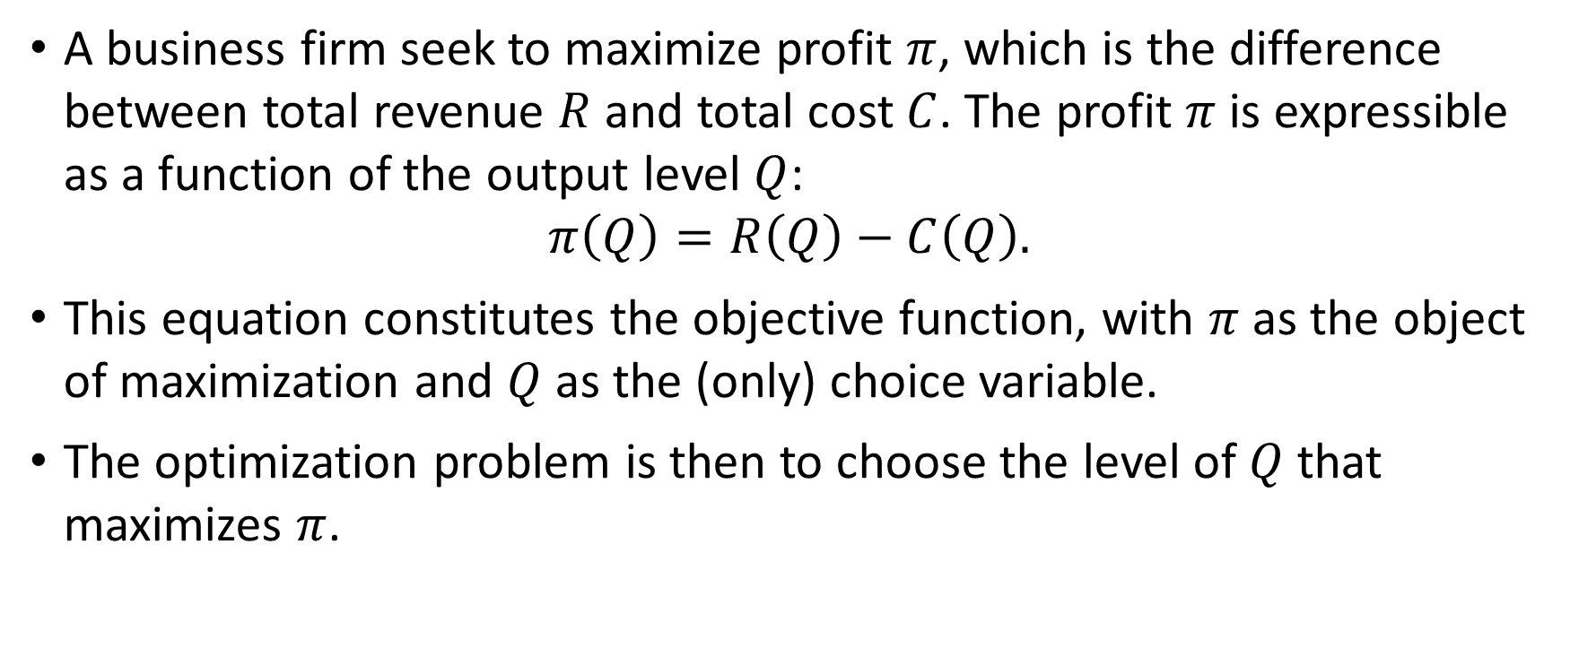
Example
A business firm seek to maximize profit $π$, which is the difference between total revenue $R$ and total cost $C$. The profit $π$ is expressible as a function of the output level $Q$:
$$π\left(Q\right)=R\left(Q\right)−C\left(Q\right).$$
This equation constitutes the objective function, with $π$ as the object of maximization and $Q$ as the (only) choice variable.
The optimization problem is then to choose the level of $Q$ that maximizes $π$.

Slide 5
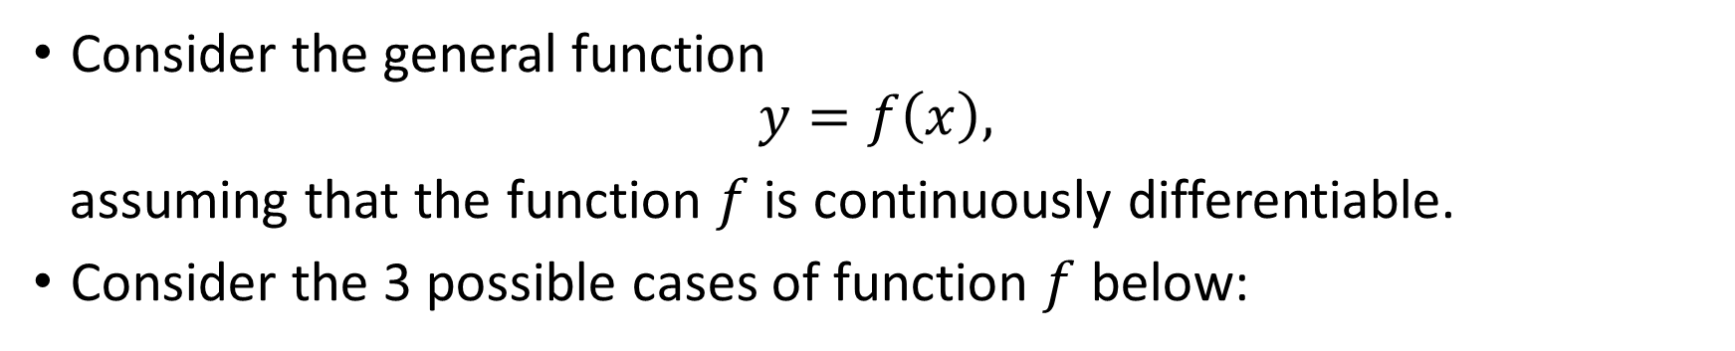
Relative Maximum and Minimum: First-Derivative Test
Consider the general function
$$y=f\left(x\right),$$
assuming that the function $f$ is continuously differentiable.
Consider the 3 possible cases of function $f$ below:
y
y
y
D
A
B
C
E
0
x
0
x
0
x

Slide 6
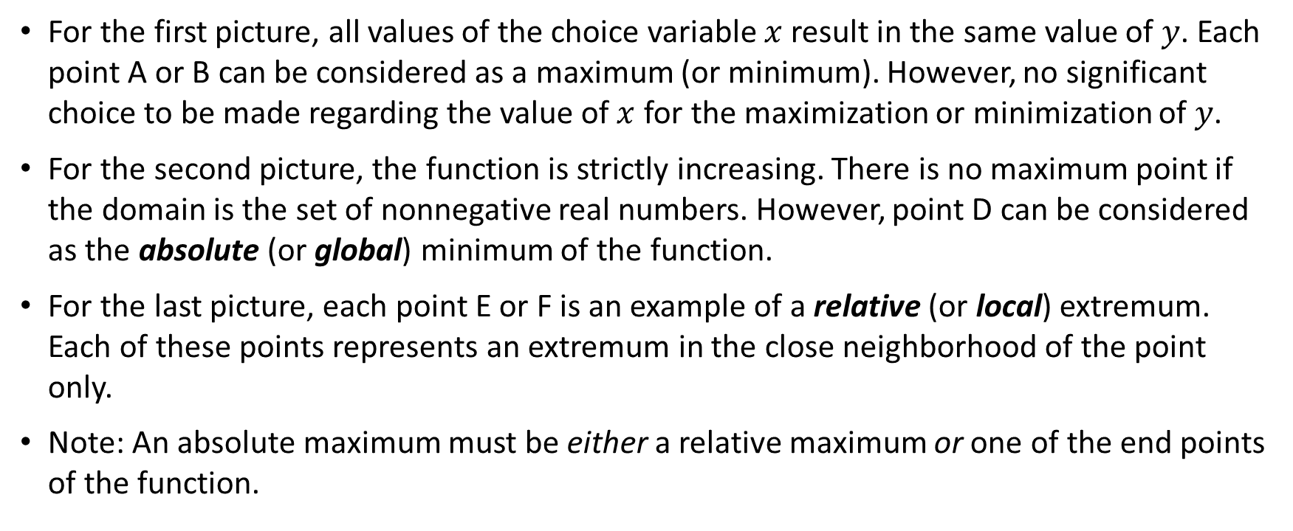
Relative vs Absolute Extremum
For the first picture, all values of the choice variable $x$ result in the same value of $y$. Each point A or B can be considered as a maximum (or minimum). However, no significant choice to be made regarding the value of $x$ for the maximization or minimization of $y$.
For the second picture, the function is strictly increasing. There is no maximum point if the domain is the set of nonnegative real numbers. However, point D can be considered as the absolute (or global) minimum of the function.
For the last picture, each point E or F is an example of a relative (or local) extremum. Each of these points represents an extremum in the close neighborhood of the point only.
Note: An absolute maximum must be either a relative maximum or one of the end points of the function.

Slide 7
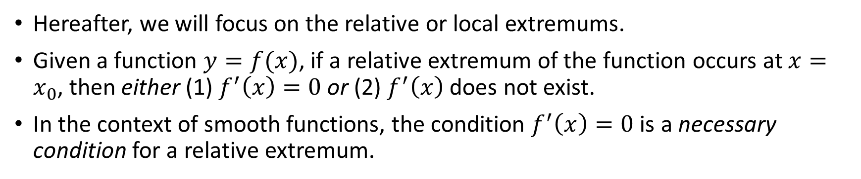
First-Derivative Test
Hereafter, we will focus on the relative or local extremums.
Given a function $y=f(x)$, if a relative extremum of the function occurs at $x=x_{0}$, then either (1) $f^{′}\left(x\right)=0$ or (2) $f^{′}\left(x\right)$ does not exist.
In the context of smooth functions, the condition $f^{′}\left(x\right)=0$ is a necessary condition for a relative extremum.
y
y
F
D
E
G
0
x
0
x

Slide 8
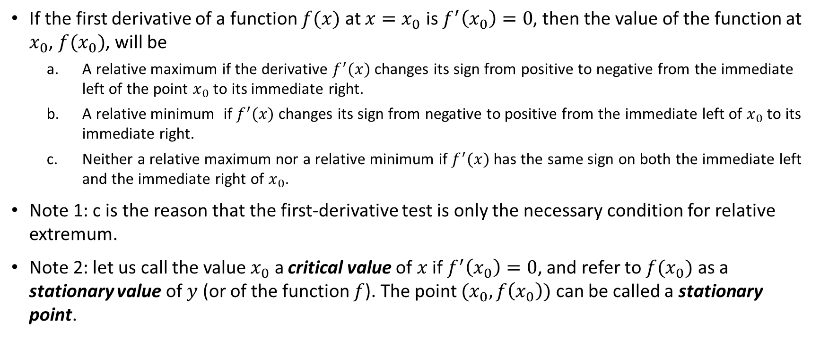
First-Derivative Test for Relative Extremum
If the first derivative of a function $f(x)$ at $x=x_{0}$ is $f^{′}\left(x_{0}\right)=0$, then the value of the function at $x_{0}$, $f(x_{0})$, will be
  A relative maximum if the derivative $f^{′}(x)$ changes its sign from positive to negative from the immediate left of the point $x_{0}$ to its immediate right.
  A relative minimum if $f^{′}(x)$ changes its sign from negative to positive from the immediate left of $x_{0}$ to its immediate right.
  Neither a relative maximum nor a relative minimum if $f^{′}(x)$ has the same sign on both the immediate left and the immediate right of $x_{0}$.
Note 1: c is the reason that the first-derivative test is only the necessary condition for relative extremum.
Note 2: let us call the value $x_{0}$ a critical value of $x$ if $f^{′}\left(x_{0}\right)=0$, and refer to $f(x_{0})$ as a stationary value of $y$ (or of the function $f$). The point $(x_{0},f\left(x_{0}\right))$ can be called a stationary point.

Slide 9
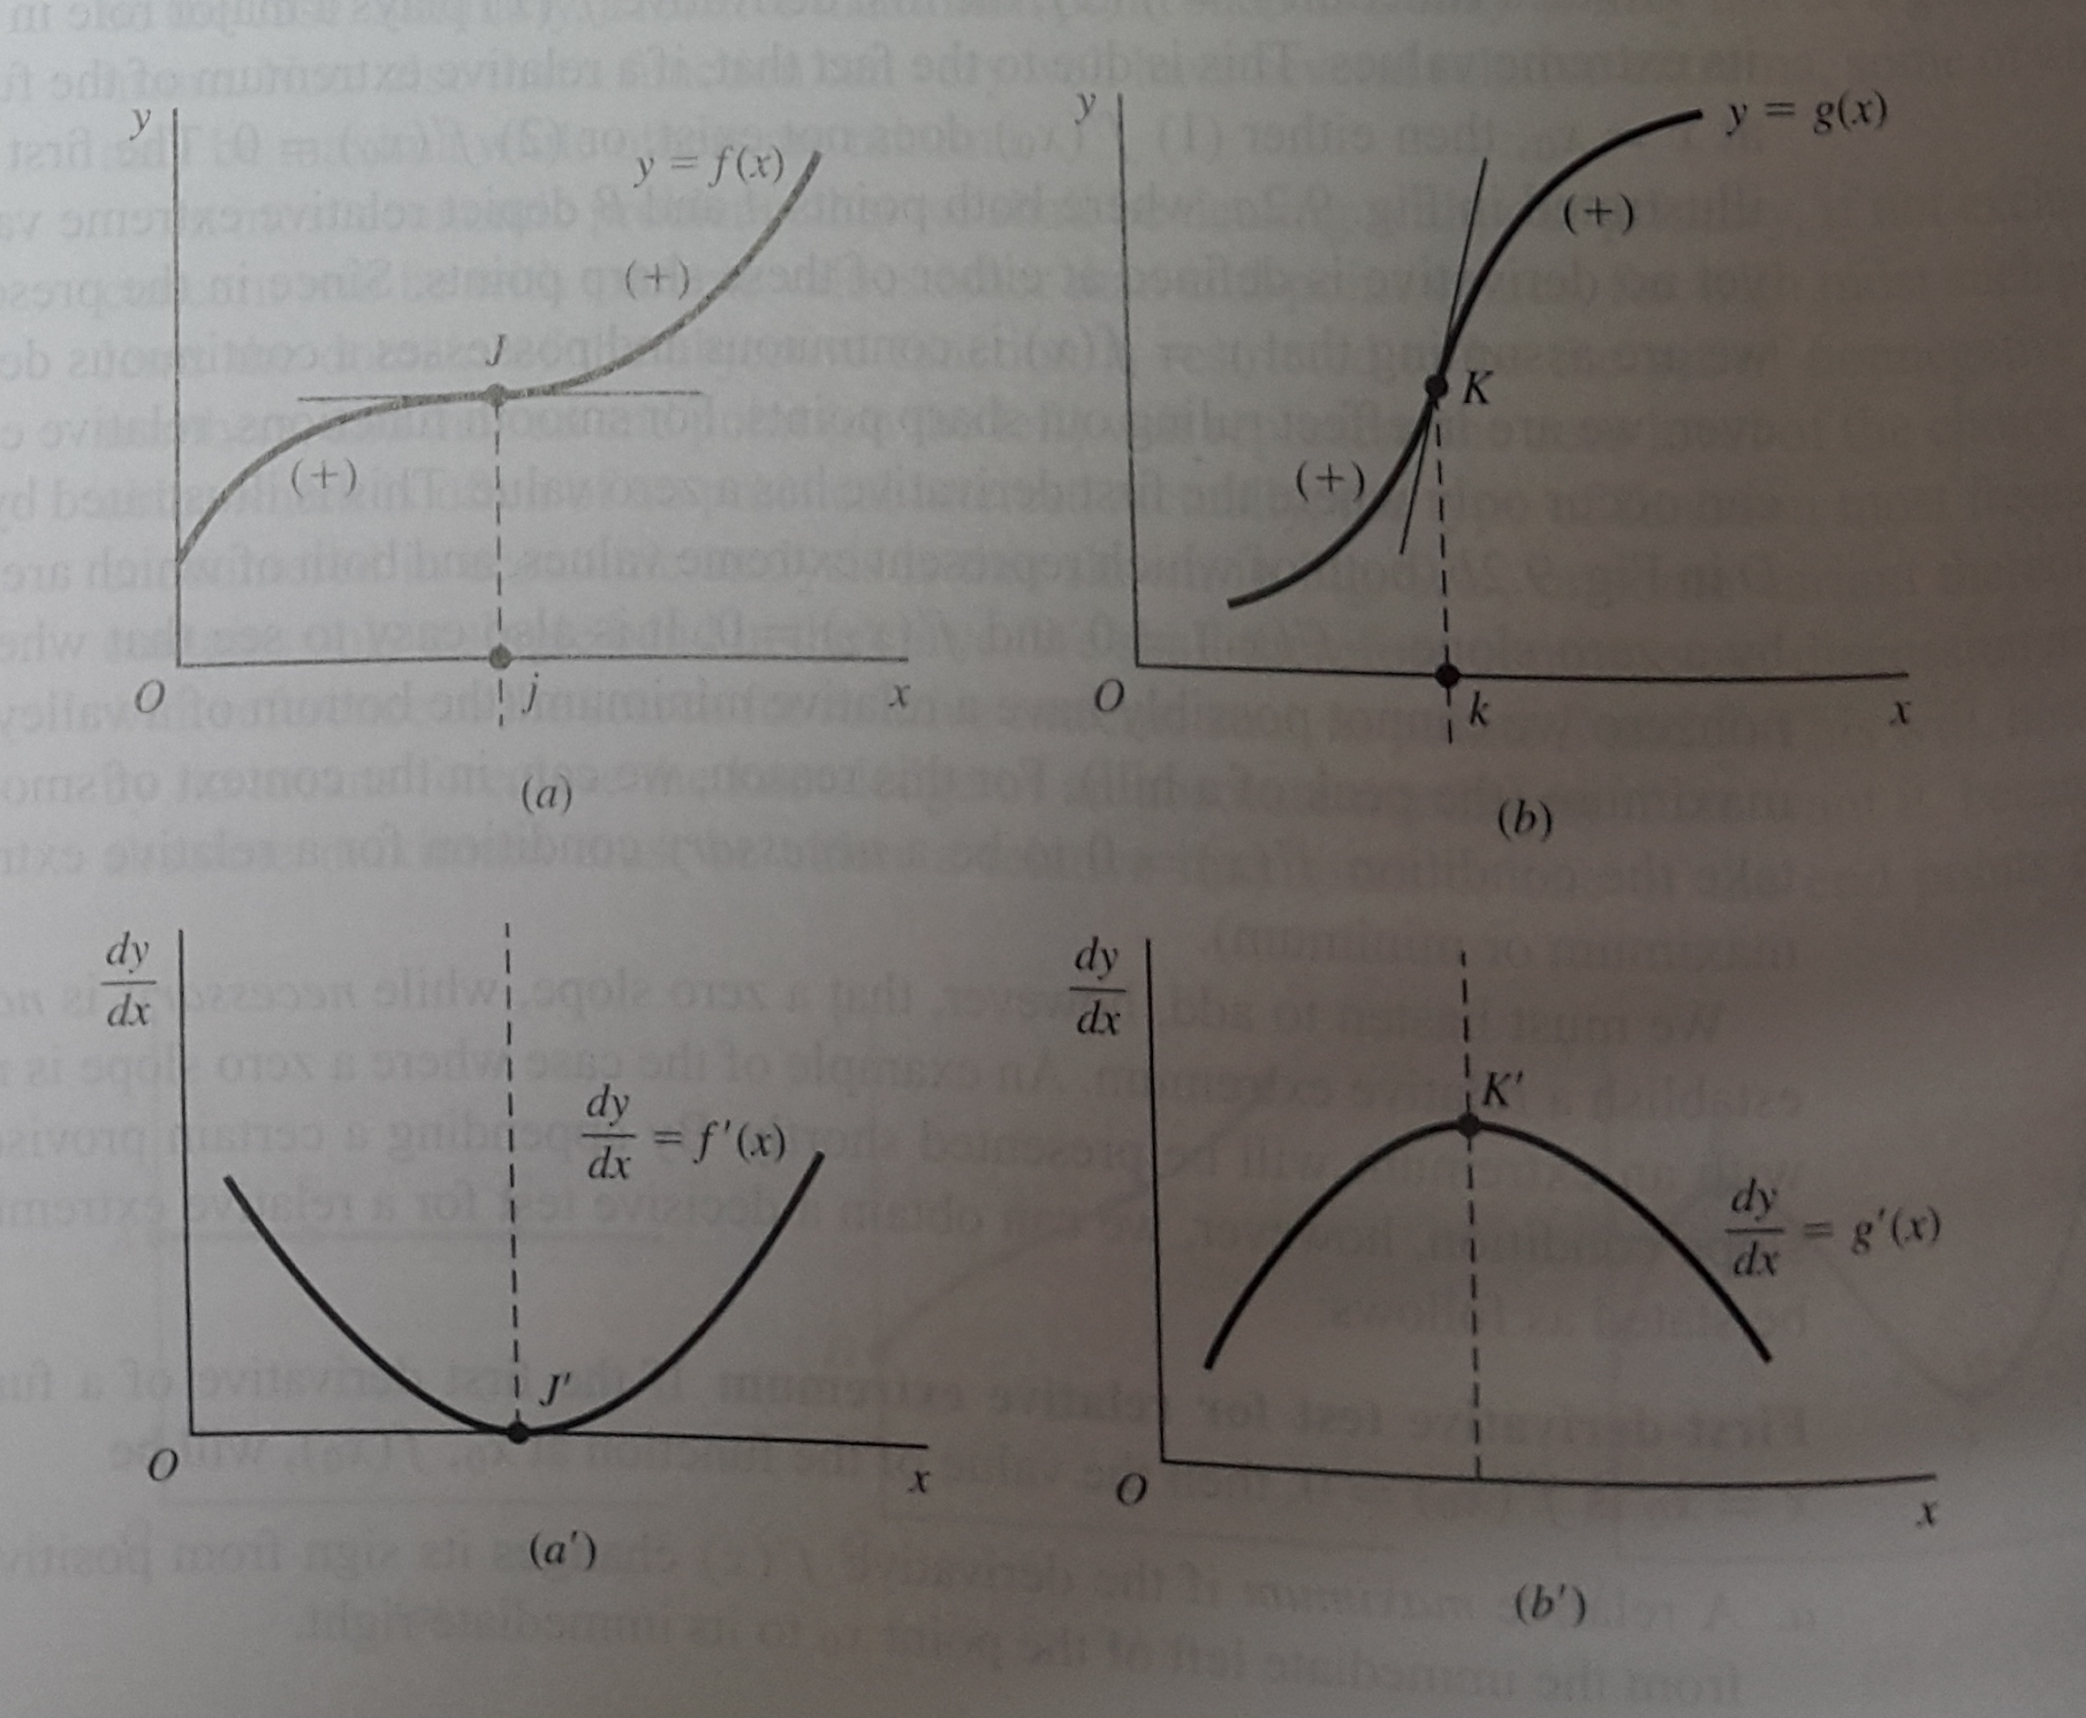

Slide 10
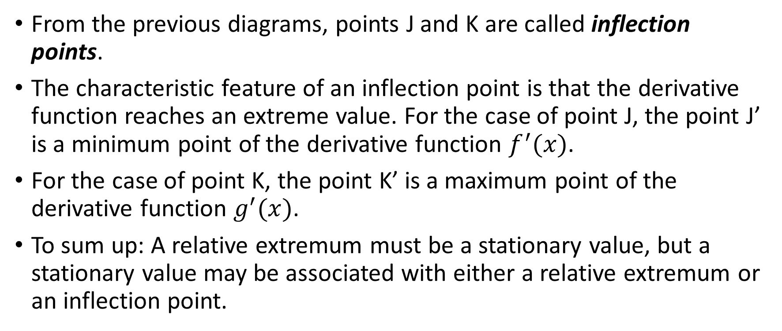
First-Derivative Test for Relative Extremum
From the previous diagrams, points J and K are called inflection points.
The characteristic feature of an inflection point is that the derivative function reaches an extreme value. For the case of point J, the point J’ is a minimum point of the derivative function $f^{′}(x)$.
For the case of point K, the point K’ is a maximum point of the derivative function $g^{′}(x)$.
To sum up: A relative extremum must be a stationary value, but a stationary value may be associated with either a relative extremum or an inflection point.

Slide 11
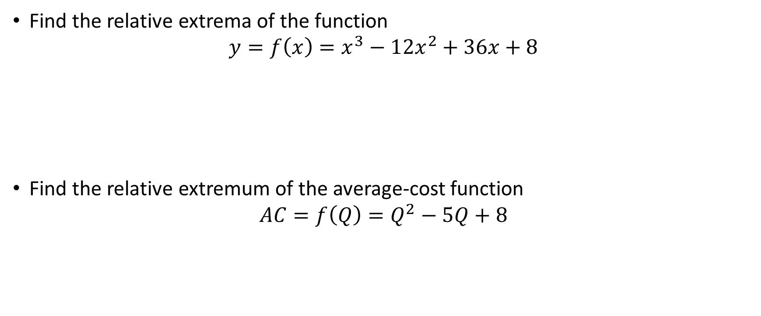
Examples
Find the relative extrema of the function
$$y=f\left(x\right)=x^{3}−12x^{2}+36x+8$$
Find the relative extremum of the average-cost function
$$AC=f\left(Q\right)=Q^{2}−5Q+8$$

Slide 12
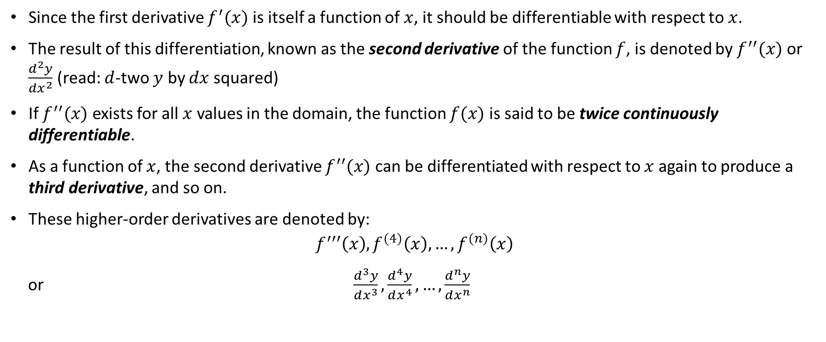
Second and Higher Derivatives
Since the first derivative $f^{′}(x)$ is itself a function of $x$, it should be differentiable with respect to $x$.
The result of this differentiation, known as the second derivative of the function $f$, is denoted by $f^{′′}(x)$ or $\frac{d^{2}y}{dx^{2}}$ (read: $d$-two $y$ by $dx$ squared)
If $f^{′′}(x)$ exists for all $x$ values in the domain, the function $f(x)$ is said to be twice continuously differentiable.
As a function of $x$, the second derivative $f^{′′}(x)$ can be differentiated with respect to $x$ again to produce a third derivative, and so on.
These higher-order derivatives are denoted by:
$$f^{′′′}\left(x\right),f^{(4)}\left(x\right),…,f^{(n)}\left(x\right)$$
or $\frac{d^{3}y}{dx^{3}},\frac{d^{4}y}{dx^{4}},…,\frac{d^{n}y}{dx^{n}}$

Slide 13
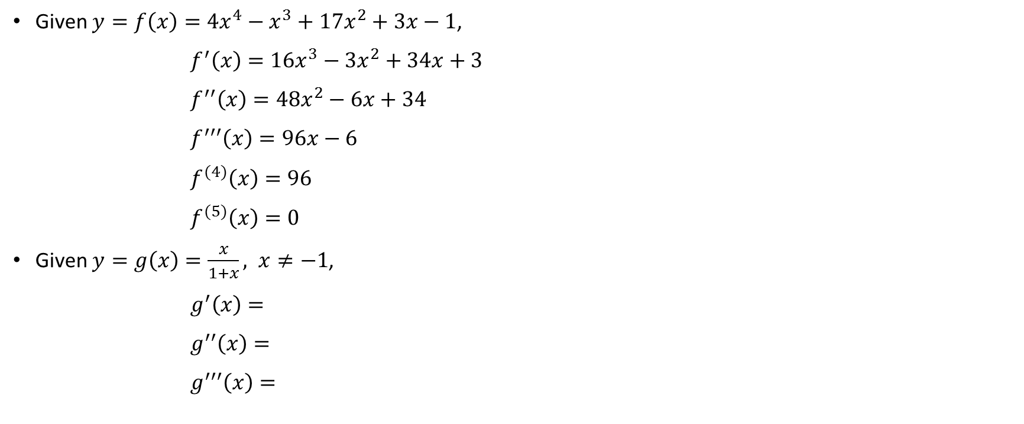
Examples
Given $y=f\left(x\right)=4x^{4}−x^{3}+17x^{2}+3x−1$,
$f^{′}\left(x\right)=16x^{3}−3x^{2}+34x+3$
$f^{′′}\left(x\right)=48x^{2}−6x+34$
$f^{′′′}\left(x\right)=96x−6$
$f^{(4)}\left(x\right)=96$
$f^{(5)}\left(x\right)=0$
Given $y=g\left(x\right)=\frac{x}{1+x}, x≠−1$,
$g^{′}\left(x\right)=$
$g^{′′}\left(x\right)=$
$g^{′′′}\left(x\right)=$

Slide 14
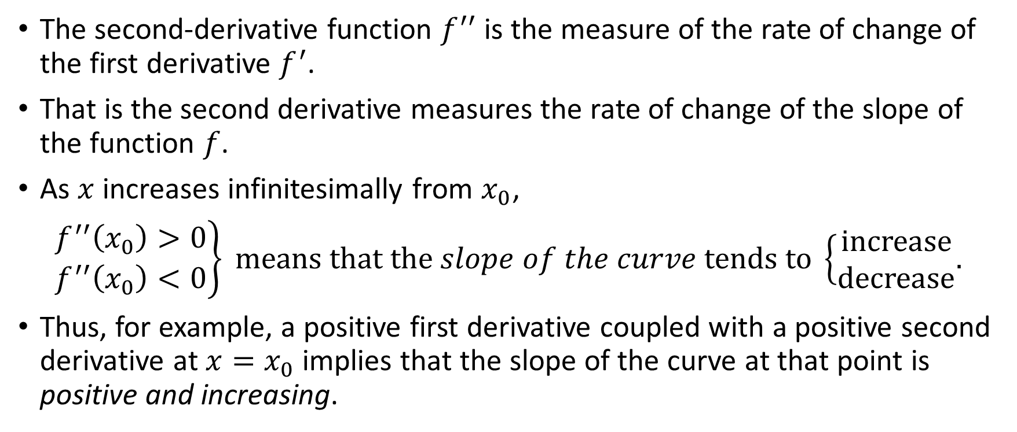
Interpretation of the Second Derivative
The second-derivative function $f^{′′}$ is the measure of the rate of change of the first derivative $f^{′}$.
That is the second derivative measures the rate of change of the slope of the function $f$.
As $x$ increases infinitesimally from $x_{0}$,
$$\left.\begin{matrix}f^{′′}\left(x_{0}\right)>0 \\ f^{′′}\left(x_{0}\right)<0\end{matrix}\right\} means that the slope of the curve tends to \left\{\begin{matrix}increase \\ decrease\end{matrix}.\right.$$
Thus, for example, a positive first derivative coupled with a positive second derivative at $x=x_{0}$ implies that the slope of the curve at that point is positive and increasing.

Slide 15
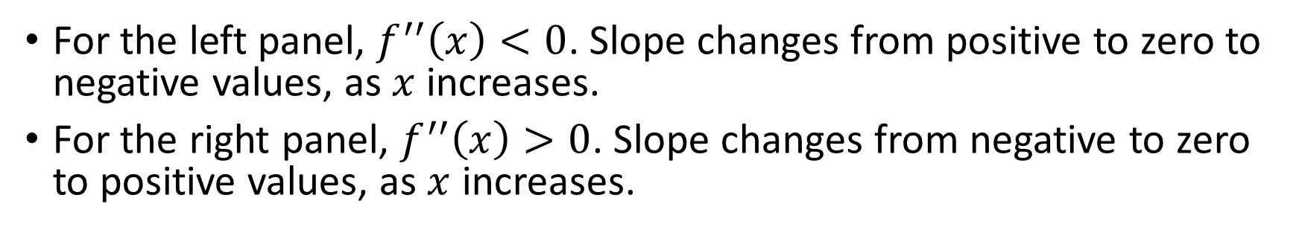
y
y
0
x
0
x
For the left panel, $f^{′′}\left(x\right)<0$. Slope changes from positive to zero to negative values, as $x$ increases.
For the right panel, $f^{′′}\left(x\right)>0$. Slope changes from negative to zero to positive values, as $x$ increases.

Slide 16
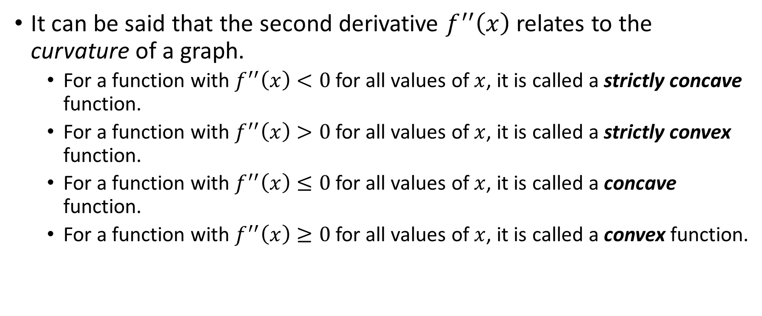
Interpretation of the Second Derivative
It can be said that the second derivative $f^{′′}\left(x\right)$ relates to the curvature of a graph.
  For a function with $f^{′′}\left(x\right)<0$ for all values of $x$, it is called a strictly concave function.
  For a function with $f^{′′}\left(x\right)>0$ for all values of $x$, it is called a strictly convex function.
  For a function with $f^{′′}\left(x\right)≤0$ for all values of $x$, it is called a concave function.
  For a function with $f^{′′}\left(x\right)≥0$ for all values of $x$, it is called a convex function.

Slide 17
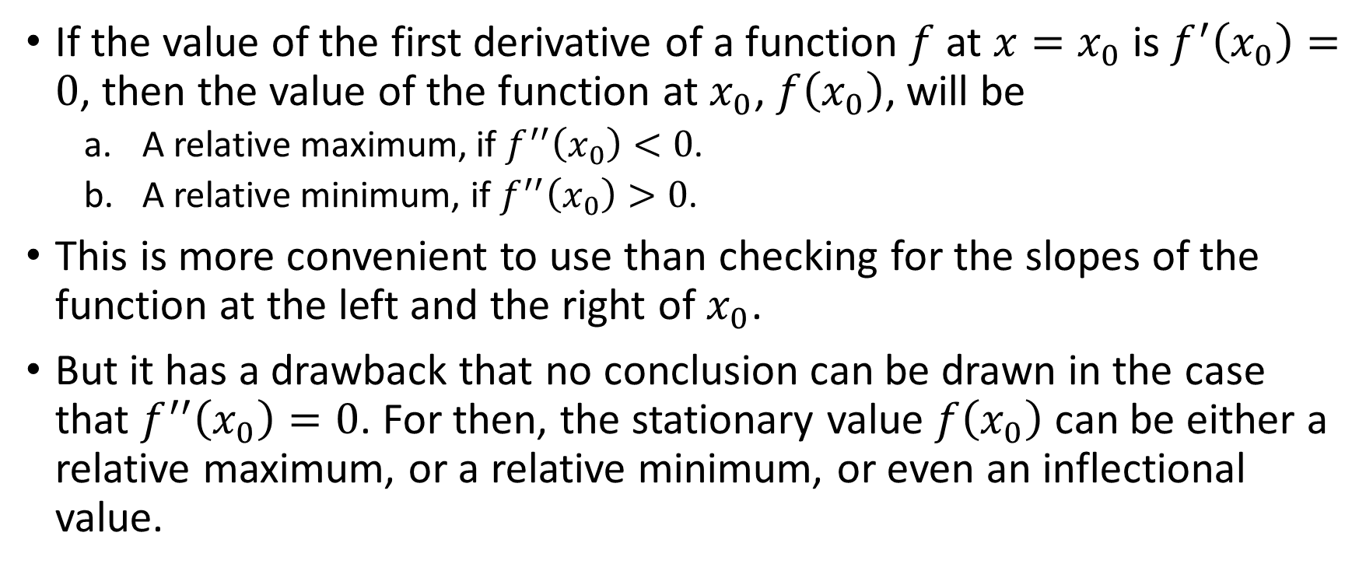
Second-Derivative Test for Relative Extremum
If the value of the first derivative of a function $f$ at $x=x_{0}$ is $f^{′}\left(x_{0}\right)=0$, then the value of the function at $x_{0}$, $f\left(x_{0}\right)$, will be
  A relative maximum, if $f^{′′}\left(x_{0}\right)<0$.
  A relative minimum, if $f^{′′}\left(x_{0}\right)>0$.
This is more convenient to use than checking for the slopes of the function at the left and the right of $x_{0}$.
But it has a drawback that no conclusion can be drawn in the case that $f^{′′}\left(x_{0}\right)=0$. For then, the stationary value $f\left(x_{0}\right)$ can be either a relative maximum, or a relative minimum, or even an inflectional value.

Slide 18
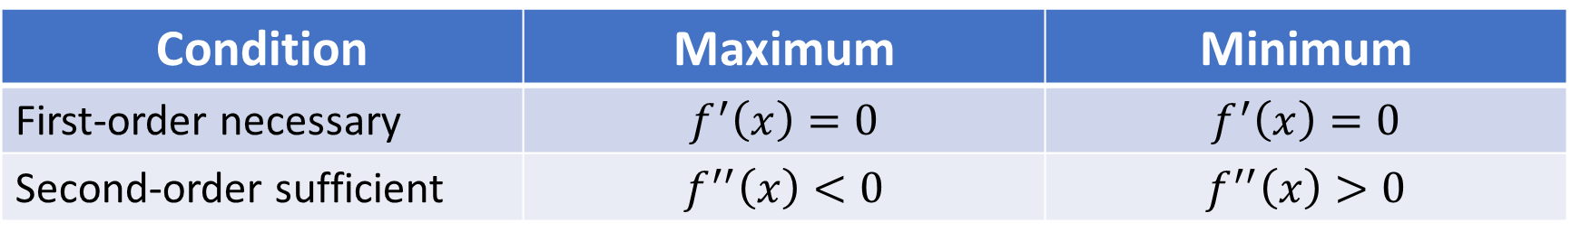
In Conclusion
Condition | Maximum | Minimum
First-order necessary | $$f^{′}\left(x\right)=0$$ | $$f^{′}\left(x\right)=0$$
Second-order sufficient | $$f^{′′}\left(x\right)<0$$ | $$f^{′′}\left(x\right)>0$$

Slide 19
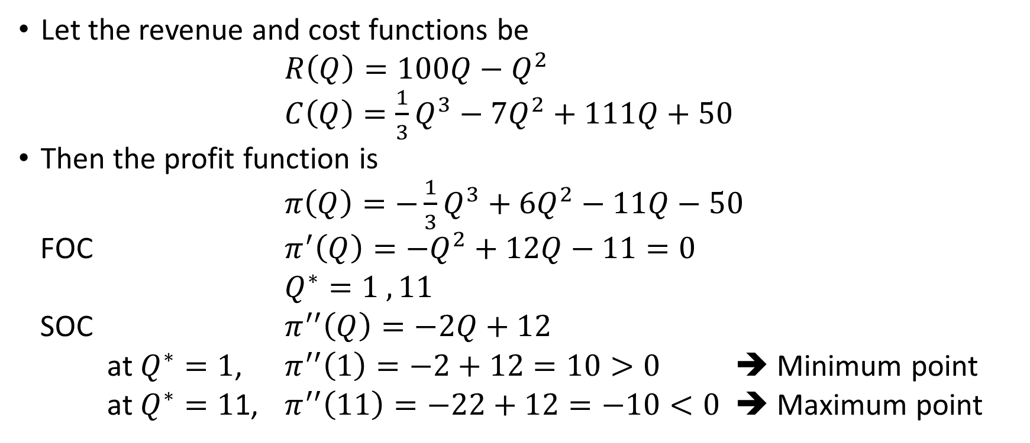
Example
Let the revenue and cost functions be
$R\left(Q\right)=100Q−Q^{2}$
$C\left(Q\right)=\frac{1}{3}Q^{3}−7Q^{2}+111Q+50$
Then the profit function is
$π\left(Q\right)=−\frac{1}{3}Q^{3}+6Q^{2}−11Q−50$
FOC $π^{′}\left(Q\right)=−Q^{2}+12Q−11=0$
$Q^{∗}=1 , 11$
SOC $π^{′′}\left(Q\right)=−2Q+12$
at $Q^{∗}=1$, $π^{′′}\left(1\right)=−2+12=10>0$ ➔ Minimum point
at $Q^{∗}=1$1, $π^{′′}\left(11\right)=−22+12=−10<0$ ➔ Maximum point

Slide 20
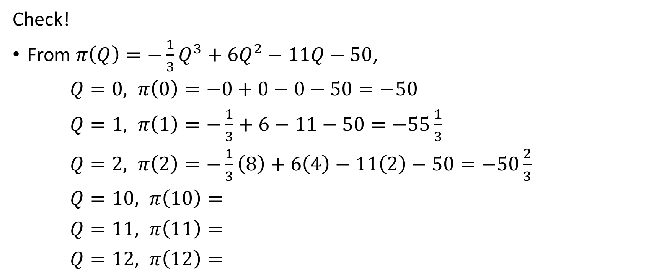
Example
Check!
From $π\left(Q\right)=−\frac{1}{3}Q^{3}+6Q^{2}−11Q−50$,
$Q=0, π\left(0\right)=−0+0−0−50=−50$
$Q=1, π\left(1\right)=−\frac{1}{3}+6−11−50=−55\frac{1}{3}$
$Q=2, π\left(2\right)=−\frac{1}{3}\left(8\right)+6\left(4\right)−11\left(2\right)−50=−50\frac{2}{3}$
$Q=10, π\left(10\right)=$
$Q=11, π\left(11\right)=$
$Q=12, π\left(12\right)=$

