Slide 1
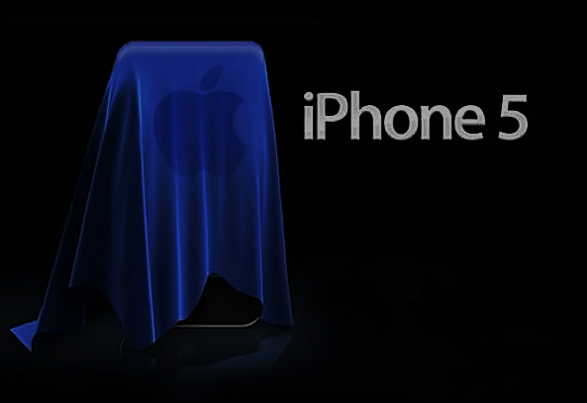
SMART PHONE: APPLE
Presented by :
Jirawut
Mahaphon
Nutt
Sorawich
Surachet

Slide 2
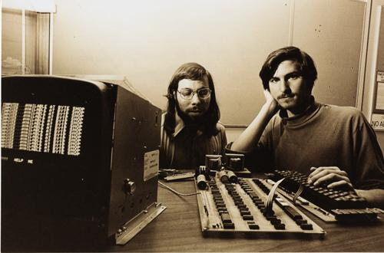
Apple: History
Steve Wozniak and Steve Jobs with Apple I
1976
Apple was established as a computer company
Notes:
Organization of Apple was established in 1976 as a computer company. However, in the last decade, Apple has expanded into a complex company that specializes in much more than just computers. It has been introduced a revolutionary product to the world.

Slide 3
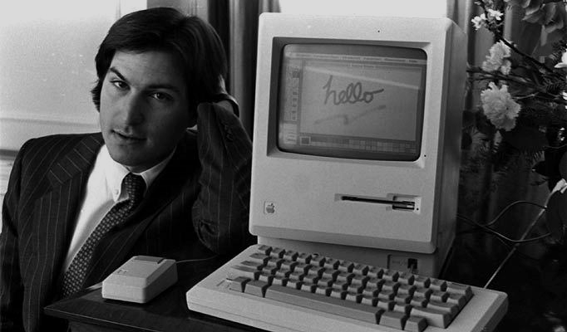
Apple: Mac
Steve Jobs with Macintosh Computer
1984
Macintosh computer was presented which lead to a change in computer industry
Notes:
In 1984 Macintosh computer was presented which lead to a change in computer industry.

Slide 4
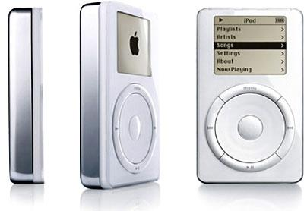
Apple: iPod
2001
Apple introduced the iPod, becoming the dominant market leader in music players
Notes:
In 2001, Apple broke the barrier with the iPod, eventually becoming the dominant market leader in music players

Slide 5
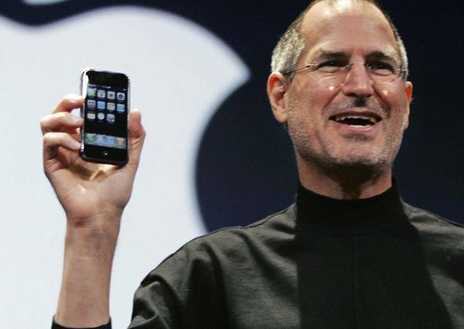
Apple: iPhone
2007
Apple presented the iPhone, which was the turning point of smart phone
Notes:
. In following, Apple joined the phone industry in 2007 with the iPhone, which has also been widely successful.

Slide 6
Main differential attributes of iPhone
All-in-on Communicational Device
Revolutionary User Interfaces
Large storage space
Apple made
Notes:
All in on communication device is that the new Apple iPhone incorporating the features of a phone, small computer, and music player.
Revolutionary User Interfaces, Apple replace a keyboard pad into muti-touch screen including a virtual keyboard.
Large storage space the first generation of iPhone has a memory storage of 4 to 16 GB available.
Most importantly, it is made by Apple.

Slide 7

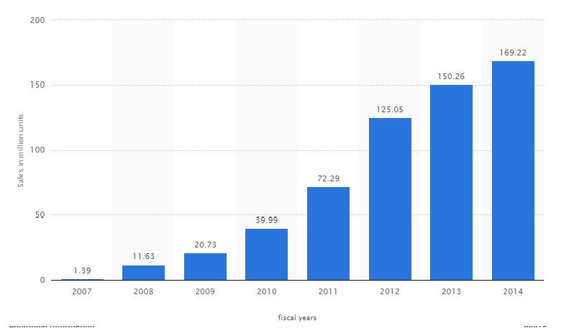
Global iPhone sales in the fiscal years 2007 to 2014
13%
20%
73%
81%
93%
78%
737%
ipohne1
iphone 3gs
iphone 4
iphone 4s
iphone 5s,5c
iphone6
iphone 3g
iphone5
Notes:
http://www.statista.com/statistics/276306/global-apple-iphone-sales-since-fiscal-year-2007/
The growth sale of iPhone was tremendously increase between 2007-2012 , the sale increases almost a 100 percent in the first five years.

Slide 8
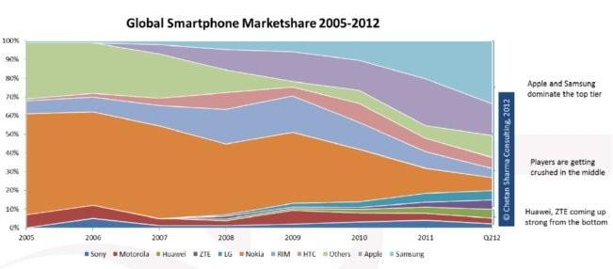
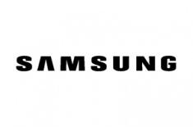



Global Smartphone Market Share
100%
90%
Others
80%
70%
60%
HTC
LG
ZTE
Huawei
Motorola
Sony
50%
40%
30%
20%
10%
0%
2005
2006
2007
2008
2009
2010
2011
2012
iPhone 1 2007
iPhone 3G 2008
iPhone 3GS 2009
Source : Gartner
Notes:
Source : http://www.gizmag.com/us-smartphone-penetration-passes-50-percent/23768/

Slide 9
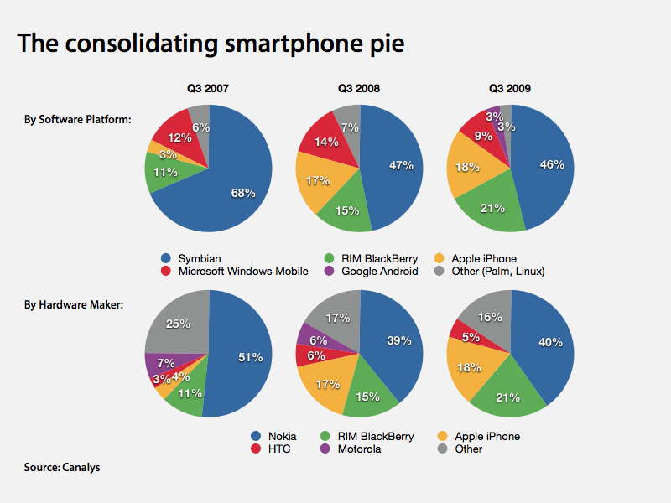
2007
2008
iPhone 1, June 2007
iPhone 3G, July 2008
2009
iPhone 3GS, July 2009
Source : Canalys

Slide 10
Global Smartphone Market Share
100%
90%
Others
80%
70%
60%
HTC
LG
ZTE
Huawei
Motorola
Sony
50%
40%
30%
20%
10%
0%
2005
2006
2007
2008
2009
2010
2011
2012
iPhone 1 2007
iPhone 3G 2008
iPhone 4 2010
iPhone 3GS 2009
iPhone 4S 2011
Notes:
Source : http://www.gizmag.com/us-smartphone-penetration-passes-50-percent/23768/

Slide 11
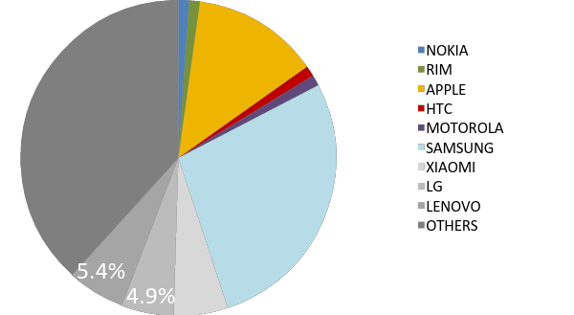
Global Smartphone Market Share 2014
11.9%
40%
25.2%
Source : TrendForce
Notes:
http://www.dazeinfo.com/2014/08/04/smartphone-market-share-q-2014-xiaomi-lenovo-worlds-top-smartphone-brands-are-chinese-apple-samsung-struggling/

Slide 12
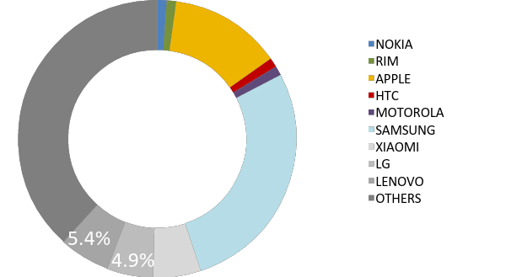
Global Smartphone Market Share 2007 & 2014
2014
11.9%
2007
40%
25.2%
Source : TrendForce
Notes:
http://www.dazeinfo.com/2014/08/04/smartphone-market-share-q-2014-xiaomi-lenovo-worlds-top-smartphone-brands-are-chinese-apple-samsung-struggling/

Slide 13
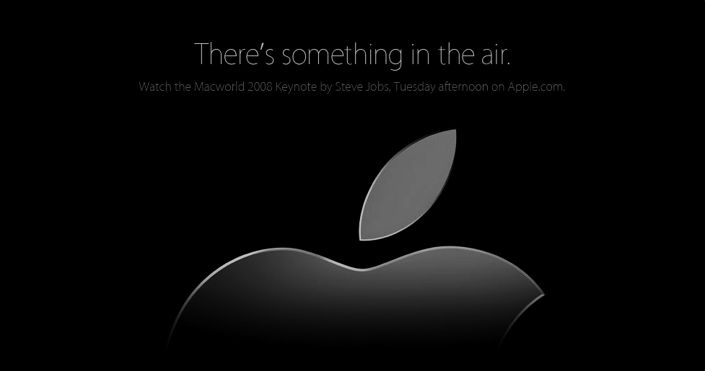
APPLE STRATEGIES
The secret of its successes in smart phone market since 2007

Slide 14
Strategies
To buy iPhone
-Product differentiation
>Technology; smooth and functional operation
>Brand image( high) & Design (“Less is more”)
–Marketing
>(next iphone expectations & pricing decoy)
–Product variety
To keep buying iphone
–Economies of network
>( Facetime, iCloud, iShare,…)
–High switching cost
>( iTune, APP,…)
Market power
Applications
–Complementary to iPhone (two-part tariff)
–Barrier to entry
Bundling
–iPhone with data plan
Notes:
Economies of scope and High switching cost
High switching cost
One thing to note about Iphone is that, when you get in, you are unlikely to get out. High Price is one thing but, the effect of some certain function that only iphone could provide and no other could be renounced. An apps like facetime, icloud or ishare certainly won't be available for any android user. It may be possible that other firm may try to come up with another similar apps but, the fact that it came out later will create a cost for consumers, who already familiar with apple, to learn it. Especially if the new apps does not significance better than apple, no one would bother to learn it.
Economies of network
In addition, with more people using apple and less are switching out. This would create an positive externalities for apple, economy of network. Lets use the same apps I mentioned before like facetime. If many of your friends love to use facetime, and lets say that you are current not owning any smart-phone and thinking of buying one. It is quite likely that you would choose an iphone, other thing remain constant. you could see an element there. With more people using some feature, its value increase as the benefit of using it is getting larger.
Bundling
Buying a pure iphone could be very expensive. However, firm can make it looks less expensive by tying in with some network provider. Which, using an individual price as a decoy, the price of the phone together with services fees will be cheaper which will lure more consumers that it is not too expensive and buy it.

Slide 15
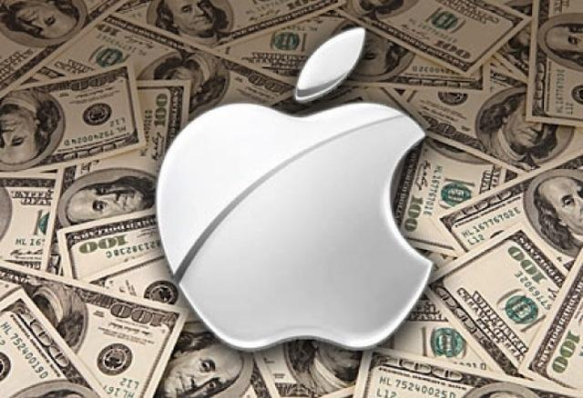
MARKET POWER
Utilize the power to employ strategies

Slide 16


Having APPs create barriers to entry into this market
Basically high investment cost and R&D
Not only Smartphone business incurring higher investment rather than specialize only phone on developing application
Less players

Slide 17
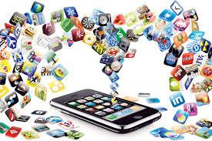
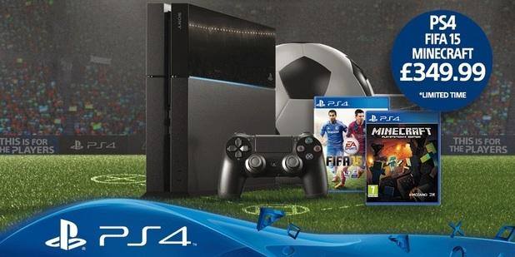
Applications are complimentary which similar to two-part tariff.
VS
$
iPhone
T
q
APPs sold
Notes:
If you want to use some useful applications, you need to buy iphone
Extracting CS from moderate and high willingness to pay customers.

Slide 18
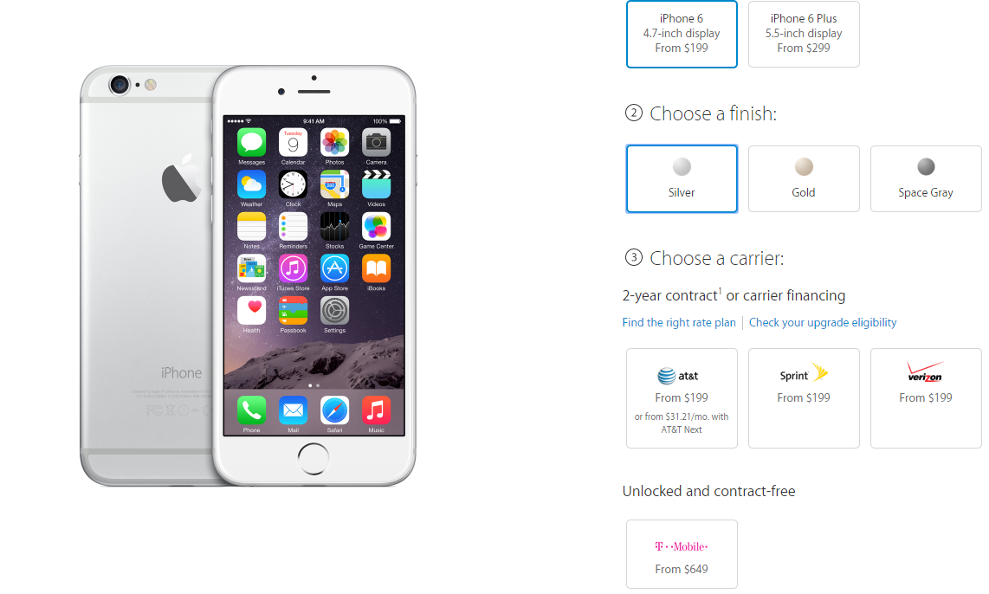
Bundling iPhone with data plan
Notes:
Bundling
Buying a pure iphone could be very expensive. However, firm can make it looks less expensive by tying in with some network provider. Which, using an individual price as a decoy, the price of the phone together with services fees will be cheaper which will lure more consumers that it is not too expensive and buy it.

Slide 19

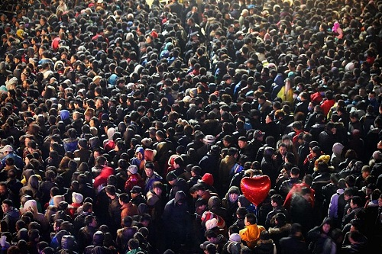
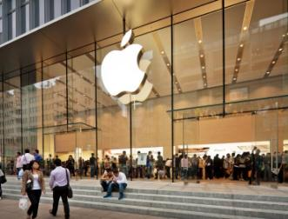
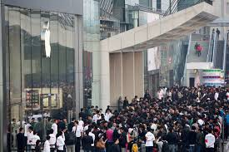

MARKETING STRATEGIES
Popularity, trend, attractiveness,…

Slide 20
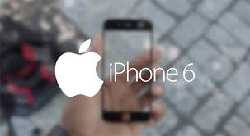
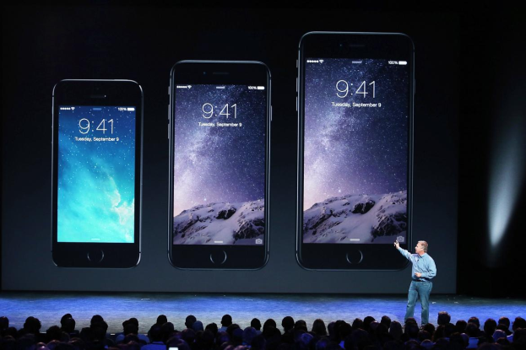
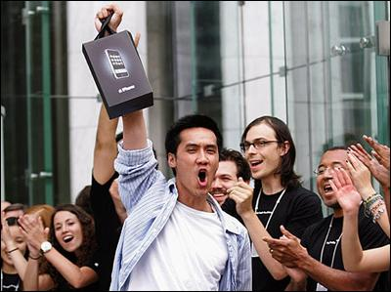
Play around expectation
Phase1
Rumor of the new iPhone
Phase 2
Presentation of the iPhone
Phase 3
Time to buy
  Create excitement and popularity
  Enhance iPhone value by giving information
  Enhance Sales by making it like a big campaign

Slide 21
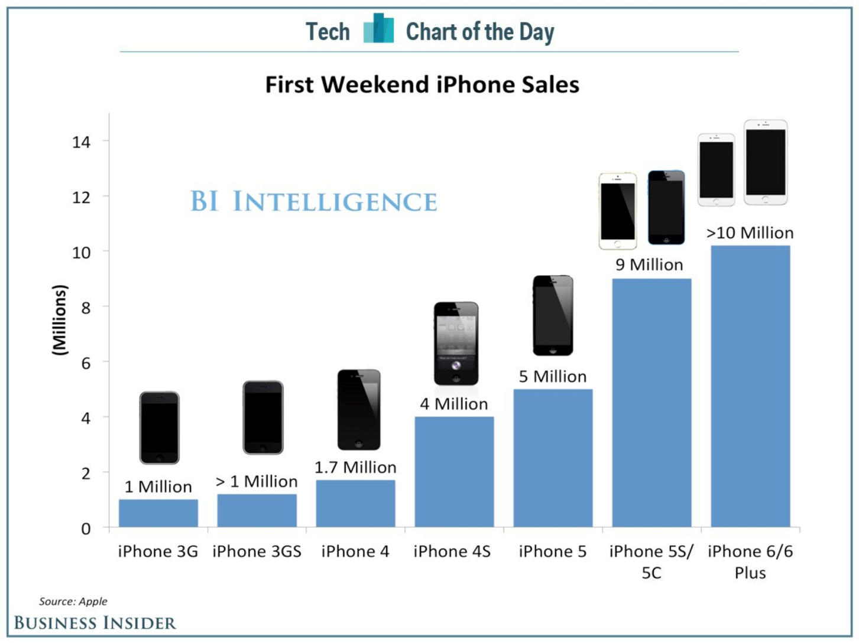
How people crazy for new iPhone

Slide 22
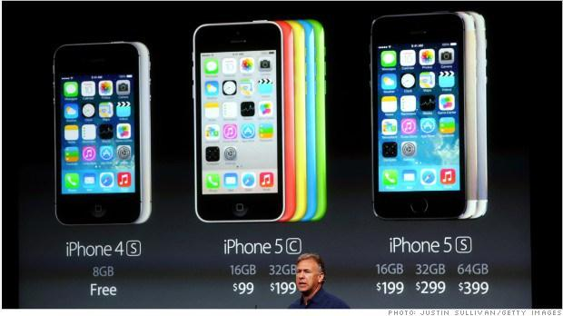
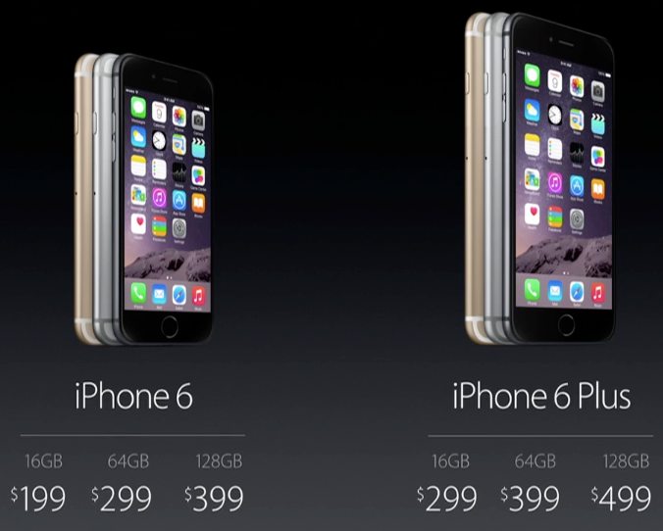
  Consumers are worse off when did not want to buy new iPhone originally
  Seem cheaper
  Affordable and more reasonable
  “Decoys explain why Apple often sells each gadget in a pricing series, such as the new iPod Touch's $229, $299, and $399 price points for different storage capacities. You may gladly spend $229 to get a hot media player, thinking it's a deal compared with the highest-priced version and not blink that you could instead buy an iPhone 4 at the lower price of $199 with more features.”
Pricing decoy
Source: Economist Dan Ariely, author of Predictably Irrational,
Notes:
=Its like when you see SALES sometimes it does always set price to make a discount
“Some people will spend $399 for a music player with slightly better technology - and Apple makes even fatter margins.”

Slide 23
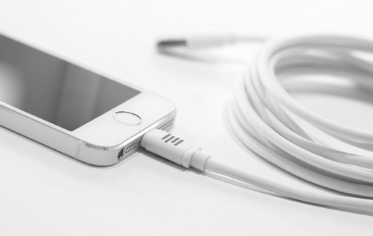
other consistent policy
Economies of network
High switching cost
Notes:
High switching cost
One thing to note about Iphone is that, when you get in, you are unlikely to get out. High Price is one thing but, the effect of some certain function that only iphone could provide and no other could be renounced. A function like facetime, icloud or ishare or hundreds of application in istore, certainly won't be available for any android user. It may be possible that other firm may try to come up with another similar apps but, the fact that it came out later will create a cost for consumers, who already familiar with apple, to learn it. Especially if the new apps does not significance better than apple, no one would bother to learn it.
Economies of network
In addition, with more people using apple and less are switching out. This would create an positive externalities for apple, economy of network. Lets use the same apps I mentioned before like facetime. If many of your friends love to use facetime, and lets say that you are current not owning any smart-phone and thinking of buying one. It is quite likely that you would choose an iphone, other thing remain constant. you could see an element there. With more people using some feature, its value increase.

Slide 24
Product differentiation :Job Era
1. It’s software stupid
2. One phone to rule them all
Notes:
One of the thing that really distinguish apple from other is operational system, the IOS. Back in 2007-2008, Nokia, a dominant firm who has variety of product and advance technology, especially their Hardware. There are many firm at that time that already there and try to compete but, it is the new comer that really turn thing around with the iPhone and here the reason why they could do it
First, their highly developed software. It is true that other firm is really advance by that time but, that mostly in term of hardware. Which, after a while they all stuck since there is a diminishing return on hardware development. It is apple that turn around and improve their operating system, IOS, which is way faster than what Nokia has and that’s visualize to consumers through touch-screen display. This has significantly improve its ability to do read and write e-mail, which is indeed very useful. It takes a year before Samsung, another firm, to came up with a touch screen but, with a lower quality operating system. The smoothness of system is no where compare to Apple.
Second, Marketing. Apple and iphone is very consisted with the idea of Job seem to do specifically good about this. With time limitation, I will not go into much detail about this but, I will only pick a very clear example which is him, Steve job himself. I don’t have an exact number but, just think of Nokia or Samsung. Their CEO is not really that well-known and is very unlikely that any of their story will be in a Hollywood movie like Job. His charismatic, or even madness personality has made him very famous and that’s really add value to his company. He is a very cool buy so his product just can't be suck.
Lastly, one phone to rule them all. This is may be kind of their marketing plan. If it is, it would be very interesting one. Unlike other firm that try to proliferate many version in their product in one single generation to capture more market share. In job time, apple seem to more emphasize on profit, not market share. Only 1 iPhone per 1 generation. This certainly minimize the choice of consumers, which there has been many research out there that – More choice does not necessary increase utility. Its only increase complexity. It is also good when advertising because they can clearly say that they only sell the best product, adding the prestige image to their brand.

Slide 25
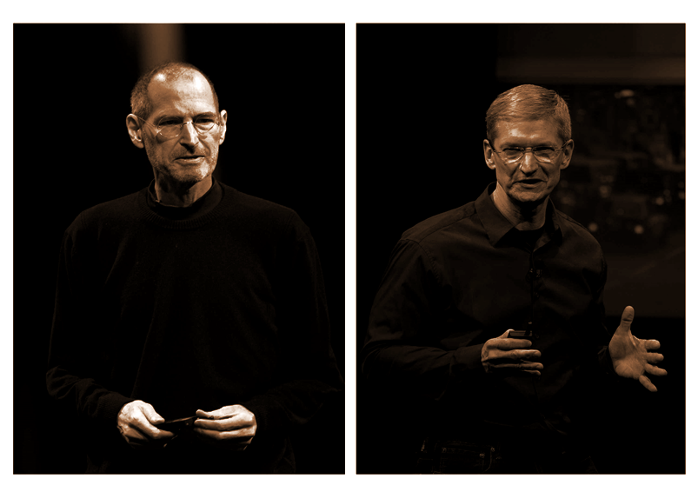
Notes:
Apple is indeed a great company and iphone is a phenomenal but, the reason behind is not all just because of technology advancement or creative advancement. Their success could be Largely track in their business strategy. Which, some is consistent, while some have been greatly emphasized in Job time, a very charismatic and dynamic CEO who already pass away. And his successor, a more of sincere and caring CEO, which took quite a different path.
But first, lets me start with consistent policy first.
High switching cost
One thing to note about Iphone is that, when you get in, you are unlikely to get out. High Price is one thing but, the effect of some certain function that only iphone could provide and no other could be renounced. A function like facetime, icloud or ishare or hundreds of application in istore, certainly won't be available for any android user. It may be possible that other firm may try to come up with another similar apps but, the fact that it came out later will create a cost for consumers, who already familiar with apple, to learn it. Especially if the new apps does not significance better than apple, no one would bother to learn it.
Economies of network
In addition, with more people using apple and less are switching out. This would create an positive externalities for apple, economy of network. Lets use the same apps I mentioned before like facetime. If many of your friends love to use facetime, and lets say that you are current not owning any smart-phone and thinking of buying one. It is quite likely that you would choose an iphone, other thing remain constant. you could see an element there. With more people using some feature, its value increase

Slide 26


Notes:
A CEO in peacetime, is what people seem to describe Tim. His policy is shifting so much from Job. Apple is no longer an underdog that on the edge of Bankruptcy but the most profitable firm in the world. Their product no longer dynamic and seem to stick on developing their hardware. Improve their camera, screen resolution and longer battery life. They also engaging in product proliferation, iPhone 5c and iPhone 6S. Which is indeed came-out to directly compete with Samsung, a company that is now has the highest market share, which is famous for cheaper and bigger product. This is in a way can be a good idea since Apple already well-established brand in consumers idea. The result is already visualized in some sense as the market share of iphone still keep going but, whether or not this is really a sustainability policy remain doubtful.

Slide 27
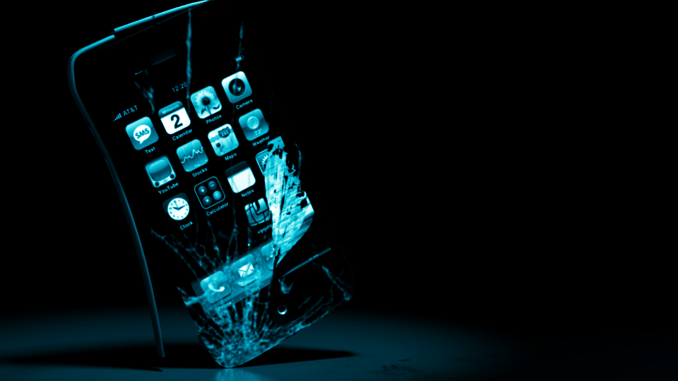
Future of iphone and apple
Notes:
Future
And this is why a future ahead of iphone and apple is still pretty much doubtful. However, lets say if cook still continue with what he has been doing. We would expected to see new iphone with larger display, faster processor, longer battery and slightly ‘variety of product’ in same generation. Sale of iphone would still continue to grow over-time if other thing remain constant. The situation will looks pretty much like in 2007 where Apple dominate the market instead of Nokia. However, this imply that apple will now play the role of Nokia and leave a space for someone, some company, that might come-up with a very bright, innovate and thus very differentiate product and become the new job and new apple. Which seem to be the case from time to time in this industry. We personally dont think such a thing call ‘peacetime’ exist in the world of technology and entrepreneur. And history has prove to us that, no one is too big to fail.

Slide 28
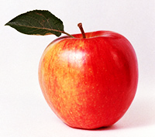
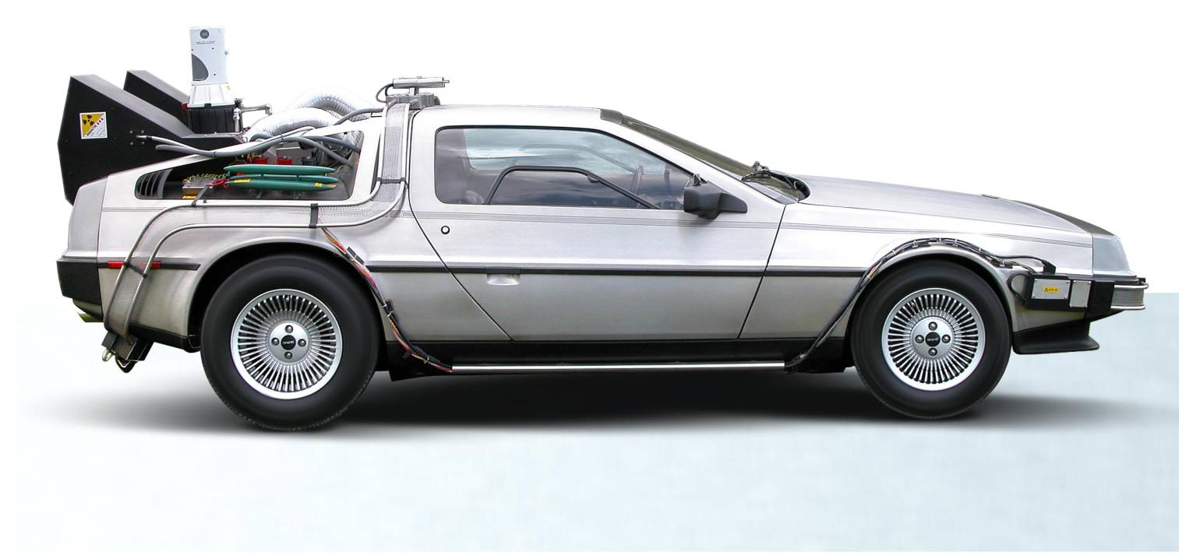
Apple in the future
Continuity strategy
It is the strategy that make all of your Apple devices can be connected. They will look alike in term of operating system and usability except the shape and the size of the devices which depends on your preferences.
Notes:
In fact, Apple could do some strategy and some new product that attract more user for example.
1. Continuity strategy
In reality, we have at least three primary screens we use almost every day such as TV, computer and a smart phone. Imagine if all of your screens can work together, how would your life be? It would be much easier right? It can be seen that some iphone users cannot efficiently use mc book although they are from the same company but they are not exactly identical and that is the positive opportunity for Apple to attract more user and gain more profit. If Apple’s strategy is fully realized, it would mean that every one that use Apple devices will look and act alike, they all can be synced, it is like if you update the data on your iphone, it would be automatically link to your mcbook. If I get a new device from the apple, I don’t have to learn anything new. So, people would get more familiar with this brand and it is difficult to change them.

Slide 29
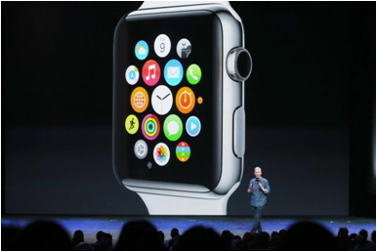
1
iWatch
- iWatch is designed to be the remote control of everything around you. It is expected to release in the beginning of next year, let’s see how would it affect to the world of technology.
Notes:
1. iWatch
secondly, it is the new product that apple is going to present called iWatch. it has been expected that a key function of the Apple Watch would be to control all things around you such as cars, music players and Apple TVs and credit cards even for the light at your home every devices can be under your command by this iWatch, all of these things can be controlled from your voice and your action. The watch becomes the center of the Apple.
However, according to the official apple, it is going to release on the beginning of next year, we could see how can it work so far, how would it can push the world forward?

Slide 30
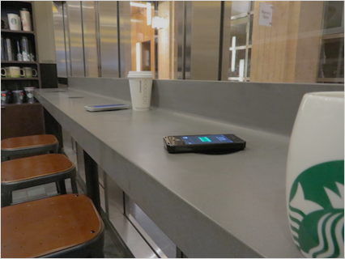
Wi-Fi charger
It has always been the question for every devices that how long the battery will last ?

