Slide 1
Multicultural Personnel Management
There is Nothing Good or Bad About Culture. There are Only Differences …

Slide 2
Describing Global Diversity
Human diversity has been popularly understood to refer to differences of color, ethnic origin, gender, sexual or religious preferences, age, and disabilities.
Having said that…
Organizational diversity recognize a wider range of characteristics:
«race, gender, age, physical ability, physical appearance, nationality, cultural heritage, personal background, functional experience, position in the organization, mental and physical challenges, family responsibilities, sexual orientation, military experience, educational background, style differences, economic status, thinking patterns, political background, style differences, economic status, political backgrounds, IQ level, smoking preference, marital status, religion, white collar, language, blue collar, weight and height»

Slide 3
Managing Workplace Diversity
Managing multicultural teams = diversity of practices based on: contexts (legal, historical, political)
How different types of organizations are considering diversity (strategic challenge or not)
Discussions:
  the discourse on diversity
  the dilemma between assimilation and cultural pluralism*
  *is a term used when smaller groups within a larger society maintain their unique cultural identities

Slide 4
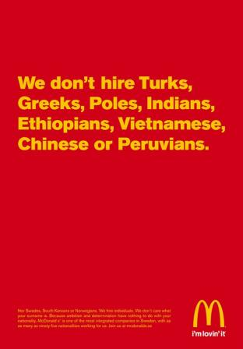
Diversity- as a Positive Speech
  Improving organizational efficiency and competitive capacity
  Recruitment and retention of top talent
  Capital image and likability (customers prefer organizations that promote diversity + better access to national and international ethnic markets)
  This is what McDonalds is trying to build with the advertisement below:
  « We don’t hire Turks, Greeks, Poles, Indians, Ethiopians, Vietnamese, Chinese or Peruvians...
  Nor Swedes, South Koreans or Norwegians. We hire individuals. We don’t care what your surname is… »

Slide 5

Diversity- as a Positive Speech
Charter of Values, which prohibits the wearing of conspicuous religious symbols has caused concern in hospitals.
The unions claim that in times of shortage, hospitals can not afford to lose a single nurse. At the same time, the Ontario Lakeridge Health diffuses Montreal unequivocal advertising for health professionals:
«We don't care what's on your head, we care what's in it».

Slide 6
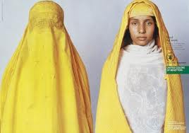
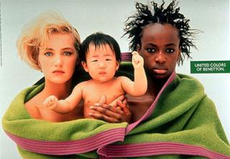
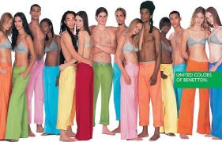
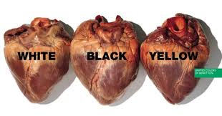
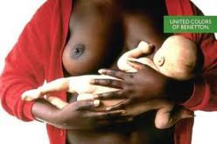
Diversity- as a Positive Speech
Benetton advertisements created by
Olivier Toscani

Slide 7
Diversity- as a Positive Speech
Diversity-holistically = the varied perspectives and approaches to work that members and different identity groups brings.
Results:
Better efficiency- multicultural teams more creative and innovative, enhance the mixing of ideas multitude of perspectives to identify different aspects of a problem
Organizations that value innovation- better manage multicultural staff
The lack of diversity management gives free rein to stereotypes, prejudices and misunderstandings and create bad working climate
Diversity management improves motivation and commitment at work

Slide 8
  The Dilemma Between:
  Assimilation & Cultural Pluralism
Assimilation: suppression of differences = resentment, frustration on the part of minorities
Pluralism: acceptance, appreciation and respect for difference, respect for the rights and ethno cultural diversity (tensions)
  rejects assimilation
  promotes economic and social integration of immigrants
  invite to combat all forms of discrimination and racism
  advocates practices of accommodation that respects the integration of persons
Notes:
Ainsi, on parlera de « soft power » des Etats-Unis, qui diffusent en effet leur civilisation sur le seul moyen de leur capacité d’influence : grâce à l’admiration que leur vouent les autres nations, l’exportation de leur culture est rendue facilitée et même abondamment réclamée. De fait ,les Etats-Unis sont devenus en moins d’un siècle le pays le plus influent au monde ,via l’American Way of Life ,la langue nationale -l’anglais -la plus utilisée dans bon nombres de secteurs ,la culture ou l’Entertainment américain, production et consommation culturelle de masse :ainsi la musique ;on citera Elvis Presley ,The Rolling Stones ,et le cinéma :Steven Spielberg ,Martin Scorsese ,Francis Ford Coppola ,ou des acteurs ,tels que Marilyn Monroe , Robert de Nioro ou Elizabeth Taylor ,culture largement consommée en Occident ,de grandes marques d’innovations (Apple ,Microsoft),un pôle d’attraction ,la Silicon Valley en Californie ,pour les « cerveaux » du monde entier, qui ont des retombées économiques énormes & favorables sur les USA.

Slide 9
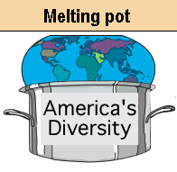

The Dilemma Between:
Assimilation & Cultural Pluralism
US- «melting pot» to «salads bowl»
«As a salad, the United States are made of different ingredients of peoples and cultures. Although mixed, these ingredients remain separate. And, as each component in a bowl has a special flavor, each cultural contribution adds to the variety and diversity of American life.»

Slide 10
Diversity May Not Deliver The Promised Improvements Right Away…
Requirements:
A fundamental culture change
New set of attitudes from all
New leadership approaches
That go way beyong diversity intake:
Fair treatment for all
Niche specialization
Celebrated diversity

Slide 11
Prevailing Thought Like…
Managing diversity means only:
Hiring
Retaining from traditionally underrepresented groups
Typical organizational response:
Expect everybody blend in, assimilate
Assign people to jobs that relate to their backgrounds
Both of these approaches are:
Limited
Limiting
Have high potential of detrimental results

Slide 12
1. Discrimination & Fairness Paradigm
Fair treatment for everyone
Restructure the HR division to resemble the society
Institute mentoring
Career development assistance
  For minorities & Women
Result:
Staff gets diversified, works remains the same…
Assimilation

Slide 13
Common Firm Characteristics Under The Fairness Paradigm
Leaders work/due process and fairness values
Top down diversity initiatives
Procedures for fair measurement and reward for individual contributions
Strong cultures work/fairness value
Bureaucratic systems to enforce fairness policies

Slide 14
Advantages & Limitations of The Fairness Paradigm
Advantages:
Increase demographic diversity
Promotes fair & equitable treatment
Limitations:
Assumes that «we’re all the same»
Mind set: diversity should not influence the work and work culture
Important differences do not count in the workplace
Firm does not develop the capacity to learn from it’s diverse workforce
Low motivation
Assimilation is the main virtue when it’s not realistic

Slide 15
2. Access & Legitimacy Paradigm
Identity groups have consumer and purchasing power
Diversity in HR will:
  Help understanding the market better
  Serve the target market much better
  Help gain legitimacy with the market segment(s)
  Shown that diversity is not just faire but it’s a business necessity
  Lead to new professional and managerial opportunities for women and minorities
  Differentiation

Slide 16
Strengths of the Access & Legitimacy Paradigm
Provides a market based motivation for diversity management
Easier for the entire firm to:
  Understand
  Justify
  Accept
  The necessity for hiring, retaining and managing well a diverse workforce

Slide 17
Limitations of the Access & Legitimacy Paradigm
Push staff to niche capabilities
Niche specialist may feel used/exploited
Hired staff to diversity segments based on ethnicity or gender
The firm don’t learn:
What makes a specialist successful in target markets
Culturally based skills
How these skills work
How these skills may be integrated into core culture/work

Slide 18
3. Learning & Effectiveness Paradigm
Learn the varied perspectives and approaches to:
Work, frame task, supervision, communicate, leading, do teamwork, reach goal, design process
  To make the entire organization more effective
  INTEGRATION

Slide 19
3. Emerging paradigm- Integration & Learning Perspective
The insights, skills, and experiences employees have developed as members of various cultural identity groups are potentially valuable resources that the work group can use to rethink its primary tasks and redefine its markets, products, strategies, and business practices in ways that will advance its mission.
This perspective links diversity to work processes-the way people do and experience the work-in a manner that makes diversity a resource for learning and adaptive change.

Slide 20
Emerging paradigm- Integration & Learning Perspective
In contrast to both paradigms, it organized itself around the theme of INTEGRATION
Promotes equal opportunity for all individuals
Acknowledges cultural differences among employees so that it learns and grows
Inclusion of diversity in the evolution of the organization
Incorporate cultural skills of employees "to rethink its first tasks and redefine its markets, products, strategies and business practices"
Opposition views = opportunity and learning occasion
We are all on the same TEAM, with our differences, NOT despite them..
Source: Thomas, D.A and Ely, R.J(1996). Making Differences matter. A new paradigm for managing diversity. Harvard Business Review. p 1-13

Slide 21
Characterization of perspective | Integration-and-learning | Access-and-legitimacy | Discrimination and -fairness
Rationale for diversifying | To inform and enhance core work and work processes | To gain access to and legitimacy with diverse markets and clients | To ensure justice and equality and eliminate discrimination
Value of cultural identity | High; a resource for learning, change, and renewal; should integrate cultural differences into core work and work processes as appropriate | Moderate; a resource only at the interface between organization and markets, clients; should differentiate to gain access and legitimacy; otherwise assimilate to dominant white culture | Low; it is a basis for unjust discrimination; should assimilate to dominant white culture
Connection between cultural diversity and work | Direct; incorporated throughout the work | Indirect; race-based division of labor to enhance access and legitimacy | Limited; norms against a connection
Indicators of progress | Increased representation of traditionally underrepresented groups that have power to change organization; process and product innovation; shared sense that cultural diversity is resource for learning | Increased representation of traditionally under- represented groups, especially in boundary or visible positions | Increased representation of traditionally underrepresented groups

Slide 22
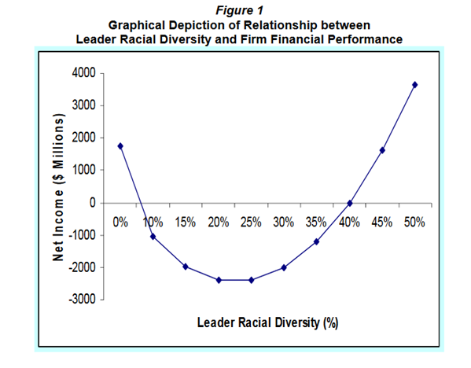
Diversity & Globalization
(6:32 min until the end): https://www.youtube.com/watch?v=Q-K_bYQ11DE

Slide 23

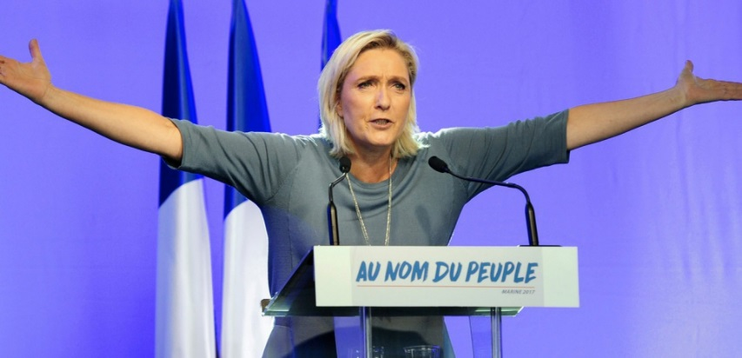
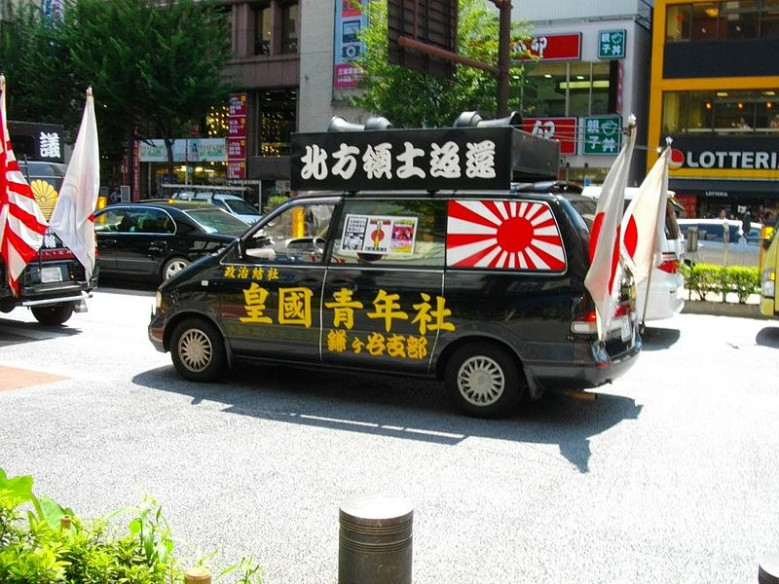

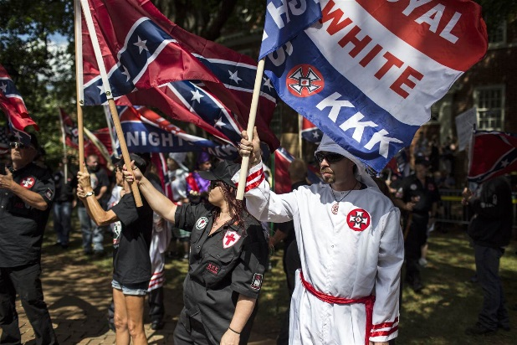
Global Diversity is Happening… No Matter What These Guys Have to Say

Slide 24
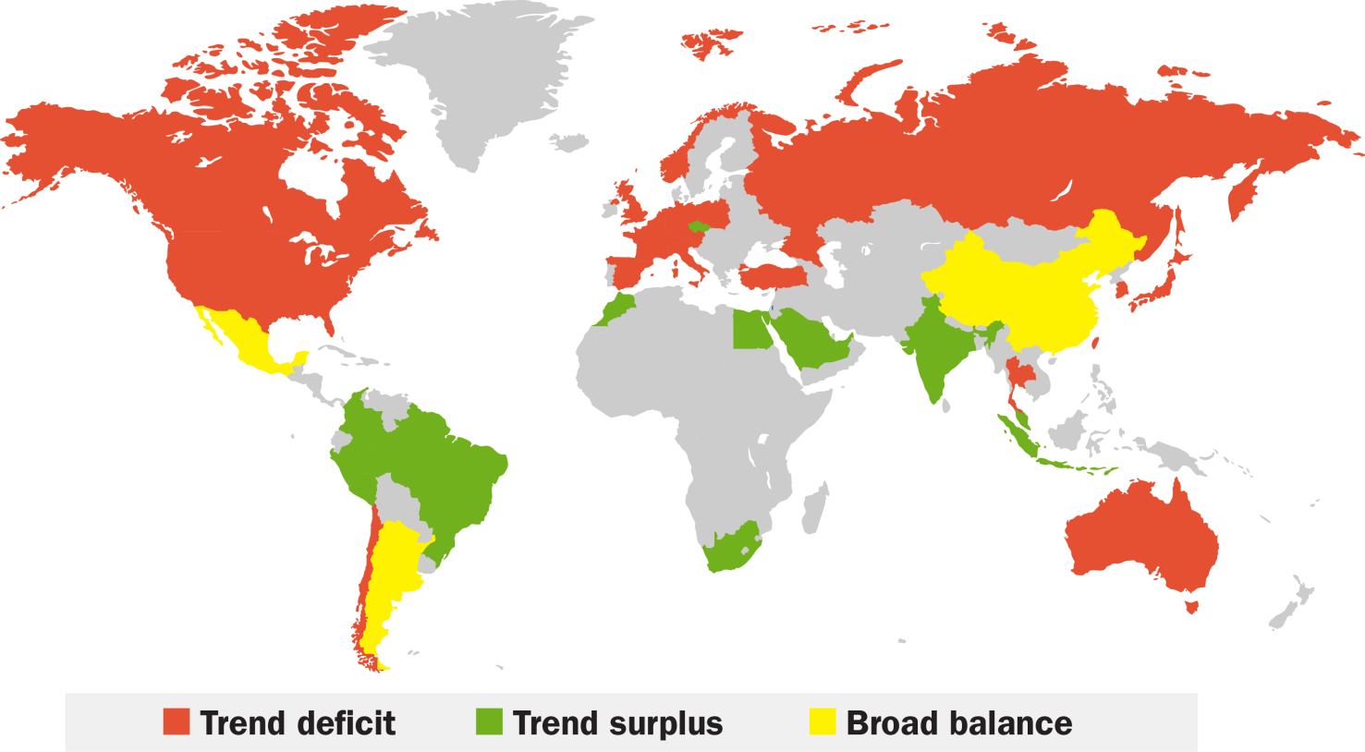
Talent Shortages in 2021: Not Pretty for Mature Markets
Source: Oxford Economics

Slide 25
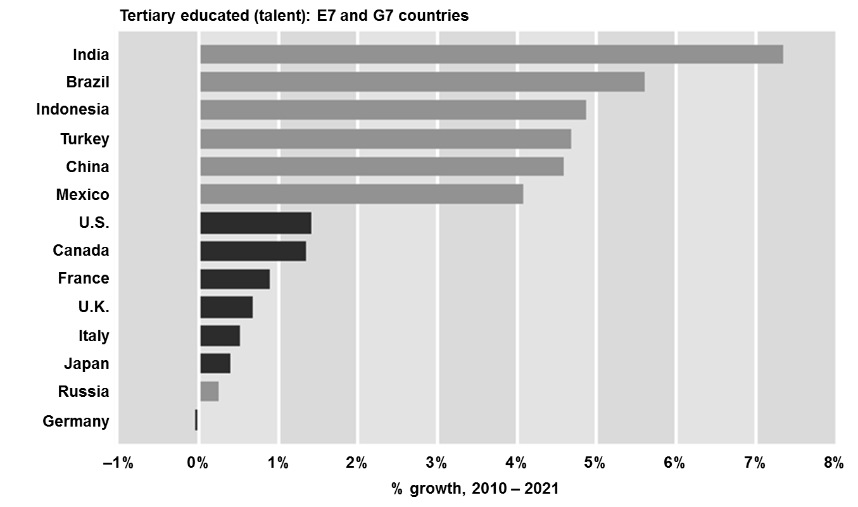
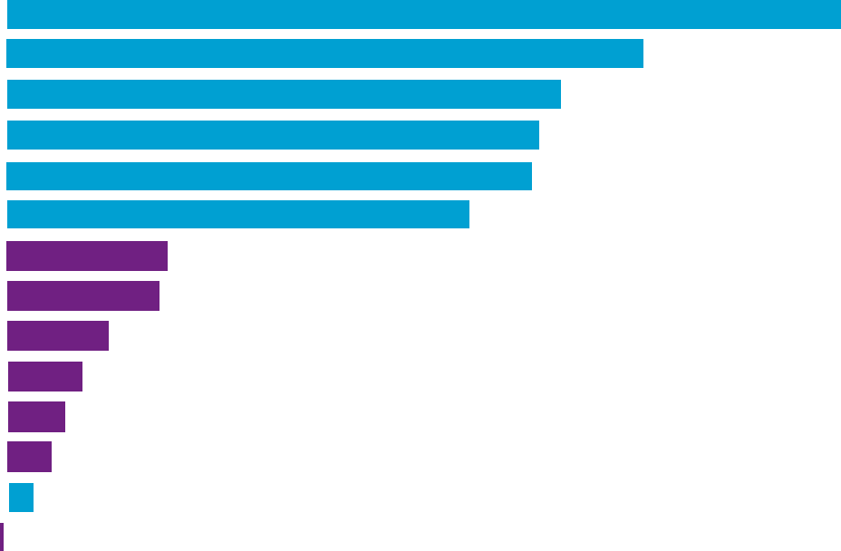
Already, More College Graduates are Coming out of the Emerging Markets than the G7 countries
Source: Oxford Economics

Slide 26
Diversity at Work Makes More Money for Companies
Marketing: – Having a diverse workforce builds trust in your brand with a diverse target market.
Operations – Valuing diversity cuts costs by reducing turnover and absenteeism.
Innovation – Diversity within a product development team is very powerful. When it's in sync with diverse target markets, the team creates new products that satisfy the markets' needs.
Source: Cultural Diversity in the Work Place, 2017 by Kimberly Amadeo
https://www.thebalance.com/cultural-diversity-3306201

Slide 27

What do you Think?
A man in his 60s works with a team of colleagues
in their 20s and 30s. The team, including the manager,
often go out socialising but don’t ask the older man along.
He finds out that they discuss work issues during these outings, and he feels left out.
Is this discrimination?
Answer: Yes, as the man is being unfairly excluded from discussions about work because of his age. The manager should find other opportunities to discuss work issues with the whole team, during working hours.

Slide 28
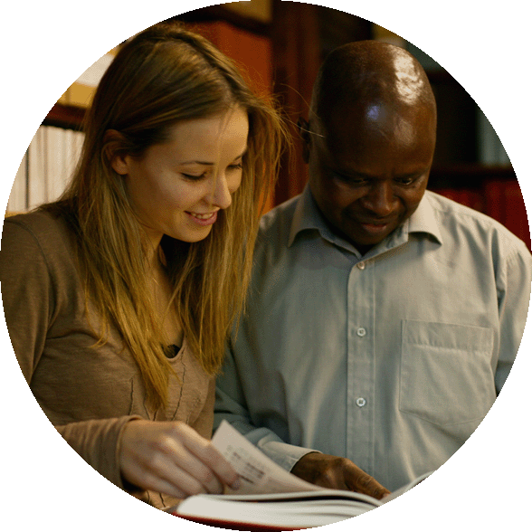
What do you Think?
A woman applies for a job with a catering firm.
She is turned down, on the grounds that the company
is only hiring people who have a formal catering qualification. Afterwards, she finds out that a friend who has no qualifications but has a different skin colour, and was interviewed after her,
has been offered the job.
Is this discrimination?
Answer: Probably yes. Discrimination on the grounds of race or ethnic origin is illegal throughout the EU, including in employment. The circumstances suggest there is a case to answer here. It would be up to the employer to prove otherwise.

Slide 29

What do you Think?
A young woman works for an IT company.
She takes on more and more responsibility but her
manager refuses to promote her, as he says she is too young and would not command the respect of other members of the team.
Is this discrimination?
Answer: Yes, because he has clearly stated that her age is
the reason for refusing her promotion. Discrimination at work
on the grounds of age is illegal throughout the EU. If the woman
is able to take on more responsibility, she should be promoted regardless of her age.

Slide 30

What do you Think?
A man works at a bar. His colleagues perceive him
as being gay and constantly make remarks and jokes
about his sexual preferences.
Is this discrimination?
Answer: Yes. Making jokes and derogatory comments at work about somebody’s sexual orientation is unfair and constitutes harassment. This would create an atmosphere in which the man would find it difficult to work effectively, and might even push
him into resigning from his job. Discrimination on the grounds
of somebody’s sexual orientation is illegal throughout the EU, under the Employment Equality Directive.

Slide 31
In Conclusion
People who are part of the minority culture do not want to be tolerated. Neither do other employees. They want to be valued. If they are valued, they can be more effective.
When power is shared, people are able to devote tremendous energy to the work at hand.
Human beings are the most important asset in any organization. They are the only sustainable competitive advantage for the future.

Slide 32
In Conclusion
There is no simple model for cross-cultural and diversity training. However, it should address the specific needs of the organization’s employees. Prewritten generic training programs are generally ineffective.
Diversity initiatives should focus on information, management, process and results.
Diversity initiatives are not a replacement for Equal employment opportunity.

