Slide 1
Early Rattanakosin Period
Politics and Trade
Thorn Pitidol
Thai Economic History
1/2018

Slide 2
Topics
Early Rattanakosin (Rama I – Bowring Treaty)
  Overview
  Trade and taxes
  The development of markets and the middle class in early Rattanakosin: perspective from Nidhi’s pakgai-bairua

Slide 3
From previous lecture
Ayudhaya's system was about managing
  Trade
  Scarcity of labour
  Extraction of production and labour
Thonburi's continued the challenges, and the challenges continued to early Rattanakosin

Slide 4
Early Rattanakosin: overview
Continuing challenges
  Rebuilding the state and society
  Overcoming the scarcity of labour
  Reviving trade
Factors transforming the challenges

Slide 5
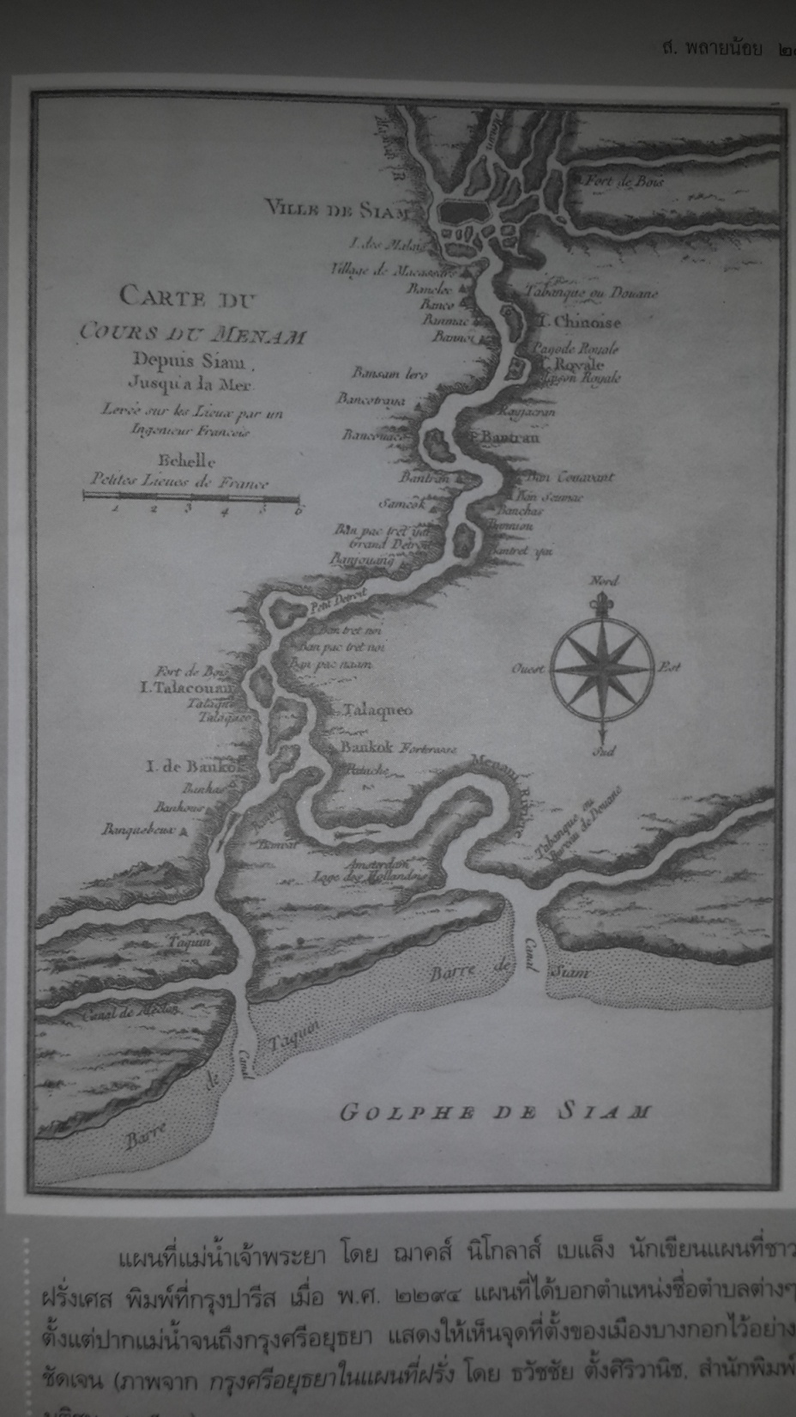

Slide 6
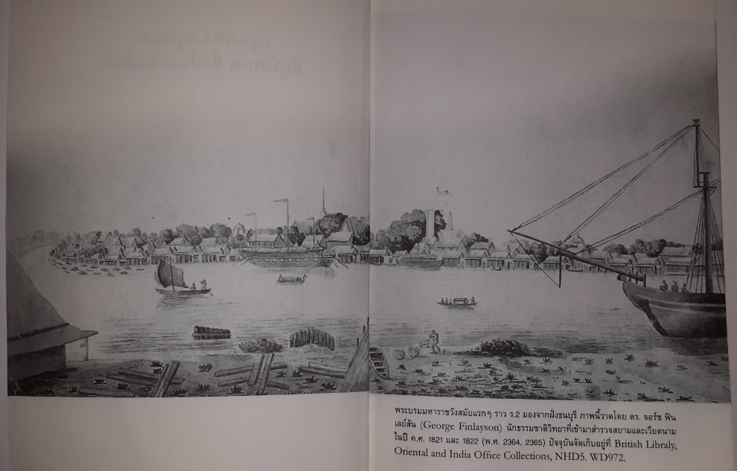
Early Rattanakosin

Slide 7
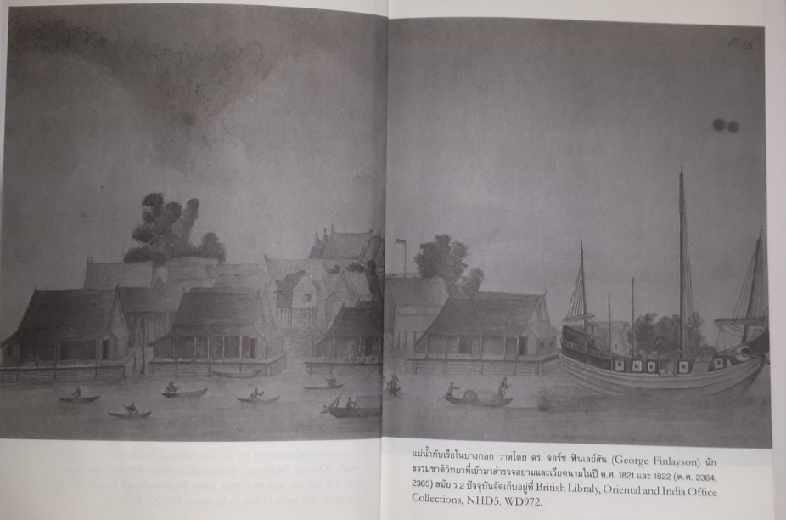
Early Rattanakosin

Slide 8
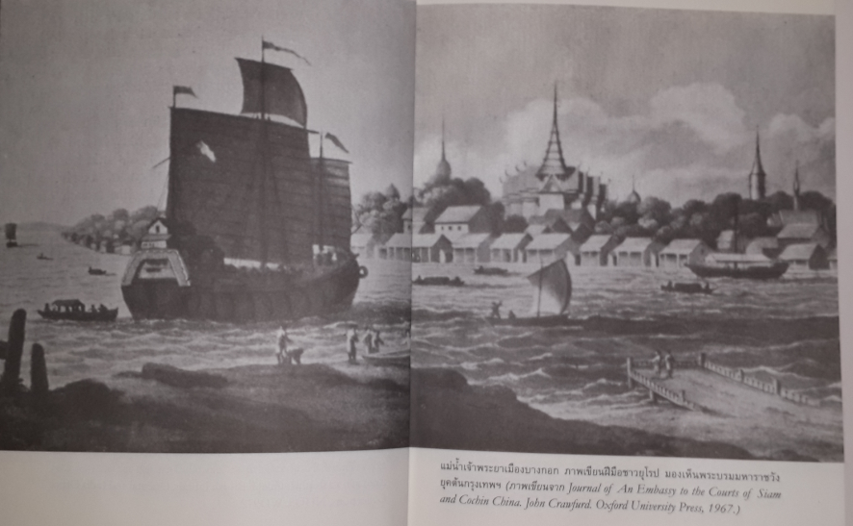
Early Rattanakosin

Slide 9
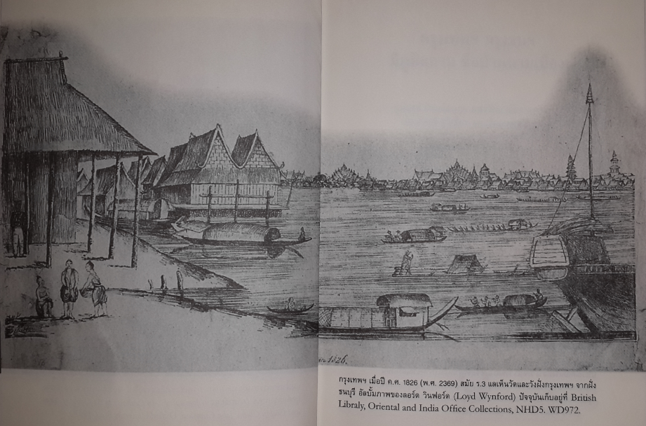
Early Rattanakosin

Slide 10
Early Rattanakosin
Rebuilding the state and society
Early Rattanakosin condition
  This enabled the elites to gather for rebuilding
But this would happen until the changing nature of trade and domestic economy obliged them to change.

Slide 11
Early Rattanakosin
Overcoming the scarcity of labour
Wars caused severe scarcity of labour, and the ruling system of early Rattanakosin had to adapt
  What were the method of responding to the scarcity of labour?

Slide 12
Early Rattanakosin
Reviving trade
The revival of international trade was mostly with "China".
  Shifted among European traders
  New control over Northeast
  The boom in Junk trade (การค้าด้วยเรือสำเภา) between Thailand and China.

Slide 13
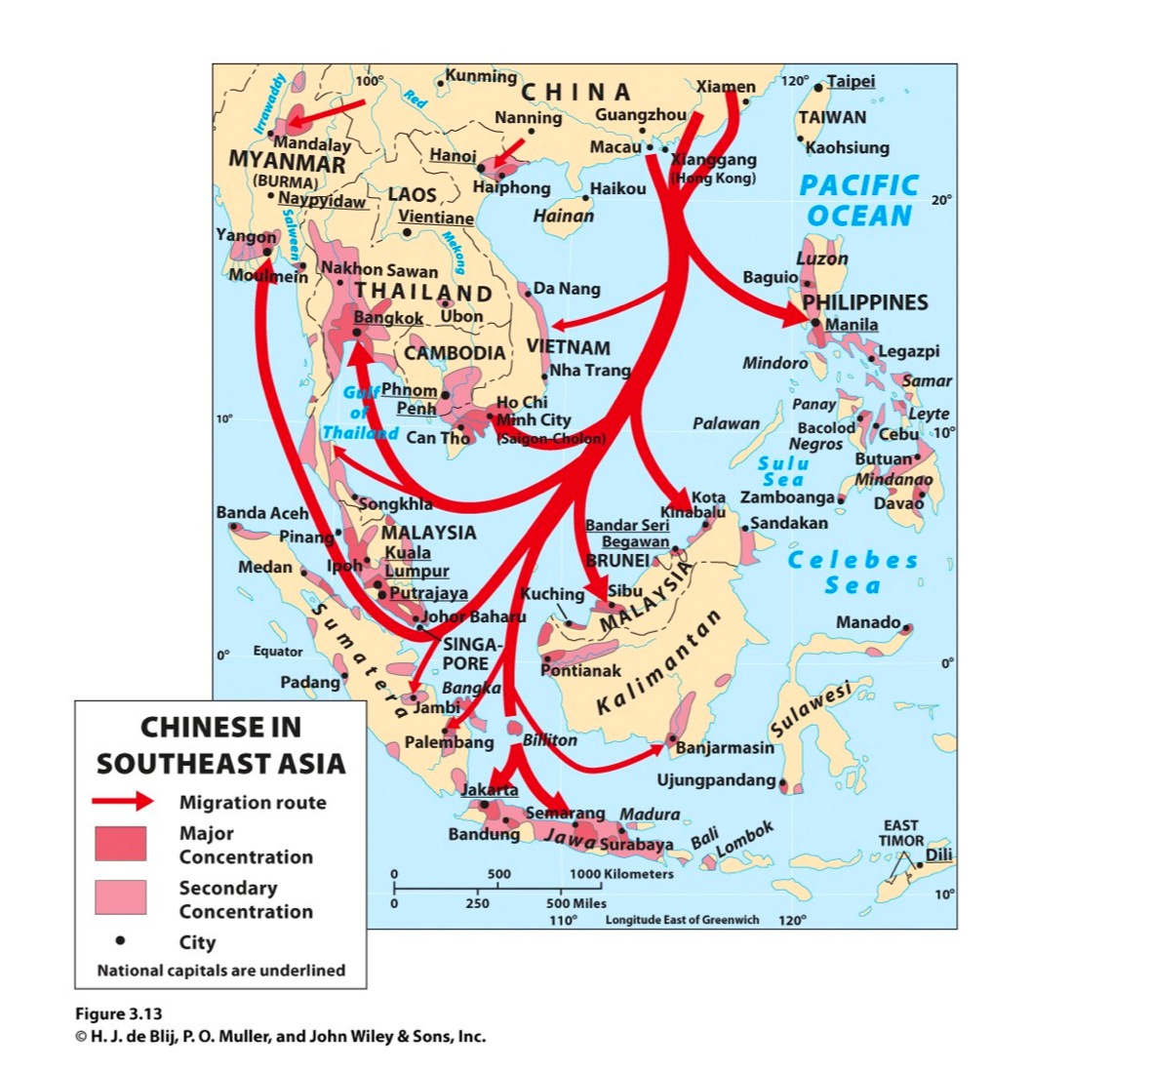
Early Rattanakosin
Factors for Transformation: Inflow of Chinese
Accommodation of the Chinese as the solution for trade and labour shortage.

Slide 14
Early Rattanakosin
Factors for Transformation: Inflow of Chinese
The Chinese’s situation
  Relations to Sakdina system
  The settlements
  The new skills of production
  The domestic trade

Slide 15
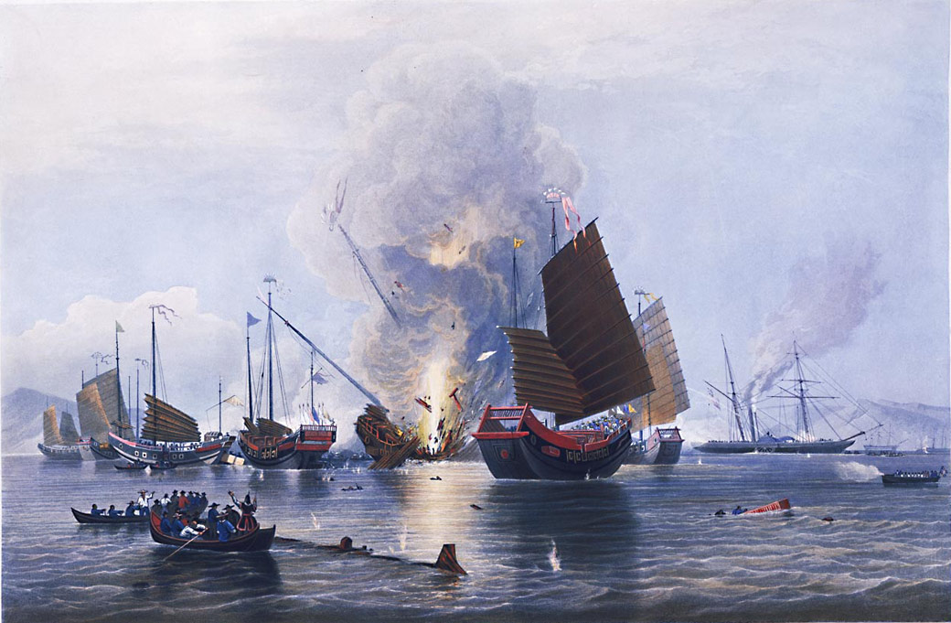
Early Rattanakosin
Factors for Transformation: Changing Economy
The change in global trade under Western imperialism

Slide 16
Early Rattanakosin: Trade and Taxes

Slide 17
Early Rattanakosin
Trade and taxes
Bangkok’s economic development and the Chinese.
  Accounts in Rama II: Chinese outnumbered Siam by 2:1 ratio.
  The assimilation process was an aspect of the success.
The nobles of early Rattanakosin tried to reap benefits from the expansion of Chinese trade.

Slide 18
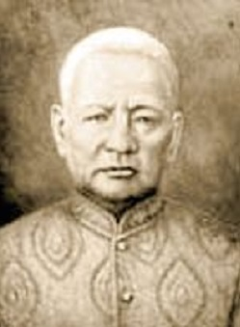
Early Rattanakosin
Trade and taxes
Landscape of Wealth
  Among 82 Siamese owned ships operating out of BKK, King owned 9, Nobles 25, Chinese 48
The Bunnag family dominated Phra Klang.
Dit Bunnag (เจ้าพระยาคลัง - สมเด็จเจ้าพระยาบรมมหาประยุรวงศ์): the largest operator in the private junk trade.

Slide 19
Early Rattanakosin
The rise of tax-collectors
Changing pattern of extraction
  Extraction from labour VS production.
  The collection of taxes no longer had to be "in-kind".
  Tax-farming became the new source of income for the king, the nobles, and the Chinese.
Chinese merchants facilitated tax collections

Slide 20
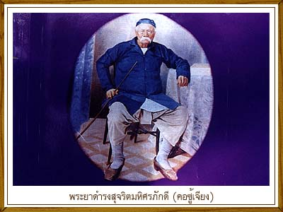
Early Rattanakosin
The rise of tax-collectors
“Nai-akorn” (tax-farmer).
  Khaw Soo Cheang, a Hokkien, were tax farmer for tin in Ranong, Chomporn, and Krabi. He became governor of Ranong in 1854. His family members became governors of many other Southern provinces.

Slide 21
Early Rattanakosin
The rise of tax-collectors
The nobles also turned toward tax-farming.
  Controlling Phra-Klang, Bunnag family controlled 31 tax-farms. From 1850s, they secured sugar tax-farms in Petchaburi, and moved to settle there as the base of their power.
How did tax-farming change the nature of production and accumulation?
Reaction from the King

Slide 22
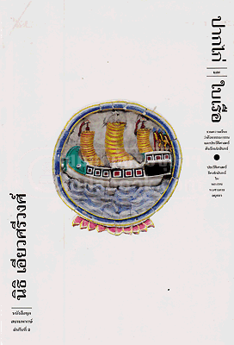
Development of markets and the middle class in early Rattanakosin:
Perspectives from Nidhi’s pakgai-bairua

Slide 23
Changing nature of trade
Ayudhaya's trade
Ayudhaya’s trade → "passing through" trade.
  Ayudhaya as “entrepot”
Kings of Ayudhaya’s monopolized trade and own junks
  Extraction was done mainly on "trade" and not on "production".
The limited impact of the trade pattern of Ayudhaya

Slide 24
Changing nature of trade
Rattanakosin's trade
Changing trade in early Rattanakosin
  Chakri dynasty as traders
  Chakri dynasty and nobles
Impact on trade activities
  King did not have a reason to prevent nobles from trade.

Slide 25
Changing nature of trade
Rattanakosin's trade
The change in export products
  Forest products became less important, replaced by agricultural products such as rice and sugar
Crucial implications on the nature of extraction
  Decline in importance of Royal monopoly
  Shifting way of gaining extractions (taxation)
  Support toward free-trade

Slide 26
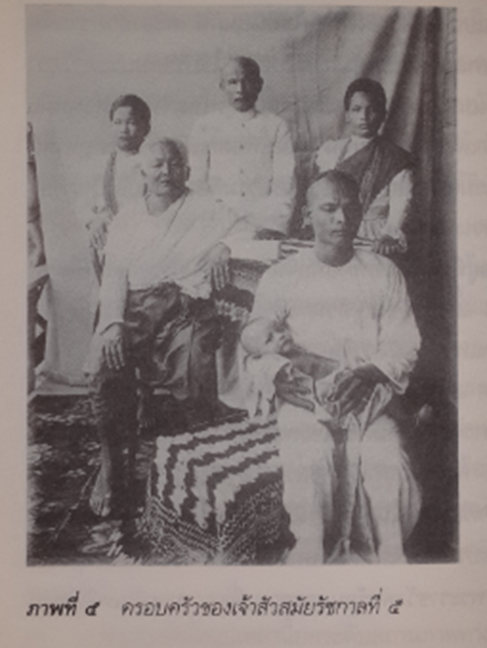
Markets in early Rattanakosin
Merchants
Two major groups of merchants in early Rattanakosin
  (1) King and nobles
  (2) Chinese with connection to Thai sakdina
Chinese in Siam: drivers of changes

Slide 27
Markets in early Rattanakosin
Chinese migrants
The inflow of Chinese was a crucial factor in the economic changes of early Rattanakosin.
  Characters of Chinese who came to Siam
  Two groups, separated by integration with Sakdina
Chinese as Sakdina’s frontman and protectors

Slide 28
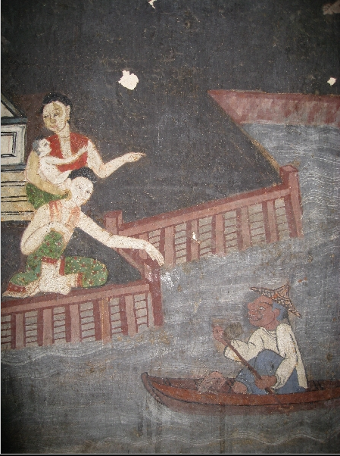
Markets in early Rattanakosin
Siam and Chinese
เหตุการณ์จีนตั้วเหียะที่ฉะเชิงเทรา
http://www.matichon.co.th/news_detail.php?newsid=1314615743&grpid=no&

Slide 29
Markets in early Rattanakosin
Chinese migrants
New production activities brought over by the Chinese migrants
  Agricultural production
    Farming of sugar-cane and the production of sugar
    Others: pepper and tobacco, and rice production
  Mining
  Ship-building

Slide 30
Markets in early Rattanakosin
Expansion of domestic markets
From subsistency the the expansion of internal trade.
  The role of Chinese traders
    Allowed to travel freely, they distributed necessities such as rice, salt, and textiles. They sold luxury imported product, in exchange for domestic products that can be exported.
  The role of canals

Slide 31
Markets in early Rattanakosin
Expansion of domestic markets
Effects of market expansion
  The effects on the local Thais
  The rising significance in the use of "money"
    Thai elites turned to the use of money to hire Chinese labour. The increased significance of money also allowed new tax system to developed.
The constraints of the expansion

Slide 32
Markets in early Rattanakosin
The emergence of the middle class
Bourgeoisie in the West
Bourgeoisie in early Bangkok
A product of capitalist development.
Developed freely from the elites
Resisted the control from the elites and the monarch
Results of the state's trade policies and the influx of Chinese migrants.
Not independent from the state and the sakdina system
Implications?

Slide 33
Markets in early Rattanakosin
The emergence of the middle class
The impact on the ruling class from the nature of bourgeoisie (Chinese)
  Consumptions
  Production
  Rationality
Impact of Sakdina on the bourgeoisie
  Incentives for capital accumulation
  Development of the local craftsmanship

