Slide 1
After Midterm
Monopoly
(Chapter 11: 11.1-11.6)

Slide 2
Monopoly
Definition: A Monopoly Market consists of a single seller facing many buyers.
The monopolist's profit maximization problem:
Max π(Q) = TR(Q) - TC(Q)
where: TR(Q) = QP(Q) and
P(Q) is the (inverse) market demand curve.
The monopolist's profit maximization condition:
ΔTR(Q)/ΔQ = ΔTC(Q)/ΔQ OR MR(Q) = MC(Q)

Slide 3
Monopoly vs Perfect Competition
In perfect competition, there are infinitely many buyers and sellers, selling homogeneous products.
As a result, perfectly competitive firms are price takers: they take price as given, and face a perfectly elastic demand curve.
In contrast, a monopolist is a price maker. It sets the market price to maximize its profit.
However, we often state the monopolist’s profit maximization problem in terms of setting quantity rather than price.
This is because TR(Q) and TC(Q) are functions of Quantity.

Slide 4
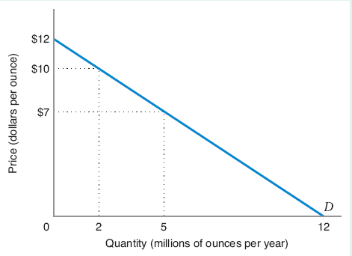
Profit Maximization by a Monopolist
The Monopolist’s Demand Curve is downward-sloping:
the higher P, the lower Q, and vice versa.
Along the demand curve, different revenues for different quantities
Profit maximization problem is the optimal trade-off between volume (number of units sold) and margin (the differential between price).

Slide 5


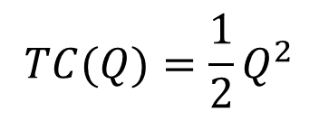
Profit Maximization by a Monopolist
Demand Curve:
Total Revenue:
Total Cost:
Profit-Maximization: MR(Q*) = MC(Q*)
$$P(Q)=12−Q$$
$$TR(Q)=Q×P(Q)=12Q−Q^{2}$$
$$TC(Q)=\frac{1}{2}Q^{2}$$

Slide 6
Profit Maximization by a Monopolist
Given the inverse demand and MC, what is the profit maximizing Q and P for the monopolist?
P = 12 – Q MC = Q MR = 12 – 2Q
Setting MC = MR ; 12 – 2Q = Q
Q* = 4 P* = 12 – 4 = 8

Slide 7
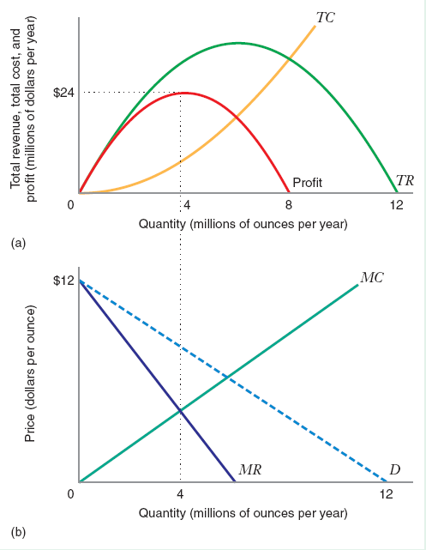
Profit Maximization by a Monopolist

Slide 8
Profit Maximization by a Monopolist
If MR > MC,
If MR < MC,
MR = MC,

Slide 9
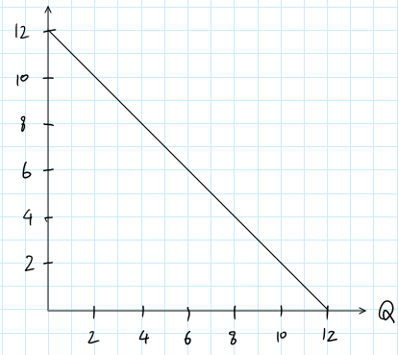
A Closer Look at MR
The extra 3m ounces is called Marginal Units.
The prior 2m ounces is called Inframarginal Units.
To sell more units, a monopolist has to lower the price.
At the lower P, the increase in TR is Area……….
The TR sacrificed is Area………..
∆TR = ……………………..

Slide 10
Marginal Revenue
Area C = price x change in quantity = P*ΔQ
Area B = - quantity x change in price = – ΔP*Q
Change in TR = ∆TR = P*ΔQ – (– ΔP*Q)
So MR =
where ∆P/∆Q = slope of the inverse demand curve.

Slide 11
Marginal Revenue
Marginal revenue has two parts:
P: increase in TR due to higher Q, i.e., the marginal units.
(ΔP/ΔQ)*Q: decrease in TR due to lower P of the inframarginal units.
Since (ΔP/ΔQ)*Q < 0, then MR is less than the price for any Q greater than 0, i.e., MR(Q) lies below P(Q).

Slide 12
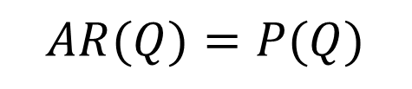
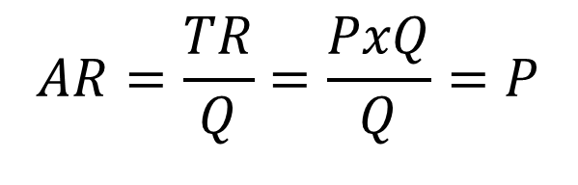
Average Revenue
$$AR=\frac{TR}{Q}=\frac{PxQ}{Q}=P$$
Since
the monopolist’s AR curve coincides with the market inverse demand curve:
$$AR(Q)=P(Q)$$

Slide 13
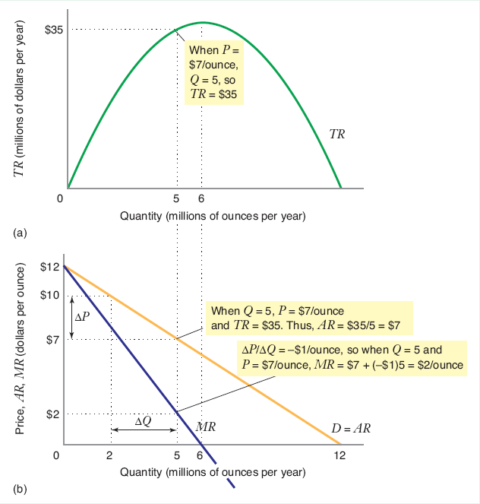
Total, Average, and Marginal Revenue

Slide 14
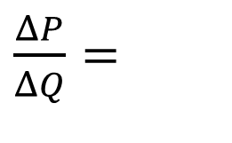
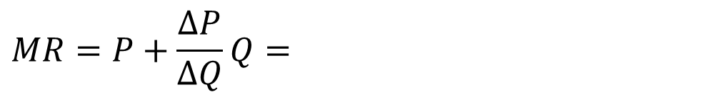
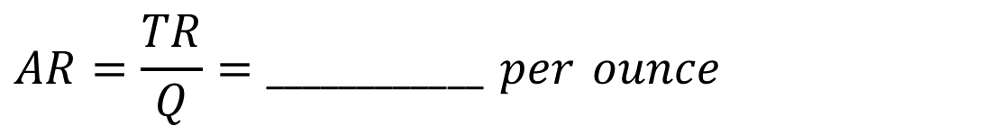
MR and AR
When P decreases by $3 per ounce (from $10 to $7),
Q increases by 3 million ounces (from 2 million to 5 million).
$\frac{ΔP}{ΔQ}=$
$$TR=P×Q=7×5=_____ million per year$$
$$AR=\frac{TR}{Q}=____________ per ounce$$
$$MR=P+\frac{ΔP}{ΔQ}Q=$$

Slide 15
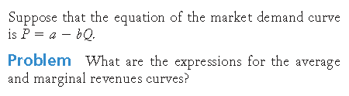

Slide 16
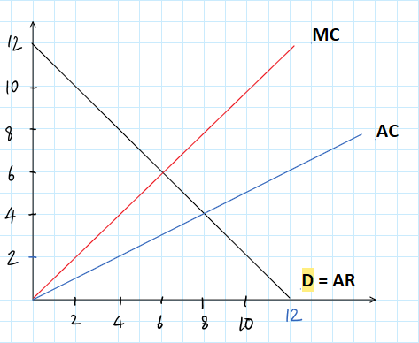
The Monopolist’s Profit Maximization Condition

Slide 17
A monopolist does not have a supply curve
A monopolist does not have a supply curve (i.e., an optimal output for any exogenously-given price) because price is endogenously-determined by demand: the monopolist picks a preferred point on the demand curve.
One could also think of the monopolist choosing output to maximize profits subject to the constraint that price be determined by the demand curve.

Slide 18
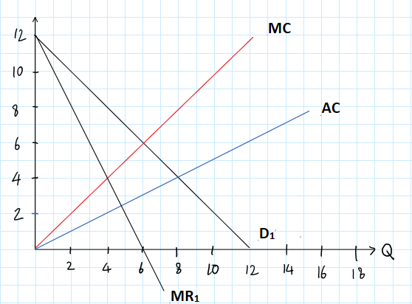
A monopolist does not have a supply curve

Slide 19
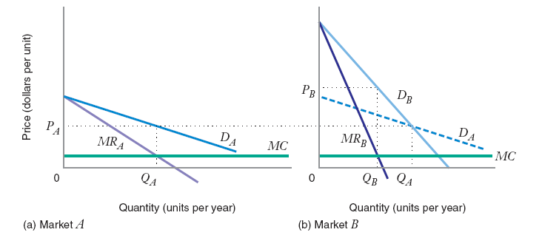
Price Elasticity of Demand and the Profit-Maximizing Price

Slide 20
Marginal Revenue and Price Elasticity of Demand

Slide 21
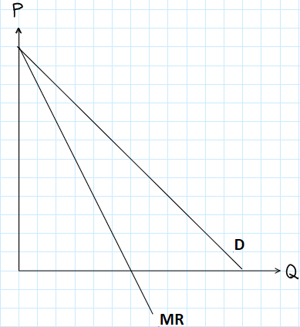
Marginal Revenue and Price Elasticity of Demand

Slide 22
Marginal Revenue and Price Elasticity of Demand

Slide 23
Inverse Elasticity Pricing Rule (IEPR)

Slide 24
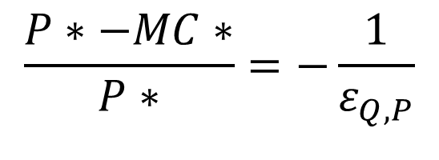
Inverse Elasticity Pricing Rule (IEPR)
Inverse Elasticity Pricing Rule (IEPR)
Monopolist’s optimal markup of price above marginal cost expressed as a percentage of price is equal to minus the inverse of the price elasticity of demand.
IEPR tells us about how much P* the monopolist should charge to maximize profits, given the PED.
The more price elasticity of demand, the smaller will be the optimal markup.
$$\frac{P∗−MC∗}{P∗}=−\frac{1}{ε_{Q,P}}$$

Slide 25
Inverse Elasticity Pricing Rule (IEPR)

Slide 26
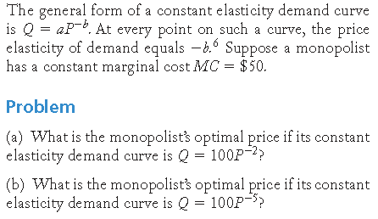
Learning-by-Doing Exercise: Computing the Optimal Monopoly Price for a Constant Elasticity Demand Curve

Slide 28
The Monopolist will only operates
on the elastic region of the demand curve.

Slide 29
The Lerner Index of Market Power
Definition: An agent has Market Power if he can affect the market price.
Sometimes, this is thought of as the degree to which a firm can raise price above marginal cost.
Definition: The Lerner Index of market power is the price-cost margin, (P*-MC)/P*.
This index ranges between 0 (for competitive firms) and 1 (for a monopolist facing a unit-elastic demand).

Slide 30
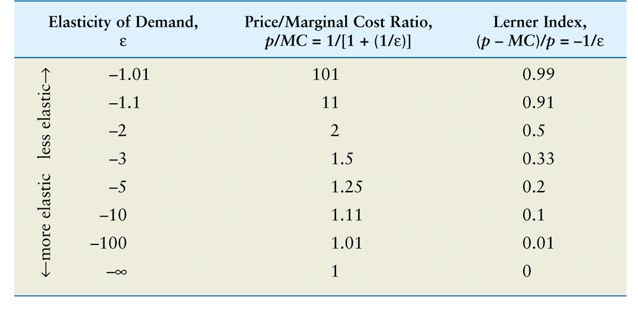
Price Elasticity of Demand, Price, and Marginal Cost

Slide 31
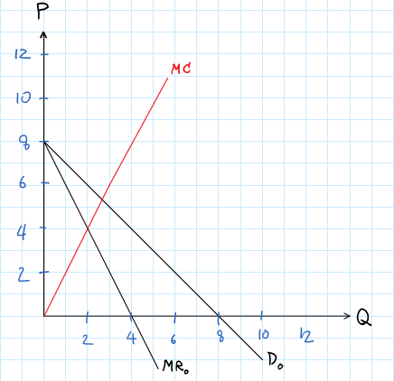
Comparative Statics – Shifts in Demand

Slide 32
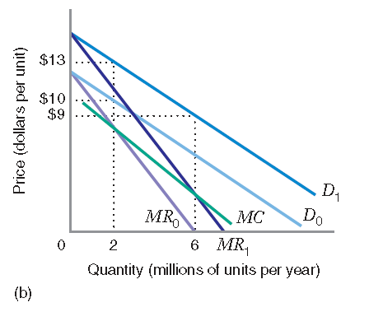
Comparative Statics – Shifts in Demand

Slide 33
The Monopoly Midpoint Rule
For a constant MC, P* is found using the midpoint rule:
P* is halfway between the vertical intercept of the demand curve a (choke price) and vertical intercept of the MC curve c.

Slide 34
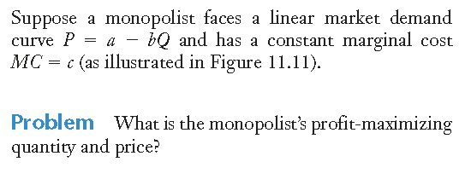
Learning-by-Doing Exercise: Computing the Optimal Price Using the Monopoly Midpoint Rule

Slide 36
Comparative Statics – Shifts in MC

Slide 37
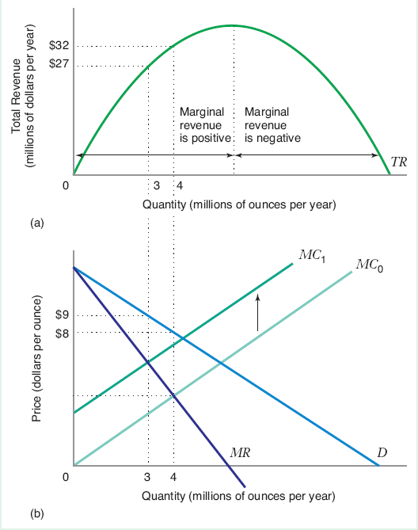
Comparative Statics – Shifts in MC
Upward shift of MC decreases the profit maximizing monopolist’s total revenue.
Downward shift of MC increases the profit maximizing monopolist’s total revenue.

Slide 38
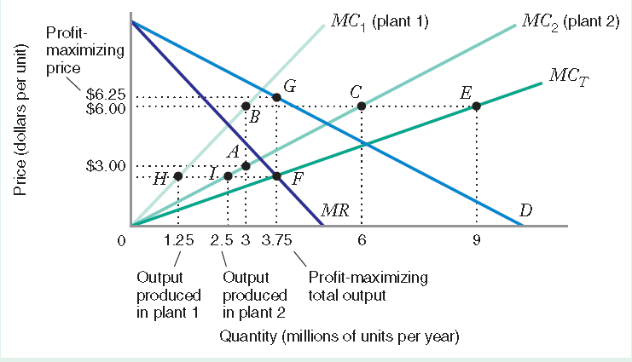
Monopoly with Multiple Plants
Output choices with 2 plants

Slide 39
Monopoly with Two Markets

Slide 40
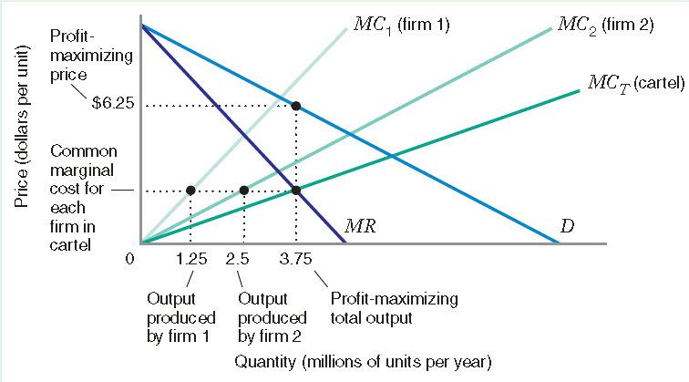
Profit Maximization by Cartel
Cartel A group of producers that collusively determines the price and output in a market.

Slide 42
The Welfare Economies of Monopoly
Since the monopoly equilibrium output does not, in general, correspond to the perfectly competitive equilibrium, it entails a dead-weight loss.
Suppose that we compare a monopolist to a competitive market, where the supply curve of the competitors is equal to the marginal cost curve of the monopolist.

Slide 43
The Welfare Economies of Monopoly

Slide 44
The Welfare Economies of Monopoly

Slide 45
Why does Monopoly exist?
Definition: A market is a natural monopoly if the total cost incurred by a single firm producing output is less than the combined total cost of two or more firms producing this same level of output among them.

Slide 46
Why does Monopoly exist?

Slide 47
Why does Monopoly exist?
Definition: Barriers to Entry are factors that allow an incumbent firm to earn positive economic profits while making it unprofitable for newcomers to enter the industry.
  Structural Barriers to Entry – occur when incumbent firms have cost or demand advantages that would make it unattractive for a new firm to enter the industry
  Legal Barriers to Entry – exist when an incumbent firm is legally protected against competition
  Strategic Barriers to Entry – result when an incumbent firm takes explicit steps to deter entry

