Slide 1
Poverty and Inequality in Thailand
Chanin Mephokee
EE460

Slide 2
Issues
Poverty
Inequality
Policies

Slide 3
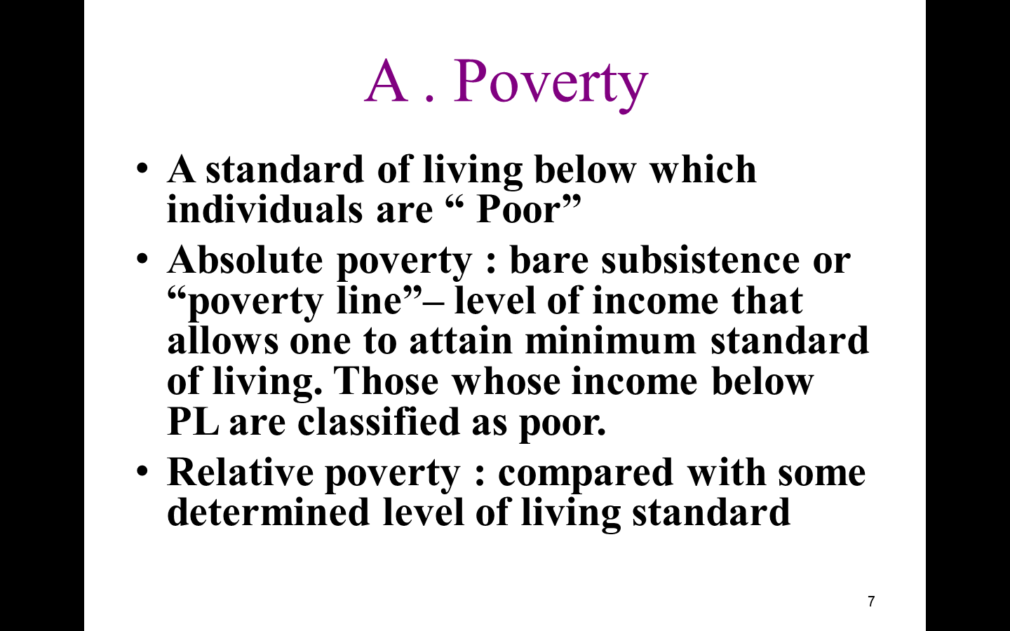

Slide 4
Absolute Poverty
Absolute poverty refers to a set standard which is consistent over time and between countries. An example of an absolute measurement would be the percentage of the population having income less than income required to sustain the human body (2500 calories per day)

Slide 5
Relative Poverty
Relative poverty views poverty as socially defined and dependent on social context. One relative measurement would be to compare the total wealth of the poorest one-third of the population with the total wealth of the rich 1 percent of the population.

Slide 6
World Bank Report
The Word Bank defines the international poverty line as $1.90 a day in 2011.
In 2016, 10 percent of people in the developing world lived at or below $1.90 a day. That is down from 43 percent in 1990 and 52 percent in 1981. In 2016, there was 767 million people are poor.
The global poor are predominantly rural, young, poor educated, employed in agricultural sector, and live in large households with more children.
The rapid decline in poverty can be seen in China, India, and Indonesia.
Since 1990, income inequality between people in the world has been narrow down, but the inequality within country has been widened.

Slide 7
Globalization
Globalization affects wage differentials in positive and negative ways in high-income and low-income country
Globalization affects on increasing in trade, FDI, and labor movement.
Trade openness and composition effects
FDI and technical effects
Labor migration and income effects in home countries and host countries.

Slide 8
Wage Inequality
Trade openness and composition effects
  HICs have CA on high skilled labor intensive
    Higher demand for high-skilled
    Lower demand for low-skilled
  LICs have CA on low-skilled labor intensive.
    Higher demand for low-skilled

Slide 9
Wage inequality
FDI and technical effects
  HICs relocate low-skilled industry to LICs
    Higher demand for low-skilled in LICs
    Lower demand for low-skilled in HICs (American low-skilled labor lost job to Chinese low-skilled)
  Technology spill-over
    higher demand for high-skilled in LICs

Slide 10
Wage inequality
Labor migration and income effects
  High-skilled labor moves to HICs
    Thai scientist moves to the USA
    Less supply of high-skilled in Thailand
    Higher wages for skilled
  Low-skilled labor moves to MICs
    Myanmar labor moves to Thailand
    Higher supply of low-skilled in Thailand
    No minimum wag improvement, no R&D improvement

Slide 11
Policies
1. Brazil raising minimum wage and increasing social safety net program has account for 80% of the decline in inequality.
2. Cambodia diversification from agriculture to light industry created more job opportunity to the poor.
3.Peru closed the wage gap between formal and informal labor and increased participation rate can reduce inequality

Slide 12
World Bank recommendations
Universal health coverage
Universal access to quality education
Rural infrastructure development (road and electricity)
Progressive taxation
Cash transfer poor families

Slide 13
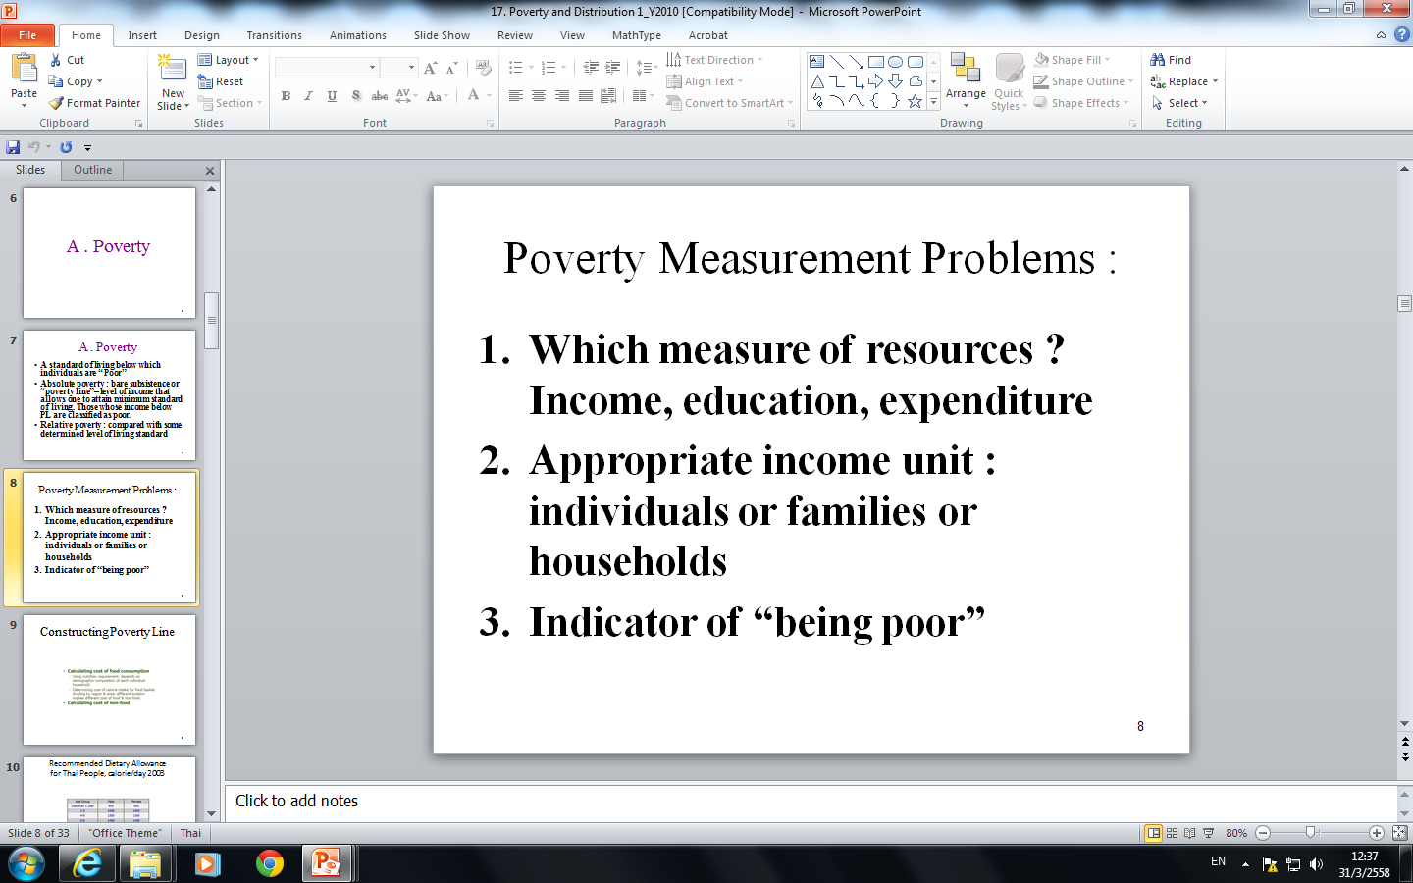

Slide 14
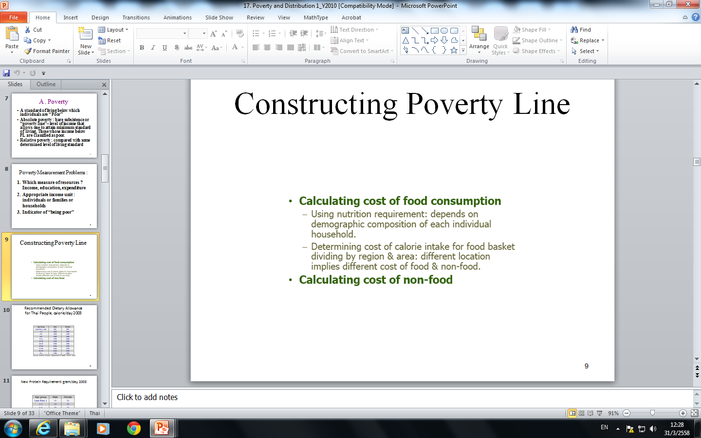

Slide 15
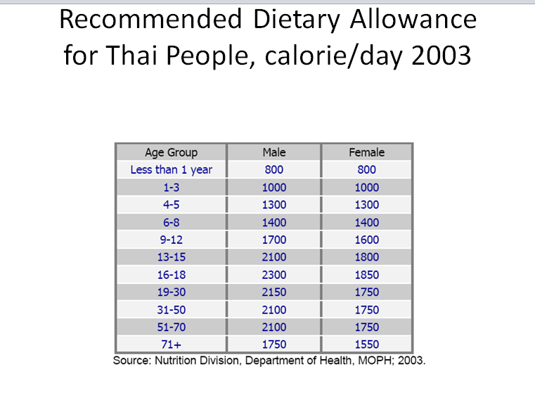

Slide 16
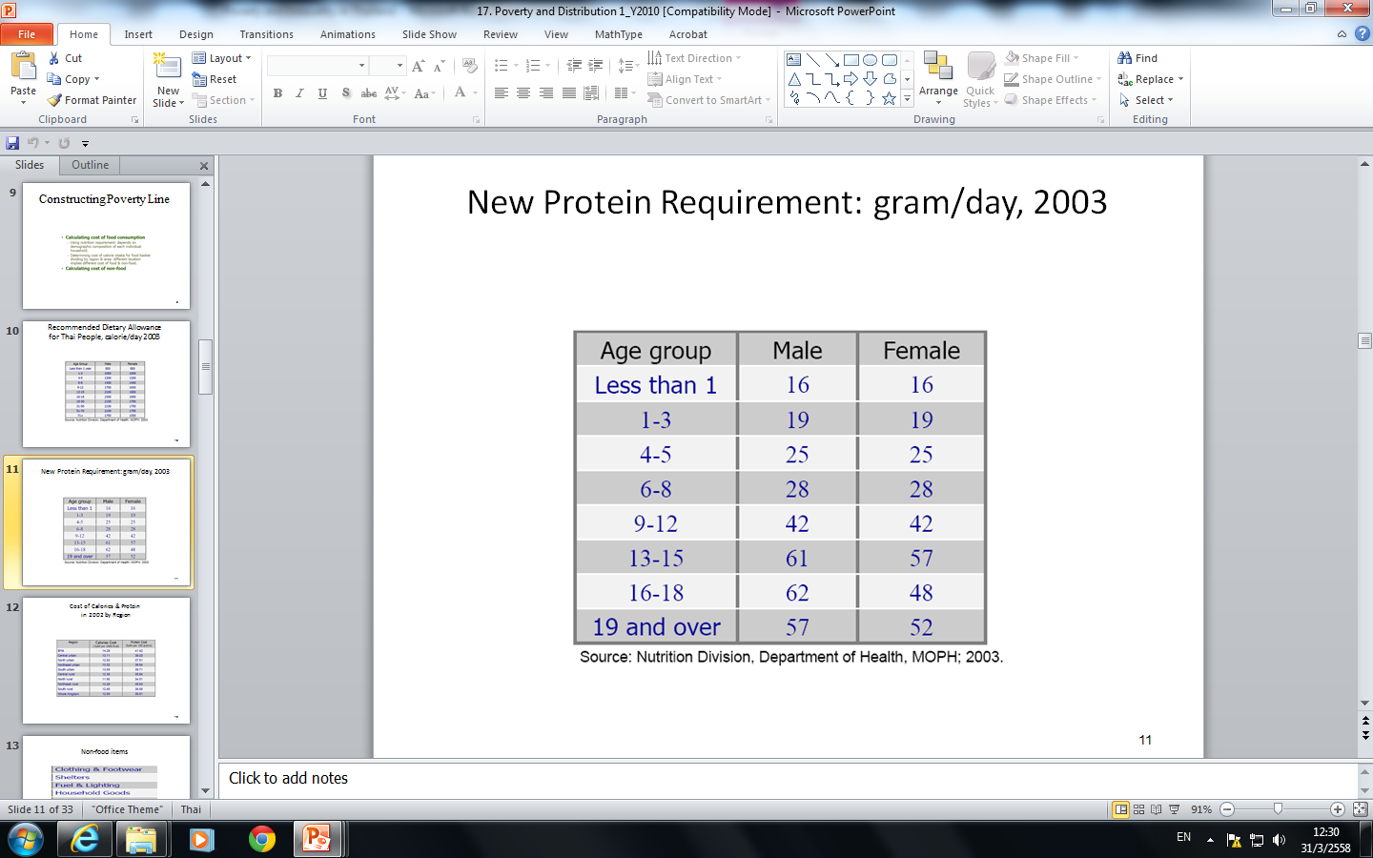

Slide 17
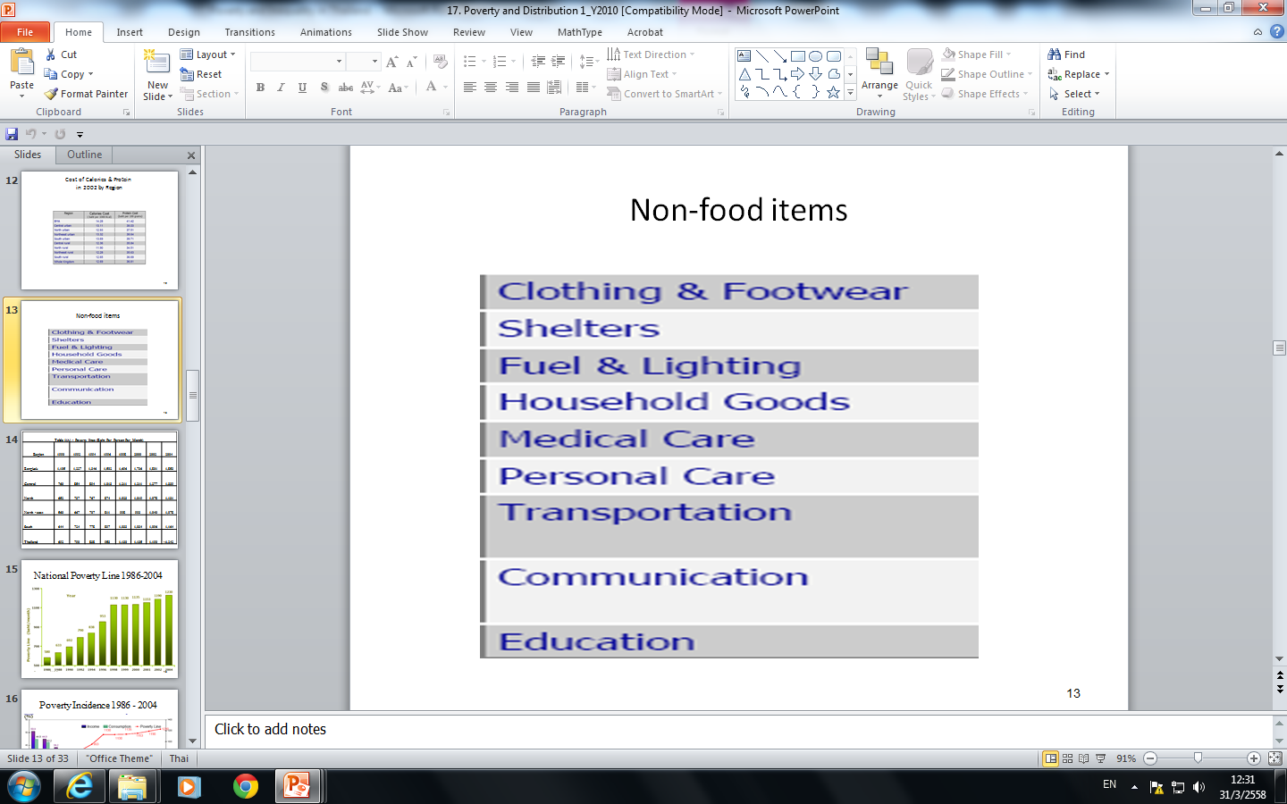

Slide 18
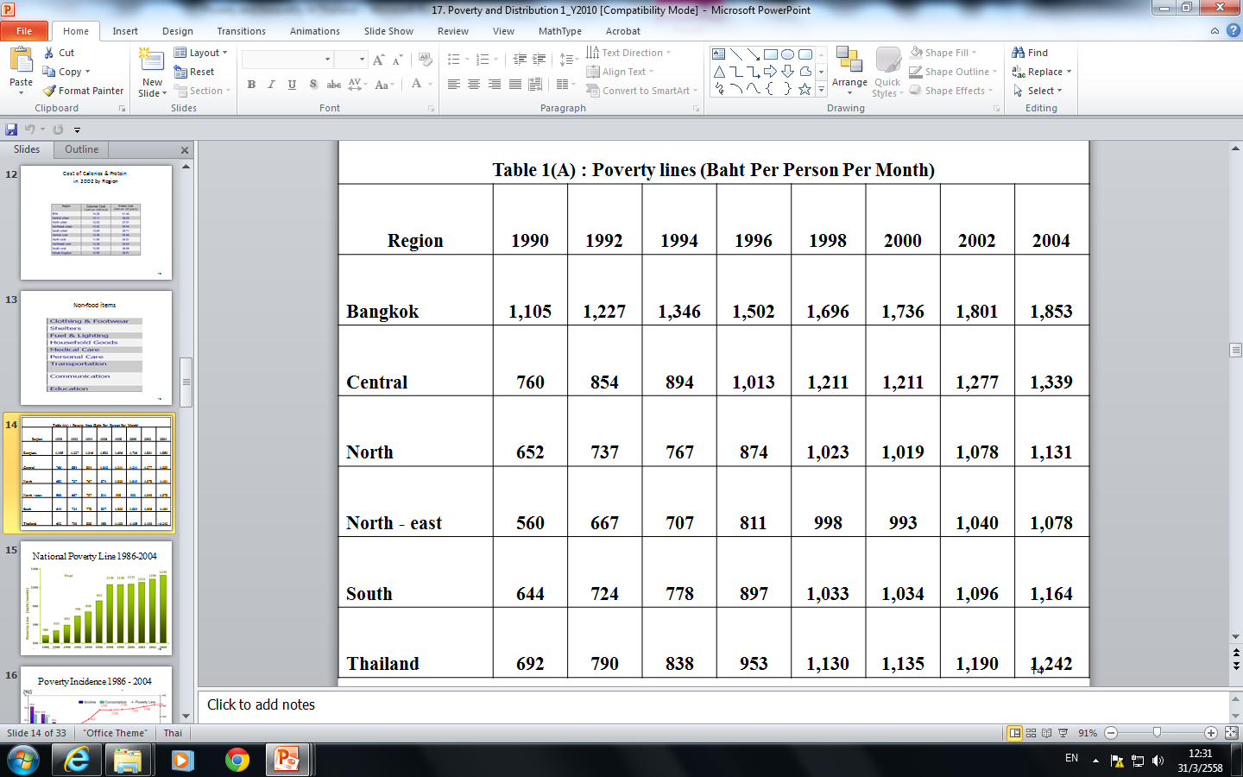

Slide 19
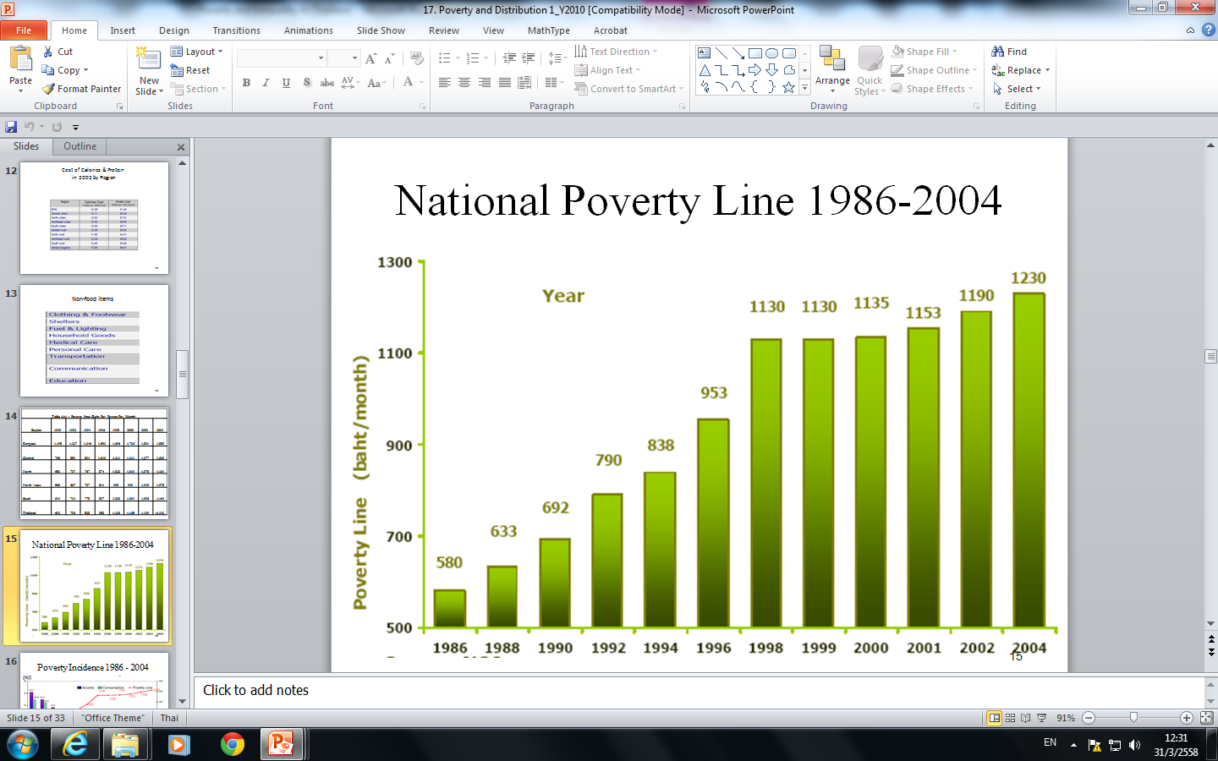

Slide 20
Poverty Headcount Ratio
% of population
2014 | 10.53
2011 | 13.2
2010 | 16.9
2009 | 19.1
2008 | 20.5

Slide 21
Population below poverty line
 | percentage
Chad | 80
Haiti | 80
Liberia | 80
Congo | 71
Sierra Leone | 70.2
Nigeria | 70
Surinam | 70

Slide 22
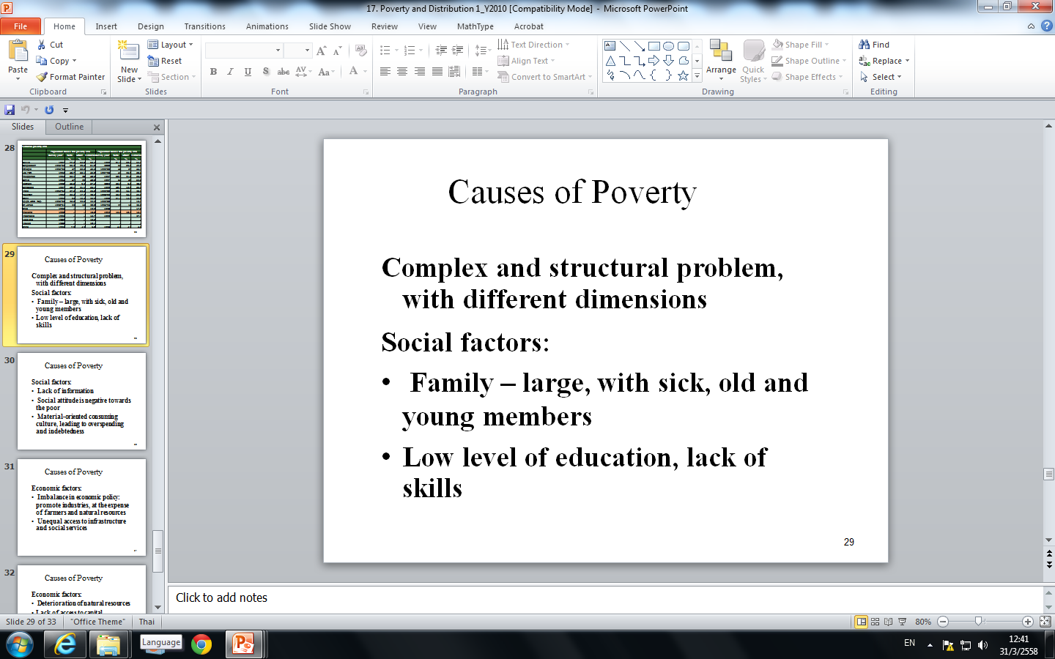

Slide 23
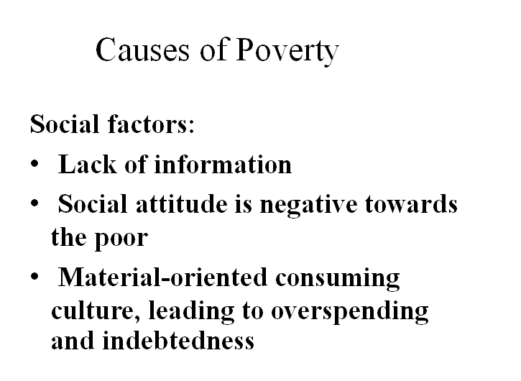

Slide 24
Causes of Poverty
Economic factors:
Imbalance in economic policy: promote industries, at the expense of farmers and natural resources
Unequal access to infrastructure and social services

Slide 25
Causes of Poverty
Economic factors:
Deterioration of natural resources
Lack of access to capital, particularly formal institutions

Slide 26
Causes of Poverty
Government administrative factors:
Laws and regulations as obstacle for poverty eradication
Partial approach in problem solving
Not promote participation by all stakeholders

Slide 27
Current Poverty Situation
1. Overall poverty rate continuously decline over the past 10 years
  Share of population under poverty line, or poverty rate, fell from 32.4 percent in 2003 to 21.9 percent in 2006 and 10.5 percent in 2014
  In 2014, the rate stood at 10.53 percent with number of poor at approximately 7.1 million persons.

Slide 28
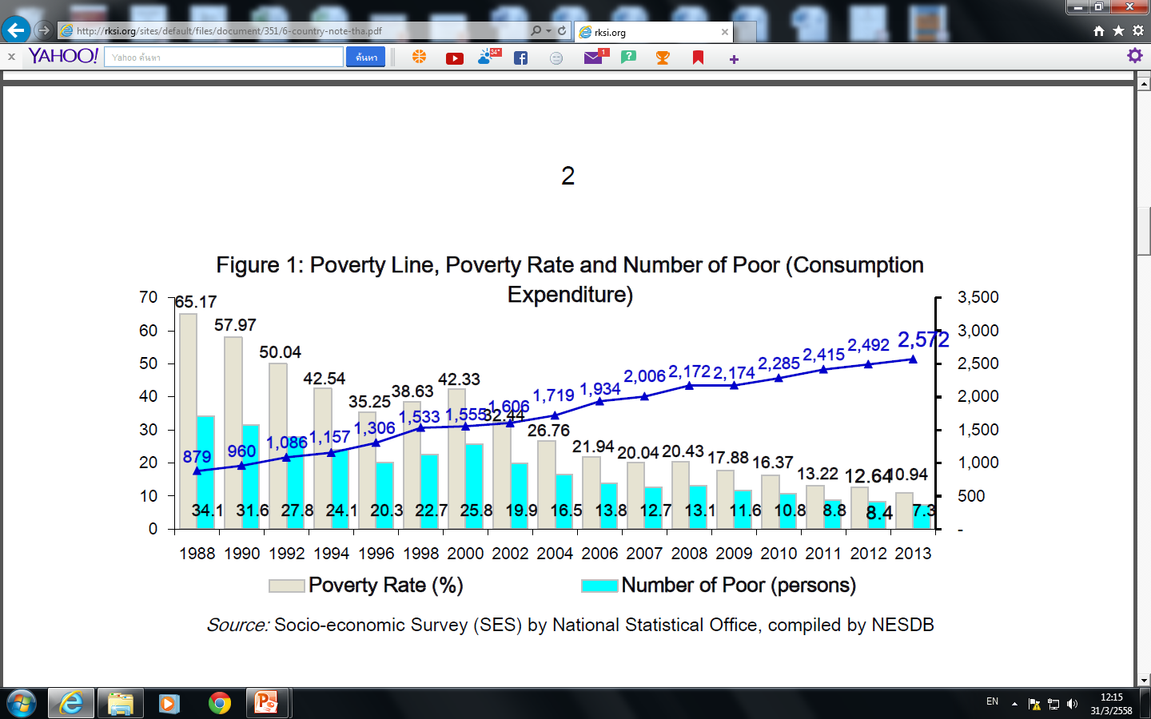

Slide 29
2.Poverty is more concentrated in rural than urban areas.
  With 4.73 million persons living in poverty and poverty rate of 13.76 percent in rural area.
  In contrast, there were 2.31 million poor persons, accounting for 7.12 percent share od total population in urban areas in 2014.
  Poverty was concentrated in the north and Northeast regions, both in rural and urban areas.

Slide 30
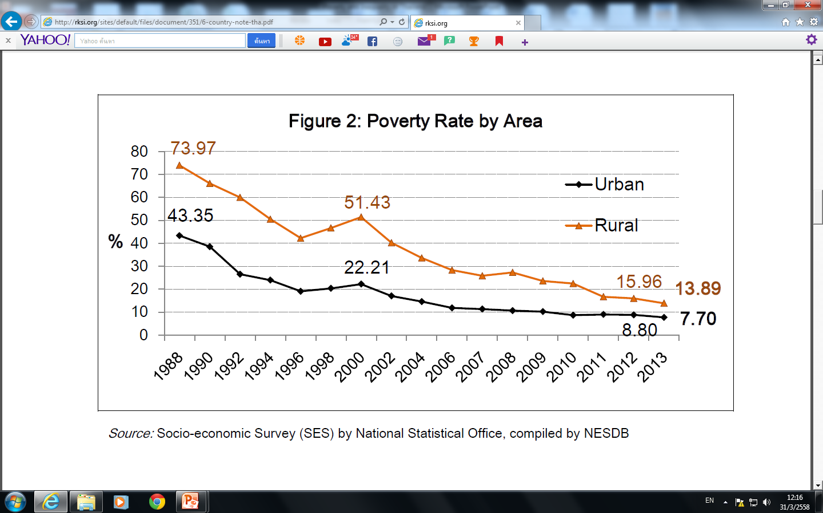

Slide 31
3. Characteristics of rural and urban poor persons differ noticeable.
  The rural poor persons mostly work in agricultural sector. Most of them also live in remote areas, where accessibility to public services; infrastructure, education, health as well as administration services, is limited.
  Urban poor persons are mostly low-skilled workers in labor-intensive non-agricultural sectors such as construction and manufacturing. The most critical issue for urban poor is their living conditions. Most of them live in slums with lack of proper infrastructure and waste system.

Slide 32
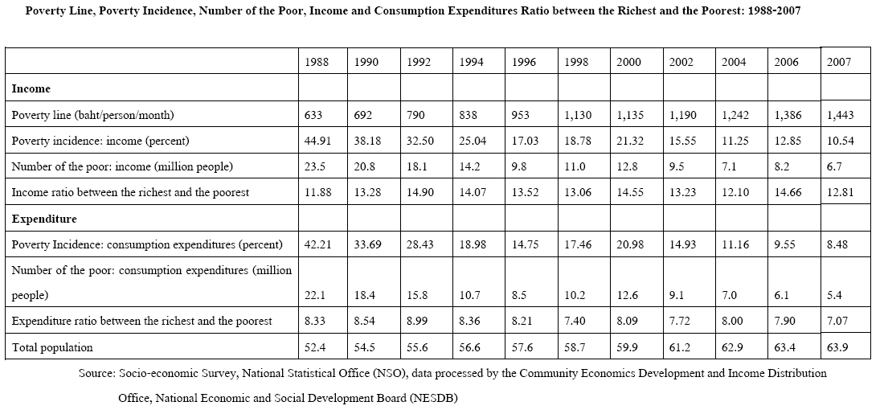
32
Notes:
32

Slide 33
33
Notes:
33

Slide 34
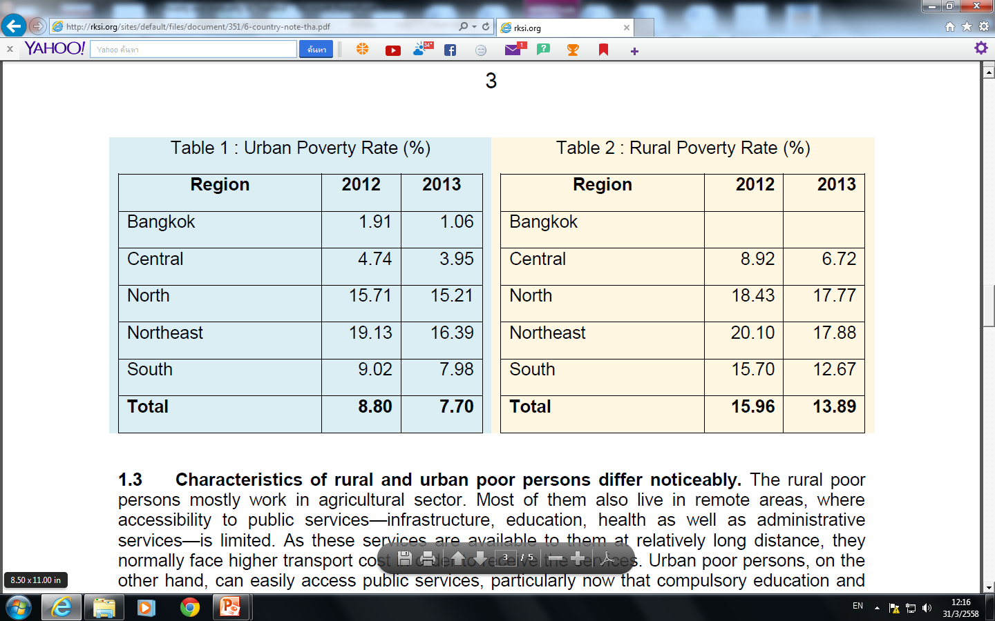

Slide 35
Poverty Incidence
While poverty has decreased due to its economic growth, the inequality increase can still be problematic from the perspective of fairness.
Inequality has a negative effect on poverty both directly and through low growth rates.

Slide 36
B . Inequality
Gini coefficient measures the inequality.
A Gini coefficient of zero expresses perfect equality, where everyone has the same income.
A Gini coefficient of one expresses maximum inequality where only one person has all income.

Slide 37
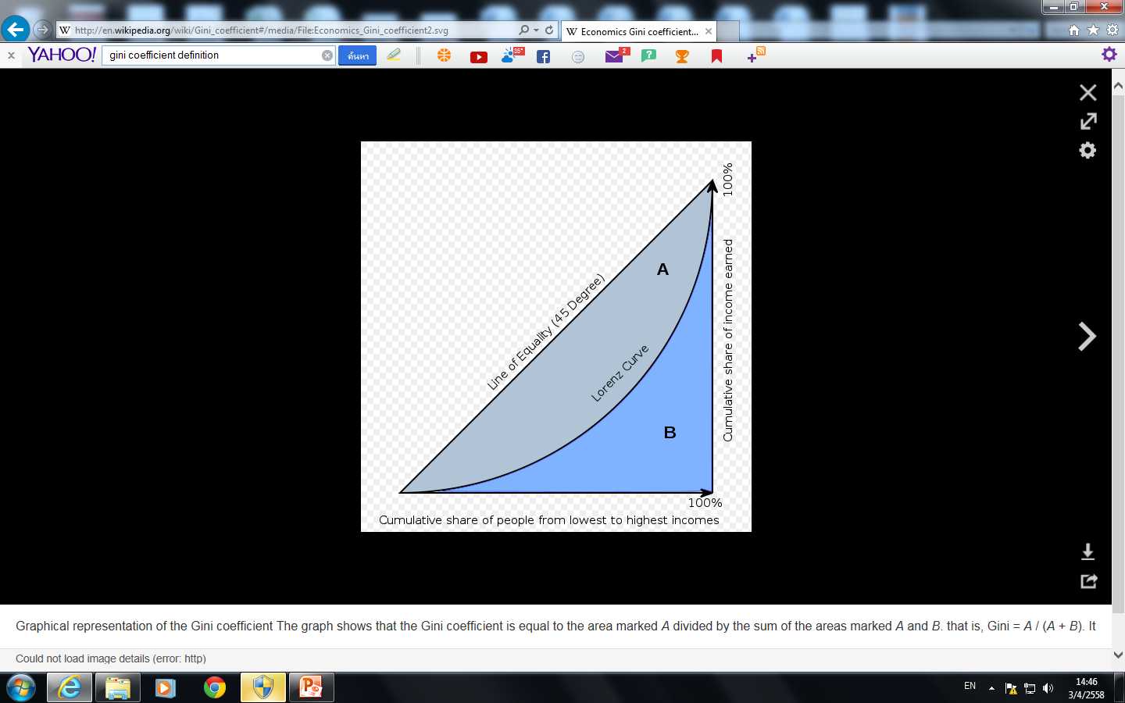

Slide 38
World Bank Gini
 |  | Year
Australia | .305 | 2006
Bangladesh | .321 | 2010
Bhutan | .387 | 2012
China | .370 | 2004
India | .336 | 2012
Japan | .381 | 2002
Thailand | .465 | 2013

Slide 39
4 worst inequality countries
Namibia | 0.707
South Africa | 0.650
Lesotho | 0.632
Botswana | 0.630

Slide 40
Inequality in Thailand
1. Income inequality has slightly improved.
  Gini coefficient of income in 2013 was 0.465.
  Income inequality was slightly higher in urban area compared to that in rural which was 0.452 in urban compared to 0.445 in rural area, in 2013.

Slide 41
41
Notes:
41

Slide 42
Population served by each doctor by Region:1988-2005
42
Source: Thai Public Health Report: 2005-2007, Ministry of Public Health
Notes:
42

Slide 43
Population per bed by Region: 1988-2005
43
Source: Thai Public Health Report: 2005-2007, Ministry of Public Health
Notes:
43

Slide 44
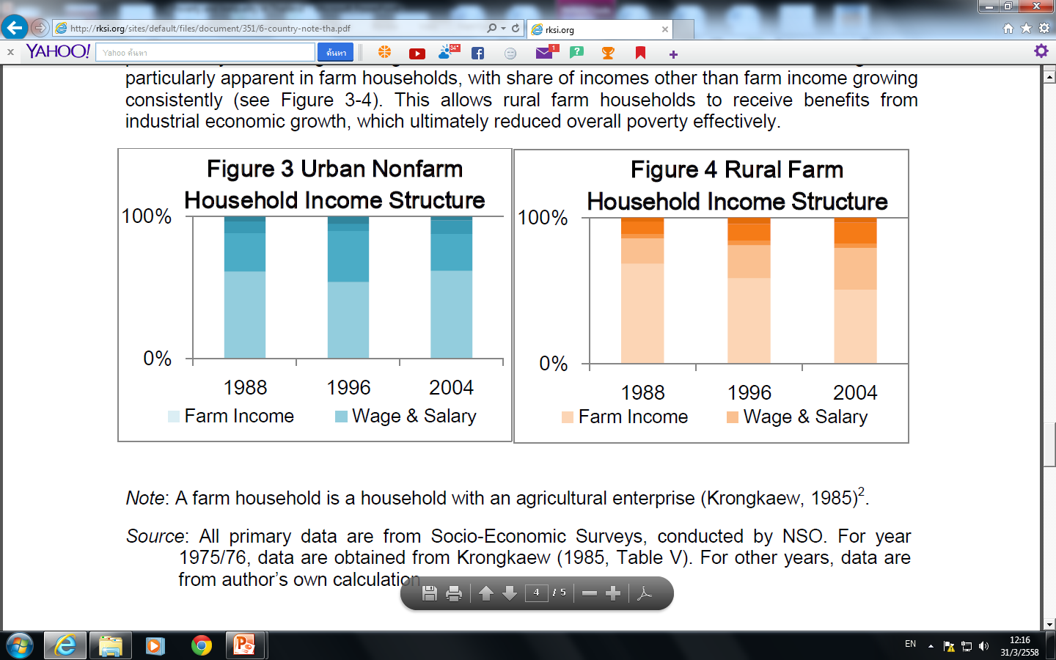

Slide 45
2.Considerable inequality in education between urban and rural areas.
  Tertiary education is more accessible in urban area.
  Net enrollment rate for tertiary education was 39.5 percent in urban, compared to 18.0 in rural area.
  The opportunity to attend tertiary education including higher vocational/technical level for population in urban area was 2.2 times higher than population in rural area.
  Most tertiary institutions are located in the urban area.

Slide 46
Rural-urban linkages: Economic Linkage and Effects on Poverty Reduction
1. Industrialization process aim to promote economic growth through economic structural change from agricultural-based to industrial based economy caused the demand for labor to increase dramatically.

Slide 47
2. the migration from rural to urban areas has brought change to the structure of household income. According to the 2002 Migration Survey by National statistical Office, as many as 85 percent of households in the lowest income quintile received remittances from migrated members.

Slide 48
3. migration from rural to urban areas to seek jobs in non-agricultural sectors has been one of the main factors causing urban poverty. With higher living cost in urban area than in rural area, these internal migrant workers ended up living in poverty. The most critical problem is the lack of housing. As working-age population migrated to urban areas, elderly and children have been left behind in rural areas.

Slide 49
C. Policies to Reduce Poverty
Policies implemented during the 11th Master Plan (2011-2016) to combat poverty include measures to reduce living expenses, 300-Baht nationwide minimum wage, rice-pledging scheme, debt-suspension program for low-income farmers, set up several activity specific funds (e.g. education loan fund, SML development fund), expand coverage and amount of elderly allowance.

Slide 50
Table : Ad Hoc Characteristics of the Poverty Target Groups
The Extreme/ Chronically Poor | The Moderately Poor | The Vulnerable
Landless Farmers Child Labors Agricultural Temporary Worker Unemployed with no other income |  | Having jobs with high risk of accident Workers with sufficient income but unstable jobs Middle-aged workers with no modern skills Petty Traders with no permanent stores Low-income earners lacking ability to plan

Slide 51
Table: Ad Hoc Characteristics of the Poverty Target Groups
The Extreme/ Chronically Poor | The Moderately Poor | The Vulnerable
Facing Extreme Hardship No Education No Savings and Assets (both durable and non-durable) General workers with high family dependents such as children, elderly, chronically illed or disabled members | Low Education No Savings, May possess some low-valued non-durable assets Farmers with little lands and low yields Peddlers | No higher than secondary education Little savings No access to formal credits Farmers with sufficient lands but locating in high risk areas

Slide 52
Table Access by the Poor to Various Poverty Programs in 2002 (% of respective groups)
Poverty Programs | Poor | Vulnerable | Non-poor, Non-Vulnerable | Total
Universal Health Care (30 Baht Scheme) | 85.4 | 86.0 | 67.1 | 69.7
Social Insurance | 0.5 | 0.8 | 9.3 | 8.1
Old Age Assistance | 0.5 | 0.7 | 0.4 | 0.4
Debt Moratorium | 2.4 | 2.4 | 1.9 | 2.0
Farmers Assistance Fund | 0.9 | 0.9 | 0.5 | 0.6
School Lunch Program | 11.1 | 12.4 | 6.8 | 7.5
Education Scholarship | 0.3 | 0.2 | 0.2 | 0.2
Education Loans | 0.9 | 1.1 | 0.6 | 0.6
People Bank | 0.1 | 0.0 | 0.2 | 0.2
Village Revolving Fund | 7.0 | 8.4 | 7.6 | 7.6
Source: Socio-Economic Survey 2002, The National Statistics Office
Note: The Vulnerable Group is defined as individuals whose household incomes were below 1.2 times of the poverty lines.

Slide 53
POVETRY REDUCTION POLICIES
The government to deal with poverty problems are:
3.1 Policy directly on poverty reduction
3.2 Policy on developing the quality of both poor and society by means of securing housing of the poor
3.3 Policy on natural resource and environmental management

Slide 54
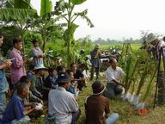

3.1 Policy directly on poverty reduction
Aims to implement at all levels namely individual, community and national.
At individual level, the government emphasizes particularly on expense reduction, increase generation and opportunity provision.

Slide 55
3.1 Policy directly on poverty reduction
At the community level, the community participation and learning process is encouraged so as to mobilize people to collaboratively solve problems and meet needs of the community.

Slide 56
3.1 Policy directly on poverty reduction
Financial assistance is also made available to ensure the poor have access to the fund. At the national level, an attempt is made to reform, restructure and manage land, natural resource, and environment to be supportive of the poor.

Slide 57
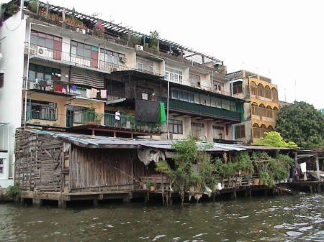
3.2 Policy on developing the quality of both poor and society by means of securing housing of the poor

Slide 58
3.3 Policy on natural resource and environmental management
The government takes the integrated approach to mobilize all relevant government agencies to concert their available resources combat to poverty at all levels.
The Area-Function-Participation (A-F-P) Approach is emphasized when implementing poverty eradication activities at the grassroots levels.

Slide 59
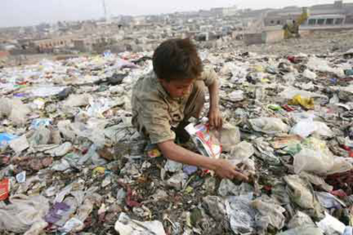
Comments

