Slide 1
Source: Jansson (2013), Chapter 4
Distribution costs of non-transportable goods
Distribution costs in this part focuses on “transport cost” of “non-transportable services” (although indeed distribution costs is much wider concept than transportable cost)
What distinguishes “services” from “material goods” is the relative importance of the “cost of personal transport in order for producer and consumer to meet and carry out the simultaneous production and consumption”.

Slide 2
Source: Jansson (2013), Chapter 4
Distribution costs of non-transportable goods
Bridging the special separation of service producers and consumers
(4 categories)
1. Consumer goes to service production plants
  Example: ____________________________________________
  Normally, consumers bear all the transport costs
  Two-stage travel:
  such as ___________________________________________________
2. Concerning producer services
  Producers goes (drives) to the consumer’s place (may bring necessary tools with them and go to consumers.
  Example __________________________________________________
  __________________________________________________________

Slide 3
Source: Jansson (2013), Chapter 4
Distribution costs of non-transportable goods
Bridging the special separation of service producers and consumers
(4 categories), cont.
3. Producers and consumers meet half way
  Example: __________________________________________________
4. Transport
  Transport itself is a service that is both non-storable and non-transportable. So bears with it relatively high distribution costs
  Transport infrastructure service (such as, airport, train station, motorway etc.) _____________________________________________
  Public transport (such as, bus ,train) ____________________________
  Transport for hire (such as called taxi) __________________________

Slide 4
Source: Jansson (2013), Chapter 4
Distribution costs of non-transportable goods
Bridging the special separation of service producers and consumers
(4 categories), cont.
Two borderline cases (not include in distribution models that follow)
Public utilities (such as electricity, water supply, etc.)
  Water is material enough to be storable and transportable (via water pipeline) and could be viewed as good
  Electricity is arguably immaterial and non-storable, but could be transportable via electricity cable
  In general transportable costs are high in relation to production costs (normally distribution systems are tailor-made in each case)
Information and communication
  In case where information can be stored on tape or disc, printed on paper or written in a letter, it becomes transportable good. Such goods can give rise to service, e.g. when a reel of film is enjoyed as a movie in a cinema)
  Communication means the transportation of information (e.g. by telephone wire or by wireless distribution). A telephone conversation does not require a meeting, but simultaneity in time is necessary for the production and consumption of information (distinct from email)

Slide 5
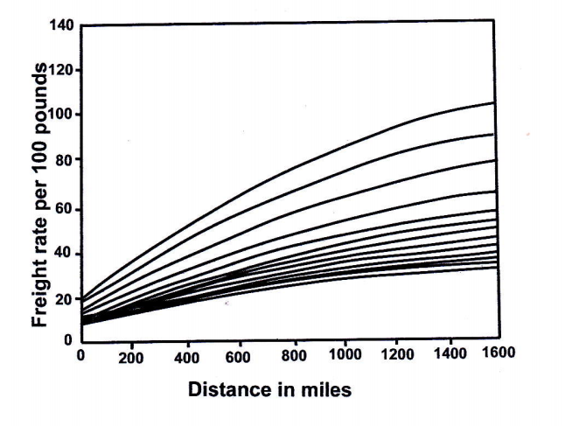
Figure 4.1 in Jansson (2013), P.56
Freight rate structure with respect to distance of US trucking firm
Normally assume linear relationship between “transport costs” and “distance”
However, for almost all modes of goods transport (and in particular shipping), the transport cost per ton-mile of a particular commodity tapers off markedly as the transport distance increases
In the figure, the bunch of freight curves represent different articles (different bulkiness, fragility an so o) involve different transport costs, but seems to be similarly related to transport distance
Note: Normally
  the handling cost (loading and unloading) is relatively high for bigger vehicles
  long-distance transport vehicles should be much bigger than short-distance transport vehicles

Slide 6
Figure 4.2 (b) in Jansson (2013), P.56
FC = f₁(S) + f₂(S)*D
FC = Freight cost per ton
S = ship size
D = transport distance
€
Cost per ton of given ship
Figure 4.2 (a) The total transport cost per ton as a function of the transport distance, given the ship size
f₁(s) shows handling cost per ton
intercept
F₁(S)
f₂(s) shows hauling cost per ton-mile
slope
Distance
Figure 4.2 (a) in Jansson (2013), P.56
f₁(s) is normally an increasing function of “S”
(diseconomies of ship size in the cargo
handling because the loading/unloading
capacity can generally not be increased at the
same rate, as the laytime cost is increasing
with ship size)
f₂(s) is normally a decreasing function of “S”
(economies of ship size in transport)
That means the longer the transport distance is the bigger the optimal ship will be because f₂(S)*D will carry more and more weight
€
(s₃)
(s₄)
(s_{n})
(s₁)
(s₂)
Freight curve
Distance

Slide 7
Figure 4.2 (b) in Jansson (2013), P.56
€
Figure 4.2 (b) The freight curve as an envelope of the cost lines of a number of ships of different sizes
Cost per ton of given ship
Shows cost per ton as a function of distance for a number of different ship size
The steepest line applies to the smallest ship and so on
The handling cost becomes higher as the ship size increases, where the hauling cost per ton becomes lower
FC = f₁(S) + f₂(S)*D
F₁(S)
Distance
“Freight curve” is an envelope, which is tangent to each but intersects none of the cost lines.
The tangency point between a particular line (representing a particular ship size) and the freight curve indicates the distance for which the ship is the optimum size
FC = bD^{λ}
The distance-elasticity of FC (λ) is normally positive but less than 1
  In the truck case in figure 4.1 λ is around 0.5
  For the short-sea and deep sea tanker freight rate λ is much lower
Figure 4.2 (a) in Jansson (2013), P.56
€
(s₃)
(s₄)
(s_{n})
(s₁)
(s₂)
Freight curve
FC = bD^{λ}
Distance
In addition to freight rate comes the time cost of the goods in transit to make up the full transport cost. The value of goods time is relatively low except for perishable and/or particular high value goods

Slide 8
Source: Jansson (2013), Chapter 4
Generalized Travel Cost with Respect to Distance
When it comes to personal transport to obtain service, or service producer to go to the consumer’s place and provide service, the resistance of distance is more pronounced than for trade of goods
(one main reason for this is that non-motorized modes of
transport, which nearly extinguished for goods transport still
play an important role in the case of consumer services)
Here explain “Individual modes of travel” and “Public transport generalized cost”

Slide 9
Source: Jansson (2013), Chapter 4
Individual modes of travel
There are limits for walking and cycling, the limits varies widely between individuals
The reasonable cycling distance is longer than walking distance
When heavy or bulky goods are to be carried the car is indispensable
The generalized cost (GC) of travel on foot increases progressively with distance (sometimes use a quadratic functional form)
Local transport modal choice studies indicate that walking time on the margin is valued (that is costs) between 1.5 to twice as much as car driving or bus riding time cost.
Unfortunately, there is no firm empirical evidence of the exact rate of increase with distance, either of walking time cost or of the cycling time cost
Note: Time cost of each travel mode is travelers’ willingness to pay for saving time under a particular circumstance for that mode of travel.

Slide 10
Source: Jansson (2013), Chapter 4
Individual modes of travel
Individual modes of travel
When it comes to motorized mode of transport, it is well known from travel demand, and value of time research (for example in SIKA, 2008), that the time cost is about twice as high for long-distance travel compared to short-distance travel. This reflects a gradually rising cost of travel time, when the journey takes more than 1 or 2 hours.
A linear approximation of travel time cost function up to a journey time of about one hour seems justified in the case of car travel (more in literature regarding travel demand and time cost)
The main disadvantages of car travel compared to walking or biking is _________________________________________________________
The distance independent part of the generalized cost of a car trip include the time and effort to find the keys to the car and garage, the walking and the effort to get the car out of the garage (which does not matter for long distance trips but which could be decisive for the choice mode for short trips)

Slide 11
Source: Jansson (2013), Chapter 4
Individual modes of travel
The research based on the Norwegian national travel survey RVU2001 (Samferdsel nr3, 2003) shows that
For travel to/from work walking is the main mode of transport up to a distance of 1 km, where walking and car travel are equally frequent
For a distance 3 km walking is almost down to zero
The parking price and availability at the place of work is quite important for the modal split.
  For work trips up to 3 km, the share of walking and cycling rises from 36% to 80% when the parking goes from “free, always available” to “no parking”
Cycling is not as common in hilly Norway as in Denmark, Holland and northern Germany, as well as generally in Sweden.
In small and medium-sized towns where travel distances are relatively short, cycling is more important than public transport in Sweden, from south to north

Slide 12
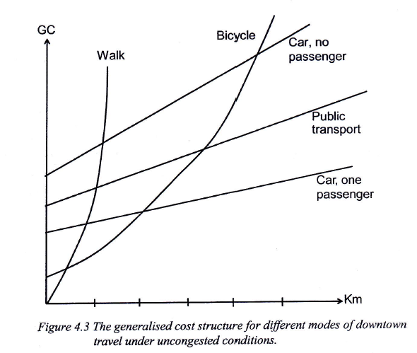
The generalized cost structure for different modes of downtown travel under uncongested conditions
Individual modes of travel
Figure 4.3 in Jansson (2013), P.59

Slide 13
Source: Jansson (2013), Chapter 4
Individual modes of travel
After the initial stage where the cost of walking is increasing progressively with distance, the all mode GC is more or less proportional to distance when the different modes are represented only in their respective niche range
A linear approximation of all the GC-curve seems reasonable with one exception: the effort of a walk with a burden is increasing progressively with distance. In that case a quadratic functional form is more adequate
In the case of long-distance travel, further consideration may include value of time differs between different modes of travel due to comfort differences. Time cost per hour tends to increase with total travel time

Slide 14
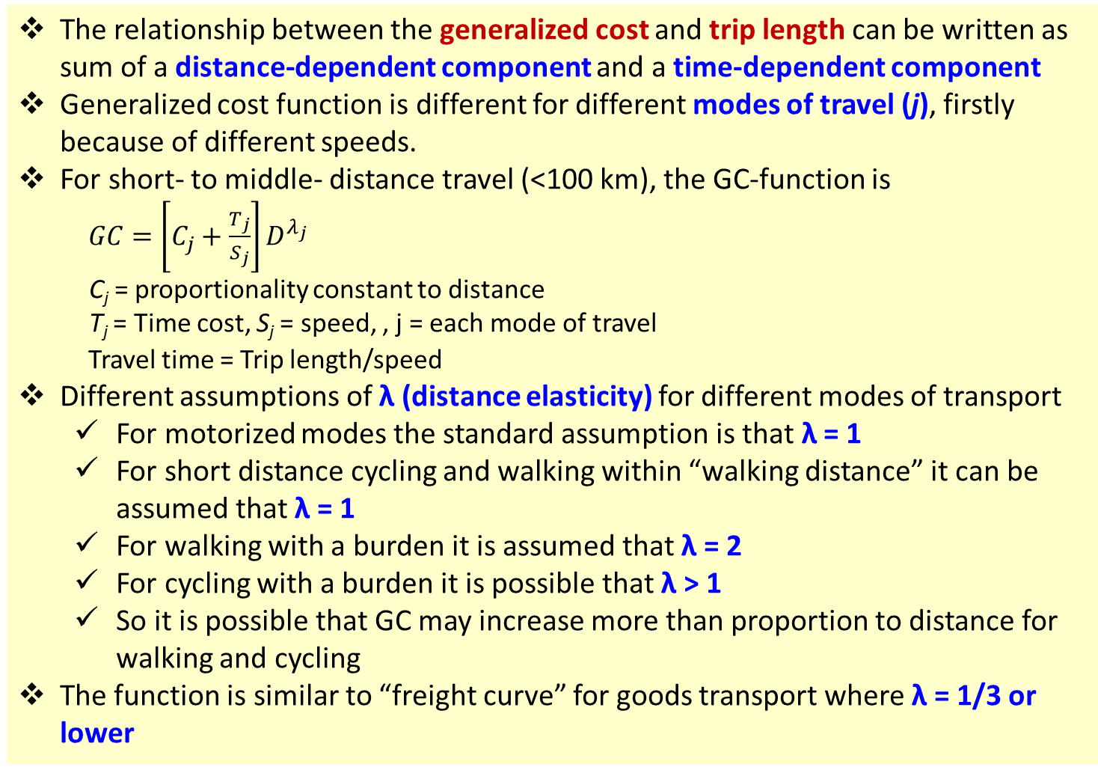
Source: Jansson (2013), Chapter 4
Individual modes of travel
The relationship between the generalized cost and trip length can be written as sum of a distance-dependent component and a time-dependent component
Generalized cost function is different for different modes of travel (j), firstly because of different speeds.
For short- to middle- distance travel (<100 km), the GC-function is
$GC=\left[C_{j}+\frac{T_{j}}{S_{j}}\right]D^{λ_{j}}$
C_{j} = proportionality constant to distance
T_{j} = Time cost, S_{j} = speed, , j = each mode of travel
Travel time = Trip length/speed
Different assumptions of λ (distance elasticity) for different modes of transport
  For motorized modes the standard assumption is that λ = 1
  For short distance cycling and walking within “walking distance” it can be assumed that λ = 1
  For walking with a burden it is assumed that λ = 2
  For cycling with a burden it is possible that λ > 1
  So it is possible that GC may increase more than proportion to distance for walking and cycling
The function is similar to “freight curve” for goods transport where λ = 1/3 or lower

Slide 15
Source: Jansson (2013), Chapter 4
Public transport generalized cost
The cost structure of public transport is more complex than modes of individual transport
Public transport is an important service itself
The necessary access and regress trips at either end constitute the distribution costs of public transport services
The strong dependence of the public transport generalized costs on trip volume along a particular route is a distinguishing characteristics
Given the transport infrastructure, the individuals modes of transport (walk, bicycle, and private car) are constant cost activities for low to medium rates of the infrastructure capacity utilization. As the capacity limit is approached, car transport (in particular) shows accelerating increasing costs.
The public transport infrastructure also has capacity limit, but before this limit is approached, the generalized cost per trip is steadily falling in the whole preceding range of infrastructure of capacity utilization due to the “Mohring effect” and marked economies of vehicle size (see for example Nash and Matthews, 2005 and Jansson et al. 2013)

Slide 16
Source: Jansson (2013), Chapter 4
Public transport generalized cost
“Mohring Effect”
Mohring (1972) argues that urban public transport exhibits considerable economies of scale if users' waiting time is included in the cost function.
The ”Mohring effect” is the observation that, if the frequency of a transit service (e.g., buses per hour) increases with demand, then a rise in demand shortens the waiting times of passengers at stops and stations.
Because waiting time forms part of the costs of transportation, the Mohring effect implies increasing returns to scale for scheduled urban transport services.
The implication is that without subsidisation, frequencies will be lower than socially optimal.

Slide 17
Source: Jansson (2013), Chapter 4
Distribution cost per unit of service
Important factors in Distribution cost of non-transportable goods
  ______________________________________________________
  ______________________________________________________
  ______________________________________________________
Distinction between producer and consumer services matter
  Consumer service: Households are customers. It is more reasonable to assume that the customer are evenly spread, so that the total number of potential customers will increase approximately in proportion to the size of the market area
  Producer service: Their customers are other firms and/or public authorities that are located in the central cities to a large extent. So, producer service firms typically form clusters in the central city or in science parks because they want to be close to each other
Here, producer services are left out of consideration for a moment

Slide 18
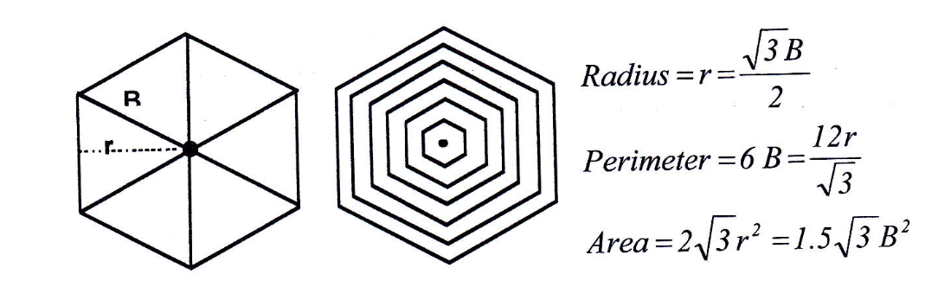
Shape of market area: it is of very little consequence for the present analysis whether circular, square or hexagonal market areas are assumed as long as the density of demand is constant over space
Hexagonal market area
B is base of each triangle
Figure 4.4 in Jansson (2013), P.62

Slide 19
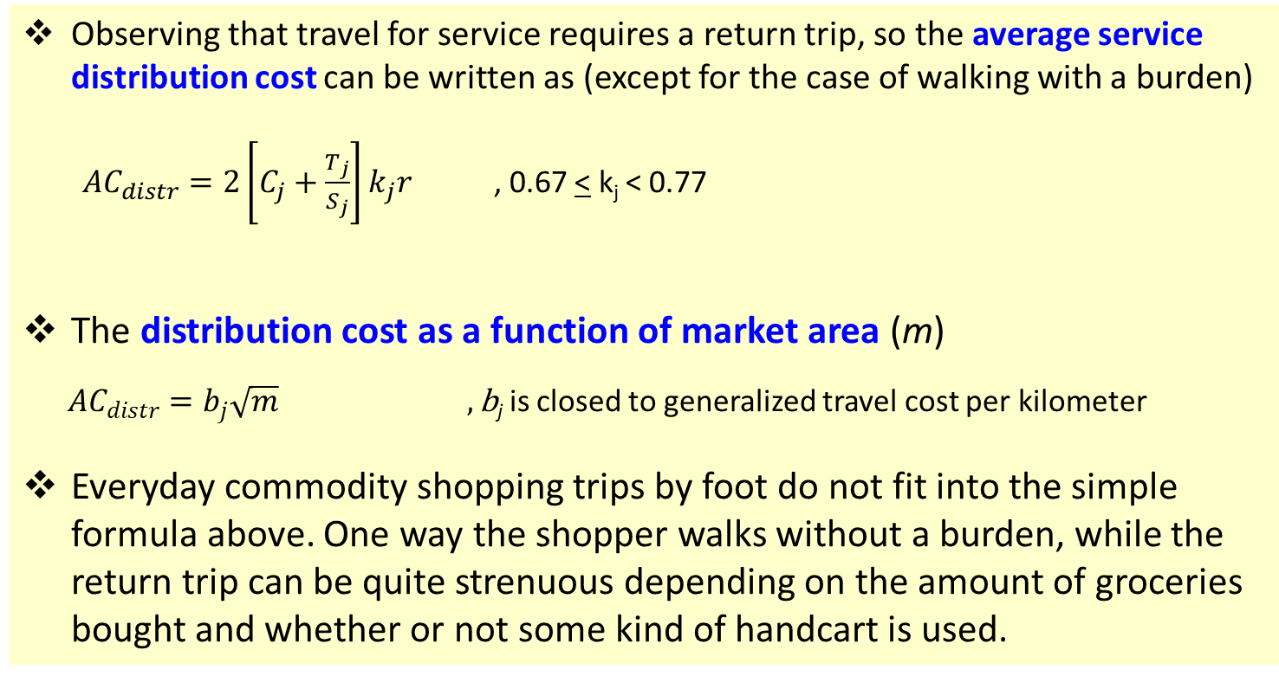
Source: Jansson (2013), Chapter 4
Distribution cost: Hexagonal market area
Observing that travel for service requires a return trip, so the average service distribution cost can be written as (except for the case of walking with a burden)
${AC}_{distr}=2\left[C_{j}+\frac{T_{j}}{S_{j}}\right]k_{j}r$ , 0.67 < k_{j} < 0.77
The distribution cost as a function of market area (m)
${AC}_{distr}=b_{j}\sqrt{m} ,\text{b}\text{j}$ is closed to generalized travel cost per kilometer
Everyday commodity shopping trips by foot do not fit into the simple formula above. One way the shopper walks without a burden, while the return trip can be quite strenuous depending on the amount of groceries bought and whether or not some kind of handcart is used.
j = different modes of transport
C_{j} = vehicle cost per km
T_{j} = Time cost
S_{j} = speed

Slide 20
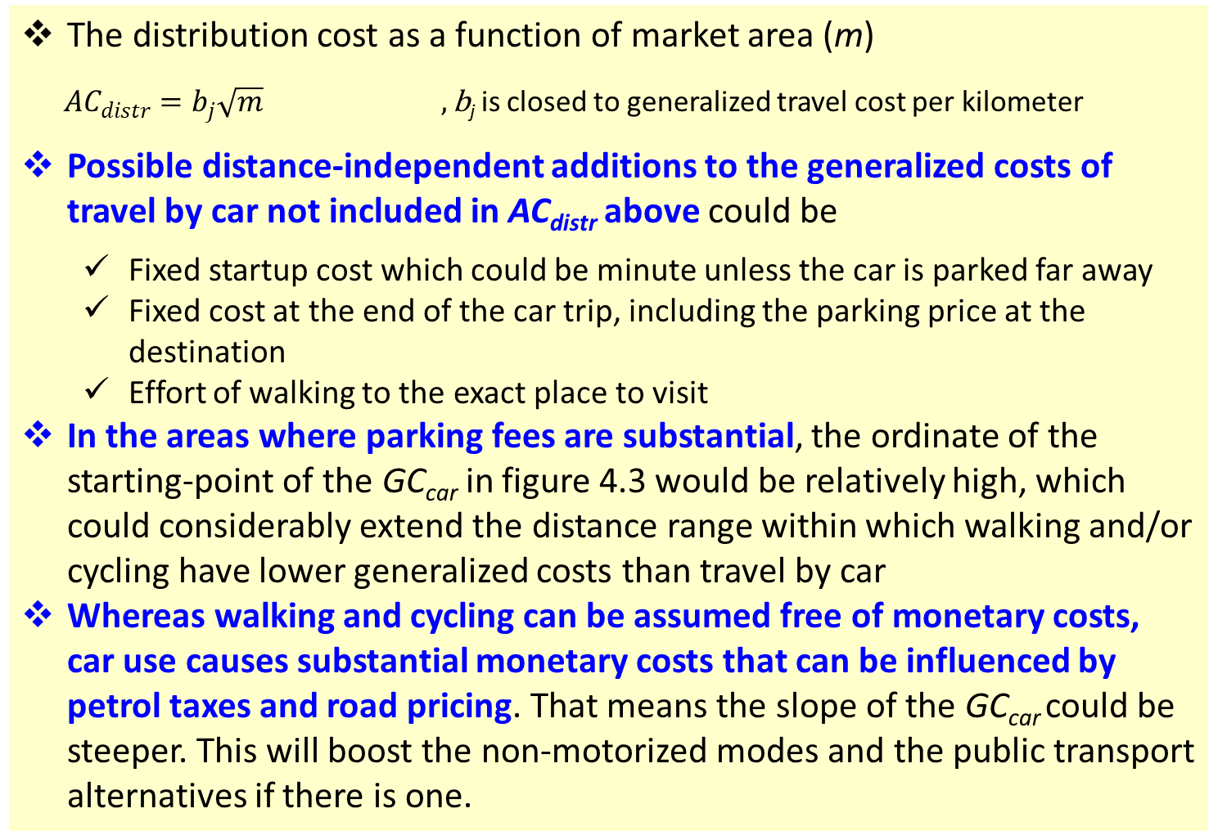
Source: Jansson (2013), Chapter 4
Distribution cost: Hexagonal market area
The distribution cost as a function of market area (m)
${AC}_{distr}=b_{j}\sqrt{m} ,\text{b}\text{j}$ is closed to generalized travel cost per kilometer
Possible distance-independent additions to the generalized costs of travel by car not included in AC_{distr} above could be
  Fixed startup cost which could be minute unless the car is parked far away
  Fixed cost at the end of the car trip, including the parking price at the destination
  Effort of walking to the exact place to visit
In the areas where parking fees are substantial, the ordinate of the starting-point of the GC_{car} in figure 4.3 would be relatively high, which could considerably extend the distance range within which walking and/or cycling have lower generalized costs than travel by car
Whereas walking and cycling can be assumed free of monetary costs, car use causes substantial monetary costs that can be influenced by petrol taxes and road pricing. That means the slope of the GC_{car} could be steeper. This will boost the non-motorized modes and the public transport alternatives if there is one.

Slide 21
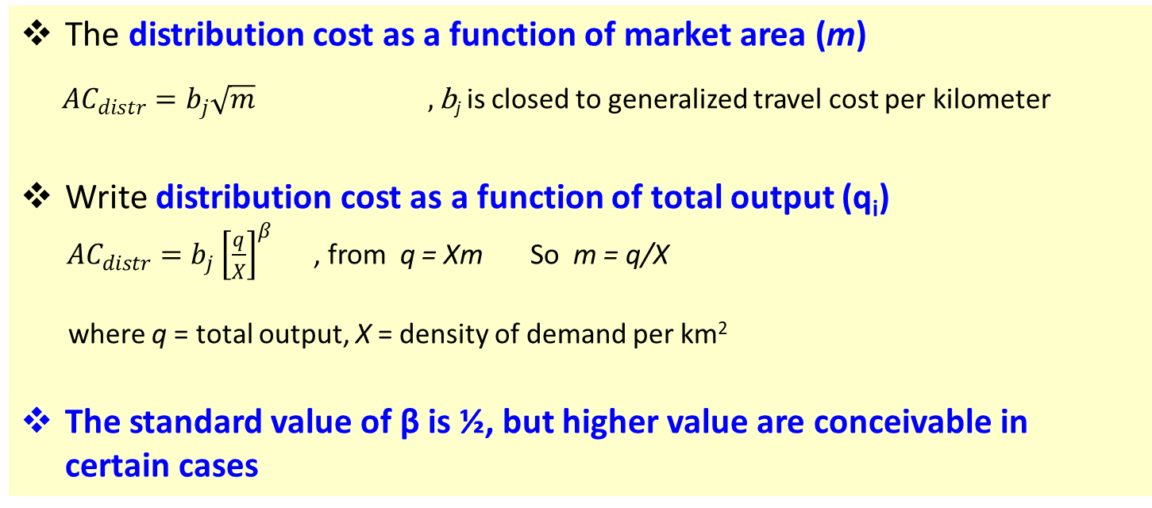
Source: Jansson (2013), Chapter 4
Distribution cost: Hexagonal market area
The distribution cost as a function of market area (m)
${AC}_{distr}=b_{j}\sqrt{m} ,\text{b}\text{j}$ is closed to generalized travel cost per kilometer
Write distribution cost as a function of total output (q_{i})
${AC}_{distr}=b_{j}{\left[\frac{q}{X}\right]}^{β}$ , from q = Xm So m = q/X
where q = total output, X = density of demand per km²
The standard value of β is ½, but higher value are conceivable in certain cases

Slide 22
Parameter values in the distribution cost function
MODE of travel | Vehicle cost (C), €/km | Value of time (T), €/h | Speed (S), km/h | Geometric constant (k) | b
Walking within walking distance | - | 9 | 5 | 0.72 | 1.4
Cycling within cycling distance | - | 6 | 15 | 0.72 | 0.3
Car driving for private purpose in urban area | 0.3 | 5 | 40 | 0.77 | 0.4
Car driving on business in urban area | 0.3 | 20 | 40 | 0.77 | 0.7
Long-distance car driving for private purpose | 0.2 | 10 | 85 | 0.77 | 0.3
Table 4.1 in Jansson (2013), P.64, original data from SIKA (2008) and traffic planning rules-of-thumb

