Slide 1
Inputs and Production Functions in the Short Run:
A Quick Review

Slide 2
Key Concepts
The production function tells us the maximum possible output that can be attained by the firm for any given quantity of inputs.
Production Function:
  Q = output
  K = Capital
  L = Labor
The production set is a set of technically feasible combinations of inputs and outputs.

Slide 3
The Production Function & Technical Efficiency

Slide 4
Total Product (TP), Average Product (AP), and Marginal Product (MP)

Slide 6
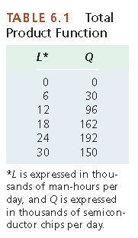
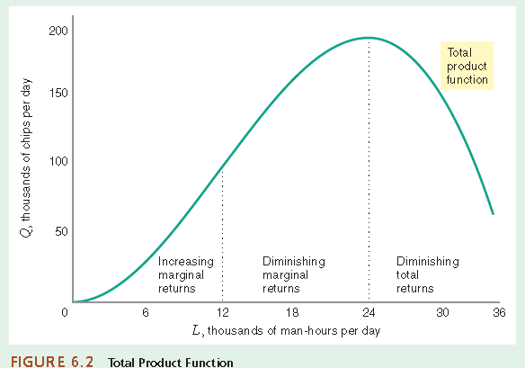

Slide 7
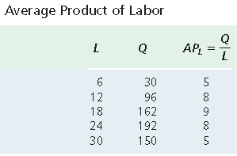
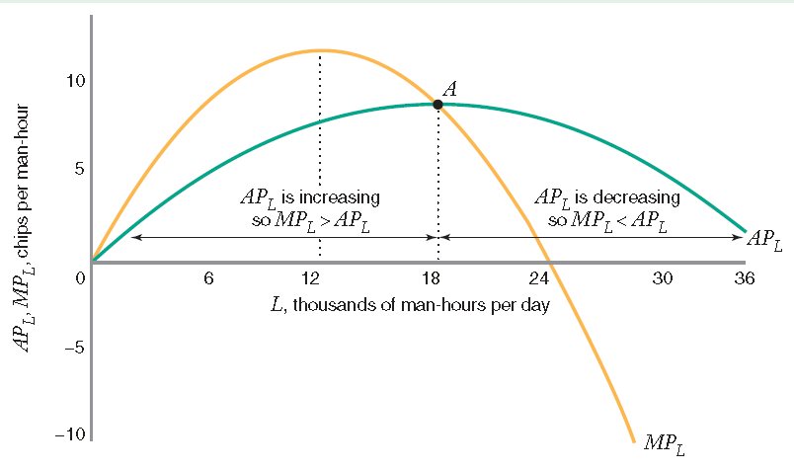

Slide 8
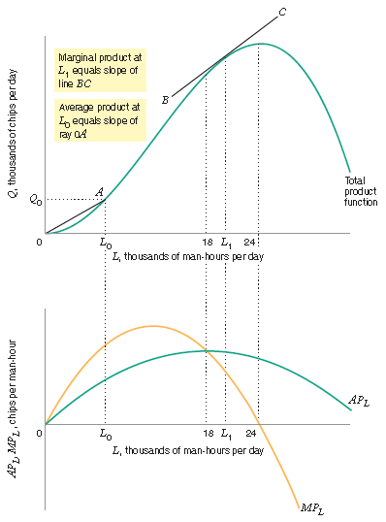

Slide 9
Relationship between TP, AP, MP

Slide 10
Law of Diminishing Marginal Product of Labor

Slide 11
Inputs and Production Functions in the Long Run

Slide 12
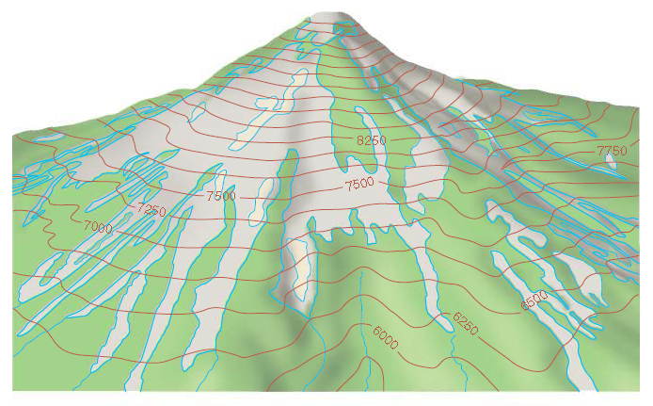

Product Mountain

Slide 13
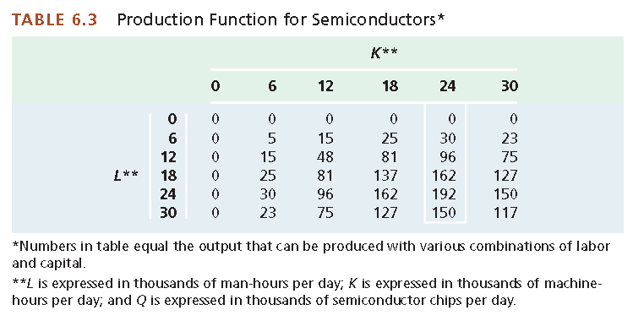

Slide 14
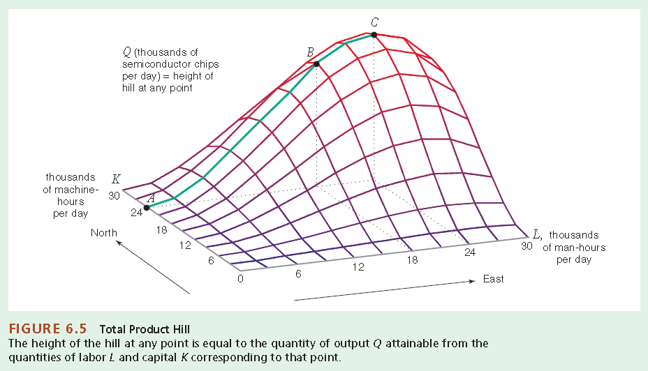

Slide 15
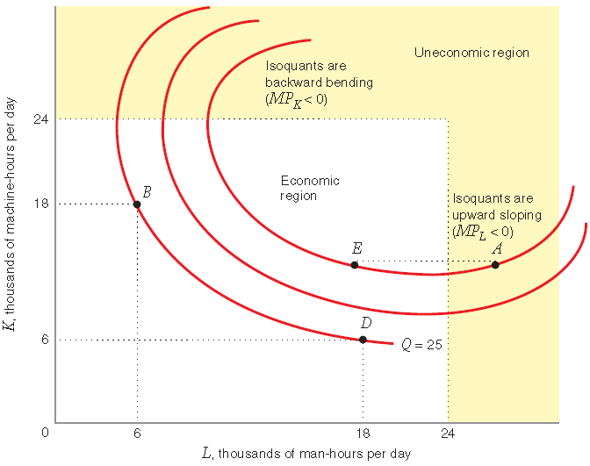
Economic and Uneconomic Regions of Production

Slide 16
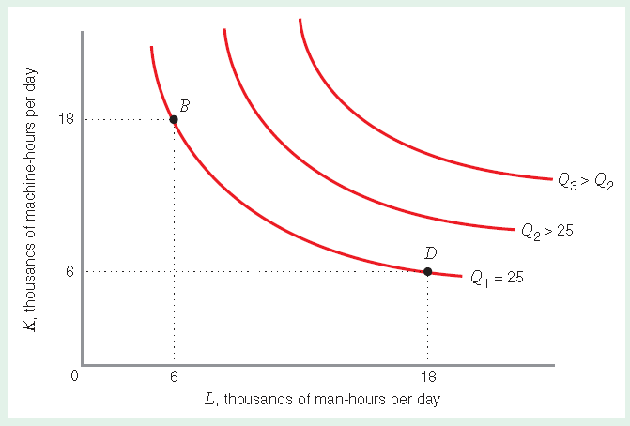

Slide 17
MARGINAL RATE OF TECHNICAL SUBSTITUTION
marginal rate of technical substitution of labor for capital: The rate at which the quantity of capital can be reduced for every one-unit increase in the quantity of labor, holding the quantity of output constant.
• The rate at which the quantity of capital can be decreased for every one-unit increase in the quantity of labor, holding the quantity of output constant, or
• The rate at which the quantity of capital must be increased for every one-unit decrease in the quantity of labor, holding the quantity of output constant.

Slide 18
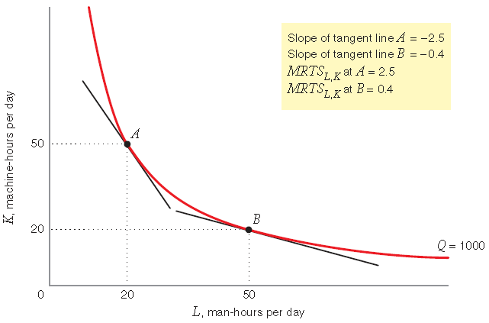
MARGINAL RATE OF TECHNICAL SUBSTITUTION IS DIMINISHING.

Slide 19
MARGINAL RATE OF TECHNICAL SUBSTITUTION

Slide 20
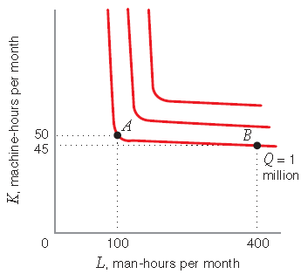
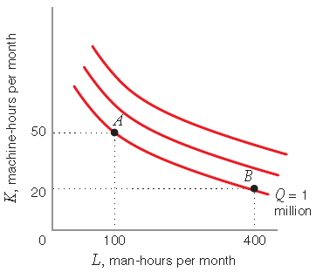
we explore how to describe the ease or difficulty with which a firm can substitute between different inputs
Input Substitution Opportunities and the Shape of Isoquants

Slide 21
The ease or difficulty with which a firm can substitute among inputs depends on the curvature of its isoquants
• When the production function offers limited input substitution opportunities, the MRTSL,K changes substantially as we move along an isoquant. In this case, the isoquants are nearly L-shaped, as in Figure a
• When the production function offers abundant input substitution opportunities, the MRTSL,K changes gradually as we move along an isoquant. In this case, the isoquants are nearly straight lines, as in Figure b

Slide 22
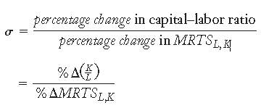
Elasticity of Substitution can help us describe the firm’s input substitution opportunities
Elasticity of substitution: A measure of how easy it is for a firm to substitute
labor for capital. It is equal to the percentage change in the capital–labor ratio
for every 1 percent change in the marginal rate of technical substitution of
labor for capital as we move along an isoquant

Slide 23
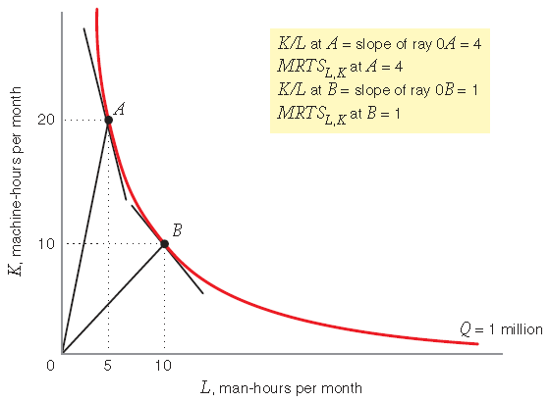
Elasticity of Substitution of Labor for Capital

Slide 24
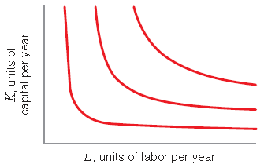
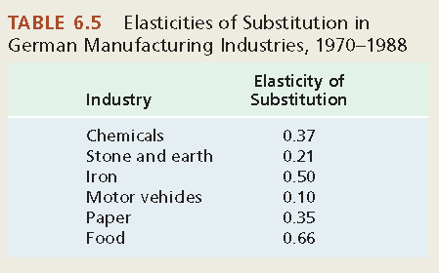
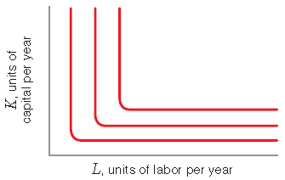
Elasticities of Substitution in German Industries11
11This example is based on “Estimated Substitution Elasticities of a Nested CES Production Function Approach for Germany,” Energy Economics 20 (1998): 249–264.

Slide 25
The shape of the isoquant indicates the degree of substitutability of the input.
K
σ = 0
σ = 1
σ = 5
σ = ∞
L
0

Slide 26
4 Special Production Functions
The linear production function
The fixed-proportions production function
The Cobb–Douglas production function
The constant elasticity of substitution production function

Slide 27
4 Special Production Functions
The Linear Production Function
The Fixed-Proportion Production Function
The Cobb-Doughlas Production Function
The Constant Elasticity Production Function

Slide 28
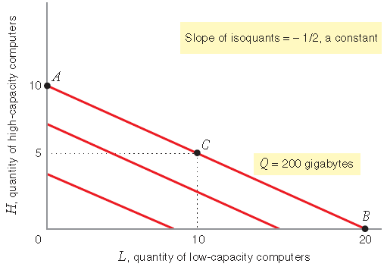
Linear Production Function (Perfect Substitutes)
Isoquants for a Linear Production Function

Slide 29
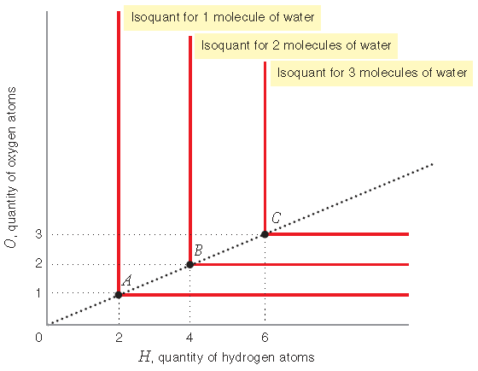
Fixed-Proportions Production Function (Perfect Complements)
Isoquants for a Fixed-Proportions Production Function

Slide 30
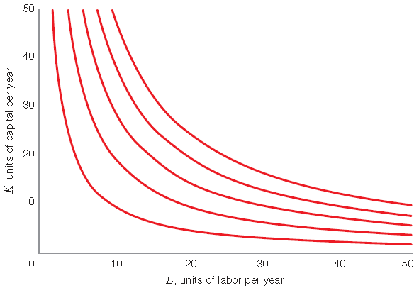
Cobb–Douglas Production Function
Isoquants for a Cobb–Douglas Production Function

Slide 31
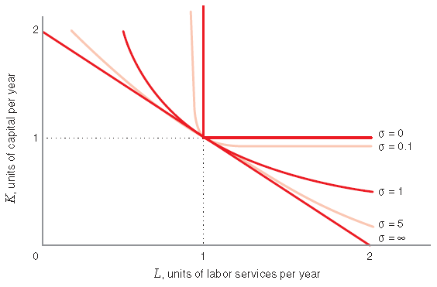

Constant Elasticity of Substitution Production Function
Isoquants for the CES Production Function

Slide 32
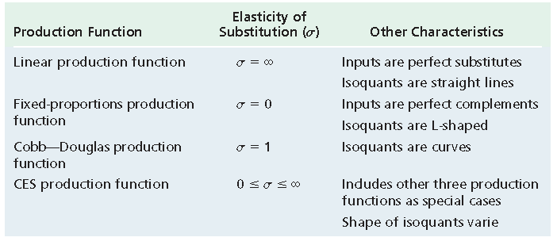
Characteristics of Production Functions: A Summary

Slide 33
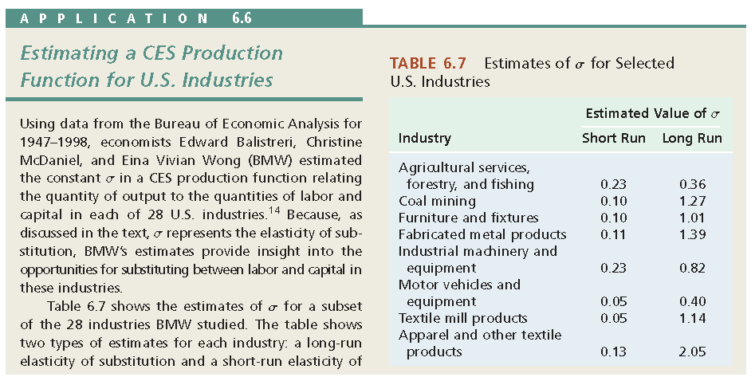
14Edward Balistreri, Christine McDaniel, and Eina Vivian Wong, “An Estimation of US Industry-Level
Capital–Labor Substitution Elasticities: Support for Cobb-Douglas,” North American Journal of Economics
and Finance 14 (2003): 343–356.

Slide 34

Returns to Scale
Question: By how much would a semiconductor firm be able to increase its output
if it doubled its man-hours of labor and its machine-hours of robots?
Returns to scale The concept that tells us the percentage by which output will increase when
all inputs are increased by a given percentage.

Slide 35
3 Types of Returns to Scale
increasing returns to scale: proportionate increase in all input quantities resulting in a greater than proportionate increase in output.
constant returns to scale: A proportionate increase in all input quantities simultaneously that results in the same percentage increase in output.
decreasing returns to scale A proportionate increase in all input quantities resulting in a less than proportionate increase in output.

Slide 36
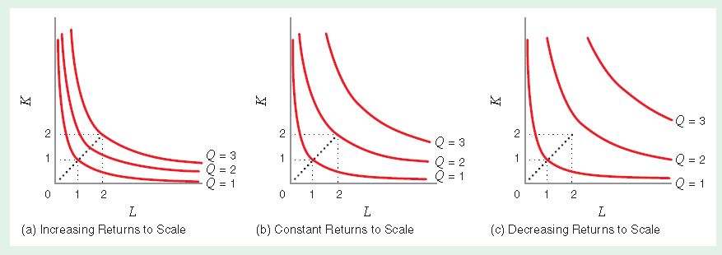
Increasing, Constant, and Decreasing Returns to Scale

Slide 37

Learning-by-Doing: Returns to Scale for a Cobb–Douglas Production Function
Does a Cobb–Douglas production function, exhibit increasing, decreasing, or constant returns to scale?

Slide 38
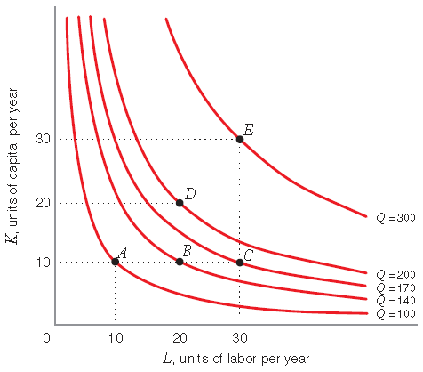
Returns to Scale Versus Diminishing Marginal Returns

Slide 39
Technological progress
technological progress : A change in a production process that enables a firm
to achieve more output from a given combination of inputs or, equivalently,
the same amount of output from less inputs.

Slide 40
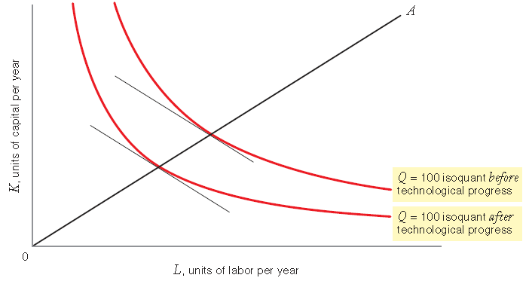
Neutral Technological Progress (MRTSL,K Remains the Same)
neutral technological
progress Technological
progress that decreases the
amounts of labor and capital
needed to produce a
given output, without affecting
the marginal rate of
technical substitution of
labor for capital.

Slide 41
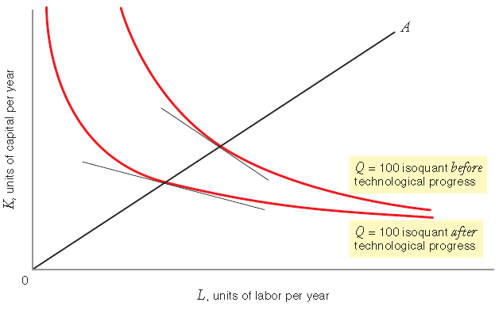
Labor-Saving Technological Progress (MRTSL,K Decreases)
labor-saving technological
progress
Technological progress that
causes the marginal product
of capital to increase relative
to the marginal product
of labor.

Slide 42
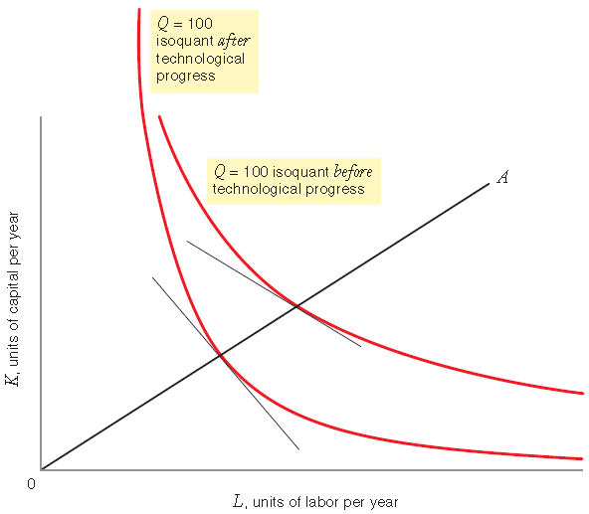
Capital- Saving Technological Progress (MRTSL,K Increases)
capital-saving technological
progress
Technological progress that
causes the marginal product
of labor to increase relative
to the marginal product of
capital.

Slide 43
Learning-by-Doing: Technological Progress

