Slide 1
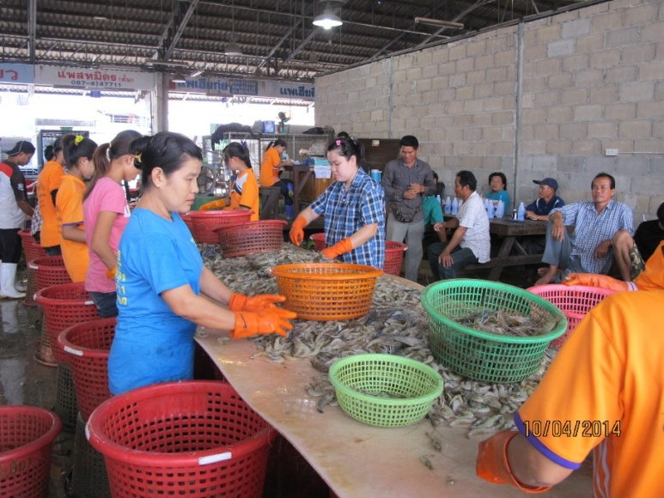
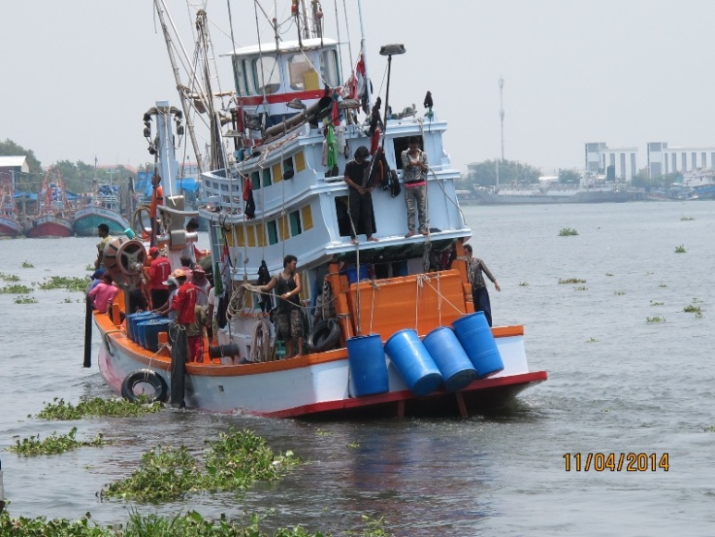
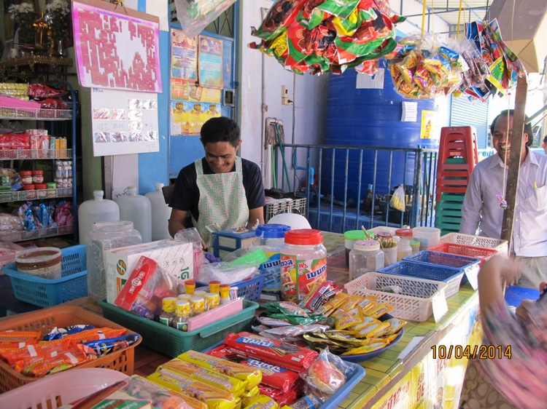
2 July 2015, Economics Department, Thammasart
CLMV Migrant Workers in Thailand
Migration structure & trends
Situation of migrant workers
Srawooth Paitoonpong, Ph. D.

Slide 2
Typology of MWs in Thailand
Registration – irregular MWs who are pardoned by Cabinet decision (A-13)
MOU – MWs who come to work in Thailand under MOU between Thailand and C, L, M
NV – Irregular MWs whose registration expire and are allowed to stay and work through national verification
OSSC – MWs who are registered at One Stop Service Center under the order of NCPO (National Committee for Peace and Order) in June-October 2014
Irregular – Migrant workers enter the Kingdom without immigration documents

Slide 3
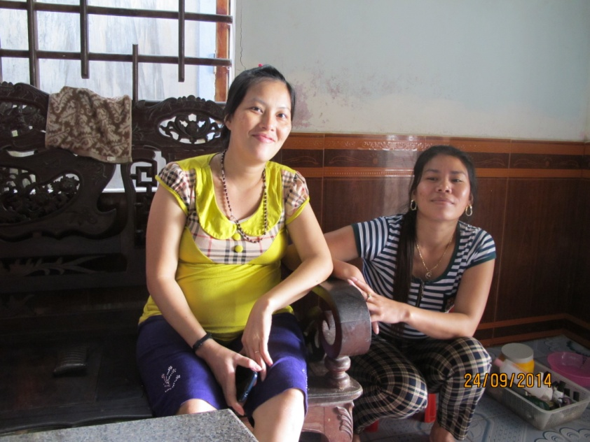
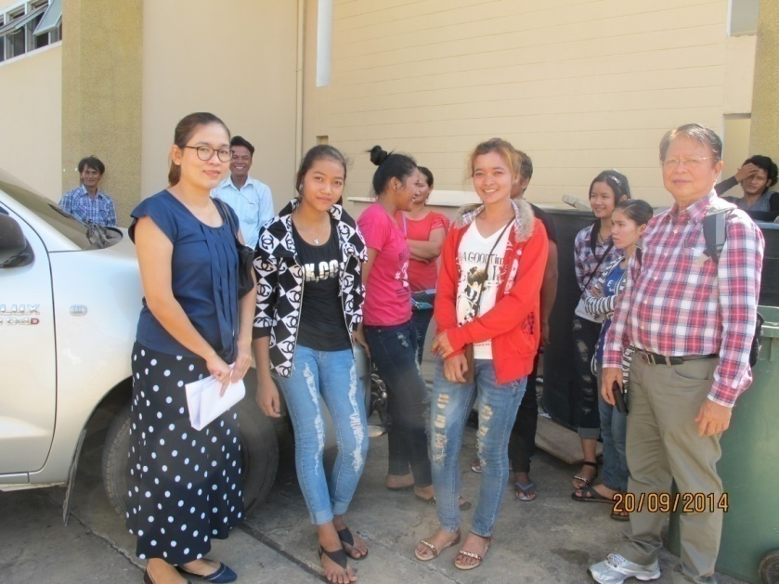
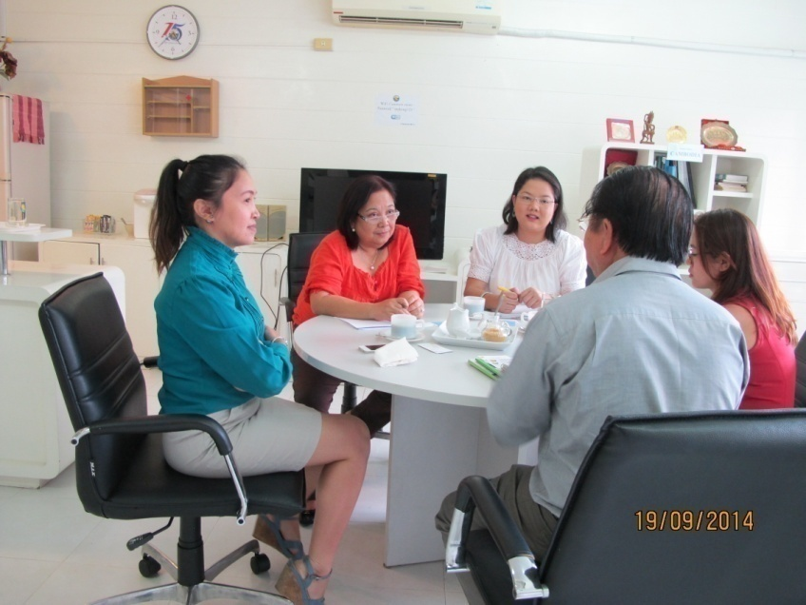
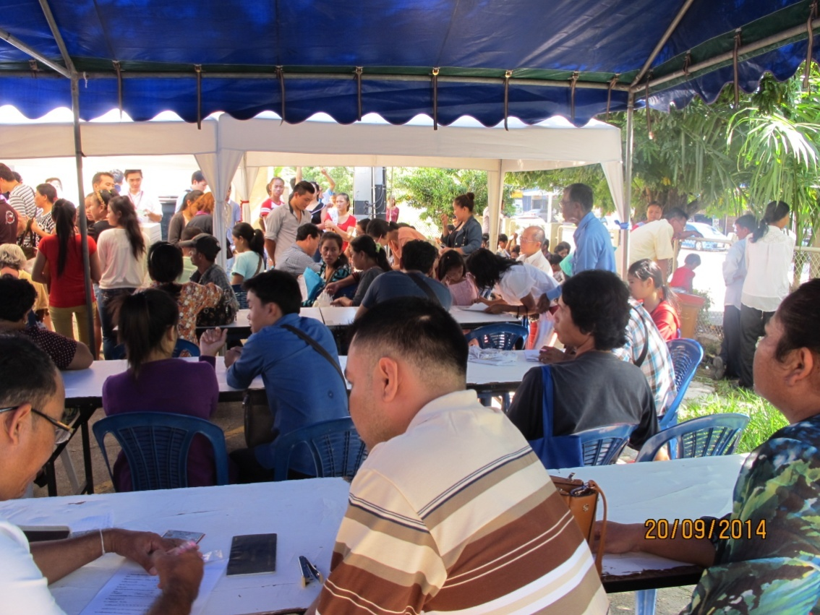

Slide 4
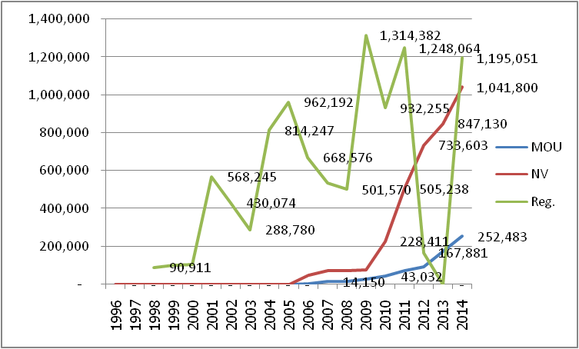
TRENDS of Mekong migrant workers
Registered MW 1.25 million in 2011 dropped to 0 in Dec/2013 ????
228,365 became NV in 2012 . Where are 1.02 mil.?
Repatriated + Undergrounded + returned home (flood crisis)
Became NV in 2014: 308,197 and (252,483 MOU)
OSSC (new registration) 1.53 million (31 October 14)
Notes:
228,365 = 733,603 in Dec 2012 – 505,238 in Dec 2011

Slide 5
Structure: CLM migrant workers in Thailand, 2014
Type of migration | Total | Myanmar | Lao PDR | Cambodia
Grand total | 2,876,617 | 1,710,936 | 286,696 | 887,985
Male | 1,637,432 | 1,025,548 | 163,076 | 448,807
Female | 1,230,185 | 685,388 | 105,620 | 439,178
% women | 42.9 | 40.1 | 39.3 | 49.5
NV total | 1,084,978 | 946,946 | 33,013 | 105,019
Male | 680,792 | 597,980 | 18,899 | 63,913
Female | 404,186 | 348,966 | 14,114 | 41,106
MOU total | 248,964 | 140,342 | 21,994 | 86,628
Male | 146,904 | 84,562 | 11,690 | 50,652
Female | 102,060 | 55,780 | 10,304 | 35,976
OSSC total | 1,533,675 | 623,648 | 213,689 | 696,338
Male* | 809,736 | 343,006 | 132,487 | 334,242
Female* | 732,939 | 280,642 | 81,202 | 362,096
As of 31 October, 2014
The total CLM migrant workers is 2.9 milions not including dependents of 92,560.
Notes:
Estimated from averaged gender composition of the registered MWs in 2009-2011 December
Note:*Numbers of NV and MOU are as of October 2014; Number of OSSC is as of 31 October 2014 updated on 29 November 2014. The dependents (aged below 15) registered under OSSC is 92,560, consisting of 40,801 Myanmar, 42,609 Cambodia and 9,150 Lao.
** Estimated from average proportion of women migrant workers to the total number of migrant workers under Article 13 (Registration), 2009-2011.
Sources: NV and MOU (Office of Foreign Workers Administration, November 2014); OSSC (Department of Local Administration, 29 November 2014)

Slide 6
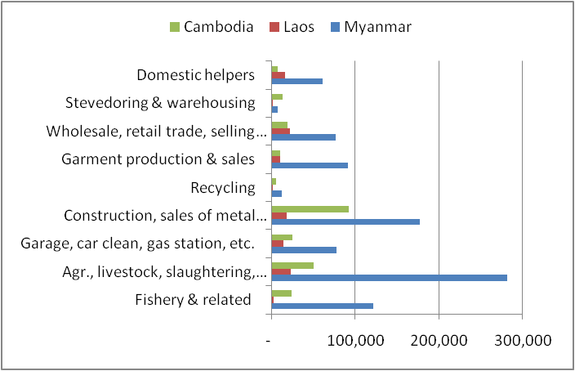
Skill demand: Low-skilled, manual labour, domestic work, work literacy in related activities
Number of registered CLM MW 2011 by activities
Notes:
After 2011, no occupational classification of the NV.

Slide 7
Vietnam
At present, there are about 50,000 Vietnamese migrants working in Thailand illegally (Matichon 15/6/2014).
Unlike CLM migrant workers, Vietnamese migrants come to Thailand with passport which allows them to stay as tourists in Thailand for 30 days (arrival by air and 15 days for arrival by land). After entry, they illegally work without work permit and renew their visa before it expires. The finefor overstay for THB 500/day (approximately US$ 15.6).
The penalty for violation of the Foreign Workers Employment Act 2008 is a fine of THB 2,000 – 100,000 (US$ 62.5-3,125) or an imprisonment of not more than 5 years or both fine and imprisonment. In practice, an arrested migrant is fined THB 2,000 (Ibid.).
There are increasing flows of Vietnamese irregular migration to China, Lao PDR, Cambodia, Thailand and beyond (ILO Vietnam2014).

Slide 8
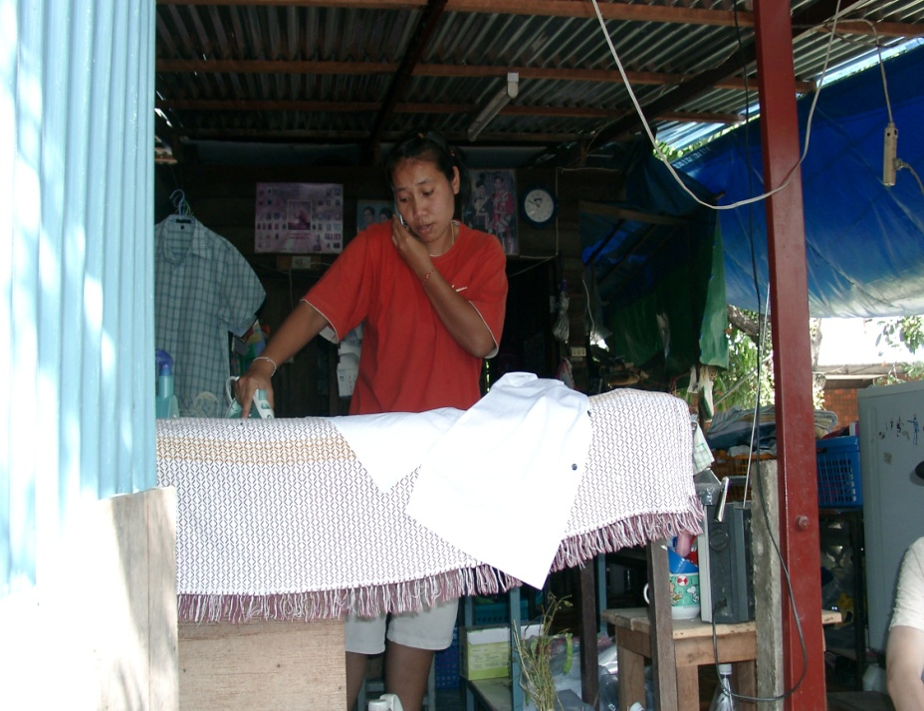
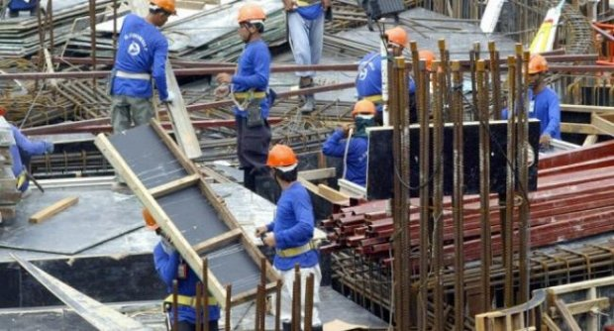
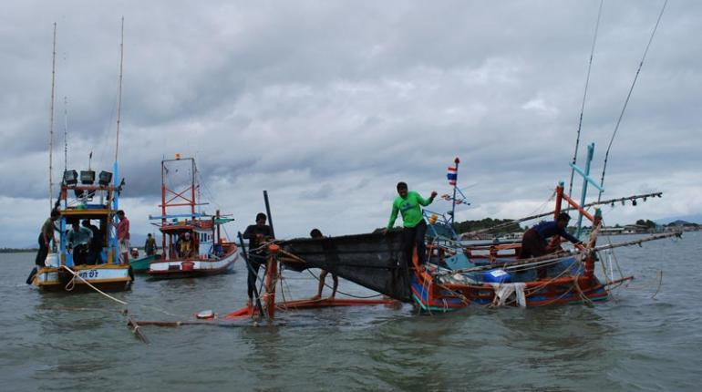
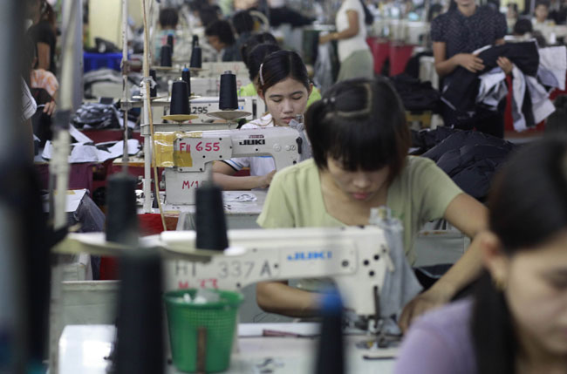
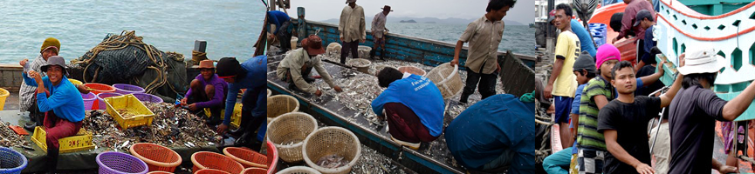
Domestic work
Construction
Garment
Fishery
Work in Thailand

Slide 9
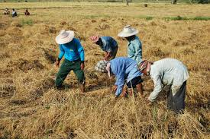
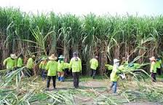
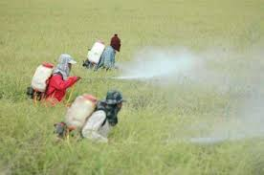
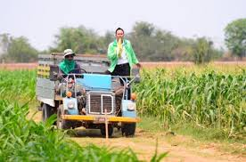
Farming
Pesticide

Slide 10
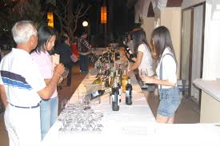
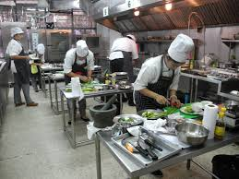
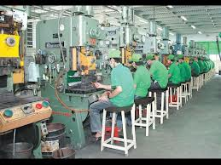
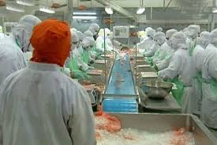
Sales
Cooking
Machine operator
Food processing

Slide 11
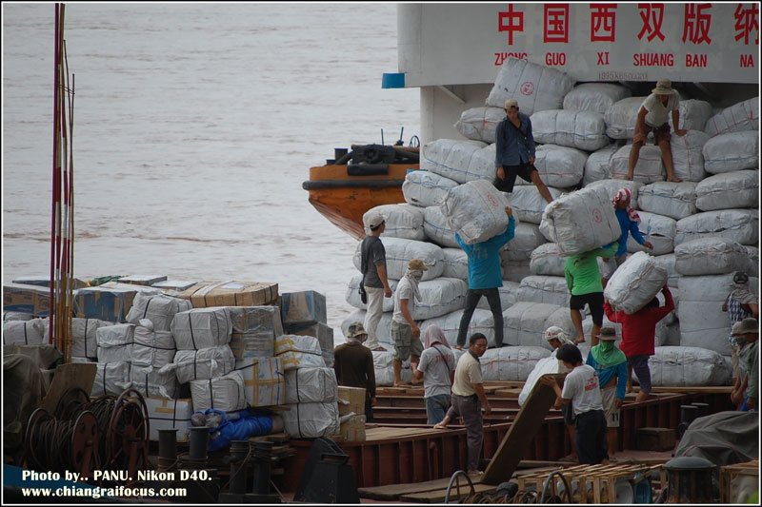
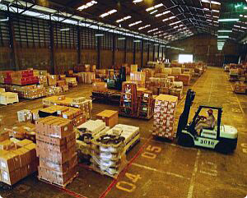
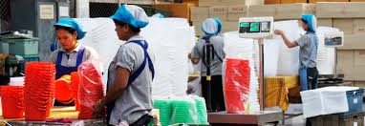
Stevedore
Manufacturing

Slide 12
Regulatory framework
Immigration Act B.E.2522 (1979, 1992)
Alien Employment Act B.E. 2521 amended in 2551 (1978, 2008)
Labor Protection Act B.E. 2541 amended 2551 (1998, 2008)
Relevant acts
  Social Security Act 1990
  Workmen’s Compensation Act 1994
  Labour Relation Act B.E. 2518 (1975)
  Investment Promotion Act B.E. 2520 (1977)
  Industrial Estate Authority of Thailand Act B.E. 2522 or The Industrial Act 1979
  Foreign Business Act B.E. 2532 (1999)
  The Petroleum Enterprise Act 1971
Notes:
Alien employment Act is the same as Alien Working Act due to translation

Slide 13
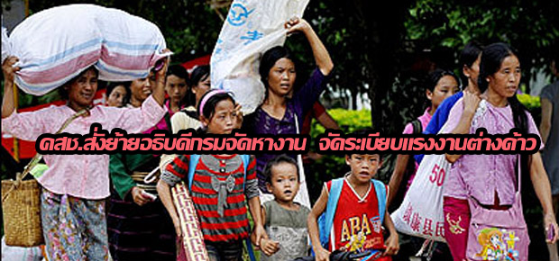
Management
From 2001- June 2014: Committee on Illegal Migrant Workers Administration
25 June 2014: Committee on Management Policies on Migrant Workers Problems (CMP-MWP) by chaired by Vice Chairman of NCPO
General management: Office of Foreign Workers Administration (OFWA)
June 2014, NCPO sacked Director General of Department of Employment & Director of OFWA

Slide 14
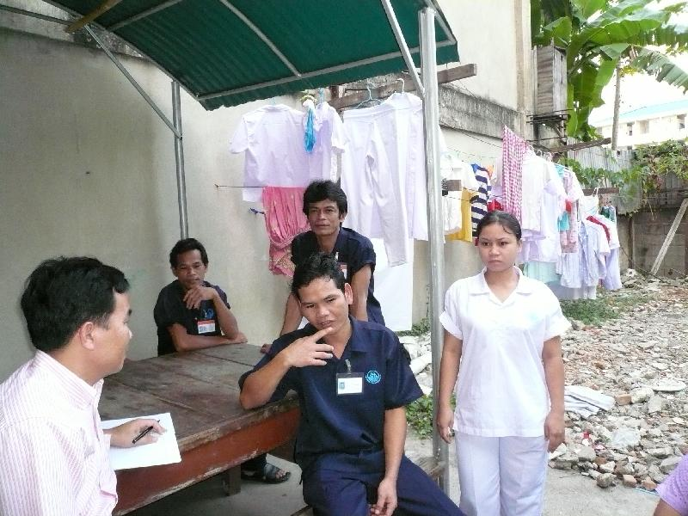
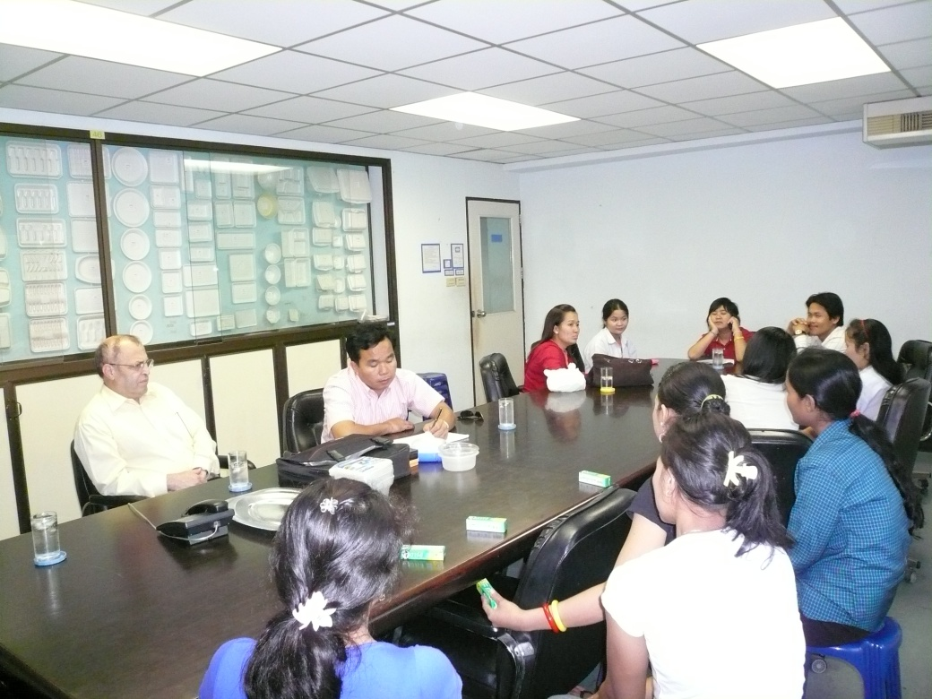
Management - Brokers
two types of brokers: Coordinating with government agencies and recruitment agencies (export/import workers) (and informal brokers);
210 recruitment agencies;
Some RAs are not efficient and not honest
Missing spouse
Unqualified MWs from Cambodia

Slide 15
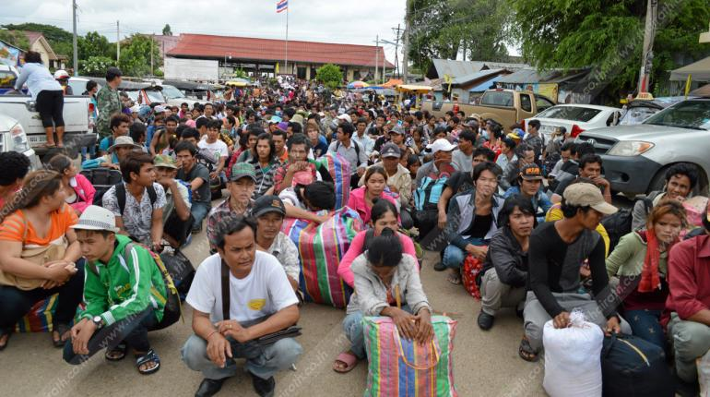
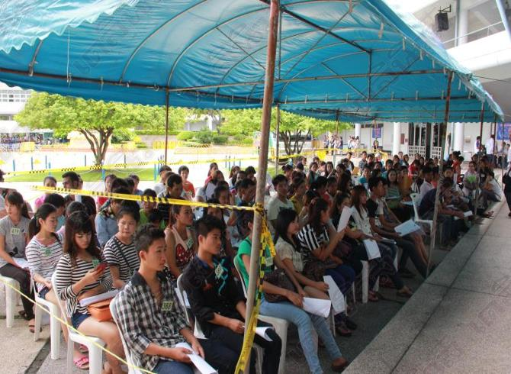
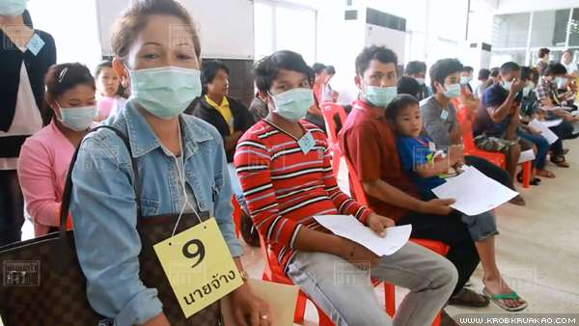
Panic of NCPO
Exodus of Cambodian migrant workers
Open registration at OSSC, 26 June-31 October 2014

Slide 16
Situation of migrant workers in Thailand
Poverty: Income poverty & Non-income poverty (lack of basic needs, rights and integration in destination)
Income : wage and OT; good wages that comply with laws and overtime of THB 51-54 per hour ???; (have savings and remittances).
Livelihood: language, participation in cultural activities, consultation with Thai people, awareness of rights and protection, children’s education, and security in life and assets, healthcare, housing, etc.
Vary by work location, nationality, and type

Slide 17
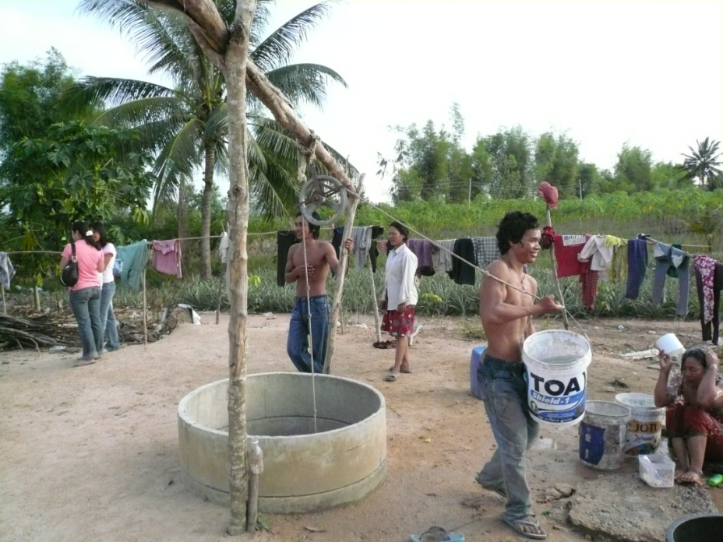
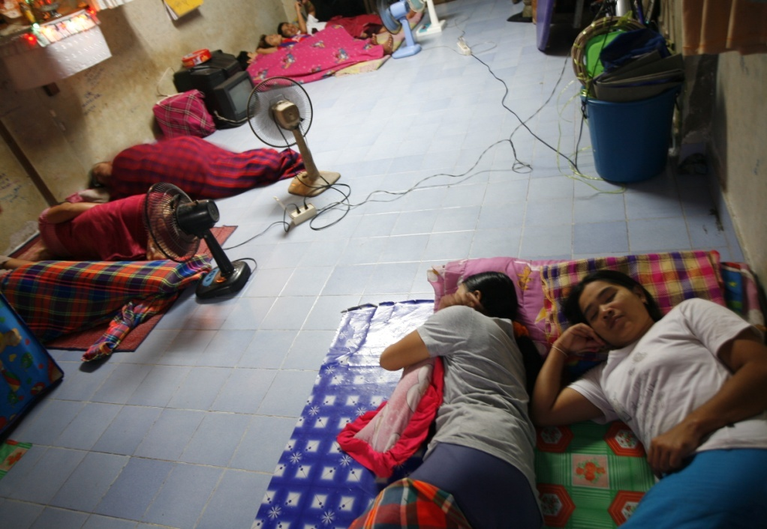
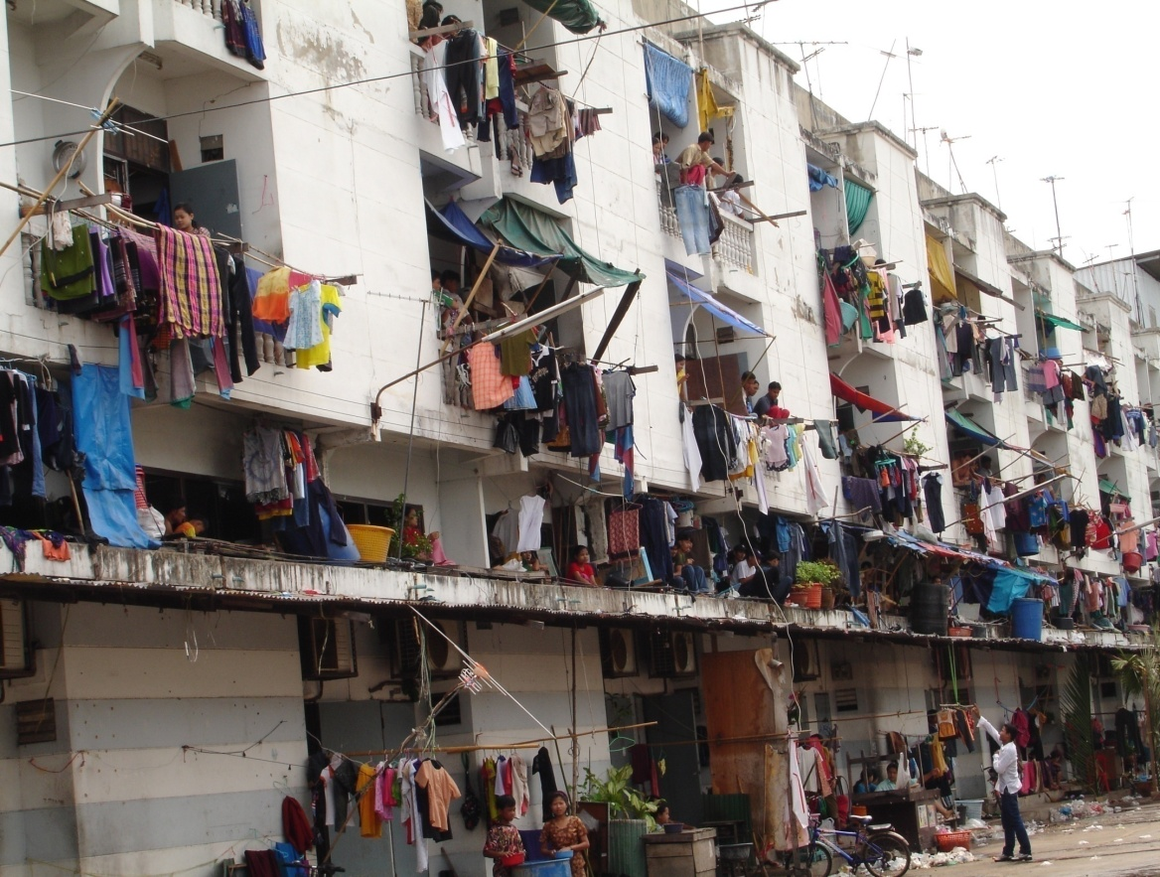
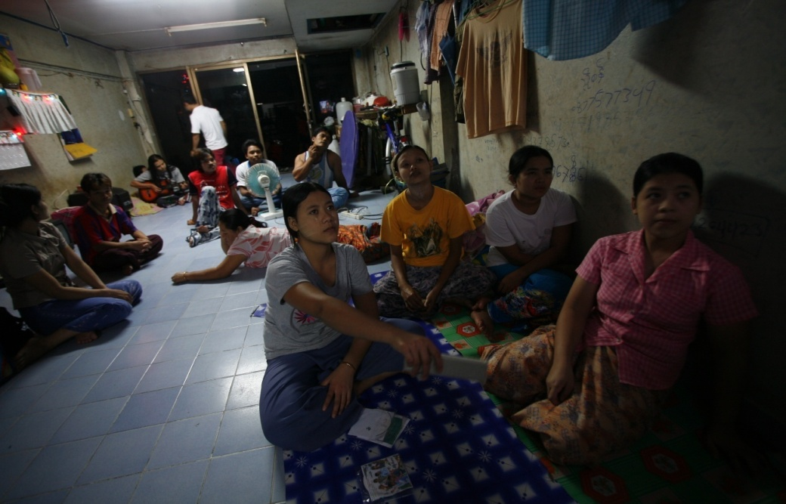
Living conditions
17

Slide 18
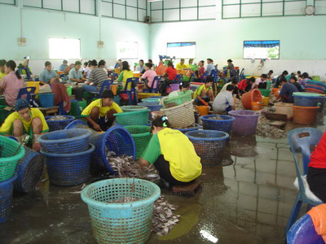
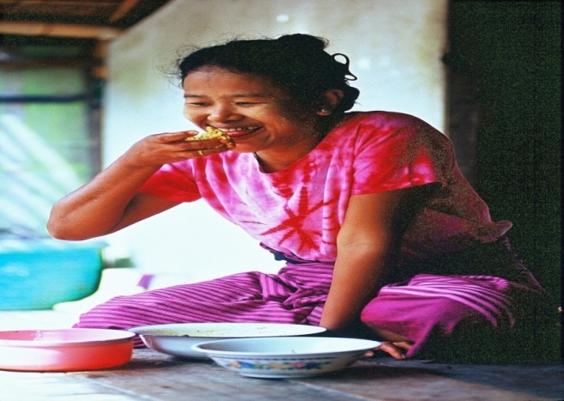
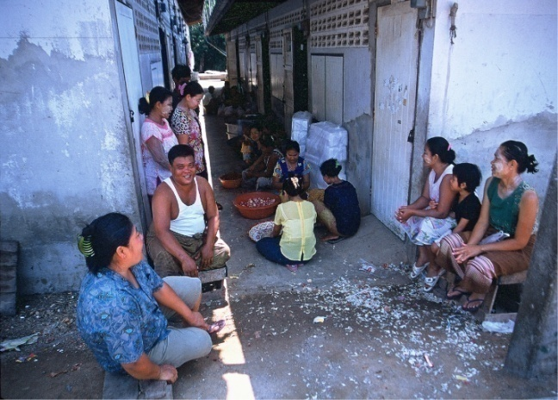
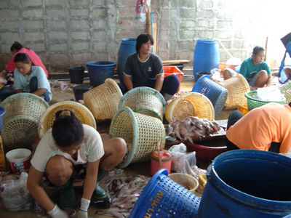
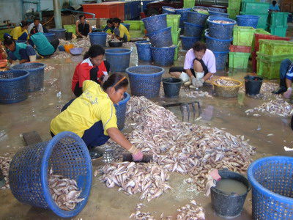
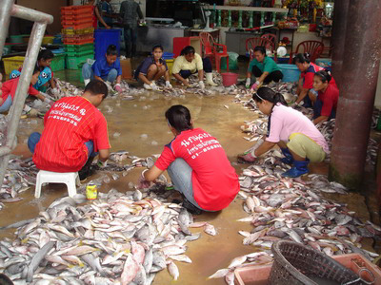
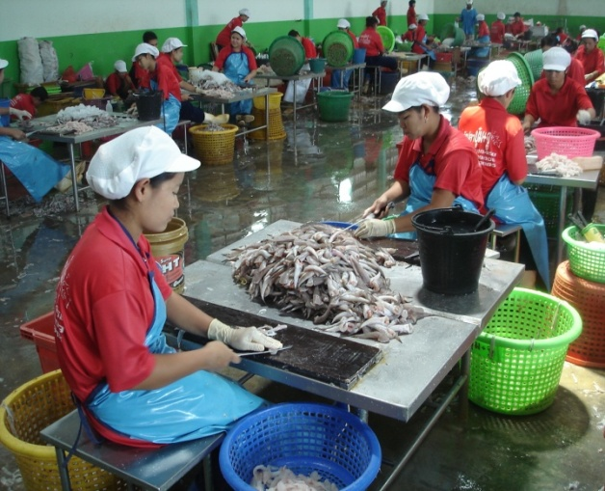
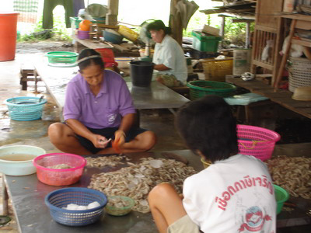
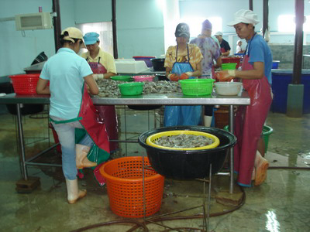
18

Slide 19
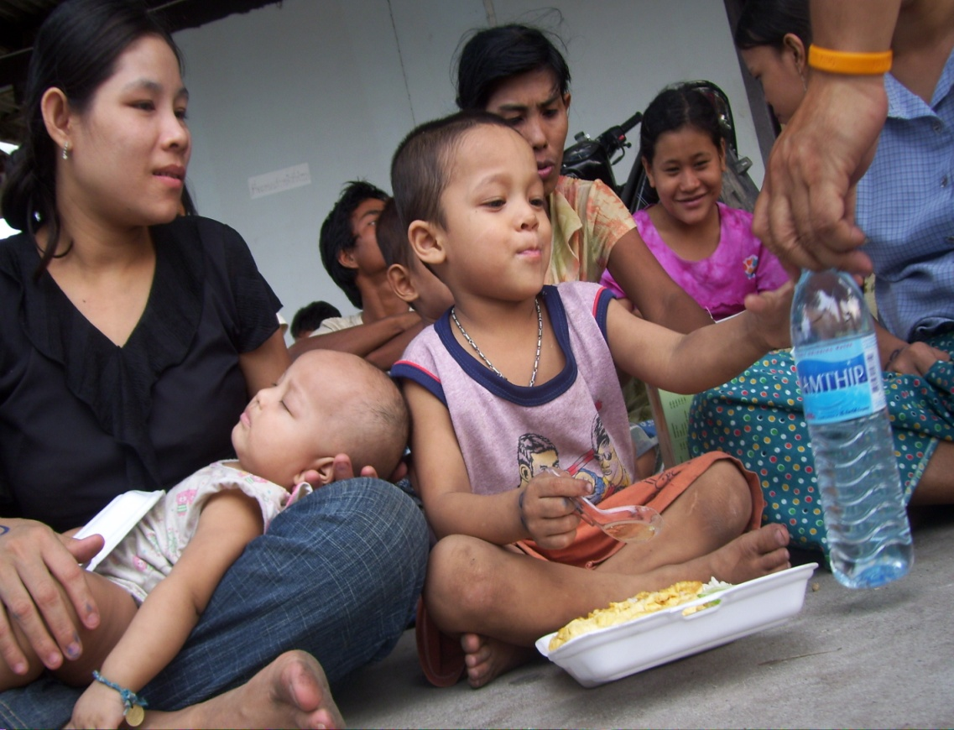
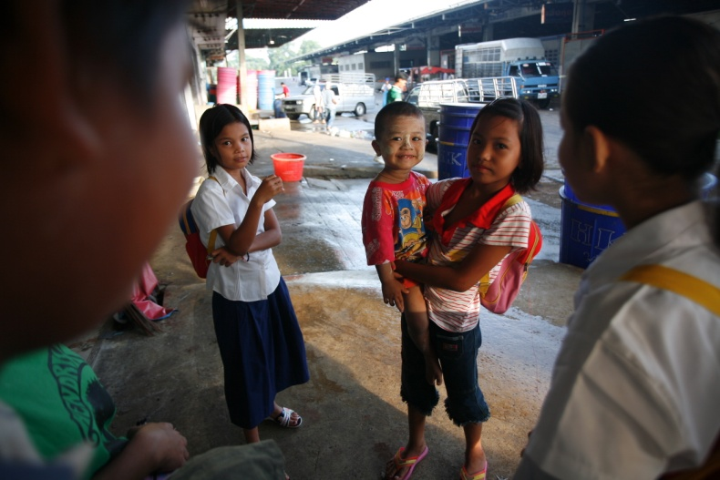
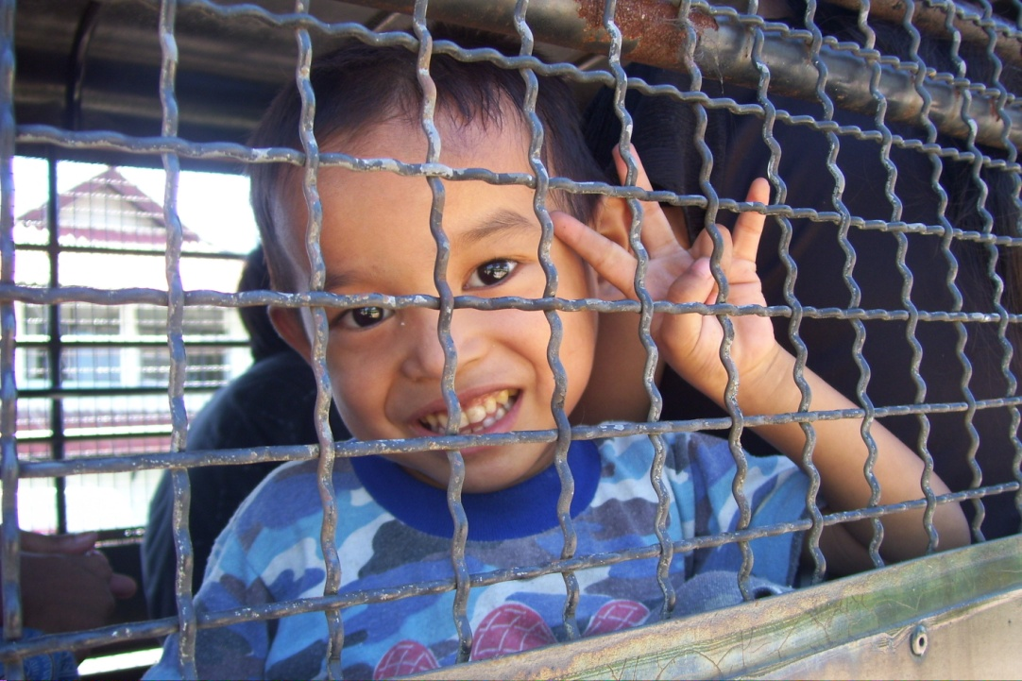
Thailand unseen

Slide 20
Rights and protection needs of migrants: access to social protection, health services, education
MW are vulnerable to exploitation and abuse by employers, landlords, officials, and criminals;
Undocumented workers are even more at risk;
Regulatory:
Wage and workplace: Labour Protection Act 1998, 2008
Social protection: SSA 1990 and WCF 1994 for legal MW;
Health services: SSA; Compulsory Migrant Health Insurance Scheme (CMHIS)
Children education: Learning centers, formal education

Slide 21
Integration institutions & programs
Integration institutions & programs varies according to the group, the irregular and regular MWs.
temporary MWS are expected to return home at the end of their contract so no long-term integration is envisaged for them.
they are not expected to bring dependents with them, there is no provision for the integration of their dependents.

Slide 22
Integration institutions & programs
Social protection
  Immigration law 1979
  Alien Employment Act 1978
  Social Security Act 1990
  Workmen’s Compensation Act 1994
Protect or regulate?

Slide 23
Immigration law
Immigration law determines MWs’ legal status (regular/irregular) as well as their entitlement to resources;
Including a constraining factor affecting MWs’ opportunities in labor market by determining who can/cannot do certain kind of jobs and for how long.
MW’s legal status is a factor which is as important as jobs available in labor market.

Slide 24
Alien Employment Act 1978
Defines immigrants’ eligibility for engaging in employment;
Determines occupations that MWs are allowed to engage in;
Sets the repatriation fund;
Collect levies from employers;
Regulates migrants’ conditions to change employers and workplaces;
Provide for the involvement of trade unions and employers in the reviewing the employment of MWs and for appealing;
Regulates the hiring of low-skilled MWs from CLM, structuring their contract employment through dependency ceiling, sector-specific restrictions,

Slide 25
Social Security Act 1990
Contributions: 5% of the monthly salary by employer and worker and additional contribution of between 2-3% by the government
Benefits:
  illness or injury (not related to work),
  maternity,
  disability,
  death,
  child allowance,
  old age pension and
  unemployment.
Eligibility: Only legal MW with work permit
Some benefits not applicable for MW (the SSA amended in 2015 allows MW to receive lump sum pension when they leave Thailand)

Slide 26
Workmen’s Compensation Act 1994
Cover work injuries and sickness;
Compulsory, employers pay a minimal contribution, 0.2-1.0 percent of the worker’s wage with adjustment by “experience rate”;
For MWs, Thailand has MOU with Cambodia and the Lao PDR regarding Cambodian and Lao MWs in Thailand, covering them with work injury insurance.
MOUs apply only to legal MWs from the two countries.

Slide 27
Workmen’s Compensation Act 1994
Compensation benefits:
1. Compensation amount or indemnity
  in case of injuries, disability or death at 60% of monthly wages, from 3 days to 15 years depending on the case.
2. Medical expenses
  up to THB 45,000 to 300,000 depending on the severity of the cases as prescribed in the Ministerial Regulations.
3. Industrial rehabilitation expenses
  as necessary, up to Baht 20,000.
4. Funeral expenses
  at a minimum amount equal to 100 times the minimum daily wage rate (THB 300 currently).

Slide 28
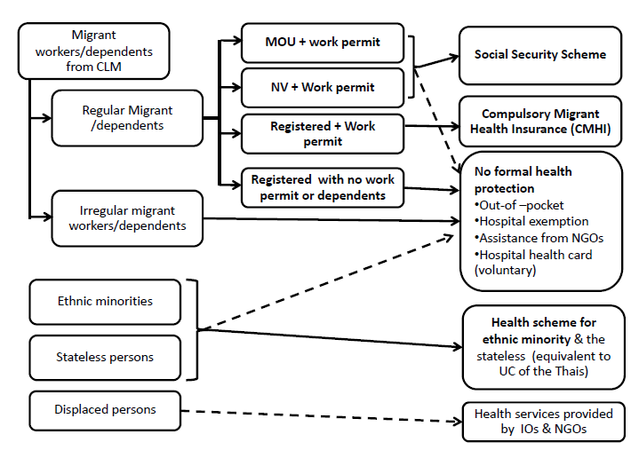
Healthcare for MWs
Medical benefits under SSA 1990 and WCA 1994
Universal Health Scheme
Compulsory Migrant Health Insurance (CMHI)

Slide 29
Education for MWs’ children
2 types
  public school or formal education and
  migrants’ learning centers or informal education. (MLC)
Public education for children of MWs through a cabinet resolution, July 2005
MLC -- uncertified schools starting appearing in the 1990s.
  run by members of the children's ethnic community
  Some -- like school, teaching basic education, in some cases extends from kindergarten to post ten levels.
  Mainly use Burmese as the medium of instruction (some use Karen, Shan and other regional languages at the lower grades) and curricula based on the Burma national curriculum.
  Some have lessons in basic Thai language, social and cultural orientation, basic legal knowledge, heath care and vocational training in skills like using computers.
Notes:
opposed to the Burmese military regime and sympathetic with opposition groups in Karen and Shan states.

Slide 30
Human trafficking
Legal measures in Thailand, such as
Prevention and Suppression of Trafficking in Persons Act 2008 (PSTPA 2008)),
Penal Code,
Criminal Procedure Code 1934,
Child Protection Act, B.E. 2546 (2003)
Prevention and Suppression of Prostitution Act B.E. 2539 (1996), the Anti-Money Laundering Act B.E. 2542 (1999), the Witness Protection Act B.E. 2546 (2003),
Labor Protection Act B.E. 2541 (1998, amended 2008),
Extradition Act B.E. 2551 (2008), and
International Cooperation in Criminal Matters Act B.E. 2535 (1992).

Slide 31
Situation of migrant workers in Thailand
Integration of MWs varies
  MWs from Myanmar and Cambodia are more men than women.
  Most male Myanmar migrants are in Surathani while Myanmar women are concentrated in Tak due to different types of work.
Average age of migrant is 28 years old. Older workers was in Ranong (aged 35-39 and 40-50) have higher proportion than in other provinces.
Average time of stay: Myanmar and Cambodian migrants is 4-5 years, Lao migrants is 6.5 years.
Notes:
The study is in 2011, after which situation changes

Slide 32
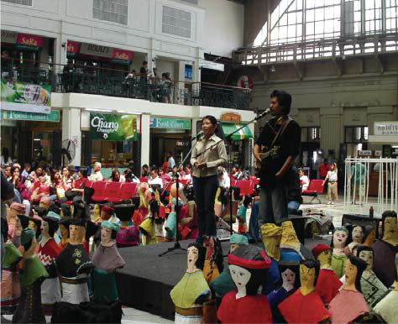
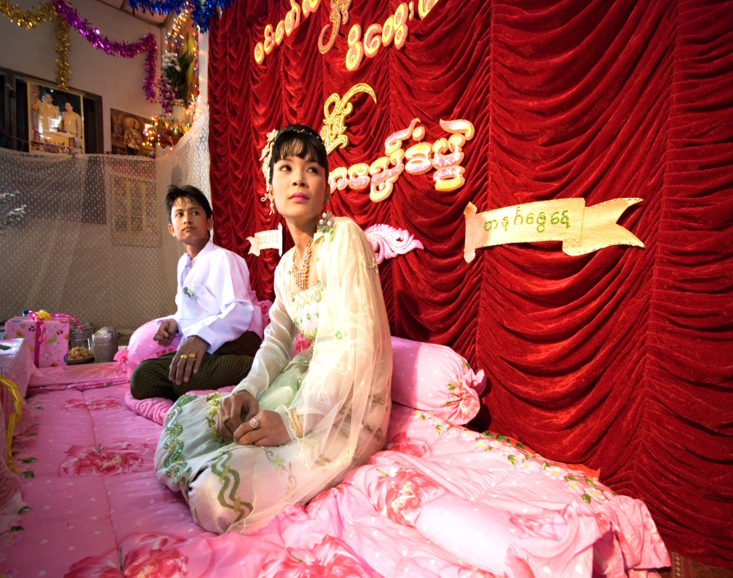
Situation of migrant workers in Thailand
Living conditions:
Participation in cultural
& social activities

Slide 33



Working & living environment
33

Slide 34
Social security issues:
Informal sectors are excluded (60% of migrants work as domestic workers, in the fisheries, or in agriculture).
Compliance problems associated with the SSS. Employers might not make regular monthly contributions, thus rendering migrants unable to access the SSS.
4 types of SS benefits not assessable by MWs: maternity benefits, child allowances, unemployment insurance and old-age benefits.
Year | Number of CLM migrant workers with work permit |  |  |  | Number of migrant workers in SSS | % of migrant worker in SSS
 | Registration | National verification | MOU | Total
2012 | 167,881 | 733,603 | 93,265 | 994,749 | 249,961 | 25.1
2013 | n.a. | 174,042 | 847,130 | 1,021,172 | 397,246 | 38.9
2014 (July) | n.a. | 1,149,088 | 251,373 | 1,400,461 | 415,588 | 29.7

Slide 35


WCF
MWs have work injuries;
Many employers refuse to pay the compensation.
WCF officials fail to order employers to pay the compensations to the injured migrants;
Irregular MWs are denied the right to be protected by WCF.

Slide 36


Labor protection
Thailand has a few laws to protect workers, some are not applied to MWs
A study by ARMC finds that MWs are well protected but the findings was challenged (by Andy Hall) that it is not correct.

Slide 37

Health of MWs
Illnesses and death of MWs are often results of unsanitary living conditions, unhealthy diets and unsafe work environments.
MWs may arrive healthy but develop severe health problems because of poor living and working environment.
During 2004-2008, the most common illness is diarrhoea, malaria, pyrexia (fever with unknown cause), pneumonia and dengue fever.
Most common cause of death among MWs was NCD, followed by accidents, infectious diseases and homicide/suicide.
Notes:
NCD=Non-communicable diseases

Slide 38




Health services & prevention

Slide 39



At least 8,000- 10,000 MWs’ children in Samutsakorn
Pictures courtesy of LPN

Slide 40
Number of migrants’ children in Thai schools by nationalities 2011 academic year
 | Myanmar | Cambodia | Lao PDR | Total
Kindergarten | 11,543 | 1,953 | 915 | 14,411
Primary school | 32,228 | 3,820 | 2,245 | 38,293
Lower secondary school | 4,247 | 637 | 300 | 5,184
Upper secondary school | 536 | 170 | 81 | 787
Vocational school | 11 | 0 | 1 | 12
Total | 48,565 | 6,580 | 3,542 | 58,687

Slide 41
Integration institutions reform
From 2001- June 2014: Committee on Illegal Migrant Workers Administration
25 June 2014: Committee on Management Policies on Migrant Workers Problems (CMP-MWP) by chaired by Vice Chairman of NCPO
General management: Office of Foreign Workers Administration (OFWA)
NCPO sacked Director General of Department of Employment & Director of OFWA

Slide 42
Concluding remarks
Still a large number of MWs from CLM/V to Thailand;
MWs from Vietnam to Thailand is increasing not only the illegal but also the legal;
Thailand will need MWs in the near future depending on its structural change and development process of CLM/V;
Skill structure is changing to more skilled than manual labour, more women than men in domestic work;
Lack of data on number and details of MWs because a large number of MWs are undocumented; yet, even with data on NV and MOU, no detailed breakdown s are available;
Notes:
Some not mentioned in text and needs to be proved

Slide 43
Concluding remarks
6. IOs, NGOs, have played key roles on MW issues, therefore their roles are imperative and need strong and sustainable supports;
7. Living conditions of MWs in Thailand though not so bad is not so good, only legal MWs have rights to access social protection, health and education services but not undocumented MWs; MWs are subject to exploitation and extortion;
8. Network access has improved (because of continued migration and scale and modern IT, MWs can connect to each other and are better informed about their peers);
9. Sending countries are still mostly poor, probably except one;

Slide 44
Concluding remarks
10. Most returned MWs have sent remittances and use them productively;
11. Some MWs’ children have education in Thailand; many MWs benefits from health services in Thailand;
12. Some of skill learned are useful, some are not if they do not migrate (over-qualified);
13. Many MW become self-confident because of going abroad – experience.

Slide 45
End Part 2 A (slide1-44)

