Slide 1
Asian Financial Crisis (1997)
EE 452 INTERNATIONAL MONETARY ECONOMICS
Members:
Ekachart Torsuwapun (5904641726)
Kantapong Visantavarakul (6004640030)
Janista Thanakarnjanasuth (6004640121)
Jeerath Kaewpaluek (6004640154)
Richaya Hemnusornnanon (6004640188)

Slide 2
Goals
Three possible factors: Current account imbalances (CAI), non-performing loans (NPL), and foreign reserve adequacy
Empirical models and result analysis
Impact of Asian financial crisis
Policy Implications

Slide 3
Three Possible Factors

Slide 4
Cause
Current Account Imbalance

Slide 5
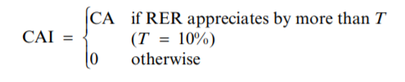
Current Account Imbalance (CAI)
Calculate in term of index
Determine from current account (as percentage of GDP)
No simple way to conclude sustainability of CA, but combination of CA deficit and significant Real Appreciation(RER) is signal of imbalance for sure
Therefore, CAI define as follows
Note: T is threshold set equal to 10%, although the result is the same when set as 0%
Notes:
Price goes up+ CA deficit = export performance delines
Expectation of declining export causes stock price to decline.
sharp exchange rate appreciation appears to have contributed to weaker exports and adverse shifts in market sentiment.

Slide 6
Current Account Imbalance (CAI)
The crisis index worsens when a high-deficit country with an appreciated currency meets both weak-fundamentals in the real and financial sectors and low-reserves criteria
The extent that there is insufficient availability of foreign reserves—that is, in light of fundamental model of currency crises, low reserves enhance the vulnerability of the economy to speculative attacks.
Therefore, the combination of current account deficit and currency real appreciation with low-reserves are significantly correlated the higher crisis index, therefore cause the devaluation rate or a fall in foreign reserves (or both).
Notes:
Fundamental = basic macroeconomic indexes such as economic growth rate, inflation rate and unemployment rate.

Slide 7
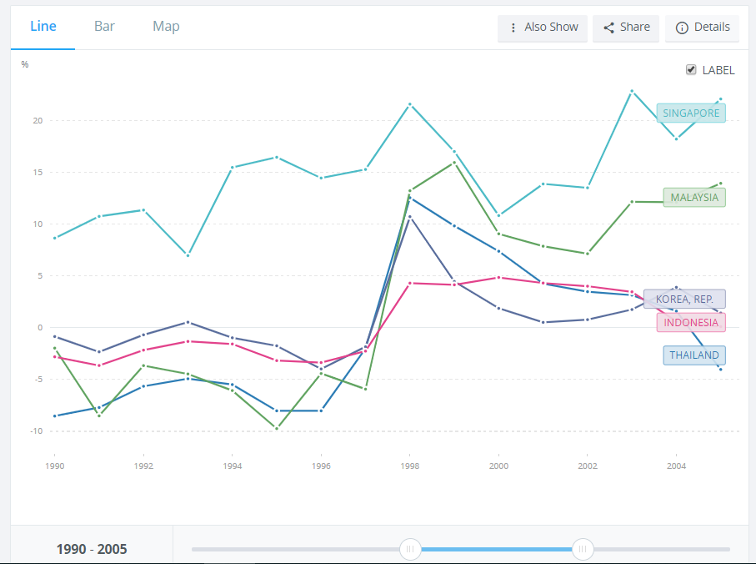
CA Balance
Notes:
https://www.imf.org/external/pubs/ft/fandd/basics/current.htm
http://citeseerx.ist.psu.edu/viewdoc/download?doi=10.1.1.631.8111&rep=rep1&type=pdf
http://si2.bcentral.cl/public/pdf/banca-central/pdf/v12/537-582.pdf

Slide 8
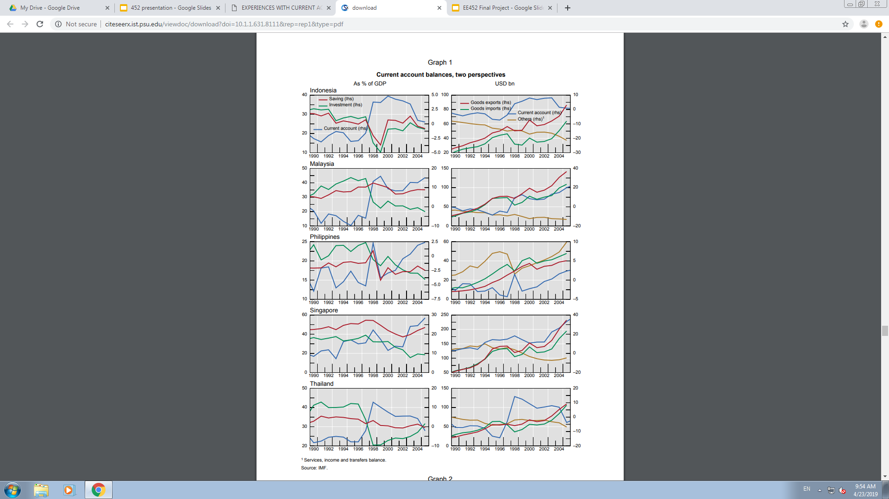
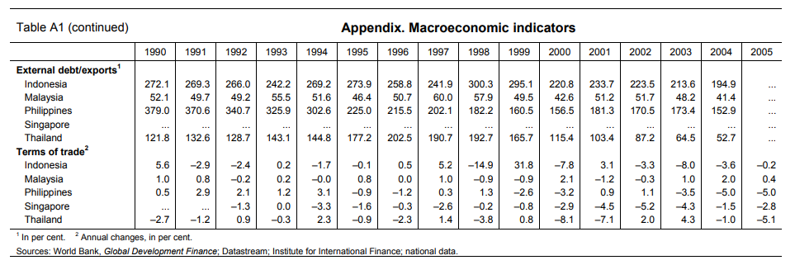
Notes:
First, current account deficits reflected an excess of investment over (high) saving rates, as opposed to high consumption. t incremental capital output ratios rose in Asian economies prior to the crisis, suggesting a deterioration in efficiency, and experience with current account deficits illustrates how high growth rates can be associated with significant external and domestic vulnerabilities. Rapid growth was linked to high rates of investment spending, which drove the current account cycle.
Second, The sharp slowdown in export growth in 1996 affected Thailand most severely. After growing nearly 25 percent in 1995, Thailand’s export revenues in dollars fell 1.3 percent in 1996. This partly reflected a significant drop in the terms of trade (see table A1). Export growth also fell sharply in Malaysia (26 percent to 5.8 percent) and the Philippines (32 percent to 17 percent) and more moderately in Indonesia (13.4 percent to 9.7 percent). The reasons cited for this slowdown included a significant decline in manufacturing export prices, most notably for semiconductors and other electronics products, and an appreciation of the dollar against the yen, which caused Southeast Asian effective exchange rates to appreciate (see Goldman Sachs, 1997). In Thailand, the slowdown in economic activity was associated with a significant shift in market sentiment starting in early 1996, as reflected in declining stock prices that hit other countries.
News of the drop in export growth in 1996 raised significant concerns about the sustainability of exchange rates and current account deficits.
Finally, the shocks cited above triggered sporadic episodes of speculative pressure, particularly against the Thai baht from 1995 onward. The eventual collapse of the baht in July 1997 triggered depreciations in the exchange rates of Indonesia, the Philippines, and Malaysia. Current account deficits switched sharply into surpluses around this time, reflecting the sudden withdrawal of external financing.

Slide 9
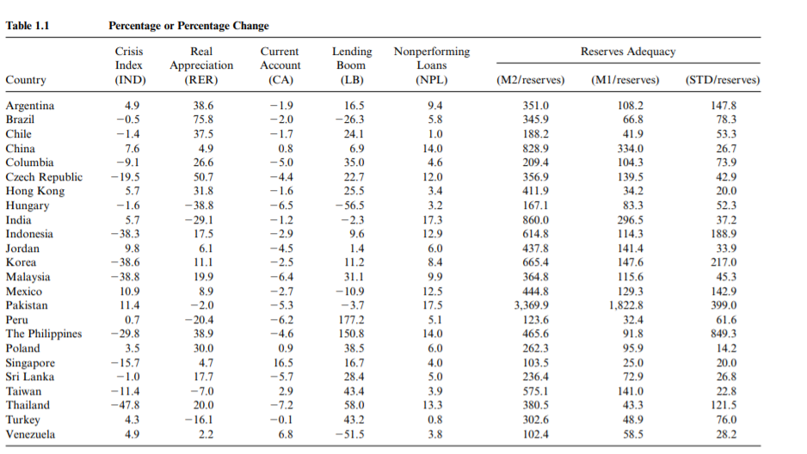

Slide 10
Cause
Non-performing loans which is subjected to lending boom

Slide 11
NON-PERFORMING LOAN (NPL)
Non-performing loan was affected by overlending or lending boom (LB).
Overlending causes 2 aspects including quantity and quality.
Percentage change in GDP of both LB and NPL is shown in figure 1.1 in the previous slide.

Slide 12
For the quantity, it is apparent that the percentage of LB was the largest in the Philippines, Thailand, and Malaysia with the number of 151% ,58%, and 31%, respectively.
In Thailand, the lending boom was notably larger for finance and securities companies than for banks. Moreover, the non-bank share of lending to the private sector was also relatively significant.
In summary, the evidence suggests that the lending boom was sustained in the Philippines, Thailand, and Malaysia. Also, these countries were the first to be hit by currency speculation in 1997.

Slide 13
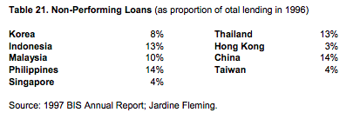
Quality of loan was the main point that led to the NPL. Since quality of loans made by banks and non-banks were low, investment became more risky and poorly perform.
From the table above, it illustrates that these estimations vary across countries, the figure also show the a strong correlation between the amount of bad loans and the extent of the currency crises.

Slide 14
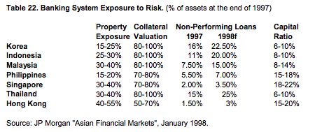
The table above represents a share of total assets, but what is the main problem that leads to the crisis is non-performing loans (NPL). In 1997, it is clear that NPL was the highest in Korea (16%), Thailand (15%), and Indonesia (11%). However, all Asian countries are expected to increase sharply in 1998 ,Korea ,Indonesia ,Malaysia ,and Thailand were the most problematic compared to other countries. The banks in these four countries were also severely under-capitalized (with capital asset ratios only 6-8%) ,and the ratio was expected to get worsen in the following years.

Slide 15
We can conclude that positive lending boom led to the higher non-performing loans in the four significant countries including Thailand. Moreover, asset deflation and the sharp drop in the value of collateral triggered the outstanding surge in the shares of non-performing loans.

Slide 16
INDEXES OF FOREIGN RESERVES ADEQUACY AND FUNDAMENTAL PERFORMANCES
Reserve availability can be captured by 1.) M1/reserves, 2.) M2/reserves, and 3.) foreign debt service burden (i.e. short-term foreign debt + interest payment on foreign debt) to foreign reserves (STD/reserves).The values of these variables are reported in table 1.1.
To test the joint role of fundamental and foreign reserves in determining the currency crisis, we classify the countries in our sample as being strong or weak.

Slide 17

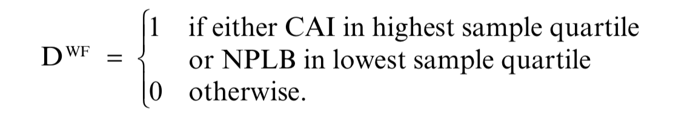
Regarding foreign reserves, we ues a board classification according to which a country is strong if the ratio of M2 reserves is in the lowest quartile of the sample, defined as follows
Which we focus on current account imbalances. Countries are classified as being strong or weak according to the scheme

Slide 18
Testing for the Role of Fundamentals Imbalances in the Crisis
The results of the regression of IND on CAI and NPLB are shown in column 1 of table 1.2.
Both a large current account deficit associated with a real appreciation
A larger rate of nonperforming loans
Which associated with a lending boom worsen the crisis index.

Slide 19
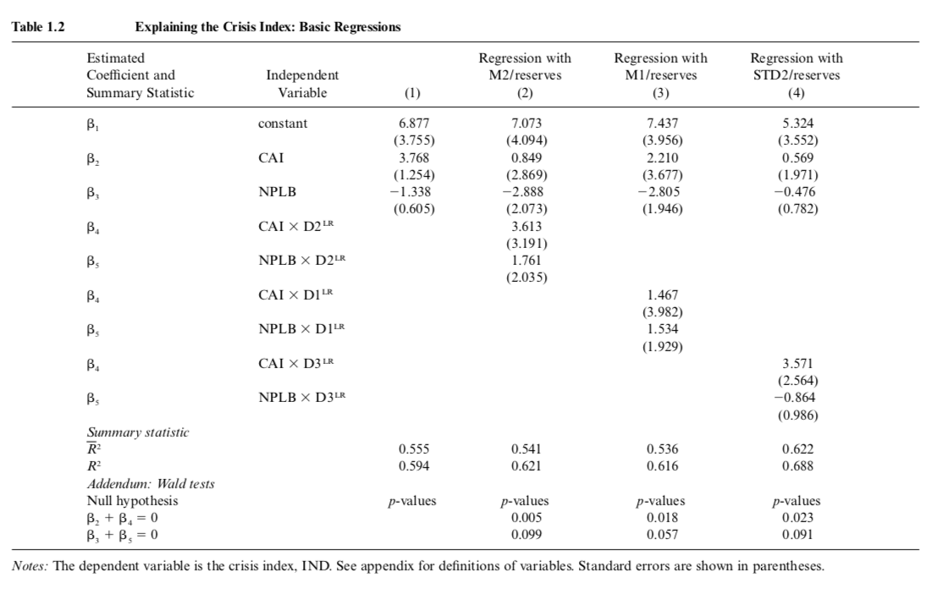

Slide 20
i) β₂ and β₃ are statistically significant only when reserves are low.
- The coefficients β₂ and β₃ measure the effects of CAI and NPLB on the crisis index in countries with high reserves (D^{LR} = 0).
- But Looking at the regression results shown in columns 2–4, the coefficients β₂ and β₃ are not significant on their own but only when reserves are low.

Slide 21
ii) β₂ + β₄ = 0 and β₃ + β₅ = 0 can be rejected at 1% and 10% significant levels.
The sums of the coefficiient β₂ + β₄ and β₃ + β₅ measure the impact of fundamental imbalances on the crisis index in countries with low reserves (D^{LR} = 1).
the case in which we use the reserve dummy D2^{LR}, based on M2 data
The tests indicate that the hypothesis β₂ + β₄ = 0 and β₃ + β₅ = 0 can be rejected at 1% and 10% significance levels.

Slide 22
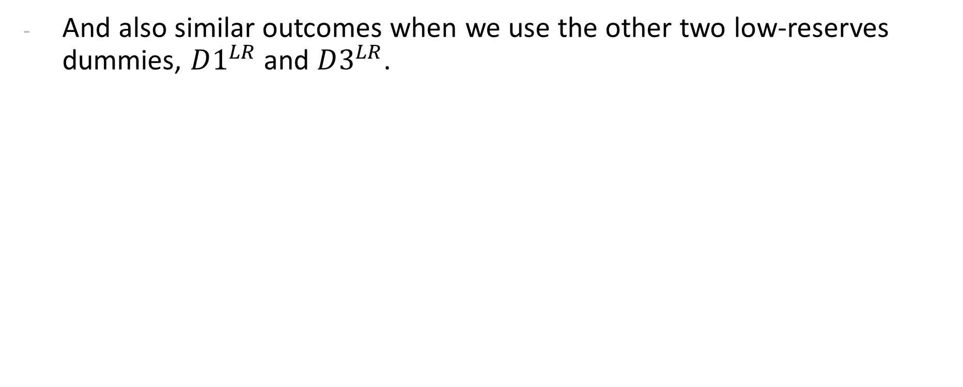
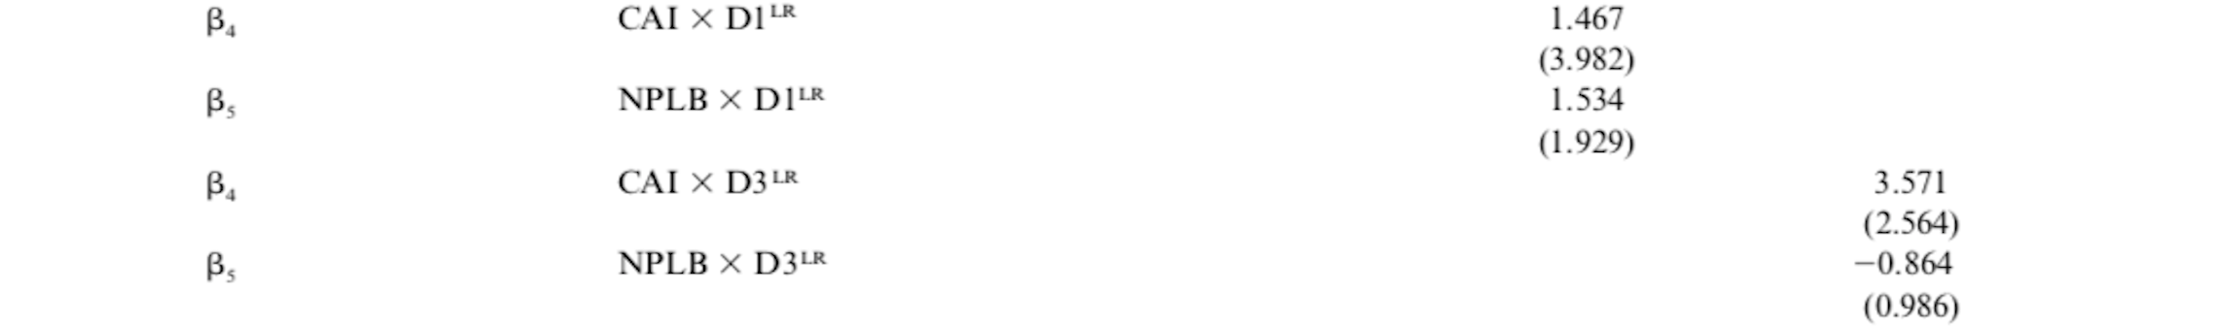

Slide 23
We can conclude that the results suggest that structural imbalances (current account deficits/currency appreciation and nonperforming loans/lending boom) play as an important role of the beginning of the crisis which there is insufficient availability of foreign reserves.
In both fundamental and nonfundamental models of currency crises, low reserves increase the vulnerability of the economy to speculative attacks.

Slide 24
Empirical Model and Results Analysis

Slide 25
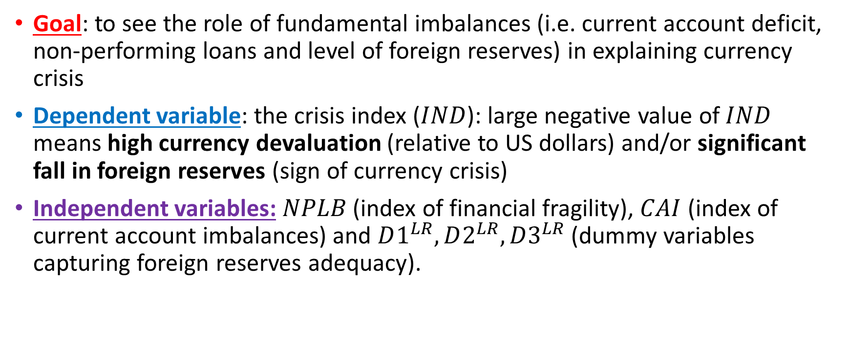
Model Setup

Slide 26

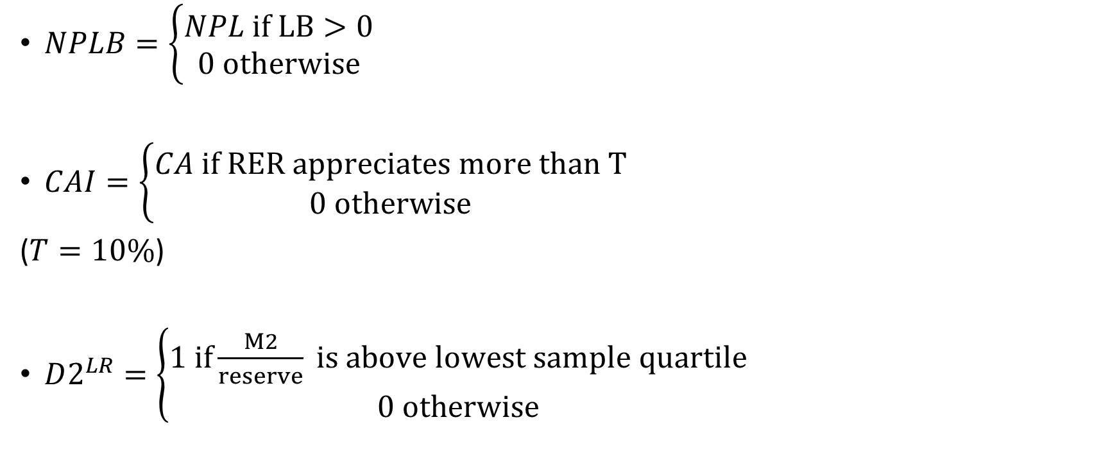

Slide 27
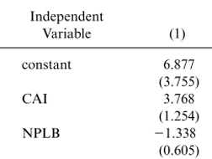
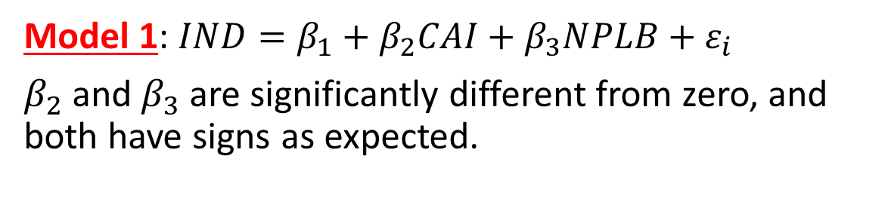
Results (1)

Slide 28
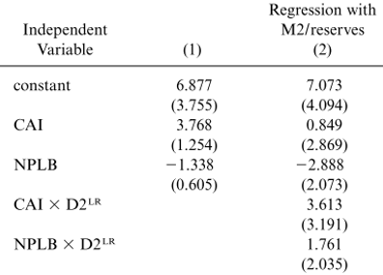
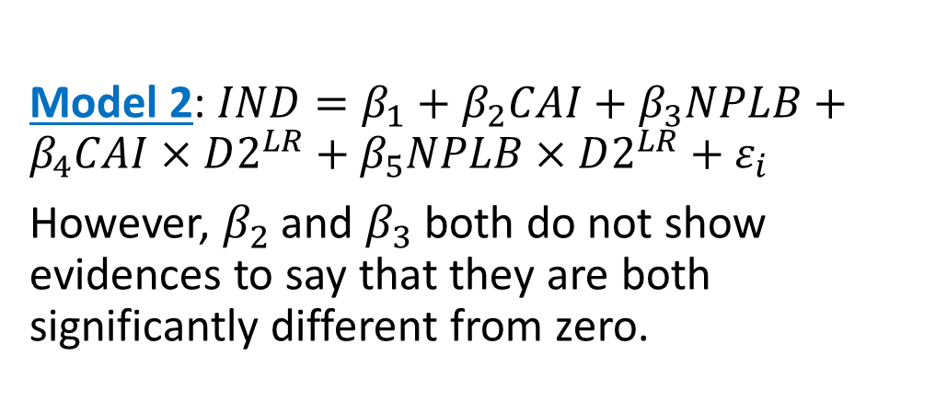
Results (2)
If we are interested in countries with low reserves, how do we test?

Slide 29
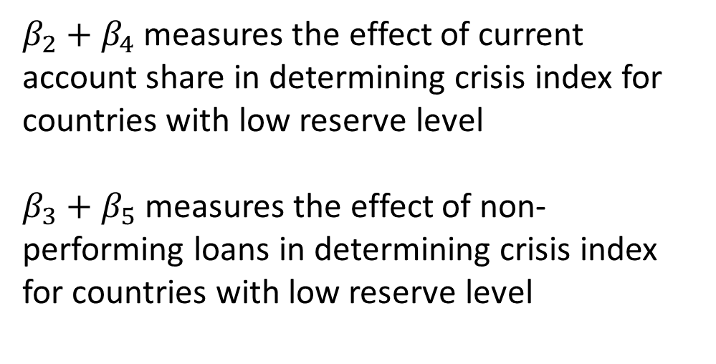

Result(3)

Slide 30
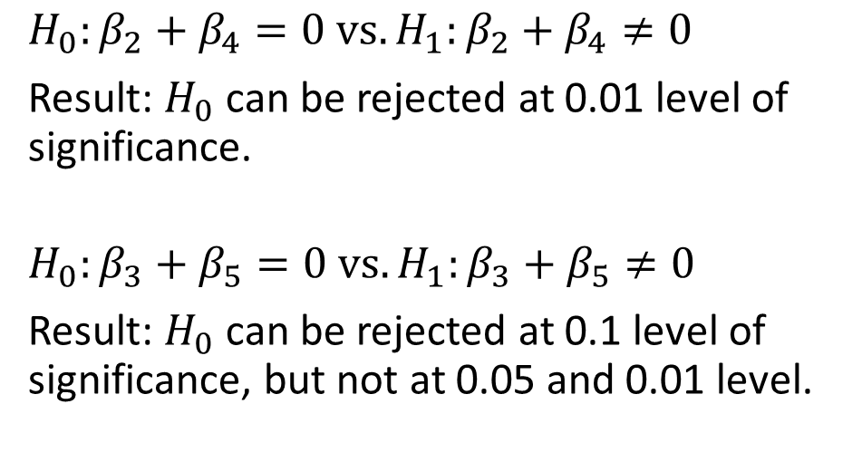
Result(4)

Slide 31
Conclusion from data analysis
Fundamental factors, namely (1) NPL (lending boom, together with high percentage of NPL) and (2) current account (currency real appreciation, together with low level of current account share), can significantly determine crisis index.
Level of foreign reserves plays a role in explaining whether the local currency will depreciate sharply or level of foreign reserves will fall significantly (i.e. large negative value of index crisis). This can be explained by second generation model of currency crisis.

Slide 32
Impact of Asian Financial Crisis

Slide 33
Impact of Asian Financial Crisis: Overview
Contagion spread to neighbors: speculation against other countries currencies (i.e. Malaysia, Indonesia, South Korea). These countries share common characters: they are affected by economic slowdown in Japan.
Countries face a dilemma: (1) raise very high interest rate to prevent local currency depreciation and (2) let it depreciate, but debt dominated in dollars will be greater in terms of local currency
Many countries have to depend on IMF loan. The conditions of IMF loan include (1) raising interest rate, (2) avoid budget deficit, and other structural transformations. That is why many countries in this region show current account surplus, mostly from decrease in imports.

Slide 34
Short-Term Impacts After The Crisis
Increase in inflation generated upward pressure on wages and increases value-added tax and public utility charges.
Slow economic performance from business profitability deteriorated due to higher taxes and utility charges and other factors.
Bad debts continue to create economic and financial instability.
Direct investment remained sluggish due to uncertainty of the economy, exchange rate and profitability.
Notes:
https://www.jri.co.jp/english/periodical/rim/1998/RIMe199801crisis/

Slide 35
Long-Term Impacts After The Crisis
Increase in external debts from the devaluation of local currency: Thailand's external debts from around $89 billion rose to over $100 billion.
The devaluation of currency enhanced the country’s export and gains price competitiveness.
Exchange rate adjustments among the ASEAN countries in order to facilitate intra-regional trade.

Slide 36
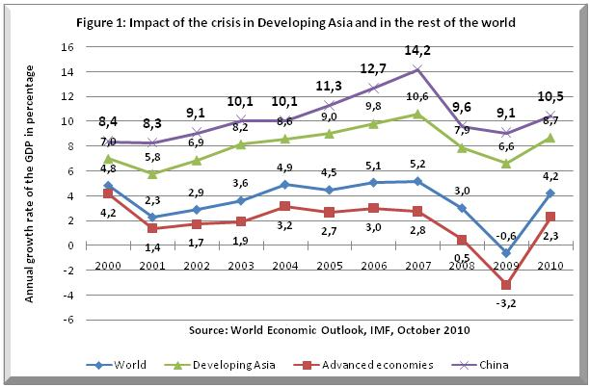
http://links.org.au/node/2616

Slide 37
Policy Implications

Slide 38
Policy Implications
We will look into policy implementation in case of country surrender the complete fixed exchange rate system, in example of Thai government, that could not maintain the fixed exchange rate and had to let exchange rate float and baht started to depreciate since July 1997.
Problem: Sharp depreciation of local currency.
Goal: To use the policy to prevent sharp depreciation of local currency.

Slide 39
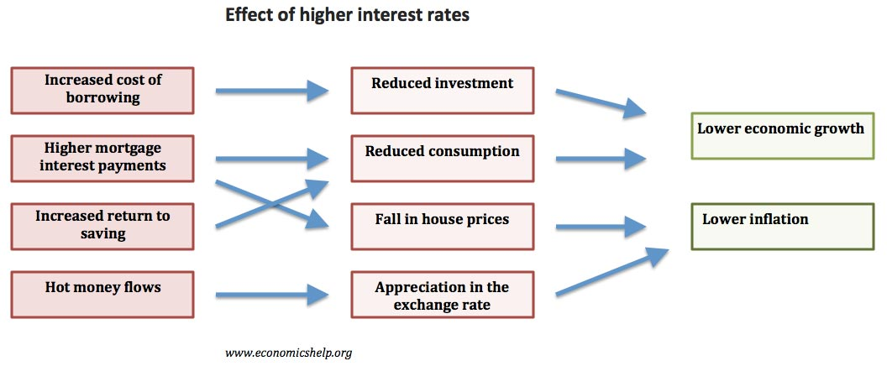
Contractionary Monetary Policy
Contractionary monetary policy: increase interest rates, decrease in gross national production and an appreciation of the local currency in a float exchange rate system in the short run.

Slide 40
Contractionary Monetary Policy
By raising domestic interest rates, it would also make the domestic-currency assets more attractive for investors and encouraging external liabilities to attempt to reschedule the debts. Strengthening the balance of payments by reducing runoffs of foreign liabilities.
Notes:
, rather than finance repayments through borrowings in domestic credit markets

Slide 41
Effects of Monetary Policy on Countries
According to IMF, In Korea and Thailand, interest rates were raised to high levels in real terms for only few months, but as market conditions stabilized, currencies recovered and interest rates back to below pre-crisis levels.
While in Indonesia, it maintained negative real interest rates through year 1998, the collapse in local currency was much worse and drawn-out than in others.

Slide 42
Risks and Conflict of Implementation
Higher interest rates may increase debt-service burdens for firms, lower loan performance, add to pressures on the banking system.
Domestic debtors may not have the option of rolling over their external obligations since foreign investors pulling investment out of the region.
Since the lack in the stock of the international reserve, the effects of government intervention is limited.
Contractionary monetary policy limits inflation, leads to appreciation and increasing current account deficit.

Slide 43
Other IMF Implementations
Tight fiscal policy to generate surplus
Structural reform
enhancing labor market flexibility
Strengthen financial systems, regulation and supervision
Privatisation
Trade liberalisation
Prioritizing improvement of secondary education and infrastructure

Slide 44
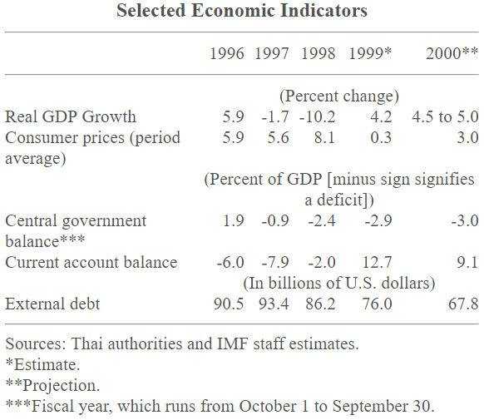
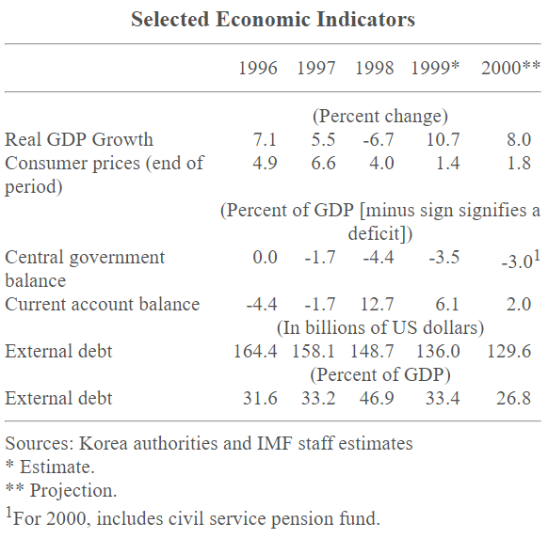
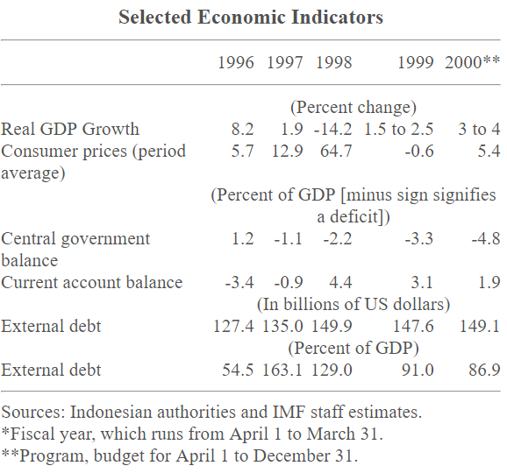
Thailand
Korea
Indonesia

Slide 45
Negative Effects of IMF Programs
Moral hazard.
Increase unemployment and poverty rate.
  In Korea, it increased rate of unemployment from 3% to 10%.
  In Indonesia, poverty rates rose from 11% to 40-60% and GDP declined by 15% in the first year.

Slide 46
Other Implementation
Malaysia’s National Economic Recovery Plan

Slide 47
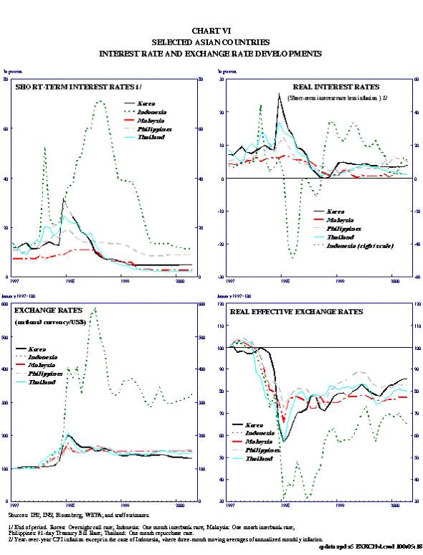

Slide 48
References
Adamchik, V., (2016). Macroeconomic Policy in an Open Economy, Available at: https://slideplayer.com/slide/6985176
Corsetti, G., Pesenti, P., & Roubini, N. (2001). Fundamental determinants of the Asian crisis: the role of financial fragility and external imbalances. In Regional and Global Capital Flows: Macroeconomic Causes and Consequences, NBER-EASE Volume 10 (pp. 11-41). University of Chicago Press.
Iijima, K. (1998). Background and Impact of the Asian Currency Crisis, Available at: https://www.jri.co.jp/english/periodical/rim/1998/RIMe199801crisis/
Krugman, Paul R., et al. International Economics: Theory and Policy. Pearson, 2015.
Ghosh, A., Ramakrishnan, U., Current Account Deficits: Is There a Problem?, Available at: https://www.imf.org/external/pubs/ft/fandd/basics/current.htm
Gould, D., Kamin, S., (1999). 'The Impact of Monetary Policy on Exchange Rates During Financial Crises', Available at: https://www.frbsf.org/economic-research/files/gould_kamin.pdf

Slide 49
References
Moreno, R., (2006). Experiences with current account deficits in Southeast Asia, Available at: http://citeseerx.ist.psu.edu/viewdoc/download?doi=10.1.1.631.8111&rep=rep1&type=pdf
Moreno, R., Experiences with current account deficits in Southeast Asia, Available at: http://si2.bcentral.cl/public/pdf/banca-central/pdf/v12/537-582.pdf
Richardson, D., (1998). Asian Financial Crisis, Available at: https://www.aph.gov.au/About_Parliament/Parliamentary_Departments/Parliamentary_Library/Publications_Archive/CIB/CIB9798/98cib23
How the IMF helped create and worsen the Asian financial crisis, Available at: https://www.essentialaction.org/imf/asia.htm
Government Intervention in the Exchange Rate, Available at: https://dineshbakshi.com/economics/a-level-economics/government-macro-intervention/revision-notes/616-government-intervention-in-exchange-rate
(2000). Recovery from the Asian Crisis and the Role of the IMF, Available at: https://www.imf.org/external/np/exr/ib/2000/062300.htm

