Slide 1

MK 322 Retail Management
Chapter 17: Store Layout, Design, Visual Merchandising Part III
By Ajarn Suwalya K.

Slide 2
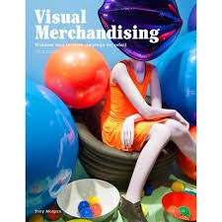
Visual Merchandising

Slide 3
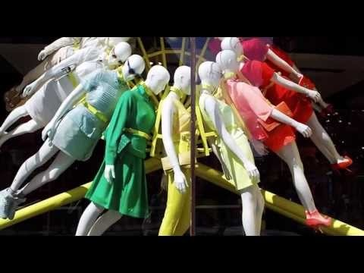
Visual Merchandising
Visual merchandising is the presentation of a store and its merchandise in ways that will attract the attention of potential customers
Notes:
1

Slide 4
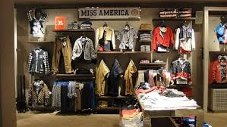
Fixtures
Primary purpose of fixtures are to efficiently hold and display merchandise
Define areas of a store and direct traffic flow
Fixtures are harmonized with other design elements such as floor coverings and lighting as well as overall image of the store
Notes:
1

Slide 5
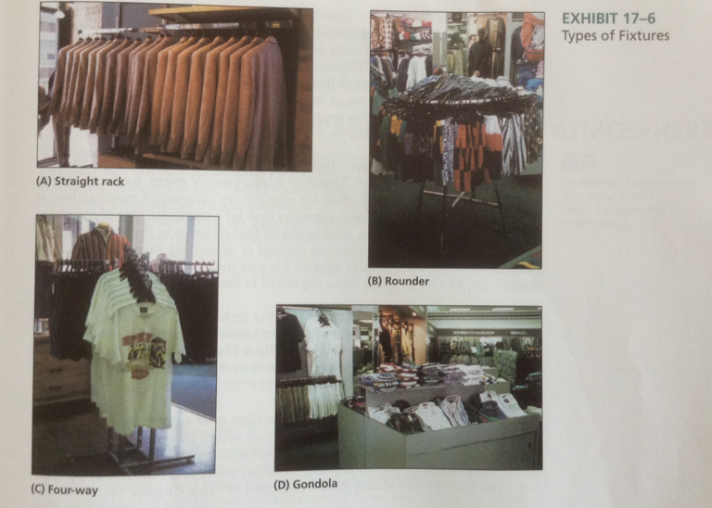
Fixtures
Notes:
1

Slide 6
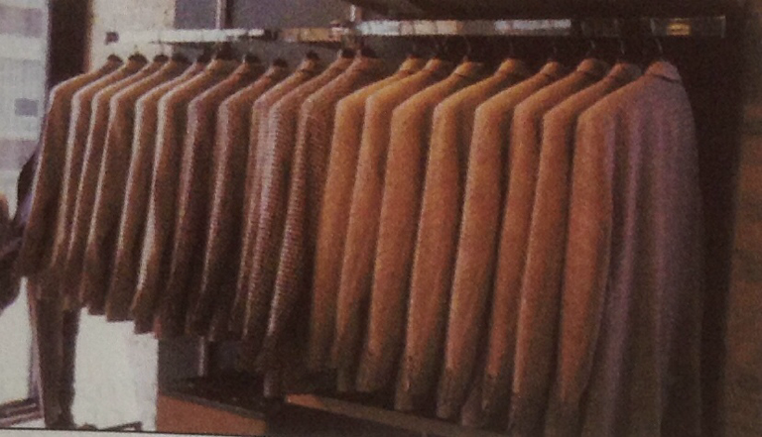
Straight Rack
Straight rack consists of a long pipe balance between supports in the floor or attached to the wall
Notes:
1

Slide 7
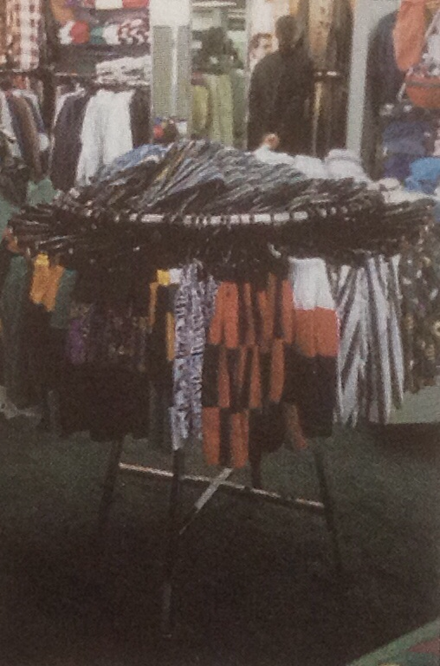
Rounder
A rounder or bulk fixture or capacity fixture is a round fixture that sits on a pedestal, although smaller than straight rack, it is designed to hold a maximum amount of merchandise
Notes:
1

Slide 8
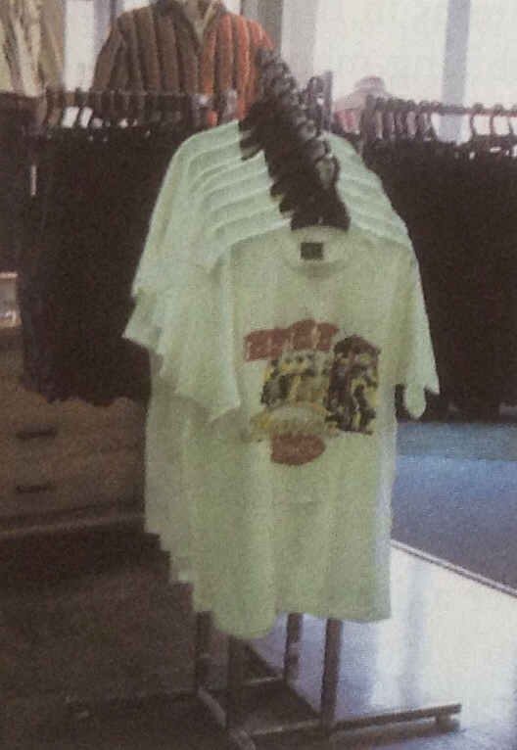
Four-Way Fixture
A four-way fixture or feature fixture
Has two crossbars that sit perpendicularly on a pedestal
Holds large amount of merchandise and allows the customer to view the entire garment
Notes:
1

Slide 9
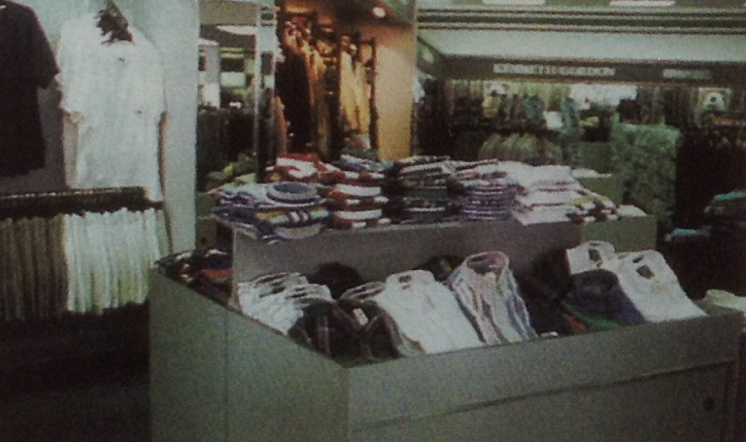
Gondola
A gondola is an island type of self-service counter with tiers of shelves, bins, or pegs
Extremely versatile and used extensively
Notes:
1

Slide 10
Visual Techniques
Idea-Oriented:method of presenting merchandise based on specific idea or image of store
Item and Size: common technique in discount, grocery, hardware and drugstores
Color: bold merchandising technique
Price Lining: men's dress shirt $49,$69 and $99
Vertical Merchandising- presented vertically using walls and high gondolas
Tonnage Merchandising: end cap using stacks of Pepsi 6 packs
Frontal Presentation: expose as much merchandise as possible to catch customer's eye- bookstores
Notes:
1

Slide 11
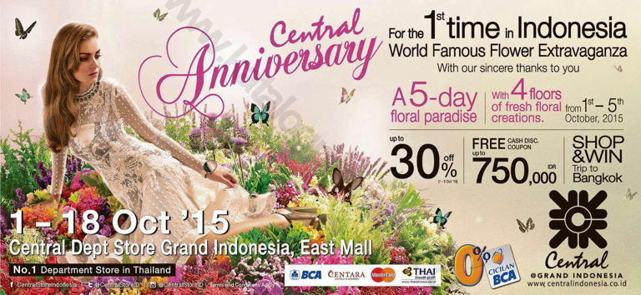
Presentation Techniques
Notes:
1

Slide 12
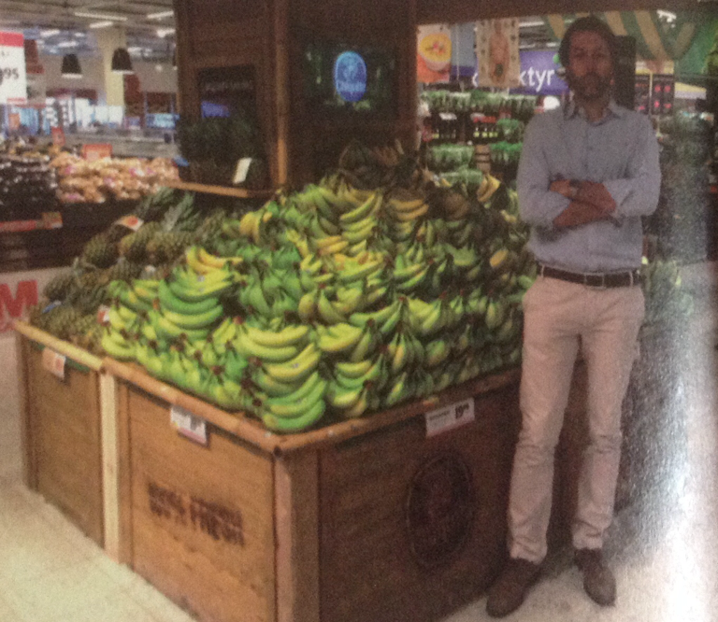
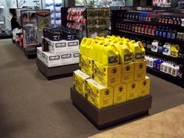
Tonnage Merchandising
Notes:
1

Slide 13
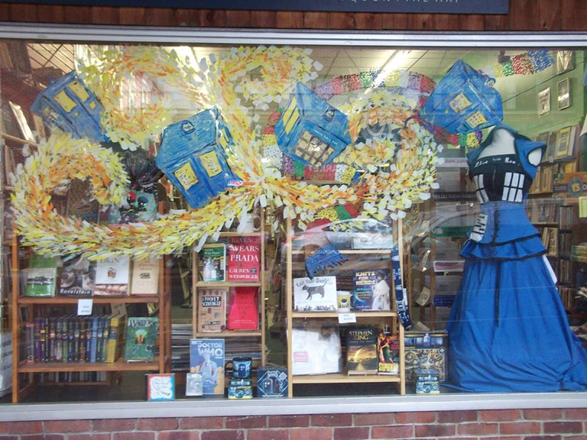
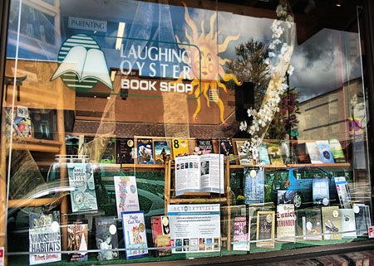
Frontal Presentation
Notes:
1

Slide 14
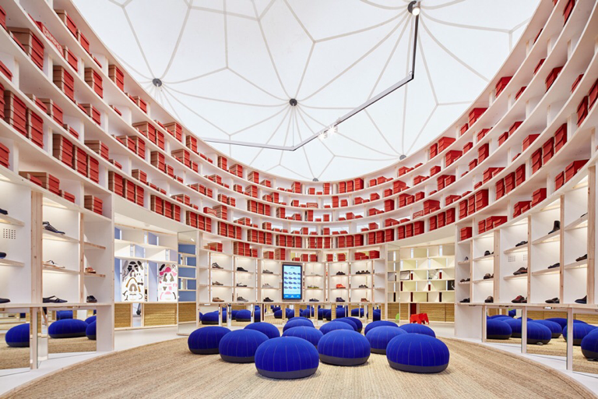
Creating an Appealing Store Atmosphere

Slide 15
Lighting
Highlighting Merchandise- draws cutomers in stores
Mood Creation- clothing, supermarkets?
Energy- Efficient Lighting : LED or light-emitting diode is replacing fluorescent; reduce costs up to 75% and last 10 times longer than standard bulbs
Notes:
1

Slide 16
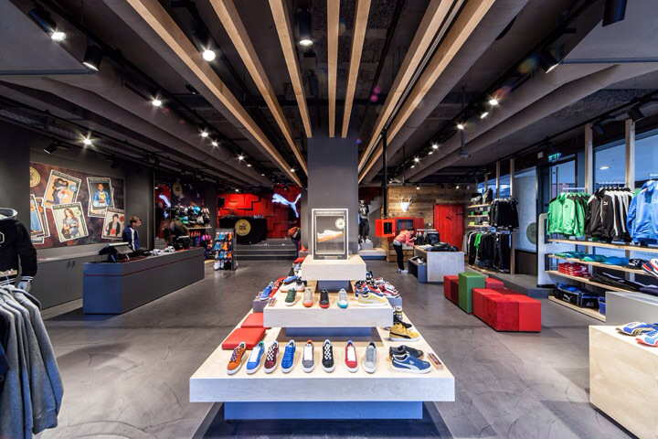
Lighting
Notes:
1

Slide 17
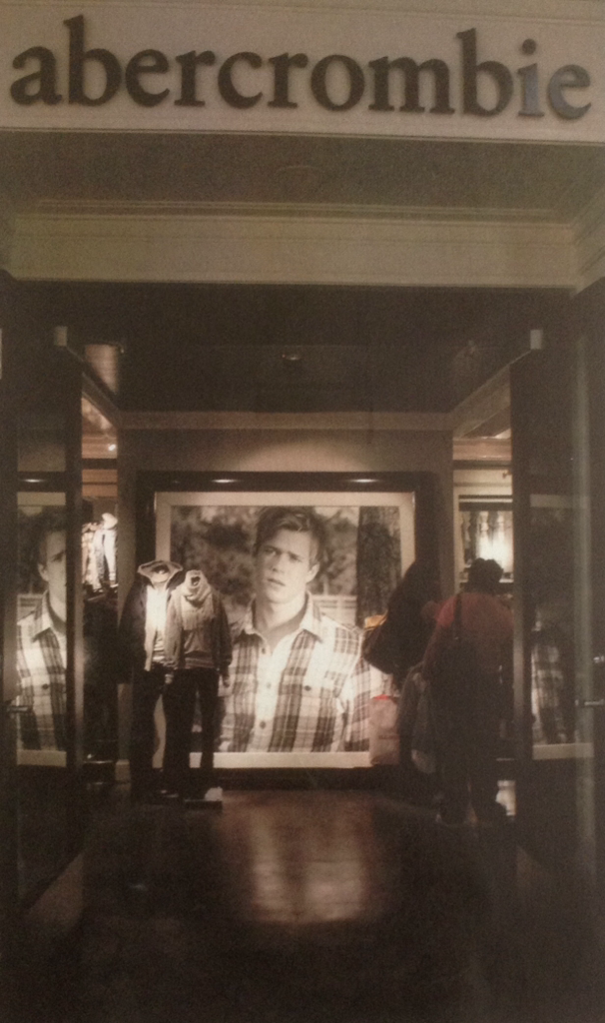
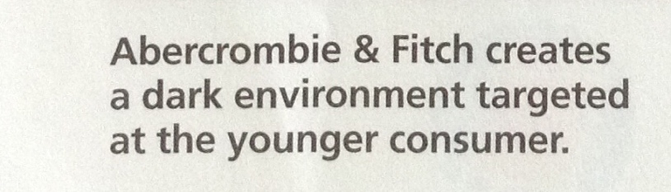
Lighting
Notes:
1

Slide 18
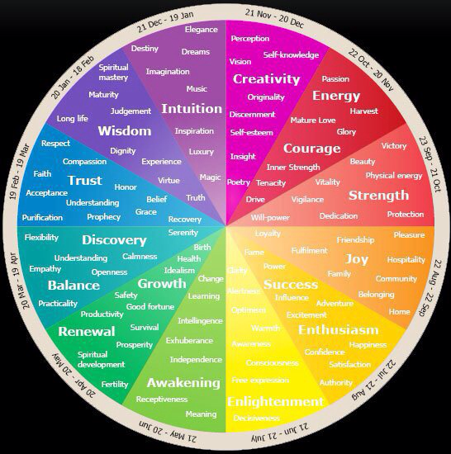
Color
Enhance retailer image
Help create mood
Cool colors- white,blue,green have peaceful,gentle,calming effect
Culture- different impact
Notes:
1

Slide 19
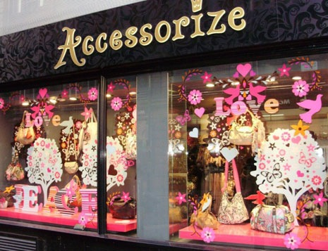
Color
Notes:
1

Slide 20
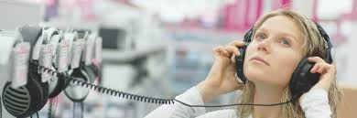
Music
Can add or detract from retailer's total atmosphere
Music can control the pace of store traffic
– Zara vs Starbucks?
Seasonal music
Notes:
1

Slide 21
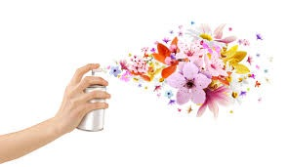
Scent
Large impact on customer's mood and emotions
Scents can improve customers' subjective shopping experience by making then feel they are spending less time examining merchandise, waiting for sales help or checking out
Usage of different essence in different departments
Baby Powder
Suntan Lotion
Lilacs
Cinnamon and Pine Scents
Notes:
1

Slide 22
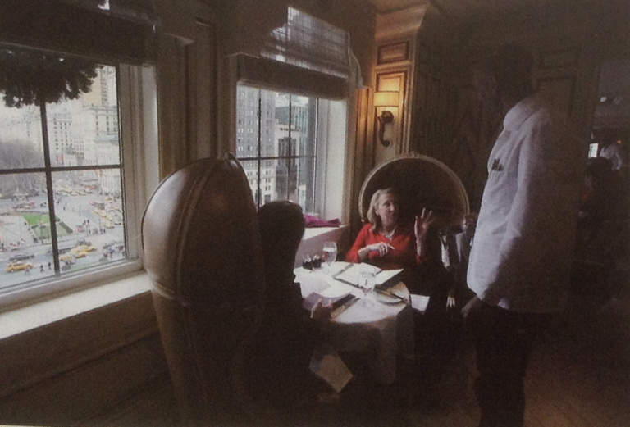
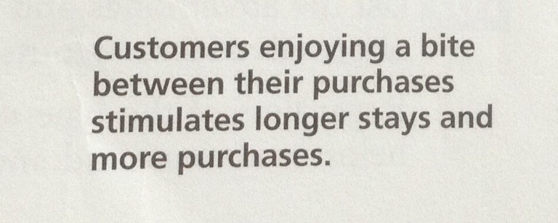
Taste
Difficult to appeal to consumers' taste buds
Grab a bite without leaving the stores encourages customers to linger longer and enjoy the shopping experience more
Notes:
1

Slide 23
Just How Exciting Should a Store Be?
Bass Pro Shops, Barnes and Noble
Attempt to create entertaining shopping experience by viewing stores as theatrical scenes
Floor and walls constitute the stage and scenery
Lighting, fixtures, and displays are props
Merchandise represents performance
Depends on shopping goals? Utilitarian or Hedonic
Notes:
1

Slide 24


