Slide 1
Topic 3 Part 4
The Theory of Demand
(Chapter 5)

Slide 2
Consumer Welfare
Economists often measures the impact of price changes on a consumer’s well-being in monetary terms.
Three ways to measure welfare:
  Change in Consumer Surplus (∆CS)
  Compensating Variation (CV)
  Equivalent Variation (EV)
CV and EV are based on Hicksian Approach.

Slide 3
Consumer Surplus
The individual’s demand curve can be seen as the individual’s willingness to pay curve.
On the other hand, the individual actually pay the market price for (all) the units consumed.
Consumer Surplus is the difference between what the consumer is willing to pay and what the consumer actually pays.

Slide 4
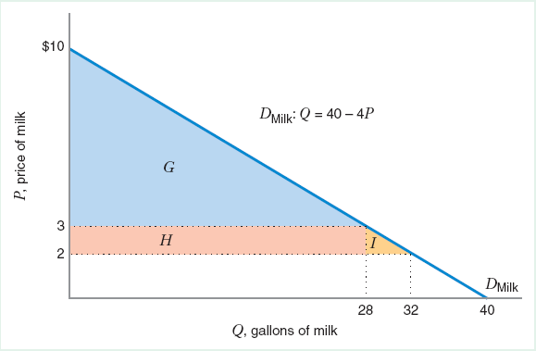
Consumer Surplus
The area under an ordinary demand curve and above the market price provides a measure of consumer surplus.
When P = 3, CS = Area G.
When P = 2, CS = G + H + I.
∆CS = H + I > 0
Positive ∆CS represents the higher welfare of a consumer as price falls.

Slide 5
CV and EV
CV and EV are “monetary” measures of the welfare change due to the price change.
CV and EV measure the change in your spending when price changes.
When price falls (rises), you spend less (more) money, your welfare increases (decreases).

Slide 6
Compensating Variation (CV)
At your ORIGINAL utility (U₁), CV is the difference between “the income required to buy the optimal bundle BEFORE the price change, Bundle A” and “the income required to buy the optimal bundle AFTER the price change, Bundle B”.
Notice that: income to buy A = original income.

Slide 7
Equivalent Variation (EV)
At your NEW utility (U₂), EV is the difference between “the income required to buy the optimal bundle BEFORE the price change, Bundle E” and “the income required to buy the optimal bundle AFTER the price change, Bundle C”.
Notice that: income to buy C = original income.

Slide 8
CV and EV
In the case of Price FALL, CV and EV are “positive”. This is because AFTER the price falls, you need LESS money to buy the optimal bundle AFTER the price change, (Bundle B for CV and Bundle C for EV).
Positive values of CV and EV imply that we “GAIN” after the price falls. That is, our welfare, measured in monetary terms, rises.

Slide 9
CV and EV
In the case of Price RISE, CV and EV are “negative”. This is because AFTER the price rises, you need MORE money to buy the optimal bundle AFTER the price change, (Bundle B for CV and Bundle C for EV).
Negative values of CV and EV imply that we “LOSE” after the price rises. That is, our welfare, measured in monetary terms, falls.

Slide 10
CV and EV (Another Interpretation)
CV reflects New Price and Old Utility, i.e.
Suppose the price has already changed (and utility has changed), the consumer is willing to accept/pay CV and go back to the original utility (at the original price).
When CV > 0, “accept” CV < 0, “pay”

Slide 11
CV and EV (Another Interpretation)
EV reflects Old Price and New Utility, i.e.
Suppose the price has NOT changed yet (and utility has NOT changed), the consumer is willing to pay/accept EV and go to the new utility (at the new price).
When EV > 0, “pay” EV < 0, “accept”

Slide 12
Quasi-linear utility function does not have income effect.
We will have EV = CV = ∆CS.

Slide 14
Applications of the Theory of Demand
Market Demand and Network Externalities
Demand for Leisure and Supply for Labor
Consumer Price Index

Slide 15
Market Demand
The market demand function is the horizontal sum of the individual demands.
In other words, market demand is obtained by adding the quantities demanded by the individuals (or segments) at each price and plotting this total quantity for all possible prices.

Slide 16
Market Demand
P
P
P
10
Q = 10 - P
Q = 20 – 5P
4
Q
Q
Q
Segment 1
Segment 2
Market Demand
Q₁ = 10 – P, for P < 10
Q₁ = 0, for P ≥ 10
Q₂ = 20 – 5P, for P < 4
Q₂ = 0, for P ≥ 4
Q_{M} = 30 – 6P, for P < 4
Q_{M} = 10 – P, for 4 ≤ P < 10
Q_{M} = 0, for P ≥ 10
Exercise
Suppose there are 10 identical consumers whose individual inverse demand is given by P = 20 – 2Q.
Derive the market demand function.

Slide 17
Network Externalities
If one consumer's demand for a good changes with the number of other consumers who buy the good, there are network externalities.
For example, think about a food review on YouTube. Your demand for the food may increase when there are many people buying the same food.

Slide 18
Network Externalities
Bandwagon effect: A positive network externality that refers to the increase in each consumer’s demand for a good as more consumers buy the good.
For example, Facebook likely confers positive network externalities since it is more useful to a user if more people are using it as well.

Slide 19
Network Externalities
P
D₂ (mkt demand when people believes that many people are buying)
D₁
Bandwagon Effect:
(increased quantity demanded when more consumers purchase)
A
•
P₁
B
C
•
•
P₂
Market Demand
w/ Positive Net. Ext.
Pure
Price
Effect
Bandwagon Effect
Q
Q₁
Q₂
Q₃ (Q₂ + Bandwagon Effect)

Slide 20
Network Externalities
Snob effect: A negative network externality that refers to the decrease in each consumer’s demand as more consumers buy the good.
For example, a road can confer negative network externalities since a driver on the road creates traffic for other drivers.

Slide 21
Network Externalities
P
Market Demand
w/ Negative Net. Ext.
Snob Effect:
(decreased quantity demanded when more consumers purchase)
A
•
P₁
C
B
•
•
P₂
D₁
D₂ (mkt demand when people believes that many people are buying)
Snob Effect
Pure Price Effect
Q
Q₁
Q₃
Q₂

Slide 22
Labor Supply Curve
All workers face labor-leisure trade-off.
They have 24 hours a day, which are allocated between working and resting.
Workers value both income from working and their leisure time.
MU for both are positive but diminishing.
Leisure is a normal good: as income rise, people want to consume more leisure.

Slide 23
Labor Supply Curve
One can think of “wage” as “price of leisure” since when we rest, we forego wage income.
Now, if wage rises, leisure becomes more expensive.
SE implies that workers will work more.
IE implies that, with more money from higher wage, workers can work less and rest more.
Two effects work in the opposite directions.

Slide 24
Labor Supply Curve
The labor supply curve slopes upward over the region where the SE > IE.
Because leisure is more expensive, workers substitute away from leisure and work more.
The labor supply curve bends backward over the region where the IE > SE.
Given a higher wage, workers now become richer. Since leisure is a normal good, more leisure is consumed, and workers work less.

Slide 25
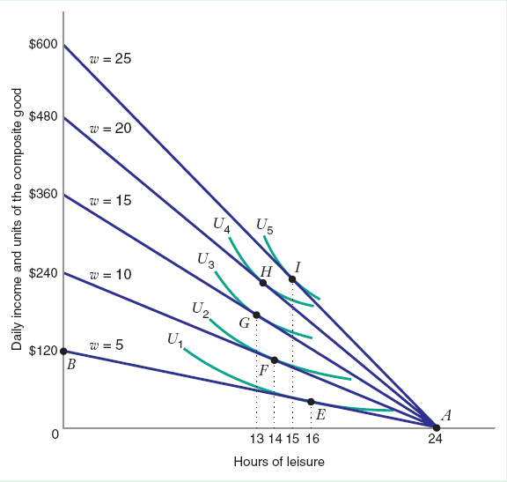
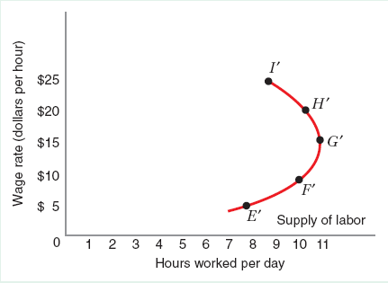
Labor Supply Curve
Backward-Bending Labor Supply
Hrs of Leisure
Hrs of Work

Slide 26
Consumer Price Index (CPI)
CPI is an index (a number) that tells us about the cost of living of typical consumers.
It measures changes in the price level and can be used to calculate the inflation rate.
CPI is a fixed-weight index, calculated from a fixed basket of goods.

Slide 27
Consumer Price Index (CPI)
Since CPI is calculated from a fixed basket of goods, it ignores the fact that people would “substitute” expensive goods with cheaper goods.
This is called the “substitution bias” and causes CPI to overestimate the cost of living when the price level rises.

Slide 28
Consumer Price Index (CPI)
Example
Assume a consumer buys two goods:
food with P_{F,1} = $3 and clothing with P_{C,1} = $8.
At these prices, the consumer buy 80 units of food and 30 units of clothing, (F, C) = (80, 30).
Thus, the cost of living before the price change is $480.

Slide 29
Consumer Price Index (CPI)
Example (cont)
Suppose the prices of food and clothing rises; the new prices are P_{F,2} = $6 and P_{C,2} = $9.
CPI assumes that the consumer would still buy the original bundle, (F, C) = (80, 30). With this approach, the cost of living after the price change would be $750.
CPI = 750/480 = 1.56. Inflation = 56%.

Slide 30
Consumer Price Index (CPI)
Example (cont)
In reality, there exists a bundle that could give the consumer the same happiness as (F, C) = (80, 30).
From the diagram, such bundle is (40, 60) and costs $720 after the price change.
If CPI were to account for the substitution, CPI would be 720/480 = 1.5. Inflation = 50%.

