Slide 1

MK 322 Retail Management
Chapter 10: Information Systems and Supply Chain Management
By Ajarn Suwalya K.

Slide 2

Creating Strategic Advantage through Supply Management and Information Systems

Slide 3
Supply Chain Management
Supply Chain Management: is a set of activities and techniques firms employ to efficiently and effectively manage the flow of merchandise from the vendor's to the retailer's customers.
These activities ensure that the customers are able to purchase merchandise in the desired quantities at a preferred location at the appropriate time.
Distribution Center (DC): A warehouse that receives merchandise from multiple vendors and distributes it to multiple stores
Notes:
1

Slide 4
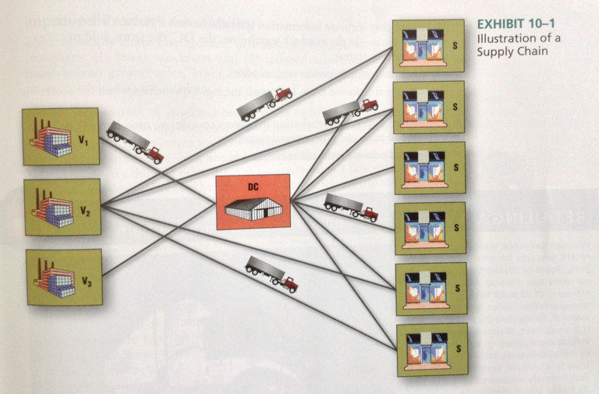
Supply Chain Management
Notes:
1

Slide 5

Strategic Advantage
In Chapter 5, strategic advantages are unique and sustainable advantages enabling retailers to realize a higher-than-average return on their assets
For example Walmart's success is in its information and supply chain management systems
Notes:
1

Slide 6
Strategic Advantage
Consider the various activities that retailers keep merchandising in stock
Accurately forecast sales and needed inventory levels for each category and SKU
Monitor sales to detect deviations from the forecast
Transport the right amount of merchandise from the DCs to each store
Make sure that accurate information is available that indicates where the merchandise is-in the vendor's warehouse, the DC, the store, sold to customer, or in transit
Notes:
1

Slide 7
Strategic Advantage
Place accurate, timely orders with vendors
Replenish merchandise from DCs with the right quantities when the stores need it
Ensures that buyers and marketing managers coordinate merchandise delivery with special sales and promotional materials
Collect and process returned merchandise delivery with special sales and promotional materials
Collect and process returned merchandise
Notes:
1

Slide 8

The Flow of Information and Merchandise in a Supply Chain

Slide 9
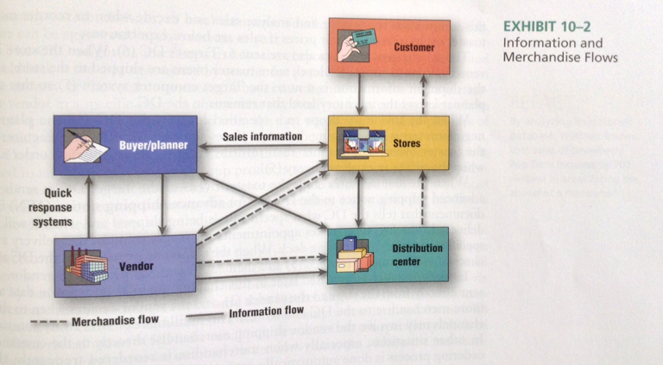
Information Flows
Notes:
1

Slide 10
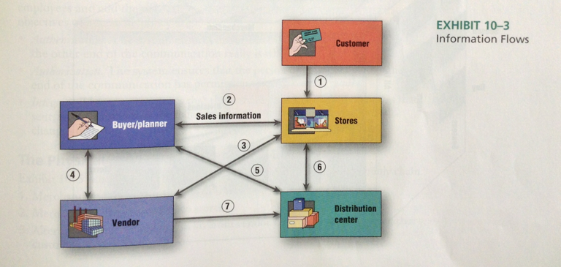
Information Flows
Notes:
1

Slide 11
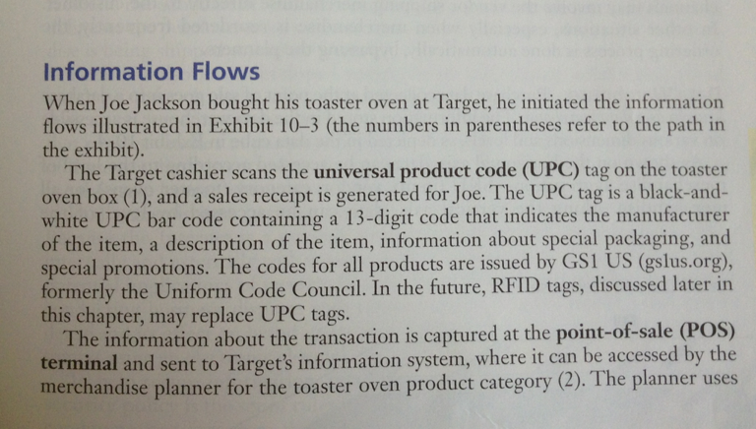
Information Flows
Notes:
1

Slide 12
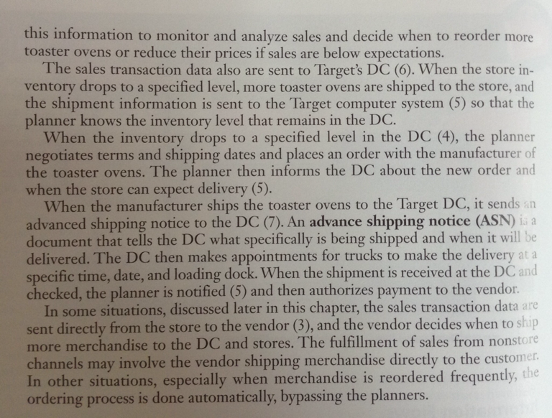
Information Flows
Notes:
1

Slide 13
Data Warehouse
Purchase data collected at the point of sale goes into the database known as a data warehouse
The information stored in the data warehouse is accessible on various dimensions and levels
Notes:
1

Slide 14
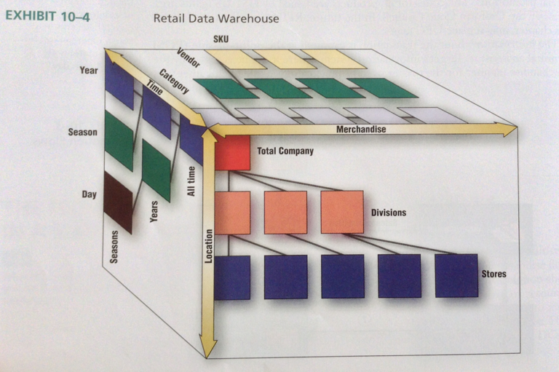
Data Warehouse
Notes:
1

Slide 15
Electronic Data Interchange(EDI)
EDI is the computer-to-computer exchange of business documents using a standardized format
Retailers have developed standards for exchanging information about purchase order changes, order status, transportation routings, advance shipping notices, on-hand inventory status, and vendor promotions as well as information that enables vendors to put price tags on merchandise
Notes:
1

Slide 16
The Physical Flow of Merchandise- Logistics
Logistics is the aspect of supply chain management that refers to "the planning, implementation, the control of the efficient flow and storage of goods, services, and related information from the point of origin to the point of consumption to meet customers' needs
Notes:
1

Slide 17
The Physical Flow of Merchandise- Logistics
Exhibit 10-5 illustrates the physical flow of merchandise within the supply chain
Merchandise flows from vendor to DC
Merchandise goes from DC to stores
Alternatively, merchandise can go from vendor directly to stores or even customer
Notes:
1

Slide 18
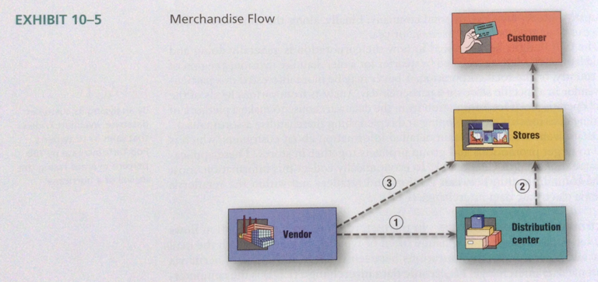
The Physical Flow of Merchandise- Logistics
Notes:
1

Slide 19
The Distribution Center –Main Roles
Management of Inbound Transportation
Dispatcher is a person who coordinates deliveries to the DC
Receiving and Checking
Storing and Cross-Docking
- The WiiU cartons are unloaded from the inbound truck going to specific stores
Notes:
1

Slide 20
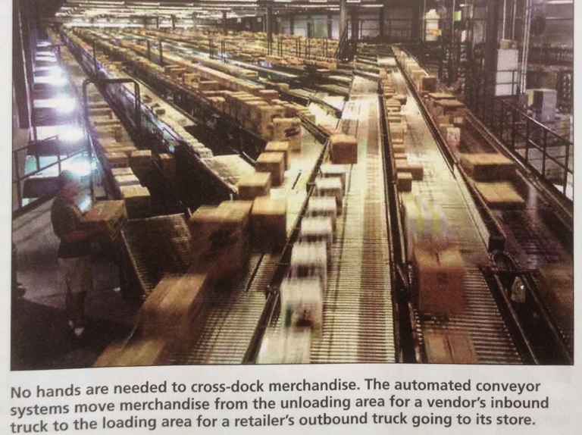
Cross-docking
Notes:
1

Slide 21
The Distribution Center – Main Roles
Getting Merchandise Floor – Ready
Floor-ready merchandise is merchandise ready to be placed on the selling floor in the store
Ticketing and marking refer to affixing price and identification labels to the merchandise
Preparing to Ship Merchandise to a Store
Management of Outbound Transportation
Notes:
1

Slide 22
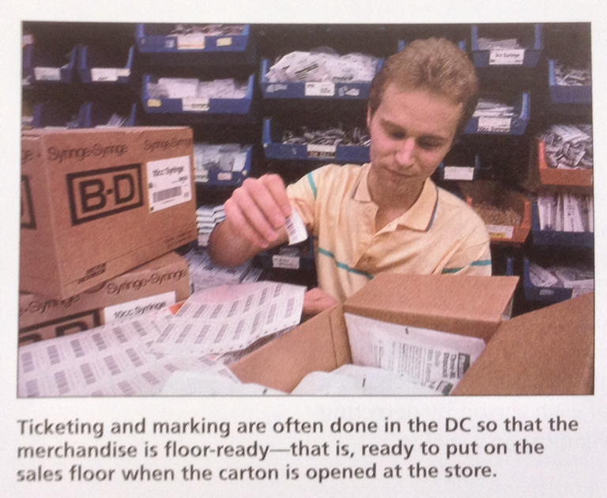
Ticketing and Marking
Notes:
1

Slide 23
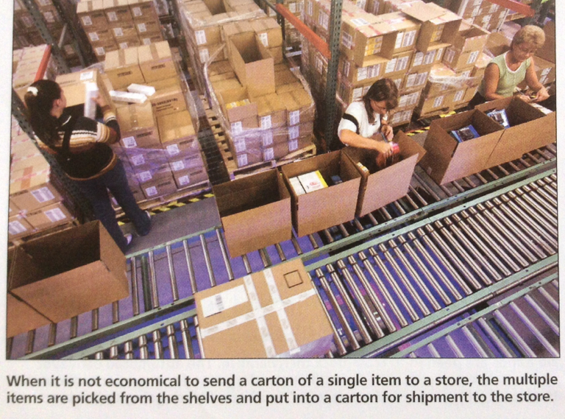
Prepare Shipment to Store
Notes:
1

Slide 24
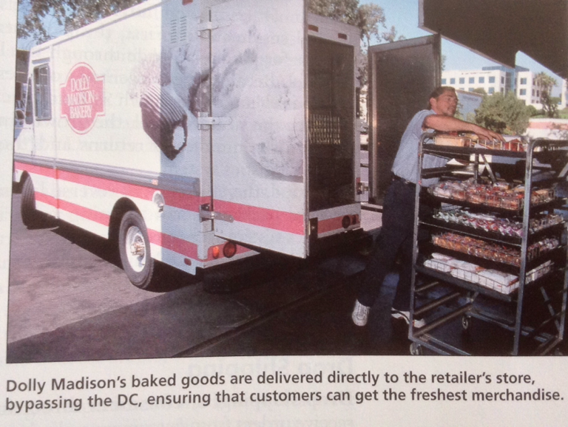
Direct Delivery
Notes:
1

Slide 25
Radio Frequency Identification (RFID)
RFID is a technology that allows an object or person to be identified at a distance by means of radio waves
RFID devices are tags that transmit identifying information and are attached to individual items, shipping cartons, and containers
The primary benefit of tagging items to retailers is economically provide accurate,real-time measure of item inventory levels
With these data, retailers can dramatically reduce inventory levels and stockouts
Notes:
1

Slide 26
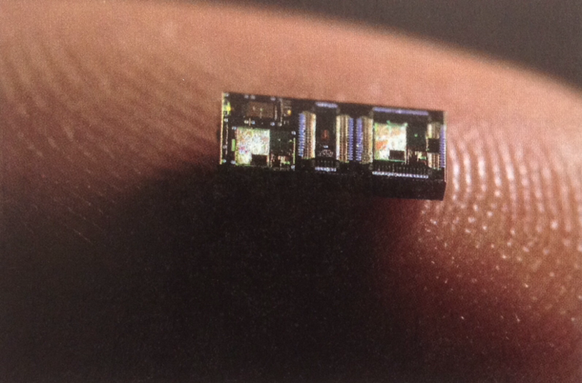
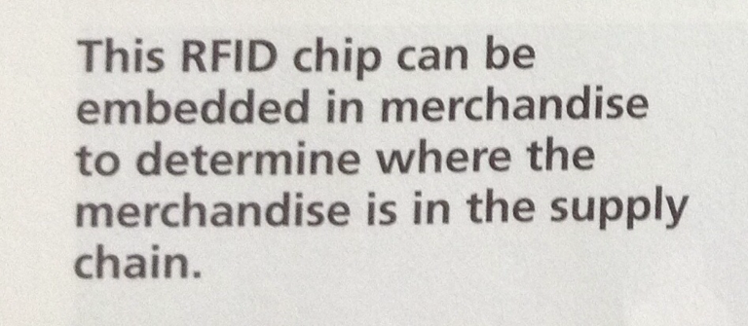
Radio Frequency Identification (RFID)
Notes:
1

Slide 27


