Slide 1
FN 221: Personal Finance
Thanachote Rungsitivat, CFA, FRM

Slide 2
Tax
Personal Income Tax
Corporate Income Tax
Excise Tax
Value Added Tax
Etc.

Slide 3
Personal Income Tax
Personal Income Tax (PIT) is a direct tax levied on income of a person.
A person means an individual, an ordinary partnership, a non-juristic body of person and an undivided estate. In general, a person liable to PIT has to compute his tax liability, file tax return and pay tax, if any, accordingly on a calendar year basis.

Slide 4
Taxable Person
Taxpayers are classified into “resident” and “non-resident”. “Resident” means any person residing in Thailand for a period or periods aggregating more than 180 days in any tax (calendar) year. A resident of Thailand is liable to pay tax on income from sources in Thailand as well as on the portion of income from foreign sources that is brought into Thailand. A non-resident is, however, subject to tax only on income from sources in Thailand.

Slide 5
Assessable Income
Income chargeable to the PIT is called “assessable income”. The term covers income both in cash and in kind. Therefore, any benefits provided by an employer or other persons, such as a rent-free house or the amount of tax paid by the employer on behalf of the employee, is also treated as assessable income of the employee for the purpose of PIT. Assessable income is divided into 8 categories as follows :
income from personal services rendered to employers;
income by virtue of jobs, positions or services rendered;
income from goodwill, copyright, franchise, other rights, annuity or income in the nature of yearly payments derived from a will or any other juristic Act or judgment of the Court;
income in the nature of dividends, interest on deposits with banks in Thailand, shares of profits or other benefits from a juristic company, juristic partnership, or mutual fund, payments received as a result of the reduction of capital, a bonus, an increased capital holdings, gains from amalgamation, acquisition or dissolution of juristic companies or partnerships, and gains from transferring of shares or partnership holdings;
income from letting of property and from breaches of contracts, installment sales or hire-purchase contracts;
income from liberal professions;
income from construction and other contracts of work;
income from business, commerce, agriculture, industry, transport or any other activity not specified earlier. Income chargeable to the PIT is called “assessable income”. The term covers income both in cash and in kind. Therefore, any benefits provided by an employer or other persons, such as a rent-free house or the amount of tax paid by the employer on behalf of the employee, is also treated as assessable income of the employee for the purpose of PIT. Assessable income is divided into 8 categories as follows :
income from personal services rendered to employers;
income by virtue of jobs, positions or services rendered;
income from goodwill, copyright, franchise, other rights, annuity or income in the nature of yearly payments derived from a will or any other juristic Act or judgment of the Court;
income in the nature of dividends, interest on deposits with banks in Thailand, shares of profits or other benefits from a juristic company, juristic partnership, or mutual fund, payments received as a result of the reduction of capital, a bonus, an increased capital holdings, gains from amalgamation, acquisition or dissolution of juristic companies or partnerships, and gains from transferring of shares or partnership holdings;
income from letting of property and from breaches of contracts, installment sales or hire-purchase contracts;
income from liberal professions;
income from construction and other contracts of work;
income from business, commerce, agriculture, industry, transport or any other activity not specified earlier.

Slide 6
Deduction and Allowances
Certain deductions and allowances are allowed in the calculation of the taxable income. Taxpayer shall make deductions from assessable income before the allowances are granted. Therefore, taxable income is calculated by :
TAXABLE INCOME = Assessable Income - deductions - allowances

Slide 7
Deductions allowed for the calculation of PIT
Type of Income | Deduction
a. Income from employment | 40% but not exceeding 60,000 baht
b. Income received from copyright | 40% but not exceeding 60,000 baht
c. Income from letting out of property on hire
1) Building and wharves | 30%
2) Agricultural land | 20%
3) All other types of land | 15%
4) Vehicles | 30
5) Any other type of property | 10%
d. Income from liberal professions | 30% except for the medical profession where 60% is allowed
e. Income derived from contract of work whereby the contractor provides essential materials besides tools | actual expense or 70%
f. Income derived from business, commerce, agriculture, industry, transport, or any other activities not specified in a. to e. | actual expense or 65% - 85% depending on the types of income

Slide 8
Allowances (Exemptions) allowed for the calculation of PIT
Types of Allowances | Amount
Personal allowance
Single taxpayer | 30,000 baht for the taxpayer
Undivided estate | 30,000 baht for the taxpayer’s spouse
Non-juristic partnership or body of persons | 30,000 baht for each partner but not exceeding 60,000 baht in total
Spouse allowance | 30,000 baht
Child allowance (child under 25 years of age and studying at educational institution, or a minor, or an adjusted incompetent or quasi-incompetent person) | 15,000 baht each (limited to three children)
Education (additional allowance for child studying in educational institution in Thailand) | 2,000 baht each child
Parents allowance | 30,000 baht for each of taxpayer’s and spouse’s parents if such parent is above 60 years old and earns less than 30,000 baht
Life insurance premium paid by taxpayer or spouse | Amount actually paid but not exceeding 100,000 baht each
Approved provident fund contributions paid by taxpayer or spouse | Amount actually paid at the rate not more than 15% of wage, but not exceeding 500,000 baht
Long term equity fund | Amount actually paid at the rate not more than 15% of wage, but not exceeding 500,000 baht
Home mortgage interest | Amount actually paid but not exceeding 100,000 baht
Social insurance contributions paid by taxpayer or spouse | Amount actually paid each
Charitable contributions | Amount actually donated but not exceeding 10% of the income after standard deductions and the above allowances

Slide 9
Tax Credit for dividends
Any taxpayer who domiciles in Thailand and receives dividends from a juristic company or partnership incorporated in Thailand is entitled to a tax credit of 3/7 of the amount of dividends received. In computing assessable income, taxpayer shall gross up his dividends by the amount of the tax credit received. The amount of tax credit is creditable against his tax liability.

Slide 10
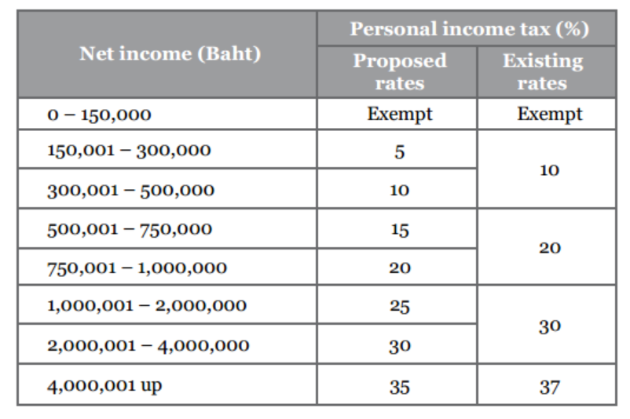
Progressive Tax Rates

Slide 11
Separate taxation
There are several types of income that the taxpayer shall not include or may not choose to include such income to the assessable income in calculating the tax liability.
Income from sale of immovable property
Taxpayer shall not include income from sales of immovable property acquired by bequest or by way of gift to the assessable income when calculating PIT. However, if the sale is made for a commercial purpose, it is essential that such income must be included as the assessable income and be subject to PIT.
Interest
The following forms of interest income may, at the taxpayer’s selection, be excluded from the computation of PIT provided that a tax of 15 per cent is withheld at source:
interest on bonds or debentures issued by a government organization;
interest on saving deposits in commercial banks if the aggregate amount of interest received is not more than 20,000 baht during a taxable year;
interest on loans paid by a finance company;
interest received from any financial institution organized by a specific law of Thailand for the purpose of lending money to promote agriculture, commerce or industry.
Dividends
Taxpayer who resides in Thailand and receives dividends or shares of profits from a registered company or a mutual fund which tax has been withheld at source at the rate of 10 per cent, may opt to exclude such dividend from the assessable income when calculating PIT.

Slide 12
Withholding Tax
Types of income (baht) | Withholding tax rate (baht)
1. Employment income | 5 - 37 %
2. Rents and prizes | 5 %
3. Ship rental charges | 1 %
4. Service and professional fees | 3 %
5. Public entertainer remuneration - Thai resident - non resident | 5 % 5 - 37 %
6. Advertising fees | 2 %

Slide 13
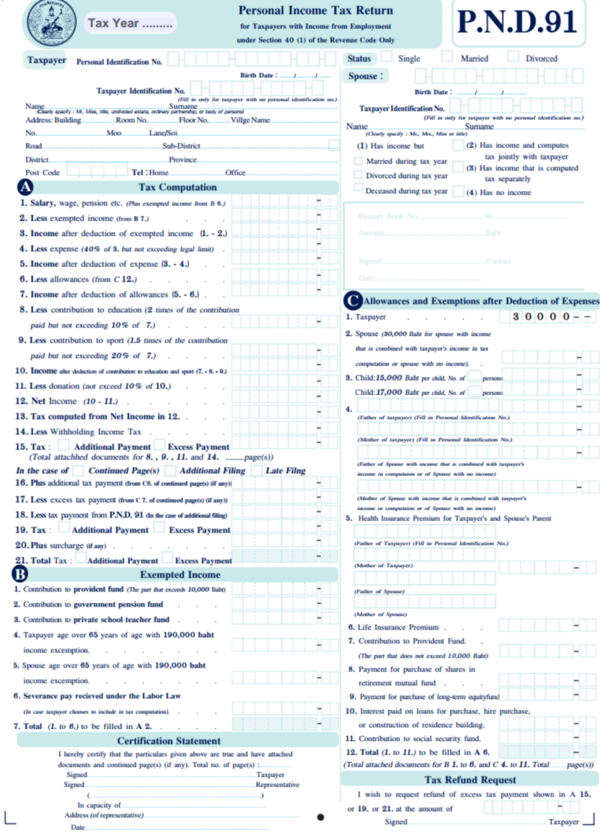

Slide 14
Tax Planning Strategies
Consumer Purchasing
  Consumer debt
  Job-related expenses
  Health care expenses
  Housing expenses
  Donations
Investment Decisions
  Tax-exempt investments
  LTF and RMF
Retirement Plans
  RMF
  Provident/Pension Fund

Slide 15
Cash Management Strategy
Meeting Daily Money Needs
  Managing Cash – cash, check, credit/debit card
    Avoid overspending – through credit card – will need to payback using savings or borrowing leads to lower savings and future wealth.
    Failing to put unneeded funds in an interest-earning savings account or investment plan to achieve long term goals.
  Sources of Quick Cash
    Liquidate savings or borrow
      Savings account, Mutual Funds, Other investments, etc.
      Borrow – credit card, personal loan, etc.
      Both will reduce your net worth and your potential to achieve long-term financial security.

Slide 16
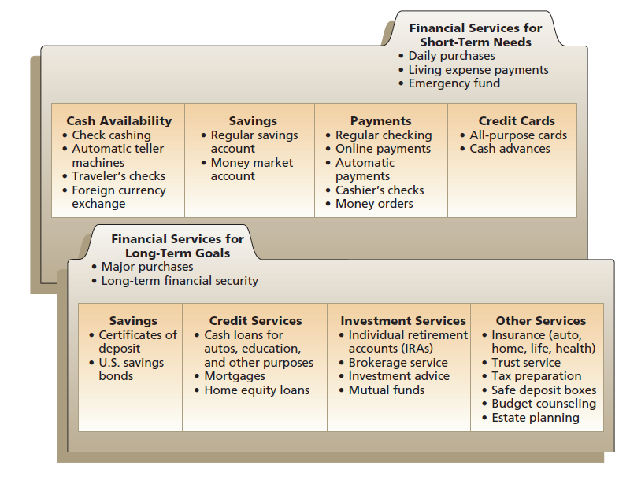
Cash Management Strategy

Slide 17
Types of Financial Services
Savings – safe storage of funds for future use. Selection commonly based on interest rate earned, liquidity, safety and convenience.
  Depository Protection Agency
Payment Services – The ability to transfer money to other parties. E.g. Current accounts, etc.
Borrowing – short term borrowing – credit cards and cash loan. Long term borrowing – home mortgage
Other financial services – insurance protection, investments, real estate purchases, tax assistance, financial planning, etc.

Slide 18
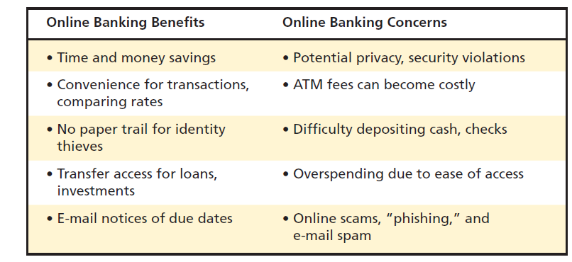
Online banking

Slide 19
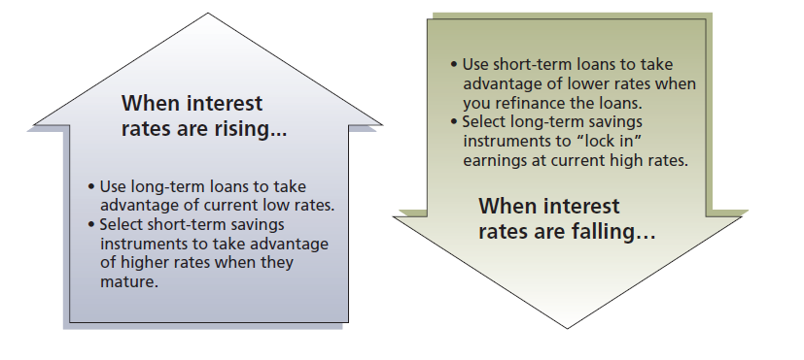
Opportunity Costs of Financial Services

Slide 20
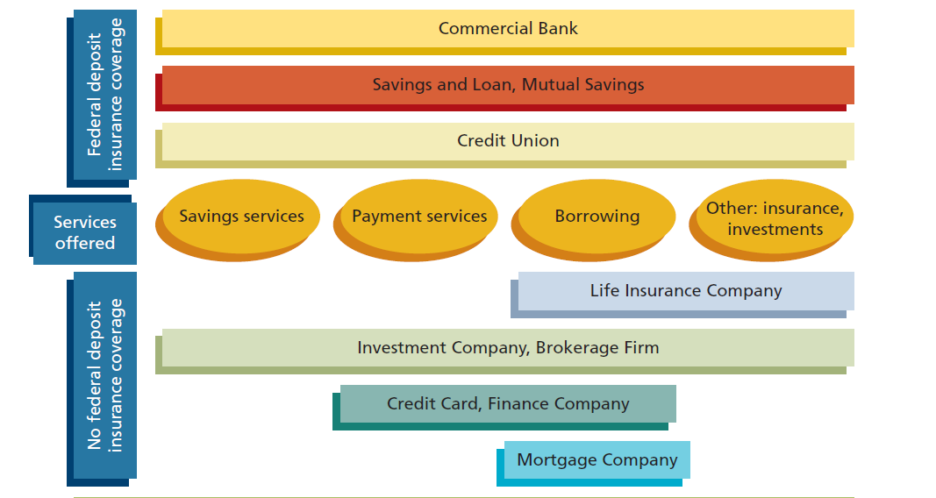
Financial Institutions

Slide 21
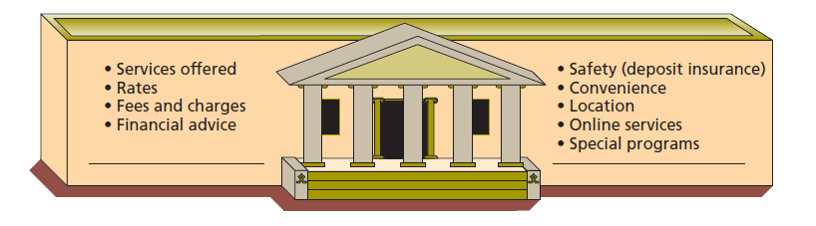
How should you choose a financial institution?

Slide 22
Case: Smith’s Situation
Smith has overspent, because he has made too many impulse purchases
Smith does not always have enough money in his current account to pay his current bills.
Smith occasionally has to use his savings to pay for everyday purchases.
Smith does not always put extra funds in a savings or investment account.

Slide 23
Case: Smith’s Situation
Analysis
  Smith realized that he does not manage his cash very well.
  He needs to understand how to manage his daily money needs effectively.
  He needs to understand that there are several financial services to meet a variety of his needs.
  He has not realized that there are opportunity costs associated with the way he uses these financial services.

Slide 24
Smith’s Choices
Deposit Institutions
  Commercial Banks
  Savings and Loan Associations
Other Financial Institutions
  Life Insurance Companies
  Investment Companies
  Finance Companies
  Mortgage Companies
  Pawnshops

Slide 25
Commercial Banks
Full range of financial services (most common for Smith – he also knows that if he chooses a large commercial banks, they often have higher creditability and more branches – making him easier to get money from his account if required)
  Current Account
  Savings Account
  Lending
  Other Services
Convenience of many full-branches services
DPA insurance for up to certain amount

Slide 26
Savings and Loan Association
Needs to be a member
Owned by depositors
Profits go to depositors by paying them higher rates of savings
Higher risk
Not highly regulated

Slide 27
Life Insurance Companies
Life Insurance Policies
  Provide financial security to dependents of policyholder
  Many policies have savings and investment features (Smith could be interested to put in his long term investments)
  Life Insurance Companies have expanded their services to include investment and retirement planning – also provide tax savings benefit.

Slide 28
Investment Companies
Also referred to as Fund Management Companies
Allow Many Different Investment Options
Offer Money Market Funds (Investment in bonds)
Pays a competitive interest rates on investments
Smith does not consider other type of financial institutions at this time.

Slide 29
Savings Plan
Savings Account
Bill of Exchange
Bonds

Slide 30
Evaluating Savings Plans
Rates of Return
  Compounding: The yield on your savings usually will be greater than the stated interest rate. Compounding refers to interest that is earned on previously earned interest.
  The more frequent the compounding, the higher the rate of return will be.

Slide 31
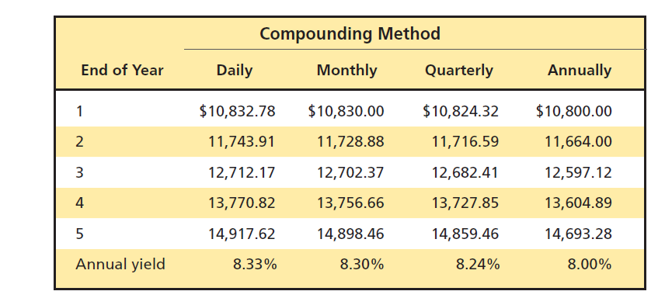
Annualized Percentage Yield (APY)
APY = 100 [(1 + Interest/Principal)^{365/days in term} – 1]

Slide 32
Inflation
The rate of return you earn on your savings should be compared with the inflation rate. When the inflation rate was over 10 percent, people with money in savings accounts earning 5 or 6 percent were experiencing a loss in the buying power of that money.
As inflation rate increases, the interest rates offers to savers should also increase. This gives you an opportunity to select savings option that will minimize the erosion of your money on deposits.

Slide 33
Tax considerations
The interest rate you earned are normally taxed at 15%. Look at the after tax interest rate return on your savings to compare.

Slide 34
Liquidity
Liquidity allows you to withdraw your money on short notice without a loss of principal or fees. Some savings plans (Fixed deposits) impose penalties for early withdrawal or have other restriction (amount xxx can be withdraw per day).

Slide 35
Safety
Depository Protection Agency coverage (ONLY for commercial banks)
Per Holder name per Bank
To diversify: deposit up to coverage amount will all commercial banks
Period | Coverage
11 Aug 2012 – 10 Aug 2015 | Baht 50 million
11 Aug 2015 – 10 Aug 2016 | Baht 25 million
11 Aug 2016 – Onwards | Baht 1 million

Slide 36
Restrictions and Fees
Other limitations can affect your choice of a savings program.
  Some institutions charge a transaction fee for withdrawal
  Some free offering in the beginning once you open account requires you to do something – maintaining minimum balance up to a certain amount for a certain time period. Failing to do so may causes you to make suboptimal decision during the account opening.

Slide 37
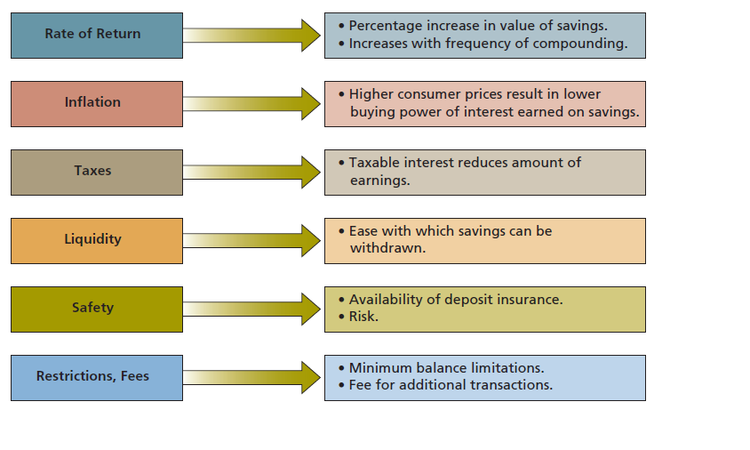
Evaluating Savings Plan

Slide 38
Factors Used to Evaluate Savings Options
Rate of Return
  Compounding
    How much will the account grow over time?
    How often is interest compounded?
    Look at full disclosure on all savings accounts of fees, interest rates and APY.
Inflation
  What is the interest rate Smith will earn compared to the rate of inflation?
  Does the interest rate change with market rates?

Slide 39
Factors Used to Evaluate Savings Options
Tax considerations
  Is the money Smith earns taxed?
Liquidity
  How easy is it to take money out of his savings account?
  Is there any penalty for withdrawing the money?

Slide 40
Factors Used to Evaluate Savings Options
Safety
  Is the savings account insured by DPA?
Restrictions/Fees
  Are there minimum balance requirements?
  What are the fees if Smith goes below the minimum balance requirements?
  Is there a transaction fee for withdrawal from the account?

Slide 41
Smith’s Savings Choice
Smith has decided to keep two savings accounts. He wants to keep his regular savings account, because it is liquid and does not require a minimum balance. He decides to keep his emergency fund in this account. He also decides to get a money market fund with an investment company. He knows this account s not insured but decides the additional interest he will receive is worth the risk.

Slide 42
Electronic Payment Methods
Can Smith check his account balances online?
Can Smith transfer funds electronically from one account to the other?
Can Smith get preauthorized payments for his regular bills?
Can Smith use his debit card to make purchases?
Can Smith pay his bills online?
Are there any fees for any of these services?

Slide 43
Factors Used to Evaluate Checking Accounts
Restrictions and Fees
  What are the minimum balance requirements and the penalties for going below this balance?
  Are there service charges?
  What are the check printing and overdraft fees?
Interest
  Does the account pay interest?
  How often does it pay interest?
Special Services
  Does the account have overdraft protection?
  Does the financial institution return cancelled checks?
  Are other services (safe deposit box, low-rate loans, etc) that may be used infrequently bundled with the account?

Slide 44
Payment Methods
Electronic Payments
  Debit Card
  Online Payments
  Stored-value cards – prepaid cards
  Smart Card (True money, Rabbit, etc)

Slide 45
Avoid Identity Theft
Use different signature on checks, withdrawal
Shred or burn financial information containing your name, account number, address, credit card number, etc.
Use passwords involving both letters and numbers
Subscribe to SMS services
Keep your credit card slips in a safe place.
Maintain up to date anti virus software.
Make sure you do not forget your ATM card in the machine.
Do not provide any financial information on a call as banks do not normally contact you for that.

Slide 46
Thank you

