Slide 1
East Asian Regionalism
Part I Reviewing of key concepts

Slide 2
Preferential Trading Agreements
Preferential trading agreements are trade agreements between countries in which they lower tariffs for each other but not for the rest of the world.
Under the WTO, such discriminatory trade policies are generally not allowed:
  Each country in the WTO promises that all countries will pay tariffs no higher than the nation that pays the lowest: called the “most favored nation” (MFN) principle.
  An exception is allowed only if the lowest tariff rate is set at zero.

Slide 3
Preferential Trading Agreements (cont.)
There are two types of preferential trading agreements in which tariff rates are set at or near zero:
A free trade area: an agreement that allows free trade among members, but each member can have its own trade policy towards non-member countries.
  An example is the North America Free Trade Agreement (NAFTA).

Slide 4
Preferential Trading Agreements (cont.)
A customs union: an agreement that allows free trade among members and requires a common external trade policy towards non-member countries.
  An example is the European Union.

Slide 5
Preferential Trading Agreements (cont.)
Are preferential trading agreements necessarily good for national welfare?
No, it is possible that national welfare decreases under a preferential trading agreement.
How? Rather than gaining tariff revenue from inexpensive imports from world markets, a country may import expensive products from member countries but not gain any tariff revenue.

Slide 6
Preferential Trading Agreements (cont.)
Preferential trading agreements increase national welfare when new trade is created, but not when existing trade from the outside world is diverted to trade with member countries.
Trade creation
  occurs when high-cost domestic production is replaced by low-cost imports from other members.
Trade diversion
  occurs when low-cost imports from nonmembers are diverted to high-cost imports from member nations.

Slide 7
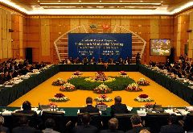
APEC Forum www.olemiss.edu/courses/pol337/apec.ppt
APEC is the premier forum for facilitating economic growth, cooperation, trade and investment in the Asia-Pacific region

Slide 8
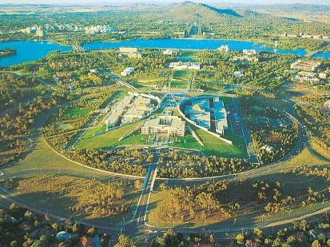
Birth of APEC 1989
APEC begins as an informal Ministerial-level dialogue group in Canberra, Australia in 1989
12 founding members:
  Australia, New Zealand
  6 ASEAN economies
  Japan and South Korea
  Canada and the United States

Slide 9
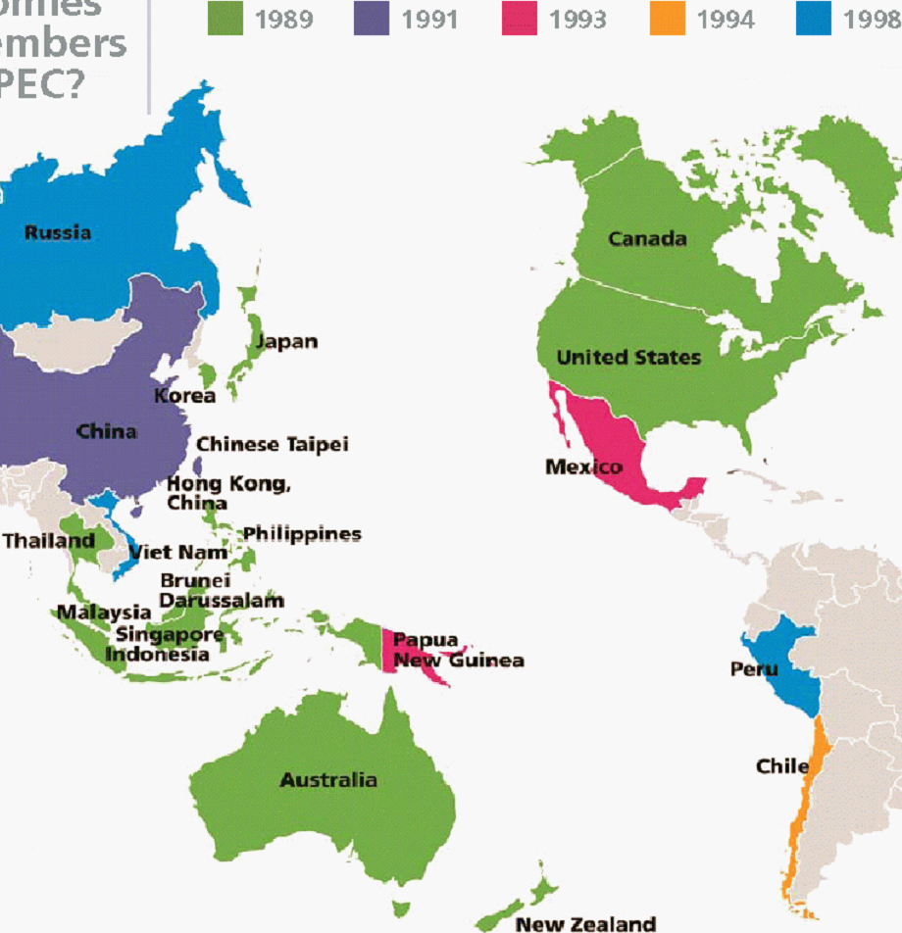
Expansion of APEC 1991-1998
1991: China, Taiwan, and Hong Kong
1993: Mexico and Papua New Guinea
1994
  Chile
1998
  Russia
  Vietnam
  Peru

Slide 10
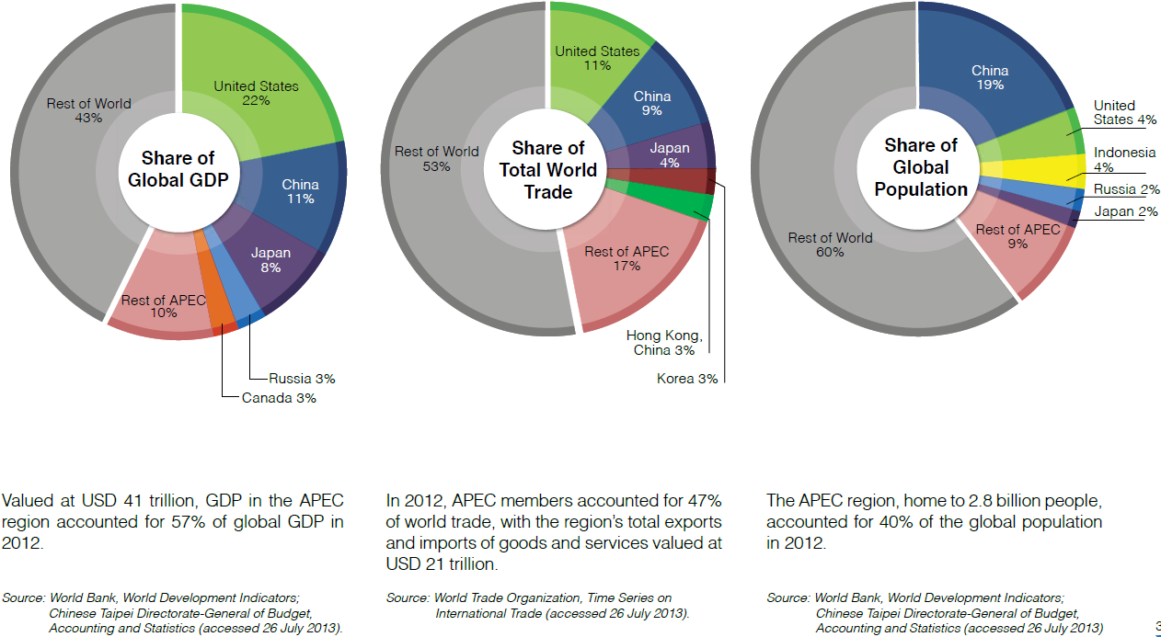

Slide 11
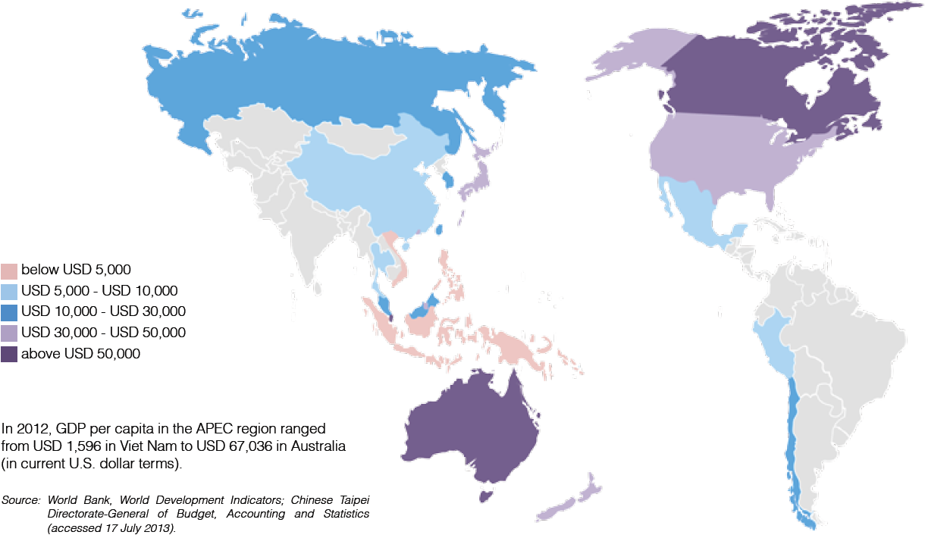

Slide 12
Host Economy
Every year one of the 21 member economies
  plays host to APEC meetings
  serves as the APEC Chair
  chairs the annual
    Economic Leaders’ Meeting
    Ministerial Meetings
  (prior to 2010) filled Executive Director of the APEC Secretariat

Slide 13

APEC Secretariat
Based in Singapore
Executive Director
  from the “host economy”
  Singapore in 2009
Deputy Executive Director
  from the “host economy” of the next year
fixed 3-year terms since 2010
mostly diplomats

Slide 14
Policy Development
Economic Leaders’ Meeting
APEC Ministerial Meeting
  Annual APEC Ministerial Meetings of foreign and economic/trade ministers
  Held immediately before Economic Leaders’ Meetings
Sectoral Ministerial Meetings
  edu., energy, env., fin., HR, sci-tech, sme, t.t.

Slide 15
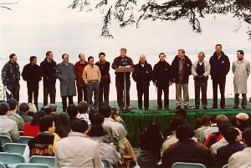
Leaders’ Meetings
Held annually since 1993
1993, Blake Island, Seattle, US
  APEC Leaders Economic Vision Statement

Slide 16
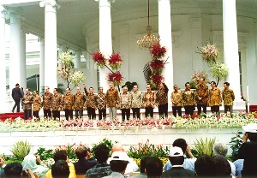
``Bogor Goals”
APEC Economic Leaders' Declaration Of Common Resolve (1994)
Free and open trade and investment in the Asia-Pacific
  by 2010 for developed economies
  by 2020 for developing economies

Slide 17
``Three Pillars”
3 specific areas crucial to achieving the Bogor Goals:
  Trade and investment liberalization
  Business facilitation
  Economic and technical cooperation

Slide 18
``Three Pillars”
Trade and investment liberalization
  reducing and eliminating tariff
  reducing and eliminating non-tariff barriers to trade and investment
  opening markets
Business facilitation
Economic and technical cooperation

Slide 19
``Three Pillars”
Trade and investment liberalization
Business facilitation
  reducing the costs of business transactions
  improving access to trade information
  bringing into line policy and business strategies to facilitate growth
  free and open trade
Economic and technical cooperation

Slide 20
``Three Pillars”
Trade and investment liberalization
Business facilitation
Economic and technical cooperation
  assisting member economies build the necessary capacities to take advantage of global trade and the New Economy
  https://www.youtube.com/watch?v=UGi2w4zij_k

Slide 21
ASEAN Economic Community
From Charosporn Chalermtiarana, Ph.D.
Fiscal Policy Office, Ministry of Finance
http://www.youtube.com/watch?v=6oXzh2YgXdw&list=TLf6cUVvj2UAE

Slide 22










ASEAN Countries
ASEAN was first formed in 1967 with six member countries: Brunei, Indonesia, Malaysia, Philippines, Singapore and Thailand and was subsequently joined by Cambodia, Laos, Myanmar and Vietnam.

Slide 23
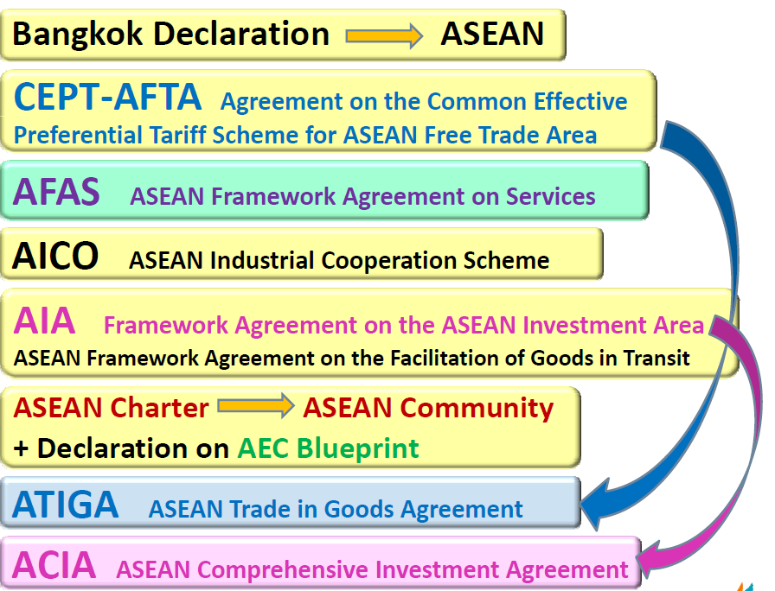
History
1967
1992
1995
1996
1998
2007
2009
2011

Slide 24
ASEAN Economic Community (AEC)
Transform ASEAN into a region with free movement of goods, services, investment, skilled labour, and freer flow of capital
Elimination of tariff and other trade obstacles, ease of customs
AEC Blueprint and strategic schedule (endoresed by ASEAN Summit, 2007) set the goal of regional economic integration by December 2015

Slide 25


Overview of AEC
AEC
Single Market and
Production base
characteristic
objective
Free flow of goods
services, investment,
and skilled labor
To create a stable, prosperous and highly competitive ASEAN economic region
Freer flow of capital
Notes:
AEC : Opening up opportunity

Slide 26
Objectives of AEC
AEC Blueprint
Single market and production base
Competitive economic region
Equitable economic development
Integration into the global economy

Slide 27

Single Market and Production Base
Characteristics of AEC
goods
service
investment
capital
skilled labor
AEC

Slide 28
AEC : Opening up opportunity
create a competitive market and will open up greater opportunities for socioeconomic growth
enhancement in ﹕
  trade development
  investment liberalization
  collaboration in regional supply chain

Slide 29
Trade development
Removal of tariff and other trade obstacles, ease of customs, AEC E-Commerce Platform, common language
Simple, harmonized and standardized trade and customs
Greater choice of goods and services for consumers through increases in intra-regional trade, standardization.

Slide 30
Trade development
Reduction in transaction costs in ASEAN will enhance export competitiveness – Air/Truck/Rail Link
Lowering of production costs can be passed onto consumers who can benefit from lower prices of goods and services

Slide 31
Investment liberalization
Free flow of goods, services, skilled labour, and capital (%)
Facilitate trade and investment
A more competitive market

Slide 32
Collaboration in regional supply chain
Regional integration which will improve efficiencies and competitiveness of ASEAN members – custom, immigration, seamless flow of data, mutually recognize protocol.
Development of the region into a global production and sourcing hub
Accelerates the infrastructure development for enhancing supply chain efficiency and access to new markets

Slide 33
Potential Economic Impact of AEC
Source: ERIA

Slide 34
Progress
ASEAN members have completed 72% of economic blueprints needed to bring about the AEC
Tariff of nearly 8,000 items have been cut
Full benefits will be realized only when there is harmonization in other sectors of the economy including taxation regime, labour legislation, licensing requirement, etc.

Slide 35
Business Opportunities in Thailand
Potential Sectors
Automotive
& Parts
Electrical & Electronics
Halal Food Production Hub
Tourism Hub
Manufacturing & Assembly Hub
Machinery and Metalworking Production Base

Slide 36
ASEAN economy is integrating to achieve the goal of AEC in 2015.
Numerous benefits are offered to
businesses and investors.
Thailand is a Hub in many sectors for ASEAN
Single market
Production base

Slide 37
Questions
First
How far has East Asian economic regionalization gone compared with other regions and from a historical perspective?
Second
What are the basic feature of regionalism?
Why has East Asian regionalism evolved the way it has, especially after Asia financial crisis?
Third
How will East Asian regionalism affect the global and regional balance of power and the United States?

Slide 38
Regionalization VS. Regionalism
Regionalization
A concentration of economic activities, whether caused by market forces or government policies.
Regionalism
Coordinated government policies to promote greater regional economic transaction.
  Nature forces: proximity, cultural affinity, comparative advantage, and government efforts.
  Ben Anderson’s Imagined Communities.

Slide 39
Evidence of Regionalization
Regional FDI
Regional value chains
Closer economic ties through trade
Japanese, Western, and ethnic Chinese capitalist.
  Alliances and Rivalries go in all direction

