Slide 1
International Portfolio Investment
15
Chapter fifteen
Chapter Objectives:
Why investors diversify their portfolios internationally.
How much investors can gain from international diversification.
The effects of fluctuating exchange rates on international portfolio investments.
The reasons for “home bias” in portfolio holdings.

Slide 2
International Correlation Structure and Risk Diversification
Security returns are much less correlated across countries than within a country.
  This is so because economic, political, institutional, and even psychological factors affecting security returns tend to vary across countries, resulting in low correlations among international securities.
  Business cycles are often high asynchronous across countries.

Slide 3
International Correlation Structure
Stock Market
AU
FR
GM
JP
NL
SW
UK
US
Australia
.59
Relatively low international correlations imply that investors should be able to reduce portfolio risk more if they diversify internationally rather than domestically.
France
.29
.58
Relatively low international correlations imply that investors should be able to reduce portfolio risk more if they diversify internationally rather than domestically.
Germany
.18
.31
.65
Japan (JP)
.15
.24
.30
.42
Netherlands
.24
.34
.51
.28
.62
Switzerland
.36
.37
.48
.28
.52
.66
UK
.32
.38
.30
.21
.39
.43
.70
US
.30
.23
.17
.14
.27
.27
.28
.44

Slide 4
Domestic vs. International Diversification
When fully diversified, an international portfolio can be less than half as risky as a purely domestic portfolio.
A fully diversified international portfolio is only 12% as risky as holding a single security.
Portfolio Risk (%)
0.44
Swiss stocks
0.27
U.S. stocks
0.12
International stocks
1 10 20 30 40 50
Number of Stocks

Slide 5
Optimal International Portfolio Selection
The correlation of the U.S. stock market with the returns on the stock markets in other nations varies.
The correlation of the U.S. stock market with the Canadian stock market is 70%.
The correlation of the U.S. stock market with the Japanese stock market is 24%.
A U.S. investor would get more diversification from investments in Japan than Canada.

Slide 6
Summary Statistics for Monthly Returns 1980-2007 ($U.S.)
Stock Market
Correlation Coefficient
Mean
(%)
SD
(%)
β
Country stock market vs. world
CN
FR
GM
JP
UK
Canada (CN)
1.07
5.55
1.00
France (FR)
0.49
1.20
6.00
1.04
1.07% monthly return = 12.84% per year
Germany (GM)
0.46
0.73
1.19
6.29
1.03
Japan (JP)
0.34
0.40
0.32
0.92
6.53
1.10
United Kingdom
0.59
0.61
0.56
0.42
1.19
5.20
0.97
United States
0.72
0.55
0.52
0.31
0.61
1.11
4.25
0.88

Slide 7
Summary Statistics for Monthly Returns 1980-2007 ($U.S.)
Stock Market
Correlation Coefficient
Mean
(%)
SD
(%)
β
Country stock market vs. world
CN
FR
GM
JP
UK
Canada (CN)
measures the sensitivity of the market to the world market.
Clearly the Japanese market is more sensitive to the world market than is the U.S.
1.07
5.55
1.00
France (FR)
0.49
1.20
6.00
1.04
Germany (GM)
0.46
0.73
1.19
6.29
1.03
Japan (JP)
0.34
0.40
0.32
0.92
6.53
1.10
United Kingdom
0.59
0.61
0.56
0.42
1.19
5.20
0.97
United States
0.72
0.55
0.52
0.31
0.61
1.11
4.25
0.88

Slide 8
Selection of the Optimal International Portfolio
2.0%
Efficient frontier
SD
1.5%
OIP
HK
NL
IT
UK
GM
US
SW
CN
1.0%
Monthly Return
JP
0.5%
R_{f}
Monthly Standard Deviation
0.0%
0.0%
1.0%
2.0%
3.0%
4.0%
5.0%
6.0%
7.0%
8.0%
9.0%
10%
15-7

Slide 9
Market Beta and Sharpe Ratio
World β measures sensitivity
of a national market return to
the world market movements
Sharpe Ratio measures historical
performance of stocks (i.e. excess
return adjusted for risk)
Calculate “Gain from OIP”
Method 1: Increase in SR
Method 2: Increase in portfolio return at domestic-equivalent risk level

Slide 10
Gains from
International Diversification
For a U.S. investor, OIP has more return and more risk. The Sharpe measure is 20% higher, suggesting that an equivalent-risk OIP would have 1.73% more return than a domestic portfolio. (Risk-free = 0.55%)
return
OIP
1.42%
1.26%
ODP
OIP
ODP
Mean Return
1.42%
1.26%
risk
4.51%
Standard Deviation
4.51%
4.43%
4.43%

Slide 11
Effects of Changes in the Exchange Rate
The realized dollar return for a U.S. resident investing in a foreign market will depend not only on the return in the foreign market but also on the change in the exchange rate between the U.S. dollar and the foreign currency.

Slide 12
Effects of Changes in the Exchange Rate
The realized dollar return for a U.S. resident investing in a foreign market is given by
R_{i$} = (1 + R_{i})(1 + e_{i}) – 1
= R_{i} + e_{i} + R_{i}e_{i}
Where
R_{i} is the local currency return in the i^{th} market
e_{i} is the rate of change in the exchange rate between the local currency and the dollar

Slide 13
International Bond Investment
There is substantial exchange rate risk in foreign bond investment. This suggests that investors may be able to increase their gains if they can control this risk, for example, with currency forward contracts or swaps.
The advent of the euro is likely to alter the risk-return characteristics of the euro-zone bond markets enhancing the importance of non-euro currency bonds.

Slide 14
International Mutual Funds: A Performance Evaluation
Investor can easily achieve international diversification by investing in a home-based international mutual fund.
The advantages include
Savings on transaction and information costs.
Circumvention of legal and institutional barriers to direct portfolio investments abroad.
Professional management and record keeping.

Slide 15
International Diversification through Country Funds
Recently, country funds have emerged as one of the most popular means of international investment.
A country fund invests exclusively in the stocks of a single country. This allows investors to:
  Speculate in a single foreign market with minimum cost.
  Construct their own personal international portfolios.
  Diversify into emerging markets that are otherwise practically inaccessible.

Slide 16
American Depository Receipts
Foreign stocks often trade on U.S. exchanges as ADRs.
It is a receipt that represents the number of foreign shares that are deposited at a U.S. bank.
The bank serves as a transfer agent for the ADRs

Slide 17
American Depository Receipts
There are many advantages to trading ADRs as opposed to direct investment in the company’s shares:
  ADRs are denominated in U.S. dollars, trade on U.S. exchanges and can be bought through any broker.
  Dividends are paid in U.S. dollars.
  Most underlying stocks are bearer securities, the ADRs are registered.
Adding ADRs to domestic portfolios has a substantial risk reduction benefit.

Slide 18
World Equity Benchmark Shares
World Equity Benchmark Shares (WEBS)
  Country-specific baskets of stocks designed to replicate the country indexes of 22 countries.
  WEBS are subject to U.S. SEC and IRS diversification requirements.
  Low cost, convenient way for investors to hold diversified investments in several different countries.

Slide 19
Country ETFs: iShares
Developed ex-US markets iShares MSCI Australia Index
iShares MSCI Canada Index
iShares MSCI German Index
iShares MSCI Japan Index
iShares MSCI United Kingdom Index
Emerging markets iShares MSCI Brazil Index
iShares FTSE/Xinhua China 25 Index
iShares MSCI Hong Kong Index
iShares MSCI Mexico Index
Market Vectors Russia ETF
iShares MSCI Singapore Index
iShares MSCI South Korea Index
iShares MSCI Taiwan Index
Notes:
ETF: combines stock and mutual fund features
Thai ETFs:
SET50
SET100
MAI
Energy
China

Slide 20
International Diversification with WEBS
Recent research suggests that WEBs are an excellent tool for international risk diversification.
For investors who desire international exposure, WEBs may well serve as a major alternative to such traditional tools as international mutual funds, ADRs, and closed-end country funds

Slide 21
International Diversification with
Hedge Funds
Hedge funds which represent privately pooled investment funds have experienced phenomenal growth in recent years.
This growth has been mainly driven by the desire of institutional investors, such as pension plans, endowments, and private foundations, to achieve positive or absolute returns, regardless of whether markets are rising or falling.

Slide 22
International Diversification with
Hedge Funds
Unlike traditional mutual funds that generally depend on “buy and hold” investment strategies, hedge funds may adopt flexible, dynamic trading strategies, often aggressively using leverages, short positions, and derivative contracts, in order to achieve their investment objectives.
These funds may invest in a wide spectrum of securities, such as currencies, domestic and foreign bonds and stocks, commodities, real estate, and so forth.
Many hedge funds aim to realize positive returns, regardless of market conditions.

Slide 23
International Diversification with
Hedge Funds
Hedge funds tend to have relatively low correlations with various stock market benchmarks and thus offer diversification.
In addition, hedge funds allow investors to access foreign markets that are not easily accessible.
  For example, J.P. Morgan provides access to the Jayhawk China Fund, a hedge fund investing in Chinese stocks not readily available in U.S. markets.
Also, hedge funds may allow investors to benefit from certain global macroeconomic events. In fact, many hedge funds are classified as “global/macro” funds.
  Examples of global/macro funds include such well-known names as George Soros’ Quantum Fund, Julian Robertson’s Jaguar Fund, and Louis Bacon’s Moore Global Fund.

Slide 24
International Diversification with
Hedge Funds
Legally, hedge funds are private investment partnerships. As such, these funds generally do not register as an investment company under the Investment Company Act and are not subject to any reporting or disclosure requirements.
  As a result, many hedge funds operate under rather opaque environments.
While investors may benefit from hedge funds, they need to be aware of the associated risk as well.
  Hedge funds may make wrong bets based on the incorrect prediction of future events and wrong models.
  The failure of Long Term Capital Management provides an example of the risk associated with hedge fund investing.

Slide 25
International Diversification with
Hedge Funds
Hedge fund advisors typically receive a management fee, often 1 – 2 percent of the fund asset value as compensation, plus performance fee that can be 20 – 25 percent of capital appreciation.
Investors may not be allowed to liquidate their investments during a certain lock-up period.
In the United States, only institutional investors and wealthy individuals are allowed to invest in hedge funds.
In many European countries, however, retail investors are also allowed to invest in these funds.

Slide 26
Home Bias in Portfolio Holdings
As previously documented, investors can potentially benefit a great deal from international diversification.
The actual portfolios that investors hold, however, are quite different from those predicted by the theory of international portfolio investment.

Slide 27
Home Bias in Portfolio Holdings
Home bias refers to the extent to which portfolio investments are concentrated in domestic equities.
Country
Share in World Market Value
Proportion of Domestic Equities in Portfolio
France
2.6%
64.4%
Germany
3.2%
75.4%
Italy
1.9%
91.0%
Japan
43.7%
86.7%
Spain
1.1%
94.2%
Sweden
0.8%
100.0%
United Kingdom
10.3%
78.5%
United States
36.4%
98.0%
Total
100.0%

Slide 28
Why Home Bias in
Portfolio Holdings?
Three explanations come to mind:
  Domestic equities may provide a superior inflation hedge.
  Home bias may reflect institutional and legal restrictions on foreign investment.
  Extra taxes and transactions/information costs for foreign securities may give rise to home bias.

Slide 29
Why Home Bias in
Portfolio Holdings?
A study of the brokerage records of tens of thousands of U.S. individual investors shows that wealthier, more experienced, and sophisticated investors are more likely to invest in foreign securities.
Another study shows that when a country is remote and has an uncommon language, foreign investors tend to stay away.

Slide 30
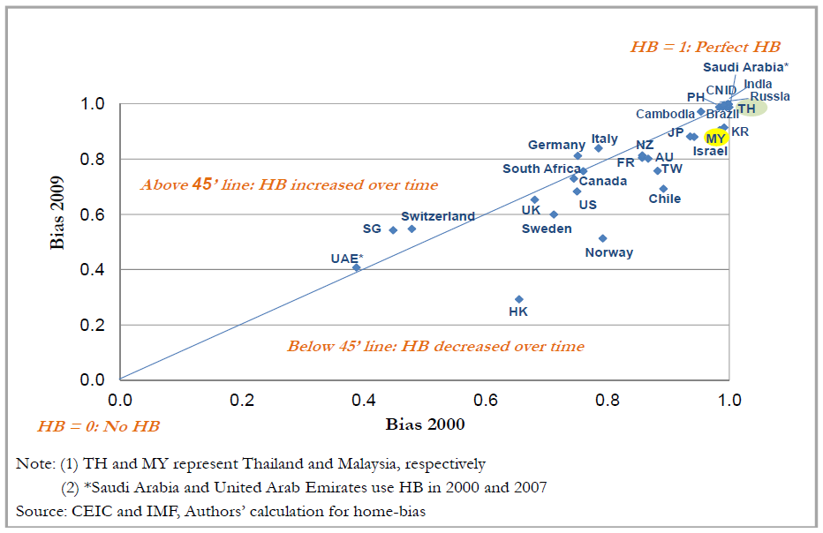
Home bias in Portfolio Investment: Equities

Slide 31
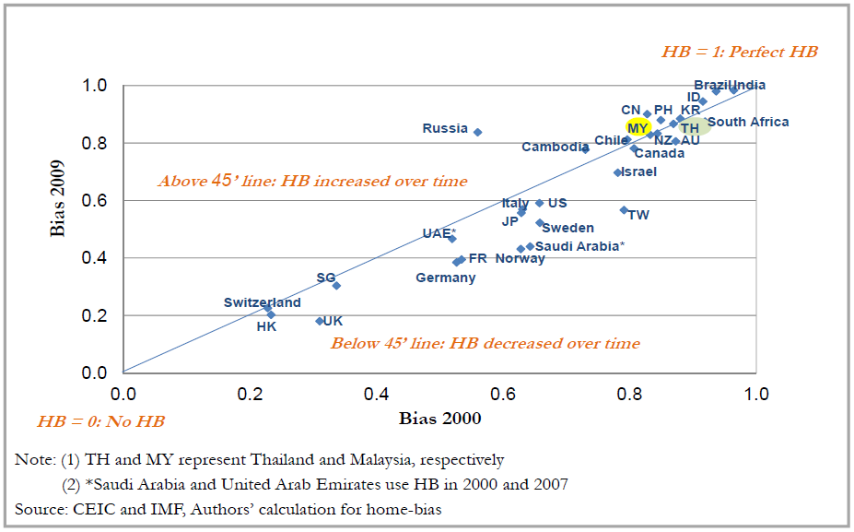
Home bias in Portfolio Investment: Bonds

Slide 32
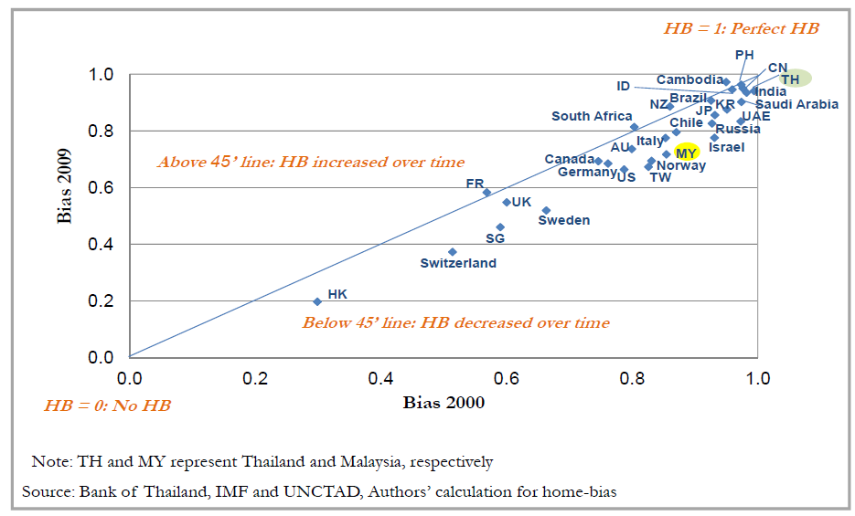
Home bias in Direct Investment

Slide 33
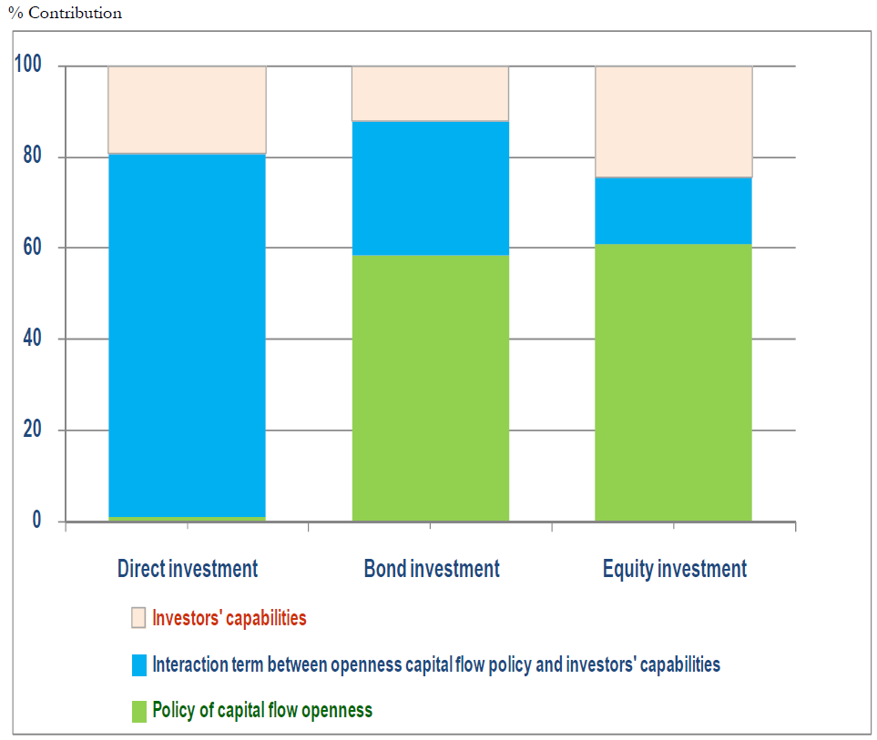
Contribution to home Bias explanation

