Slide 1

MK 322 Retail Management
Chapter 7: Retail Locations Part II
By Ajarn Suwalya K.

Slide 2
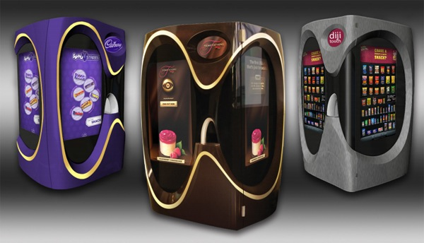
Nontraditional Locations

Slide 3
Pop-Up Stores and Other Temporary Locations
Pop-up stores are temporary locations that focus on new products or limited group of products
Pop-up stores are particularly attractive to retailers with high seasonal sales such as Toys "R" Us.
In 2009, Toys "R" Us had 90 "Express"pop-up store and in 2010 increase dramatically to 600
Notes:
1

Slide 4
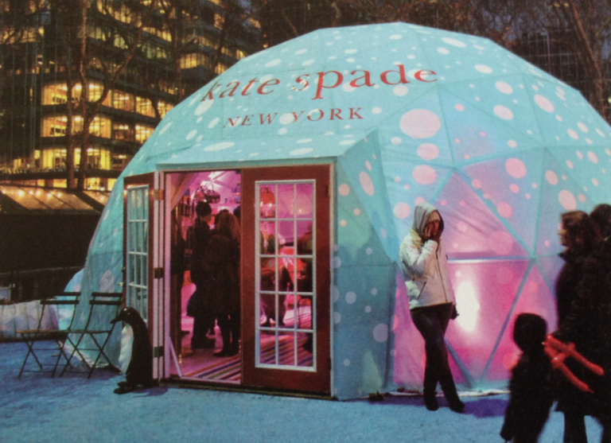
Pop-Up Stores and Other Temporary Locations
This Kate Spade pop-up store is an attractive temporary location for the high-fashion retailer/designer.
Notes:
1

Slide 5
Store-within-a-Store
Store-within-a-store locations involve an agreement in which a retailer rents a part of the retail space in a store operated by another independent retailer
The host retailer sublets the space
The store-within retailer manages the assortment, inventory, personnel,and systems and delivers a percentage of sales or profits to the host
For example-Department stores, in China the Modern Plaza
Benefits include enhancing brand image in high traffic areas like JC Penny and Sephora
Notes:
1

Slide 6
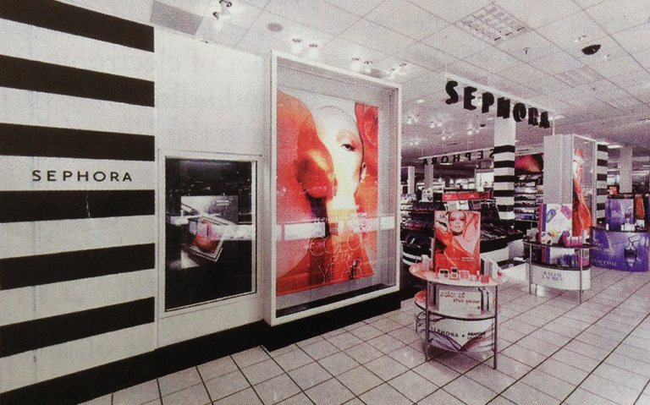
Store-within-a-Store
JCPenny has partnership with Sephora using a store-within-a-store strategy.
Notes:
1

Slide 7
Merchandise Kiosks
Merchandise kiosks are small selling spaces, typically located in the walkways of enclosed malls, airports, college campuses, or office buildings
For example, Apple kiosks sell iPods and other high volume Apple products
Notes:
1

Slide 8
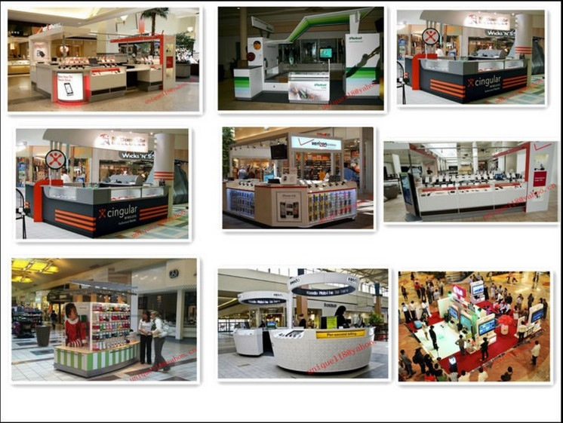
Merchandise Kiosks
Notes:
1

Slide 9
Airports
A high-Pedestrian area has become very popular with national chains
Passengers waiting time to shop and enjoy a quick meal at the restaurant
The best-selling products are those that make good gifts, necessities and easy-to-pack items
Duty-free for international airports, for example King Power
Notes:
1

Slide 10
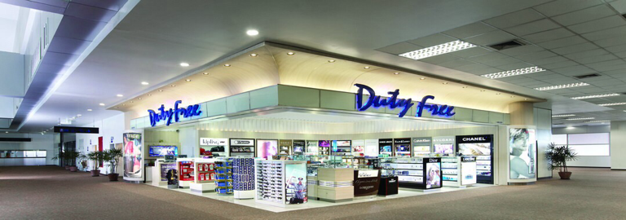
Airports
Notes:
1

Slide 11
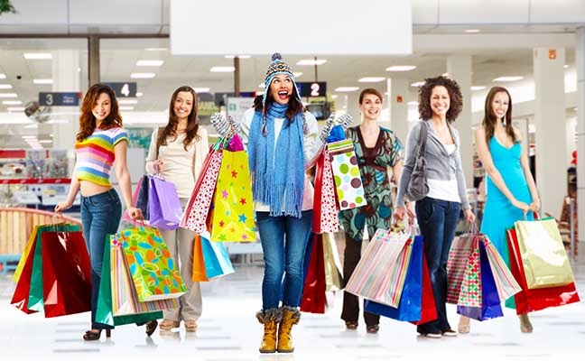
Locations and Retail Strategy

Slide 12
Shopping Behavior of Consumers in Retailer's Target Market
A first and critical factor affecting the type of location that consumers select to visit is the shopping situation in which they are involved
Three types of shopping situations are convenience shopping, comparison shopping and speciality shopping
Notes:
1

Slide 13
Convenience Shopping
Consumers engaged in convenience shopping are
Concerned about minimizing effort to get the product and service they want
Insensitive about price and indifferent about brands they buy
Not spending time evaluating different brands or retailers
Examples include, cup of coffee during work break, buying gas for a car, or buying milk for breakfast in the morning
Notes:
1

Slide 14
Convenience Shopping
Retailers targeting customers involved in convenience shopping such as quick service restaurants, convenience stores, and gas stations, usually locate their stores close to where their customers and are easily accessible
Convenience stores, drugstores, fastfood restaurants, full-line discount stores are located in neighborhood strip centers and freestanding locations
Notes:
1

Slide 15
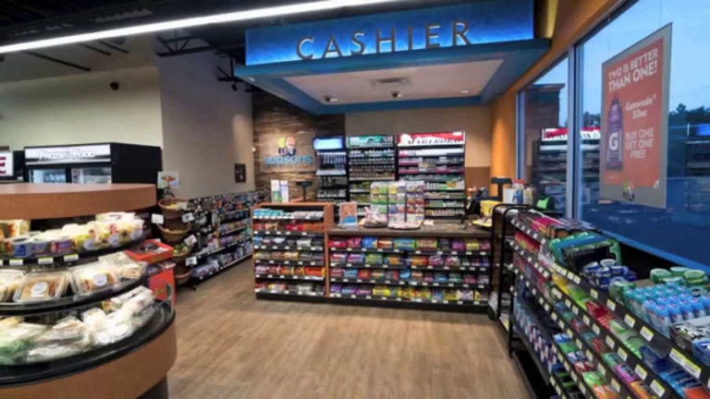
Convenience Shopping
Notes:
1

Slide 16
Comparison Shopping
Consumers involved in comparison shopping are
More involved in the purchase decision
They have a general idea about the type of product or service the want, but do not have a well-developed preference for brand or model
Thet seek information and are willing to spend effort to compare alternatives
Examples are buying furniture, appliances, apparel,consumer electronics and hand tools
Notes:
1

Slide 17
Comparison Shopping
Furniture retailers locate next to one another to create a "furniture row"
Enclosed malls offer the same benefits to consumers interested in comparison shopping for fashion apparel
Category specialists offer the same benefit of comparison shopping as a collection of co-located speciality stores
Notes:
1

Slide 18
Comparison Shopping
Category specialists are destination stores, places where consumers will go even if it is inconvenient
Just like enclosed malls are destination locations for fashionable-apparel comparison shopping
Category specialists locate in power centers, primarily to reduce costs and create awareness of their location, and secondarily to benefit from multiple retailers that attract more consumers and the resulting potential for cross-shopping
Power centers, are a collection of destination stores
Notes:
1

Slide 19
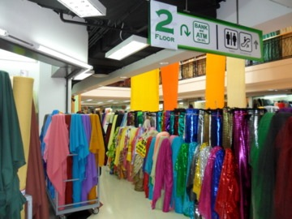
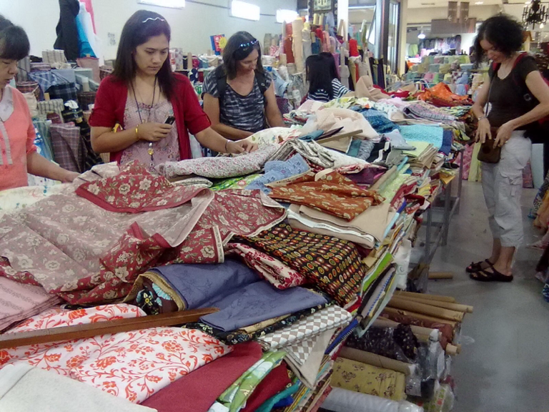
Comparison Shopping
Notes:
1

Slide 20
Speciality Shopping
Consumers who go speciality shopping
Know what they want and will not accept a substitute
Are brand and/or retailer loyal and will pay a premium and spend extra effort, if necessary get exactly what they want
Examples include buying organic vegetables, a luxury automobile, or high-end road or mountain bike
Notes:
1

Slide 21
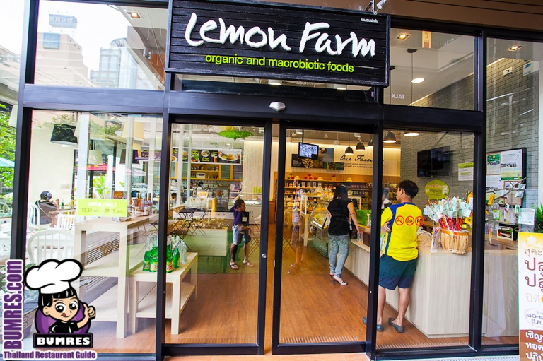
Speciality Shopping
Thus consumers are willing to travel to inconvenient location
Having location is not as important for retailers selling unique merchandise or services
Notes:
1

Slide 22
Density of Target Market
A second factor affecting retailer's choice of location is the density of the retailer's target market in relation to the location
A good location has many people in the target market who are drawn to it
For example, a convenience store located near a CBD can be sustained by customers living or working close
Notes:
1

Slide 23
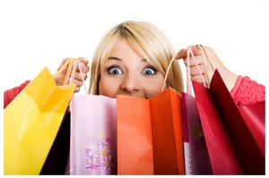
Uniqueness of Retail Offering
The last factor is uniqueness of offering
Convenience of locations are less important for retailers with unique, differentiated offerings
For example Brass Pro Shops provide unique merchandise assortment and store atmosphere
Customers will travel to wherever the store is located and its location will become a destination
Notes:
1

Slide 24


