Slide 1
Theories of economic growth
EE463 Globalization and international economic development
Faculty of economics
Thammasat university

Slide 2
Why are some countries rich? Or poor?
There are no easy answers. However, based on observations it is agreed that long-run economic growth may be the single most fundamental determinant.
Examples:
United States, starting 1900
Japan, 1950-1990
South Korea, starting 1970
Taiwan: starting1980
Singapore: starting1980
China: starting 1990
Economic growth needs:
Asset accumulation
Making assets more productive

Slide 3
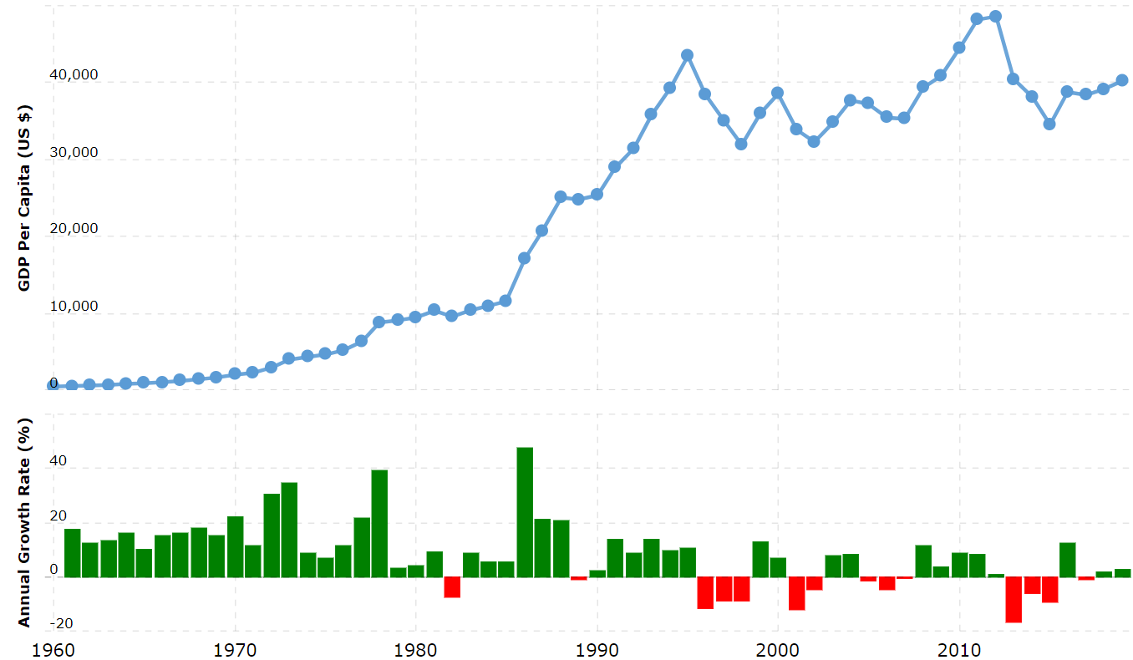
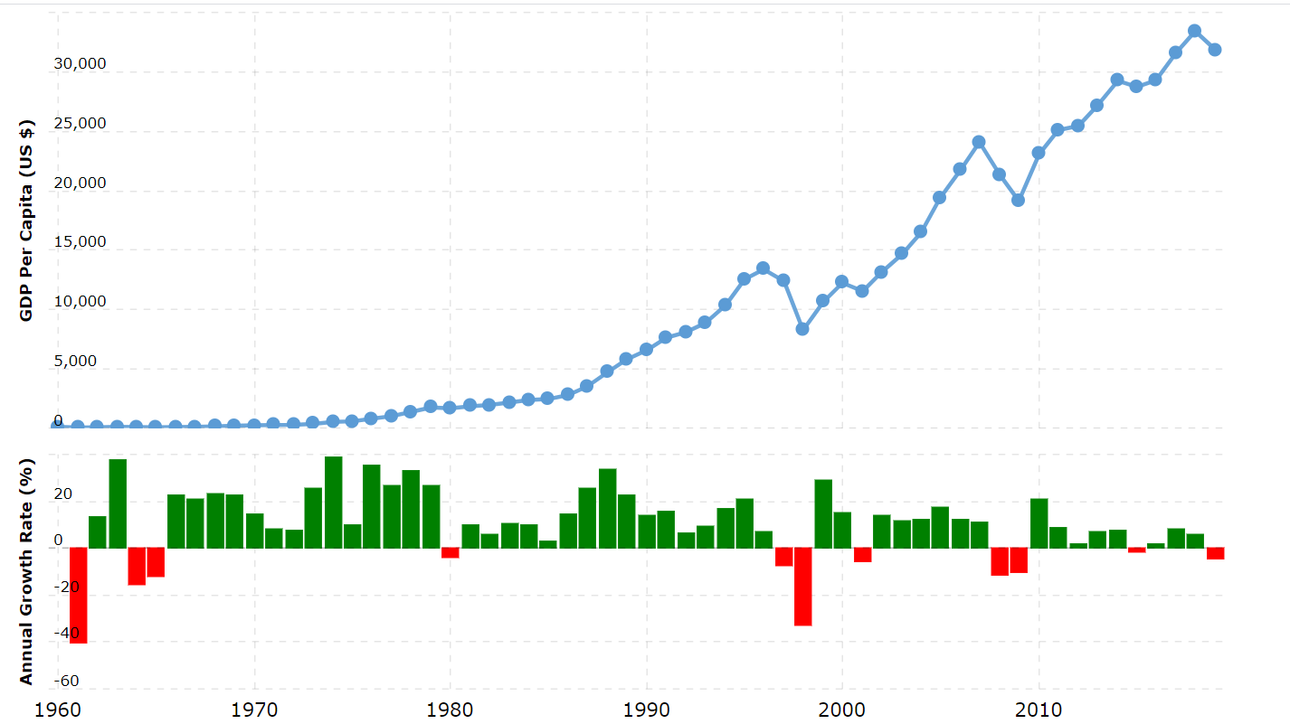
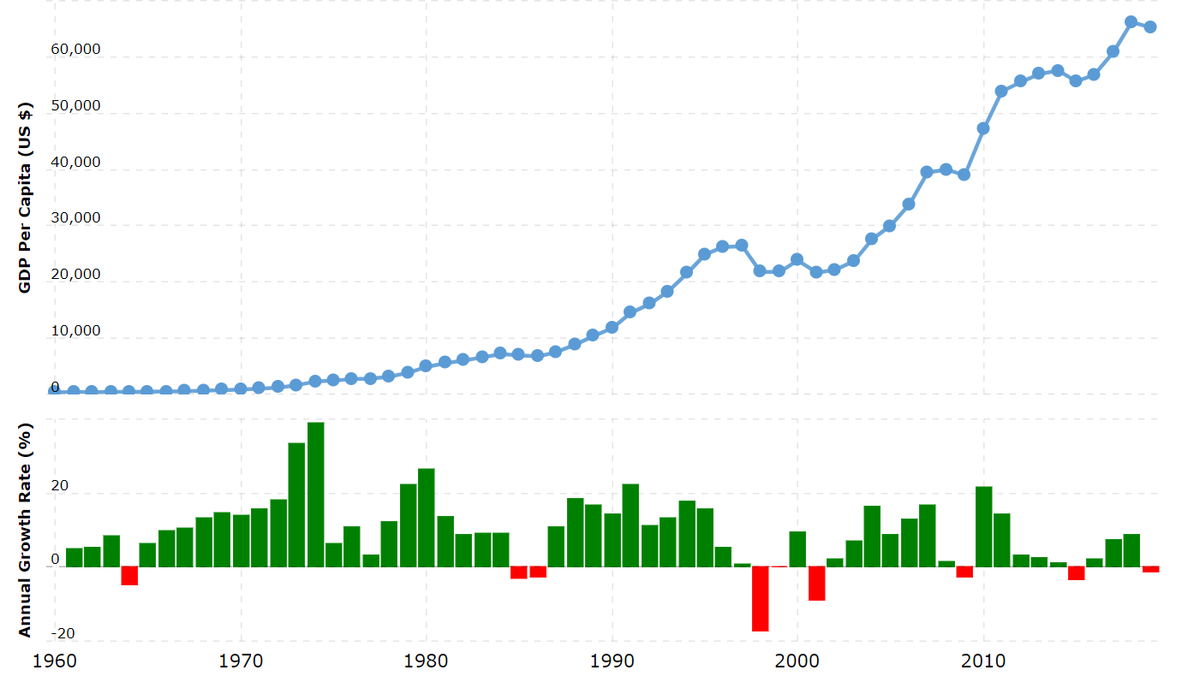
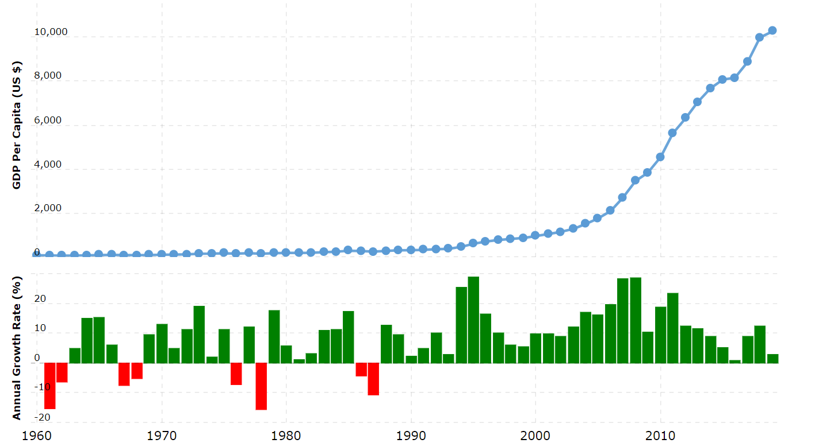
GDP per capita,
1960-2020
Japan
South Korea
Singapore
PR China

Slide 4
Basic growth model
Total output is a function of capital and labor
Change in capital depends on the rate of saving and eventually investment (minus depreciation)
Change in labor depends on the growth rate of the labor force

Slide 5
Basic growth model
Y = F (K, L) Total output (Y) is a function of capital stock (K) and labor (L)
S = sY = I Savings (S) = average saving rate (s) times income (Y) = investment (I)
∆K = I – (dK) Change in capital stock (∆K ) = investment – capital depreciation (dK)
∆L = nL Change in labor force = growth rate of population (n) times labor fiorce

Slide 6
Harrod-Domar growth model
Capital ($ million)
b
$20
Isoquant II 200,000 keyboards
a
c
Isoquant I 100,000 keyboards
$10
Quantity of labor (person years)
100
200

Slide 7
Harrod-Domar growth model
Assumptions:
Fixed coefficient and constant-returns-to-scale production function
Growth requires a right mix of capital and labor
Output is a linear function of capital
Incremental capital-output ratio (ICOR) used as a measure to measaure the productivity of capital (to determine the impact on output of additional capital). The lower the ICOR, the better

Slide 8
Neoclassical production function (SOLOW MODEL)
Capital-output and capital-labor outputs are no longer fixed
Output is a function of capital per worker
More investments (capital) per worker will increase worker output; however it will give diminishing returns

Slide 9
Solow growth model
Capital ($ million)
Builds on the Harrod-Domar model, but allows for more flexibility and substitution betweeb factors of production
b
$20
$18
d
Isoquant II 200,000 keyboards
a
c
$10
Isoquant I 100,000 keyboards
Quantity of labor (person years)
100
200

Slide 10
Equation for solow growth model
∆k = sy – (n + d)k
Change in capital stock (∆k ) = saving rate times income per worker – (population growth rate + depreciation) times capital per worker
Basically the equation tells us that change in in capital stock is equal to savings minus capital depreciation

Slide 11
Summary of solow model
The Solow model is a powerful tool for analyzing the relationships between saving, investment, population growth, output and economic growth
However it indicates that once an economy reaches its long run potential level of income and economic growth matches population growth there is no chance for sustained increase in income
This deficiency has been corrected with the introduction of another variable, which is technological change (which increases productivity)

Slide 12
Convergence debate
Higher income countries have relatively lower growth rates (as predicted by Solow), and lower income countries have the potential to achieve higher growth rates. This is the case for most countries, however not for all cases
Example: Japan had high rate of growth from 1960-1990.in 1960, its GDP per capita was 1/3 of the US, and grew at 9% per year. In 1990, its GDP per capita was 85% of the US but growth rate fell to 4%
Example: In 1960 Zambia’s GDP per capita was $1,803 and in 2009 was $1,765. The economy did not grow because of the lack of foreign investments, government policy, lack of technological change and occurrence of natural disasters

Slide 13
conclusion
Economic models help us understand the implications of capital, labor, savings rates, population growth rates, technological change and other factors on output and growth
The Harrod-Domar model assumes a fixed-coefficient production function which helps simplify the model but is limited in explaining wah mix of capital and labor is need to produce output. It focuss on savings; however savings alone is not sufficient for growth

Slide 14
conclusion
The Solow model improves on some weaknesses of the Harrod-Domar model by allowing flexibility in the mix of capital and labor in the production process. It looks at diminishing marginal product of capital and introduces technological change as a critical factor.
However it does not discuss
the fundamental causes of factor accumulation and productivity growth, and
the issue of allocation of resources across sectors

Slide 15
conclusion
Several implications of the Solow model:
Poor countries have the potential tio grow rapidly
Growth rates tend to slow down as incomes increase
Across countries that share important common characteristics, the incomes of poor countries can converge with those of rich countries
Acquiring new technology is central to accelerating and sustaining growth

