Slide 1

MK 322 Retail Management
Chapter 2: Types of Retailers Part I
By Ajarn Suwalya K.

Slide 2
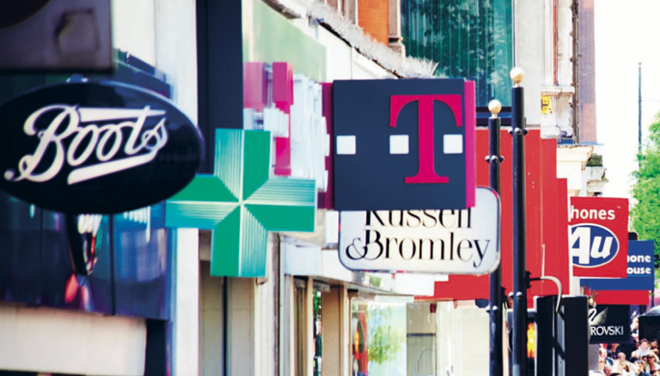
Retailer Characteristics

Slide 3
Type of Merchandise
North American Industry Classification System(NAICS)- developed in U.S, Canada and Mexico to collect data on business activity of each country.
The classifications for retailers selling merchandise, based largely on the type of merchandise sold,are illustrated in Exhibit 2-1
Notes:
1

Slide 4
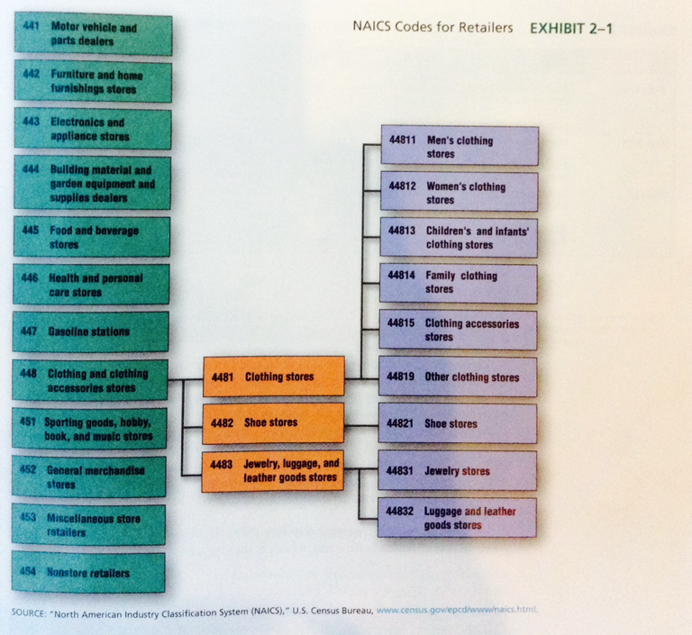
Type of Merchandise
Notes:
1

Slide 5
Variety and Assortment
Variety: the number of merchandise categories a retailer offers.
Referred to as Breadth of merchandise
Assortment: is the number of different items offered in a merchandise category.
Referred to as Depth of merchandise
Stock-keeping unit (SKU): each different item of merchandise
Notes:
1

Slide 6
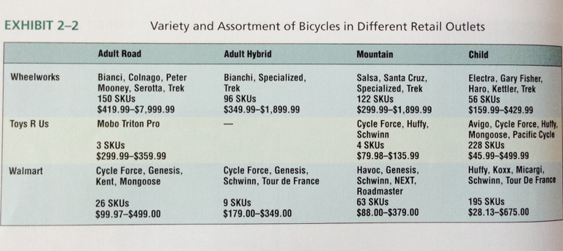
Type of Merchandise
Notes:
1

Slide 7
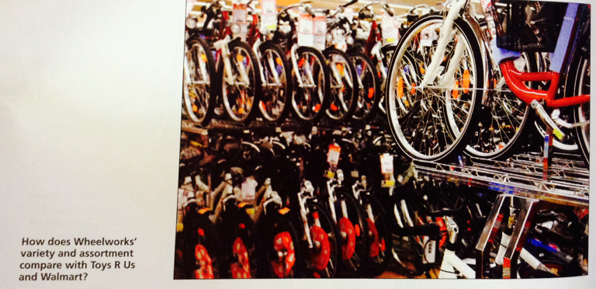
Type of Merchandise
Notes:
1

Slide 8
Services Offered
Retailers also differ in the services they offer customers.
Customers expect almost all retailers to provide certain services:displaying merchandise, accepting credit cards, providing parking, and being open at convenient hours.
Some retailers charge customers for other services such as home delivery and gift wrapping.
Notes:
1

Slide 9
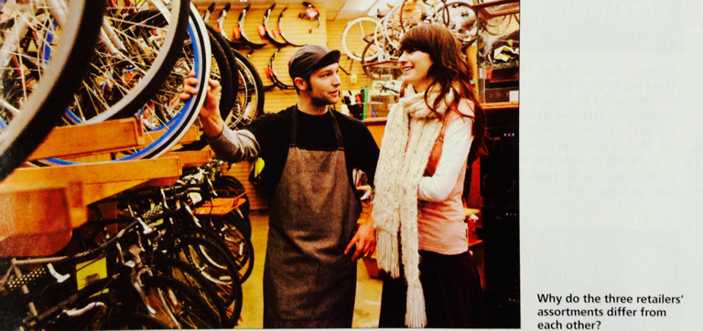
Type of Merchandise
Notes:
1

Slide 10
Prices and Cost of Offering Breadth and Depth of Merchandise and Services
Stocking a deep and broad assortment is appealing to customers but costly for retailers.
When a retailer offers many SKU's, its inventory investment increases because the retailer must have backup stock for each and every SKU.
Notes:
1

Slide 11
Prices and Cost of Offering Breadth and Depth of Merchandise and Services
Services attract customers to the retailer, but are also costly
More staff must be paid to provide information and assist customers, alter products to meet customers'needs, and demonstrate merchandising.
Child care facilities, restrooms, dressing rooms take up valuable space that could be used to stock and display merchandise.
Notes:
1

Slide 12
Prices and Cost of Offering Breadth and Depth of Merchandise and Services
To make a profit, retailers that offer broader variety, deeper assortments, and/or additional services need to charge higher prices.
For example, department stores have higher prices than discount stores partially because of their higher costs.
Department stores stock more fashionable merchandise and have to reduce prices when they make a mistake about guessing what popular styles will be.
They also provide more personal sales service and have expensive mall locations.
Notes:
1

Slide 13
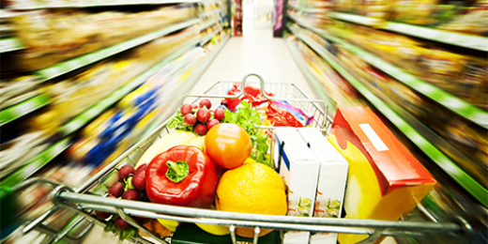
Food Retailers

Slide 14
Food Retailers
The food retailing landscaping is changing dramatically.
Many supermarkets offer pharmacies,health care clinics, banks and café.
The world's largest food retailer, Walmart attains more than $443 billion in sales of supermarket-type merchandise.
In this measure it is followed by Carrefour(France), Tesco(United Kingdom), Metro Group (Germany), Schwartz Group (Germany) and Kroger (United States)
Notes:
1

Slide 15
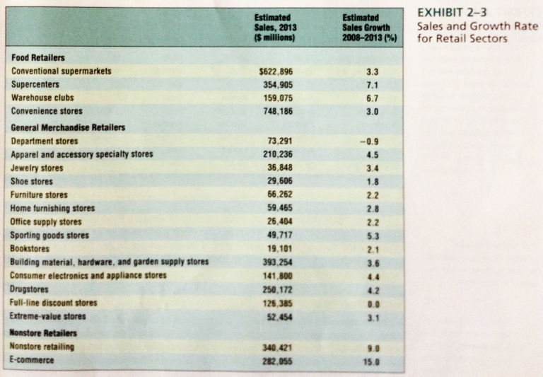
Food Retailers
Notes:
1

Slide 16
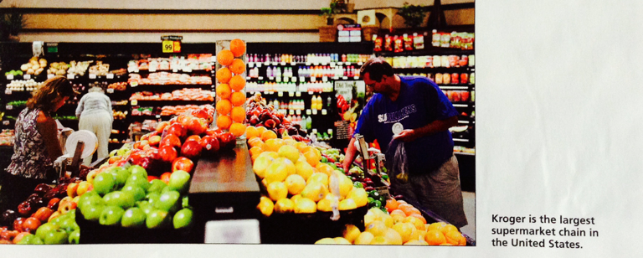
Food Retailers
Notes:
1

Slide 17
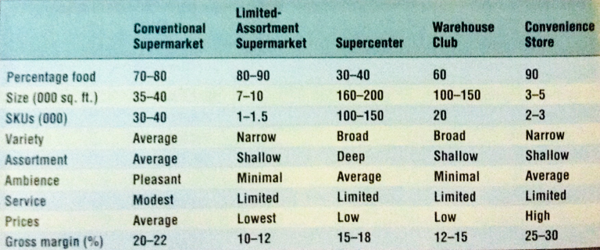
Food Retailers
Notes:
1

Slide 18
Supermarkets
A conventional supermarket: is a large, self-service retail food store offering groceries, meat, and produce, as well as some nonfood items such as health and beauty aids and general merchandising.
Perishables including meat, produce, baked goods and dairy products account for 30% percent of supermarket sales and typically have higher margins than packaged goods.
Notes:
1

Slide 19
Supermarkets
Conventional supermarkets carry about 30,000SKUs
Limited-assortment supermarkets or extreme-value food retailers only stock about 1,500 SKUs.
Example in US is Save-A-Lot and ALDI
Notes:
1

Slide 20
Supermarkets
Other retailers offer food merchandise to build the traffic in their stores and increase the sales of more profitable nonfood merchandise
They have superior operating efficiencies and bargaining power to achieve low costs and low prices.
Notes:
1

Slide 21
Supermarkets
To compete successfully, supermarkets differentiate their offerings by
1) emphasizing fresh perishables
2) targeting green and ethnic consumers
3) providing better value with private-label merchandise
4) providing a better shopping experience
Notes:
1

Slide 22
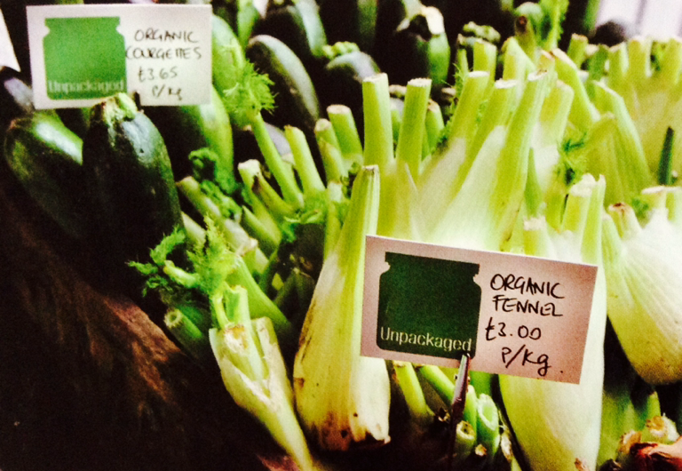
Supermarkets
Health-conscious and environmentally conscious are demanding
organic and locally produced foods from food retailers.
Notes:
1

Slide 23
Supercenters
Supercenters: large stores (160,000 to 200,000 square feet) that combines a supermarket with a full-line discount stores.
Walmart operates more than 3,000 supercenters in US
Tesco Lotus
Big C
Notes:
1

Slide 24
Hypermarkets
Hypermarkets: also large (160,000-200,000 square feet), combination of food (60 to 70 percent) and general merchandise (30 to 40 percent) stores.
The world's second largest retailer Carrefour operates hypermarkets.
They stock fewer SKUs than supercenters – between 40,000 and 60,000 items ranging from groceries, hardware, and sports equipment to furniture and appliances to computers and electronic
Notes:
1

Slide 25
Hypermarkets
Both face challenges in finding locations for new big box(large,limited-service)stores
Land for building in Europe and Japan is expensive
Notes:
1

Slide 26
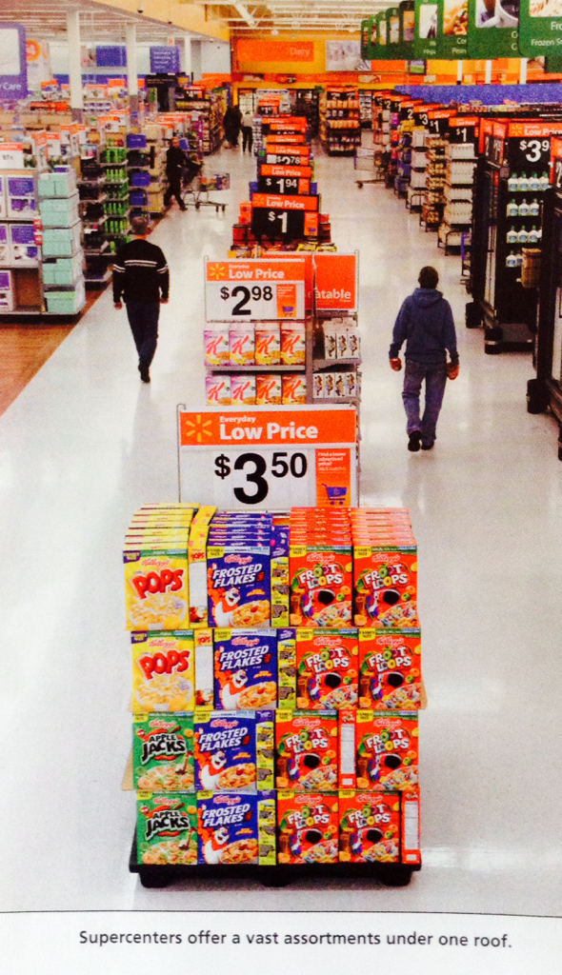
Hypermarkets
Notes:
1

Slide 27
Warehouse Clubs
Warehouse Clubs: retailers that offer a limited and irregular assortment of food and general merchandise with little service at low prices for ultimate consumers and small businesses.
Warehouse clubs are large (100,000 to 150,000 square feet) and typically located in low-rent districts.
Notes:
1

Slide 28
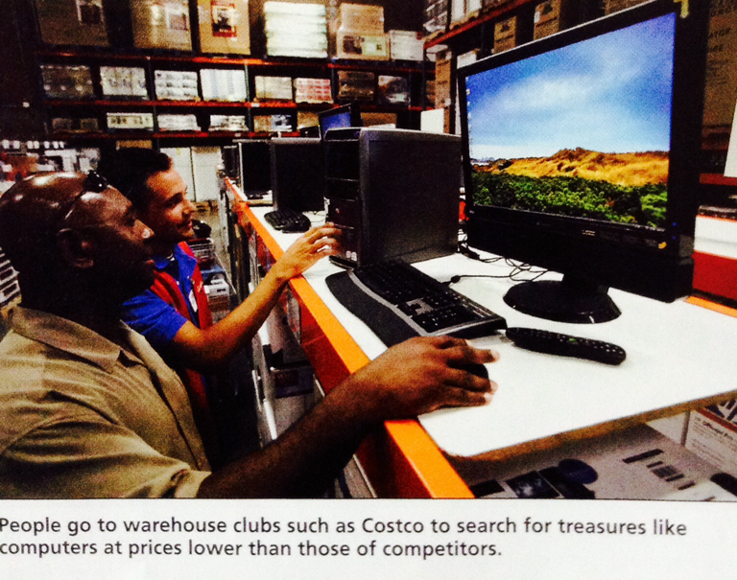
Warehouse Clubs
Notes:
1

Slide 29
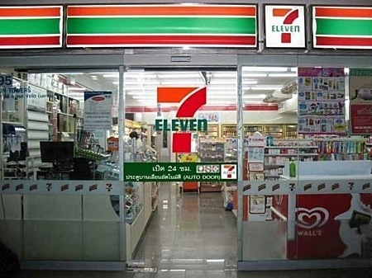
Convenience Stores
Convenience Store: a store that provides a limited variety of assortment of merchandise at a convenient location in a 3,000- to 5,000-square-foot store with speedy checkout.
Notes:
1

Slide 30
Convenience Stores
More than half the items bought are consumed within 30 minutes of purchase.
Charge higher prices than supermarkets for similar products like milk, eggs, and bread,etc
To compete against big retailers, thet add counter services for bill payments,etc.
To increase convenience, they open stores close to where consumers shop and work.
Open 24 hours
Notes:
1

Slide 31
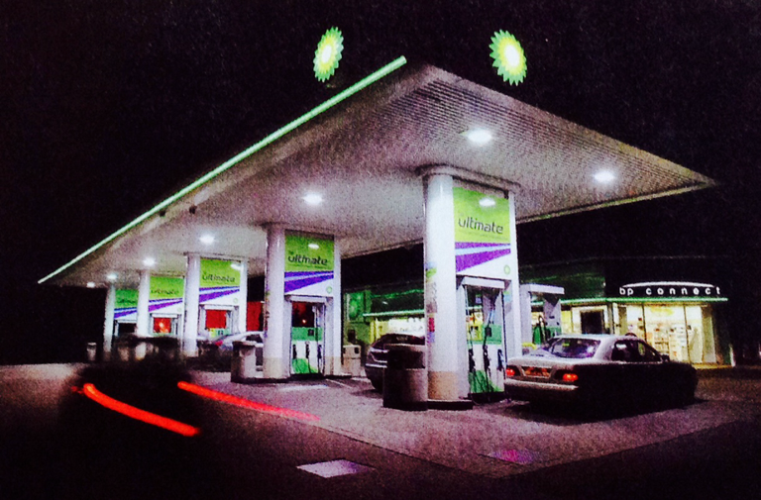
Convenience Stores
At convenience stores you can jump out of your car and pick up a Coke and some chewing gum while getting gas.
Notes:
1

