Slide 1

INTEGRATED BRAND COMMUNICATION
Massimiliano La Franca

Slide 2


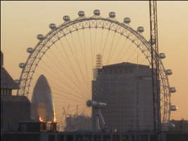
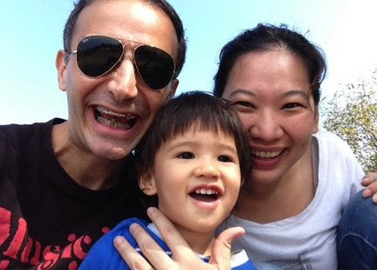
Let’s get to know each other…
Born in Italy, adopted by UK and married to Thai
Actor, musician, marketer and planner
New hubby, new daddy

Slide 3

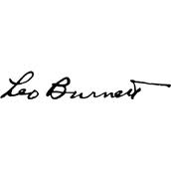

My over 12 years marketing experience

Slide 4






Some things we’ve done in Thailand in the past 3 years

Slide 5
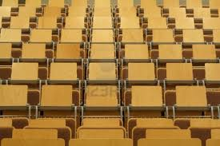
few words about you…?

Slide 6
Exercise
5 mins to talk to someone you don’t know
Tell them your name and one thing why we all should remember you
Everyone presents the other person with the name and the one thing
Suggestions
Think something memorable
Listen

Slide 7
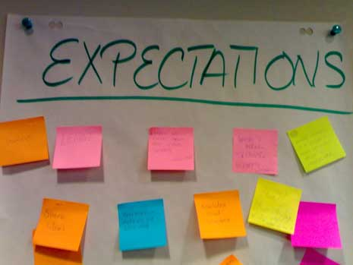

Slide 8
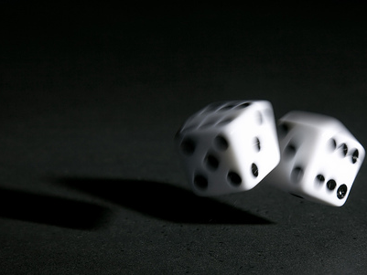
Few basic rules…

Slide 9

Participation

Slide 10

2 ways conversations

Slide 11
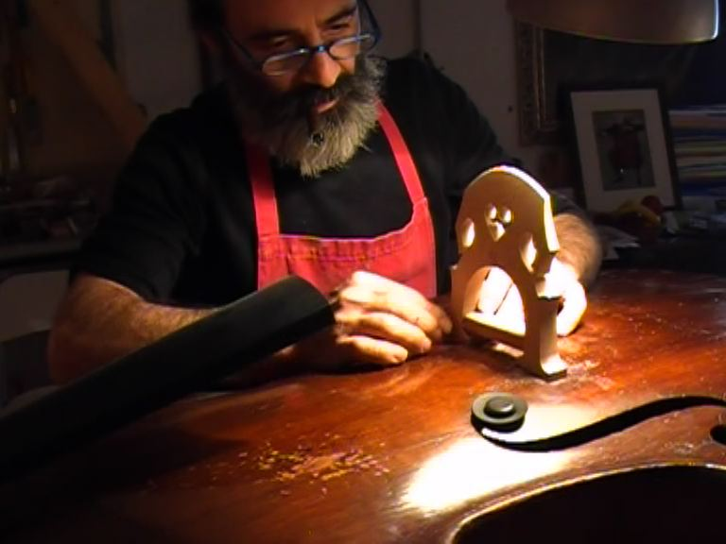
Workshops not lectures

Slide 12

Our plan
Frame communication within the big picture
The phases of communication development
  Planning and strategic development
  Communication development - executions
  Judging and testing communication
Social media: how it works and why is it important
Case studies and work on a specific project
Exam

Slide 13

Our reference
Advertising and Promotion: An Integrated Marketing Communications Perspective, Global Edition 9th
G. BELCH – M. BELCH

Slide 14
One word on evaluation
Participation: SPEAK UP or I won’t know if you’re alive!
Case study: let’s get our hands dirty…
Mid-term and final written evaluation: I’m not interested in “memory test”, I’m interested in students who want to understand some useful concept and play with them…but it doesn’t mean is going to be easy
Final result will be based on Practice (Participation and Case Study) and Theory (written exams)

Slide 15
Let’s make it clear…
Participation and case study presentation (25%)
Mid term exam (25%)
Final exam (50%)

Slide 16
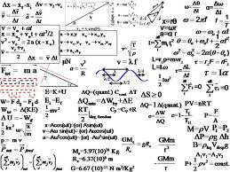
This is not marketing

Slide 17
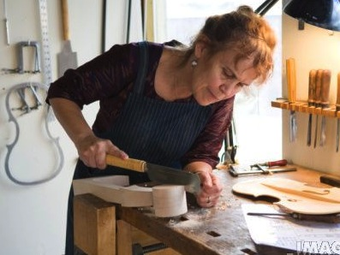
It looks much more like this…

Slide 18
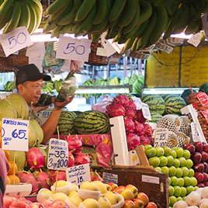
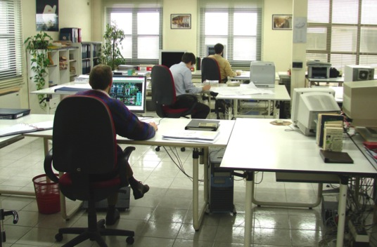
Marketing
Office-ing

Slide 19
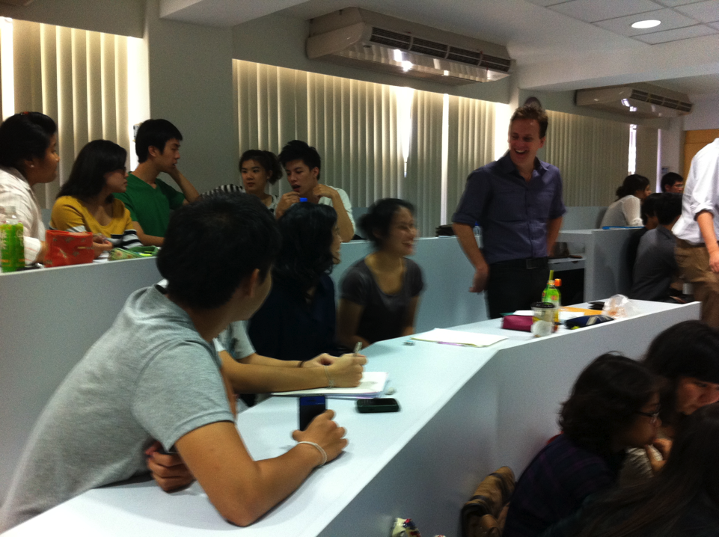
Learning from previous experience @ Thammasat:
Start and finish on time
Small work groups
Examples and real cases
External speakers
Upload charts in advance
…most importantly..

Slide 20

Don’t wink…

Slide 21
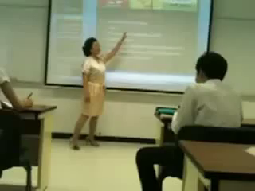
One last thing before we start…

Slide 22
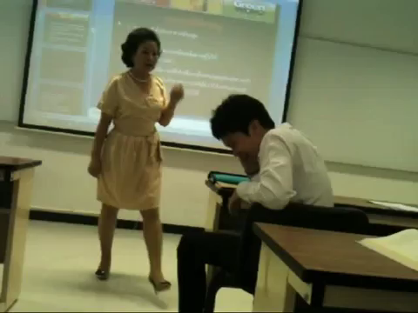
In fact…

Slide 23
Let’s start from the very big picture…

Slide 24
The context
promotion
marketing
business

Slide 25
The big picture
Business: the core activities of a company (trade of goods, services or both to consumers)
Marketing: it is an integrated process through which companies build strong customer relationship and create value for their customers and for themselves (Kotler)
Promotion: one of the activities of the marketing mix
Notes:
Marketing: a set of actions that keep the business alive

Slide 26
?
How many P’s in marketing mix?

Slide 27
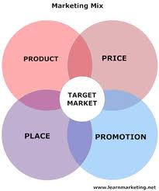
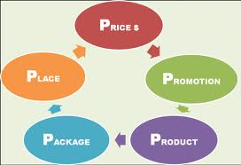
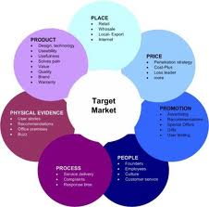
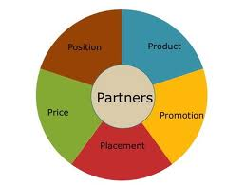

Slide 28

Promotion
Is one of the ‘unknown’ number of P’s
A mean to an end
A tool that can be used to convince consumers
A tool that can be used to influence behaviors

Slide 29
So when we talk…
Business: we talk sales, selling products or services, turnover, profit, margins…
Marketing: we talk activities to launch new products, to increase consumption of existing ones…
Promotion: we talk promoting sales by generating awareness of products, convince people to try, change existing behaviors, give price incentives…

Slide 30
The context
promotion
marketing
business

Slide 31
Many touch points under “promotion”
Promotion
Advertising
Social media
Direct mktg
PR
Brand activation
Sales Promo
…
We will mainly talk about “communication”

Slide 32
This course’s focus: integrated communication
How it works
How agencies develop strategies
How agencies create executions

Slide 33

What do I mean with Integrated Communication?
Some examples

