Slide 1

Group Assignment 5
Retail Growth Strategies

Slide 2
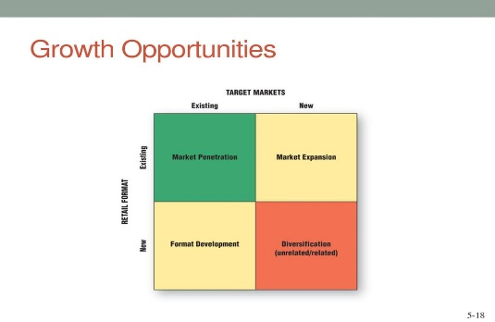
Group Assignment: Please refer the assignment to your group project category
Please analyze your retail project category in its current situation. ( does not necessarily have to be retail store of the project you are working)
Identify the 4 growth strategies they are implementing for your retail industry.
Analyze its success and failure ( could be both domestic and international examples)
Please create a power point slide presentation on each of the 4 growth strategy- one slide/strategy
Please create 4 pages ppt. slide maximum to be due next Tuesday March 2nd. Please design the 4 pages by using photos, graphs, charts, visuals to make one page interesting ka.
Notes:
1

Slide 3
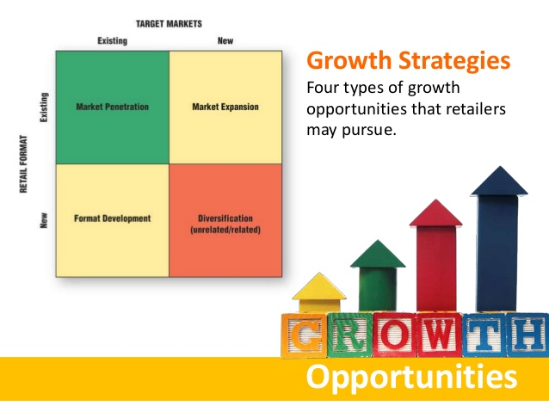
Notes:
1

Slide 4

6 Retailers for MK 322
Sequence
Pekaboo
Black white
Rainbow (bookstore)
JJ+
Savage
BLACKCARD

Slide 5

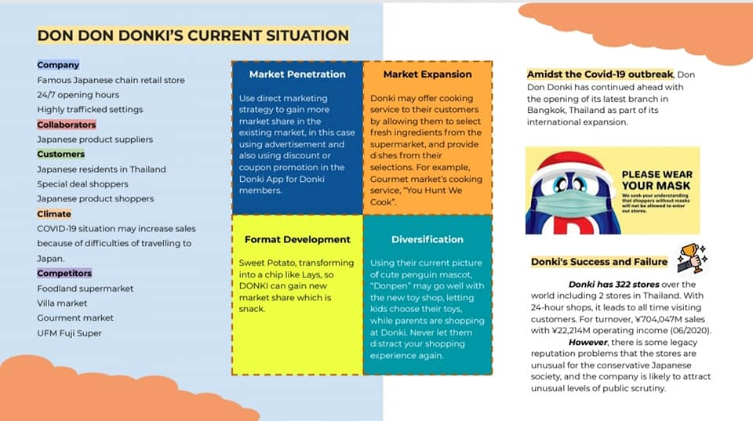
Pekaboo

Slide 6

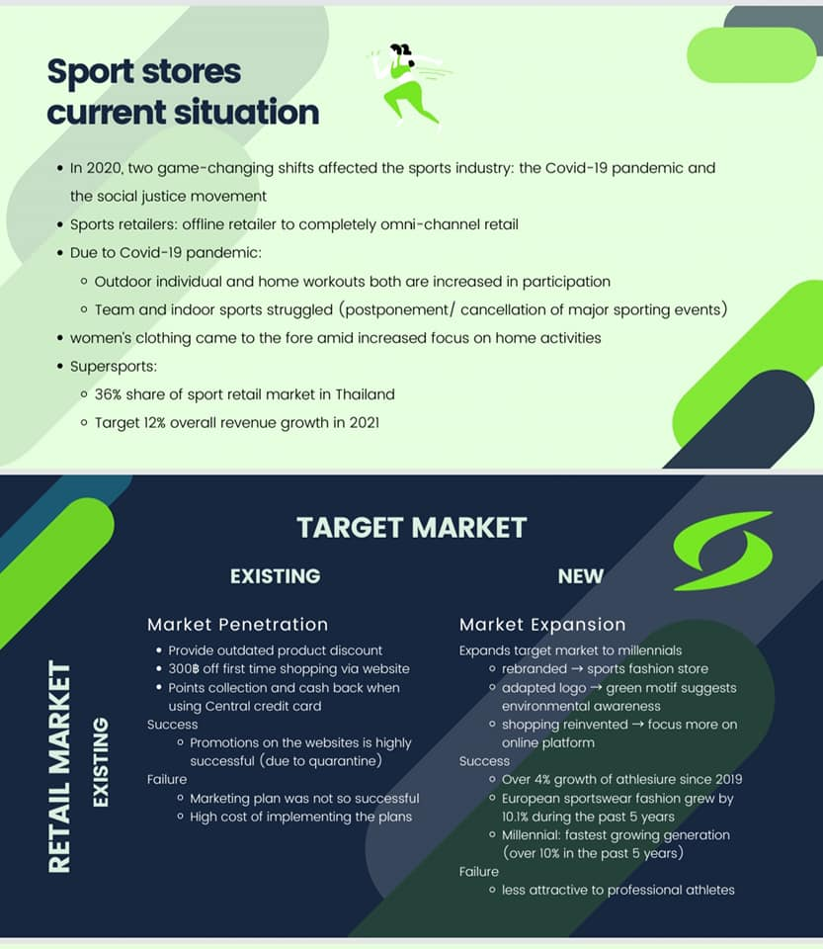
Black White

Slide 7
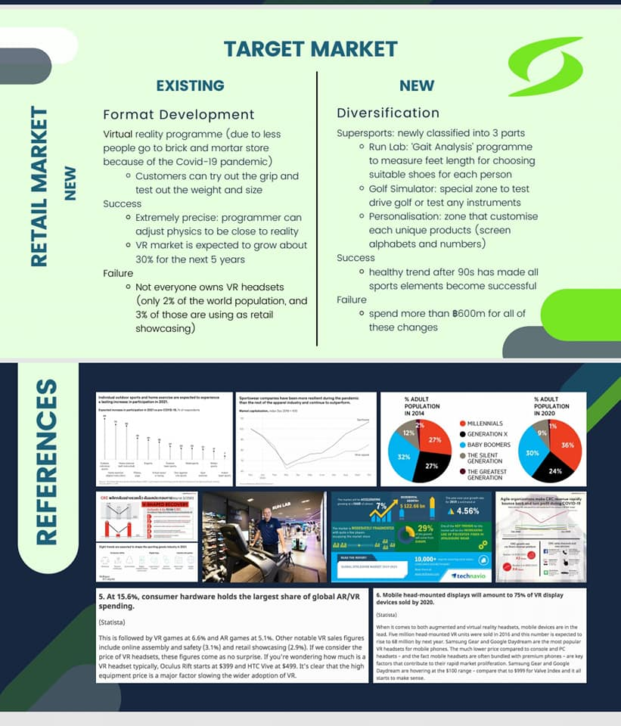
Black White

Slide 8


Rainbow

Slide 9

Rainbow

Slide 10
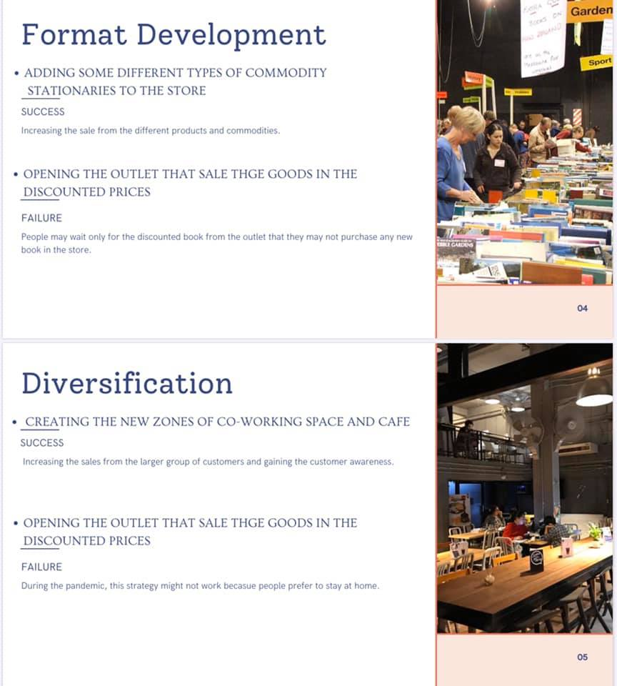
Rainbow

Slide 11

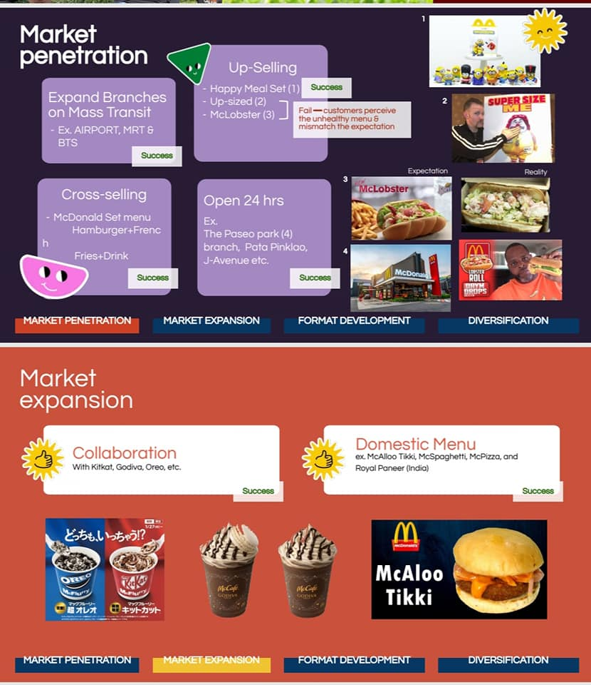
JJ+

Slide 12
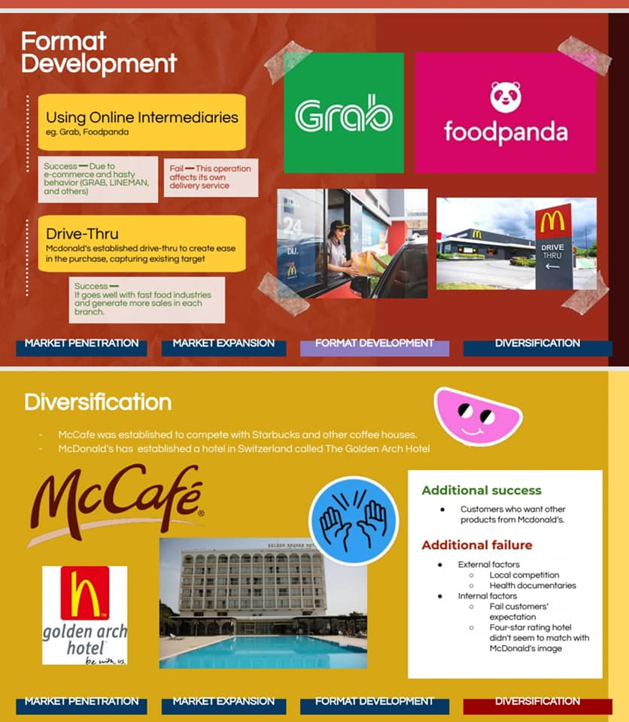
JJ+

Slide 13

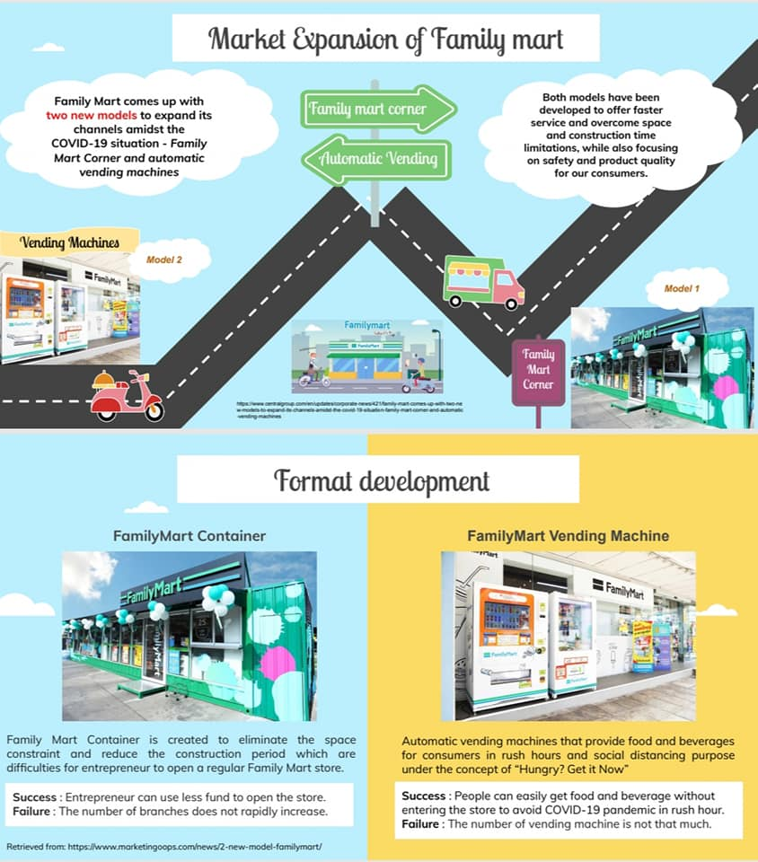
Savage

Slide 14
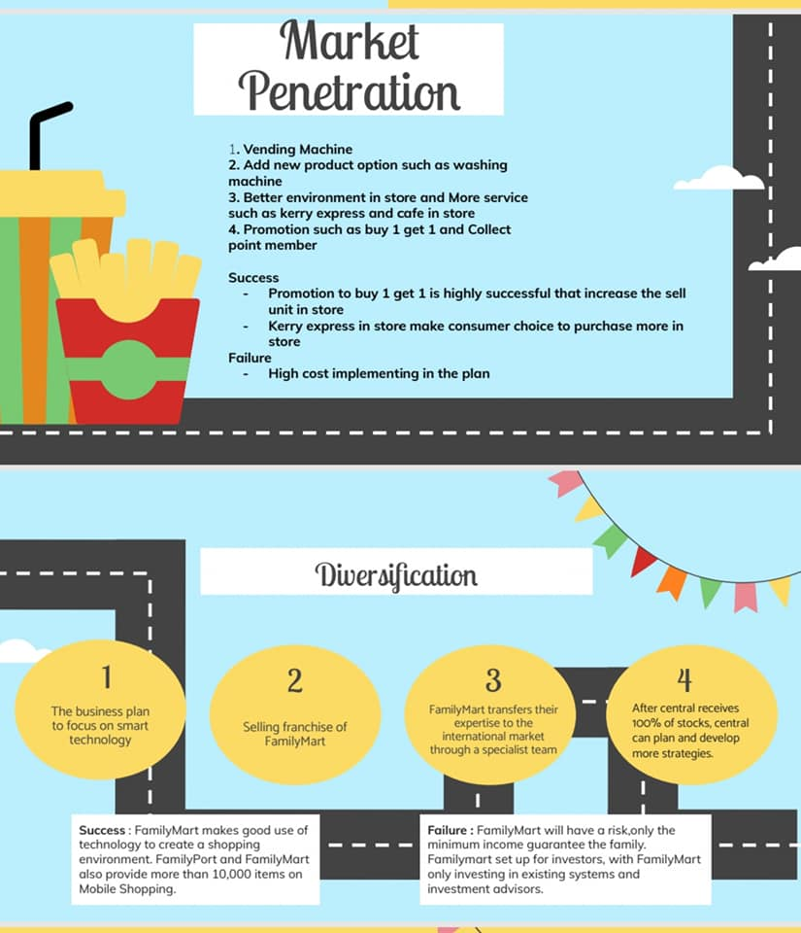
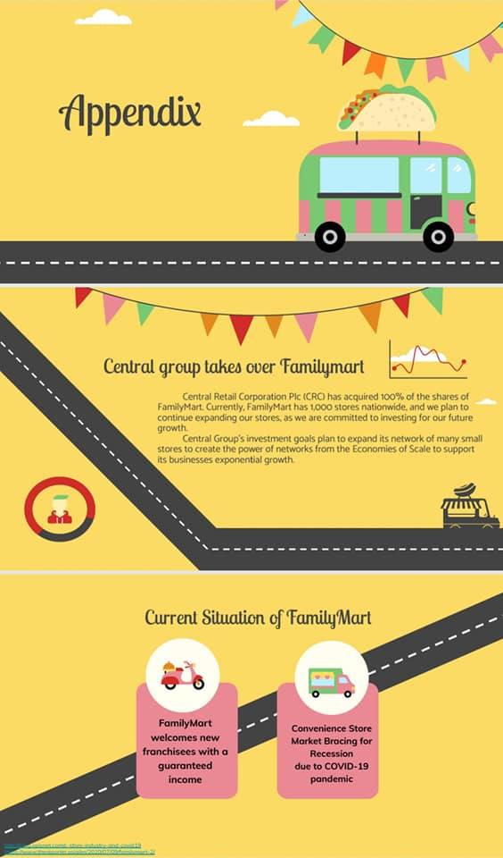
Savage

Slide 15

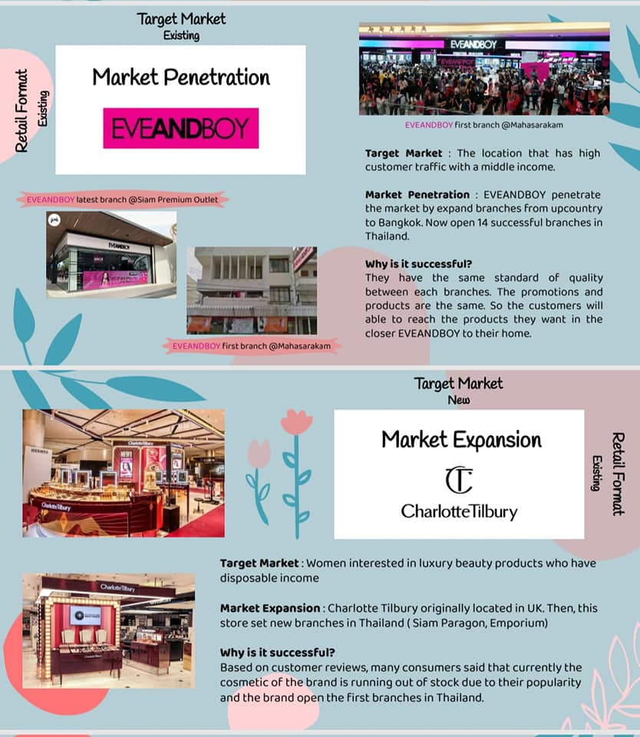
BLACKCARD

Slide 16
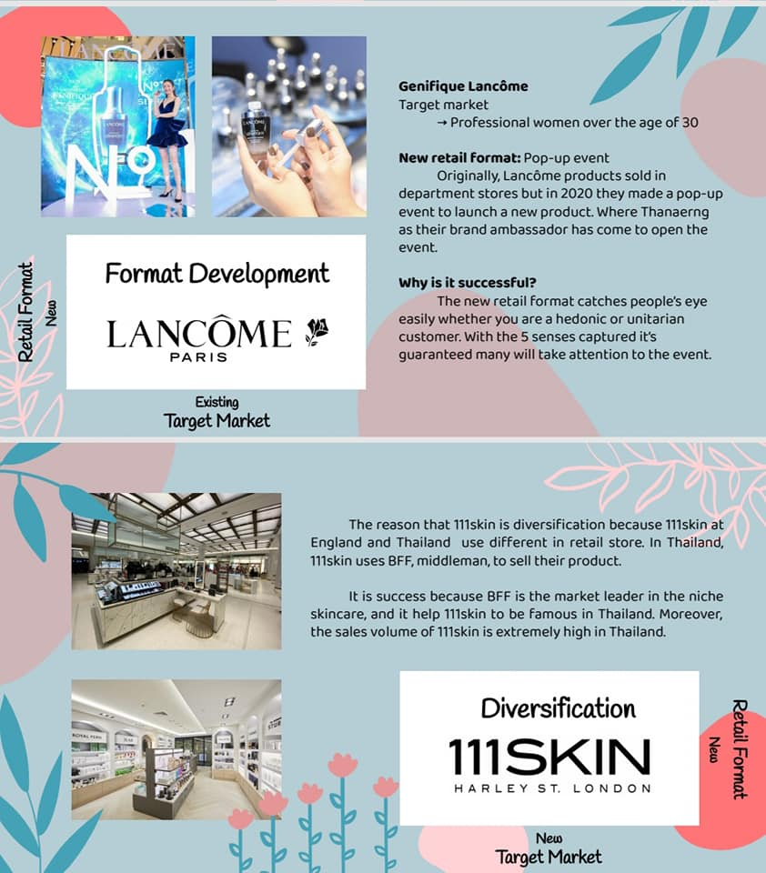
BLACKCARD

Slide 17


