Slide 1
PY200 General Psychology
Introduction

Slide 2
Outlines
What is psychology?
The work of psychologists
The major specialties field of psychology
History of psychology
Perspectives in psychology
Research in Psychology
Ethics

Slide 3
What is Psychology
Psychology → Psyche (mind) + Logo (knowledge/ study of)
“Psychology is the scientific study of behaviours and mental processes”.
Scientific methods is the orderly, analytical process used in all sciences to analyse and solve problems
Behaviour is observable, measurable action or responses in both humans and animals.
Example: eating, speaking, laughing, running, reading and sleeping
Mental process is not directly observable. It is the private internal working of the mind
Examples: thinking, imagining, dreaming

Slide 4
Goals of Psychology
Describe The different ways that organism behave. Describe behaviours and mental processes of autistic children.
Explain The cause of behaviour
The cause of Autism: genetics and biological factors that results in maldeveloped brain
Predict How organism will behave in certain situation. Autistic children are overwhelmed by strange stimuli and have difficulty paying attention. Based on these information, what psychologists can predict?
Control To control an organism’s behaviour
How to help autistic children learn to control undesirable behaviours
Various Treatments
Notes:
Difficulty learning in a school environment because there are too many activities and stimuli in the classroom

Slide 5
Psychology vs. Psychiatry:
Do You Know the Difference?
Psychiatrists are trained medical doctors,
  they can prescribe medications
  they spend much of their time with patients on medication management as a course of treatment.
Psychologists focus extensively on psychotherapy
  Psychologists must obtain a PhD or PsyD/ DPsych doctoral degree
  They treat emotional and mental suffering in patients with behavioral intervention.
  Psychologists are also qualified to conduct psychological testing, which is critical in assessing a person’s mental state and determining the most effective course of treatment.

Slide 6
Subfields of Psychology
Behavioral Genetics
Behavioral Neuroscience
Clinical Psychology
Clinical Neuropsychology
Cognitive Psychology
Counseling Psychology
Cross-cultural Psychology
Notes:
Behavioral genetics - Seeks to understand: How we might inherit certain behavioral traits/ How the environment influences whether we actually display such traits
Bhv neuroscience - Focuses on how the brain, nervous system, and other biological aspects of the body, determine behavior
Clinical - Deals with the study, diagnosis, and treatment of psychological disorders
clinica neuro - Unites the areas of neuroscience and clinical psychology
Focuses on the origin of psychological disorders in biological factors
Cognitive - Focuses on higher mental processes, such as thinking, memory, and problem-solving
Counselling - Focuses primarily on educational, social, and career adjustment problems
Cross-cultural - Investigates the similarities and differences in psychological functioning in and across various cultures and ethnic groups
Cross-cultural psychology - Investigates the similarities and differences in psychological functioning in and across various cultures and ethnic groups

Slide 7
Subfields of Psychology
Developmental Psychology
Educational Psychology
Environmental Psychology
Evolutionary Psychology
Experimental Psychology
Forensic Psychology
Health Psychology
Notes:
Dev - Studies how people grow and change from the moment of conception through death
Education – teaching and learning process (eg relationship between motivation and school performance)
Environment – the relationship between people and their physical environment
Evolution - Considers how behavior is influenced by our genetic inheritance from our ancestors
Experiment - Studies the processes of sensing, perceiving, learning, and thinking about the world
Forensic – legal issues – accuracy of witness memories
Health - Explores the relationship between psychological factors and physical ailments or disease

Slide 8
Subfields of Psychology
Industrial/
organizational Psychology
Personality Psychology
Program Evaluation
Psychology of Women
School Psychology
Social Psychology
Sport Psychology
Notes:
I/O – psychology of workplace
Personality - Focuses on consistency in people’s behavior over time and traits that differentiate one person from another
School – counselling children who have academic/ emotional problems
Social - Study of how people’s thoughts, feelings, and actions are affected by others
Sport – applies psychology to athletic activity and exercise

Slide 9
How did Psychology evolve as a discipline?
Imagine living in the late 1800s and early 1900s when the electric light, radio and airplane were being invented and the average human life span was about 30 years
This was the time when psychology broke away from philosophy and became a separate field of study
Debated in definition, approach, and goals
We will highlight those early psychologists whose idea and criticisms shaped the field

Slide 10
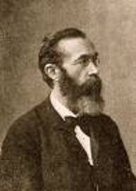
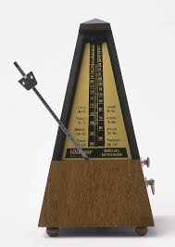
Wilhelm Wundt
Psychology was not considered an area of study until the German scientist Wilhelm Wundt opened the first laboratory and faculty of Psychology in the University of Leipzig in 1879
His work focused on consciousness – or the awareness of immediate experience.
Asked subjects to drop balls from a platform or listen to a metronome and reported their own sensations
Sensations were the key to analyzing the structure of the mind
Notes:
Focused on the structure of the mind- What it is made of: sensations, feelings, images.

Slide 11
Structuralism
The study of the most basic elements, primarily sensations and perceptions that make up our conscious mental experience,
Assembling hundred pieces of jigsaw puzzle into a complete picture
Combine hundred pieces of sensations into a complete conscious experience.
Introspection: a method of exploring conscious mental processes by asking subject to look inward and report their sensations and perceptions.
Criticism: Introspection was not a scientific technique
People had difficulty describing some kinds of inner experiences

Slide 12
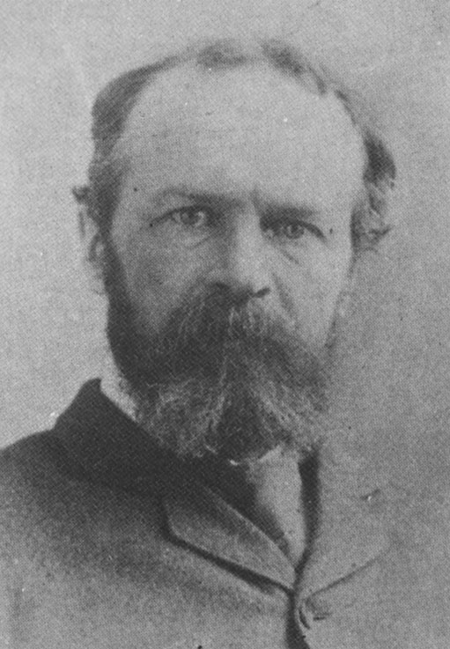
William James
Functionalism became popular with the publication of Principles of Psychology in 1890 by William James.
Functionalism is the idea that psychology should focus on the function or purpose of consciousness rather than its structure.
Mental activities have developed through ages of evolution because of their adaptive function such as helping humans survive
How mental process help organisms adapt to their environment.
How does the mind allow people to function in the real world (work, play, adapt, etc.)
Concentrated on what the mind does and the role of behavior in allowing people to adapt to their environments
Notes:
Functionalism is heavily based on the work of Charles Darwin and his theory of natural selection.
Natural selection posits that heritable characteristics that provide an organism with a competitive advantage are more likely to be passed on to the next generation and thus less advantageous characteristics become extinct over generations.
The Functionalists like William James applied this theory to humans. By studying what consciousness does for humans, we can discover how it works.

Slide 13
Gestalt
Gestalt Psychology – the belief that consciousness and behaviour must be studied as a whole rather than in separate disciplines.
Hermann Ebbinghaus, Max Wertheimer, and others
“The whole is greater than the sum of its parts”.
Deals with perceptions – how we see and understand things
when trying to make sense of the world around us, Gestalt psychology suggests that we do not simply focus on every small component.
Instead, our minds tend to perceive objects as part of a greater whole and as elements of more complex systems.

Slide 14
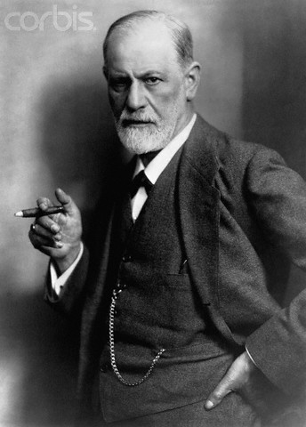
Sigmund Freud
Sigmund Freud – Austrian physician who founded the psychoanalytic approach to psychology.
From his work with people with psychological problems like phobias, irrational fears, and anxieties, Freud developed a theory based on the existence of the unconscious.
He felt that these disturbances were based on personal conflicts on an unconscious level.
Unconscious – collection of thoughts, memories, and desires that are well below the surface of conscious awareness but that exert influence on behaviour.
Psychoanalytic Theory – explains personality, motivation, and mental disorders by focusing on unconscious determinants of behaviour.

Slide 15
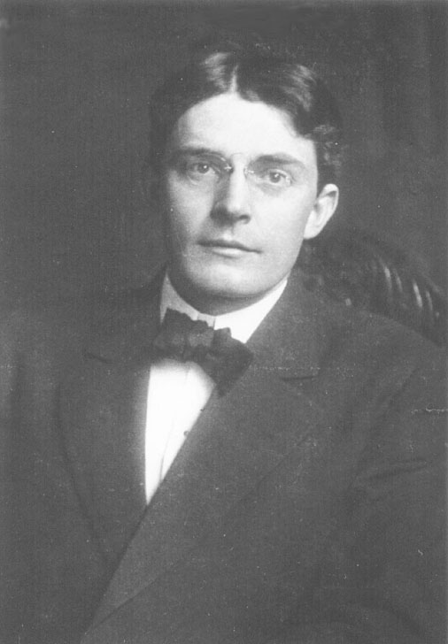
Behaviourism
Behaviourism was founded by John B. Watson in 1913.
It stated that scientists should only study observable behaviour and that consciousness should be abandoned because ultimately, consciousness and perceptions are private events and cannot be objectively verified.
This means that psychology would suffer from a lack of reliability.
Behaviour – any overt and observable response or activity by an organism.
Stimulus – any detectable input from the environment.

Slide 16
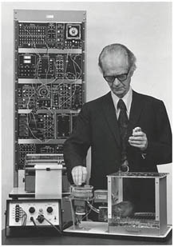
B.F. Skinner
Behaviourism gained greater influence in the 1950’s with the work of B.F. Skinner.
By using stimulus and response pairings, he could control the behaviour of rats and pigeons with remarkable consistency.
He discovered the principle that organisms tend to repeat responses that lead to positive outcomes and not repeat responses that lead to negative ones.
This simple principle would go on to form the foundation of behaviour modification used in schools, prisons, factories and hospitals.
Skinner’s work sparked heated debates over the concepts of free will and determinism in his work “Beyond Freedom and Dignity”. If all our behaviour was determined by external stimuli, what choice did we really have concerning our behaviours and desires?

Slide 17
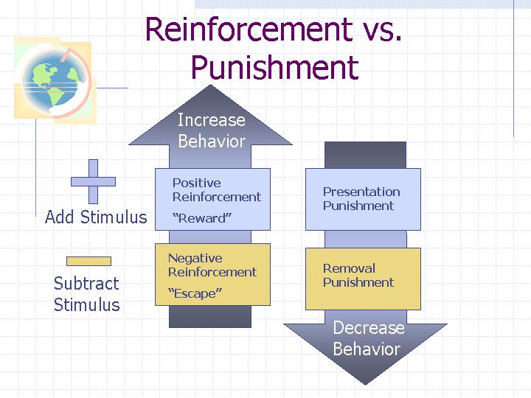

Slide 18
Current Perspectives

Slide 19
Current Perspectives
Psychodynamic/ Psychoanalysis
Behaviourism
Humanistic perspective
Biological/ neuroscience perspective
Cognitive
Socio-cultural
Evolutionary psychology

Slide 20
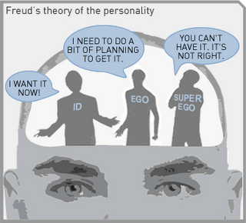
Psychoanalytic/ Psychodynamic
Childhood experiences greatly influence the development of later personality traits and psychological problems
The influence of unconscious fears, desires, and motivations on thoughts and behaviours.
  Behavior is motivated by unconscious inner forces and conflicts over which the individual has little control

Slide 21
Behaviourism/ Learning
Assumes a learner is essentially passive, responding to environmental stimuli.
Classical conditioning: Watson studied observable behavior and stimulus and response (not thought). When we are born mind is “blank”, we are then shaped by behaviour
Skinner (operant conditioning): Behaviour is shaped through positive reinforcement, negative reinforcement (reward) and punishment. Skinner believed that we do have such a thing as a mind

Slide 22
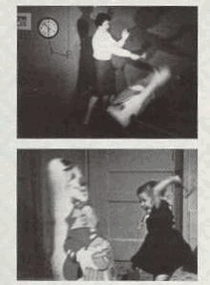
Behaviourism
Emphasizes cognitive influence on behavior, rather than conditioning influences from the environment
  Social-cognitive theory
  Albert Bandura
  The Bobo Doll Study
Notes:
How organisms learn new behavior or modify existing ones, depending on whether events in their environments reward or punish these behaviours

Slide 23
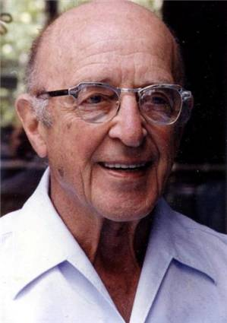
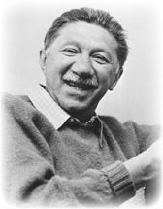
Humanistic Approach
Humanism was a direct reaction to the stripping of free will that psychoanalytic theory and behaviourism entailed.
Humanism is the approach that emphasizes the unique qualities of humans, personal freedom, and personal growth.
Carl Rogers and Abraham Maslow.
Human behaviour is determined by an individual’s “self-concept”, which animals presumably lack.
Each of these self-concepts seeks to grow, evolve and develop and psychological disturbances arise when these drives are blocked.
Notes:
Existentialism is concerned with alienation and apathy in modern life.
Humanism is concerned with helping people realize their full potential.

Slide 24
Humanistic Approach
Suggests individuals naturally strive to grow, develop, and be in control of their lives and behaviour
Seek and reach fulfillment
Emphasis is on free will
Contrasts to determinism
Existentialism - Freedom and responsibility. People are free to choose and are responsible for their choices
Notes:
Existentialism is concerned with alienation and apathy in modern life.
Humanism is concerned with helping people realize their full potential.

Slide 25
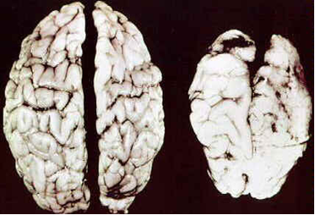
Biological/ Neuroscience Perspective
Advances in knowledge of how the brain works led to an increase in the research in the biological basis of human behaviour
They believed that much of human behaviour can be explained in terms of the bodily structures and biochemical processes that allow organisms to behave.
Focuses on how our genes, hormones and nervous system interact with our environment to influence learning, personality, memory, motivation, emotions and coping techniques.
Notes:
Neuroscience perspective: Views behavior from the perspective of the brain, the nervous system, and other biological functions

Slide 26
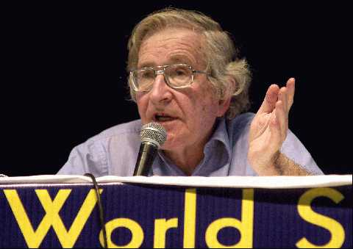
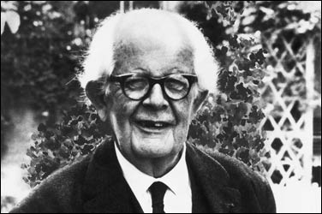
Cognitive Approach
Examines how we process store and use information and how this information influences what we attend to, perceive, learn, remember, believe and feel.
Information processing
Renewed the belief that thinking was a physical experience and needed to be studies even though it was unobservable.
Notes:
Focuses on how people think, understand, and know about the world

Slide 27
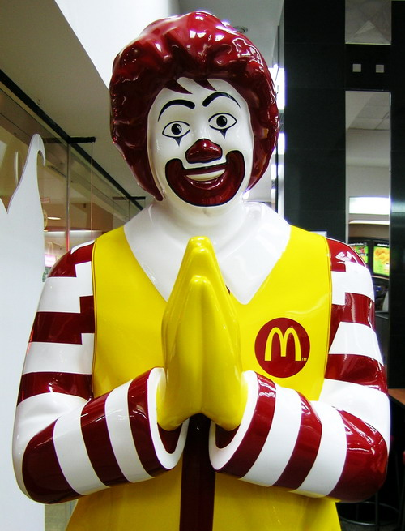
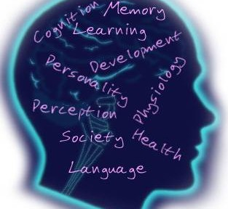
Sociocultural Perspective
How does our gender, culture, income, race affect our behavior and thoughts? The experiences of different groups are different and affect their development.
Notes:
Social psychology
Study of how people’s thoughts, feelings, and actions are affected by others
Investigates the similarities and differences in psychological functioning in and across various cultures and ethnic groups

Slide 28
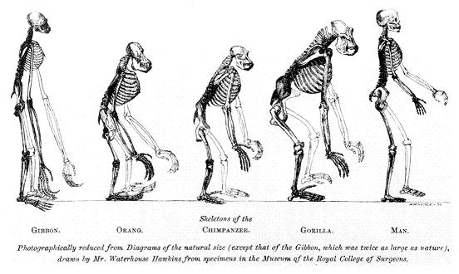
Evolutionary Psychology
Most recent development, pioneered by David Buss
The fittest organisms reach maturity and reproduce
How evolutionary ideas such as adaptation and natural selection explain human behaviours and mental processes.
Eg. Men are engineered to behave as hunters and women as gatherers. Therefore our visual-spatial organization would be different.
Aggression, Mate selection, Decision making, Fear, Depression
Notes:
Considers how behavior is influenced by our genetic inheritance from our ancestors
Stems from Darwin’s On the Origin of Species

Slide 29
Research in Psychology

Slide 30
Psychology is a scientific study
Empirical Rules: Observable + Measureable
Scientific Method: An approach of gathering information and answering questions so that the errors and bias are minimised
  Hypothesis : an educated guess about some phenomenon and is stated in precise, concrete language to rule out confusion or error in the meaning of its terms.
  Empirical Testing/ Evidence
  Theory

Slide 31
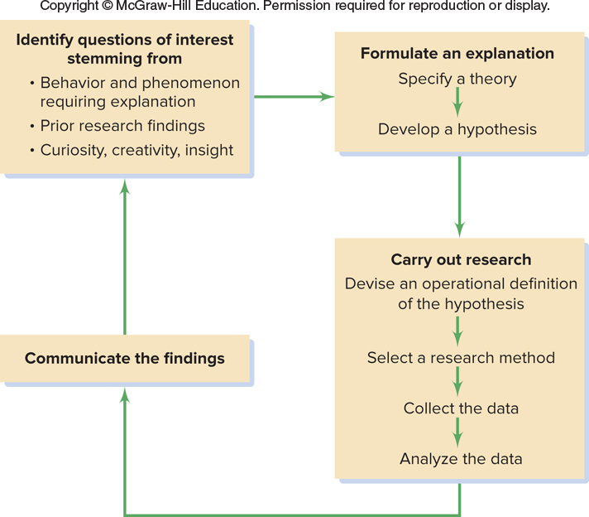
Figure 1: The Scientific Method

Slide 32
Naturalistic Observation
A relatively normal environment in which researchers gather information by observing individuals’ behaviours without attempting to change or control the situation.
Very useful for observing how individuals behave in relatively normal environments
Unable to control and many things happen, so it is difficult to identify what causes what

Slide 33
Case study
An in-depth analysis of the thoughts, feelings, beliefs, experiences, behaviours, or problems of a single individual.
Advantage: its detailed information allows greater understanding of a particular person’s life
Disadvantage: the obtained information may not apply to others

Slide 34
Survey
A way to obtain information by asking many individual – either person to person, by telephone, or by mail – to answer a fixed set of questions about particular subjects
Advantage: an efficient way to obtain much information from a large number of people
Disadvantage: the obtained information can contain errors or be biased because people may not remember accurately or answer truthfully

Slide 35
Correlation
An association or relationship in the occurrence of two or more events
Correlation coefficient: Represents the strength and direction of the relationship between two variables
-1.00 to +1.00
There is an association between 2 variables?
The strength of the relationship
The closer the number is to -1.00 or +1.00 the greater is the strength of the relationship
0 = no relationship
Positive correlation: as one variable tends to increase, another one tends to increase
Negative correlation: as one variable tends to increase, another one tends to decrease
Notes:
Positive correlation: Hours of revision and exam results → ppl who do more revision get higher exam results
Negative correlation → flu shot and infection → when the flu shots are given to the number of people the
incidence rate of flu is reduced
Heavy drinkers get lower grade
depressed people who continue medication for at least six months are less likely to relapse than are people who take medication for less than six months.

Slide 36
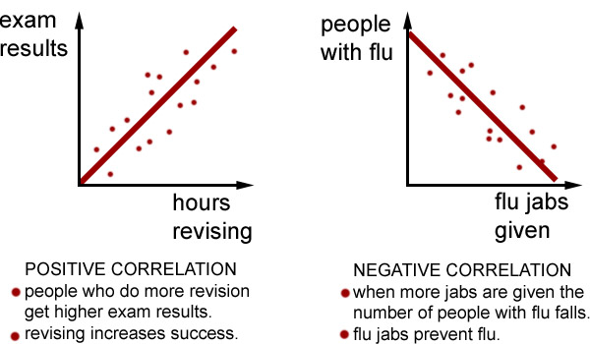
Correlation

Slide 37
Experiment
A method for identifying cause-and-effect relationships by following a set of rules and guidelines that minimize the possibility of error, bias, and chances occurrence
7 Rules
  Rule 1: Ask - - Hypothesis
  Rule 2: Identify - - independent variable/ dependent variable
  Rule 3: Choose - - Sample/ subjects for the experiment
  Rule 4: Assign - - Experimental group/ Control group
  Rule 5: Manipulate
  Rule 6: Measure
  Rule 7: Analyse - - statistical procedures

Slide 38
Experiment
Independent variable: a treatment or something that the researcher controls or manipulates
It is called independent because its value does not depend on and is not affected by the state of any other variable in the experiment
Dependent variable: one or more of the subjects’ behaviours that are used to measure the potential effects of the treatment or independent variable
The "dependent variable" represents the output or effect {what you want to measure}
You are assessing how it responds to a change in the independent variable, so you can think of it as depending on the independent variable.
Expected to change as a result of changes in the independent variable
Notes:
The "dependent variable" represents the output or effect, or is tested
to see if it is the effect. It is what you want to measure.
The "independent variables" represent the inputs or causes, or are
tested to see if they are the cause. Other variables may also be
observed for various reasons.
Control group: The control group, receive either no?treatment or a
standard treatment.
Experimental group: the group that is exposed to the experiment (In
the design of experiments, the independent variable is exposed to the
experimenter group)

Slide 39
Experiment
Hypothesis: Ritalin will increase positive classroom behaviours of children diagnosed with ADHD
Independent variable?
Dependent variable?
Independent variable causes an effect on the dependent variable.
Hypothesis: How long you sleep affects your test scores
IV =
DV =

Slide 40
Experiment
In a study to determine whether how long a student sleeps affects test scores
IV =
DV =
You want to compare brands of paper towels, to see which holds the most liquid.
IV =
DV =
In an experiment to determine how far people can see into the infrared part of the spectrum
IV =
DV =
If you want to know whether caffeine affects your appetite
IV =
DV =
Notes:
length of time spent sleeping /the test score.
the brand of paper towel/ the amount of liquid absorbed by a paper towel.
the wavelength of light/ whether the light is observed (the response)
the presence/absence of amount of caffeine /the dependent variable is how hungry you are

Slide 41
Experiment
Random selection: each participant in a sample population has an equal chance of being selected for the experiment
To avoid potential error or bias that may come from their knowingly or unknowingly to choose the “best” subject for their experiment
Experimental Group: is composed of those who receive the treatment
Control Group: is composed of participants who undergo all the same procedures as the experimental participants except that the control participants do not receive the treatment

Slide 42
Experiment
Blind: participants do not know whether they receive the treatment or not
Double-blind procedure: neither participants nor researcher knows which group is receiving which treatment
Placebo: some intervention, such as taking a pill, receiving an injection, or undergoing an operation, that resembles medical therapy (or treatment) but that, in fact, has no medical effects
A bogus treatment that has the appearance of being genuine

Slide 43
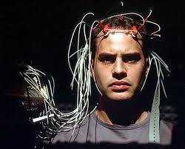
Brain Imaging
The use of methods such as CAT scan, PET scan, fMRI to learn what is happening in the brain when a person is solving a problem, listening to music, and so on

Slide 44
The Ethics of Research
Guidelines that protect participants
  Protection of participants from physical and mental harm
  Right of participants to privacy regarding their behavior
  Assurance that participation in research is completely voluntary
  Necessity of informing participants about the nature of procedures before their participation in the experiment
  All experiments must be reviewed by an independent panel before being conducted

