Slide 1
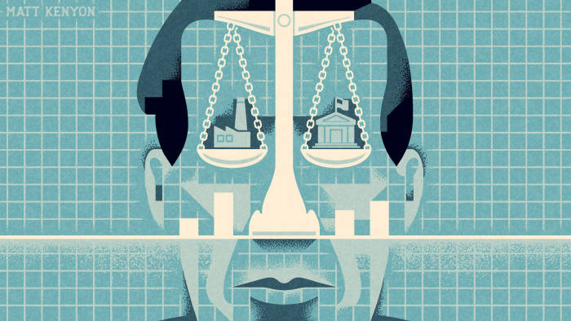

EE403
Law & Economics
Tort V

Slide 2
Strict Liability or Negligence
Both strict liability and negligence result in efficient injurer care.
However, this includes only the injurer’s costs of precaution and the victim’s damages. What about the administrative cost?
Strict liability will be cheaper to apply because plaintiffs need only prove causation, not fault.
For negligence suit, the plaintiff will have to prove causation and fault ➔ more fact-finding and therefore involve more costly trials.
BUT we expect fewer lawsuits under negligence as compared to strict liability.
Unclear which system will be cheaper overall.

Slide 3
Strict Liability or Negligence
Other factors that may affect the choice between strict liability and negligence.
  the goal of compensating victims, which strict liability accomplishes but negligence does not.
  Errors in calculating the due standard of care
    No affect on strict liability
    Inefficient care choice by the injurer
  Errors in calculating the amount of the victim’s damages (D does not equal to A) (but correctly sets x = x*)
    inefficient care choice under strict liability,
    will not distort the injurer’s care choice under negligence so long as the error is not large (given that the due standard is set correctly)

Slide 4
Errors in evaluating damages (D)
Random errors
  Damages could be set too high or too low, but on average are correct
Systematic errors
  Damages are set incorrectly on average – consistently too high, or consistently too low

Slide 5
Effect of random errors of D : Strict liability
Under strict liability, random errors in damages have no effect on incentives
  Injurer only cares about expected level of damages (on average the error is zero)
  As long as damages are right on average, injurers still internalize cost of accidents, set efficient levels of precaution and activity
Notes:
First, let’s look at the effects of errors under a strict liability rule

Slide 6
Effect of systematic errors of D (underestimate D) :
Strict liability
$
wx + p(x) D
p(x) D
wx + p(x) A
wx
p(x) A
x
x*
Precaution (x)
Under estimate damage ➔ precuation less than the optimal
Over estimate damage ➔ precuation higher than the optimal

Slide 7
Effect of systematic errors of D : Strict liability
Under strict liability:
  random errors in setting damages have no effect
  systematic errors in setting damages will skew the injurer’s incentives
    if damages are set too low, precaution will be inefficiently low
    if damages are set too high, precaution will be inefficiently high
  failure to consistently hold injurers liable has the same effect as systematically setting damages too low
    if not all injurers are held liable, precaution will be inefficiently low

Slide 8
Effect of systematic errors of D (underestimate D) : negligence
$
wx + p(x) D
wx + p(x) A
wx
p(x) D
p(x) A
x^{n} = x*
x
Under a negligence rule, small errors in damages have no effect on injurer precaution

Slide 9
Systematic errors in setting x* (for negligence)
$
wx + p(x) A
wx
p(x) A
x₁
x*
x₂
x
Under a negligence rule, injurer’s precaution responds exactly to systematic errors in setting the legal standard

Slide 10
Random errors in setting x* (for negligence)
$
wx + p(x) A
wx
p(x) A
x*
x^{n}
x
Under a negligence rule, random errors in the legal standard of care lead to increased injurer precaution

Slide 11
Sum up the effects of errors
Under strict liability:
    random errors in setting damages have no effect
    systematic errors in setting damages will skew the injurer’s incentives in the same direction
    failure to consistently hold injurers liable lead to less precaution
    (Note : we don’t have to consider the case of errors in setting x* )
Under negligence:
    small errors, random or systematic, in setting damages have no effect
    systematic errors in the legal standard of care will skew the injurer’s precaution in the same direction
    random errors in the legal standard of care lead to more precaution
So…(if we want x to be at x*)
    when court can assess damages more accurately than standard of care, strict liability is better (because of ii)
    when court can better assess standards, negligence is better (because of b.)
    when standard of care is vague, court should err on side of leniency (because of iii)

