Slide 1

National Income and Product Account
2

Slide 2
2.1 The component of Macroeconomy
Macroeconomics focuses on five groups:
Households
Firms
(1) + (2) = the private sector
(3) Government (the public sector)
The rest of the world (the international sector)
Financial institution

Slide 3
2.2 Circular flow diagram
Circular flow: A diagram showing the income received and payments made by each sector of the economy.

Slide 4
Injection
Withdrawal
Export
Import
Foreign Sector
Wage, Rent, Interest, Profit
Investment
Saving
Firms
Financial Institutions
Households
Payment for Goods &Service
Tax
Tax
Government
Government
Spending
Government
Spending

Slide 5
2.3 National Income and Product Account
National income and product accounts:
Data collected and published by the government describing the various components of national income and output in the economy.
Office of the National Economics and Social Development Board (NESDB)
  www.nesdb.go.th

Slide 6
Gross Domestic Product
Gross Domestic Product (GDP): The total market value of all final goods and services produced within a given period by factors of production located within a
country.

Slide 7
Concept of final goods and services
Final goods and services: Goods and services produced for final use.
Intermediate goods: Goods that are produced by one firm for use in further processing by another firm.
Value added: The difference between the value of goods as they leave a stage of production and the cost of the goods as they entered that stage.

Slide 8
2.4 GDP versus GNP
Gross Domestic Product (GDP):
Look at output that use factor of production within the country to produce goods and services
Gross National product (GNP)
The total market value of all final goods and services produced within a given period by factors of production owned by a country’s citizens, regardless of where the output is produced.

Slide 9
2.4 GDP versus GNP
Example
  Profit from factory located in other country
  Maid and labor work in other country
  GNP = GDP + Income from Thai factors of production used to produce G&S abroad - Income from foreign factors of production used to produce G&S in Thailand
  GDP = GNP + Income from foreign factors of production used to produce G&S in Thailand - Income from Thai factors of production used to produce G&S abroad
Count as GNP but not GDP in our country
but count as GDP in foreign country

Slide 10
2.5 Measurement of GDP
Production approach
Expenditure Approach
Income Approach

Slide 11
2.5.1 Production Approach
Calculated from value of final goods and services
Calculated using value added method

Slide 12


Production Approach: using final G&S values
  Calculate total value of final goods and service: suppose there are 400 apples and 300 oranges in the economy
B 10
B 5
GDP = (price of apples × amount of apples)
+ (price of oranges × amount of oranges)
= (B 10 × 400) + (B 5 × 300)
GDP = B 4,000 + B 1,500 = B 5,500

Slide 13
Production Approach: using value-added values
Value added The difference between the value of goods as they leave a stage of production and the cost of the goods as they entered that stage.

Slide 14
Production Approach: using value-added values
Value added in production of bottle orange juice
Stage of production |  | Sales |  |  | Value Added
(1) | Orange |  | 500
(2) | Orange juice |  | 650
(3) | Orange juice in bottle (factory level) |  | 900
(4) | Retail sale (Supermarket level) |  | 1200
 | Total value added
500
150
250
300
1200

Slide 15
Some concerns: measuring GDP
EXCLUSION OF USED GOODS AND PAPER TRANSACTIONS
GDP is concerned only with new, or current, production.
GDP ignores all transactions in which money or goods change hands and in which no new goods and services are produced.
Example:
A house build 3 years ago, should it be counted in GDP this year ?
How about commission fee for the commissioner who sell the house?
It should not be counted as GDP this year
It should be counted as GDP this year

Slide 16
2.5.2 Expenditure Approach
Expenditure approach: A method of computing GDP that measures the amount spent on all final goods during a given period.

Slide 17
THE EXPENDITURE APPROACH
There are four main categories of expenditure:
Expenditure Categories:
■ Personal consumption expenditures (C): household spending on consumer goods
■ Gross private domestic investment (I): spending by firms and households on new capital, i.e., plant, equipment, inventory, and new residential structures
■ Government consumption and investment (G)
■ Net exports (X - M): net spending by the rest of the world, or exports (EX) minus imports (IM)
GDP = C + I + G + (X - M)

Slide 18
THE EXPENDITURE APPROACH (C)
Personal Consumption Expenditures (C)
personal consumption expenditures (C): expenditures by consumers on goods and services.
There are three main categories of consumer expenditures: durable goods, nondurable goods, and services.

Slide 19
THE EXPENDITURE APPROACH (C)
Durable goods: Goods that last a relatively long time, such as cars and household appliances.
Nondurable goods: Goods that are used up fairly quickly, such as food and clothing.
Services: The things we buy that do not involve the production of physical things, such as legal and medical services and education.

Slide 20
THE EXPENDITURE APPROACH (I)
Gross Private Domestic Investment (I)
Gross private domestic investment (I): Total investment in capital—that is, the purchase of new housing, plants, equipment, and inventory by the private (or nongovernment) sector.
There are three main categories of investment expenditures: nonresidential investment, residential investment, and changes in inventories

Slide 21
THE EXPENDITURE APPROACH (I)
Nonresidential investment: Expenditures by firms for machines, tools, plants, and so on.
Residential investment : Expenditures by households and firms on new houses and apartment buildings.
Change in business inventories: The amount by which firms’ inventories change during a period. Inventories are the goods that firms produce now but intend to sell later.
= inventory end of period – inventory beginning of period

Slide 22
Example of changes in inventories
Inventory beginning of the year is 2 unit, price of each unit is 10 Baht
= 2*10 = 20 Baht
In that year can produce 7 unit, price of each unit is 10 Baht
= 7*10 = 70 Baht
In that year can sell 6 unit, price of each unit is 10 Baht = 60 Baht
Inventory at the end of the year is 3 units, price of each unit is 10 Baht = 30 Baht
Changes in inventories =
= Inventory end of period – inventory beginning of period
= 30 – 20 = 10 Baht

Slide 23
GDP vs. Total Sales
Question: GDP = Total Sales ????
Ans:
GDP = final sales + change in business inventories
+ other components of GDP
GDP = final sales + (inventory end of period –
inventory beginning of period)
+ other components of GDP

Slide 24
THE EXPENDITURE APPROACH (I)
Gross Investment versus Net Investment
Depreciation: The amount by which an asset’s value falls in a given period.
Gross investment: The total value of all newly produced capital goods (plant, equipment, housing, and inventory) produced in a given period.
Net investment = Gross investment - Depreciation.
capital_{end} _{of period} = capital_{beginning} _{of period} + net investment
capital_{end} _{of period} = capital_{beginning} _{of period} + Gross investment
- Depreciation

Slide 25
THE EXPENDITURE APPROACH (G)
Government Consumption and Investment (G)
Government consumption (purchases) and investment (G): Expenditures by federal, state, and local governments
For goods and services that government consumes in providing public services
For investment.

Slide 26
THE EXPENDITURE APPROACH (X - M)
Net Exports (EX - IM)
Net exports (EX - IM): The difference between exports (sales to foreigners of Thai produced goods and services) and imports (Thai purchases of goods and services from abroad).
The figure can be positive or negative.

Slide 27
THE EXPENDITURE APPROACH
Conclusion
Gross Domestic Product
GDP = C + I + G + (X - M)
Net
Domestic Product
NDP = C + net I + G + (X - M)
NDP = C + (I – Depreciation) + G + (X - M)
NDP = C + I + G + (X - M) - Depreciation
NDP = GDP - Depreciation
Net
National Product
NNP = GNP - Depreciation

Slide 28
Expenditure on Gross Domestic Product at Current Market Prices (Original), 2011-2019, (Millions of Baht)
 | Private Consumption Expenditure | General Government Consumption Expenditure | Gross Fixed Capital Formation | Change in Inventories | Exports of Goods and Services | Imports of Goods and Services | Expenditure on Gross Domestic Product | Statistical Discrepancy | Gross Domestic Product
 | C | G | I | I | X | M
2011 | 5,742,852 | 1,397,530 | 2,769,018 | 37,451 | 8,109,950 | 7,631,792 | 10,425,009 | 115,125 | 10,540,134
 | 54.49% | 13.26% | 26.27% | 0.36% | 76.94% | 72.41% | 98.91% | 1.09% | 100.00%
2012 | 6,293,508 | 1,544,330 | 3,245,925 | 137,205 | 8,529,212 | 8,400,223 | 11,349,957 | 25,392 | 11,375,349
 | 55.33% | 13.58% | 28.53% | 1.21% | 74.98% | 73.85% | 99.78% | 0.22% | 100.00%
2013 | 6,475,849 | 1,643,464 | 3,180,865 | 298,352 | 8,753,512 | 8,362,555 | 11,989,487 | -90,777 | 11,898,710
 | 54.42% | 13.81% | 26.73% | 2.51% | 73.57% | 70.28% | 100.76% | -0.76% | 100.00%
2014 | 6,644,632 | 1,729,869 | 3,146,155 | -37,252 | 9,111,735 | 8,217,427 | 12,377,712 | -236,616 | 12,141,096
 | 54.73% | 14.25% | 25.91% | -0.31% | 75.05% | 67.68% | 101.95% | -1.95% | 100.00%
2015 | 6,974,351 | 2,334,149 | 3,375,475 | -108,626 | 9,340,694 | 7,811,706 | 14,104,337 | -566,852 | 13,537,485
 | 51.52% | 17.24% | 24.93% | -0.80% | 69% | 57.70% | 104.19% | -4.19% | 100.00%
2016 | 7,260,410 | 2,461,539 | 3,484,345 | -420,724 | 9,950,612 | 7,804,666 | 14,931,516 | -398,041 | 14,533,475
 | 49.96% | 16.94% | 23.97% | -2.89% | 68.47% | 53.70% | 102.74% | -1.95% | 100.00%
2017 | 7,537,993 | 2,531,913 | 3,580,036 | -49,559 | 10,534,540 | 8,442,039 | 15,692,884 | -240,002 | 15,452,882
 | 48.78% | 16.38% | 23.16% | -0.32% | 68% | 54.63% | 101.55% | -1.55% | 100.00%
2018 | 8,002,725 | 2,643,380 | 3,726,894 | 395,148 | 10,616,164 | 9,169,689 | 16,214,622 | 150,950 | 16,365,572
 | 49% | 16% | 23% | 2% | 65% | 56% | 99% | 1% | 100.00%
2019 | 8,448,321 | 2,722,780 | 3,814,370 | 227,414 | 10,086,594 | 8,543,405 | 16,756,074 | 119,817 | 16,875,891
 | 50.06% | 16.13% | 22.60% | 1.35% | 59.77% | 50.62% | 99.29% | 0.71% | 100.00%
data source: NESDB

Slide 29
Expenditure on Gross Domestic Product, Chain volume measures [reference year = 2002], 2014-2020, (Millions of Baht)
 | Private Consumption Expenditure | General Government Consumption Expenditure | Gross Fixed Capital Formation | Change in Inventories | Exports of goods and services | Imports of goods and services | Expenditure on gross domestic product (sum up) | Expenditure on gross domestic product (CVM) | Gross domestic product (CVM)
 | C | G | I | I | X | M
2014r | 4,785,280 | 1,457,176 | 2,252,515 | - 63,572 | 7,086,417 | 6,477,507 | 9,040,496 | 9,119,449 | 9,232,088
 | 52% | 16% | 24% | -1% | 77% | 70% | 98% | 99% | 100%
2015r | 4,909,901 | 1,493,835 | 2,350,865 | -111,914 | 7,175,008 | 6,477,761 | 9,343,404 | 9,409,628 | 9,521,426
 | 52% | 16% | 25% | -1% | 75% | 68% | 98% | 99% | 100%
2016r | 5,051,349 | 1,526,255 | 2,418,543 | -340,739 | 7,368,450 | 6,413,521 | 9,621,277 | 9,725,610 | 9,848,502
 | 51% | 15% | 25% | -3% | 75% | 65% | 98% | 99% | 100%
2017r | 5,207,330 | 1,530,150 | 2,463,149 | - 68,590 | 7,750,198 | 6,812,906 | 10,076,574 | 10,113,169 | 10,259,941
 | 51% | 15% | 24% | -1% | 76% | 66% | 98% | 99% | 100%
2018r | 5,445,591 | 1,570,599 | 2,555,863 | 259,187 | 8,009,911 | 7,376,626 | 10,472,917 | 10,526,902 | 10,689,790
 | 51% | 15% | 24% | 2% | 75% | 69% | 98% | 98% | 100%
2019p | 5,660,992 | 1,597,105 | 2,606,957 | 111,260 | 7,773,334 | 6,995,499 | 10,764,405 | 10,771,254 | 10,932,067
 | 52% | 15% | 24% | 1% | 71% | 64% | 98% | 99% | 100%
2020p1 | 5,606,049 | 1,611,132 | 2,481,063 | 153,895 | 6,262,668 | 6,065,819 | 10,092,190 | 10,108,873 | 10,265,322
 | 55% | 16% | 24% | 1% | 61% | 59% | 98% | 98% | 100%
data source: NESDB

Slide 30
2.5.2 THE INCOME APPROACH
Income approach for GDP or GNP
National income = factor income
+ (indirect taxes – subsidies)
+ net business transfer payments
+ surplus of government enterprise
National income = NNP – Statistical discrepancy

Slide 31
THE INCOME APPROACH
Factor Incomes = compensation of employees
+ proprietors’ income
+ corporate profits
+ net interest
+ rental income

Slide 32
THE INCOME APPROACH
Composition of Factor Incomes
Compensation of employees: Includes wages, salaries, and various supplements—employer contributions to social insurance and pension funds, for example—paid to households by firms and by the government.
Proprietors’ income: The income of unincorporated businesses
Corporate profits: The income of corporate businesses.
Net interest: The interest paid by business
Rental income: The income received by property owners in the form of rent

Slide 33
THE INCOME APPROACH
Indirect taxes: eg. sales taxes, custom duties, and license fees
Subsidies: government payments to firms or households for which it receives nothing in return.
Net business transfer payments: Net transfer payments by businesses to others.
Surplus of government enterprises: Net income of government enterprises

Slide 34
Income approach for GDP or GNP
National income = factor income
+ (indirect taxes – subsidies)
+ net business transfer payments
+ surplus of government enterprise
National income = NNP – Statistical discrepancy
Note: Statistical discrepancy is Data measurement error.
GNP = NNP + Depreciation
GNP = National income + Statistical discrepancy + Depreciation

Slide 35
THE INCOME APPROACH
Summarize
GNP = National income + statistical discrepancy +
depreciation
GNP = factor incomes
+ (indirect taxes – subsidies)
+ net business transfer payment
+ Surplus of government enterprise
+ Statistical discrepancy
+ Depreciation

Slide 36
THE INCOME APPROACH
Relationship between GDP, GNP, NNP, and NI
  GNP = GDP + Income from Thai factor of production used to
  produce G&S abroad – Income from foreign
  factor of production used to produce G&S in Thailand
  GDP = GNP + Income from foreign factor of production used to
  produce G&S in Thailand – Income from Thai factor of
  production used to produce G&S abroad
  NNP = GNP – Depreciation
  National Income = NNP – Statistical Discrepancy
Note: Statistical discrepancy is data measurement error

Slide 37
THE INCOME APPROACH
Relationship between National Income (NI), personal income (PI), and Disposable Income (DI)
  Personal Income = NI – Amount of national income not going to households
  Example of Amount of national income not going to households is Retained earnings of corporation
  Retained earnings of corporation =
  Corporate profits - Dividends
  Personal Income = NI
  – (Corporate profits – Dividends)
  – Other parts of NI not going to households

Slide 38
THE INCOME APPROACH
Relationship between National Income (NI), personal income (PI), and Disposable Personal Income (DI)
Disposable personal Income (DI) =
Personal Income (PI) – Personal income taxes
People spends Disposable Personal Income (DI) for
  Personal consumption expenditures (C)
  Personal interest payment
  Transfer payments made by households
  Personal saving (S)
If there is no “Personal interest payment” and “Transfer payments made by households” DI = C+S

Slide 39
GDP, GNP, NNP, NI, PI and DI
  Net factor income from abroad (NFIEA)= Income from Thai factor of
  production used to produce G&S abroad – Income from foreign factor of production used to produce G&S in Thailand
+ NFIEA
GNP
- Depreciation
GDP
- Statistical discrepancy
NNP
NI
(Corporate profits – Dividends)
Other parts of national income not going
to household
PI
- Personal income tax
DI
C
Personal interest payment
Transfer payments made by
households
S

Slide 40
Variables in English and Thai
GDP = Gross Domestic Product --- ผลิตภัณฑ์มวลรวมภายในประเทศ
GNP = Gross Domestic Product--- ผลิตภัณฑ์ประชาชาติเบื้องต้น
NDP = Net Domestic Product --- ผลิตภัณฑ์ในประเทศสุทธิ
NNP = Net National Product --- ผลิตภัณฑ์ประชาชาติสุทธิ
NI = National Income --- รายได้ประชาชาติ
PI = Personal Income --- รายได้ส่วนบุคคล
DI = Disposable Income --- รายได้พึงใช้จ่าย

Slide 41
Measurement of GDP by Income Approach,
2010-2019, (Millions of Baht)
 | GDP | GNP | NNP | NI | DI
2010 | 10,808,142 | 10,355,372 | 8,764,596 | 8,764,596 | 2,054,475
2011 | 11,306,907 | 11,034,197 | 9,295,671 | 9,295,671 | 2,242,584
2012 | 12,357,344 | 11,791,146 | 9,832,988 | 9,832,988 | 2,427,798
2013 | 12,915,159 | 12,089,670 | 10,005,145 | 10,005,145 | 2,552,293
2014 | 13,230,306 | 12,549,609 | 10,335,413 | 10,335,413 | 2,460,654
2015 | 13,743,478 | 13,034,505 | 10,689,671 | 10,689,671 | 2,692,529
2016 | 14,590,337 | 13,904,972 | 11,416,586 | 11,416,586 | 2,721,979
2017r | 15,488,664 | 14,794,813 | 12,166,150 | 12,166,150 | 2,802,573
2018r | 16,368,711 | 15,575,607 | 12,801,363 | 12,801,363 | 3,011,753
2019p | 16,898,086 | 16,275,574 | 13,364,106 | 13,364,106 | 3,025,249
data source: NESDB, NSO

Slide 42
2.6 NOMINAL GDP vs. REAL GDP and GDP Deflator
Nominal GDP: Gross domestic product measured in current prices
= (P_{1 current}× Q₁) + (P_{2 current}× Q₂) + ……..+ (P_{n current}× Q_{n})
Real GDP: Gross domestic product measured in constant prices
= (P_{1 base year} × Q₁) + (P_{2 base year}× Q₂) + ……..+ (P_{n base year}× Q_{n})

Slide 43
2.6 NOMINAL GDP vs. REAL GDP and GDP Deflator
GDP deflator = Nominal GDP Σ (P_{current} × Q_{current})
Real GDP
x 100 =
x 100
Σ (P_{base year} × Q_{current} )
The GDP deflator is one measure of the overall price level.
Overall price increases can be sensitive to the choice of the base year.

Slide 44
Example: NOMINAL GDP vs. REAL GDP calculation
Three Goods Economy: Books (B), Rulers (R), Erasers (E)
Year | P_{B} | Q_{B} | P_{R} | Q_{R} | P_{E} | Q_{E}
Year 1 | 100 | 80 | 20 | 300 | 5 | 250
Year 2 | 120 | 60 | 30 | 250 | 6 | 150
Year 3 | 130 | 90 | 35 | 400 | 7 | 450

Slide 45
Example: NOMINAL GDP vs. REAL GDP calculation
Using year 1 as a base year, Find
Nominal GDP for year 1 =
Nominal GDP for year 2 =
Nominal GDP for year 3 =
Real GDP for year 1 =
Real GDP for year 2 =
Real GDP for year 3 =

Slide 46
Example: NOMINAL GDP vs. REAL GDP calculation
Using year 1 as a base year, Find
GDP deflator for year 1 =
GDP deflator for year 2 =
GDP deflator for year 3 =
Inflation rate for year 2 (from year 1) =
Inflation rate for year 3 (from year 2) =

Slide 47
Level of GDP 1993 – 2020 (Unit: Millions of Baht)
Source: Draw using data from www.nesdb.go.th
21 of 38

Slide 48
Level of growth GDP 1993 – 2020 (Unit: Percent)
Source: Draw using data from www.nesdb.go.th
22 of 38

Slide 49
GDP, Chain Volume Measure (CVM)
Another way to measure Real GDP by using previous years prices as weight instead of using only based year price then link all data into series number.
For details of GDP (CVM) calculation, visit the following link (The document is in Thai language provide by NESDB)
https://www.nesdc.go.th/article_attach/02CVMs.pdf

Slide 50
2.7 LIMITATIONS OF THE GDP CONCEPT
GDP and SOCIAL WELFARE
  Crime
  Leisure
  Income distribution….may use GDP per capita
  Pollution
GDP and MEASUREMENT
  Underground economy
  Nonmarket activities: such as household production,
  voluntary work

Slide 51
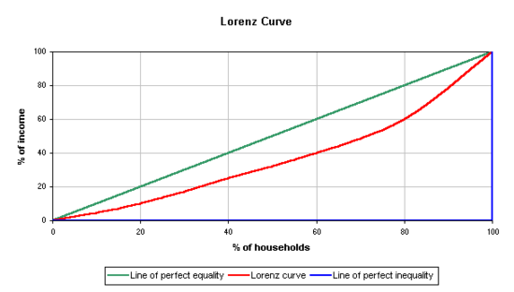
1.5.6 Income distribution (Lorenz Curve and Gini-coefficient)
A
X
B
Y
Z

Slide 52
1.5.6 Income distribution (Lorenz Curve and Gini-coefficient)
At point X
20% of household receives
20% of income
At point Y
20% of household receives
10% of income
At point Z
20% of household receives
0% of income
Point X is on the “Perfect Equality Line”
Point Y is on the “Lorenz Curve”
Point Z is on the “Perfect Inequality Line”
Gini-coefficient
=
area A
area A + area B
Gini-coefficient
Unequal income distribution

Slide 53
Gini-Coefficient of Income,
Thailand, 1988-2019
Bad
Good
Data Source: NESDB

Slide 54
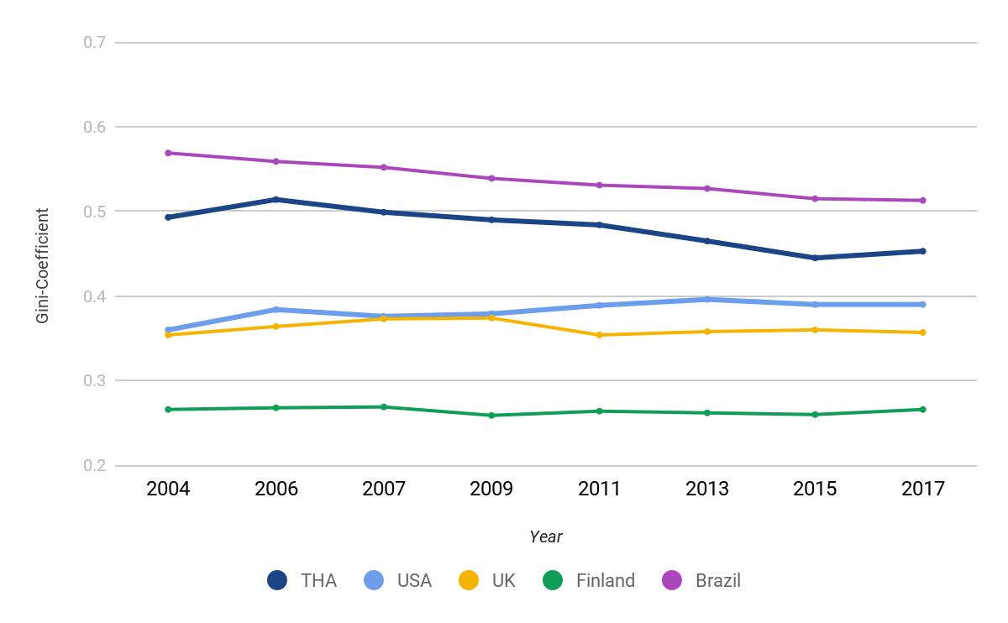
Gini-Coefficient of Income,
Thailand and other countries, 2004-2017
Bad
Good
Data Source(s): NESDB, OECD, Trading Economics

Slide 55
Poverty Headcount Ratio at National Poverty Line,
Thailand, 2000-2019, (% of population)
Data source: NESDB

