Slide 1
FN 281: Personal Finance
Thanachote Rungsitivat, CFA, FRM

Slide 2
Successful Money Management
Spending money now reduces saving and investing for long term goals
Buying on credit results in payments later and reduces the amount of future income available for spending.
Using savings for purchases results in lost interest earnings and inability to use savings for other purposes
Comparison shopping can save you money and improve the quality of your purchases but uses up something of value you cannot replace: your time

Slide 3
Money Management Activities
Storing and Maintaining Personal Financial Records and Documents
Creating Personal Financial Statements
Creating and Implementing a Plan for Spending and Saving

Slide 4
The Situation
Jane wants to follow the three money management activities to begin the process of long-term financial planning. Jane has just graduated from university and has found a job working in an accounts receivables department of a small company. Jane wants to be able to save for a home and other goals but does not know where she stands today.

Slide 5
Storing and Maintaining Personal Financial Records and Documents
Jane has never been very systematic about maintaining her financial records. She keeps her bank and credit card statements but throws everything else into a bag in the corner of her apartment along with other important financial documents. She realizes the she will never understand what her current financial position is until she organizes her records.

Slide 6
Jane’s Home File
Personal and Employment Records
Tax Records
Credit Records
Housing Records
Investment Records
Estate and Retirement Planning Records
Money Management Records
Financial Services Records
Consumer Purchases and Automobile Records
Insurance Records

Slide 7
Jane’s Safe Deposit Box
Birth, marriage, and death certificates
List of bank account numbers
Automobile title, copies of insurance policies
Serial numbers of expensive equipment (TVs, stereo, etc.)
List of credit card numbers and contacts
Investment accounts and contacts
Tax form (LTF, RMF, etc) to be used for filing tax refund
Copy of her Will

Slide 8
Jane’s Electronic System
Computer or Smartphone
List of all checks written and other banking transactions
List of all credit card transactions (keep hard copy as well!!!)
List of all investment accounts and performance results of investments
Electronic versions of Will and other Financial Documents

Slide 9
Personal Financial Statements
Purpose of Personal Financial Statements
Report your current financial position in relation to the value of the items you own and the amounts you owe
Measure your progress toward your financial goals
Maintain information on your financial activities
Provide data you can use when preparing tax forms or applying for credit

Slide 10
Personal Financial Statements (continued)
BALANCE SHEET: WHERE ARE YOU NOW?
Also called the Net Worth Statement or Statement of Financial Planning
Preparation of Balance Sheet requires using the following Steps
STEP 1: LISTING ITEMS OF VALUE
Assets - what you own
Liquid assets
  Real estate
  Personal possessions
  Investment assets

Slide 11

Personal Financial Statements (continued)
STEP 2: DETERMINING THE AMOUNTS OWED
Liabilities - what you owe
  Current liabilities (< 1 year)
  Long term liabilities
STEP 3: COMPUTING NET WORTH
Assets – Liabilities = Net Worth
Assets = Net Worth + Liabilities
Insolvency is the inability to pay debts when they are due

Slide 12

Personal Financial Statements (continued)
Net Worth is an indication of the financial position at any given date
Ways to increase Net Worth
Increasing your savings
Reducing spending
Increasing the value of investments and other possessions
Reducing the amounts you owe
3-12

Slide 13

Personal Financial Statements (continued)
THE CASH FLOW STATEMENT
Cash Flow is the actual inflow, outflow for a given time period
The Cash Flow statement is also called personal income and expenditure statement
3-13

Slide 14
Personal Financial Statements (continued)
THE CASH FLOW STATEMENT
The process of preparing cash flows statement follows these steps
STEP 1: RECORD INCOME
  Wages, salaries, and commissions
  Self-employment business income
  Savings and investment income
  Gifts, grants, scholarships and educational loans
  Government payments, such as Social Security, public assistance, and unemployment benefits
  Amounts received from pension and retirement programs
  Alimony and child support payments
3-14

Slide 15
Personal Financial Statements (continued)
STEP 2: RECORD CASH OUTFLOWS
  Fixed Expenses
  Variable expenses
STEP 3: DETERMINE NET CASH FLOWS
  The difference between income and outflows can either be positive or negative
  Cash flow statement provides the foundation for preparing and implementing a spending, saving, and investment plan
3-15

Slide 16
Jane’s Balance Sheet
Assets
Liquid Assets
Real Estate
Personal Possessions
Investments and Retirement Assets
Liabilities
Current Liabilities
Long-Term Liabilities
Net Worth
Assets - Liabilities

Slide 17
Jane’s Liquid Assets
Jane has a current account that currently has THB 6,750 in it.
Jane has a savings account with a THB 15,000 balance
Total Liquid Assets = THB 21,750 (6,750 + 15,000)

Slide 18
Jane’s Personal Possessions
Toyota year 2000 valued at THB 98,000
Laptop at THB 35,000
iPad at THB 22,000
Jewelry worth THB 88,000
Total Value of Personal Possessions THB 243,000

Slide 19
Jane’s Investment Assets
Mutual Fund Account THB 55,000
Retirement Account at Work THB 21,000
Equity Account THB 30,000
Total Value THB 106,000

Slide 20
Value of Jane’s Assets
Liquid Assets THB 21,750
Personal Possessions THB 243,000
Investments THB 106,000
Total Assets THB 370,750

Slide 21
Jane’s Current Liabilities
Credit Card Balance THB 41,000
Balance on Automobile loan THB 75,000
Installment Loans on Computer and iPad THB 35,000
Total Current Liabilities THB 151,000

Slide 22
Jane’s Long-Term Liabilities
Student Loan Balance THB 85,000
Total Long-Term Liabilities THB 85,000

Slide 23
Jane’s Total Liabilities
Jane’s Current Liabilities THB 151,000
Jane’s Long-Term Liabilities THB 85,000
Total Liabilities THB 236,000

Slide 24
Jane’s Net Worth
Net Worth = Assets – Liabilities
Jane’s Net Worth = THB 370,750 – THB 236,000
= THB 134,750

Slide 25
Using a Balance Sheet to Measure Your Wealth
A snapshot of your financial status at a particular time.
Assets you own
Debt or liabilities you’ve incurred
Your net worth or equity

Slide 26
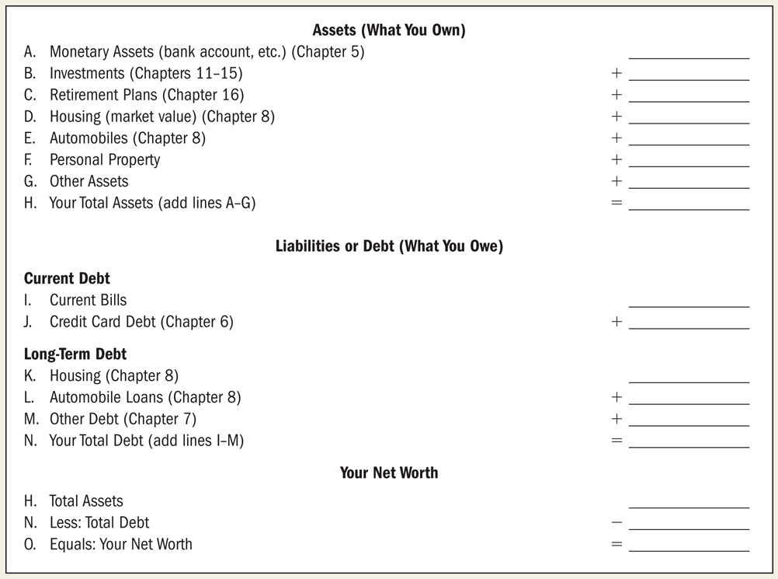
Personal Balance Sheet

Slide 27
Jane’s Personal Cash Flow
Jane has a pretty good understanding of what income she can expect for a month. However, she realizes that she does not understand completely where her money is going.
She knows she stops by the ATM about once a week but does not know where her cash goes. She knows it will not be easy, but she decides to track her cash expenditures for at least one month to determine what she spends.

Slide 28
Jane’s Monthly Income
Salary Gross THB 21,000
Less Deductions
  Personal Income Tax THB 1,760
  Social Security THB 750
Salary Net THB 18,490
Interest Income THB 60
Income on Investments THB 420
Total Income THB 18,970

Slide 29
Fixed Monthly Expenses
Rent THB 5,500
Automobile Loan Payment THB 3,320
Student Loan Payment THB 860
Internet THB 520
Automobile Insurance THB 230
Credit Card Payment THB 400
Total Fixed Expenses THB 10,830

Slide 30
Variable Monthly Expenses
Food at Home THB 1,100
Food away from Home THB 3,680
Clothing THB 1,250
Cell Phone THB 460
Utilities THB 790
Personal Care THB 1,200
Gas THB 590
Total Variable Expenses THB 9,070

Slide 31
Jane’s Monthly Cash Surplus or Deficit
Cash Surplus (Deficit) = + Monthly Net Income
– Monthly Fixed Expenses
– Monthly Variable Expenses
Jane’s (Deficit) = + THB 18,970 – THB 10,830 – THB 9,070
= (THB 930)

Slide 32
Using an Income Statement to Trace Your Money
Financial motion picture—tells you where your money has come from and where it has gone over some period of time.
Income and expenditure, net income statement
Cash basis—based on actual cash flows
Income – expenses (over given time period)

Slide 33
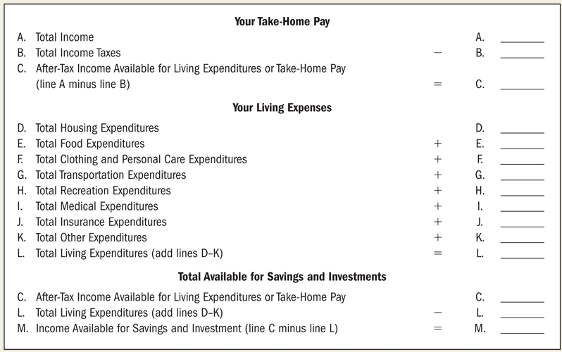
A Simplified Income Statement

Slide 34
Budgeting for Skilled Money Management
CHARACTERISTICS OF SUCCESSFUL BUDGETING
  Well-planned
  Realistic
  Flexible
  Clearly communicated

Slide 35
Creating and Implementing a Budget
Assessing Jane’s Current Situation
Planning her Financial Direction
Implementing Her Budget
Evaluating Her Budget Program

Slide 36
Jane’s Budget Strategies
Jane realizes she needs to cut back on her spending if she wants to reach her financial goals. She looks at what she spent this last month and realizes there are several places she can save. One of her biggest expenses for the month is eating out She decides to eat at home more. However, she wants to make sure she can stick to her budget, so she wants to build in some fun activities.

Slide 37
Jane’s Budgeted Fixed Expenses
Rent THB 5,500
Automobile Loan Payment THB 3,320
Student Loan Payment THB 860
Internet THB 280
Automobile Insurance THB 230
Credit Card Payment THB 800
Total Fixed Expenses THB 10,990

Slide 38
Jane’s Budgeted Variable Expenses
Food at Home THB 3,000
Food away from Home THB 500
Clothing THB 750
Cell Phone THB 400
Utilities THB 800
Personal Care THB 1,000
Gas THB 600
Entertainment THB 400
Total Variable Expenses THB 7,450

Slide 39
Jane’s Budgeted Surplus
Cash Surplus (Deficit) = + Net Income
– Fixed Expenses
– Variable Expenses
Jane’s (Deficit) = + THB 18,970 – THB 10,990 – THB 7,450
= THB 530

Slide 40
Jane’s Conclusions Regarding Money Management
Jane realizes that the following will help her achieve her financial goals:
Balance Sheet
Cash Flow Statement
Budget
Identify savings goals

Slide 41
Using Ratios: Financial Thermometers
Financial ratios allow you analyze raw data in the balance sheet or income statement then compare it to targets.
Ratios help you understand how you are managing financial resources.

Slide 42
Question 1: Do I Have Enough Liquidity to Meet Emergencies?
Current ratio: monetary assets divided by current liabilities
  Should be greater than 1.0
  Aim for above 2.0
Month’s Living Expenses Covered Ratio: monetary assets divided by annual living expenditures divided by 12
  Should aim for 3 to 6 months of liquid assets
  Less if enough credit and insurance

Slide 43
Question 2: Can I Meet
My Debt Obligations?
Debt Ratio: total debt or liabilities divided by total assets
  Should decrease as you get older.
Long-term Debt Coverage Ratio: total income available for living expenses divided by total long-term debt payments

Slide 44
Question 3: Am I Saving as Much as I Think I Am?
Savings Ratio: income available for saving and investments divided by income available for living expenses
Effective saving is by paying yourself first

Slide 45
Tax
Personal Income Tax
Corporate Income Tax
Excise Tax
Value Added Tax
Etc.

Slide 46
Personal Income Tax
Personal Income Tax (PIT) is a direct tax levied on income of a person.
A person means an individual, an ordinary partnership, a non-juristic body of person and an undivided estate. In general, a person liable to PIT has to compute his tax liability, file tax return and pay tax, if any, accordingly on a calendar year basis.

Slide 47
Taxable Person
Taxpayers are classified into “resident” and “non-resident”. “Resident” means any person residing in Thailand for a period or periods aggregating more than 180 days in any tax (calendar) year. A resident of Thailand is liable to pay tax on income from sources in Thailand as well as on the portion of income from foreign sources that is brought into Thailand. A non-resident is, however, subject to tax only on income from sources in Thailand.

Slide 48
Assessable Income
Income chargeable to the PIT is called “assessable income”. The term covers income both in cash and in kind. Therefore, any benefits provided by an employer or other persons, such as a rent-free house or the amount of tax paid by the employer on behalf of the employee, is also treated as assessable income of the employee for the purpose of PIT. Assessable income is divided into 8 categories as follows :
income from personal services rendered to employers;
income by virtue of jobs, positions or services rendered;
income from goodwill, copyright, franchise, other rights, annuity or income in the nature of yearly payments derived from a will or any other juristic Act or judgment of the Court;
income in the nature of dividends, interest on deposits with banks in Thailand, shares of profits or other benefits from a juristic company, juristic partnership, or mutual fund, payments received as a result of the reduction of capital, a bonus, an increased capital holdings, gains from amalgamation, acquisition or dissolution of juristic companies or partnerships, and gains from transferring of shares or partnership holdings;
income from letting of property and from breaches of contracts, installment sales or hire-purchase contracts;
income from liberal professions;
income from construction and other contracts of work;
income from business, commerce, agriculture, industry, transport or any other activity not specified earlier.

Slide 49
Progressive Tax Rates

Slide 50
Deduction and Allowances
Certain deductions and allowances are allowed in the calculation of the taxable income. Taxpayer shall make deductions from assessable income before the allowances are granted. Therefore, taxable income is calculated by :
TAXABLE INCOME = Assessable Income - deductions - allowances

Slide 51
Deductions allowed for the calculation of PIT
Type of Income | Deduction
a. Income from employment | 50% but not exceeding 100,000 baht
b. Income received from copyright | 50% but not exceeding 100,000 baht
c. Income from letting out of property on hire
1) Building and wharves | 30%
2) Agricultural land | 20%
3) All other types of land | 15%
4) Vehicles | 30
5) Any other type of property | 10%
d. Income from liberal professions | 30% except for the medical profession where 60% is allowed
e. Income derived from contract of work whereby the contractor provides essential materials besides tools | actual expense or 70%
f. Income derived from business, commerce, agriculture, industry, transport, or any other activities not specified in a. to e. | actual expense or 65% - 85% depending on the types of income

Slide 52
Allowances (Exemptions) allowed for the calculation of PIT
Types of Allowances | Amount
Personal allowance
Single taxpayer | 60,000 baht for the taxpayer
Undivided estate | 60,000 baht for the taxpayer’s spouse
Non-juristic partnership or body of persons | 60,000 baht for each partner but not exceeding 120,000 baht in total
Spouse allowance | 60,000 baht
Child allowance (child under 25 years of age and studying at educational institution, or a minor, or an adjusted incompetent or quasi-incompetent person) | 30,000 baht each
Education (additional allowance for child studying in educational institution in Thailand) | none
Parents allowance | 30,000 baht for each of taxpayer’s and spouse’s parents if such parent is above 60 years old and earns less than 30,000 baht
Life insurance premium paid by taxpayer or spouse | Amount actually paid but not exceeding 100,000 baht each
Approved provident fund contributions paid by taxpayer or spouse | Amount actually paid at the rate not more than 15% of wage, but not exceeding 500,000 baht
Long term equity fund | Amount actually paid at the rate not more than 15% of wage, but not exceeding 500,000 baht
Home mortgage interest | Amount actually paid but not exceeding 100,000 baht
Social insurance contributions paid by taxpayer or spouse | Amount actually paid each
Charitable contributions | Amount actually donated but not exceeding 10% of the income after standard deductions and the above allowances

Slide 53
Exercise
Calculate Personal Income Tax for:
Calculate How much LTF/RMF can be bought for:
What is the reduction in Tax from such investment

Slide 54
Tax Credit for dividends
Any taxpayer who domiciles in Thailand and receives dividends from a juristic company or partnership incorporated in Thailand is entitled to a tax credit of 3/7 of the amount of dividends received. In computing assessable income, taxpayer shall gross up his dividends by the amount of the tax credit received. The amount of tax credit is creditable against his tax liability.

Slide 55
Separate taxation
There are several types of income that the taxpayer shall not include or may not choose to include such income to the assessable income in calculating the tax liability.
Income from sale of immovable property
Taxpayer shall not include income from sales of immovable property acquired by bequest or by way of gift to the assessable income when calculating PIT. However, if the sale is made for a commercial purpose, it is essential that such income must be included as the assessable income and be subject to PIT.
Interest
The following forms of interest income may, at the taxpayer’s selection, be excluded from the computation of PIT provided that a tax of 15 per cent is withheld at source:
interest on bonds or debentures issued by a government organization;
interest on saving deposits in commercial banks if the aggregate amount of interest received is not more than 20,000 baht during a taxable year;
interest on loans paid by a finance company;
interest received from any financial institution organized by a specific law of Thailand for the purpose of lending money to promote agriculture, commerce or industry.
Dividends
Taxpayer who resides in Thailand and receives dividends or shares of profits from a registered company or a mutual fund which tax has been withheld at source at the rate of 10 per cent, may opt to exclude such dividend from the assessable income when calculating PIT.

Slide 56
Withholding Tax
Types of income (baht) | Withholding tax rate (baht)
1. Employment income | 5 - 35 %
2. Rents and prizes | 5 %
3. Ship rental charges | 1 %
4. Service and professional fees | 3 %
5. Public entertainer remuneration - Thai resident - non resident | 5 % 5 - 37 %
6. Advertising fees | 2 %

Slide 57
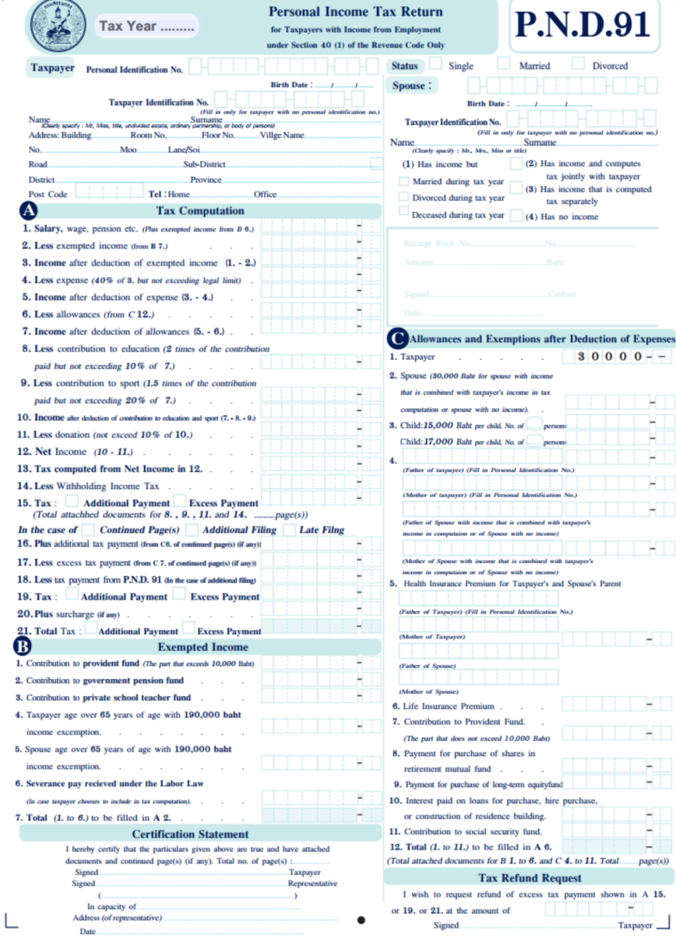

Slide 58
Tax Planning Strategies
Consumer Purchasing
  Consumer debt
  Job-related expenses
  Health care expenses
  Housing expenses
  Donations
Investment Decisions
  Tax-exempt investments
  LTF and RMF
Retirement Plans
  RMF
  Provident/Pension Fund

Slide 59
Thank you

