Slide 1
The hard road ahead for Thailand’s economic recovery
Bhanupong
Lecture 9

Slide 2
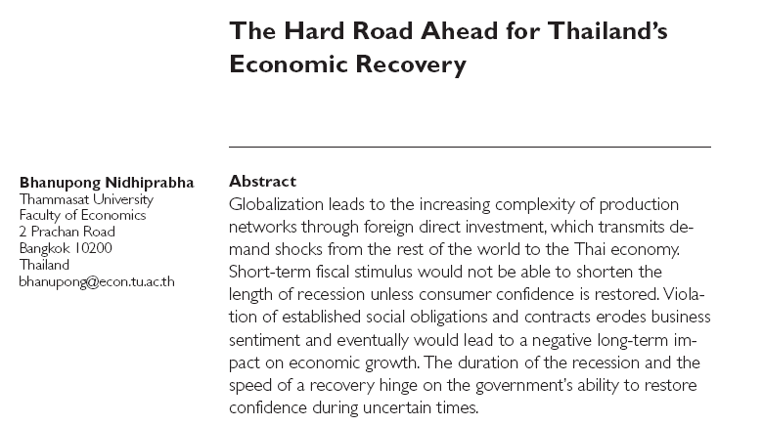

Slide 3
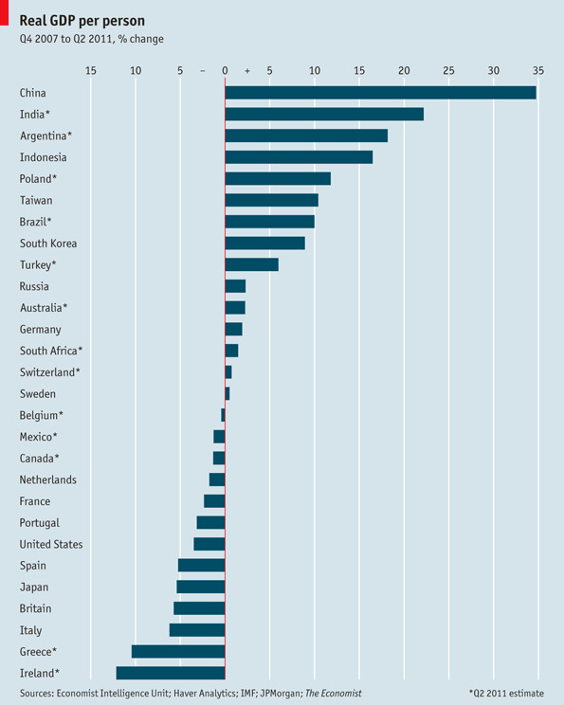

Slide 4
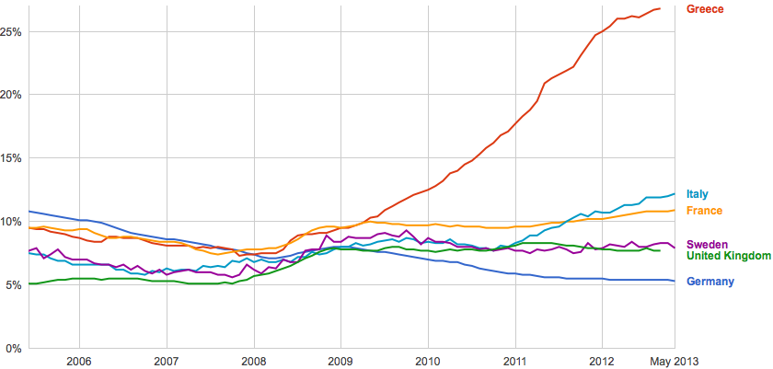
Unemployment rate in Europe

Slide 5
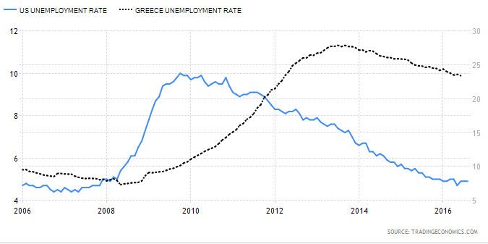
Unemployment in Greece and the US

Slide 6
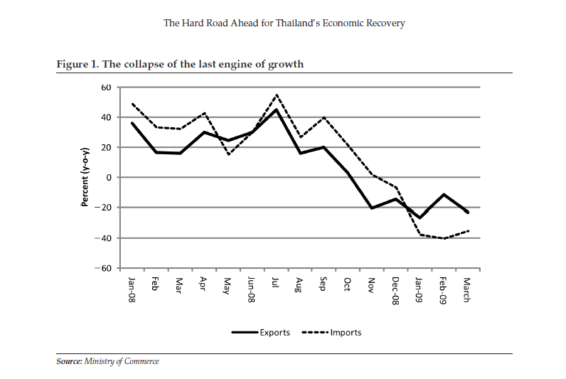

Slide 10
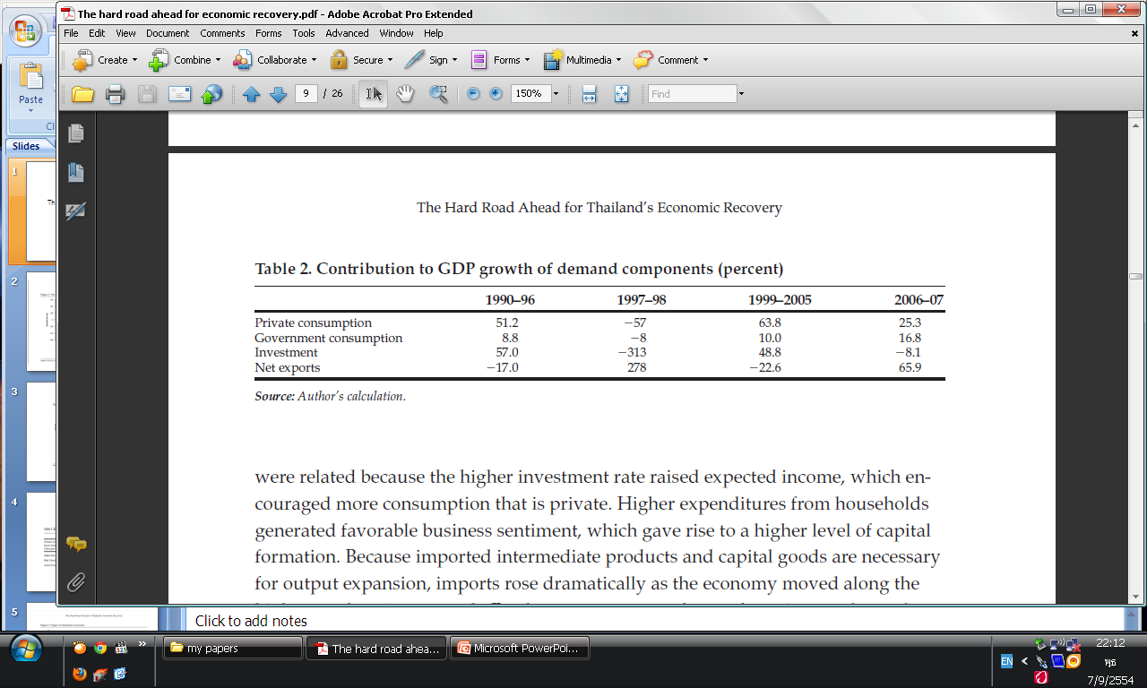

Slide 11
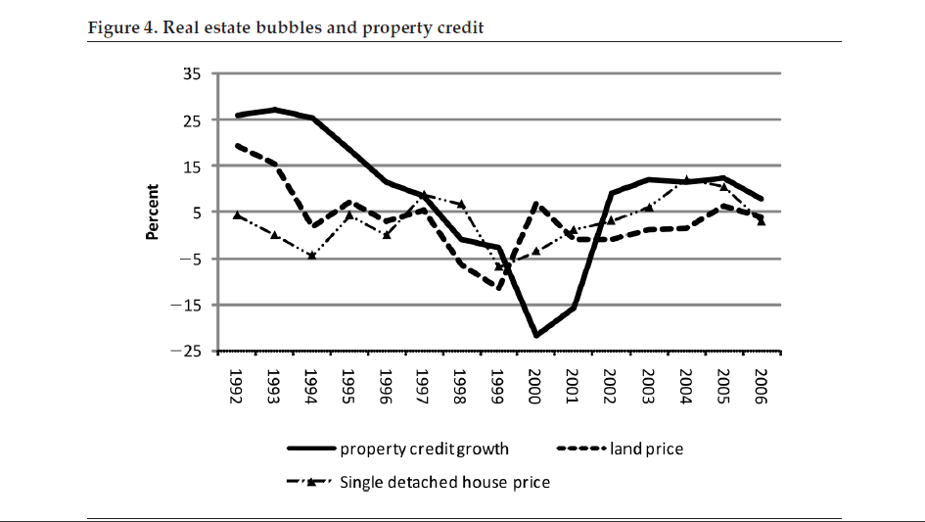

Slide 12
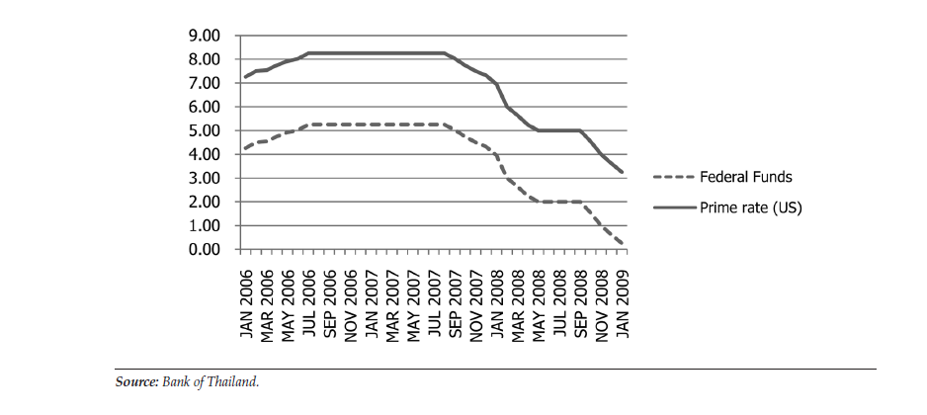
The Fed and its impact on commercial banks’ prime lending rate

Slide 13
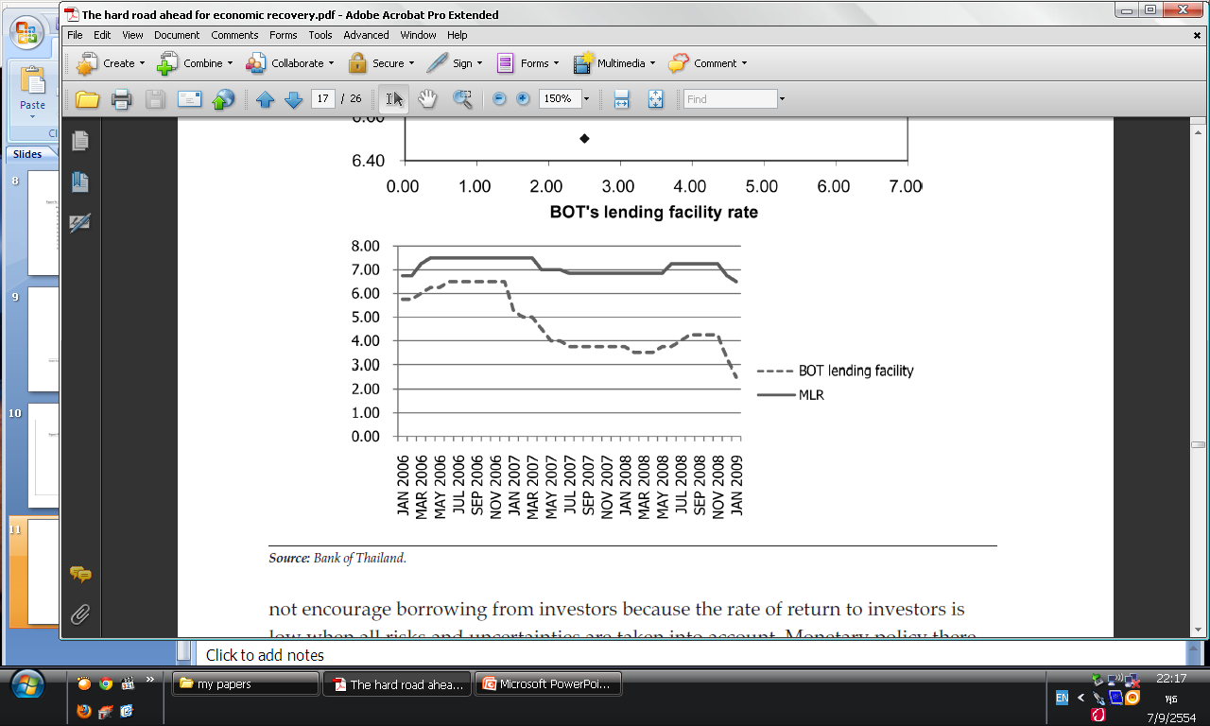
The BOT and its impact on commercial bank Minimum Lending Rate (MLR)

Slide 14
Pessimism and effectiveness of monetary policy
In a mild business cycle, fear of recession and pessimistic expectations can increase the perception of the fall in future income and it can turn a mild recession into a depression (J.M.K)
During the boom investment would expand in response to strong sales growth.
In turn, capital spending on new plants would generate employment and income that further induce more capital formation.

Slide 15
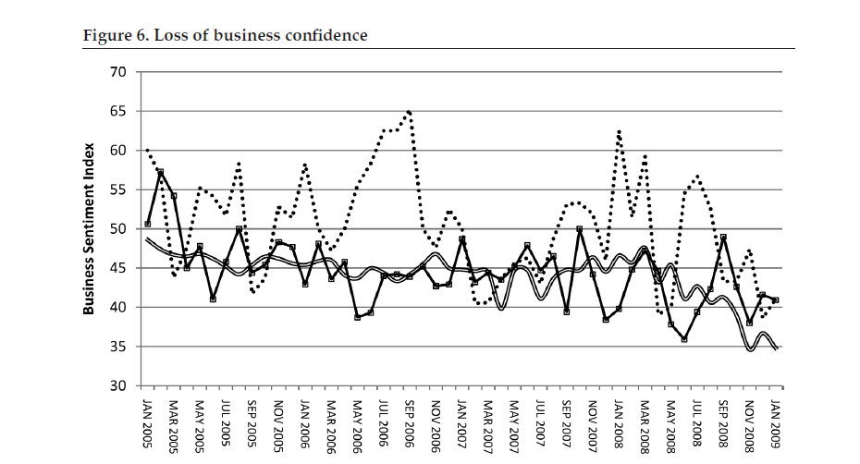

Slide 16
Business Sentiment Index (BSI)
Source: Bank of Thailand
A survey of 1,500 business enterprises
Index = 50 indicates that business sentiment remains stable.
Index > 50 indicates that business sentiment has improved.
Index < 50 indicates that business sentiment has worsened.

Slide 17
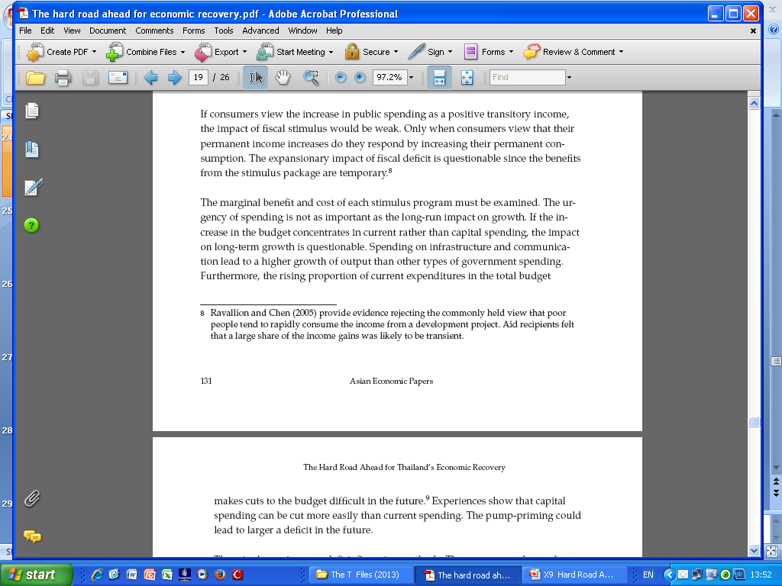
Transitory vs. Permanent Income

Slide 18
Business sentiment and consumer confidence
Business sentiment can be restored and maintained by policy consistency.
If the government and the public adhere to the rule of law, political shocks can be minimized as a concern for fairness would be eased.
Once we allow elements of unknowns to violate established social obligations and contracts, business confidence erodes quickly; eventually it could lead to a negative long-term impact on economic growth.
Business Sentiment Index is formulated based on: output prices, domestic and foreign orders, and liquidity.

Slide 19
Business Sentiment Index output prices

Slide 20
Business Sentiment Index

Slide 21
Business Sentiment Index

Slide 22
Business Sentiment Index

Slide 23
Short-term political gain, long-term economic losses
Fiscal policy is the only option left. (Why?)
Unless the government maintains law and order to restore business sentiment and enhance consumer confidence, both the monetary and fiscal policy package would fail miserably.
Ultra-populist policy would lead to an unsustainable fiscal position.
Fiscal discipline has been neglected in the pursuit of short-run political gain at the expense of the long-term economic growth and stability

Slide 24
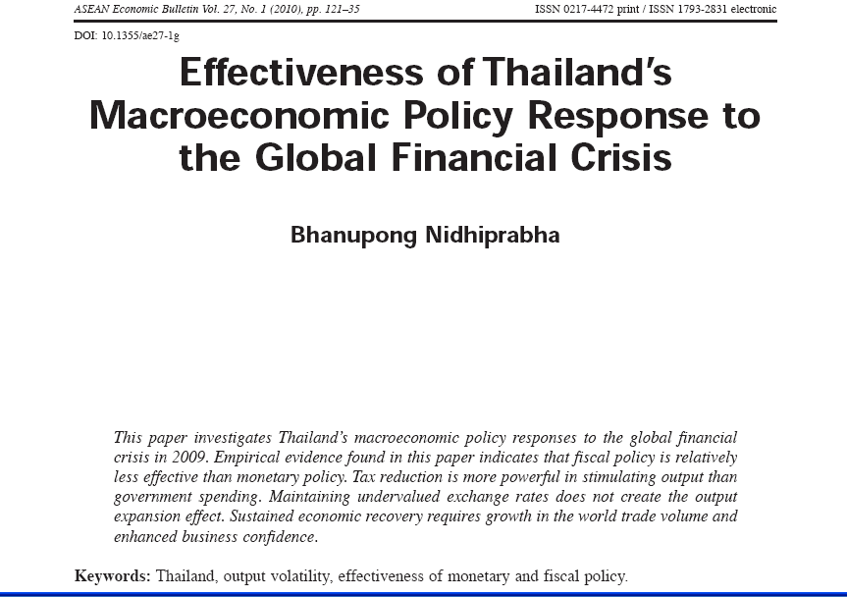

Slide 25
When consumption and investment spending are constrained by poor business sentiment and weak consumer confidence, the recovery must come from the rebound of export demand.
A sustainable recovery depends on the resumption of world trade expansion and regained consumer confidence.

Slide 27
The year 2006 witnessed a fundamental change
in Thailand’s politics, which has a profound
impact on the previously stable economy.
The economic outcome of policy responses to external shocks is influenced by the
quality of institutions.
Political transformation through military coups, revolution, and civil war cycles involve high risk exposure to output and consumption volatility that would lead to serious economic crises.

Slide 28
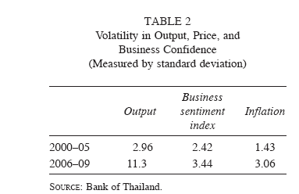

Slide 29
The effectiveness of policy responses depends on the government’s ability to
maintain the rule of law, accountability, human rights, and effective legal infrastructure.

Slide 30
Maintaining the rule of law implies predictable outcomes from court ruling of legal disputes. Investors can proceed with less concern about risk and uncertainty that may arise from policy inconsistency.

Slide 31
If those policy stimuli can be used under a favorable investment environment, Thailand can recover quickly from the global financial crisis and would have been subject to lesser adverse consequences of the global recession.
Thailand has sufficient policy instruments to respond to fluctuations in the global export demand, but those policy instruments must be selectively chosen to ensure maximum impacts on stabilization.

Slide 32
Monetary policy remains effective despite the high degree of capital convertibility because its impact on the exchange rate intensifies the initial impact of monetary policy on the aggregate demand.
Currency appreciation does not necessarily lead to output contraction.
These macroeconomic policies would be more powerful with accompanying measures to boost consumer confidence and business sentiment to nourish the animal spirits of investors.

Slide 33
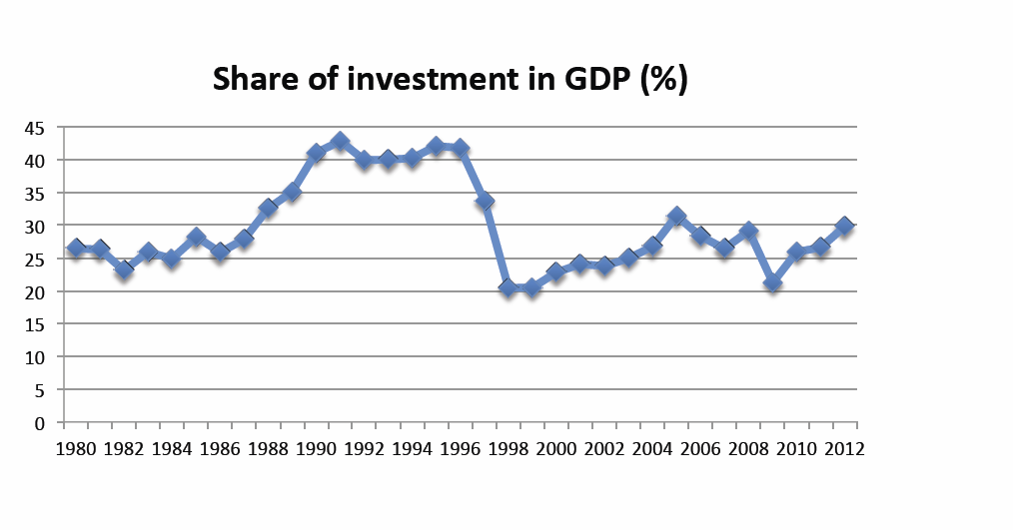
Investment slumps in Thailand

Slide 34
Slow going: world GDP
The second quarter of 2016, according to The Economist’s estimates, was none too exhilarating.
Global year-on-year economic growth reached 2.7%, a whisker below the previous quarter’s. Blame the slowdown on Asia.
China clocked in at 6.7%—well below its long-term average, but better than expected, and propped up by a hefty, demand-boosting increase in government spending.
India’s performance worsened, too, though with growth above 7% it remains the world’s fastest-expanding big economy. Such figures provoke envy in rich countries.

Slide 35
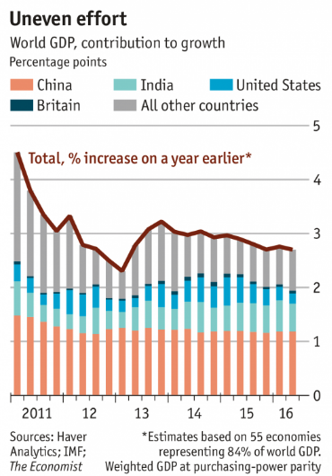

Slide 36
Slow going: world GDP
In America, growth slipped to little more than one-sixth of India’s rate (though strong income numbers this week brought cheer).
Among advanced economies, the surprising bright spot was Britain: output ticked up at an annual rate of 2.2%, up from 2% in the previous quarter.
All that uncertainty in the run-up to the Brexit referendum seems not to have greatly affected the economy. Yet.

Slide 37
How China's government strategy to fuel growth is seriously failing:
China has a massive debt problem, its economic growth is slowing, and it is now becoming a major concern for investors around the world.
China takes on huge amounts of debt in order to fuel its ferocious economic growth.
In June, Li Yang, a senior researcher with the China Academy of Social Sciences said China’s total borrowings were more than double its GDP in 2015 at 168.48 trillion yuan ( $25.6 trillion).

Slide 38
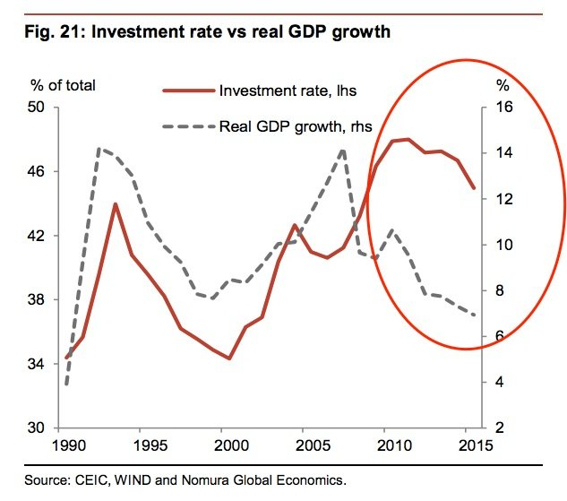
More debts, followed by higher investment (the way it used to be)
This chart proves that China's strategy of fueling growth by taking on debt and investing in state-owned enterprises
is not working anymore

Slide 39
Ghost cities in China
Some Chinese cities are now notoriously known as “ghost cities” for their empty skyscrapers, luxury apartments and magnificent squares.
These “ghost cities” are a result of excessive housing and infrastructure construction, and speculation on property demand.
The emergence of ghost cities is a consequence of China's land-centred urbanization.
Land-centred urbanization is rooted in local GDPism, which in turn results in aggressive developmentalism and excessive investment among China's local governments.

Slide 40
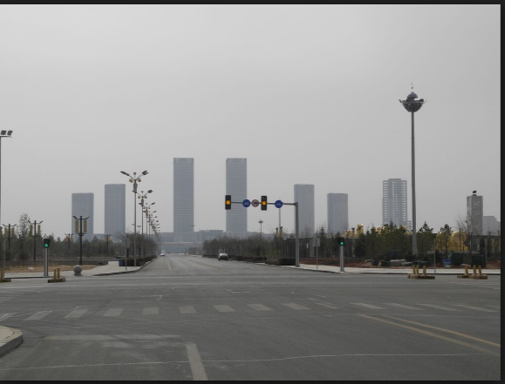
A Ghost City in China

Slide 41
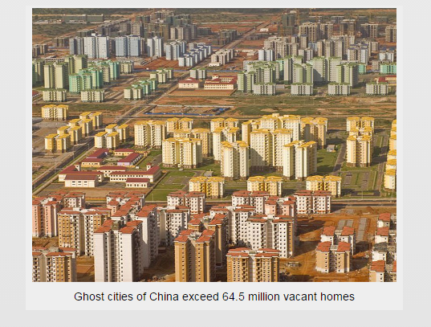
As many as 24 new cities are being built every year! How is this possible ?
The Chinese Government has allowed for this this expansion to continue in order to keep their economy growing but the level of infrastructure development is far ahead of the demand for property.

Slide 42
Not as effective as before
China's strategy of fueling growth by taking on debt and investing in state-owned enterprises is not working anymore.
But growth is slowing. China no longer puts up double-digit GDP growth, and instead is recording numbers like 6.7 % for the second quarter of 2016.
A number of asset managers and analysts believe the number is lower.
Extra debt is no longer producing the growth it did back in 2005.

Slide 43
Zombie firms in China
The term "Zombie Company" was applied to Japanese firms supported by Japanese banks during the period known as the loss decade after the collapse of the Japanese asset price bubble in 1990s.
By 2016 following economic downturn in Chinese industrial companies (steel, aluminum, paper ) had developed gross overproduction capacity problems, with overcapacity rising from 0% in 2007 to an average of 13% by 2015, with figures higher than 30% in some industries (cement, steel in 2014).
At the 2016 National People’s Congress the country's government recognized the issue of the 'Zombie Enterprises' and announced that it was to close or reorganize many state owned (public) industrial companies by 2020.
In coal and steel industries resultant loss of work was expected to result in 1.8 million redundancies (15% of workforce), with total redundancies estimated to be up to 6 million workers.

Slide 44
Impact of Global Recession on Thailand’s Exports

