Slide 1
EE401 Political Economy
Chapter 2 Pre-capitalist Society and Absolutist Political Institution
iii. Transition: Economic and Political Liberalism
Ploy Thammapiranon 2/2017
BE, Thammasat University

Slide 2
Transition: Economic and Political Liberalism
1. Revolution of ideas
1.1 The rise of Protestantism (c.16-17)
1.2 The scientific revolution (c.17)
1.3 The Enlightenment (c.17-18)
1.4 Political liberalism (c.17-18)
2. Revolution in England
3. Political Liberalism
4. Transition to Capitalism

Slide 3
1. Revolution of ideas
1.1 The rise of Protestantism (c.16-17)
Religious individualism.
  Direct relationship between God and individuals.
  Faith is the matter of individuals.
  Against elaborate ceremonies and rituals.
Hard work and frugality in this life.
The spiritual success of a man was justified from work and profit

Slide 4
1. Revolution of ideas
1.2 The Scientific Revolution (c.17)
Copernicus and the heliocentric model of the universe.
New science of Galileo
  Reason and experiments.
  Universe governed by natural laws.
Newton’s law of physics and mechanics.
Confidence in human intellect.

Slide 5
1. Revolution of ideas
1.3 The Enlightenment (c.17-18)
Confidence in ‘Reason’ in understanding society and the world.
  Reject traditional beliefs in religion, customs and politics.
  ‘Human’ is the center.
  Use of New Science to explain the world.
  Individual freedom from religious and secular oppression.

Slide 6
1. Revolution of ideas
1.4 Political liberalism (c.17-18)
Decaying old social orders
  Revolution of ideas undermined the authority of the Catholic Church and Monarchs.
  Local lords, unchartered merchants, manufacturers, farmers, workers supported the Reformation and against mercantilism.
Religious conflicts led to political conflicts and social revolution

Slide 7
2. Revolution in England
2.1 Why England first?
English monarchs were weaker and local lords stronger vis-à-vis Continental Europe.
The monarch’s arbitrary tax policy.
1215 the Magna Carta:
  Limit on the monarchy’s power to tax.
  Great Council of nobility for consultation.
    Great Council was the seed of pluralist political institutions in England.

Slide 8
2. Revolution in England
2.1 Why England first?
1265 Great Council became the first elected Parliament.
  Inclusion of minor lords and ‘gentry’ (new merchants and trading farmers).
1346 Black Death; 1381 the Peasants’ Revolt ➔ Dissolution of serfdom in England.

Slide 9
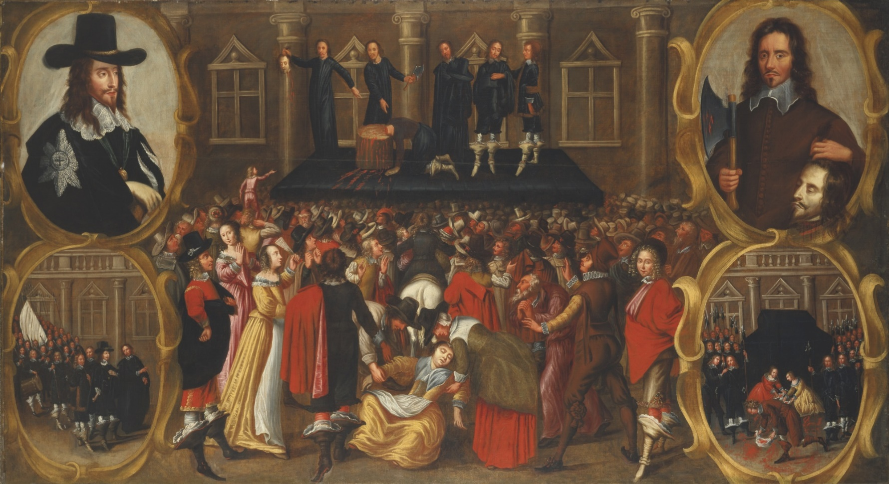
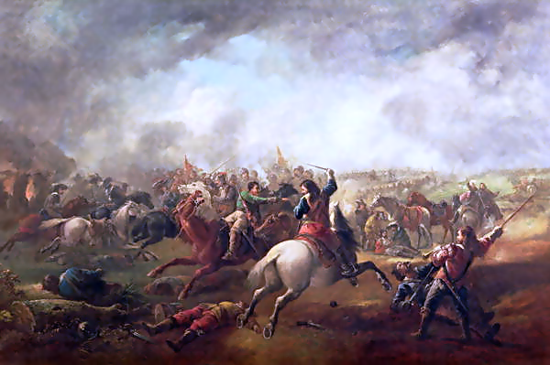
2. Revolution in England
2.2 The 1648 Revolution
1640-42
1642-48
1649-60
1661
Restoration of King Charles II.
The Commonwealth.
Civil war and revolution by Oliver Cromwell.
Conflicts between Parliament and King Charles I on more taxes.

Slide 10
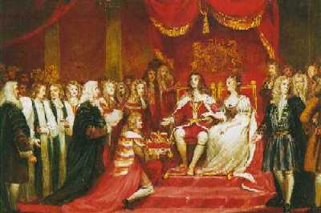
2. Revolution in England
Parliaments
Free Elections
Freedom of Speech
➔ Empower parliament and society
2.3 The Glorious Revolution
1688
1689
the Bill of Rights
King James II was removed and fled to France.
King William III and Queen Mary appointed as joint Monarchs.

Slide 11
2. Revolution in England
2.4 Results
i. Democratic Revolution in England gave rise to the modern world’s first pluralist political institutions.
  Sovereignty belongs to a representative body (elected Parliament).
  Such body became more inclusive over time.
  Separation of powers, checks and balance within the political institutions.

Slide 12
2. Revolution in England
2.4 Results
ii. Reforms towards markets
The Glorious Revolution consisted of a broad coalition of landed gentry, commercial aristocrats, manufacturers, farmers, workers.
  Major forces behind Parliament.
  In favor of freer trade, taxation by representation, tax and fiscal reforms.
Reforms included enforcement of private property; patents of property rights for ideas (1642); uniform tax; and promotion of industry and international trade.

Slide 13
2. Revolution in England
2.4 Results
iii. Economic Liberalism
Mercantilist policies gradually removed.
  Most monopoly rights were abolished.
Gold standard system.
  The Bank of England and modern banking.
Balanced government budget.
Facilitation of technology progress.

Slide 14
2. Revolution in England
2.5 The English path: a closer look
Absolutist political institutions + extractive economic institutions
Power distribution led to conflicts
Political revolution to undermine monarchy
Inclusive economic institutions
(freer markets)
Pluralist political institutions (parliamentary system)
Economic reform
Trade, production, saving, investment
Technological progress and growth
Industrial Revolution
The working class and middle class
More inclusive political institutions
(modern democracy)

Slide 15
3. Political Liberalism
Political theories to refuse ‘the divine rights of kings’.
  Rulers govern people by ‘consent’ for the interest of the people.
  State has the duty to protect natural rights of individuals
  Individual freedom with limited government.
  ‘The social contract’ theories by Hobbes and Locke.

Slide 16
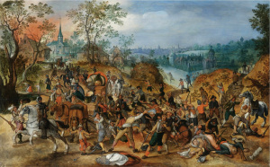
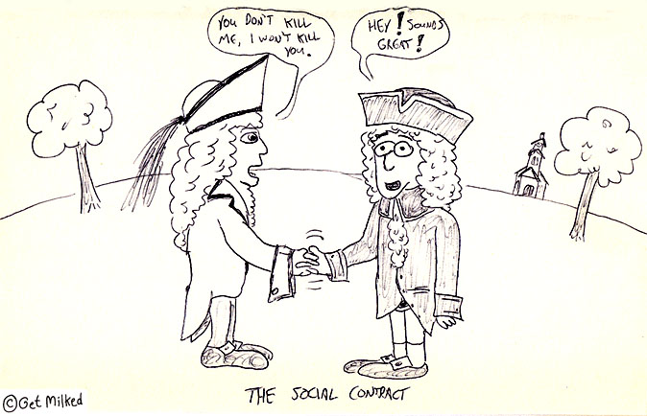
3. Political Liberalism
  3.1 Thomas Hobbes (1588-1679)
Leviathan (1651)
Foundation of modern political theory
‘The state of nature’
War of everyman against every man
‘Social contract’
Between people to set up the sovereign to protect civil society
People confer absolute power to the sovereign to enforce contract
Self-interested individuals
Natural rights endowed to individuals
Absolute authority derived from the consent of individuals

Slide 17
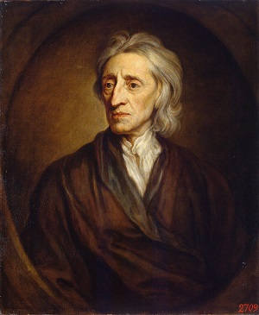
3. Political Liberalism
  3.2 John Locke (1632-1704)
‘Two Treatises of Government’
  The most important political tract on the principles of modern liberalism.
Explicit rejection of ‘divine rights’.
‘The state of nature’:
  A law of nature: natural rights of individuals.
  ‘The rights to life, limbs, liberty and possessions’.
  State of anarchy: no peace, order, protection.

Slide 18
3. Political Liberalism
  3.2 John Locke (1632-1704)
Social contract:
  People consent to curtail their rights and entrust a sovereign with power for security.
  Legitimacy of the sovereign is derived from ‘the consent of the people’.
  People have rights to change the ruler who violates the contract
  Government with popular consent:
    People’s representation in political society.
    Freedom to create mixed constitution.
    Separation of powers: no one particular type
    The rights to remove or alter arbitrary government and tyranny.

Slide 19
4. Transition to Capitalism
  4.1 Manufacturing expansion in England
Textile manufactures flourished.
The system of ‘manufactories’.
  Concentration of materials, equipment, workers.
  Division of labor → raise productivity.

Slide 20
4. Transition to Capitalism
  4.2 The Physiocrats and free trade
Reaction against French mercantilism.
Agriculture is the origin of ‘wealth’.
Manufacturing and commerce
only change forms and move things.
Laissez-faire, laissez-passer
Let people do as they please without government interference.

Slide 21
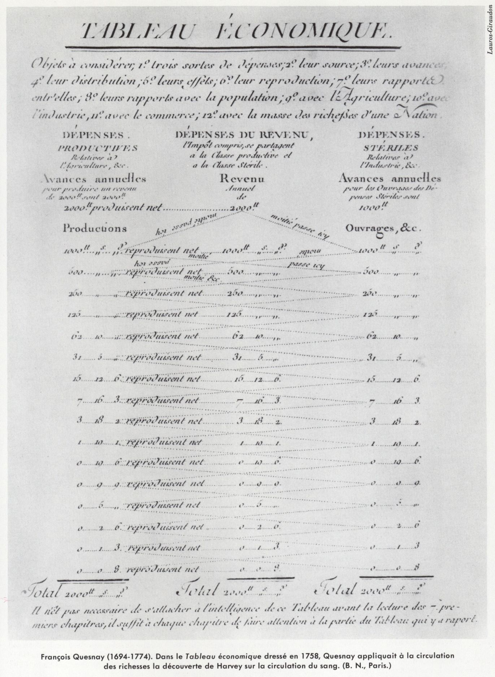
4. Transition to Capitalism
  4.2 The Physiocrats and free trade
  i. François Quesnay (1694-1774)
‘Tableau Economique’ -- the first circular flow model.
Economic policies:
  To promote accumulation and growth in agriculture.
  Free trade on agricultural products to promote growth.
  Abolition of land and farm income taxes.
  Taxes on rent income of landowners.

Slide 22
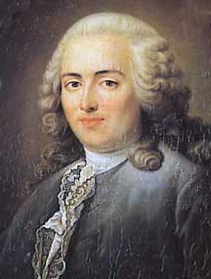
4. Transition to Capitalism
  4.2 The Physiocrats and free trade
  ii. Anne Robert Jacques Turgot (1727-81)
1774 Finance Minister to Louis XVI.
Embarked on Physiocrat reforms.
  Free trade on grain.
  Privileges of monopolies and guilds abolished.
  Corvée abolished; rent tax on landowners.
  Government spending cut.
Universal education, freedom to choose occupation, religious liberty.
Opposition from all corners.

