Slide 1
Environment and climate change
EE463 Globalization and international development
Faculty of economics
Thammasat university

Slide 2
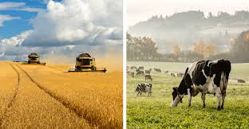
Importance of the environment
Most human livelihoods depend directly or indirectly on the environment through agriculture, hunting, fishing and forestry
Environmental quality strongly affects and is affected by, economic development
United Nations’ 2030 Sustainable Development Goals emphasize the importance of the environment and sustainability of natural resources: poverty, health, food and agriculture, water and sanitation, human settlements, energy, and climate change
The 17 Sustainable Development Goals (SDGs) aim to end poverty, protect the planet, and ensure peace and prosperity for all.

Slide 3
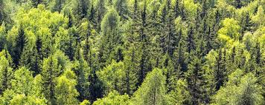
Economics and environment
Development needs natural resources; extraction using unsustainable methods causes environmental degradation, e.g., damage to soil, water supplies and forests
Population pressures on marginal land and increased demand for natural resources also accelerates environmental degradation, leading to falling farm productivity and per capita food production

Slide 4
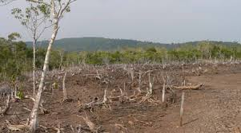
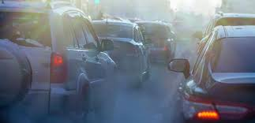
Economics and environment
Growing consumption needs leads to the destruction of forests, wetlands, and waterways.
Emission of greenhouses due to human activity have global implications such as global warming.

Slide 5
Economics and environment
Since environmental degradation is not calculated in the costs of production, it is therefore a negative externality, which requires government intervention
Environmental considerations should therefore be an integrated part of policymaking

Slide 6
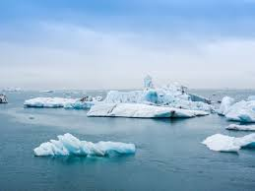
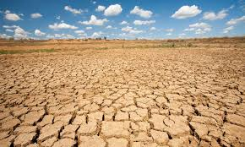
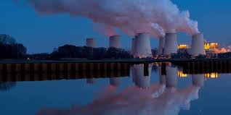
definitions
Global warming: increasing average temperatures attributed to human activities that emit greenhouse gases (CO2, CO)
Climate change: changes in climate that alter underlying probabilities of weather outcomes
Sustainability: meeting the demands of the present generation without compromising the needs of future generations

Slide 7
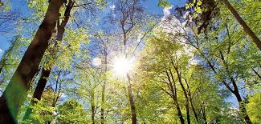
definitions
Environmental accounting: the incorporation of environmental benefits and costs into the quantitative analysis of economic activities
Environmental capital: The portion of a country’s overall capital assets that directly relate to the environment (e.g., forests, soil quality, and ground water)
Sustainable net national income (NNI): an environmental accounting measure of the total annual income that can be consumed without diminishing the overall capital assets of a nation

Slide 8
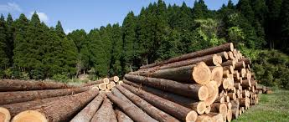
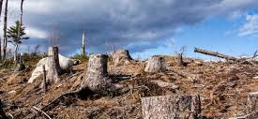
Principles of environmental accounting
Future growth and overall quality of life depend on the quality of environment
The stock of overall environmental capital assets remains constant or rises over time
If an environmental resource is damaged or depleted in a particular area, a resource of equal or greater value should be regenerated elsewhere.

Slide 9
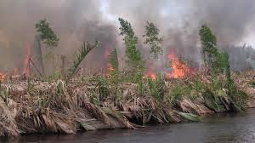
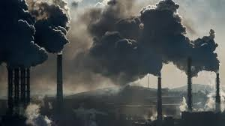
Global Warming and climate change
Destruction of the world’s remaining forests and gas emissions from industries and cars contribute to climate change caused by global warming through the greenhouse effect
Mitigation and adaptation are two responses to address climate change

Slide 10
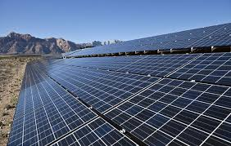
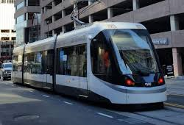
Global Warming and climate change
Climate change mitigation: any actions or efforts taken to reduce or prevent the long-term risks of climate change on human life and property by reducing the sources or enhancing the sinks of greenhouse gases emissions
Examples of mitigation strategies:
adopting renewable energy sources like solar, wind and small hydro;
developing sustainable transport (bus rapid transit, electric vehicles, and biofuels)
promoting more sustainable uses of land

Slide 11
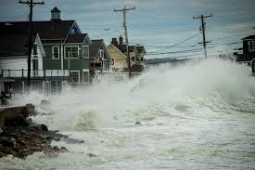
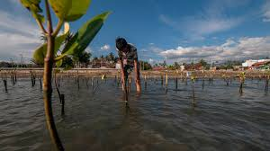
Global Warming and climate change
Climate change adaptation: adjustments in ecological, social or economic systems in response to actual or expected climatic effects. This requires changes in processes and practices to lessen the impacts of climate change
Examples of adaptation measures:
Inventorying and tracking of ecological resources
implementing early warning systems to anticipate natural disasters
Restoring and expanding natural ecosystem barriers (mangroves, reforestation)

Slide 12
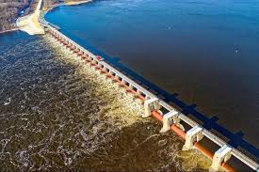
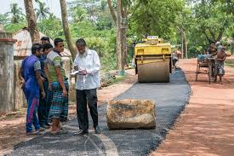
Global Warming and climate change
Examples of adaptation measures:
construction infrastructure to serve the poor (shelters, flood barriers, protected roads, bridges)
Ensuring better voice and empowerment for the poor
using scarce water resources more efficiently
adapting building codes to future climate conditions
building flood protection; raising the levels of dykes
developing drought-tolerant crops
choosing tree species and better forestry practices
demanding more government transparency

Slide 13
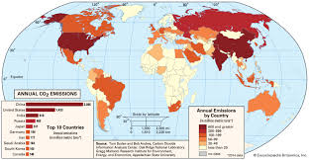
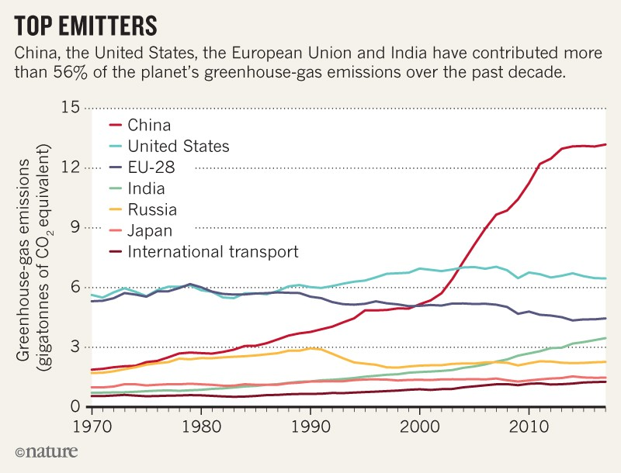

Slide 14
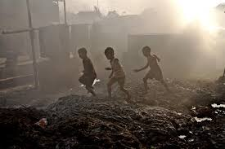
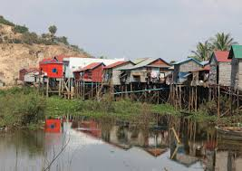
Poverty and the environment
Interaction between poverty and environmental degradation can be self-perpetuating; communities may destroy the very resources they depend upon for survival. Example: slash and burn agriculture
The poor are usually the victims of environmental degradation as they mostly live in marginal areas

Slide 15
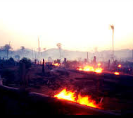
Poverty and the environment
One of the biggest ways that the environment is affected by poverty is through deforestation. Impoverished communities, unaware of the harmful ways in which they use natural resources, such as forest wood and soil, are continuing the destructive cycle that spirals the environment further downward.

Slide 16
Policies to manage the environment
Several policy options can be adopted by governments, particularly in developing countries, to address issues of environment and climate change:
Proper resource pricing: cut subsidies to industries encourage unsustainable methods of production
Community involvement: programs to improve environmental conditions are likely to be effective when communities are involved. Example: livelihood programs
Clearer property rights and resource ownership: investments in household sanitation and water saves time; granting land tenure to the poor will mean less need for government transfers to the poor

Slide 17
Policies to manage the environment
Programs to improve the economic alternatives of the poor: irrigation, sustainable farming and use of alternative fuels provide incentives to farmers to increase their productivity
Raising the economic status of women: improving educational attainment for women increases the range of economic alternatives and increases knowledge in family health and hygiene
Industrial emissions abatement practice: regulations to limit industrial poillution, including taxation on emissions, tradeable emission permits, quotas and standards
Proactive stance toward climate change and environmental degradation through public policies

Slide 18
conclusion

Slide 19


