Slide 1
Political Regime, Government, and Epidemics
Part 2

Slide 2
Plague in India
Y. pestis arrived Bombay in 1986 on the bodies of rats on ships from Hong Kong.
Officially, the epidemic began on September 23rd, when a case was diagnosed and reported.
From 1896 to 1920s, when the weather turned cold, plague erupted in Bombay before ebbed away in summer.
The periodicity of the cycle was determined by the “Oriental” rate flea Xenopsylla cheopis which was inactive in the heat and humidity.

Slide 3
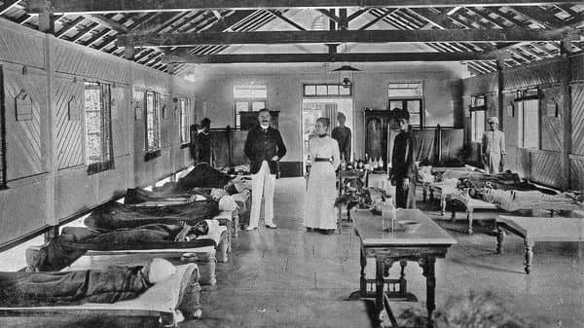
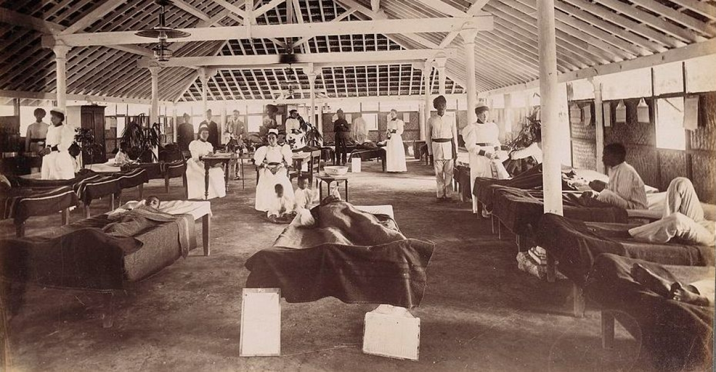
Plague hospital

Slide 4
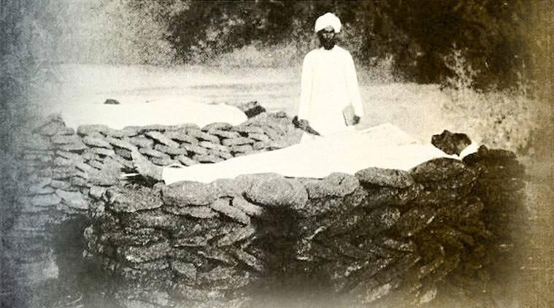
During the two decades of the epidemic, the disease killed more than 10 million Indians

Slide 5
Plague in India
That was during the British Raj – the period of British rule on the Indian subcontinent from 1858-1947
At the time, India was very important economically for the British, so they would like to end the epidemic as soon as possible.
The Epidemic Disease Act of February 1897 had given unlimited authority to a central board of plague commissioners.
Walter Charles Rand, the plague commissioner of the city Poona, noted that the measures are “perhaps the most drastic that had ever been taken to stamp out an epidemic.”

Slide 6
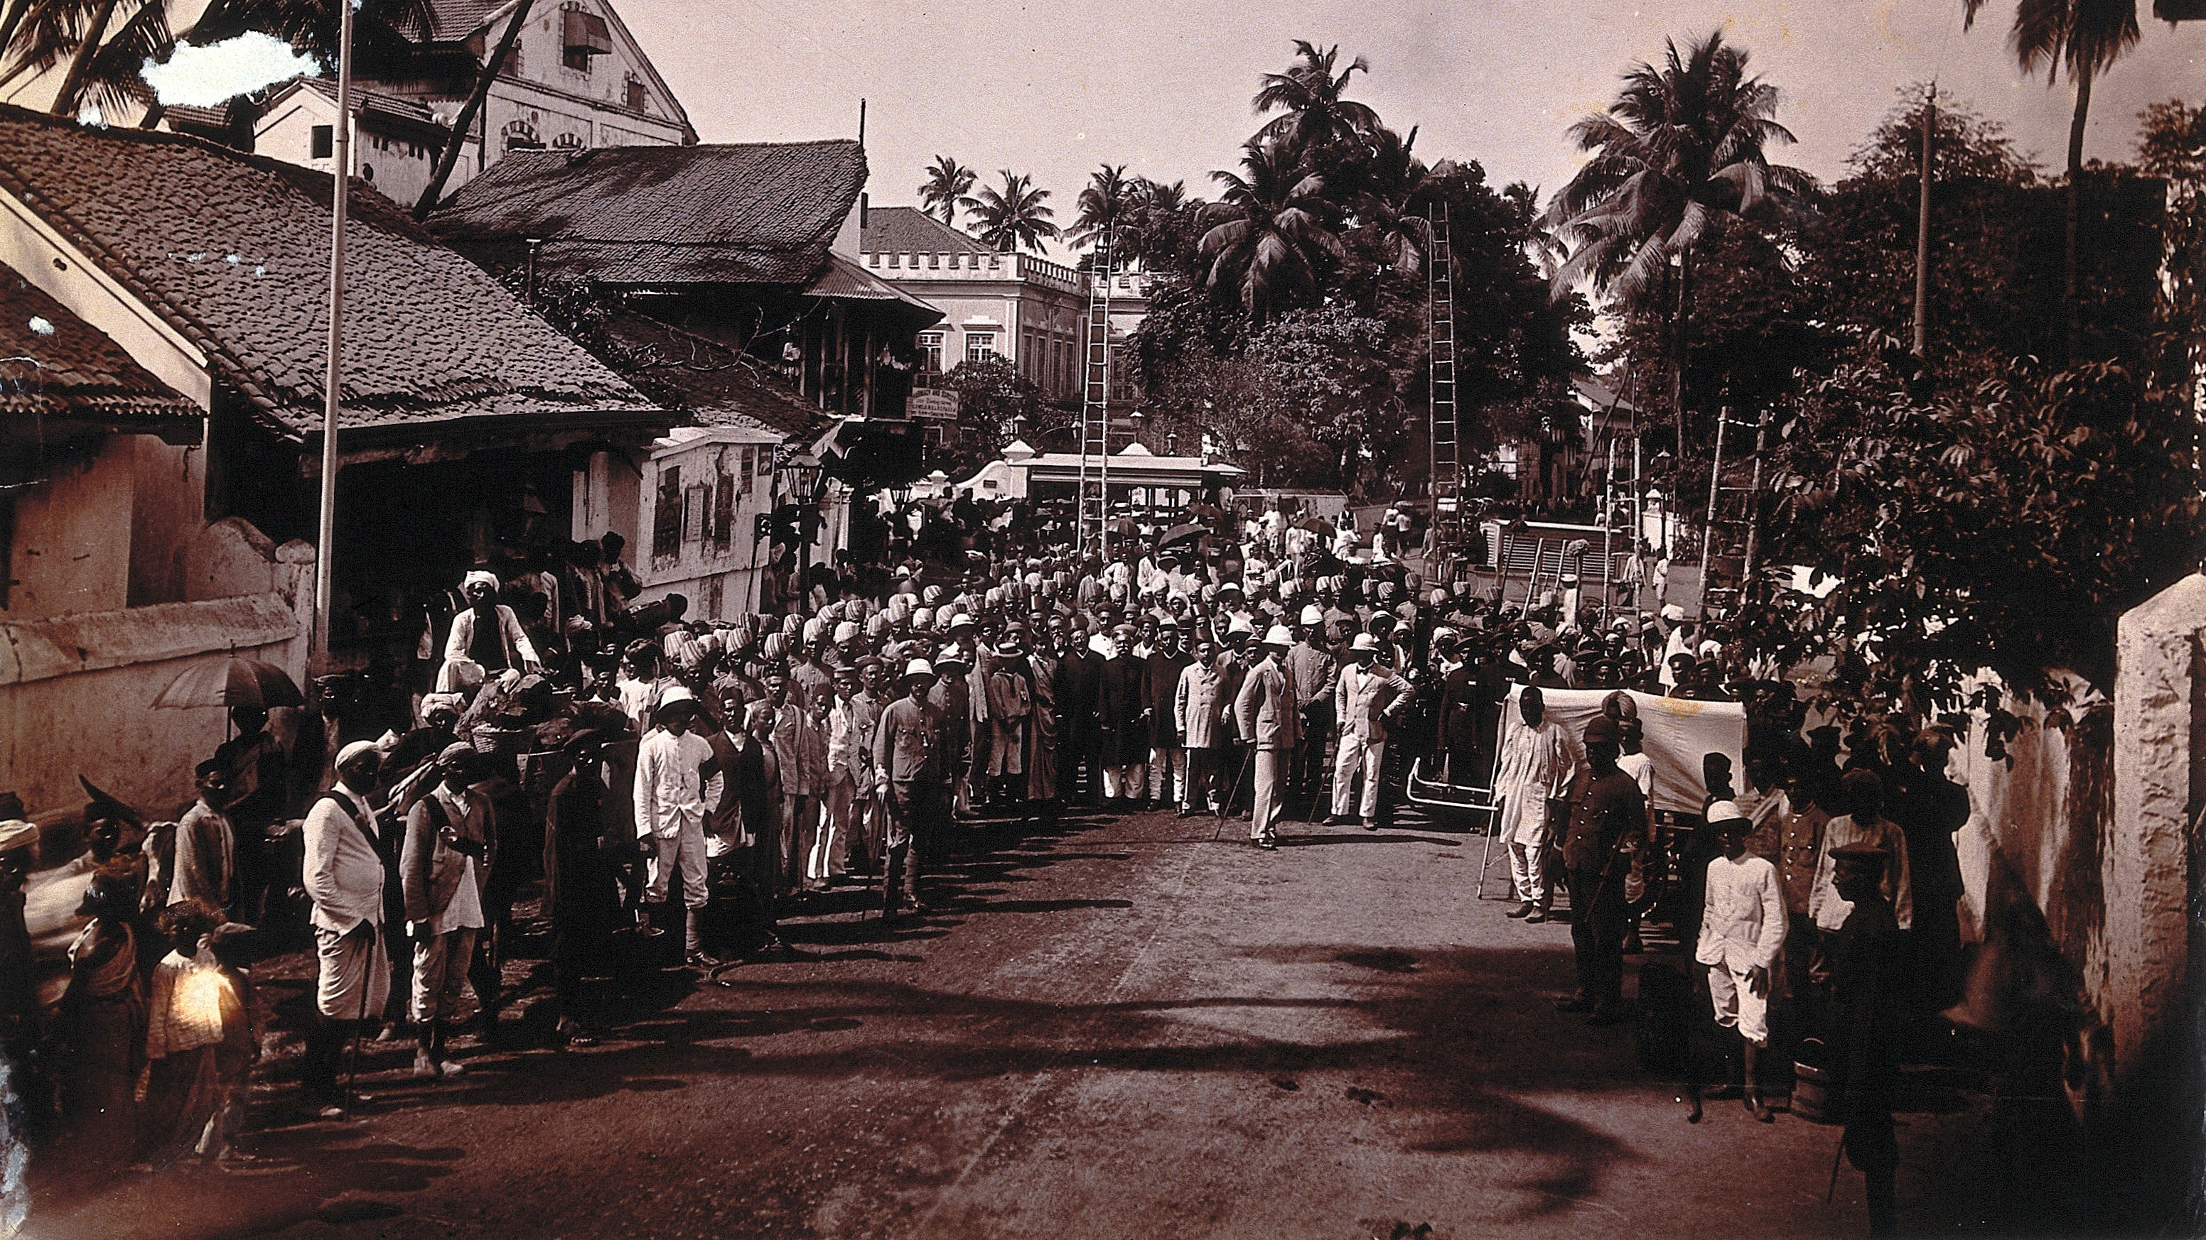
For this picture, doctors and health officials gathered on the street during the plague epidemics

Slide 7
The Measures
The measures were draconian. They were such as quarantine, the forcible isolation of cases and contacts in pesthouse, travel restrictions, exclusion of Indian traditional medical practices, and speedy burial.
A city is divided into districts. A newly appointed Vigilance Committee claimed “the right of entry the buildings by authorized officers, for cleansing, removing infected articles, removing people suspected of being infected to hospitals, and isolation of infected houses.

Slide 8
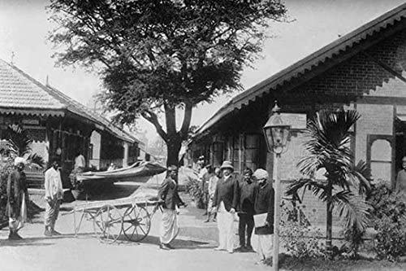
The Measures
With this authority, the committee sent out search parties of health officials accompanied by carters, sepoys (indigenous troops), British constables, and justice of the peace to hunt for cases.
Ignoring traditions of caste and religions, they subjected everyone to physical examination searching for buboes.

Slide 9
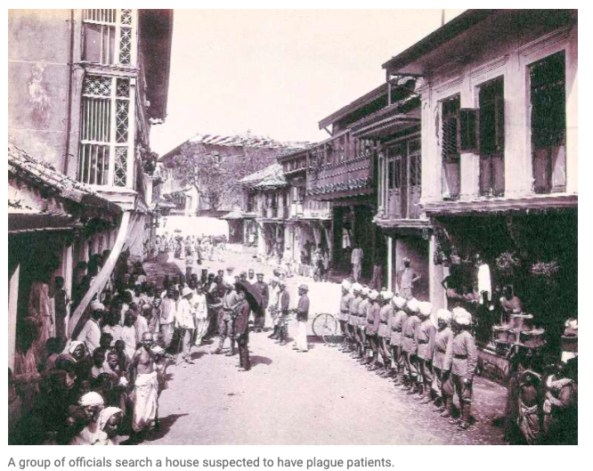

Slide 10
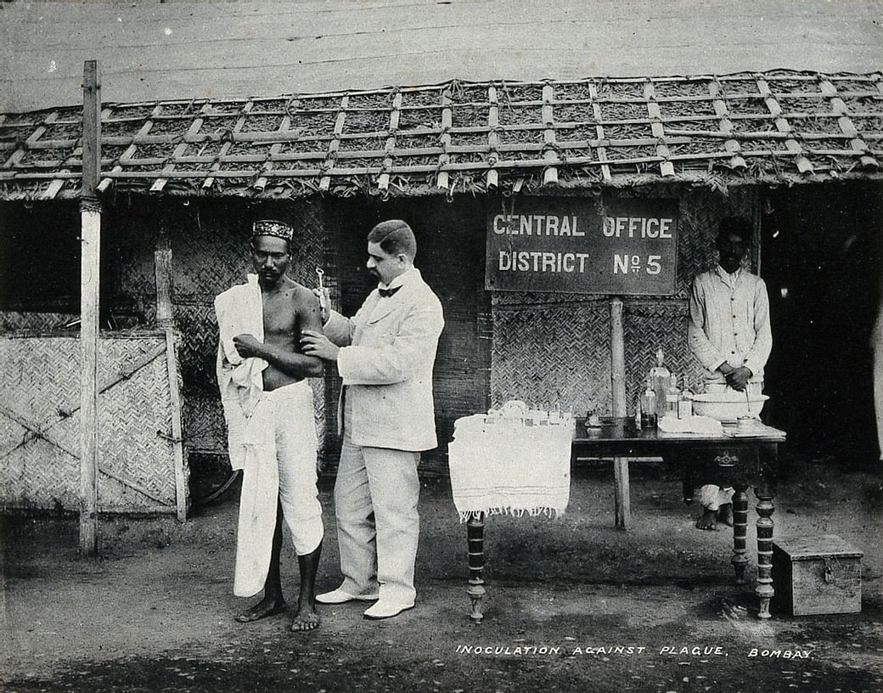
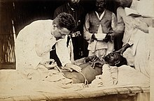
The Measures
After that, they conveyed the newly found patient to the plague hospital
Other who were close to the patients were took into custody and conducted them to “health camps” where the evacuees gathered in quarantine under canvas with no attention to Indian caste tradition.
The British divided the ills from their families, imposed Western medical practices, and violated social and religious conventions.

Slide 11
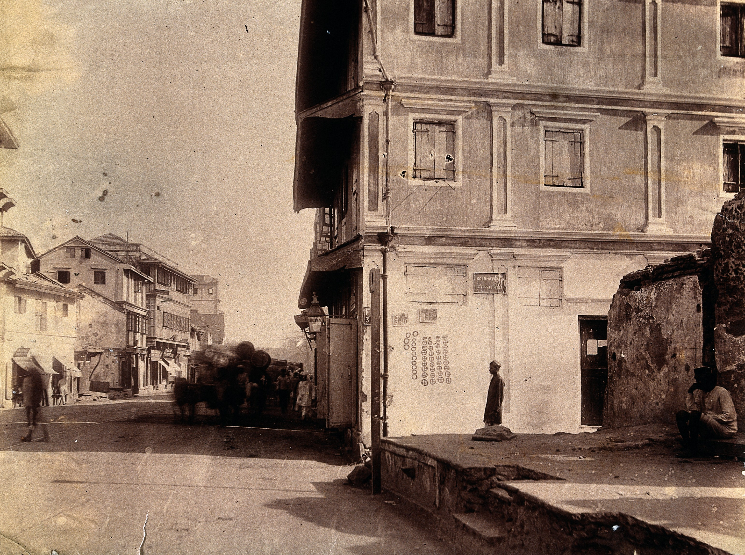
The Measures
Having located a case, the searchers marked the house.
Open circles represented deaths from plague; cross circles death from other causes.
Marked houses indicated to officials that sanitary action was needed

Slide 12
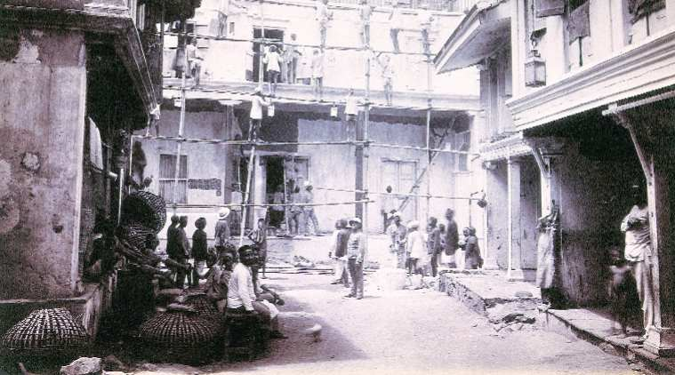
The Measures
This picture portrays workers cleaned a plague house in Bombay
But in some cases, the marked houses were burned.
Beddings, clothes, and furnishings were burned too.

Slide 13
People’s Responses to the Measures
At the beginning of the outbreak, people took flight to avoid harsh measures. By February 1897, around four hundred thousand people left the city.
These people brought the bacteria with them and spread the disease.
Relatives, friends, and neighbors attempted to protect the sick from trauma and possiby murder.
Later when the measures were even harsher, the fear turned to be the anger.
They were angrier when seeing the search team abused the power by plague regulations.

Slide 14
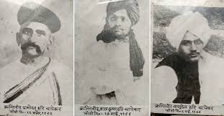
People’s Responses to the Measures
The search teams became a flashpoint for violence.
There was a general strike of transport workers and a series of strikes by weavers and spinners.
On June 22, Walter Charles Rand and three other officials were shot by the Chapekar brothers in retaliation for the draconian policies they had implemented.

Slide 15
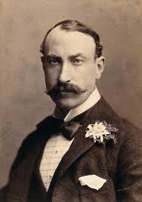
Responese to the Riots
Having difficulty dealing with both the disease and the riots, the British reconsider their measures.
The Indian Plague Commission released its report concluding that the draconian measures were ineffective.
In addition, the implementation of such measures were too costly and dangerous.
Lord Sandhurst – the governor of Bombay – turned the compulsion into a voluntary compliance.

Slide 16
Responese to the Riots
After Sandhurst’s announcement, all forms of coercive public health ceased
Small neighborhood hospitals began to appear for each indigeneous religious group.
These places open to friends and relatives of patients, provided traditional treatments, and respected norms of caste and gender.
The British set up a discretional relief fund that provided compensation for wages lost through quarantine, funeral expenses for those who needed them, and relief for their families.

Slide 17
What do we learn from this example?
No epidemic policy can be successful without compliance from people!!
An authoritarian government cannot apply their excessive power to control the situation.

Slide 18

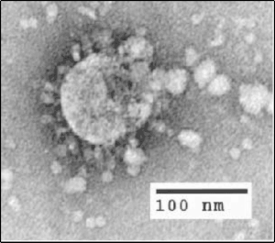
SARS (Severe Acute Respiratory Syndrome): Origin
It is caused by SARS coronavirus (SARS-CoV)
SARS-CoV is thought to be an animal virus from an as-yet-uncertain animal reservoir, perhaps bats, that spread to other animals (civet cats)
First infected humans were in the Guangdong province of southern China in late 2002.

Slide 19
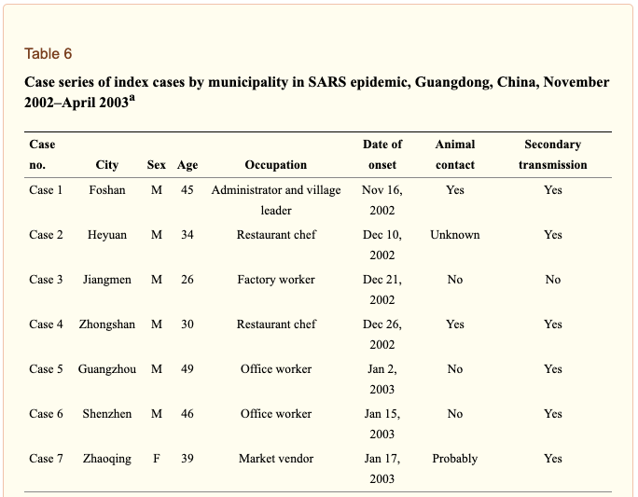
SARS (Severe Acute Respiratory Syndrome): Origin
Patient 1 had the earliest case
He had not traveled outside Foshan in the 2 weeks before his illness and had no contact history, but he had prepared food including chicken, domestic cat, and snake.
Observing other early cases, the paper found that SARS has an origin in wild animals.
https://www.ncbi.nlm.nih.gov/pmc/articles/PMC3323155/

Slide 20
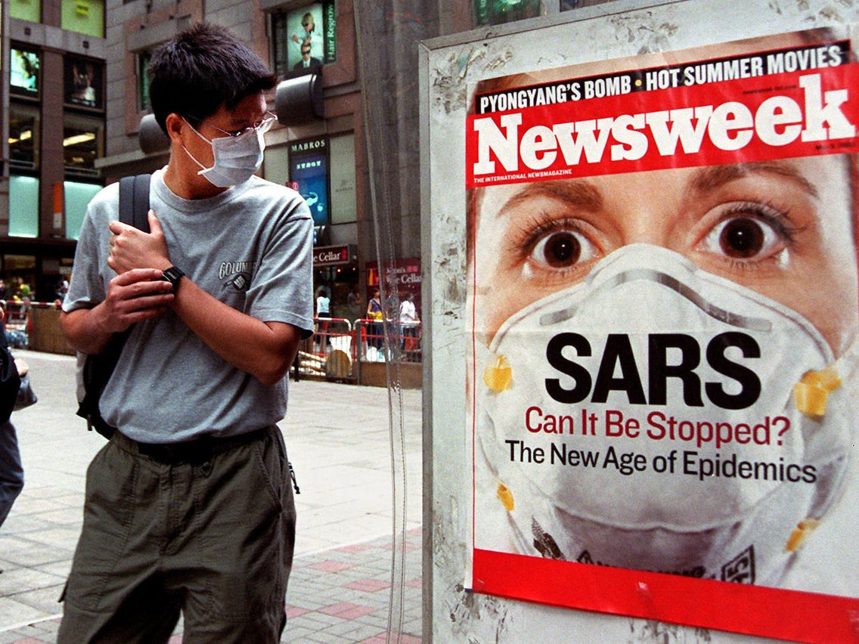
SARS (Severe Acute Respiratory Syndrome): Symptoms
Symptoms are influenza-like and include fever, muscle pain, cough, headache, diarrhea, and sore throat
No individual symptom or cluster of symptoms has proved to be specific for a diagnosis of SARS.
Severe cases often evolve rapidly, progressing to respiratory distress and requiring intensive care.
The case fertility rate (CFR) is about 10 percent

Slide 21
SARS (Severe Acute Respiratory Syndrome): transmission
The main way that SARS seems to spread is by close person-to-person contact.
It appears to have occurred mainly during the second week of illness, which corresponds to the peak of virus excretion in respiratory secretions and stool, and when cases with severe disease start to deteriorate clinically.
SARS-CoV is most readily by respiratory droplets (droplet spread) produced when an infected person coughs or sneezes.
Droplet spread can happen when droplets from the cough or sneeze of an infected person are propelled a short distance (generally up to 3 feet) through the air and deposited on the mucous membranes of the mouth, nose, or eyes of persons who are nearby.
The virus also can spread when a person touches a surface or object contaminated with infectious droplets and then touches his or her mouth, nose, or eye(s).
In addition, it is possible that the SARS virus might spread more broadly through the air (airborne spread) or by other ways that are not now known.
This is like Covid-19 which is caused by SARS-CoV 2

Slide 22
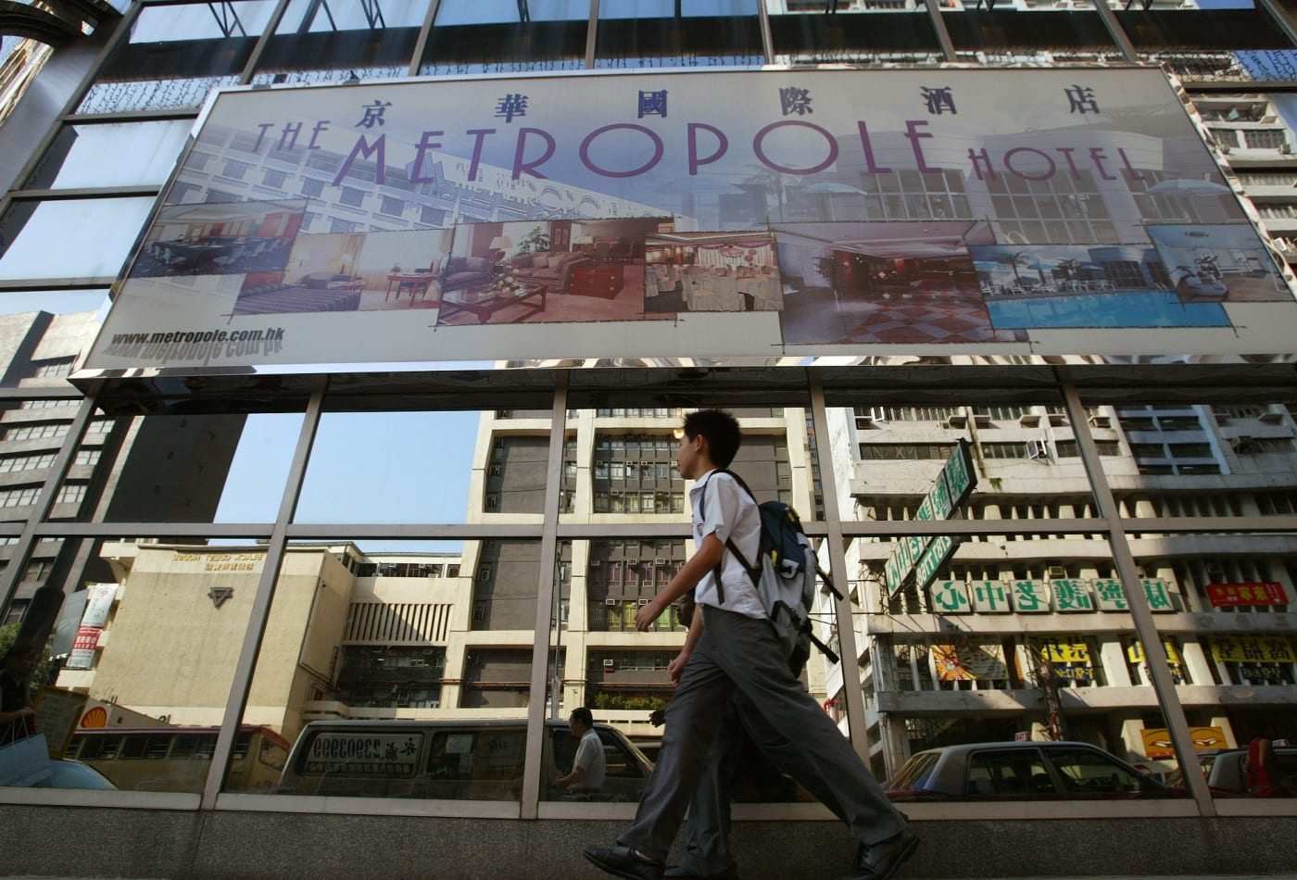
The 2003 Outbreak
SARS jumped from mainland China to Hong Kong in February 2003 when Liu Jianlun, a medical professor from Guangdong who unknowingly had SARS, checked into Room 911 at Hong Kong's Metropole Hotel
He died on early March
But during his short stay at the hotel, he unwittingly infected several other guests who brough the virus to Singapore, Toronto, and Hanoi

Slide 23

The 2003 Outbreak
SARS erupted in March 2003.
SARS also reached Thailand in March. The patient who carried SARS to Thailand was Dr. Carlo Urbani.
Who was Dr. Carlo Urbani?
  He was an Italian physician and microbiologist working at that time as a public-health specialist in the Hanoi office of WHO
  On February 28th, he was called by the hospital in Hanoi to observe an American business man who suffered from unusual influenza-like virus.
  He immediately notified WHO about the contagious disease. He is now widely credited as the first World Health Organization (WHO) officer to identify the disease.
  For the next several days, he chose to work at the hospital, documenting findings, arranging for samples to be sent for testing, and reinforcing infection control.
  On March 11th, he flew to Bangkok for a conference, and fell ill
  He died on March 29th in Bangkok
In total, there were 9 cases of SARS in Thailand, and 2 of them died

Slide 24
The 2003 Outbreak
It affected 8098 people, caused 774 deaths
Because of international cooperation to isolate and quarantine people with SARS, the World Health Organization and affected countries were able to contain SARS by July 2003.
The disease was completely eliminated by isolating and quarantining people until the virus passed out of their system and they could no longer transmit it to others.

Slide 25
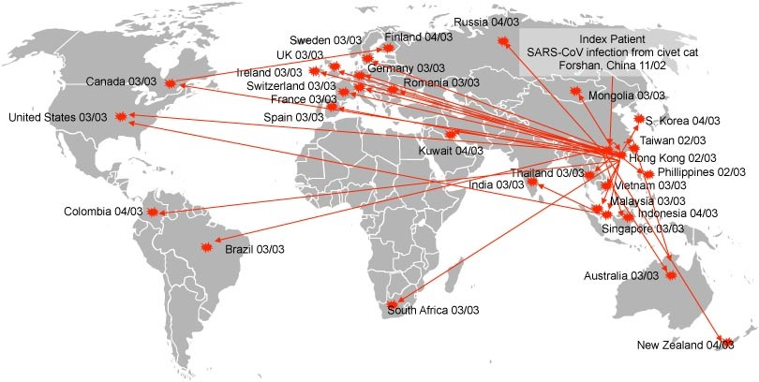
The 2003 Outbreak

Slide 26
How China mismanaged SARS
From this paper https://www.ncbi.nlm.nih.gov/books/NBK92479/
The Chinese health personnel was notified about the “strange” disease as early as mid-December.
On January 2, a team of health experts was sent to Heyuan and diagnosed the disease as an infection caused by a certain virus , and the physician who was in charge quickly reported a local anti-epidemic station which quickly reported to the provincial government and the Ministry of Health
A combined team of health experts from the Ministry and the province was dispatched for an investigation report on the unknown disease.
On January 27, the report was sent to the provincial health bureau and, presumably, to the Ministry of Health in Beijing. The report was marked “top secret.”

Slide 27
How China mismanaged SARS
Further government reaction to the emerging disease, however, was delayed by the problems of information flow within the Chinese hierarchy. For 3 days, there were no authorized provincial health officials available to open the document.
After the document was finally read, the provincial bureau distributed a bulletin to hospitals across the province. However, few health workers were alerted by the bulletin because most were on vacation for the Chinese New Year.
In the meantime, the public was kept uninformed about the disease.
Any physician or journalist who reported on the disease would risk being persecuted for leaking state secrets

Slide 28
How China mismanaged SARS
The initial failure to inform the public heightened anxieties, fear, and widespread speculation.
On February 8, reports about a “deadly flu” began to be sent via short messages on mobile phones in Guangzhou. In the evening, words like bird flu and anthrax started to appear on some local Internet site.
The panic spread quickly in Guangdong, and was felt even in other provinces.
On February 11, Guangdong health officials finally broke the silence by holding press conferences about the disease. The provincial health officials reported a total of 305 atypical pneumonia cases.
Yet in the meantime, the government played down the risk of the illness. Guangzhou city government on February 11 went so far as to announce the illness was “comprehensively” under effective control.
the public then lost awareness about the disease.

Slide 29
How China mismanaged SARS
When some reports began to question the government’s handling of the outbreak, the provincial propaganda bureau again halted reporting on the disease on February 23.
This news blackout continued during the run-up to the National People’s Congress in March, and government authorities shared little information with the World Health Organization until early April.
On March 15, the WHO issued its first global warning about SARS.
On March 25, 3 days after the arrival of a team of WHO experts, the government for the first time acknowledged the spread of SARS outside of Guangdong.

Slide 30
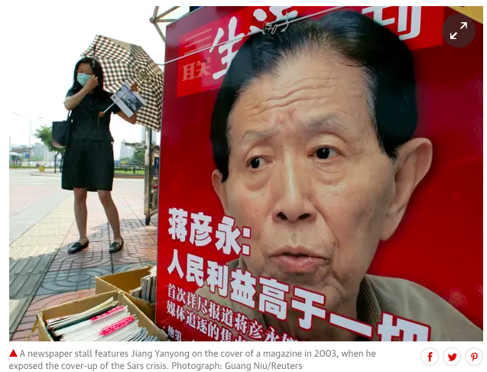
How China mismanaged SARS
On that same day, March 25, The State Council held its first meeting to discuss the SARS problem 2 days after the Wall Street Journal published an editorial calling for other countries to suspend all travel links with China until it implemented a transparent public health campaign.
Enraged by the minister’s false account, Dr. Jiang Yanyong, a retired surgeon at Beijing’s 301 military hospital, sent an e-mail to two TV stations, accusing the minister of lying.
While neither station followed up on the e-mail, Time magazine picked up the story and posted it on its website on April 9, which triggered a political earthquake in Beijing.

Slide 31
How China mismanaged SARS
This concealment was done because the government worried about economic stability.
It also worried that too much information would expose the reality of poverty, inadequate healthcare system, and a lack of preparedness for public health emergencies.
The reason that the information did not go from the provincial level to the central government as fast as it should be may be due to the law.
The Law on Prevention and Treatment of Infectious Diseases (enacted in September 1989) contains a number of significant loopholes.
  First, provincial governments are obliged to publicize epidemics in a timely and accurate manner only after being authorized by the Ministry of Health
  Second, atypical pneumonia was not listed in the law as an infectious disease under surveillance, and thus local government officials legally were not accountable for reporting the disease. While the law allows for the addition of new items to the list, it does not specify the procedures through which new diseases can be added.

Slide 32

Things became better
the Chinese Center for Disease Control and Prevention did not issue a nationwide bulletin to hospitals on how to prevent the ailment from spreading until April 3.
Premier Wen Jiabao on April 13 said that although progress had been made, “the overall situation remains grave”
On April 2, the State Council held a meeting to discuss the SARS problem. This was followed by an urgent meeting of the Standing Committee of the CCP Politburo on April 17.
On April 17, an anti-SARS joint team was created for the city of Beijing, which included leading members from the Ministry of Health and the military
After the April 17 meeting, government media began to publicize the number of SARS cases in each province, updating on a daily basis. An order from the Ministry of Health formally listed SARS as a disease to be monitored under the Law of Prevention and Treatment of Infectious Diseases.

Slide 33
Things became better
On April 20, Health Minister Zhang Wenkang and Beijing mayor Meng Xuenong were ousted for their mismanagement of the crisis.
The State Council sent out inspection teams to 26 provinces to scour government records for unreported cases and to fire officials for lax prevention efforts.
According to the official media, by May 8 China had fired or penalized more than 120 officials for their “slack” response to the SARS epidemic. It was estimated that by the end of May, nearly 1,000 government officials had been disciplined for the same reason.
Driven by political zeal, local government officials sealed off villages, apartment complexes, and university campuses, quarantined tens of thousands of people, and set up checkpoints to take temperatures.

Slide 34
Things became better
By May 7, 18,000 people had been quarantined in Beijing.
In Guangdong, 80 million people were mobilized to clean houses and streets.
In the countryside, virtually every village was on SARS alert, with roadside booths installed to examine all those who entered or left.
On May 12, China issued a set of Regulations on Public Health Emergencies.
According to these regulations, the State Council shall set up an emergency headquarters to deal with any public health emergencies, which are referred to as serious epidemics, widespread unidentified diseases, mass food and industrial poisoning, and other serious public health threats

Slide 35
Things became better
Direct involvement of the political leadership also increased program resources and mobilized resources from other systems.
On April 23, a national fund of 2 billion yuan ($US 250 million) was created for SARS prevention and control.
This central government funding was complemented by an additional 7 billion yuan ($US 875 million) from local governments.
These momentous measures appeared to have worked.
On August 16, with the last two SARS patients discharged from the Beijing Ditan Hospital, China for the time being was free from SARS.

Slide 36
What do we learn here about the Chinese Authoritarianism?
Authoritarian regime forced the government personnels to be responsible not to the public but to the higher authorities. Hence, the government will always be more sensitive to pressure that comes top down, rather than bottom up.
It hence made sense for provincial government to follow the order of the central government, even though the crisis already occurred in their area.
If indeed an outbreak is imminent, a local government official concerned about his post may well choose to lie.

Slide 37
What do we learn here about the Chinese Authoritarianism?
While the situation in China was relieved after the top leaders had ordered the government to take it serious, they had been pressured by media and people.
Starting February 11, Western news media were aggressively reporting about SARS and about government cover-ups of the number of cases in China. It is very likely that Hu Jintao and Wen Jiabao, both Internet users, made use of international information in making decisions concerning the epidemic.
In other words, external pressures can be very influential

Slide 38
So Snowden says
So dealing with a pandemic doesn’t necessarily entail authoritarianism, correct?
Right. There are many people who raised the issue of whether dealing with pandemic disease necessitates authoritarianism and that democracies are no good in dealing with pandemics. I would say that democracies are better able to enlist popular support and institute rational public health policies because they allow free information to flow, and modern public health actually depends on free information.

