Slide 1

D
BI 201/ BA 291
Management Process
by Parichat Jantori

Slide 2
Task:
Forming up a group
Imagine you and your group members want to organize a concert, a stage play, or starting a small size business.
Please list all the things/ actions that you have to do.

Slide 3
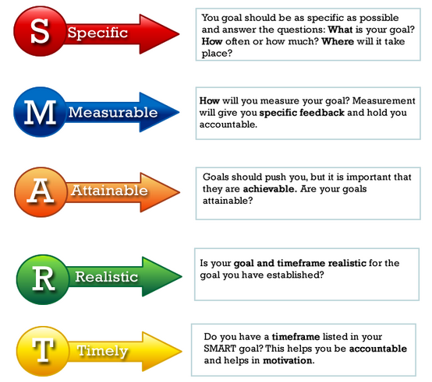
Step 1: Setting the Goal
Goals are the targets or ends the manager wants to reach.

Slide 4
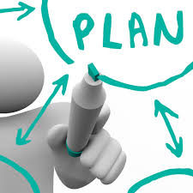
Step 2: Outlines the Plan
Plans are the actions or means the manager intend to use to achieve goals

Slide 5

How would you know that your plan is succeeding?
Managers need to develop control system that measure that performance.

Slide 6
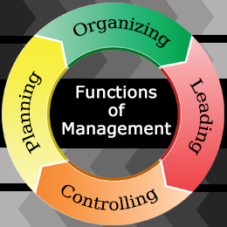
Key Takeaway

Slide 7
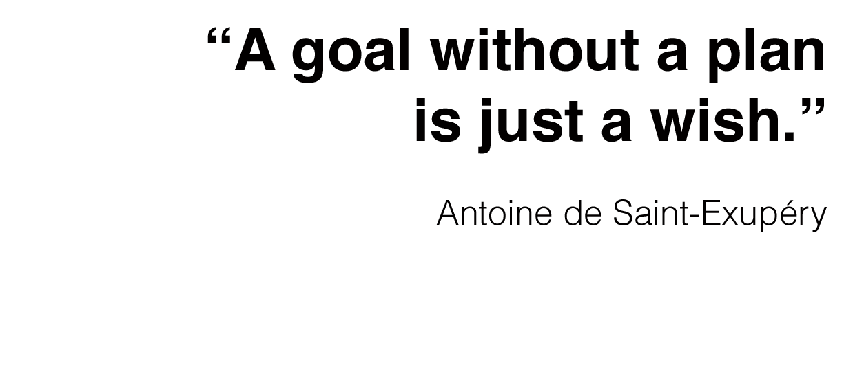
Planning
Planning defines what to do and how to do it (Goal + Course of actions)

Slide 8
Planning
Benefits of Planning
1. Planning provides direction.
2. Planning can help quantify goals and establish a means of measuring success.
3. Planning can help insure that a coherent set of actions are implemented that are consistent with the values and priorities of the decision maker.
4. Planning helps allocate limited resources like staff, materials, and time in an orderly and systematic manner.
5. Planning helps in reducing uncertainties of future as it involves anticipation of future events

Slide 9
Organizing
Once managers have selected the goals and plans,
the next step to pursue is organizing
Organizing describes how resources will be distributed and how employees will be organized according to the plan.
Organizing involves
Identification of activities/ roles
Classification of grouping of activities (Horizontal Org)
Assignment and Delegation of authority and creation of responsibility (Vertical Org)
Coordinating authority and responsibility relationships
Organization Structure

Slide 10
Designing Organizational Structure
Choosing the right organization structure is one of the most
important decisions in the company
There is no “one right way” to design organizational structure
There are no universal organization principles which are good for all cases
Organizational structure is dynamic, not static, because of the constant change in the organizational environment. Therefore, companies may change its structure when it’s necessary.

Slide 11
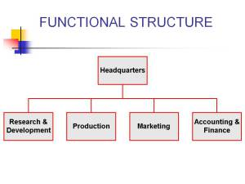
Organizational Structure

Slide 12
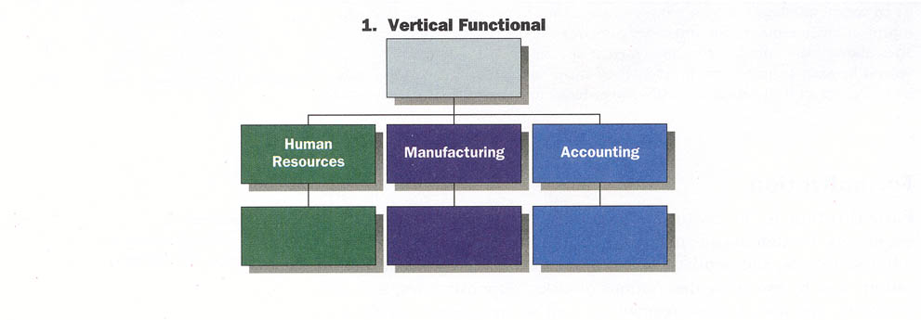
Functional Structure
Grouping of positions into departments based on similar skills, expertise, work activities, and resource use
Strengths: Cost-saving advantages from specialization, minimal duplication of people and equipment
Weakness: Functional specialist become insulted and have little understanding of what other units are doing, slow response to external changes
Notes:
It is applied in:
❖ small and middle companies
❖ if company produces one or several similar
products by using same technology for the
same market (oil, sugar, cement, beer)

Slide 13
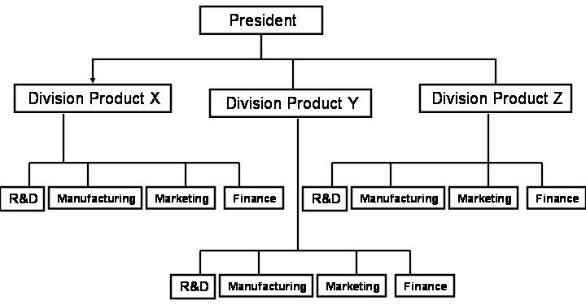
Organizational Structure

Slide 14
Division Structure
Strengths
- Allows for focus on specific customers/ markets/ products
- Good structure for growth along geographical/ product lines
- Easy pinpointing responsibility (division managers are responsible for what happens to their products and service)
- Fast response and flexible to local needs
Weakness
Duplication of activities and resources increases cost and reduces efficiency
Coordinating and integration are difficult
May be difficult to manage diverse product lines

Slide 15
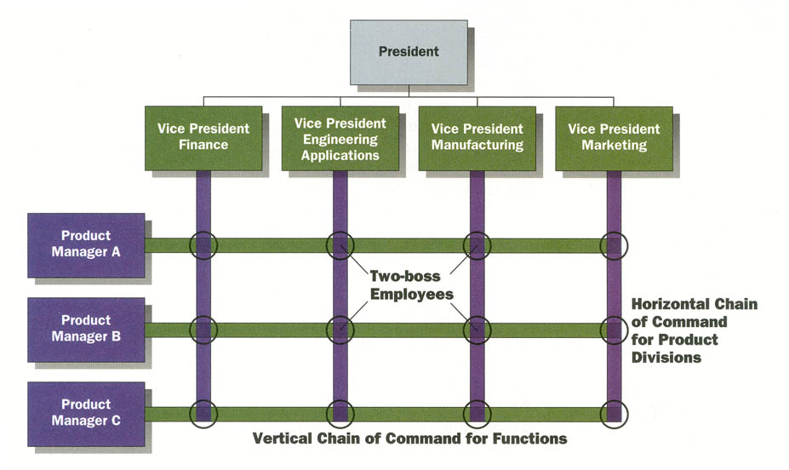
Matrix Structure
A structure in which the tasks of the organization are grouped along two organizational dimensions simultaneously (vertical and horizontal).
Matrix structure has dual lines of authority (2 supervisors)

Slide 16
Matrix structure
Strengths
Fluid and flexible design that can respond to environmental changes
Faster decision making
Interdisciplinary cooperation
Development of both generalist and specialist
Do not have to create new department to perform specific task
Weakness
Lack of control
“two bosses” may lead to conflict
Communication difficulties

Slide 17
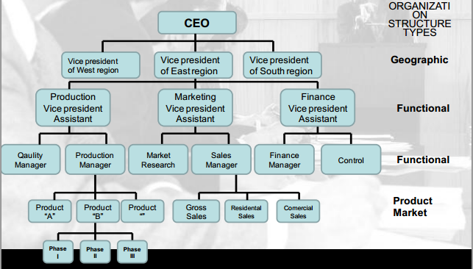
Mixed organization structure
It is also called conglomerate organization
Type of organization structure where at every organization level dominates some other type of organization structure
In practice that is most common situation

Slide 18
Leading
Effective managers know how to lead others toward organizational success
Leadership is a process of social influence, which maximizes the efforts of others, towards the achievement of the goal. If managers are effective leaders, their subordinates will be enthusiastic about exerting effort to attain organizational objectives.
Leading involves communicating, motivating, inspiring, and encouraging employees.

Slide 19
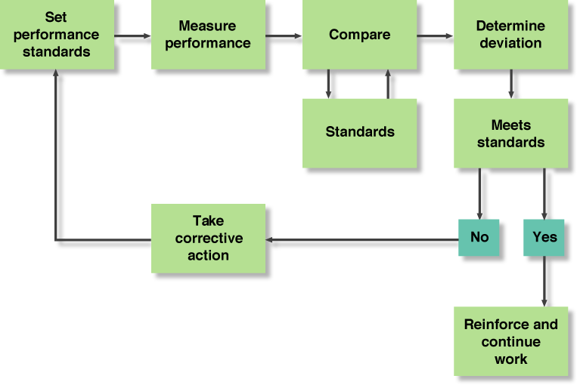
Controlling
Controlling is measurement of accomplishment against the standards and correction of deviation if any to ensure achievement of organizational goals.

Slide 20
Controlling
Why measurement?
To evaluate the result
To signal the problem and risk
To see the trends, predict the future
To benchmark and develop
To motivate and reward, enable work delegation

Slide 21
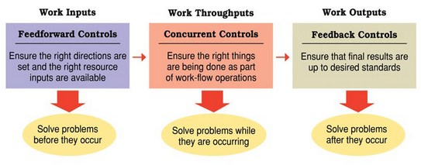
Controlling
Measurement
Quantity (Direct Measurement) or Quality (Indirect Measurement)
Input (Quantity of raw material used in production process, Quality of raw material, Punctuality of raw material delivery); Process (Resource used in process, Defect Rate, Waste); Output (Quantity of produced good, Quality, Productivity)

Slide 22
Controlling
You get what you measure
Standard/ KPI must align with goal
Do not scare people with KPI but motivate them with KPI
KPI should not limit the performance
Define clear accountability – who response for this KPI
KPI should solve existing problem, not creating new one
Not only measure, but providing feedback and take corrective action
Make it continuous, make it sustained

