Slide 1
Topic 1 Part 1
Consumer Preferences
and the Concept of Utility
(Chapter 3)

Slide 2
Motivation
  To study of how consumers with limited resources choose goods and services
  To derive the demand curve
  Businesses care about demand curves
  Government can use this to determine how to help and whom to help its people

Slide 3
Consumer Preferences
Consumer Preferences tell us how the consumer would rank (that is, compare the desirability of) any two combinations or baskets of goods, assuming these baskets were available to the consumer at no cost.
** The actual choice will depend on other factors, such as income and prices of goods. **

Slide 4
Consumer Preferences
Assumptions
Completeness
Preferences are complete if the consumer can rank any two baskets of goods, according to one of the following possibilities:
A preferred to B
B preferred to A
indifferent between A and B

Slide 5
Consumer Preferences
Assumptions
Transitivity
Preferences are transitive if a consumer who prefers basket A to basket B, and basket B to basket C also prefers basket A to basket C.
That is, if A > B and B > C, transitivity requires A > C.

Slide 6
Consumer Preferences
Assumptions
Monotonicity
Preferences are monotonic if a basket with more of at least one good and no less of any good is preferred to the original basket.
That is, more is better.

Slide 7
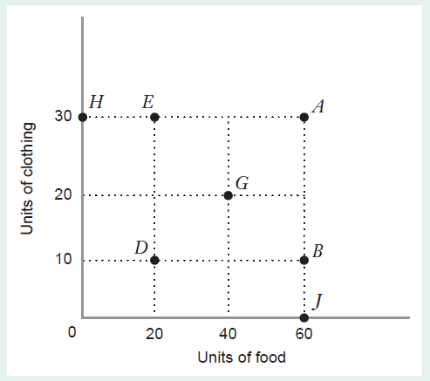
Completeness e.g. D > G, A = E, etc.
Transitivity e.g. if E > H and H > D, then E > D
Monotonicity e.g. E > H, A > B, etc.
Ex: Give 2 sets of any 3 baskets where the 3 assumptions hold.

Slide 8
Types of Ranking
Ordinal Ranking gives info about the Order in which a consumer ranks baskets.
Cardinal Ranking gives info about the Order and Intensity of a consumer’s preference.
Example: Students are ranked according to their exam marks.
An ordinal ranking lists the students in order of their marks (i.e., Harry did best, Joe did second best, and so on).
A cardinal ranking gives the mark of the exam, (i.e., Harry got 80, Joe got 75, and so on).

Slide 9
The Utility Function
The three assumptions about preferences allow us to represent preferences with a utility function.
Utility function, U(x)
– a function that measures the level of satisfaction a consumer receives from any basket of goods and services.
– It assigns a number to each basket so that more preferred baskets get a higher number than less preferred baskets.
– e.g. if A is preferred to B, then U(A) > U(B).

Slide 10
The Utility Function
Let U(y) = represent utility from consuming y units of food.
Note that this utility function represents the preference that satisfies the three assumptions.
Complete: U(y) assigns a specific utility value to each level of y.
Transitive: e.g. U(5) > U(4) > U(3).
Monotonic: more y gives more utility.

Slide 11
Marginal Utility
Marginal Utility of a good y is
  additional utility that the consumer gets from consuming one more unit of y
  the rate at which total utility changes as the level of consumption of good y rises
  MU_{y} = ΔU/Δy
  the slope of the utility function with respect to y

Slide 12
Diminishing Marginal Utility
The principle of diminishing marginal utility states that the marginal utility falls as the consumer consumes more of a good.
It reflects a human trait. The more we consume, the fuller we get, and the less satisfaction we gain from additional consumption.
Notes:
See Figure 3.2

Slide 13
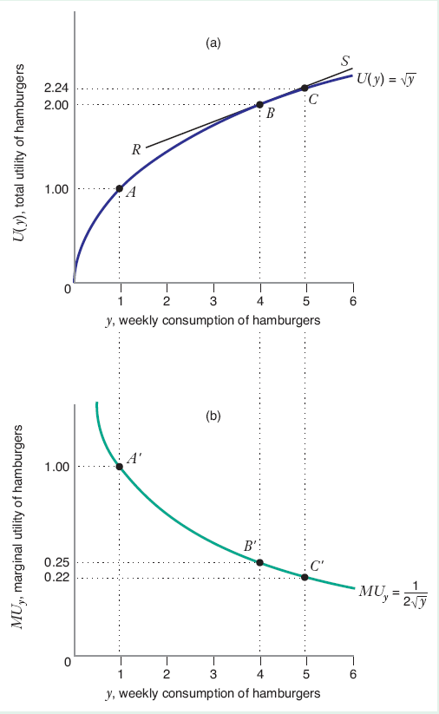
Diminishing Marginal Utility

Slide 14
Diminishing Marginal Utility
Is more always better?
Monotonicity (more is better) implies that MU must always be positive. That is, the utility graph is always upward-sloping, e.g. higher y → higher U(y).
In reality, Monotonicity is not always true, and MU can be negative. e.g. consuming too much food can cause stomachache and hence reduce utility!

Slide 15
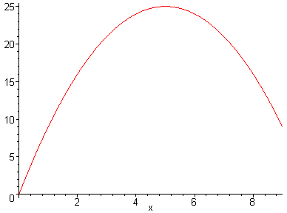
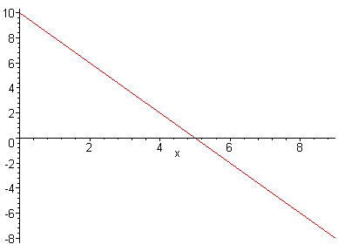
Marginal Utility
U(H) = 10H – H²
MU_{H} = 10 – 2H

Slide 16
Marginal Utility
More may not always be better.
BUT it is reasonable to assume that the consumer will not buy too much.
It makes no sense for anyone to pay money to reduce his/her happiness.
Here, the consumer would not buy more than 5 units, and we only need to draw the graph up to such point.

Slide 17
Marginal Utility
Example of U(H) and MU_{H}
U(H) = 10H – H²
MU_{H} = 10 – 2H
H | H² | U(H) | MU_{H}
2 | 4 | 16 | 6
4 | 16 | 24 | 2
6 | 36 | 24 | -2
8 | 64 | 16 | -6
10 | 100 | 0 | -10
MU = 0 at H = 5.
U(H) is maximized
at H = 5. U(5) = 25.

Slide 18
The Utility Function
We will assume that our utility function U(x) has two properties to reflect the two human traits.
More is better U’(x) > 0
Diminishing MU U’’(x) < 0
That is, the utility is a concave function.
These properties also hold in the case of multiples goods.

Slide 19
Marginal Utility – multiple goods
In reality, people consume more than one good.
  e.g. U(x, y) = x + y
The marginal utility of a good, x, is the additional utility that the consumer gets from consuming a little more of x when the consumption of all the other goods in the consumer’s basket remain constant.
  ΔU/Δx (y held constant) = MU_{x}
  ΔU/Δy (x held constant) = MU_{y}

Slide 20

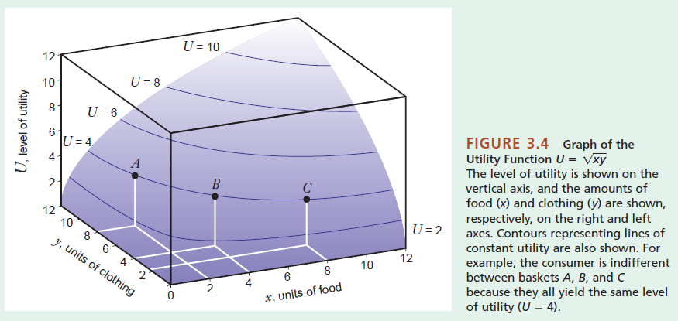
Marginal Utility – multiple goods

Slide 21
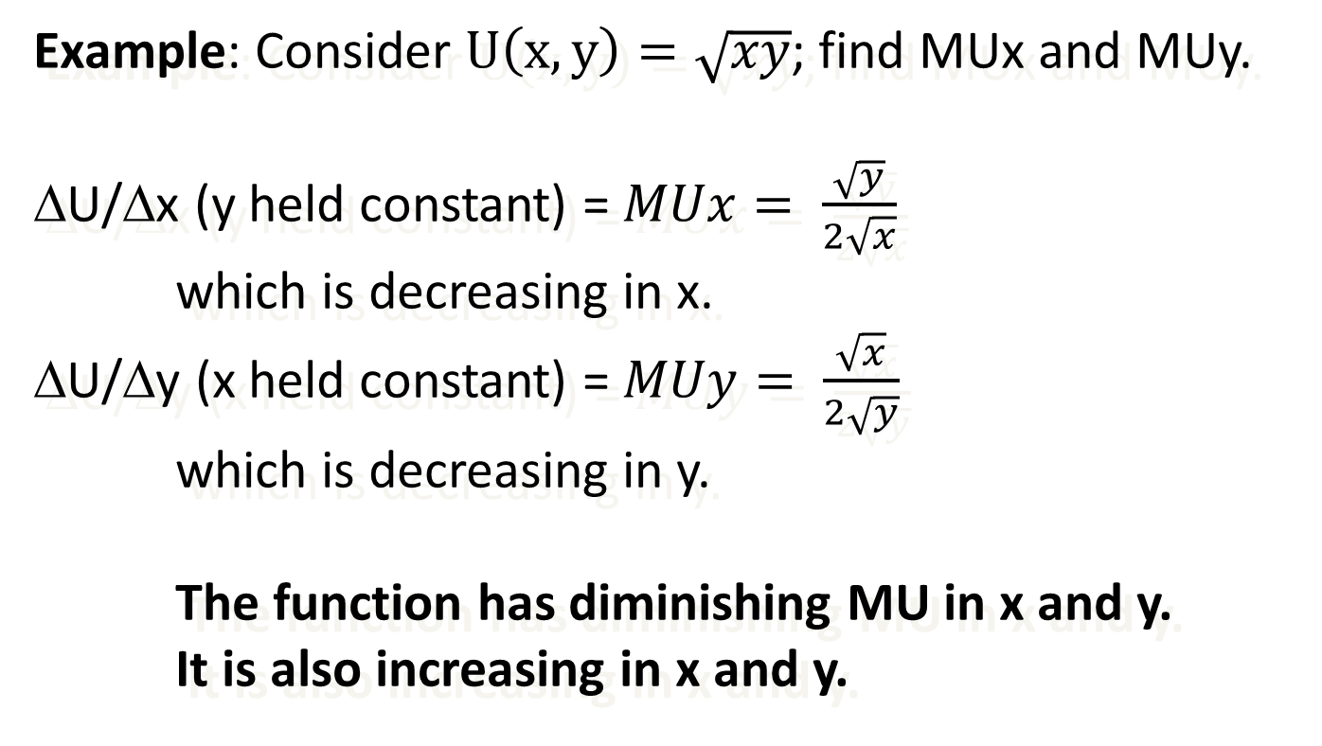
Marginal Utility – multiple goods

Slide 22
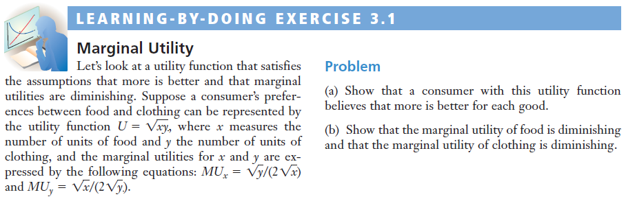
Marginal Utility – multiple goods

Slide 23
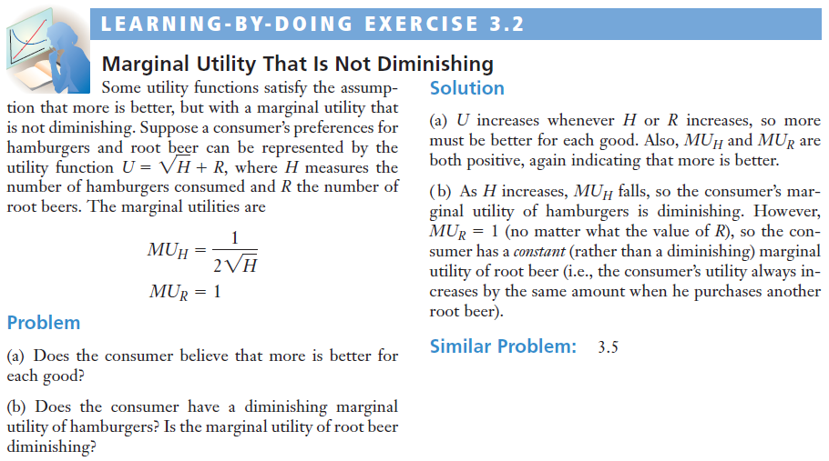
Marginal Utility – multiple goods

Slide 24
Indifference Curves
When making choices, people face trade-offs.
To illustrate the trade-offs involved in consumer choice, we introduce an indifference curve.
An Indifference Curve or Indifference Set: is the set of all baskets for which the consumer is indifferent
An Indifference Map : Illustrates a set of indifference curves for a consumer

Slide 25
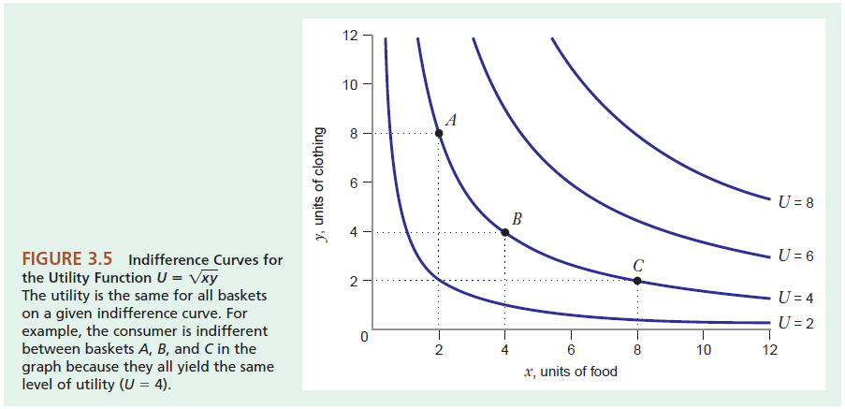
Indifference Curves

Slide 26
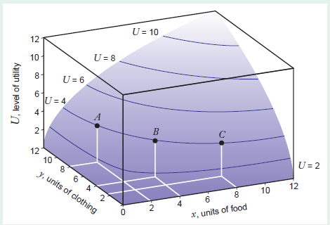
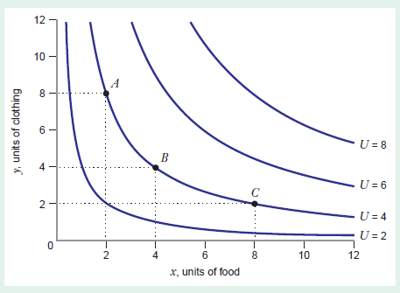

Slide 27
Indifference Curves
Key Properties
1) Monotonicity => indifference curves have negative slope – and indifference curves are not “thick”
2) Transitivity => indifference curves do not cross
3) Completeness => each basket lies on only one indifference curve

Slide 28
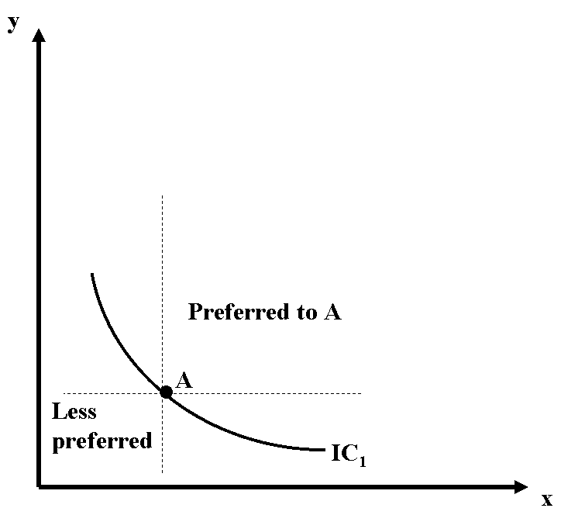
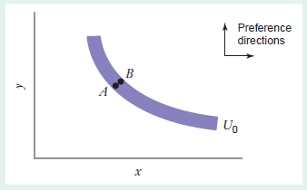
Indifference Curves
Monotonicity

Slide 29
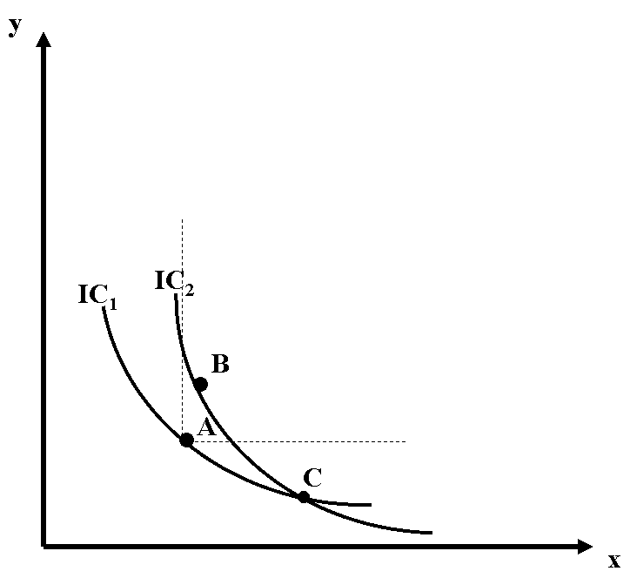
Indifference Curves
Transitivity and Completeness
Suppose that B preferred to A.
but…by definition of IC,
B indifferent to C
A indifferent to C
=> B indifferent to A by transitivity.
And thus a contradiction.

Slide 30
Indifference Curves
Example
U = xy²
Check that underlying preferences are complete, transitive, and monotonic.
x | y | xy^2
8 | 4.24 | 143.8
4 | 6 | 144
3 | 6.93 | 144.07
1 | 12 | 144
Notes:
We show later that the diminishing MRS implies averages are preferred to extremes for indifference curves.

Slide 31
Indifference Curves
Example: Utility and the single indifference curve.

