Slide 1
Poverty and inequality
EE463 Globalization and international development
Faculty of economics
Thammasat university

Slide 2
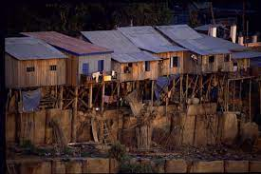
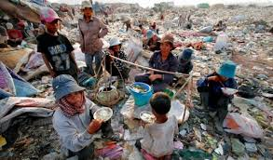
overview
Poverty is widespread. About 1.4 billion out of the world’s population of 7 billion (roughly 20%) live below the poverty line which is $1.25/day/person
Absolute poverty exists because of low level of productivity; another argument is that the poor lack opportunities to participate in the economy
Raising people out of poverty requires economic growth. Without economic growth people will remain poor
However economic growth alone is not sufficient; equitable distribution of income is also important

Slide 3
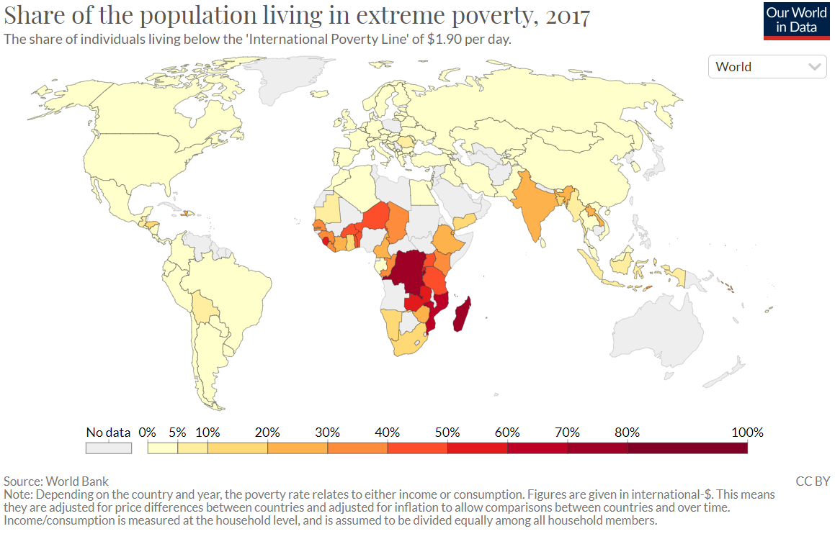

Slide 4
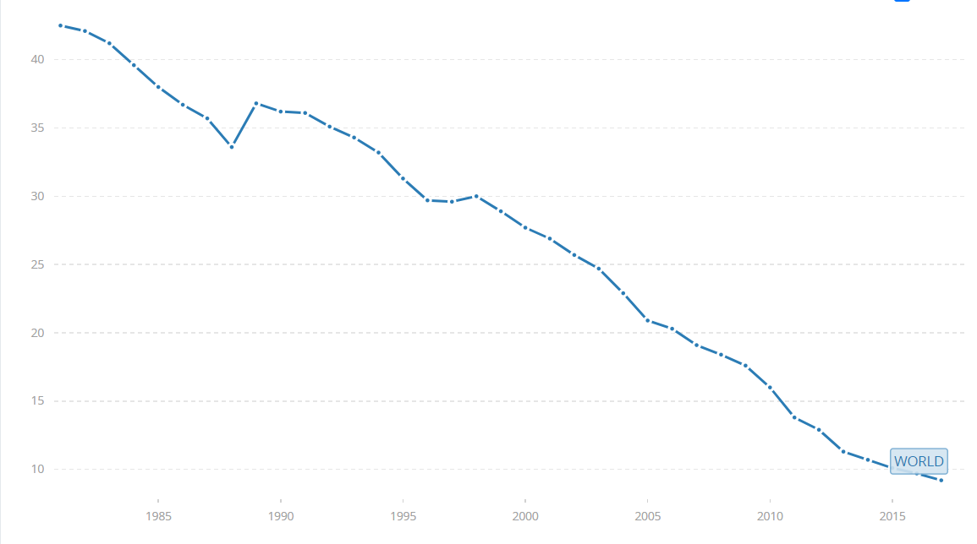
Is poverty rising or in decline?
Worldwide poverty is declining
Percentage of people living below poverty line, 1980-2015, world figures

Slide 5
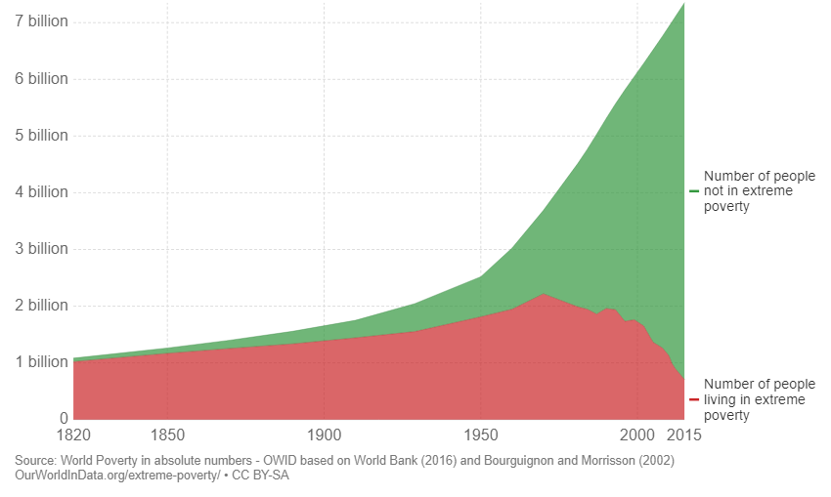
Is poverty rising or in decline?
However the absolute number remains high
World population living in extreme poverty, 1820-2015

Slide 6
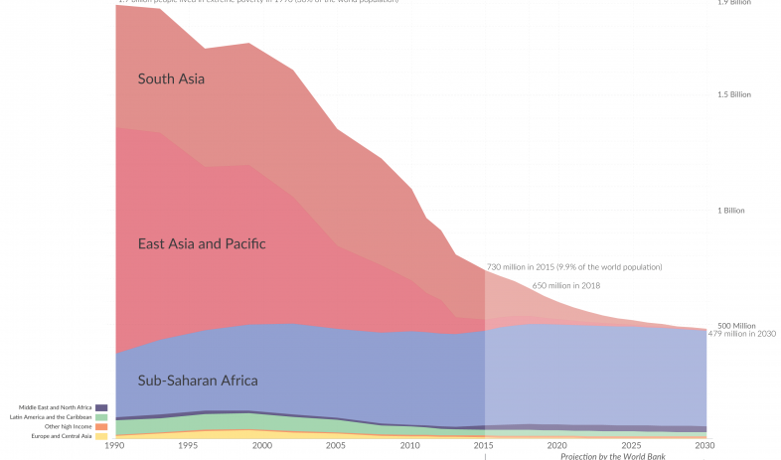
People living in poverty by region
Where the poor live
Sub Saharan Africa and South Asia have by far the most number of poor people

Slide 7
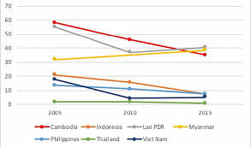
Is poverty rising or in decline?
Poverty reduction trends, 2005-2015 for countries in Southeast Asia

Slide 8
Measuring poverty
Poverty and inequality are related but are not the same
For example, the bottom quintile (20%) in an advanced country may be much better off than the bottom quintile in a less developed country
Poverty line: a specific monetary value based on the amount of some minimal consumption basket of food and basic necessities (e.g., 2,000 calories/day; $1.25 per day)
Vulnerability to adverse shocks: although people are above the poverty line, external conditions (economic/financial crisis, natural disaster) may cause them to fall below the poverty line. This group is therefore vulnerable and require government intervention

Slide 9
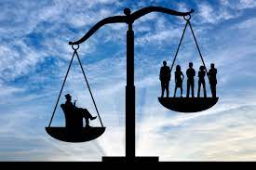
Measuring inequality
Inequality can be visualized and/or measured using:
frequency distribution of income
the Lorentz curve and
the Gini coefficient

Slide 10
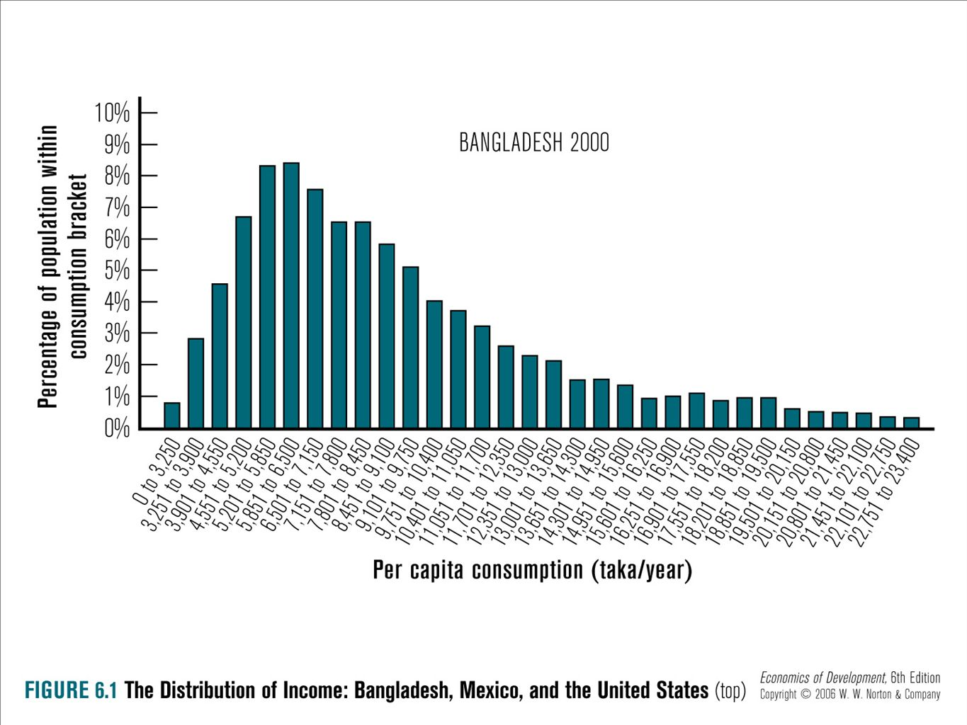
Frequency distributions Of income
The shape of the frequency distribution tells us how income is distributed in society
Bangladesh

Slide 11
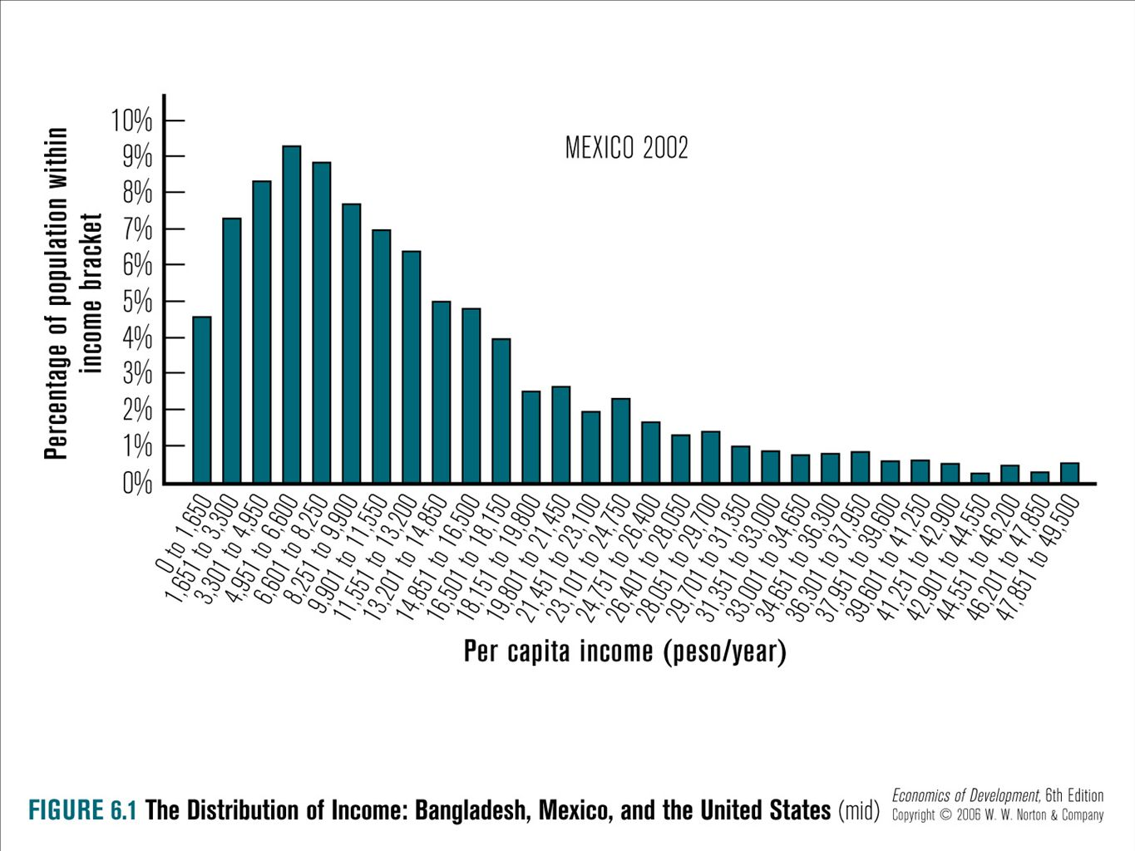
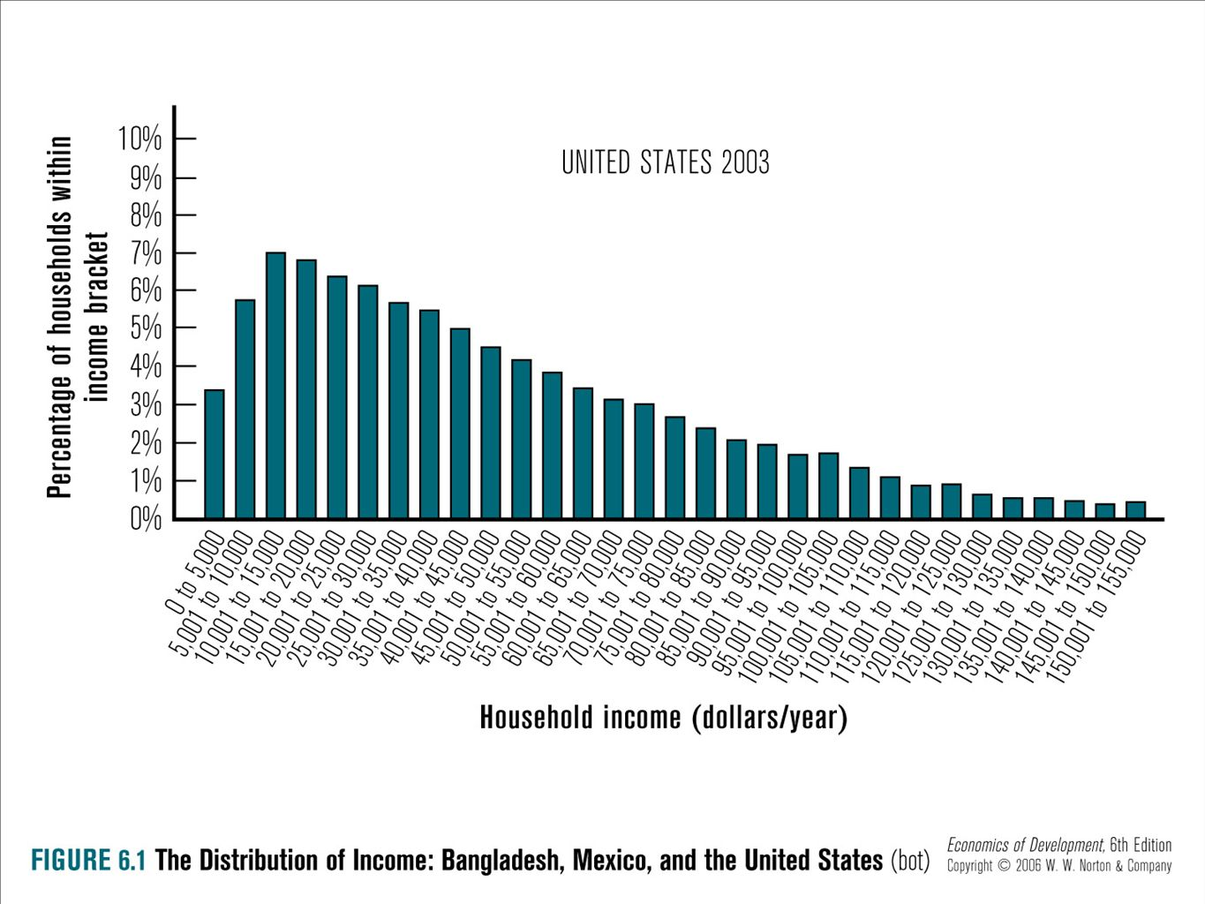
Frequency distributions Of income
Mexico
United States

Slide 12
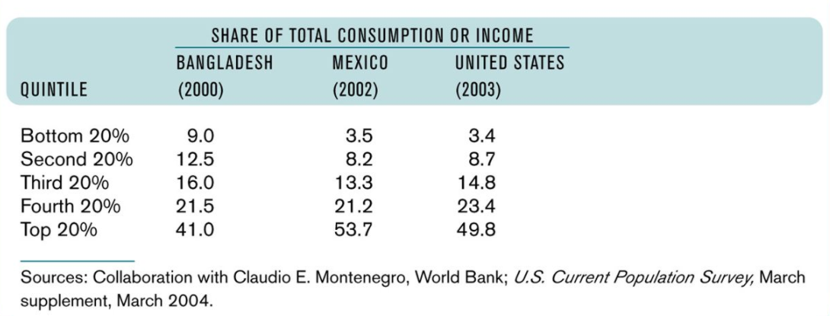
Share of total income: 3 countries

Slide 13
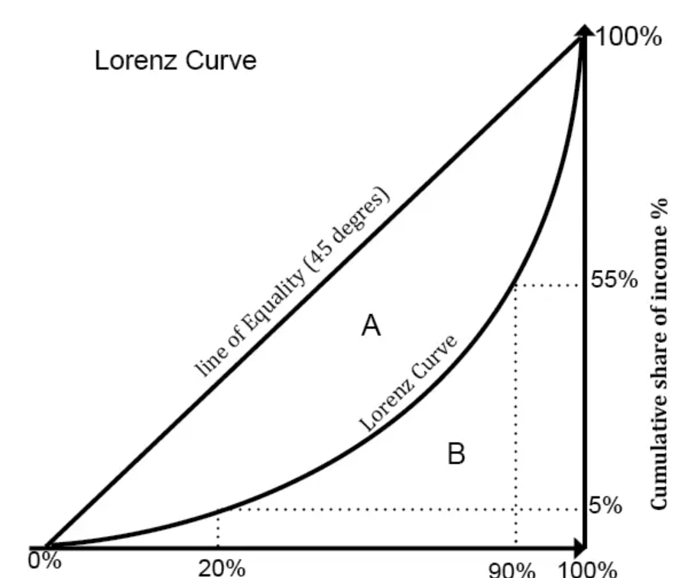
Lorentz curve
Developed by Max Lorentz (1905), the curve shows the distribution of income (or wealth) within an economy
Cumulative percent of income/consumption is plotted against cumulative percent of recipients
It shows the cumulative share of income from different sections of the population
If there was perfect equality the poorest 20% of the population would gain 20% of the total income; likewise the poorest 60% of the population would get 60% of the income
% households by income distribution

Slide 14
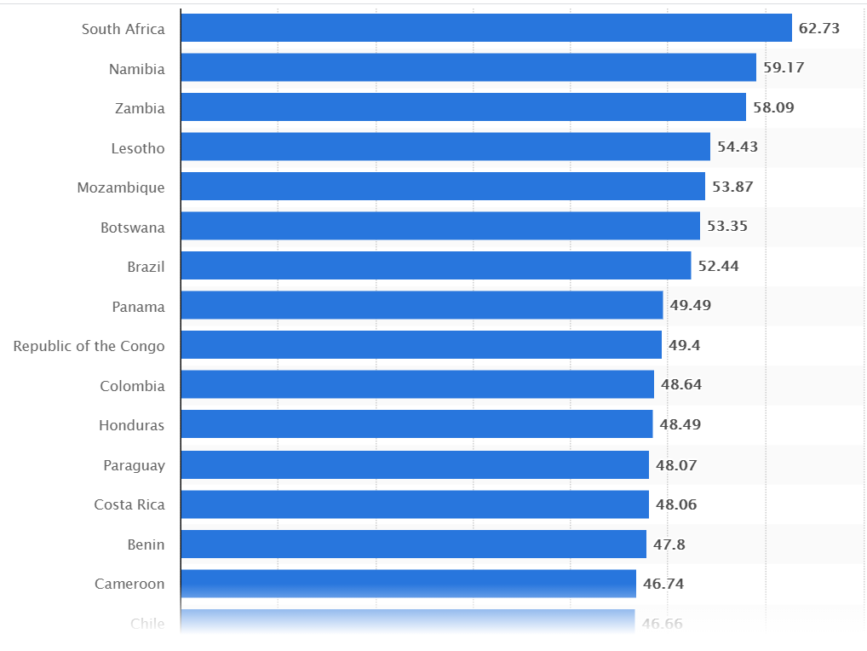
Gini coefficient
The Gini coefficient is a single number aimed at measuring the degree of inequality in a distribution.
Often used in economics to measure how far a country's wealth or income distribution deviates from a totally equal distribution
Gini coefficient = 1 means total inequality; if it is = 0 then it means all receive an equal share

Slide 15
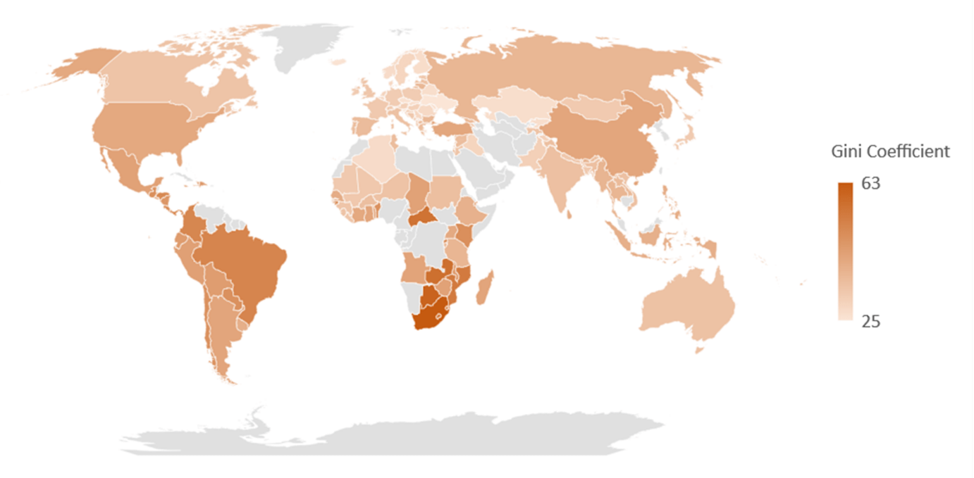
Variations across countries based on Gini coefficient

Slide 16
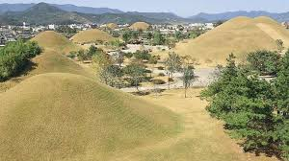
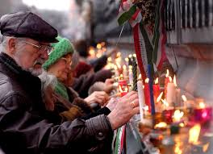
Cases of Rising and declining inequality
During the American occupation of South Korea, land was redistributed from Japanese owners to Korean farmers. This policy decreased inequality
In Eastern European and former states of the Soviet Union embarked on reforms, which resulted in decreasing inequality

Slide 17

Cases of Rising and declining inequality
South Africa has one of the highest Gini coefficient which means that inequality is high. This is a result of apartheid policies in the past which segregates blacks ands whites
High inequality in Latin America is due to land ownership in the hands of a few

Slide 18

Poverty reduction strategies
Promote market-oriented growth
  Ensure macroeconomic stability
  Facilitate open trade and investments
  Increase investments in infrastructure
  Improve credit markets
Invest in human capital
  Promote health and education
  Provide basic services to the poor
Develop social safety nets

Slide 19
Income transfers and safety nets
People are poor because they lack opportunities or are beyond the reach of the market: the old, the sick, the handicapped and people without family/networks
The poor are vulnerable to systemic shocks (natural disasters, financial crises) and therefore require government action because the market cannot resolve these issues
These situations require government intervention in the form of income transfers
Transfers can take the form of cash grants, food vouchers, or food distribution programs
Safety nets are similar to cash transfers. However safety nets apply to households that are not necessarily poor, but to those that have temporary shortfalls in consumption. One example: public employment scheme

Slide 20
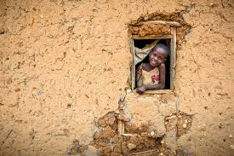
conclusion
Poverty is diminishing in countries that are growing rapidly, while in the absence of economic growth rising poverty is virtually unavoidable
Some methods of poverty intervention such as improving opportunities and providing income transfers and safety nets.

