Slide 1
Will you vote YES or No for free labor immigration from CLMV into Thailand?
Why?

Slide 2
Pros and Cons
Negative
Depression of wages
Rising unemployment
Productivity, training and innovation ignorance by employers
Pressure of public service
Exploited migrants
Crime and diseases
Human trafficking
Integration difficulties and friction with local people
Positive
Job vacancies can be filled.
Economic growth
Services to an ageing population
Immigrants bring energy and innovation.
Cultural diversity enrichment
http://greengarageblog.org/10-critical-pros-and-cons-of-illegal-immigration

Slide 3
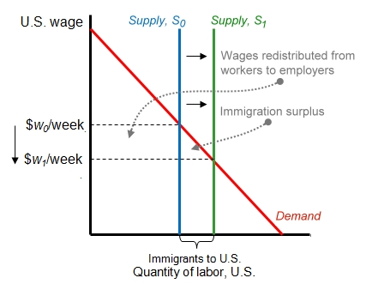

Slide 4
What to do with illegal immigrants?
DEPORT or LEGALIZE them?
USA VS THAILAND
https://www.youtube.com/watch?v=4XQXiCLzyAw
Legalize with more border enforcement
Thailand’s current immigration policy
https://www.youtube.com/watch?v=ESUqC3t96G0
Immigration is complex. The debate is not solely economic.

Slide 5
Example: Singapore
Manufacturing
Quota | Unskilled-monthly | Skilled-monthly
Tier 1 Up to 25% of the total workforce | $370 | $250
Tier 2 Above 25% to 50% of the total workforce | $470 | $350
Tier 3 Above 50% to 60% of the total workforce | $650 | $550
Services
Quota | Unskilled-monthly | Skilled-monthly
Tier 1 Up to 10% of the total workforce | $420 | $300
Tier 2 Above 10% to 25% of the total workforce | $550 | $400
Tier 3 Above 25% to 40% of the total workforce | $700 | $600

