Slide 1
International Economics
Part 1

Slide 2
Exchange Rate
Exchange Rate: a relative price (ratio of two prices) between domestic currency and foreign currency
Foreign Exchange Market: a global decentralized market for the trading of currencies
  Govt cannot control this market, but it can control exchange rate by buying and selling in this market.
For example, (baht is domestic currency)
  30 baht / 1 US dollar (direct quote)
  0.03 US dollar / 1 baht (indirect quote)

Slide 3
3 Exchange Rate Regimes
Floating Exchange Rate
  The “equilibrium” exchange rate is determined by the demand and supply of the currency.
Fixed (Pegged) Exchange Rate
  The exchange rate of is controlled by the central bank.
  The central bank can buy/sell “foreign reserve” to control the supply and demand of the currency.
Managed Float Exchange Rate (commonly used)
  The exchange rate is controlled within a certain range, but can fluctuate around within such range.

Slide 4
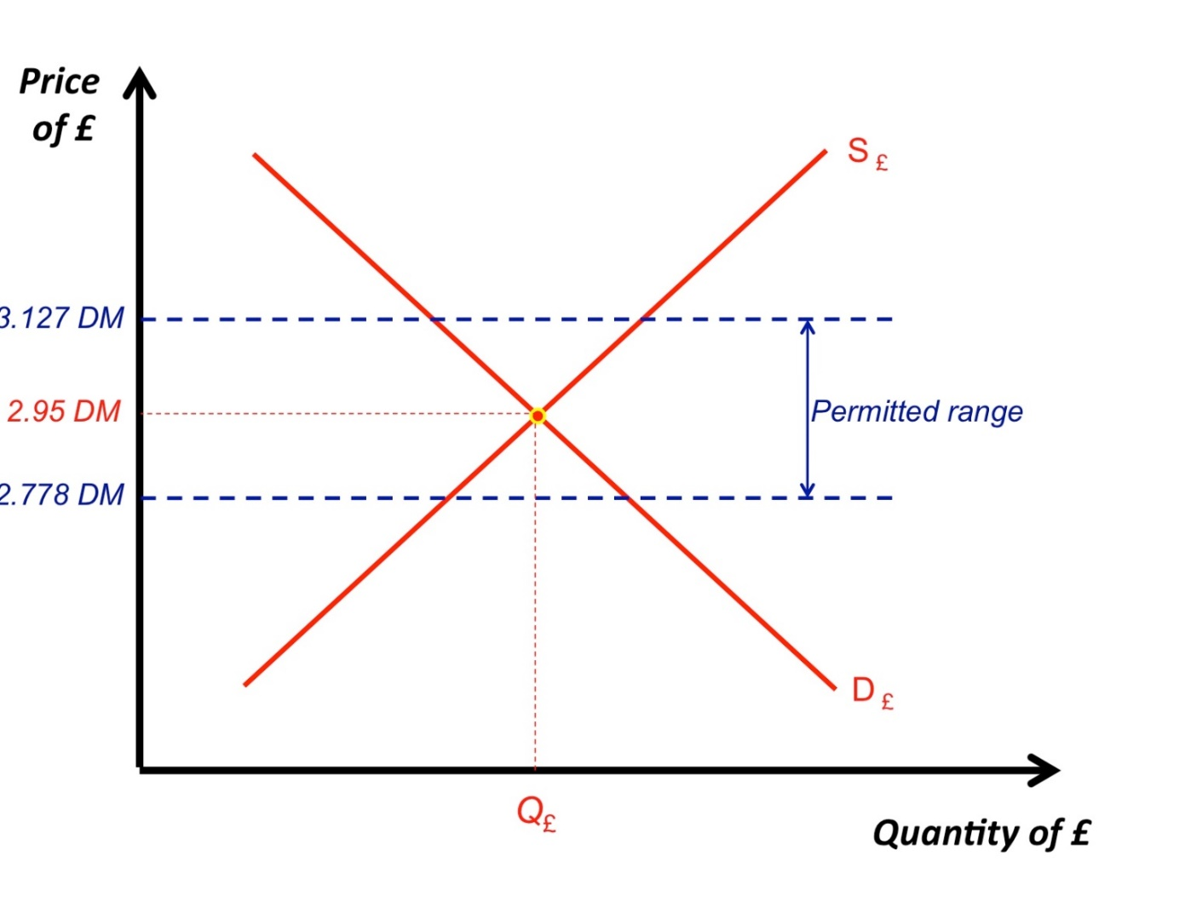
Managed Float Exchange Rate
The Govt will intervene the foreign exchange market when the exchange rate fluctuates beyond the permitted range.

Slide 5
Key Terms
The Supply of and Demand for Thai Baht
Governments, private citizens, banks, and corporations exchange baht for dollars and dollars for baht every day.
Those who demand Baht are holders of dollars (e.g. US citizens) seeking to exchange them for baht.
Those who supply Baht are holders of baht (e.g. Thai citizens) seeking to exchange them for dollars.

Slide 6
Key Terms
In Floating Exchange Rate Regime,
Appreciation of a currency The rise in value of one currency relative to another.
Depreciation of a currency The fall in value of one currency relative to another.
For example, from 30 THB / 1 USD to 33 THB / 1 USD,
Depreciation of THB
Appreciation of USD

Slide 7
Key Terms
In Fixed Exchange Rate Regime (set by the central bank),
Revaluation an official increase in the value of the currency in relation to a foreign currency.
Devaluation an official decrease in the value of the currency in relation to a foreign currency.

Slide 8
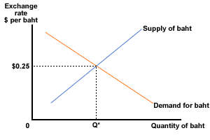
Floating Exchange Rate

Slide 9
Floating Exchange Rate
When Demand for baht increases (shift right), the price of baht (exchange rate) also goes up.
From $0.25 / 1 THB to $0.3 / 1 THB, we have
  Appreciation in THB
  Depreciation in USD
$0.3
New Demand

Slide 10
Floating Exchange Rate
In Floating Exchange Rate Regime, everything works as in the demand/supply diagram.
Higher Demand for THB >> Appreciation of THB
Higher Supply of THB >> Depreciation of THB
We need to think about the factors that affects the demand and supply of currencies.

Slide 11
Floating Exchange Rate
Factors that affects the demand and supply of currencies
Thailand increases import:
>> more D of USD = more S of THB
>> THB depreciates while USD appreciates.
Thailand attracts US investors:
>> more D of THB
>> THB appreciates while USD depreciates.
Thailand has higher interest rate
>> higher return attracts US investors.
>> more D of THB
>> THB appreciates while USD depreciates.

Slide 12
Floating Exchange Rate
Factors that affects the demand and supply of currencies
Inflation is a complex factor:
  It can increase interest rate (Fisher’s Equation) and attract foreign investors. (THB appreciates)
  But it can imply that domestic goods become more expensive, thus reducing export while raising import. (THB depreciates)
  Moreover, the purchasing power of the currency is eroding, which discourages anyone from holding the currency. (THB depreciates)
  Thus, its negative effect tends to be greater.

Slide 13
Fixed Exchange Rate
Now, suppose the central bank of Thailand wants to fix the exchange rate at 0.3 USD / 1 THB. But the equilibrium exchange rate is currently at 0.25 USD / 1 THB.
What can the CB of Thailand do?
$0.3
Fixed Rate

Slide 14
Revaluation
The CB can increase Demand for baht.
It can buy baht (and sell USD) from the foreign exchange market. This will lead to appreciation in THB.
$0.3
Fixed Rate

Slide 15
Fixed Exchange Rate
Now, suppose the central bank of Thailand wants to fix the exchange rate at 0.2 USD / 1 THB. But the equilibrium exchange rate is currently at 0.25 USD / 1 THB.
What can the CB of Thailand do?
$0.2
Fixed Rate

Slide 16
Devaluation
The CB can increase Supply of baht.
It can sell baht (and buy USD) from the foreign exchange market. This will lead to depreciation in THB.
$0.2
Fixed Rate

Slide 17
Real Exchange Rate
What we have studied so far is the “nominal” exchange rate (NER). For example, we know that to get 1 USD, we have to pay around 30 THB.
1 USD in the US may not worth the same as 1 USD in Thailand. This is why we have “Real” exchange rate.
Real exchange rate (RER) looks at the purchasing power of a currency.
For example, if RER = 1, then both 1 USD and 30 THB can be used to buy the same good in two countries.

Slide 18
Real Exchange Rate
Suppose that NER (THB/USD) = 30 THB / 1 USD.
A bottle of water costs 30 Baht in Thailand.
The same bottle costs 2 USD in the US.
RER(THB/USD) = NER(THB/USD) x (P_{US} / P_{TH})
= (30/1 ) x (2/30) = 2
RER implies that, in terms of purchasing power, people are willing to exchange 2 Thai water with 1 US water.
RER is expressed in terms of goods, not currency.

Slide 19
PPP Exchange Rate
Law of One Price If the costs of transportation are small, the price of the same good in different countries should be roughly the same.
Purchasing-Power-Parity Theory A theory of international exchange, stating that exchange rates are set so that the price of similar goods in different countries is the same.
In short, PPP uses LOP to create the PPP exchange rate.
Economists use it to compare GDP between countries.

Slide 20
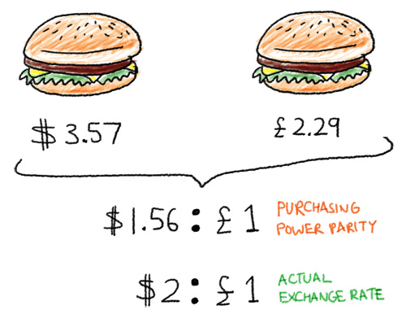
PPP Exchange Rate

