Slide 1

Factors that Affect
Hotel Demand
EE366 (1/2019)

Slide 2

Agenda
Introduction
Literature review
Theoretical framework
Research method

Slide 3

Introduction

Slide 4

Introduction
Why we chose this industry ?
What are we interested in demand factor ?
What are factors affecting hotel demand?

Slide 5

Literature Review

Slide 6

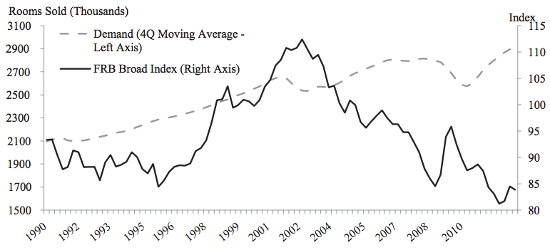
Exchange rate (Corgel, Lane & Walls, 2013)
Purchasing Power of tourists
From Q1 2000 to Q1 2012
Federal Reserve Board’s (FRB) Board Index
  <100: weak currency and >100: strong currency
  Luxury to Economy
  Upper price and lower price hotels
  Major U.S. cities
Ordinary Least Regression Model
Negative correlation

Slide 7

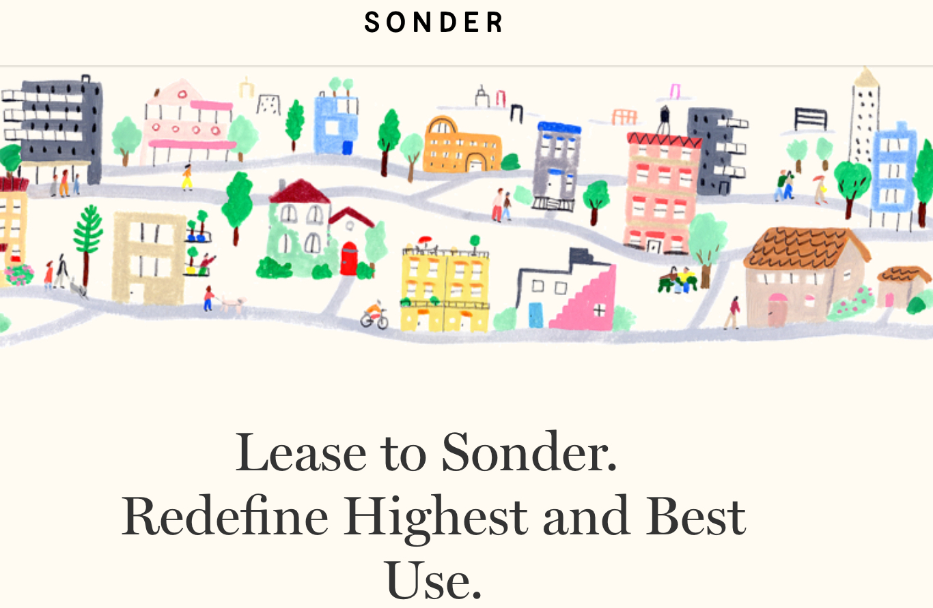

The rise of The Sharing Economy
(Zervas, Proserpio & Byers, 2016)
Sharing economy( airbnb, sonder...etc)
  Normal people providing a place (house to others) to stay with lower cost.
  Airbnb and sonder are major in hotel in hotel industries.
Impact of sharing economy
  Increase in airbnb supply, cause existing hotel industries price drop.
  Large impact in Austin ( city in texas USA)
  In short run, existing hotel industries can adjust, in long run ,they may not.

Slide 8
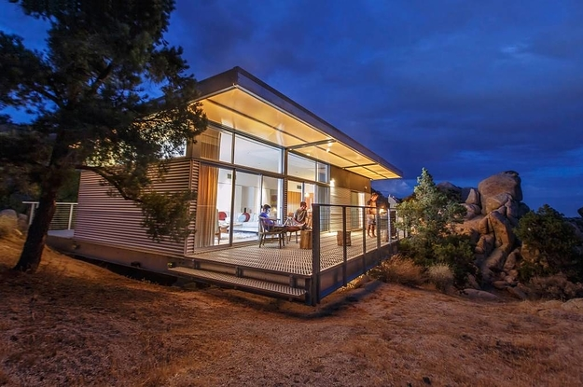





Why Airbnb Affects Hotel Demand?
Vacation Travelers
Business Travelers
Travelers want to get new experiences instead of predictable hotel service.
Airbnb recently launched an initiative to attract more business travelers.

Slide 9



Seasonality (Chen & Lin, 2014)
Impact of climate and weather on tourism
  Explored since 1990
  Little attention to the impact of weather on the operation on tourism business.
Results
  Some weather factors affect room demand but some do not
    Group visitor
      Negatively associated with hotel demand
        Typhoon and rain
      Positively associated with hotel demand
        Temperature and sunshine
Notes:
The impact of climate and weather on tourism has been explored since 1990. Most research focuses on the impact of weather on tourist behaviors but relatively little attention is given to the impact of weather on the operation of tourism businesses. Using actual operating data from the Taiwanese hotel sector, the results indicate that some weather factors affect room demand but some do not.
For group visitors, typhoon
and rain are negatively associated with room demand while temperature and sunshine hours are positively associated with room demand.

Slide 10


Price sensitivity (Masiero & Nicolau, 2012)
Price increase
  Diminish consumption
    However, price has a differentiated effect among individual
      High price does not have same reduction in utility
Motivation affect prices sensitivity to tourism activities
  Depending on age
Length of stay
  Longer stay lead to higher price sensitivity to activities
    Due to limited budget
Notes:
https://www.sciencedirect.com/science/article/pii/S0261517715001375
The results show that as price increases diminish consumption; however, ‘price’ has a differentiated effect among individuals, and thus a particular high price does not have the same reduction in utility for all tourists. Specifically, we find that motivations exert an effect on price sensitivity to activities, some diminishing and others increasing it. At this point, it is important to stress that the effect of motivations is influenced by the tourist’s Price sensitivity to tourism activities 687 age, such that the same motivation might impact differently on an individual’s price sensitivity depending on his or her age. Concerning length of stay, we find that longer stays lead to higher price sensitivity to activities (because of people’s limited budget), but there is a threshold in day five; from day six, people become less sensitive (as these longer durations are mainly associated with people who have a second home and therefore have more money for discretionary expenditure).
Masiero, Lorenzo & Nicolau, Juan

Slide 11

Theoretical Framework
Notes:
https://www.researchgate.net/publication/307951244_Managing_Demand_Downturn_for_Hotel_Rooms_Evidence_from_Cairo_Hotels

Slide 12

Theoretical Framework
Hotel Demand
Sharing Economy
Exchange Rate
Seasonality
Price Sensitivity

Slide 13
Research Methods

Slide 14


Research Methods
Secondary research
Using already existing data both qualitative and quantitative
Summarized and collated to increase the overall effectiveness of research

Slide 15

Group member
Piangprae Lertviriyavarangkool 5904640462
Sulakkhana Sangsubsin 6004641681
Nutnaree Kesa 6004640097
Thirakhun Wiwatsawatdinont 6004641327
Shin Sakuma 6004641426
Pheerada Thienrungroj 6004641384

Slide 16
References
C.-M. Chen, Y.-C. Li. (2014). ‘The effect of weather on the demand for rooms in the Taiwanese hotel
industry: An examination’, Tourism Management Perspective 12, (2014) 81–87.
Duro, J. (2016). ‘Seasonality of hotel demand in the main Spanish provinces:
Measurements and decomposition exercises ’, J.A. Duro / Tourism Management 52 (2016) 52e63
Masiero, Lorenzo & Nicolau, Juan. (2012). Price sensitivity to tourism activities: Looking for determinant factors. Tourism
Economics. 18. 10.5367/te.2012.0143.
Zervas, G., Proserpio, D. and Byers, J. (2016). The Impact of the Sharing Economy on the Hotel Industry.
Corgel, J., Lane, J., & Walls, A. (2013). How currency exchange rates affect the demand for U.S. hotel rooms. International
Journal of Hospitality Management, 35, 78–88. doi: 10.1016/j.ijhm.2013.04.014

