Slide 1
Foreign Direct Investment and Cross-Border Acquisitions
16
Chapter Sixteen
Chapter Objective:
This chapter discusses various issues associated with foreign direct investments by MNCs, which play a key role in shaping the nature of the emerging global economy.

Slide 2
Chapter Outline
Global Trends in FDI
Why Do Firms Invest Overseas?
Cross-Border Mergers and Acquisitions
Political Risk and FDI

Slide 3
Global Trends in FDI
Foreign Direct Investment often involves the establishment of production facilities abroad.
  Greenfield Investment
    Involves building new facilities from the ground up.
  Cross-Border Acquisition
    Involves the purchase of existing business.

Slide 4
Global Trends in FDI
Several developed nations are the sources of FDI outflows.
  About 90% of total world-wide FDI comes from the developed world.
Both developing and developed nations are the recipient of inflows of FDI.

Slide 5
Average Annual FDI (in Billions) 2002-06

Slide 6
Stock of foreign assets as percentage of GDP, 2007
Source: Bank of Thailand

Slide 7
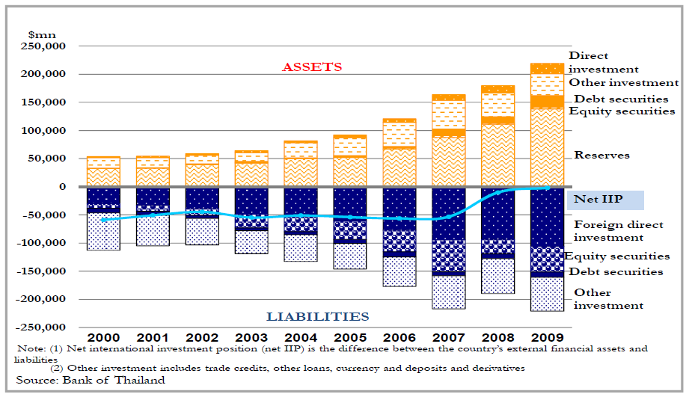
Thailand’s International Investment Position (IIP)

Slide 8
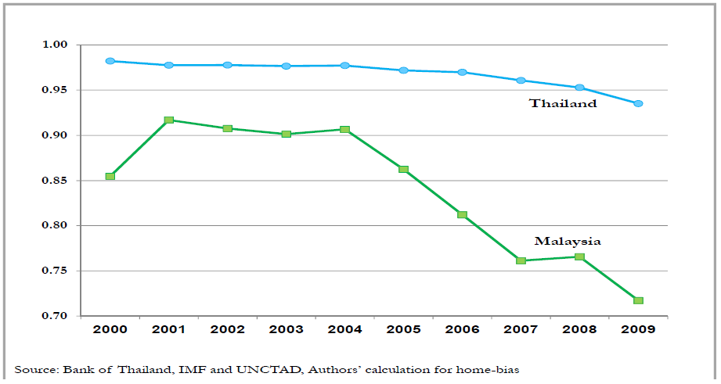
Home Bias in Direct investment

Slide 9
Why Do Firms Invest Overseas?
Trade Barriers
Labour Market Imperfections
Intangible Assets
Vertical Integration
Product Life Cycle
Mergers and Acquisitions

Slide 10
Trade Barriers
Government action leads to market imperfections.
Tariffs, quotas, and other restrictions on the free flow of goods, services and people.
Trade Barriers can also arise naturally due to high transportation costs, particularly for low value-to-weight goods.

Slide 11
Labor Market Imperfections
Among all factor markets, the labor market is the least perfect.
  Recall that the factors of production are land, labor, capital, and entrepreneurial ability.
If there exist restrictions on the flow of workers across borders, then labor services can be underpriced relative to productivity.
  The restrictions may be immigration barriers or simply social preferences.
Persistent wage differentials across countries exist. This is one of the main reasons MNCs are making substantial FDIs in less developed nations.

Slide 12
Labor Market Costs Around the World (2006)
Country | Average Hourly Cost ($) |  |  | Country |  |  | Average Hourly Cost ($)
Germany | $34.21 |  | Japan |  |  |  | $20.2
Belgium | $31.85 |  | Spain |  |  |  | $18.83
Sweden | $31.8 |  | Korea |  |  |  | $14.72
UK | $27.1 |  | Israel |  |  |  | $12.98
Australia | $26.14 |  | Taiwan |  |  |  | $6.43
Canada | $25.74 |  | Hong Kong |  |  |  | $5.78
Italy | $25.07 |  | Brazil |  |  |  | $4.91
France | $24.9 |  | Mexico |  |  |  | $2.75
US | $23.82 |  | Philippines |  |  |  | $1.07
 |  |  |  |  |  | China | $0.67

Slide 13
Intangible Assets
Intangible assets include technological, managerial, and marketing know-how, superior R&D capacities, brand names, etc.
Coca-Cola has a very valuable asset in its closely guarded “secret formula”.
To protect that proprietary information, Coca-Cola has chosen FDI over licensing.
Since intangible assets are difficult to package and sell to foreigners, MNCs often enjoy a comparative advantage with FDI.

Slide 14
Vertical Integration
MNCs may undertake FDI in countries where inputs are available in order to secure the supply of inputs at a stable accounting price.
Vertical integration may be backward or forward:
  Backward: e.g. a furniture maker buying a logging company.
  Forward: e.g. a U.S. auto maker buying a Japanese auto dealership.

Slide 15
Product Life Cycle
Firms in advanced countries develop new products for the domestic market, and then markets expand overseas.
FDI takes place when product maturity hits and cost becomes an increasingly important consideration for the MNC.

Slide 16
Product Life Cycle
Advanced
countries
production
Quantity
exports
imports
consumption
New product Maturing product Standardized product
Less advanced countries
consumption
Quantity
exports
imports
production
New product Maturing product Standardized product

Slide 17
Product Life Cycle
It should be noted that the Product Life Cycle theory was developed in the 1960s when the U.S. was the unquestioned leader in R&D and product innovation.
Increasingly product innovations are taking place outside the United States as well, and new products are being introduced simultaneously in many advanced countries.
Production facilities may be located in multiple countries from product inception.

Slide 18
Cross-Border Mergers & Acquisitions
Greenfield Investment
  Building new facilities from the ground up.
Cross-Border Acquisition
  Purchase of existing business.
  Cross-Border Acquisition represents 40-50% of FDI flows.
Cross-border acquisitions are a politically sensitive issue:
  Greenfield investment is usually welcome.
  Cross-border acquisition is often unwelcome.

Slide 19
Cross-border M&A’s
Two key advantages over greenfield investments:
  Speed
  Access to proprietary assets of the target firms
Internalization of intangible assets is a major motivating force for cross-border M&A
  Forward: to internalize the acquirer’s intangible assets
  Backward: to internalize the targeter’s intangible assets

Slide 20
M&A Process and Roles
 | Parties | Roles
Principals | Companies, Major Shareholders, Board of Directors, and Management | Originate / Sponsor deals Make / Implement decisions Approves transaction
Advisors | Financial, Legal, Auditors, Tax, Market, Technical, and Environmental | Originate deals Provide technical advice Assist in decision making Coordination
Shareholders | Minority Shareholders | Approves transaction (crucial in connected transactions)
Regulators | Securities regulator (SEC), Exchanges (SET / MAI), Industry regulators (e.g. BoT), and Government agencies (e.g. MOF) | Ensures compliance Grants approvals required for transactions

Slide 21
Top 10 Cross-Border M&A Deals 1998-2006
Year | ($ b) | Acquirer | Home | Target | Host
2000 | 202.8 | Vodafone AirTouch PLC | U.K. | Mannesmann AG | Germany
2005 | 74.3 | Royal Dutch Petroleum | Netherlands | Shell Transport & Trading | U.K.
1999 | 60.3 | Vodafone Group PLC | U.K. | AirTouch | U.S.
1998 | 48.2 | British Petroleum Co. | U.K. | Amoco | U.S.
2000 | 46.0 | France Telecom SA | France | Orange PLC | U.K.
1998 | 40.5 | Daimler-Benz AG | Germany | Chrysler Corp. | U.S.
2000 | 40.4 | Vivendi SA | France | Seagram Co. LTD | Canada
1999 | 34.6 | Zeneca Group PLC | U.K. | Astra AB | Sweden
1999 | 32.6 | Mannesmann AG | Germany | Orange PLC | U.K.
2006 | 32.2 | Mittal Steel Co NV | Netherlands | Arcelor SA | Luxembourg

Slide 22
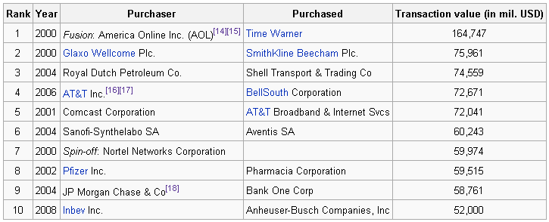
Major M&A Deals in 2000s
Note: Some of the M&A deals listed above are not cross-border M&A.
Notes:
Cross-border M&A
In a study conducted in 2000 by Lehman Brothers, it was found that, on average, large M&A deals cause the domestic currency of the target corporation to appreciate by 1% relative to the acquirers.
The rise of globalization has exponentially increased the market for cross border M&A. In 1996 alone there were over 2000 cross border transactions worth a total of approximately $256 billion. This rapid increase has taken many M&A firms by surprise because the majority of them never had to consider acquiring Due to the complicated nature of cross border M&A, the vast majority of cross border actions have unsuccessful anies seek to expand their global footprint and become more agile at creating high-performing businesses and cultures across national boundaries.[7]
Even mergers of companies with headquarters in the same country are very much of this type (cross-border Mergers). After all,when Boeing acquires McDonnell Douglas, the two American companies must integrate operations in dozens of countries around the world. This is just as true for other supposedly "single country" mergers, such as the $27 billion dollar merger of Swiss drug makers Sandoz and Ciba-Geigy (now Novartis).

Slide 23
Average Wealth Gains from Cross-Border Acquisitions: Foreign Acquisitions of U.S. firms.
Country of Acquirer | N | R&D/Sales (%) |  | Average Wealth Gain (U.S. $millions)
 |  | Acquirer | Target | Acquirer | Target
Canada | 10 | 0.21 | 0.65 | 14.93 | 85.59
Japan | 15 | 5.08 | 4.81 | 227.83 | 170.66
U.K. | 46 | 1.11 | 2.18 | –122.91 | 94.55
Other | 32 | 1.63 | 2.80 | –47.56 | 89.48
All | 103 | 1.66 | 2.54 | –35.01 | 103.19
Synergistic gains are obtained when the value of the combined firm is
greater than the stand-alone valuations of the individual firms.

Slide 24
Political Risk and FDI
Unquestionably this is the biggest risk when investing abroad.
“Does the foreign government uphold the rule of law?” is a more important question than normative judgements about the appropriateness of the foreign government’s existing legislation.
A big source of risk is the non-enforcement of contracts.

Slide 25
Political Risk
Transfer Risk
  Uncertainty regarding cross-border flows of capital.
Operational Risk
  Uncertainty regarding host countries policies on firm’s operations.
Control Risk
  Uncertainty regarding expropriation.

Slide 26
Hedging Political Risk
Geographic diversification
  Simply put, don’t put all of your eggs in one basket.
Minimize exposure
  Form joint ventures with local companies.
    Local government may be less inclined to expropriate assets from their own citizens.
  Join a consortium of international companies to undertake FDI.
    Local government may be less inclined to expropriate assets from a variety of countries all at once.
  Finance projects with local borrowing.

Slide 27
Hedging Political Risk
Insurance
  For example, the Overseas Private Investment Corporation (OPIC) a U.S. government federally owned organization, offers insurance against:
    The inconvertibility of foreign currencies.
    Expropriation of U.S.-owned assets.
    Destruction of U.S.-owned physical properties due to war, revolution, and other violent political events in foreign countries.
    Loss of business income due to political violence.

