Slide 1
Announcement
Password for downloading handouts: 40304
Case studies presentation and discussion
  Group assignment (3-4 students)
  2 case studies/group
  8 Topics to choose from:
    1. Industrial and Export Policy in South Korea
    2. Taiwan – Inside the Miracle: A Development Success Story
    3. Governance and Civil Service Reform: Mali

Slide 2
    4. Mexico: A Pioneer in Successful Debt Reduction
5. Environment and Development: Causes of Deforestation in the Brazilian Amazon Rain Forest and the Policy Response
6. NAFTA and Beyond: Impact on Mexico and Latin America
7. Property Rights Reform: China's Township and Village Enterprises
8. Efficiency and Equity Issues in Tax Reform: Bolivia

Slide 3
Some Useful Concepts
1. Development Macroeconomics
2. GDP (PPP)
3. Economic Development
4. Growth Rate of GDP
5. Scale Ratio
6. Poverty Measurement

Slide 4
1. Development Macroeconomics
In Keynes’ opinion, desired aggregate expenditure is the key to economic activity.
That is, what households, businesses and government plan to buy will be the determinant of what firms eventually produce.
Assumptions: The actual output level is below the potential level. There are unemployed resources. Demand for output is not bounded by supply of output. This is often true in the short-run.
In this course, we will consider economic growth in the long-run where factor accumulation and productivity are the major determinants of output supply.

Slide 5
Emerged as a field in the 50’s and 60’s
To study “the development process”, i.e. growth.
All countries passed through the same historical stages of economic development.
Current underdeveloped countries were merely at an earlier stage in this linear historical progress while First World (European and North American) nations were at a later stage.
Latin American, Asian and African countries were seen mostly as "underdeveloped" countries, i.e. "primitive" versions of European nations that could, with time, "develop" the institutions and standards of living of Europe and North America

Slide 6
Inducing growth necessitates structural changes to pass from a “traditional/backward/rural/subsistence” economy to a “modern/technology-based/market oriented/urban” one.
The question was: how to induce structural changes?

Slide 7
2. GDP (PPP)
GDP to measure a country’s well-being
Problem? Both conceptual and practical.
Despite these drawbacks, GDP remains a rough and ready measure of standard of living.
How to deal with different currencies and fluctuation in price?
Purchasing power parity (PPP) exchange rates

Slide 9
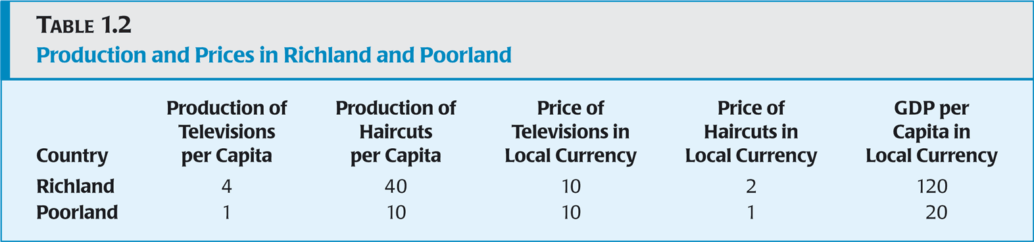
PPP is number of baht you need to buy
the same amount of goods and services
in Thailand as you could with $1 in the US.

Slide 10
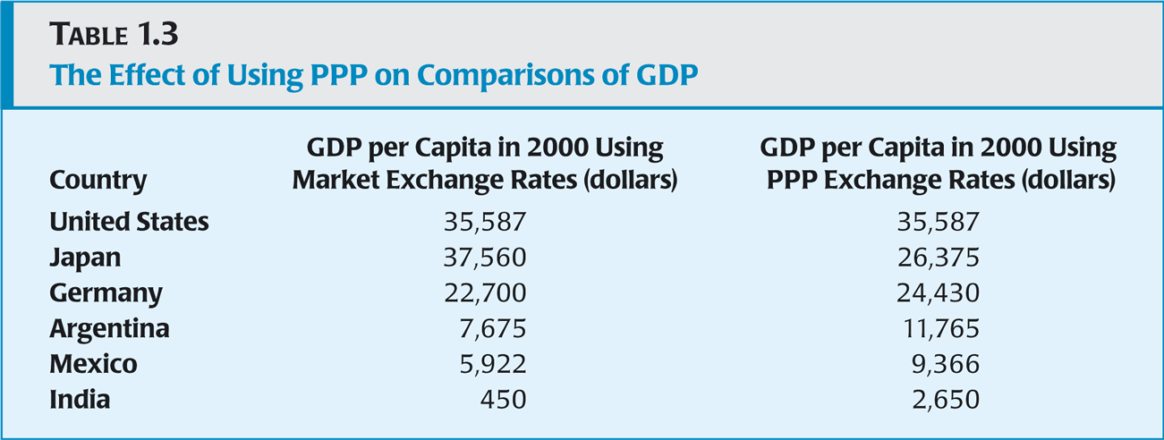

Slide 11
GDP (PPP) per capita
IMF(2008) WB(2007)
Rank | Country | $ | Rank | Country | $
1 2 3 4 5 86 180 | Qatar Luxembourg Norway Singapore Brunei Thailand Congo | 85,868 82,306 53,451 50,142 50,117 8,225 328 | 1 2 3 4 5 69 167 | Luxembourg Norway Singapore United States Ireland Thailand Congo | 78,985 53,334 50,299 45,790 43,035 8,138 298

Slide 12
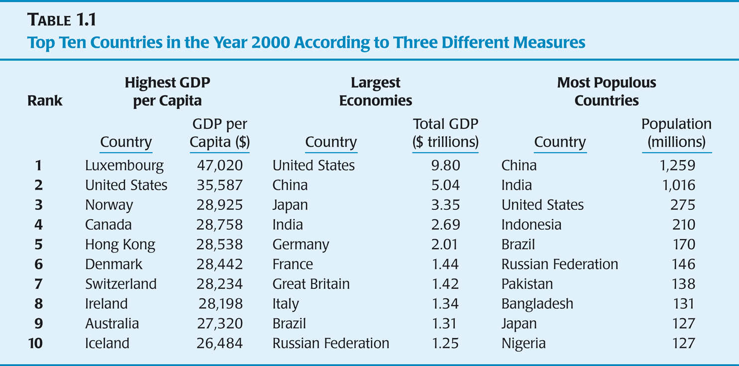

Slide 13
3. Economic Development
Development occurs with the reduction and elimination of poverty, inequality and unemployment within a growing economy.
Economic Development (defined by Nobel Laureate Amartya Sen) as “the process of expanding the real freedoms that people enjoy”.
The notion of development is complex and multidimensional -- involving improvements in human well-being.

Slide 14
Development vs Growth
There is more to economic development than growth in incomes.
Economic growth means increase in per capita income or increase in GDP. GDP is a narrow measure of economic welfare that does not take account of important non-economic aspects eg more leisure time, access to health & education, environment, freedom or social justice. Economic growth is a necessary but insufficient condition for economic development.

Slide 15
Indicators of Development
In the 40’s and 50’s => GDP
Critics realized there were other aspects
Using composite (component) indicators
UN’s Human Development Index (HDI)
Three basic dimensions of human development
1. Health: Life expectancy
2. Education: Educational attainment
3. Monetary: Adjusted real income (PPP$ per person)
Critique: ad hoc weighting issues, what to include, double counting

Slide 16
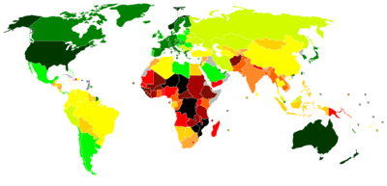
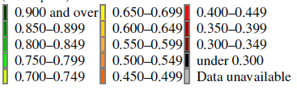
HDI MAP (2010)

Slide 17
How closely related are per-capita GDP & the HDI?

Slide 19
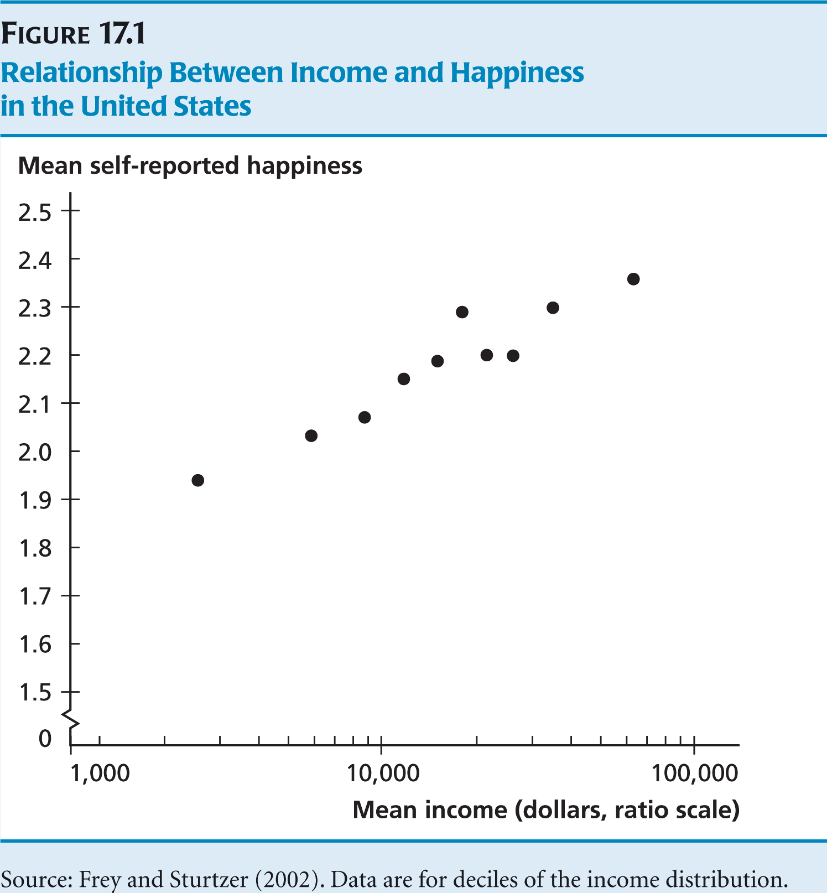

Slide 20
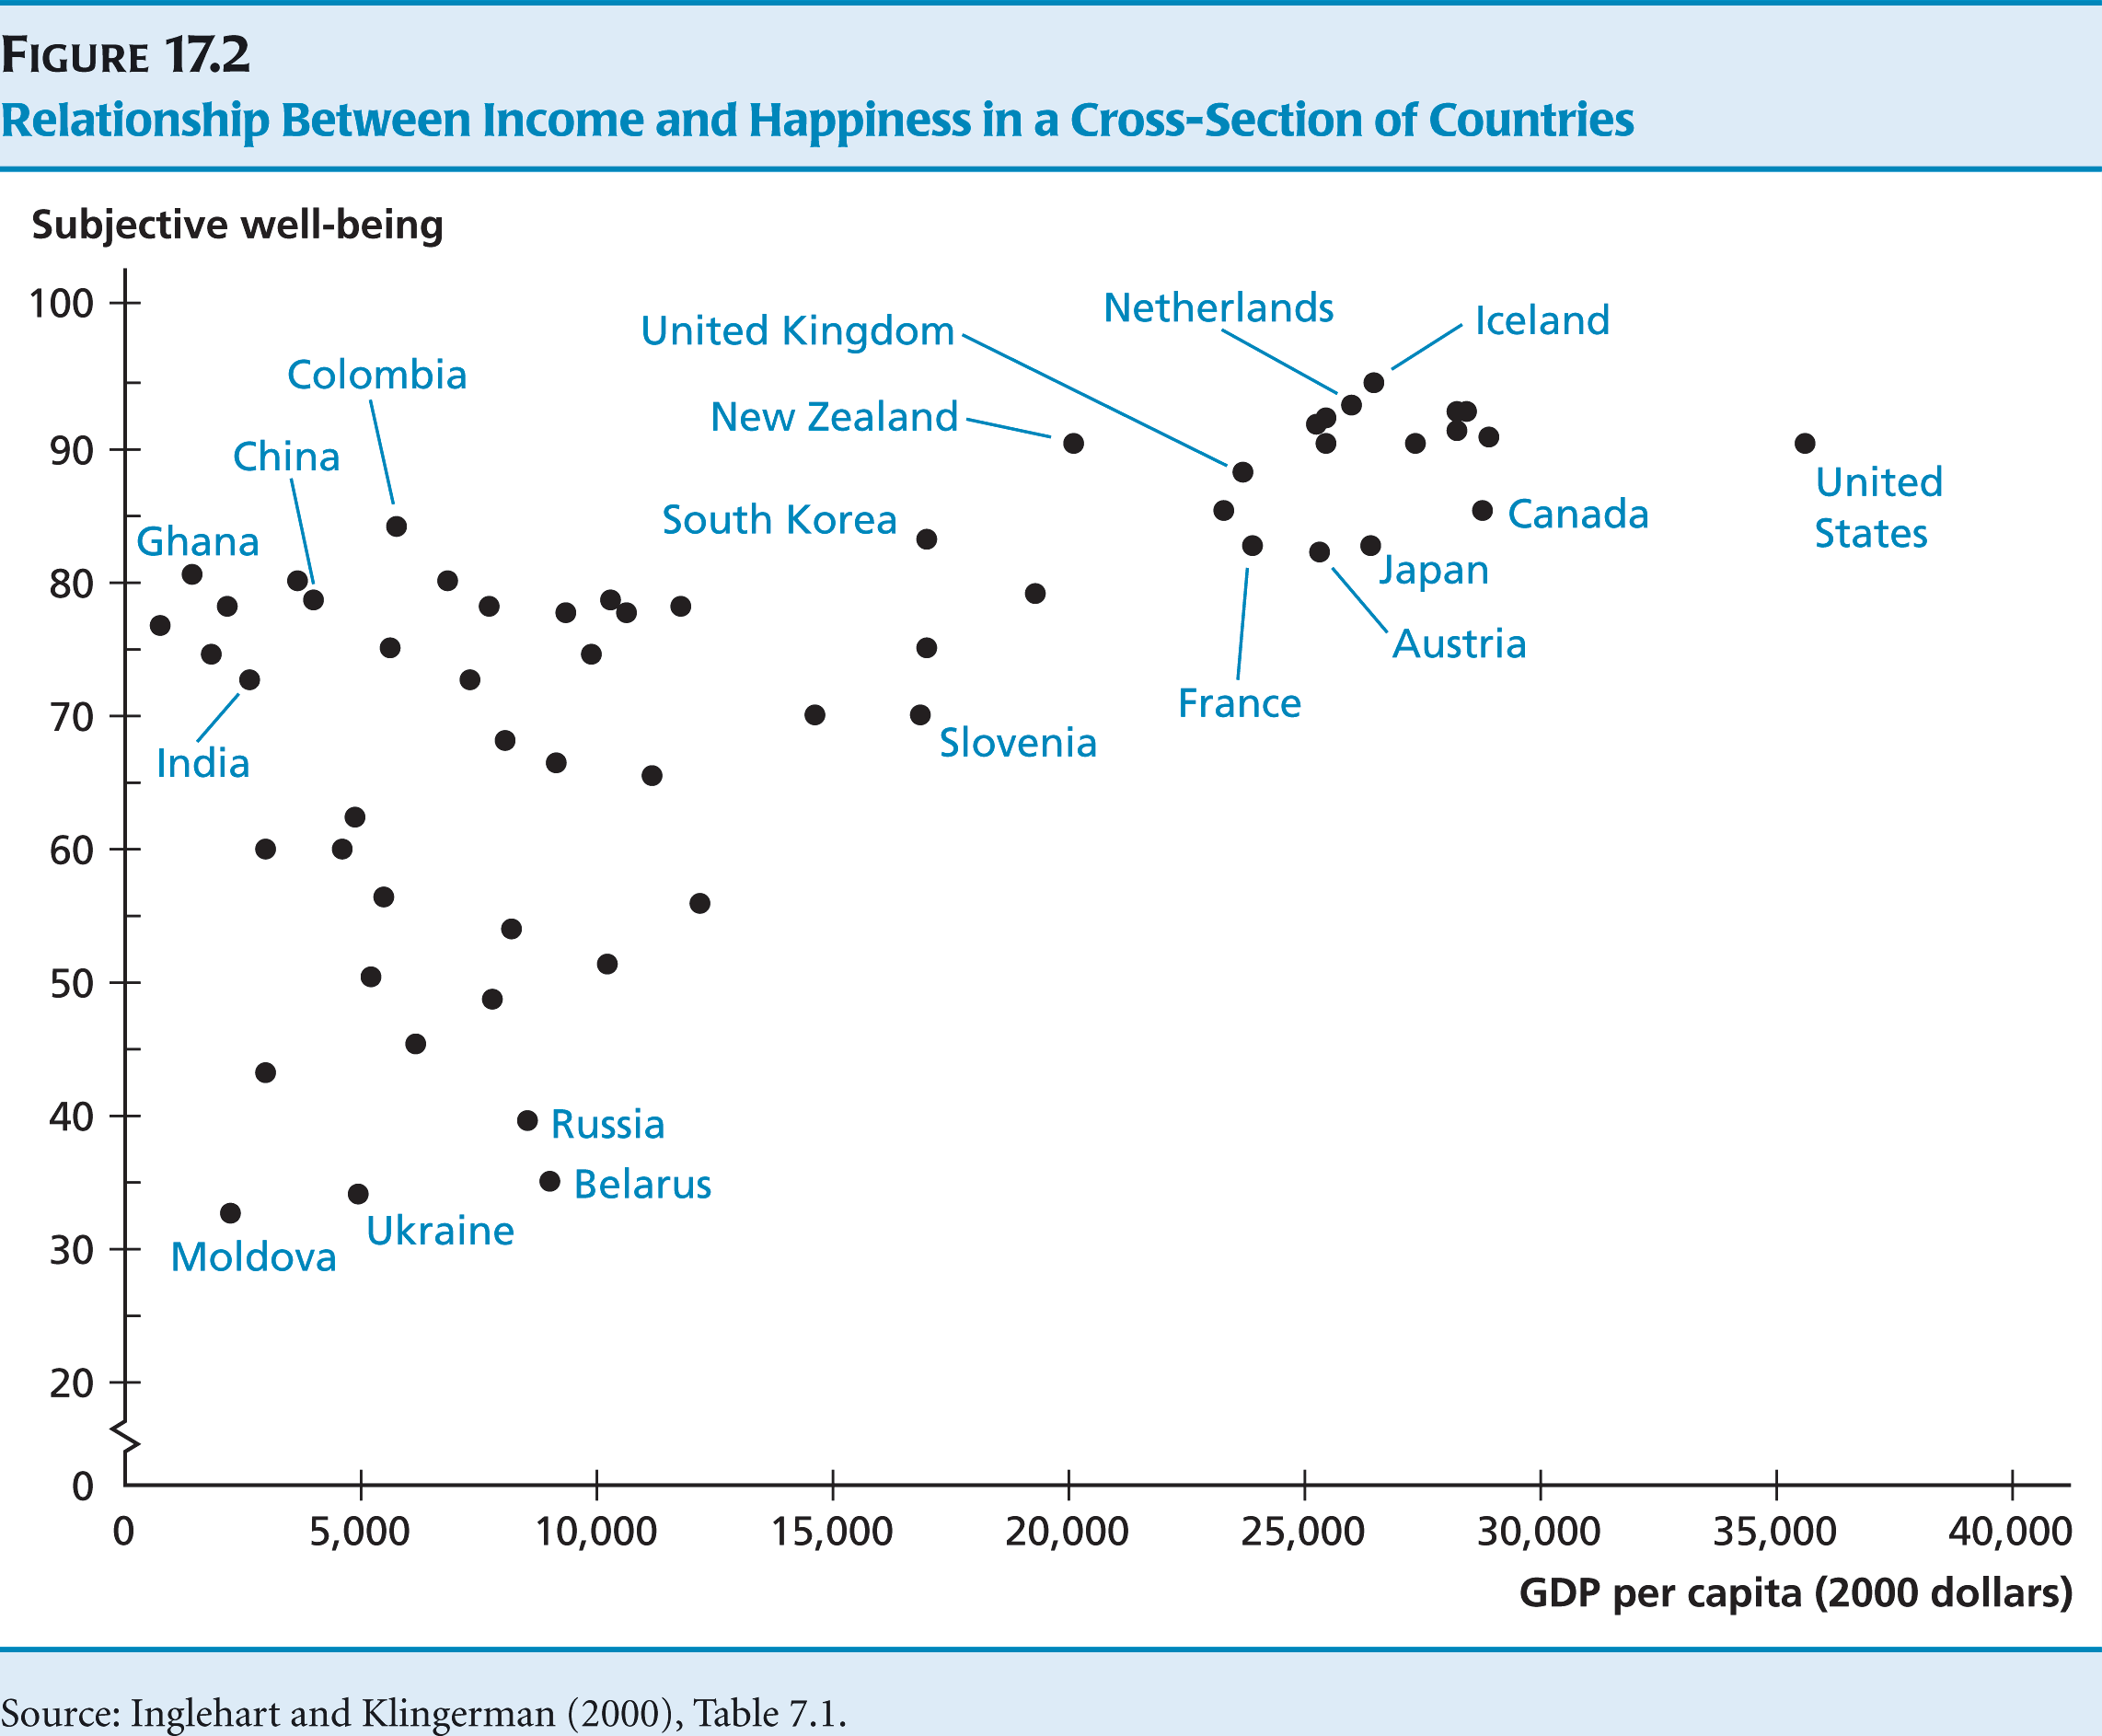

Slide 21
How Psychologists Measure Happiness
1. In general, I consider myself
(not very happy) 1 7 (very happy)
2. Compare to most of my friends, I consider myself
(less happy) 1 7 (more happy)
3. Some people are always happy no matter what. To what extent does this characterization describe you.
(not at all) 1 7 (very much)
4. Some people are always unhappy no matter what. To what extent does this characterization describe you.
(very much)1 7 (not at all)
What is your Total Score?

Slide 22
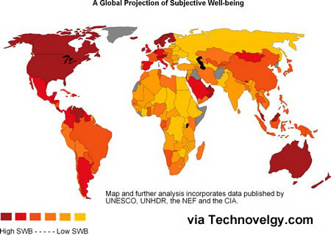

Slide 23
4. Growth rate of GDP
Growth’s effect on the level of income
Growth is important because a country that grows faster will move to a higher level of income over time.
South Korea & Philippines
1960 GDP per capita: SK $1598 and PH $2,153
Growth rate: SK 6.1%, PH 1.3%
2000 GDP per capita: SK $16,970, PH $3661

Slide 25
The growth rate of GDP per capita over 1870-2005 of the US is 1.9% per year. Hardly noticeable from one year to the next. But compounded over 135 years, the effect has been dramatic.
GDP per capita in 2005 was 12.5 times as large as GDP per capita in 1870.
Growth rates seem similar but small differences are important with compounding. At 1.7% growth each year doubling income takes 40 years. At 0.1% growth each year doubling income would take 700 years!

Slide 26
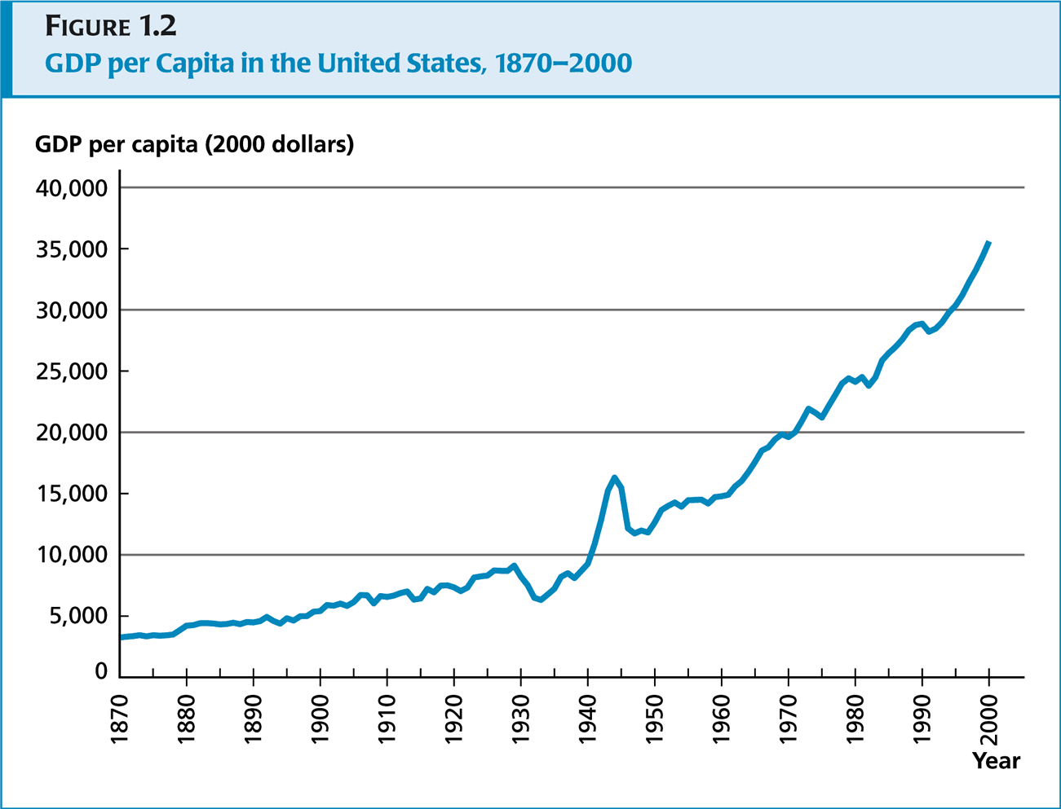

Slide 27
Working on growth rate
Rule of 72 => doubling time ≈ 72/g (g=percentage annual growth, ln2=0.693)

Slide 28
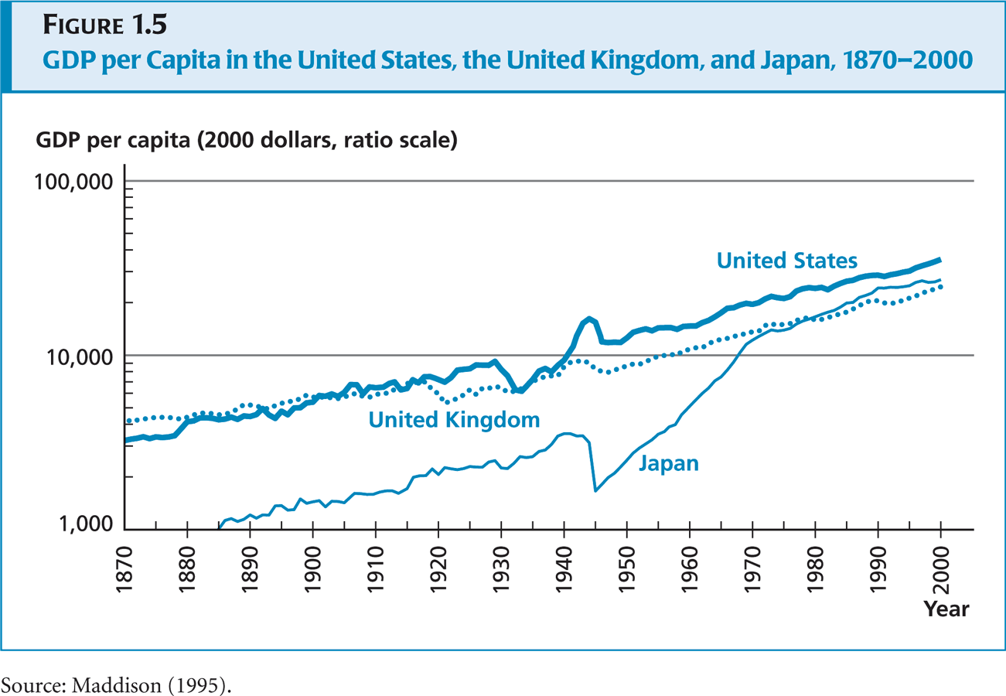

Slide 29
UK = 1.4%, US=1.9% during 1870-2000
UK was 33% richer than US in 1870
UK was 27% poorer than US in 2000
Japanese income = 25% of US income in 1885, =35% in 1939, 85% in 1990
Japan = 5.9%, US = 2.1% during 1950-1990

Slide 30
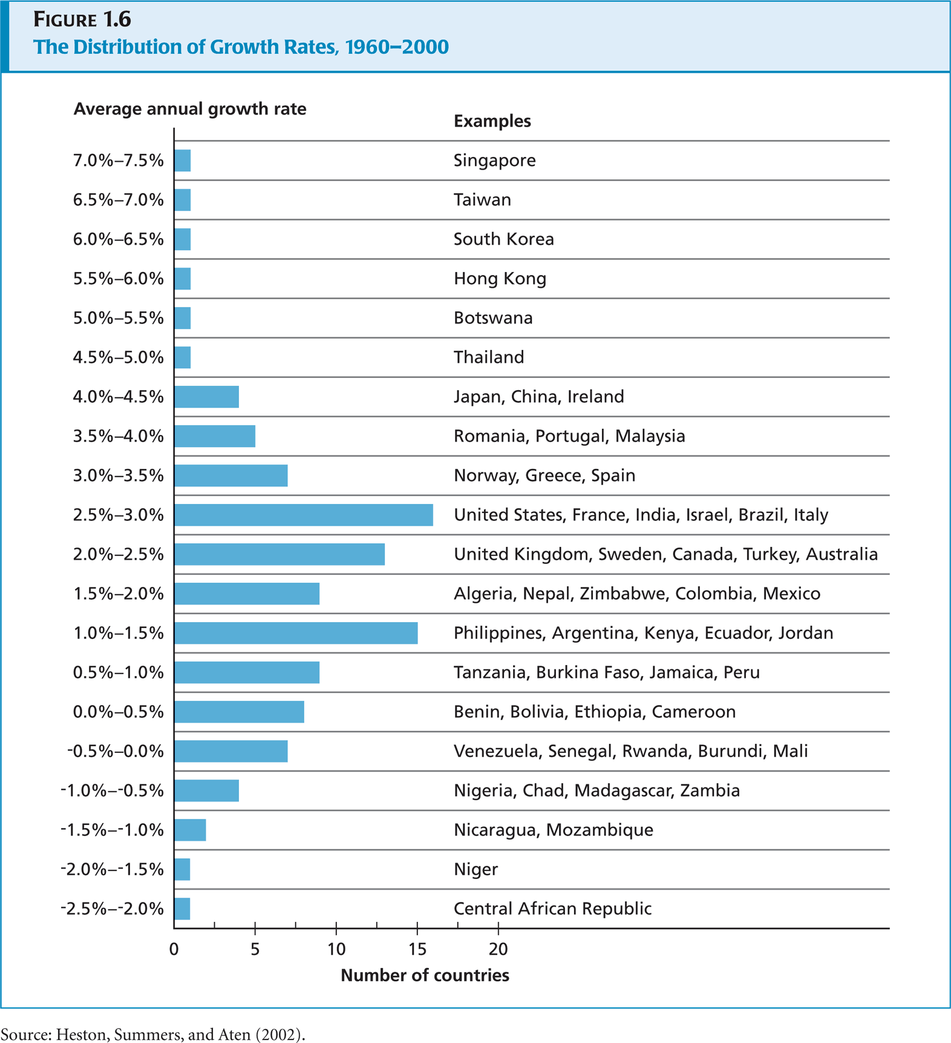

Slide 31
Income inequality between and within countries
Between-country inequality is the most important source of inequality. (60%)
In 1820, within-country inequality accounted for 87% of world inequality.
Over the period within-country inequality was roughly constant.
By 1998, the ratio of income per capita in the richest part of the world to that in the poorest part is 19:1.

Slide 32
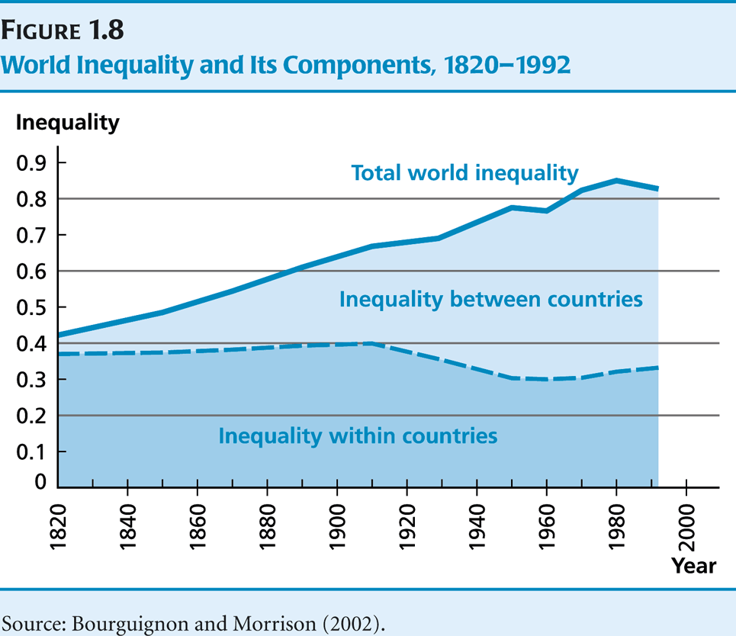

Slide 33
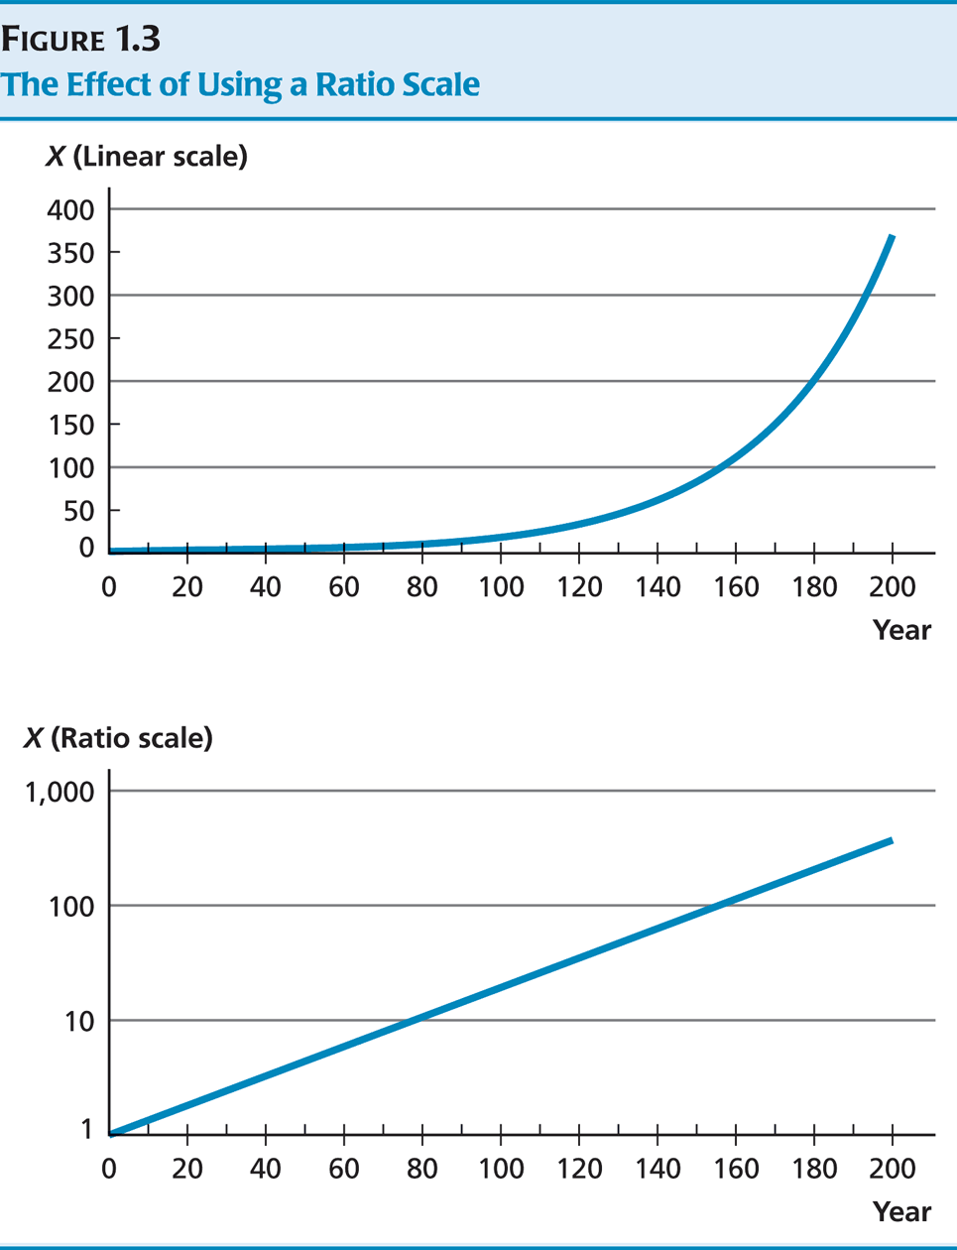
5. Ratio Scale

Slide 34
Interpreting Logarithmic
(Ratio Scale) Graphs
Connect 2 points: Slope=Growth rate
Vertical gaps = Difference in %
Change in growth rate=steeper slope

Slide 36
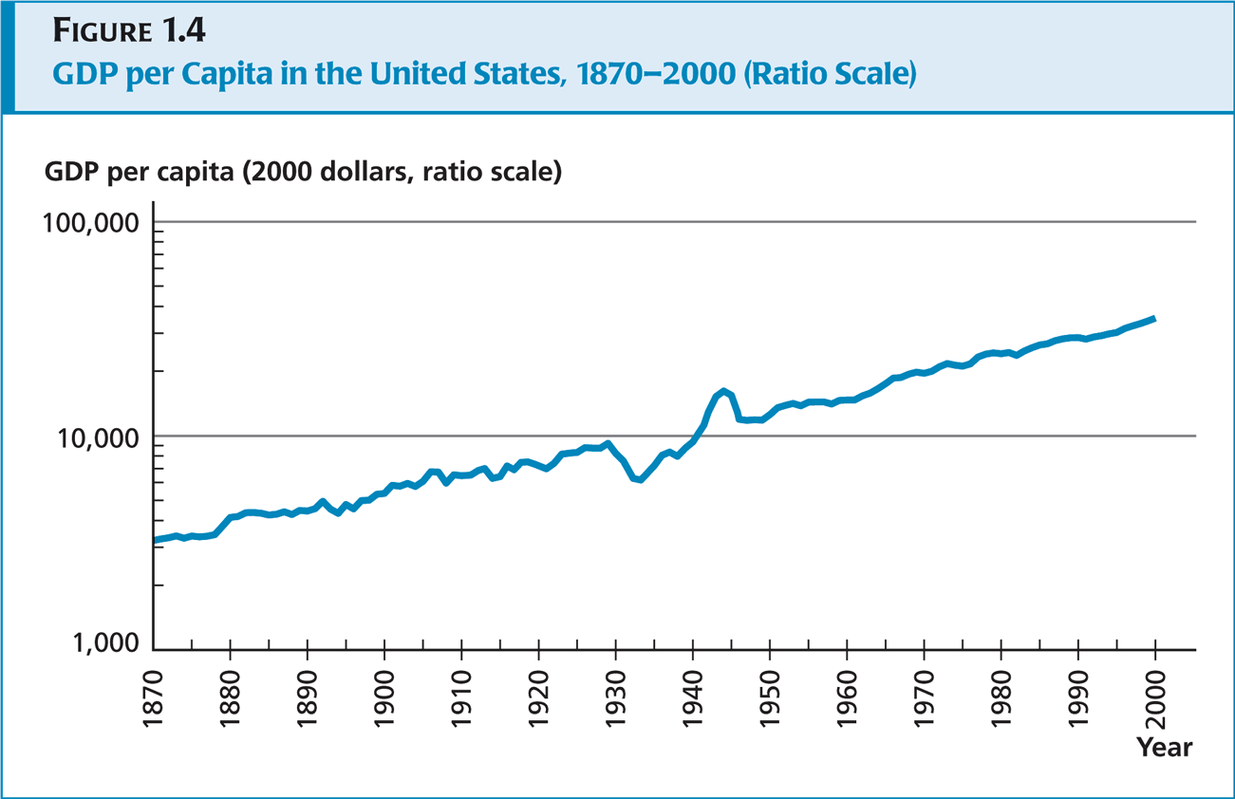

Slide 37
6. How to Measure Poverty
A poverty line = income required by a household of a certain size to meet a minimal standard of living.
Or just use $(PPP)1 a day for extreme poverty and $2$(PPP) for regular poverty.

Slide 38
Measuring poverty
Headcount ratio
Share of population below the poverty line
Being below $10 hurts as much as being below $5.

Slide 39
Measuring poverty
Poverty Gap Ratio
Monotonicity: A reduction in y of a poor person must increase poverty
Being below $10 hurts double as much as being below $5.

Slide 40
Measuring poverty
Squared poverty gap
Being below $10 hurts more than double as much as being below $5.
But, why in the form of a square?

Slide 41
Measuring poverty
Foster-Greer-Thorbecke Measures
Incorporates all three
If a=0, then HCR. (called FGT-0)
If a=1, then PGR. (called FGT-1)
If a=2, then SPG. (called FGT-2)

Slide 42
Example
Imagine 2 countries where the poverty line is $2 a day in both.
3 people live in each country.
Country A: people earn $3, $1.5 and $0.5.
Country B: people earn $5, $1 and $1.
HCR?
PGR?
SPG?

Slide 43
Poverty in the real world
Look at poverty in Madagascar. Unskilled workers are likely to be poor, but their poverty is less severe than that of herders/fishermen. Interventions needed to help the two should be different.
Look at poverty across countries. El Salvador has fewer poor than Burkina Faso, but more severe.

Slide 46
Poverty in Thailand
National Poverty line
  1994 838 baht/month =28 baht/day
  2004 1242 baht/month = 41.4 baht/day
  2007 1443 baht/month =48.1 baht/day (Bangkok 2065 Baht/month=68.8 baht/day)
The poor 5.4 million (8.5%) by HCR
The poorest region
  N/E of Thailand (2.8 million, 52.2%)
  Highest density of poor people - Mae Hong Son (67%)-

Slide 47
Poverty in Thailand
Poverty Index | 1988 | 1990 | 1992 | 1994 | 1996 | 1998 | 2000 | 2002 | 2004 | 2006 | 2007
Poverty Line (Baht/person/month) | 633 | 692 | 790 | 838 | 953 | 1,130 | 1,135 | 1,190 | 1,242 | 1,386 | 1,443
No. of poor people (millions) | 22.1 | 18.4 | 15.8 | 10.7 | 8.5 | 10.2 | 12.6 | 9.1 | 7.0 | 6.1 | 5.4
HCR (%) | 42.21 | 33.69 | 28.43 | 18.98 | 14.75 | 17.46 | 20.98 | 14.93 | 11.16 | 9.55 | 8.48
Poverty Gap Ratio | 11.40 | 8.05 | 6.62 | 3.92 | 2.85 | 3.35 | 4.24 | 2.75 | 2.01 | 1.81 | 1.45
SPG or Severity of poverty | 4.30 | 2.82 | 2.23 | 1.22 | 0.85 | 0.99 | 1.30 | 0.81 | 0.56 | 0.53 | 0.41
ที่มา : ข้อมูลจากการสำรวจภาวะเศรษฐกิจและสังคมของครัวเรือน สำนักงานสถิติแห่งชาติ ประมวลผลโดย สำนักพัฒนาเศรษฐกิจชุมชนและการกระจายรายได้ สศช.

Slide 48


