Slide 1


Chapter 1
Chapter 14
Ethical, Social and Environmental Aspects of Marketing Planning
MK 312 Marketing Planning
By
Ajarn Suwalya K.

Slide 2


Slide 3
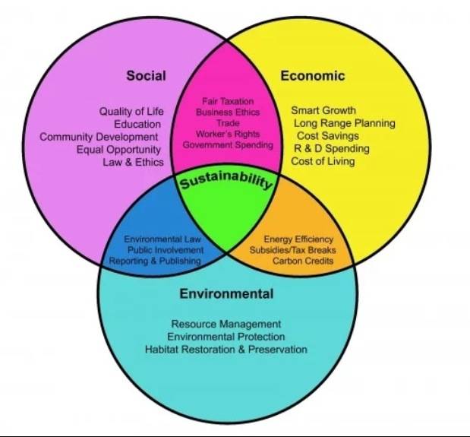

Slide 4
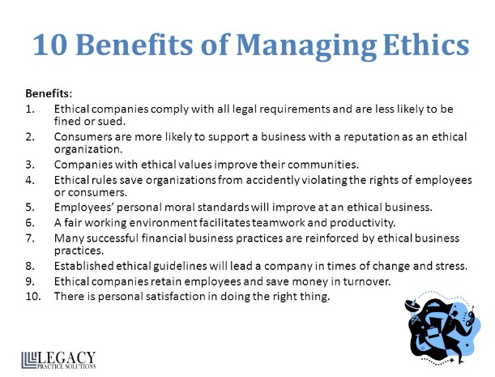

Slide 5
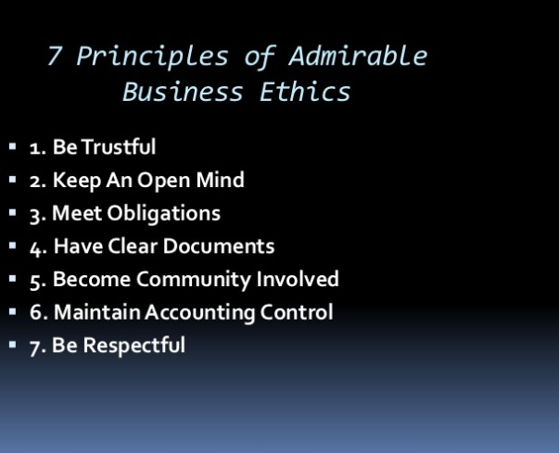

Slide 6


