Slide 1
Behavioral Finance
http://www.investopedia.com/university/behavioral_finance/
Shiller (2003)

Slide 2
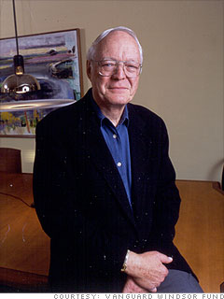
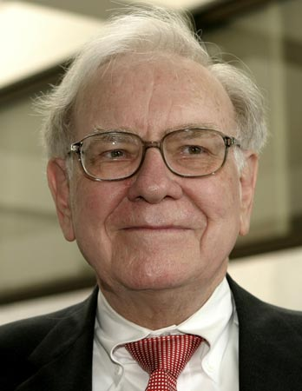
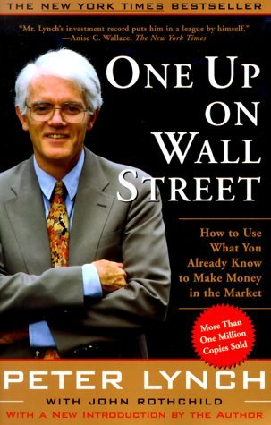
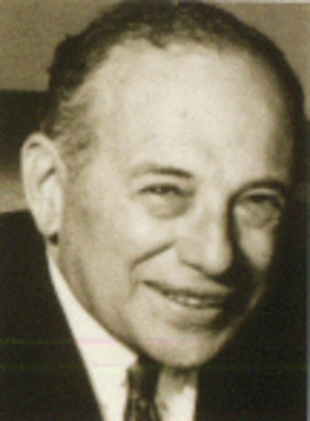
Is the stock market efficient?

Slide 3
Warren Buffett
Referred to as the "Sage" or "Oracle" of Omaha, Warren Buffett is widely viewed as one of the most successful investors in history.
Following the principles set out by Benjamin Graham, he has amassed a personal multibillion dollar fortune mainly through investing in stocks and buying companies through Berkshire Hathaway. Shareholders in Berkshire Hathaway who invested $10,000 in the company in 1965 are above the $50 million mark today.
Source: http://www.investopedia.com/university/greatest/warrenbuffett.asp

Slide 4
Peter Lynch
Peter Lynch managed the Fidelity Magellan Fund from 1977 to 1990, during which time the fund's assets grew from $20 million to $14 billion. More importantly, Lynch reportedly beat the S&P 500 Index benchmark in 11 of those 13 years, achieving an annual average return of 29%.
Source: http://www.investopedia.com/university/greatest/peterlynch.asp

Slide 5
John Neff
John Neff's average annual total return from Vanguard's Windsor Fund during his 31-year tenure (1964-1995) as portfolio manager was 13.7%, against a similar return from the S&P 500 Index of 10.6%. He showed a great consistency in topping the market's return by beating the broad market index 22 times during his tenure and was regularly in the top percent of money managers.
Source: http://www.investopedia.com/university/greatest/johnneff.asp

Slide 6
Survival frame
Imagine that Thailand is preparing the outbreak of an unusual disease, which is expected to kill 600 people. Two alternative program to combat the disease are proposed.
  If program A is adopted, 200 people will be saved
  If program B is adopted, there is a ½ probability that 600 people will be saved and a ½ that no people will be saved
Which of the two programs would you favor?

Slide 7
Mortality frame
Imagine that Thailand is preparing the outbreak of an unusual disease, which is expected to kill 600 people. Two alternative program to combat the disease are proposed.
  If program C is adopted, 400 people will die
  If program D is adopted, there is a ½ probability that nobody will die and a ½ that 600 people will die
Which of the two programs would you favor?

Slide 8
According to Tversky and Kahneman (1981) The framing of decisions and the psychology of choice. Science 211, pp. 453 – 458.
Of all the respondents to the first problem, 72% picked A
Of all the respondents to the second problem, 78% picked D
But actually these two problems are identical!
Psychological factors matter!

Slide 9
Behavioral Economics
A relatively new field that uses sociological and psychological factors in explaining economic decisions of individuals and institutions

Slide 10
Background
According to “conventional” financial theory, the world and its participants are, for the most part, rational "wealth maximizers"
The results are:
  Efficient Market Hypothesis
  CAPM
However, there are some “anomalies” (i.e., irregularities) that conventional financial theories have failed to explain

Slide 11
Some psychological factors

Slide 12
Loss Aversion, Prospect Theory, the Disposition Effect and the Endowment Effect
People have been shown to be loss averse, generally appearing to dislike losing something roughly twice as much as they like gaining it (Kahneman and Tversky, 1982)

Slide 13
Status Quo Bias and the Default Option
The term status quo bias was advanced by Samuelson and Zeckhauser to explain the tendency to stick with current choices/patterns of behavior
An example; when a University added some new options to its employment-based healthcare plan, faculty joining after this point understandably took advantage of most of the options. However, faculty previously employed (who of course had the right to take advantage of the new options) chose to participate in the new options to a far lesser degree

Slide 14
Framing Effects and Anchoring Effects
The appraisal of alternative options can also depend on the way the choice is presented, or “framed”. People have a preference for positive rather than negative frames, an effect which follows on from loss aversion
For example, in choosing cancer treatment, 82% of patients preferred surgery over radio therapy when surgery was described as having a 90% survival rate. However, only 56% preferred surgery over radio therapy when it was described as having a 10% mortality rate.

Slide 15
Mental Accounting
Mental accounting occurs when sums of money are treated and valued differently depending on where they came from and/or where they are kept
For example, most people coming to a store to buy at lamp for $50 would travel to a different branch 5 minutes away if told that they could buy the same lamp at the other location for a special sale price of $25.
However, most people coming to a store to buy a dinner table set for $1,500 would not travel to a different branch 5 minutes away if told they could buy the same set at another store for $1,475

Slide 16
Overconfidence
People have a natural tendency to be overconfident. It is a well-documented psychological bias. People’s confidence systematically exceeds the accuracy of their choices
For example, when given market reports of twenty stocks and asked to predict stock price changes, people rated their own accuracy in prediction at 68% while the actual accuracy was only 47%

Slide 17
Some anomalies

Slide 18
Anomalies (1)
The presence of regularly occurring anomalies in conventional economic theory was a big contributor to the formation of behavioral finance
January Effect:
  The January effect is named after the phenomenon in which the average monthly return for small firms is consistently higher in January than any other month of the year

Slide 19
Anomalies (2)
The Winner’s Curse
  the winner's curse - a tendency for the winning bid in an auction setting to exceed the intrinsic value of the item purchased
Equity Premium Puzzle
  Studies have shown that over a 70-year period, stocks yield average returns that exceed government bond returns by 6-7%
  However, academics believe that an equity premium of 6% is extremely large and would imply that stocks are considerably risky to hold over bonds (Next Time)

Slide 20
Shiller (2003)
The 1980s and Excess Volatility
  The anomaly represented by the notion of excess volatility seems to be much more troubling for efficient market theory than some other financial anomalies
  The efficient market hypothesis can be stated as:
  Forecast must be less variable than the variable forecasted

Slide 21
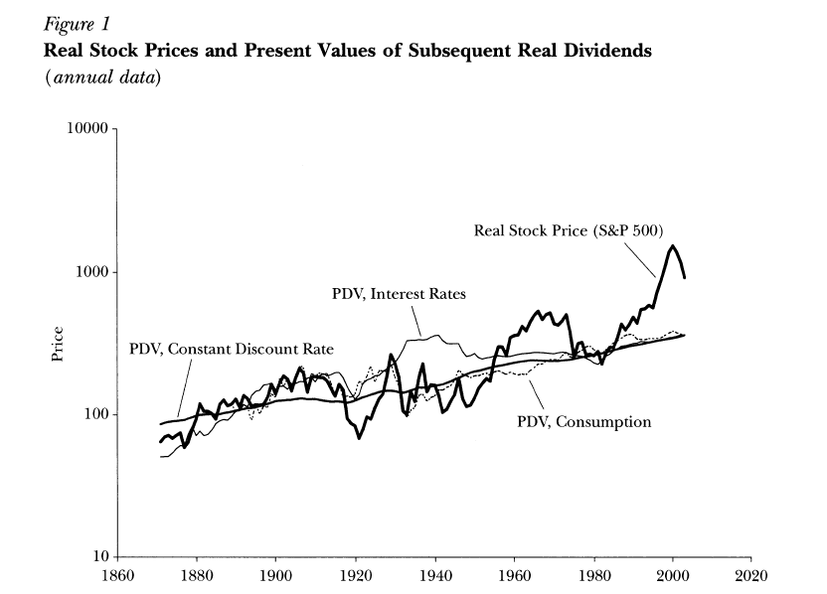

Slide 22
The Blossoming of Behavioral Finance
In the 1990s, a lot of academic discussion shifted away from the econometric analyses of time series on prices, devidends and earnings toward developing models of human psychology as it relates to financial markets
Two examples:
  Feedback Models
  Smart Money Vs. Ordinary Investors

Slide 23
Feedback Models (1)
When speculative prices go up, creating successes for some investors, this may attract public attention, promote word-of-mouth enthusiasm, and heighten expectations for further price increases
People talk about “new era” that justify the price increases, increasing the investor demand and generating another round of price increases

Slide 24
Feedback Models (2)
The high prices are ultimately not sustainable, since they are high only because of expectations of further price increases, and so the bubble eventually bursts, and prices come falling down
The presence of such feedback is supported by some “experimental” evidence
Biased Self-Attribution: Individuals attribute events that confirm the validity of their actions to their own high ability and attribute events that disconfirm their actions to bad luck or sabotage

Slide 25
Smart Money Vs. Ordinary Investors
There are two types of investors:
  Smart Money (Rational Investors)
  Feedback Traders (Irrational Investors)
It is far from clear that smart money has the power to drive market prices to fundamental values
Smart money may face some constraints to bring prices back to fundamental

Slide 26
Critics
The most notable critic of behavioral finance is Eugene Fama, the founder of market efficiency theory. Professor Fama suggests that even though there are some anomalies that cannot be explained by modern financial theory, market efficiency should not be totally abandoned in favor of behavioral finance.
In fact, he notes that many of the anomalies found in conventional theories could be considered shorter-term chance events that are eventually corrected over time. In his 1998 paper, entitled "Market Efficiency, Long-Term Returns And Behavioral Finance", Fama argues that many of the findings in behavioral finance appear to contradict each other, and that all in all, behavioral finance itself appears to be a collection of anomalies that can be explained by market efficiency.

