Slide 1

BA 291 – Introduction to Business
By Aj. Parichat Jantori

Slide 2
As we all know, in this course we have to write a business plan!!!
And it is full business plan with 25 Pages (excludes appendix)
But what is it and how to find business idea?

Slide 3
How to generate business idea
List five to seven things about yourself--things you like to do, interested in or things that you're really good at
List things that you don't think you're good at or you don't like to do. --- or what is your pain point!!!!
Ask yourself: "If there were three to five products or services that would make my personal life better, what would they be?“
Determine what products or services would make your life easier or happier, make you more productive or efficient, or simply give you more time.

Slide 4

How to generate business idea
“Find the pain point”
A pain point is a problem, real or perceived. Entrepreneurs create opportunities for themselves by creating solutions to those pain points.

Slide 5

How to generate business idea
“Asking What If question”
“What if” questions provokes us and challenge our thinking.
They challenge us to discover the business model.

Slide 6

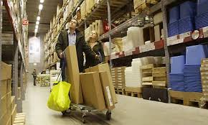
What if furniture buyers picked up components in flat pack from a large warehouse and assemble the products themselves in their home.

Slide 7

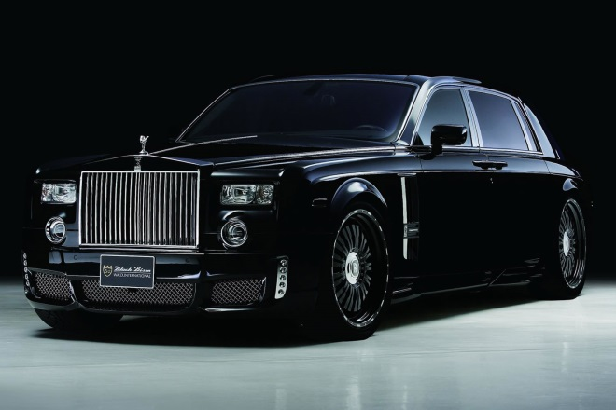
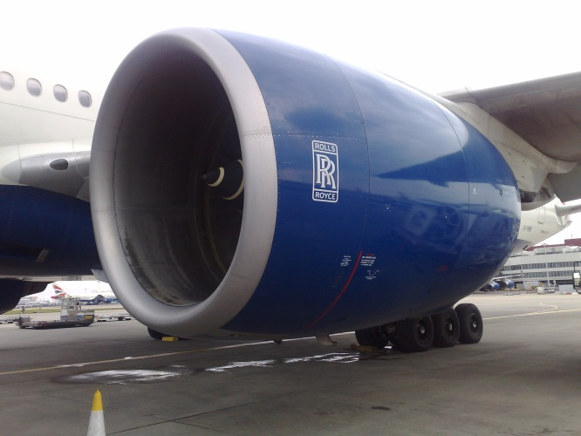
What if Airlines didn’t buy engines for their airplane, but paid for every hour an engine runs?
Rolls-Royce transformed itself from a money-losing British Manufacturer into a service firm that today is the world’s second biggest provider of large engine.
Notes:
Rolls-Royce Limited was founded in 1906 by Henry Royce and Charles Rolls at the Midland Hotel, Manchester, as a manufacturer of luxury cars, before diversifying into aircraft engine manufacturing. The production of road vehicles remained a major activity of the company until the car business was split off in 1973 as Rolls-Royce Motors.
รถราคา 30 ล้าน

Slide 8

What if Voice call were free worldwide?
In 2003 Skype launched a service that allowed free voice calling via Internet. After 5 years Skype had 400 millions registered users. It was bought by Ebay 2.6 Billion and then by Microsoft 8.5 Billion Dollars.
Notes:
In September 2005, eBay acquired Skype for $2.6 billion.^{[18]} In September 2009,^{[19]} Silver Lake, Andreessen Horowitz, and the Canada Pension Plan Investment Boardannounced the acquisition of 65% of Skype for $1.9 billion from eBay, valuing the business at $2.75 billion. Skype was later acquired by Microsoft in May 2011 for $8.5 billion.

Slide 9
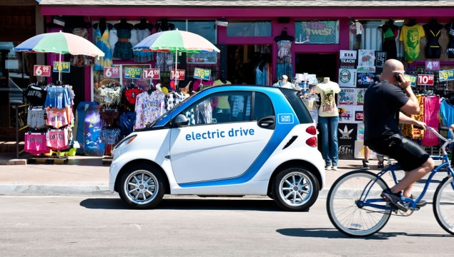
What if Car Manufacturers didn’t sell cars but provide mobility services?
Notes:
In September 2005, eBay acquired Skype for $2.6 billion.^{[18]} In September 2009,^{[19]} Silver Lake, Andreessen Horowitz, and the Canada Pension Plan Investment Boardannounced the acquisition of 65% of Skype for $1.9 billion from eBay, valuing the business at $2.75 billion. Skype was later acquired by Microsoft in May 2011 for $8.5 billion.

Slide 10
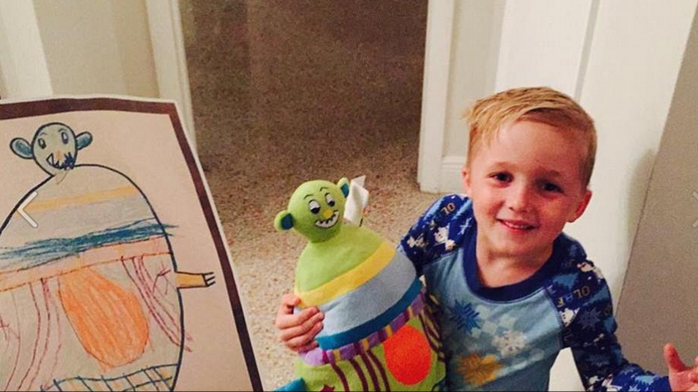
What if we could turn any drawing into a custom made doll/ gift

Slide 11
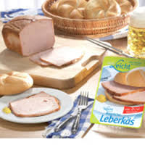
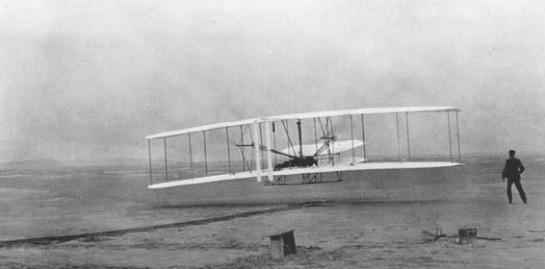
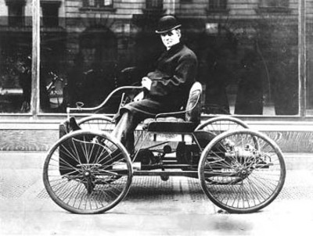
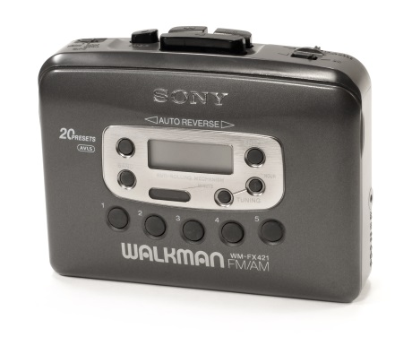
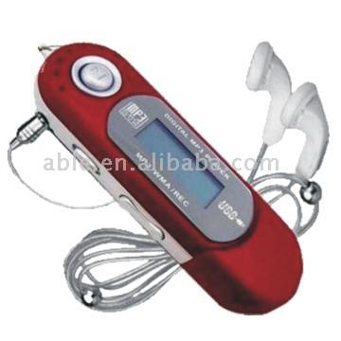
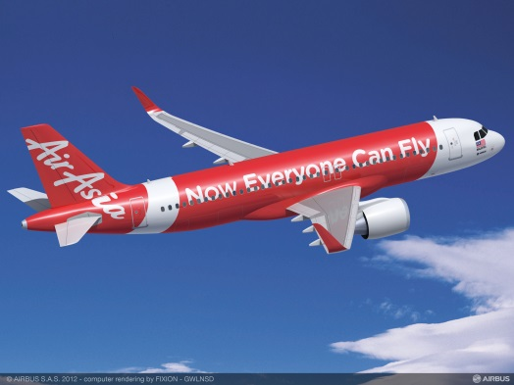
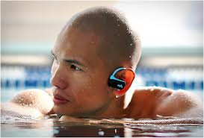
Generating Business Idea
What If?

Slide 12
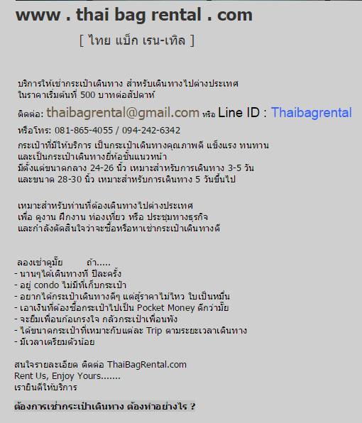

Slide 13



Slide 14
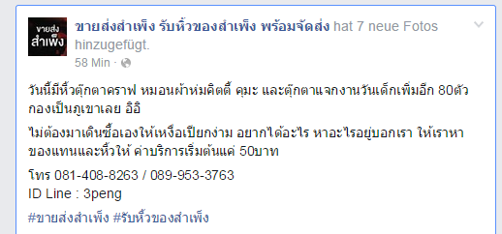
Generating Business Idea

Slide 15
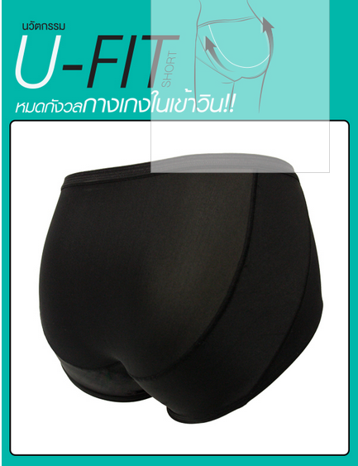
Generating Business Idea
Notes:
http://www.welt.de/wissenschaft/article9085987/Deutsche-Forscher-wollen-Nassrasur-revolutionieren.html
http://www.brandeins.de/archiv/2014/geld/gillette-wilkinson-warum-sind-rasierklingen-so-teuer/

Slide 16




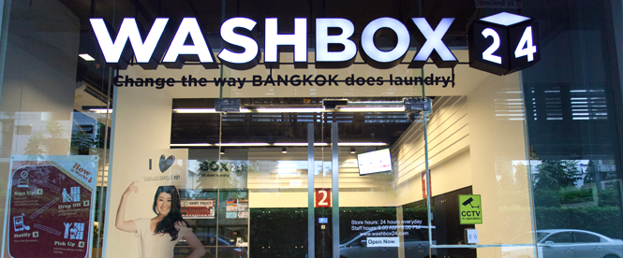
Generating Business Idea
Notes:
http://www.welt.de/wissenschaft/article9085987/Deutsche-Forscher-wollen-Nassrasur-revolutionieren.html
http://www.brandeins.de/archiv/2014/geld/gillette-wilkinson-warum-sind-rasierklingen-so-teuer/

Slide 17



Generating Business Idea
Notes:
http://www.welt.de/wissenschaft/article9085987/Deutsche-Forscher-wollen-Nassrasur-revolutionieren.html
http://www.brandeins.de/archiv/2014/geld/gillette-wilkinson-warum-sind-rasierklingen-so-teuer/

Slide 18
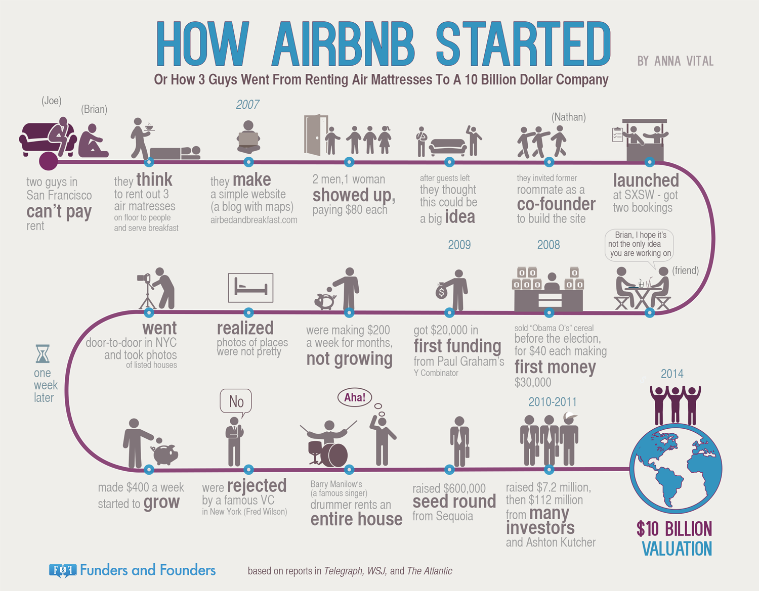
Generating Business Idea
Notes:
http://www.welt.de/wissenschaft/article9085987/Deutsche-Forscher-wollen-Nassrasur-revolutionieren.html
http://www.brandeins.de/archiv/2014/geld/gillette-wilkinson-warum-sind-rasierklingen-so-teuer/

Slide 19


“Value creation vs. Value addition”
Notes:
Value added describes what happens when you take a basic product and increase the value of that product by adding extra manufacturing process or by tacking on extra products and/or services

Slide 20
Value Proposition
A business or marketing statement that summarizes why a consumer should buy a product or use a service. This statement should convince a potential consumer that one particular product or service will add more value or better solve a problem than other similar offerings.
Notes:
http://www.investopedia.com/terms/v/valueproposition.asp

Slide 21
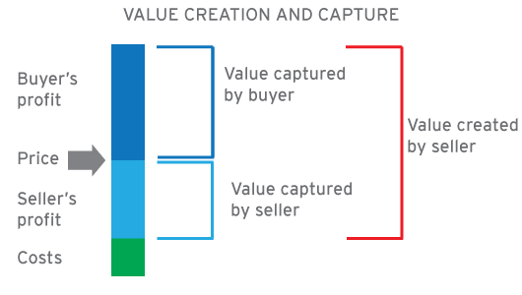
Value Price Cost
Notes:
https://www.youtube.com/watch?v=pQboj3NpG-k

Slide 22
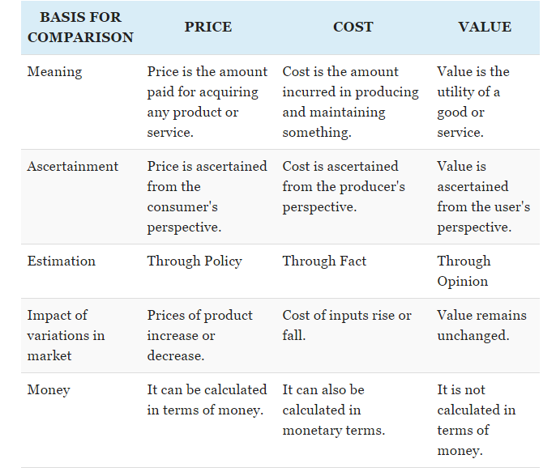
Value Price Cost
Notes:
https://www.youtube.com/watch?v=pQboj3NpG-k

Slide 23
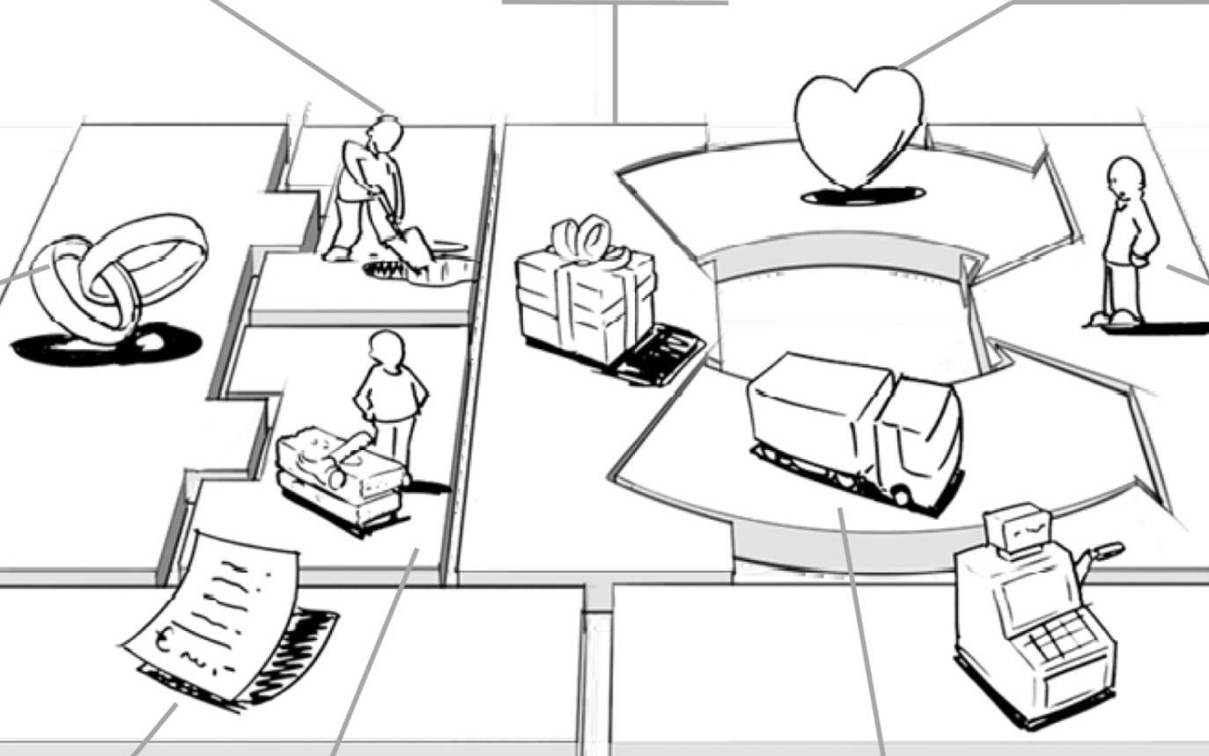
Business Model Canvas
A business model describes the rational of how an organization creates, delivers and captures value.

Slide 24

Business Model
Customer segments
Customer is the heart of any business model
Customer segment means group of customers that distinct from each other
Different segments means different offer, distribution channels, type of relationship, profit and willingness to pay.

Slide 25

Business Model
Value Propositions
Reason why customers turn to one company over another.
Newness, Design, Performance, Quality, Price, Speed of service, Customization, Accessibility, Convenience, Usability

Slide 26
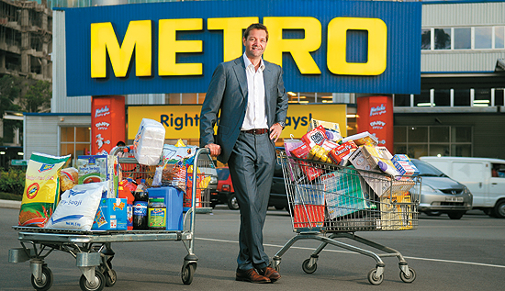
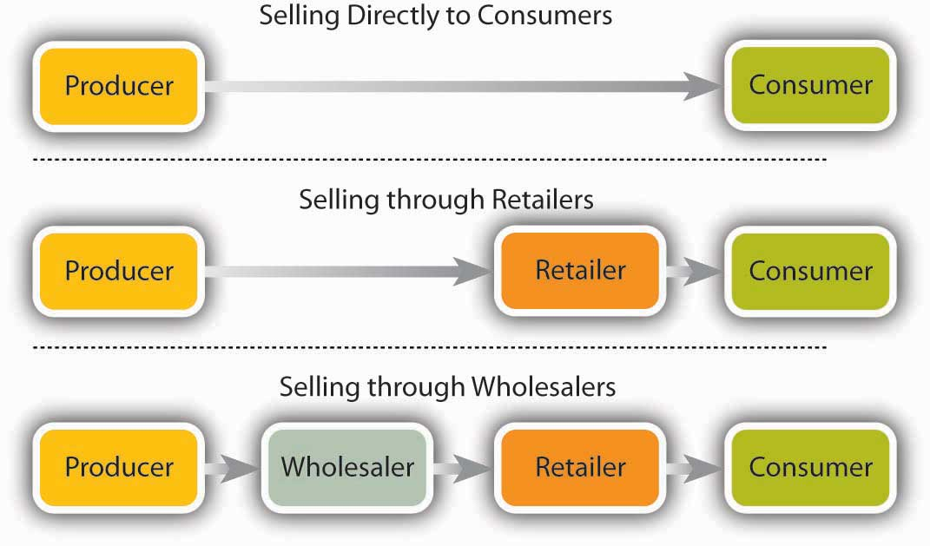
Business Model
Channels
How a company communicates with and reaches its customer segments to deliver a value proposition

Slide 27
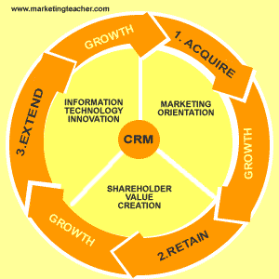
Business Model
Customer Relationships

Slide 28

Business Model
Revenue streams
The cash a company generates from each customer segment
Transaction revenues
Recurring revenues

Slide 29
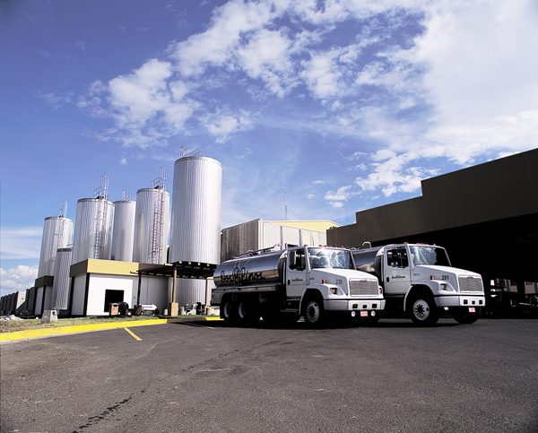

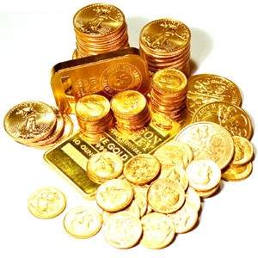

Business Model
Key Resources
The assets required to make a business model work

Slide 30
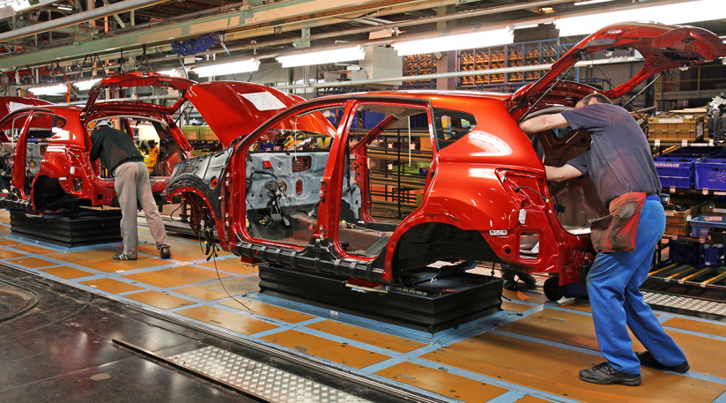

Business Model
Key activities
The most important actions a company must take to operate successfully

Slide 31

Business Model
Key Partnerships
Networks/ alliances of suppliers and partners that make the business model work.
Optimize business model
Reduce risks or uncertainty
Acquired resources and particular activities

Slide 32
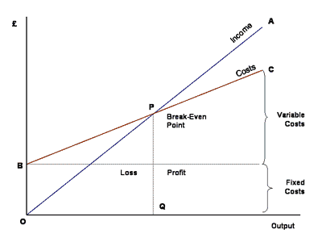
Business Model
Cost structure
All the cost incurred to operate business model

Slide 33
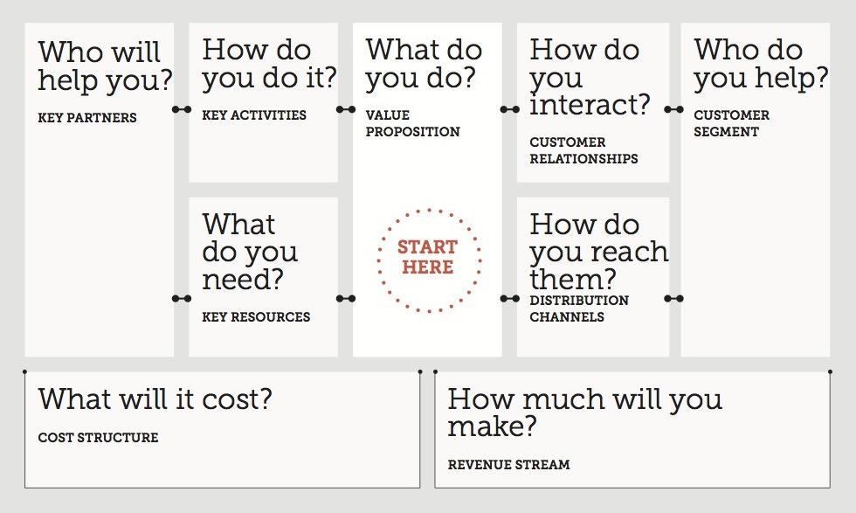
Business Model Canvas

Slide 34
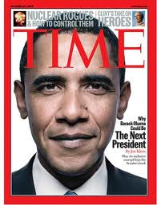
Example: Business Model
1. Subscription business model

Slide 35

Example: Business Model
2. Razor and blades (Bait and Hook) business model

Slide 36
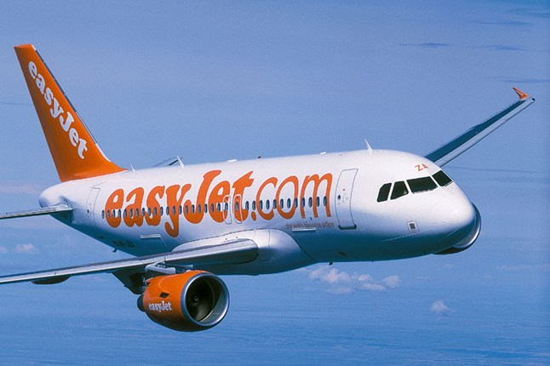
Example: Business Model
3. Low cost carrier business model

Slide 37

Example: Business Model
3. (Online) Auction business model

Slide 38

Example: Business Model
4. Free business model: One substantial customer segment is able to benefit from a free-of-charge offer. They are financed by another part of the business model or another customer segment. (Multi-sided)

Slide 39
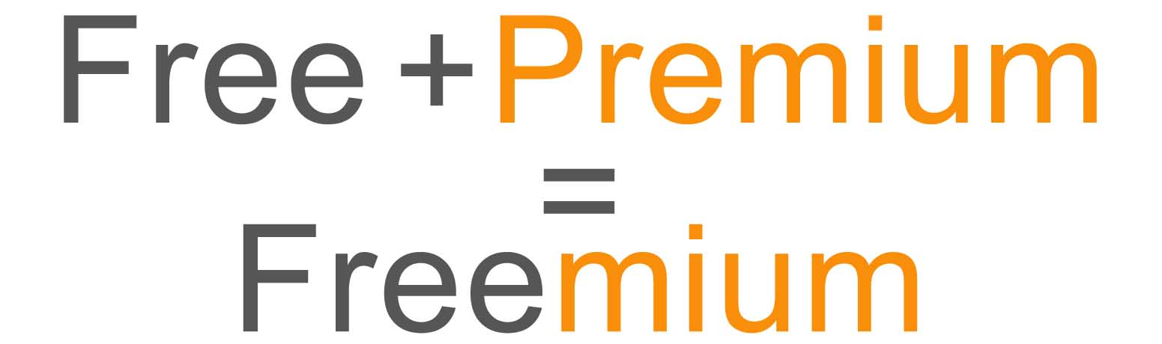
Example: Business Model
5. Freemuim

Slide 40
Example: Business Model
6. Bricks and clicks
7. Multi level marketing (MLM)
8. Open Business model

Slide 41
Business plan
Task 3: Reviewing the given business plan.
What is business plan for you. Create your own definition. Why do we need it.
List all the common things you see from each plan
Pick up one favorite business plan. Why you like it?

Slide 42
The key elements of business plan
Executive summery
Company description
Management and organization
Industry and market analysis
Competitor analysis
Product and services (operational issues)
Marketing strategy
Financial plan

Slide 43
Characters of effective business plan
Business plan
communicate
commercial
competitive
Correct
clear

Slide 44
Check your business plan
Is your business concept solid and feasible?
Is your management experience and capable?
Does your product or service create value to the customer?
Does a real market exist?
What are your target markets and are they large enough to support your business plan?
Have you thoroughly and honestly evaluate your business and your competitors?
Are your goals focused and are your strategy competitive?
Is your financial plan realistic?
How and when will the investors get their investment back?

Slide 45
Calculating break even point
Task 4: Fix versus Variable cost
If you have a car, owner of restaurant, online seller, organizer of sport or concert event, what is fix and variable cost for you?
Make a list of all the cost.

Slide 46
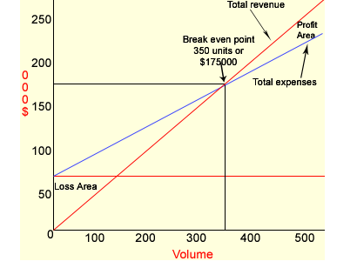
Break-even Point
B.E. is the level of sales at which profit is zero. At break -even point total sales are equal to total cost (variable + fixed).
If a firm cannot manage sales to cover variable as well as fixed costs it will have to bear losses. The following is the further explanation of this concept:

Slide 47
Break-even Point
Example:
Sales price per unit = $500
variable cost per unit = $300
Total fixed expenses = $70,000
At Break Even point, Revenues – Total cost = 0
In this example, quantity at break even point is ........Unit.

Slide 48
Break-even Point
Sales Break – Even Point
The break-even point in sales dollars can be calculated by dividing a company's fixed expenses by the company's contribution margin ratio.
The contribution margin is sales minus variable expenses. When the contribution margin is expressed as a percentage of sales it is referred to as the contribution margin ratio.
Break-even Sales = [Fixed Cost / 1 – (Variable Cost / Sales)]
Or Break-even Sales = Fix cost/ contribution margin ratio

Slide 49
Break-even Point
Example: A company has fixed expenses of $100,000 per year. Its variable expenses are approximately 80% (80 of 100) of sales. (This means that the contribution margin ratio is 20%)
Therefore, break even point in sales is 100,000 / 0.2 = 50,000 $
Let’s check the answer:
Sales – total cost = 0
500,000 – (100,000+400,000) = 0

Slide 50
Break-even Point
Example:
- A travel agency is organizing weekend trips to different cities. The package includes the transfer by coach and the overnight stay in a B&B. It is offered for 99 € per person. The coach costs 500 € per weekend, fuel 300 €, the driver 350 € per weekend; administration is charged at 100 € per weekend trip. The B&B costs 55 € per person, the salespersons get a commission of 10 € per passenger.
a. Calculate the fixed and the variable costs of a trip.
b. How many passengers will the agency have to find in order to break even?
c. The target profit per trip is 100 €. What happens to the break-even-point?
d. If the travel agency expects 45 passengers. What are the margins of safety?

Slide 51
Break-even Point
Example:
A company producing felt-tip pen estimates its monthly sales at 30,000 pens. Its fix cost is 250,000 baht/month. Its variable cost is 3.70 baht per pen.
a. If the sales price is 10 baht/pen. How many pens this company should sell in order to reach break-even point?
b. If this company wants to achieve 150,000 baht profit. How many pens should this company sell to its customer?

Slide 52
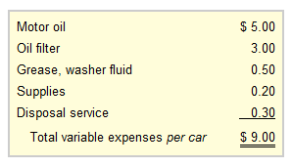
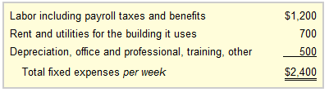
Break-even Point
Example:
At Oil Change Co. The fix and variable cost is shown as follow:
Oil Change Co. charges one flat fee of $24 for performing the oil change service.
How many car this company has to service in order to reach break-even point? Or how much is the sales break-even?

Slide 53
Payback Period
A period of time required for the return on an investment to “repay” the sum of the original investment.
Example 1: a 1000$ investment which returned 500$ per year. The pay back period would be 2 years.
Example 2: a project cost 100,000 and it is expected to return 20,000 annually, the payback period will be ………………… years.

Slide 54
Payback Period
Example 3: A project requires an investment of 200,000$ and it generates cash as follows:
1st year 20,000$, 2nd year 60,000$, 3rd year 80,000$, 4th year 100,000$ and 70,000 in the 5th year.
What is the payback period?
(20,000+60,000+80,000 = 160,000 in the first three years, 40,000/100,00 in the fourth year, therefore payback period 3.4.

Slide 55
Payback Period
Example 4: A project requires an investment of 20,000 Bath. and it generates cash as follows:
1st year 10,000$, 2nd year 8,000$, 3rd year 6,000$, 4th year 2,000$ .
What is the payback period?

Slide 56
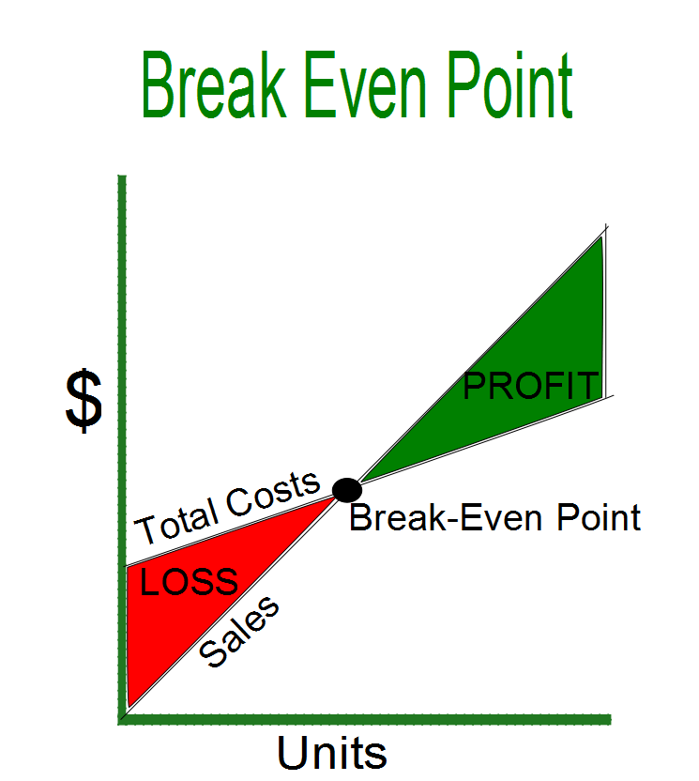
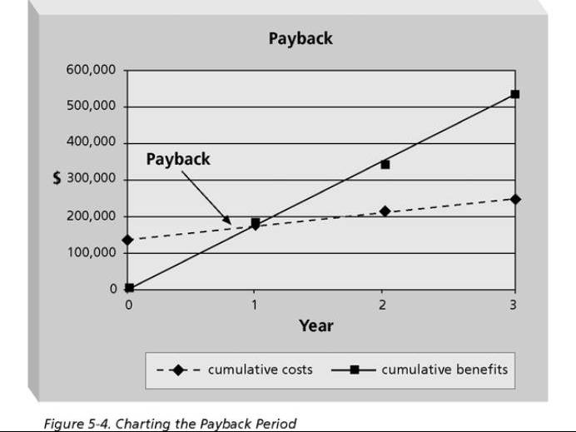
Key Takeaway

Slide 57
Questions
Would you prefer “longer or shorter” payback period?
Would you prefer “higher or lower” quantity at Break-even points?
Implications (cost structure, payback period, breakeven point)

